Slide 1

Electric Vehicle Population Data Analysis
This presentation explores the growing landscape of electric vehicles (EVs) in the USA through comprehensive data analysis. We will uncover key patterns and trends in EV adoption, registration across different states, and the market dynamics of various vehicle models and manufacturers. Join us as we delve into the insights driving the future of sustainable transportation.

Slide 2




Project Overview and Objectives
This project is dedicated to exploring and analyzing electric vehicle population data across the USA. Our primary objective is to uncover significant patterns, identify key trends, and extract valuable insights related to electric vehicle registration. This includes understanding adoption rates by state, identifying popular vehicle models, and analyzing the market share of different manufacturers.
Uncover Patterns
Analyze Trends
Extract Insights
Identify recurring behaviors and relationships within the EV dataset.
Examine how EV adoption and market dynamics change over time.
Derive actionable knowledge from the data for strategic understanding.

Slide 3
Comprehensive Data Sources
The dataset utilized for this analysis encompasses a rich array of information crucial for understanding the electric vehicle landscape. It provides granular details on vehicle characteristics and registration specifics, allowing for a multifaceted examination of the EV population.
Vehicle Type
Vehicle Specifics
Registration Details
Battery Electric Vehicles (BEV)
Vehicle Model
Registration Location (State)
Plug-in Hybrid Electric Vehicles (PHEV)
Vehicle Make
County and City of registration
Model Year
Legislative District

Slide 4
Tools and Libraries for Analysis
To conduct this in-depth analysis of the electric vehicle population data, a robust set of programming languages and specialized libraries were employed. These tools facilitate everything from data cleaning and transformation to advanced statistical analysis and compelling visual representations.
Python
Pandas
The core programming language chosen for its versatility and extensive ecosystem in data science. Python serves as the backbone for scripting and orchestrating the entire analysis pipeline, from data ingestion to model deployment.
An essential library for data manipulation and analysis. Pandas DataFrames provide efficient structures for handling tabular data, enabling operations like filtering, grouping, and merging large datasets with ease. It's crucial for preparing raw data for visualization.
Matplotlib
Seaborn
A foundational plotting library in Python, used for creating static, animated, and interactive visualizations. Matplotlib provides fine-grained control over plots, allowing for customizability and detailed graphical representations of data trends.
Built on top of Matplotlib, Seaborn offers a high-level interface for drawing attractive and informative statistical graphics. It simplifies the creation of complex visualizations like heatmaps, violin plots, and time series charts, enhancing data exploration.

Slide 5
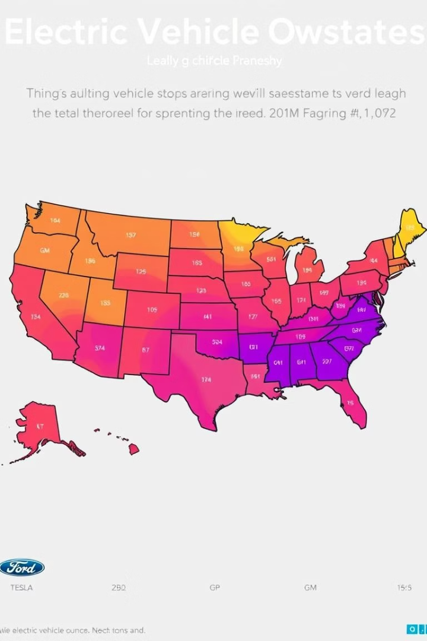
Exploratory Data Analysis (EDA) Highlights
Our exploratory data analysis involved several key visualizations to understand the distribution and market dynamics of electric vehicles. These charts provide clear, comparative insights into various aspects of the EV population.
Geographic Distribution
Distribution of electric vehicle population across different U.S. states, revealing regional adoption patterns.
Manufacturer Market Share
Market share analysis by vehicle manufacturer, highlighting dominant players in the EV industry.
Vehicle Model Popularity
Distribution by specific electric vehicle models, identifying the most popular choices among consumers.
Historical Trends
Trends in electric vehicle population growth over time, showcasing the increasing adoption rate.

Slide 6
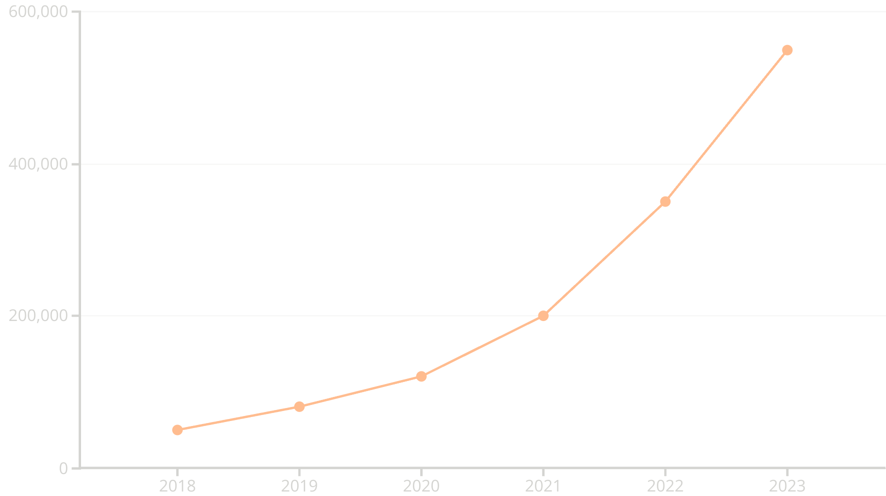
Year-on-Year EV Growth Visualization
A critical aspect of our analysis is tracking the annual growth rate of electric vehicle registrations. This line plot visually demonstrates the accelerating adoption of EVs over time, providing a clear picture of market expansion and consumer shift towards sustainable transportation.

Slide 7




Key Insights from the Analysis
Through our detailed analysis, several significant insights have emerged, painting a clear picture of the current state and future trajectory of electric vehicle adoption in the USA. These findings highlight both the successes and the areas for continued growth.
Leading States in EV Adoption
Identified the states with the highest number of electric vehicle registrations, often correlated with strong state incentives and robust charging infrastructure.
Dominant Vehicle Makes and Models
Pinpointed the most popular electric vehicle makes and models driving market growth, indicating consumer preferences and successful product strategies.
Accelerating EV Popularity
Confirmed the sustained and accelerating popularity of electric vehicles over time, reflecting increasing consumer awareness and environmental consciousness.
BEV vs. PHEV Market Share
Analyzed the shifting market share between Battery Electric Vehicles (BEVs) and Plug-in Hybrid Electric Vehicles (PHEVs), revealing trends in technology preference.

Slide 8




Conclusion and Future Outlook
This project has underscored the significant and accelerating growth of electric vehicles in the USA. The analysis clearly illustrates the critical role of state incentives and supportive policies in driving EV popularity, as well as highlighting the market's preference for certain models and manufacturers. The transition to electric mobility is not just a trend but a transformative shift towards a sustainable future.
Growing Significance
Policy Impact
Market Dynamics
Electric vehicles are becoming increasingly vital for environmental sustainability and energy independence.
State incentives and policies are crucial catalysts for broader EV adoption.
Consumer preferences for specific models and makers continue to shape the evolving EV market.

