Slide 1
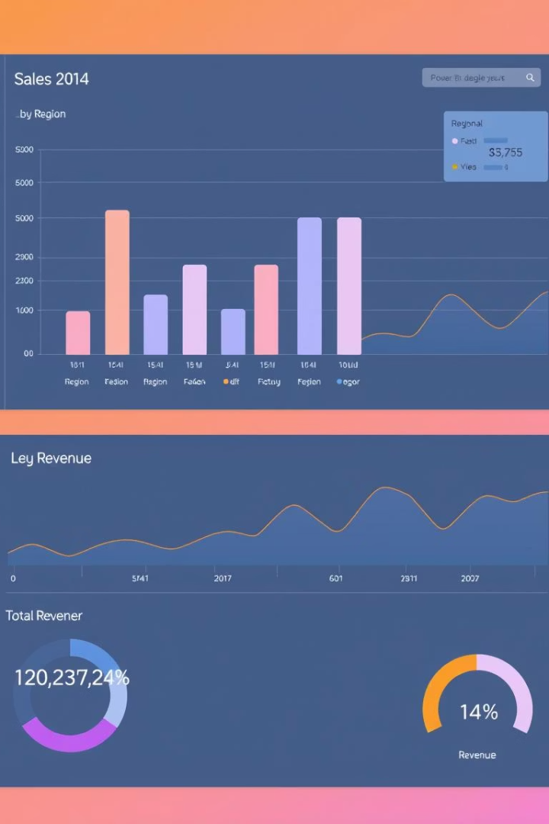
Sales Performance Dashboard
An interactive Power BI dashboard for sales performance analysis.

Slide 2

Dashboard Overview
Tracks Performance
Monitors Trends
Visualizes sales across regions, products, time.
Helps businesses monitor revenue, profit, and sales.

Slide 3




Tools Utilized
Power BI
Primary visualization tool.
Power Query
For data cleaning and shaping.
DAX
For complex calculations.

Slide 4
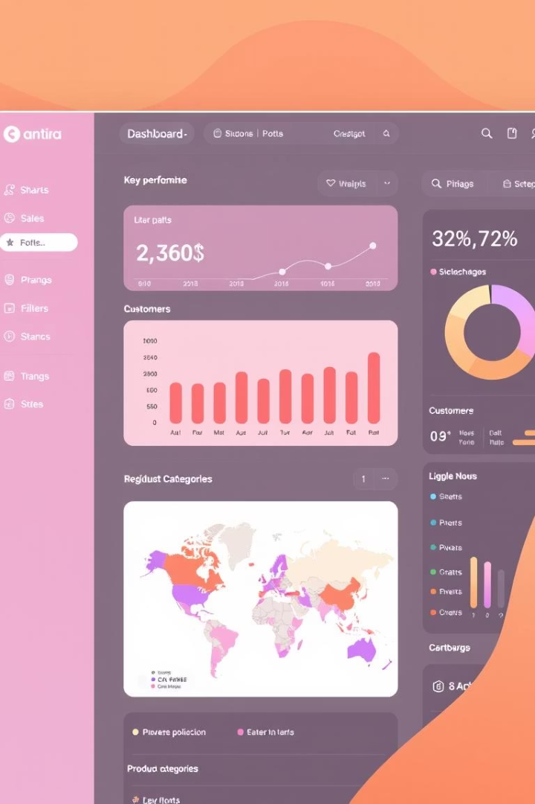
Key Features
KPIs
Total Revenue, Profit, Quantity Sold.
Performance Insights
Region-wise and product-wise analysis.
Trend Analysis
Monthly sales trends.
Dynamic Filtering
Using slicers and tooltips.

Slide 5




Techniques Applied
Data Cleaning
Power Query for shaping data.
DAX Measures
Calculations like profit margin, YOY change.
Visuals
Drill-down charts and card visuals.

Slide 6
Project Files
README.md
Sales Project.pbix
global_superstore_data.xlsx
project sales.png
Project documentation.
Power BI dashboard file.
Dashboard screenshot.
Raw sales data.

Slide 7

Dashboard Impact
12%
8%
20%
Revenue Growth
Cost Reduction
Efficiency Boost
Through optimized operations.
Improved decision-making.
Potential increase with insights.

Slide 8
Sales Dashboard Summary
Actionable Insights
Enhanced Efficiency
Strategic Growth
Gain clarity on sales trends. Identify key performance drivers.
Streamline analysis workflows. Reduce manual reporting efforts.
Inform better business decisions. Drive measurable revenue increases.

