Slide 1
Software Engineering
Component Based
Software Engineering

Slide 2
Objectives
To explain that CBSE is concerned with developing standardized components and composing these into applications
To describe components and component models
To show the principal activities in the CBSE process
To discuss approaches to component composition and problems that may arise

Slide 3
Component-based Development
Component-based software engineering (CBSE) is an approach to software development that relies on software reuse
It emerged from the failure of object-oriented development to support effective reuse
Single object classes are too detailed and specific
Components are more abstract than object classes and can be considered to be stand-alone service providers

Slide 4
CBSE Essential
Independent components specified by their interfaces
Component standards to facilitate component integration
Middleware that provides support for component inter-operability
A development process that is geared to reuse

Slide 5
CBSE and design principles
Apart from the benefits of reuse, CBSE is based on sound software engineering design principles
  Components are independent so do not interfere with each other
  Component implementations are hidden
  Communication is through well-defined interfaces
  Component are shared and reduce development costs

Slide 6
CBSE problems
Component trustworthiness –
  how can a component with no available source code be trusted?
Component certification –
  who will certify the quality of components?
  Who would pay for it
  What standard to follow
Emergent property prediction –
  how can the emergent properties of component compositions be predicted?
Requirements trade-offs –
  how do we do trade-off analysis between the features of one component and another?

Slide 7
Components
Components provide a service without regard to where the component is executing or its programming language
  A component is an independent executable entity that can be made up of one or more executable objects;
  The component interface is published and all interactions are through the published interface;

Slide 8
Component definitions
A software component is a software element that conforms to a component model and can be independently deployed and composed without modification according to a composition standard
A software component is a unit of composition with contractually specified interfaces and explicit context dependencies only. A software component can be deployed independently and is subject to composition by third-parties

Slide 9
Component as a service provider
The component is an independent, executable entity
It does not have to be compiled before it is used with other components
The services offered by a component are made available through an interface
All component interactions take place through that interface

Slide 10
Component characteristics
Standardized to conform to a model which specifies
  Component interfaces
  Component meta-data
  Component documentation
  Component deployment requirements
Independent
  Component should be independently deployable
  Component should provide services alone

Slide 11
Component characteristics…
Compos-able
  All external interactions should be publicly exposed
  Must provide the access to information about all attributes and methods
Deployable
  Component must be self contained
  Must operate as stand-alone entity on a platform that implements specific model
  Component should be in binary form

Slide 12
Component characteristics
Documentation
  Documentation help potential user to do trade-off analysis
  Syntax and semantics of the interfaces has to be provided
  Ideally the composition process should be explained with source code examples

Slide 13
Component interfaces
Provides interface
  Defines the services that are provided by the component to other components
Requires interface
  Defines the services that specifies what services must be made available for the component to execute as specified

Slide 14
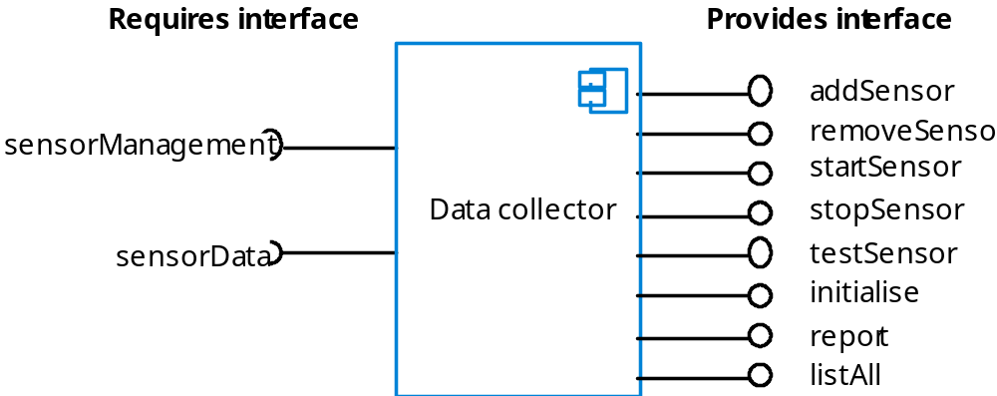
A data collector component

Slide 15
Components and objects
Components are deployable entities
Components do not define types
Component implementations are opaque
Components are language-independent
Components are standardized

Slide 16
Component models
A component model is a definition of standards for component implementation, documentation and deployment
Examples of component models
  EJB model (Enterprise Java Beans)
  COM, DCOM, COM+ model (.NET model)
  CORBA Component Model
The component model specifies how interfaces should be defined and the elements that should be included in an interface definition

Slide 17
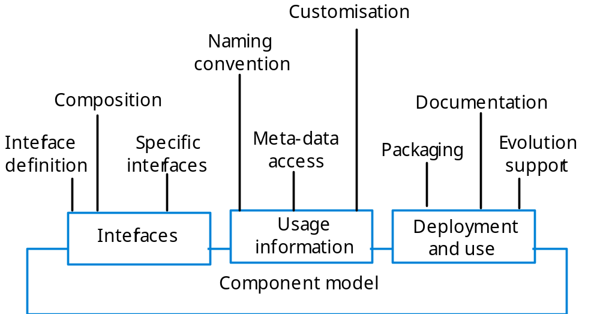
Elements of a component model

Slide 18
Middleware support
Component models are the basis for middleware that provides support for executing components
Component model implementations provide:
  Platform services that allow components written according to the model to communicate
  Horizontal services that are application-independent services used by different components
To use services provided by a model, components are deployed in a container (Wrapper). This is a set of interfaces used to access the service implementations

Slide 19
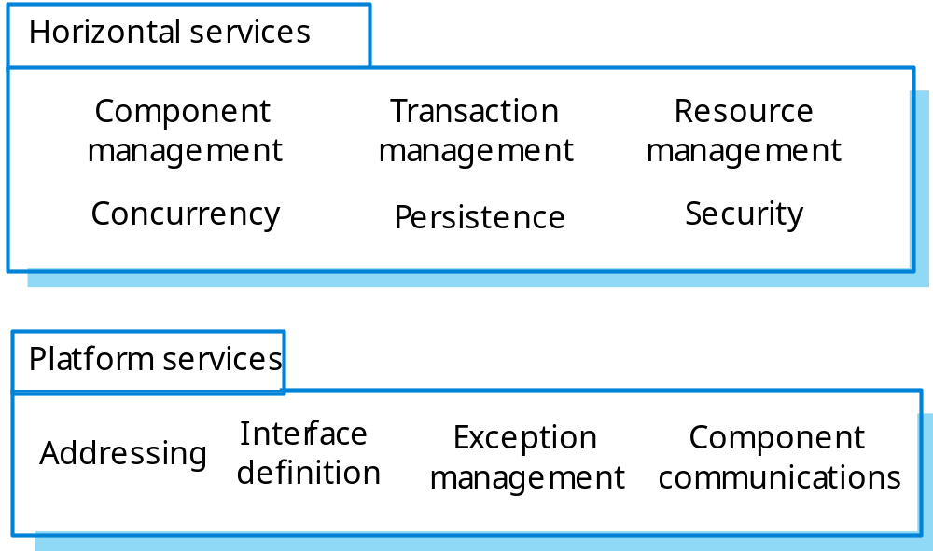
Component model services

Slide 20
Component development for reuse
Components developed for a specific application usually have to be generalized to make them reusable
A component is most likely to be reusable if it associated with a stable domain abstraction (business object-type)
For example, in a hospital stable domain abstractions are associated with the fundamental purpose - doctors, patients, treatments, etc
Should hide state representation
There is a trade-off between reusability and usability
  The more general the interface, the greater the reusability but it is then more complex and hence less usable

Slide 21
Changes for reusability
Remove application-specific methods
Change names to make them general
Add methods to broaden coverage
Make exception handling consistent
Add a configuration interface for component adaptation
Integrate required components to reduce dependencies

Slide 22
Legacy system components
Existing legacy systems that fulfill a useful business function can be re-packaged as components for reuse
This involves writing a wrapper component that implements “provides and requires interfaces” then accesses the legacy system
Although costly, this can be much less expensive than rewriting the legacy system

Slide 23
Reusable components
The development cost of reusable components may be higher than the cost of specific equivalents
Extra reusability enhancement cost should be an organizational rather than a project cost
Generic components may be less space efficient and may have longer execution times than their specific equivalents

Slide 24
The CBSE process
When reusing components, it is essential to make trade-offs between ideal requirements and the services actually provided by available components
This involves:
  Developing outline requirements
  Searching for components then modifying requirements according to available functionality
  Searching again to find if there are better components that meet the revised requirements

Slide 25
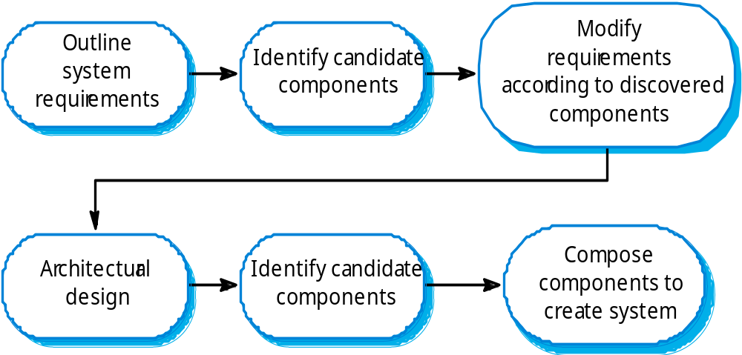
The CBSE process

Slide 26
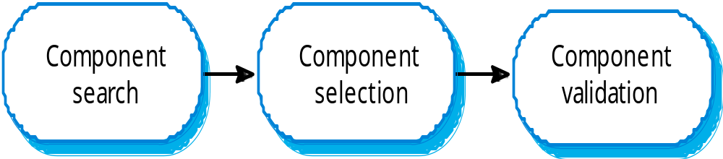
Component identification process

Slide 27
Component identification issues
Trust
  You need to be able to trust the supplier of a component
Requirements
  Different groups of components will satisfy different requirements
Validation
  The component specification may not be detailed enough to allow comprehensive tests to be developed
  Components may have unwanted functionality. How can you test this will not interfere with application?

Slide 28
Ariane launcher failure
In 1996, the 1st test flight of the Ariane 5 rocket ended in disaster when the launcher went out of control 37 seconds after take off
The problem was due to a reused component from a previous version of the launcher (the Inertial Navigation System) that failed because assumptions made when that component was developed did not hold for Ariane 5
The functionality that failed in this component was not required in Ariane 5

Slide 29
Component composition
The process of assembling components to create a system
Composition involves integrating components with each other and with the component infrastructure
Normally you have to write ‘glue code’ to integrate components

Slide 30
Types of composition
Sequential composition where
  The composed components are executed in sequence
  This involves composing the provides interfaces of each component
Hierarchical composition where
  One component calls on the services of another
  The provides interface of one component is composed with the requires interface of another
Additive composition where
  The interfaces of two components are put together to create a new component
Stateless and Stateful components

Slide 31
Interface incompatibility
Parameter incompatibility where operations have the same name but are of different types
Operation incompatibility where the names of operations in the composed interfaces are different
Operation incompleteness where the provides interface of one component is a subset of the requires interface of another

Slide 32
Composition trade-offs
When composing components, you may find
  Conflicts between functional and non-functional requirements
  Conflicts between the need for rapid delivery and system evolution
You need to make decisions such as:
  What composition of components is effective for delivering the functional requirements?
  What composition of allows for future change?
  What will be the emergent properties of the composed system?

Slide 33
Key points
CBSE is a reuse-based approach to defining and implementing loosely coupled components into systems.
A component is a software unit whose functionality and dependencies are completely defined by its interfaces.
A component model defines a set of standards that component providers and composers should follow.
During the CBSE process, the processes of requirements engineering and system design are interleaved

Slide 34
Key points…
Component composition is the process of ‘wiring’ components together to create a system.
When composing reusable components, you normally have to write adaptors to reconcile different component interfaces.
When choosing compositions, you have to consider required functionality, non-functional requirements and system evolution

Slide 35
Good Composition Principle
Principle of Separation
  Design your system such that each component has clearly defined role
  The roles should not overlap
Single large component has benefits but also pitfalls
Using multiple components has problems as well as benefits

Slide 36
Component Examples
Study Chapter 19 from Sommerville
MS Office Tools use components
Guess Them…

Slide 37
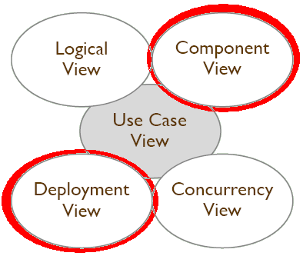
UML Views & Diagrams
Each view is a projection of the complete system
Each view highlights particular aspects of the system
Views are described by a number of diagrams
No strict separation, so a diagram can be part of more than one view

Slide 38
UML Views & Diagrams
Component View
  Shows the organization of the code components and their dependencies.
  Represents the physical components of a system.
  Described by the Component Diagrams.
  Used by developers
Deployment View
  Shows the deployment of the system into the physical architecture with computers and devices.
  Represent the deployment of a system on hardware.
  Represented by the Deployment Diagram.
  Used by developers, system integrators, and testers.

Slide 39
Implementation Diagrams
Show aspects of physical implementation, including:
  Structure of Components
  Run-time Deployment System
Two type of Implementation Diagrams
  Component Diagrams
    Show the structure of components, including the classifiers that specify them and the artifacts that implement them
  Deployment Diagrams
    Show the structure of the nodes on which the components are deployed

Slide 40
Component Diagram
Shows the dependencies among software components, including the classifiers that specify them
It Has only a type form, not an instance form
To show component instances, use a deployment diagram
Components represent physical modules of code
Dependencies between components and their interfaces are represented
Dependencies include: composition, communication, etc
Component does not have its own features (for example, attributes, operations), it acts as a container for other classifiers

Slide 41
Component Diagram - Notation
Component diagram is a graph of components connected by dependency relationships
Components may also be connected to components by physical containment representing composition relationships
Components typically expose a set of interfaces, which represent the services provided by the elements that reside on the component

Slide 42

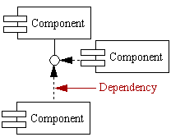
Component Diagram - Notation
Component
A component is a physical building block of the system. It is represented as a rectangle with tabs.
Interface
An interface describes a group of operations used or created by components.
Dependencies
Draw dependencies among components using dashed arrows. (Arrow start from consumer and ends at service provider)

Slide 43
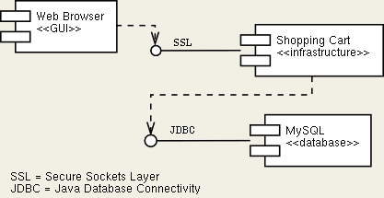
Component Diagram - Example
Web browser communicates customer orders to a shopping cart
The shopping cart accesses a database for persistence and for transactions

Slide 44
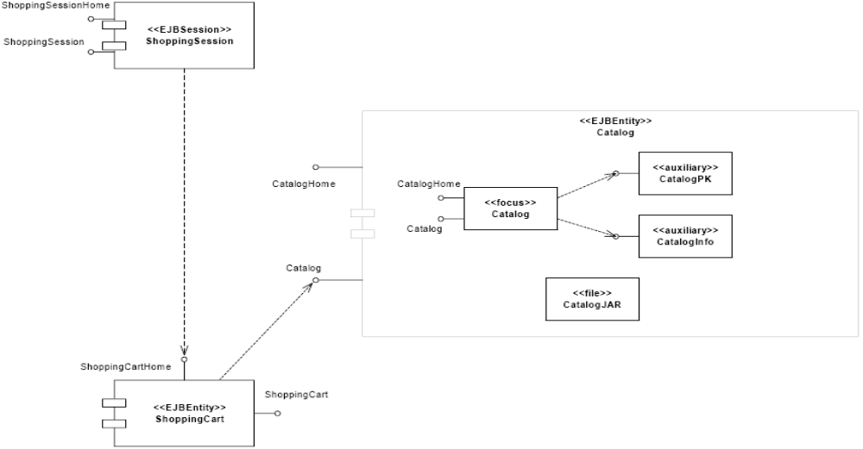
Component Diagram - Example

Slide 45
Deployment Diagram
Deployment diagrams depict the physical resources in a system including nodes, components, and connections
Represents the physical relationships among software and hardware components as realized in a running system
Useful for showing how components and objects move about in distributed systems
Nodes represent computational elements (an intelligent device, processor, server, etc)
Captures the distinct number of computers involved
Shows the communication modes employed
Component diagrams can be embedded into deployment diagrams effectively

Slide 46
Deployment Diagram - Notation
Deployment diagram is a graph of nodes connected by communication associations
Nodes may contain component instances
This indicates that the component runs or executes on the node
Components may contain instances of classifiers, which indicate that the instance resides on the component

Slide 47


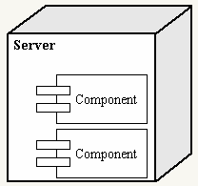
Deployment Diagram - Notation
Node
A node is a physical resource that executes code components.
Association
Association refers to a physical connection between nodes, such as Ethernet.
Components and Nodes
Place components inside the node that deploys them.

Slide 48
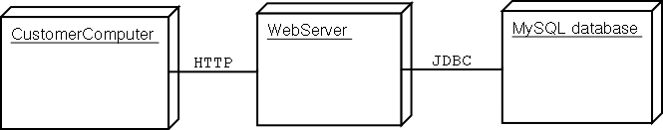
Deployment Diagram - Notation

Slide 49
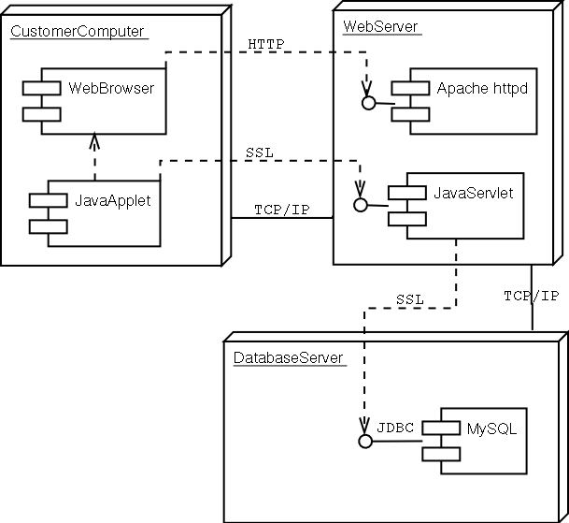
Deployment Diagram - Notation

