Slide 1

SMART INDIA HACKATHON 2024
Problem Statement ID – SIH1624
Problem Statement Title – To develop an AI based model for electricity demand projection
Theme – Smart Automation
PS Category – Software
Team ID -
Team Name - BROCODE

Slide 2

ElectroAI
BROCODE
Problem: Delhi faces significant challenges related to electricity consumption due to its rapid urbanization and growing population.
Proposed Solution: In our project, we aim to develop an advanced machine learning model to predict future electricity bill trends and consumption patterns. By leveraging historical data sourced from internet databases, surveys, and comprehensive research on past trends, the model will analyze and identify patterns that influence electricity usage and costs. This approach enables the incorporation of various factors such as seasonal variations, energy consumption behaviors, and economic influences. Our model will help aid consumers and utility providers in making informed decisions regarding energy management and future cost projections.

Slide 3
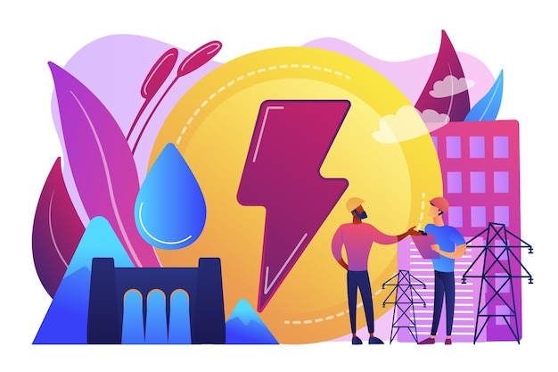
ElectroAI
BROCODE
Addressing the Problem:
This model accurately predicts rising electricity prices and growing daily power consumption needs.
Since coal, a non-renewable resource, dominates power generation, transitioning to more sustainable alternatives and adopting green energy is essential.
This model can be used by industrial professionals, including technical and management personnel in the electricity field, to predict future power consumption trends and plan measures for sustainable development in the current context.
This model will help in preventing the electricity wastage on a large scale and will help save a lot of resources and will act as a remarkable step towards sustainable development.

Slide 4
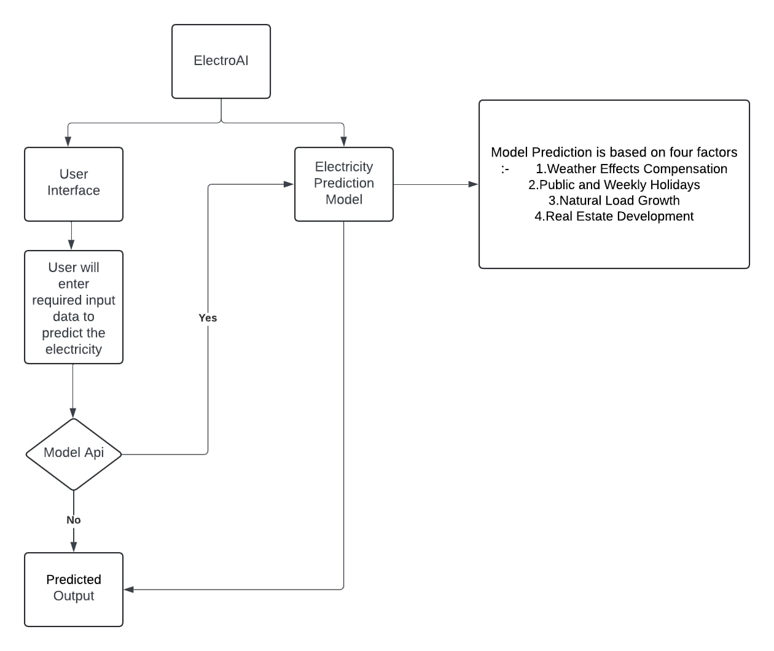
FLOWCHART

Slide 5
FLOWCHART EXPLANATION
User Interface:
This is the starting point where the user interacts with the system.
The user provides necessary input data to initiate the prediction process.
Electricity Prediction Model:
This is the core component of the system.
It takes the user-provided input data and applies a prediction model to estimate future electricity consumption.
The model is based on four factors:
- Weather Effects Compensation: This considers how weather conditions (e.g., temperature, humidity) can influence electricity usage.
- Public and Weekly Holidays: These events can lead to changes in electricity demand.
- Natural Load Growth: This accounts for the overall increase in electricity consumption over time.
- Real Estate Development: New construction or development can impact electricity demand.
Model API:
This is an interface that connects the user interface to the prediction model.
It handles the transmission of input data to the model and receives the predicted output.
Predicted Output:
This is the final result of the prediction process.
The system presents the predicted electricity consumption to the user.

Slide 6

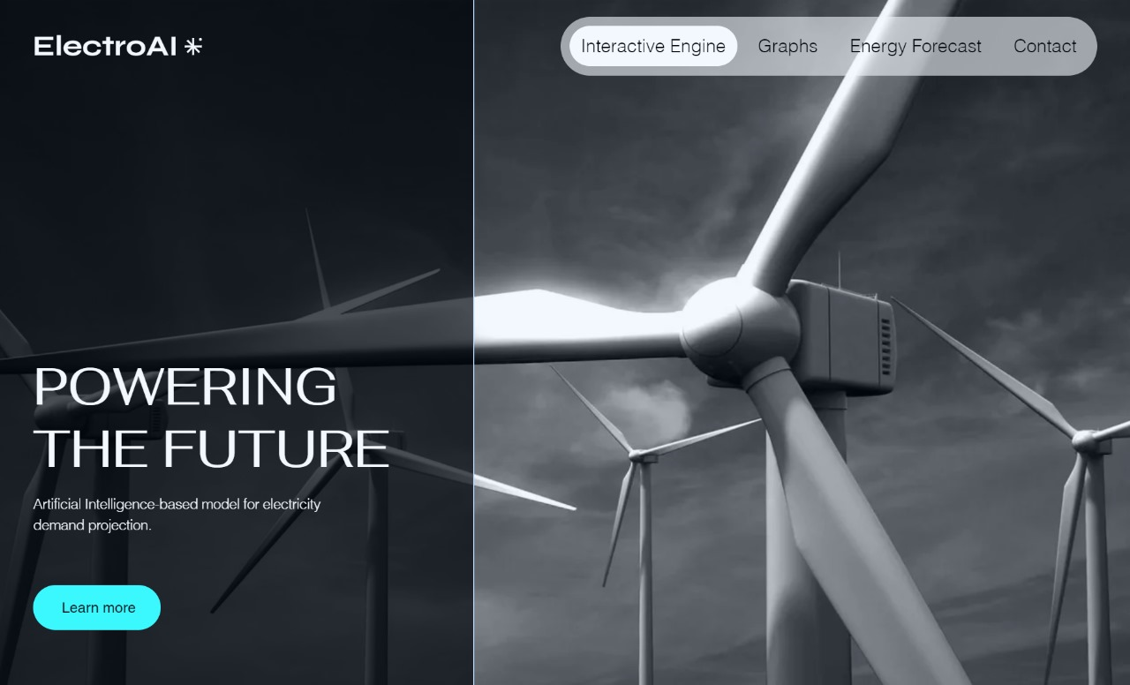
PROTOTYPE
Link to the Website: https://raghavpershad.wixstudio.io/my-site-1

Slide 7
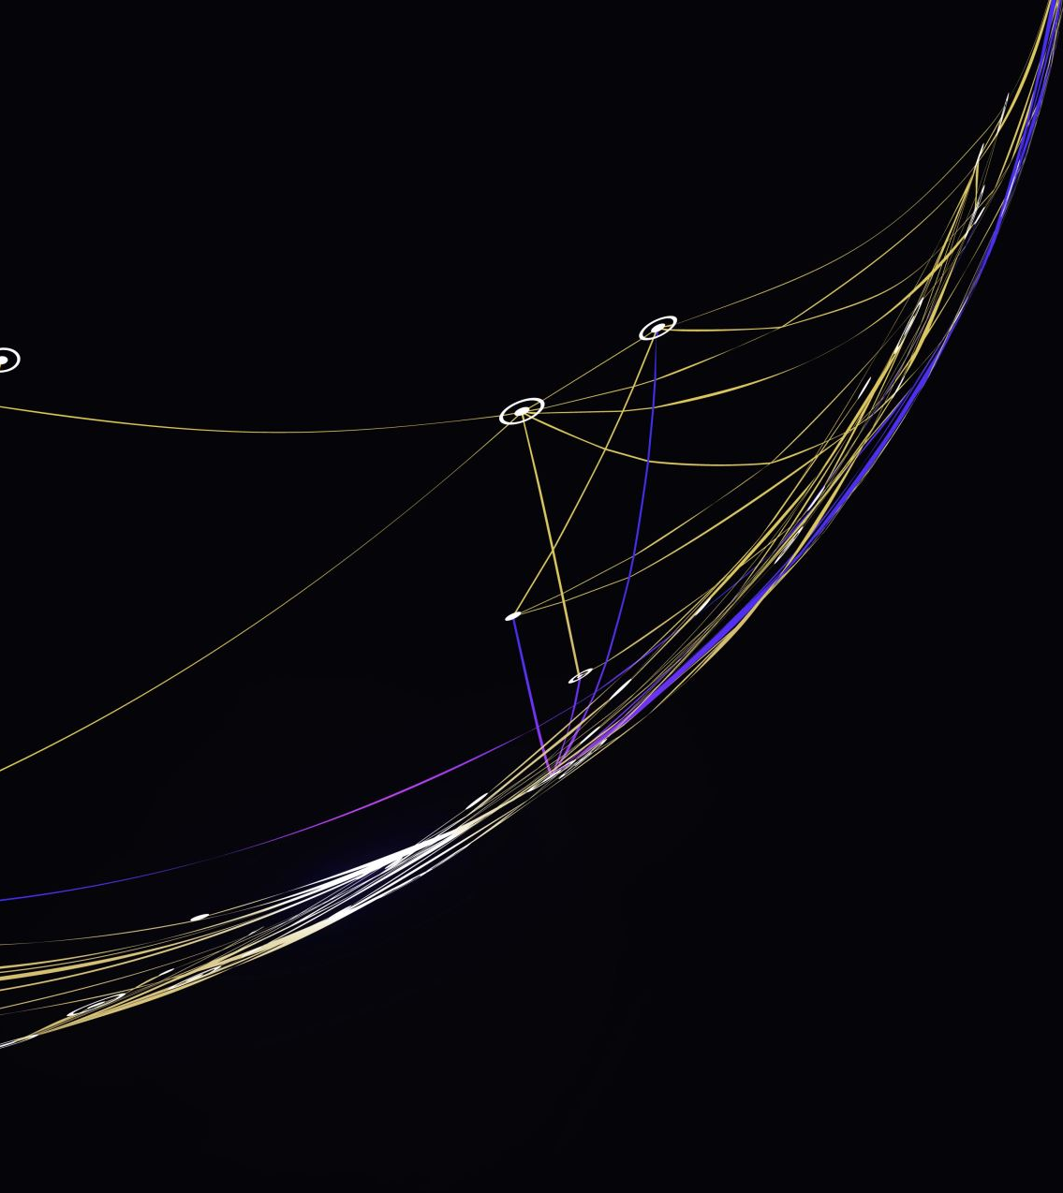
Explaining the Prototype
Streamlit Version of Electro-AI: Visualization Platform for Electricity Usage Prediction
This Streamlit app is designed to visualize the functionality and performance of the Electro-AI model, which aims to predict electricity consumption based on various factors such as population density, industrial activity, residential vs. commercial power usage ratio, air quality index (AQI), solar radiation, and more. The goal is to make the prediction process and results easily interpretable for users through interactive visualizations.
GitHub Link for Repository: https://github.com/HATAKEkakshi/Electro-AI.git

Slide 8

Key Features for the Prototype:
Dual Dataset Support:
The app works with two separate datasets:
Dataset 1: Focused on general electricity consumption trends.
Dataset 2: Enriched with additional features such as environmental conditions and population data.
Model Training Visualization:
RNN Model: One part of the application is dedicated to showing how a Recurrent Neural Network (RNN) model is trained using the first dataset.
LSTM Model: Another section visualizes the training of a Long Short-Term Memory (LSTM) model on the second dataset, which includes temporal dependencies and additional environmental and demographic factors.
Training Data Visualization:
Users can explore the training data used for both models. Interactive charts and graphs show data distribution, trends over time, and relationships between variables.
Model Accuracy:
The app provides a comparison of the performance of both models. Accuracy metrics, such as Mean Absolute Error (MAE) or Root Mean Square Error (RMSE), are displayed for both the RNN and LSTM models.
Users can visualize how each model's accuracy evolves during the training process using graphs such as loss curves and accuracy metrics.
Predicted Output Visualization:
The predicted electricity usage output from both models is displayed in graph form. Users can toggle between actual vs. predicted results to see how well each model performs in different scenarios.
A range of visualizations, including time series plots, bar charts, and scatter plots, are provided to analyze predictions over various time periods (daily, monthly, yearly).

Slide 9





TECHNOLOGY STACK
FEATURES
Daily Consumption Analysis: Industrial and public consumption is occurring on a massive scale. This platform analyses the large scale consumption and categorizes it on the basis of various factors.
\ Geospatial Data: There is a huge difference between the electricity demands of different locations. This model correctly predicts the area-specific electricity needs.
Past Trend Analysis & future trend prediction of public consumption : Past consumption data can reveal trends in per-year increases in daily consumption, allowing machine learning models to predict future consumption patterns.
Graphical Representation of the Economic Trends: The current unit consumption will be depicted graphically w.r.t some common economical factors such as Elasticity and Demand and a corresponding future trend curve (predicted one) would be depicted, hence, the industrial decisions can be taken accordingly and with a great precision.
React.js (Frontend Development)
TensorFlow (Machine Learning Model)
FLASK (API Development)
Node.js (API Integration) Python (Data Analytics)
Numpy, Pandas, Matplotlib, Scikitlearn, XGBoost (Python libraries)

Slide 10
TECHNICAL APPROACH
BROCODE
TECHNICAL APPROACH
1. Problem Definition and Requirements Gathering
- **Define Objectives**:
- **Identify Data Sources**:
2. Data Collection and Preprocessing
- **Data Acquisition**:
- **Data Cleaning**:
- **Feature Engineering**:
- **Data Splitting**:
3. Model Development
- **Model Selection**:
- **Incorporating Area-Wise Data**:
- **Energy Mix Prediction**:
4. Model Training and Evaluation
- **Model Training**:
- **Evaluation Metrics**:
- **Iterative Refinement**:
5. Deployment and Integration
- **Model Deployment**:
- **API Development**:
- **Integration with Existing Systems**:
6. Monitoring and Optimization
- **Continuous Monitoring**:
- **Model Retraining**:
- **Optimization for Green Energy**:
7. User Interface and Reporting
- **Dashboard Development**:
- **Reporting and Analytics**:
8. Feedback Loop and Continuous Improvement
- **User Feedback**:
- **Continuous Innovation**:

Slide 11
IMPACTS & BENEFITS
Promotion of Green Energy
Environmental Impact
Resource Conservation: By optimizing energy use and promoting green energy, the model contributes to conserving natural resources and reducing environmental degradation.
Sustainability Goals: The model supports global sustainability goals by encouraging the use of renewable energy and reducing carbon emissions.
Area-Specific Insights
Tailored Energy Solutions: Area-wise data allows for the creation of localized energy solutions, addressing specific needs and challenges of different regions.
Community Empowerment: Local governments and communities can use the insights to promote local green energy initiatives, enhancing energy independence and sustainability.
Integration with Renewable Sources: The model can optimize the integration of renewable energy sources like solar and wind by predicting when and where energy will be needed most, allowing for better planning and storage.
Carbon Footprint Reduction: By promoting green energy usage through informed decision-making, the model can help reduce reliance on fossil fuels, leading to lower greenhouse gas emissions.

Slide 12
IMPACTS & BENEFITS
Enhanced Energy Management
Demand Forecasting: Accurate predictions of electricity usage allow utility companies to manage supply and demand more effectively, preventing blackouts or wastage of resources.
Grid Stability: By predicting consumption patterns, the model can help maintain grid stability, reducing the likelihood of grid failures or overloads.
Weather Effects
Weather Condition Demand Forecasting: By using integration of Renewable Weather and climate data, including temperature, humidity, rainfall, wind speed, and seasonal variations will help in accurately predicting the correct electricity demand and will thus ensure smooth power supply.
Economic Efficiency
Cost Savings for Consumers: With accurate predictions, consumers can be advised on when to use electricity to minimize costs, leading to more efficient energy consumption.
Operational Cost Reduction: Energy providers can reduce operational costs by optimizing the generation and distribution of electricity based on precise demand forecasts.

Slide 13

RESEARCH & REFERENCES
For the ElectroAI bot, data was collected from multiple reliable sources to ensure a comprehensive understanding of electricity consumption patterns. We gathered historical power usage data from local electricity boards and government databases, which included both residential and commercial consumption. Additionally, we incorporated publicly available datasets on environmental factors like air quality (AQI), solar radiation, and weather conditions. Population density and industrial activity data were also sourced from municipal and census records. These diverse datasets were combined to create a robust foundation for training the AI models, enabling accurate and area-specific electricity usage predictions.
Drive link for the Database on which we will train the bot:
https://drive.google.com/drive/u/0/folders/1Stge6mbg8twoLG3-Uk6P_xWlCZcoAHqU

Slide 14

Team Members:
Raghav Pershad (Team Lead)
Hemant Kumar
Nidhi Singh
Archit Nirula
Jaskaranjeet Singh
Om Vinayak
Students of Amity University, Noida

