Slide 1
Theoretical Cosmology
Kazuya Koyama and Vincent Vennin
ICG Lectures, 2016

Slide 2
Outline
Lecture 1: Overview and the Expansion
Lecture 2: The Early Universe
Lecture 3: Inflation
Lecture 4: Dark Energy
2 x 1 hour 15 minutes (15 minutes break )
Notes:
Lecture 1 will cover an overview of the standard model of cosmology; then I will go into details about the expansion including how it affects and is affected by the geometry of the universe, the types of matter and energy, the different types of distance measures, and thermodynamics. Lecture 2 will discuss the early universe, focusing on the thermal history, the nucleosynthesis of the light elements, and the production of the cosmic microwave background radiation. Lecture 3 will then cover some of the conceptual problems with the big bang and how inflation theory could solve them, along with other unknowns such as dark matter and dark energy.
Encourage questions.

Slide 3
Overview
Cosmological principle
Big Bang cosmology

Slide 4
The Cosmological Principle
Copernican principle: we do not occupy a special place in the Universe
Cosmological principle: Universe is homogeneous and isotropic on very large scales
Homogeneous = same everywhere
Isotropic = same in all directions
We observe isotropy, and assuming isotropy everywhere via the Copernican principle implies homogeneity
Notes:
The cosmological principle is one of the foundations of modern cosmology. It is often confused with:
Copernican principle: we do not occupy a special place in the Universe. Called such because of Copernicus who formulated a model of the universe with the Sun at the center rather than the Earth. You’ve probably heard of Ptolemy and his epicycles – eventually the Copernican model won out, both because it was a simpler explanation of the data and because the people who thought the Earth should be at the center of the Universe eventually thought it was okay if the Sun was at the center. Now, of course, we don’t think of either being at the “center” or indeed that there is a center. But the point is that it’s a philosophical principle, which means it’s not something you can test with data. On the other hand…
Cosmological principle: on very large scales, the universe is homogeneous and isotropic. This is a funny kind of principle because it depends on the scale over which you average; obviously at the scale of people it is not homogeneous and isotropic, or even at the scale of galaxies. Scales at which this is true can be tested as surveys become larger. It could be that it applies on linear scales which is above ~10 Mpc, but structures such as walls and voids have been observed on larger scales up to ~100 Mpc. I like to think of it as an asymptotic kind of principle, wherein the larger you take your average, the closer to homogeneous and isotropic the universe becomes, but of course that needs to be tested by large scale surveys, which can only test up to < 10 Gpc (the observable universe).
One reason for believe the Cosmological principle is that we observe isotropy, i.e. in the CMB radiation to 1 part in 10^5; assuming isotropy everywhere via Copernicus thus implies homogeneity (otherwise, we are in a very special place).

Slide 5
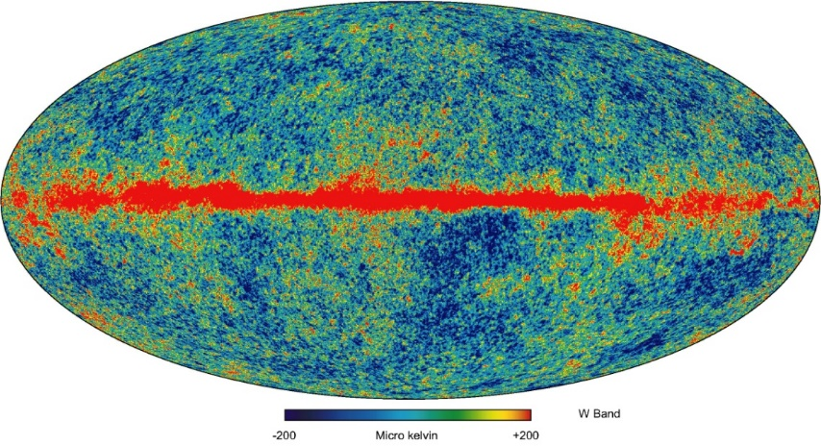
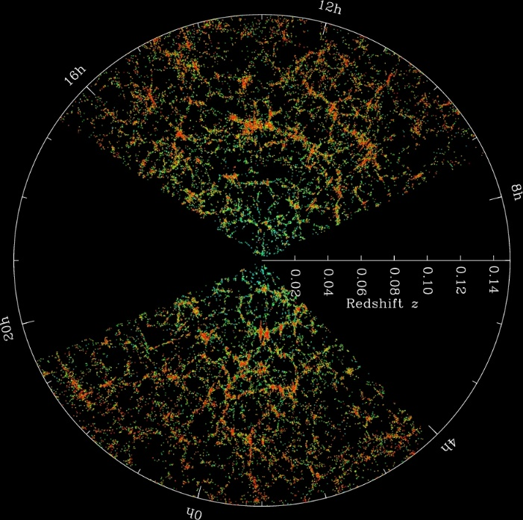
Isotropy and homogeneity
6000 Mpc
Isotropy
Cosmic Microwave Radiation
Homogeneity
galaxy distribution
ESA Planck
SDSSIII

Slide 6
Big Bang Cosmology
Cosmological principle: the Universe is homogeneous and isotropic
(on very large scales)
The Big Bang: the Universe was very small, hot, and dense in the past
Hubble expansion
The Cosmic Microwave Background
Primordial Nucleosynthesis (or BBN)
Notes:
The big bang model is thus based on the cosmological principle and the observations of the Hubble expansion, the CMB, and Nucleosynthesis

Slide 7
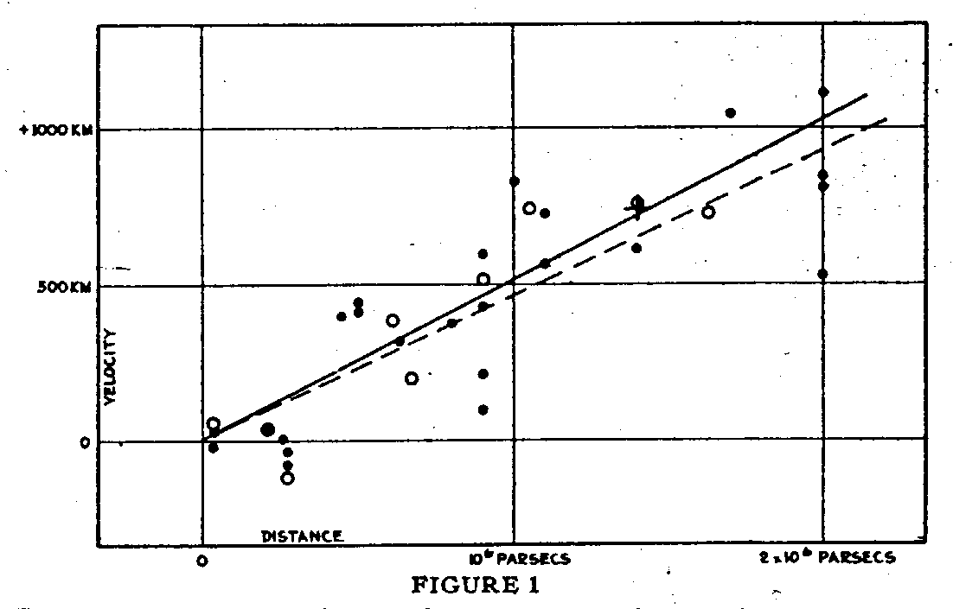

Velocity
500 km/s
$$v=H_{0}d$$
1 Mpc
Distance
Notes:
Hubble observed a linear relation between the distance of galaxies and their recession velocity
Applying cosmological principle, this means relative velocity between any two galaxies proportional to distance between them
[CLICK] Hubble’s distances were off so he measured a rate of 500 km/s/Mpc

Slide 8
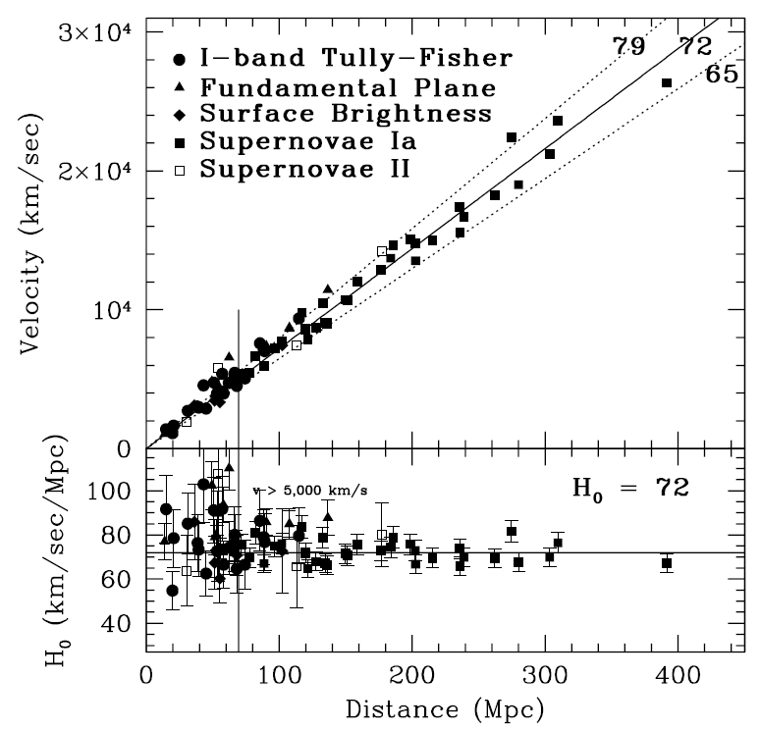
Hubble key projects

Slide 9
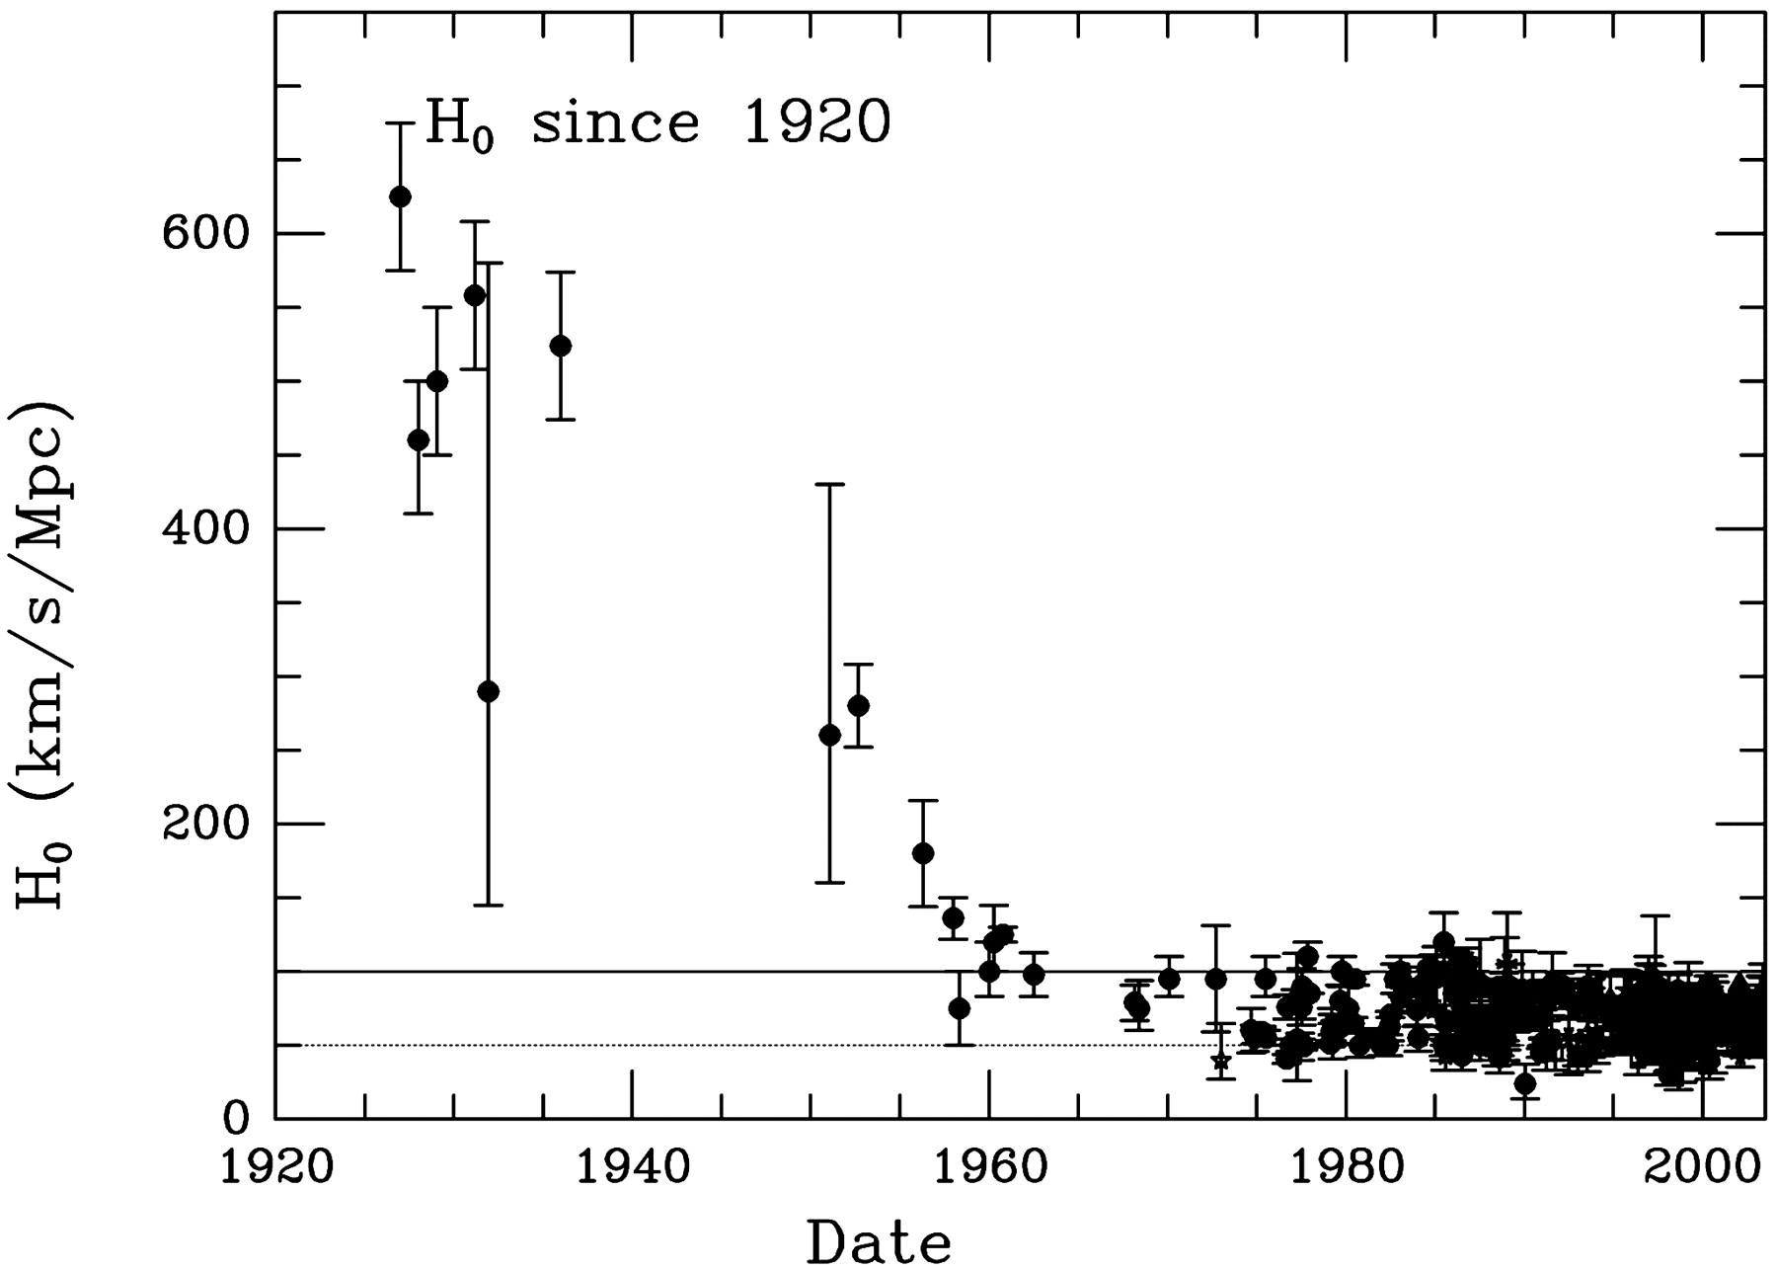
Notes:
Today it is closer to 100, (here plot of results from Hubble key project measurements), so we represent it in terms of 100 H = h where h ~ 0.7. [CLICK] It’s interesting to see how this measured value has changed over time; once we figured out the Period-luminosity relation (more or less) of Cepheid variable stars we brought the value down below 100. I think this plot is really a nice lesson in the irrelevance of error bars…

Slide 10
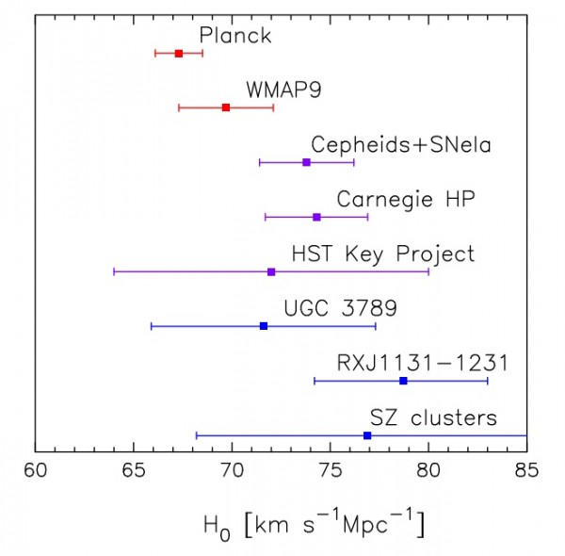
The present day
Hubble parameter
Natural unit
Riess et.al. arXiv:1604.01424

Slide 11
Implications of Expansion
Big Bang model: the Universe is expanding now, so it was very small in the past, and had a “beginning”
Steady State model: matter is continually created as space expands, so the Universe is homogeneous in time as well as space
Either interpretation valid until the discovery of the microwave background radiation, which favored BB
Notes:
Implications: Expansion itself doesn’t necessitate the Big Bang model in which all of space and time was initially condensed into a very small point. The Steady State model, in which matter is continually created so there was no beginning (uniform in time as well as space), was viable alternative until discovery of microwave background radiation

Slide 12
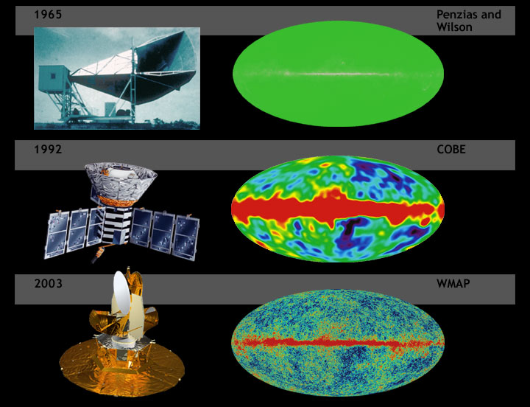
Cosmic Microwave Background (CMB)
Notes:
Starting with observations from the ground, CMB observed to be incredibly isotropic: same temperature everywhere in the sky to 1 part in 10^5 and a perfect blackbody spectrum

Slide 13
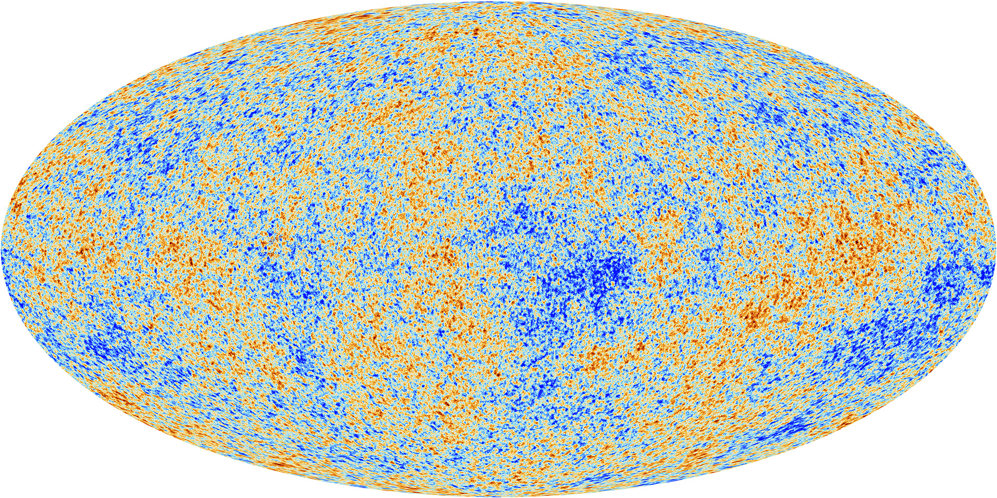
Planck 2015

Slide 14
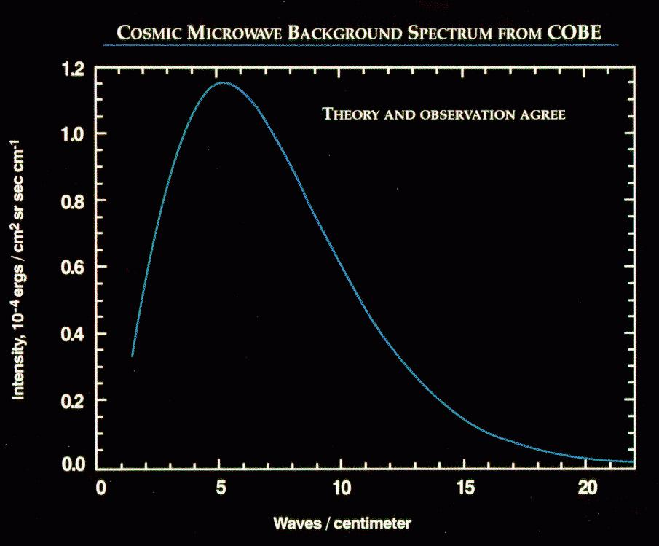
evidence Universe
was once hotter
than .1 eV
Notes:
We will see that the temperature of radiation cools as the universe expands, so a current temperature of 2.75 K was once incredibly hot

Slide 15
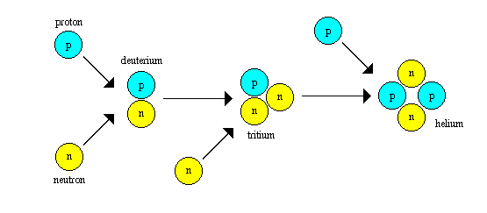
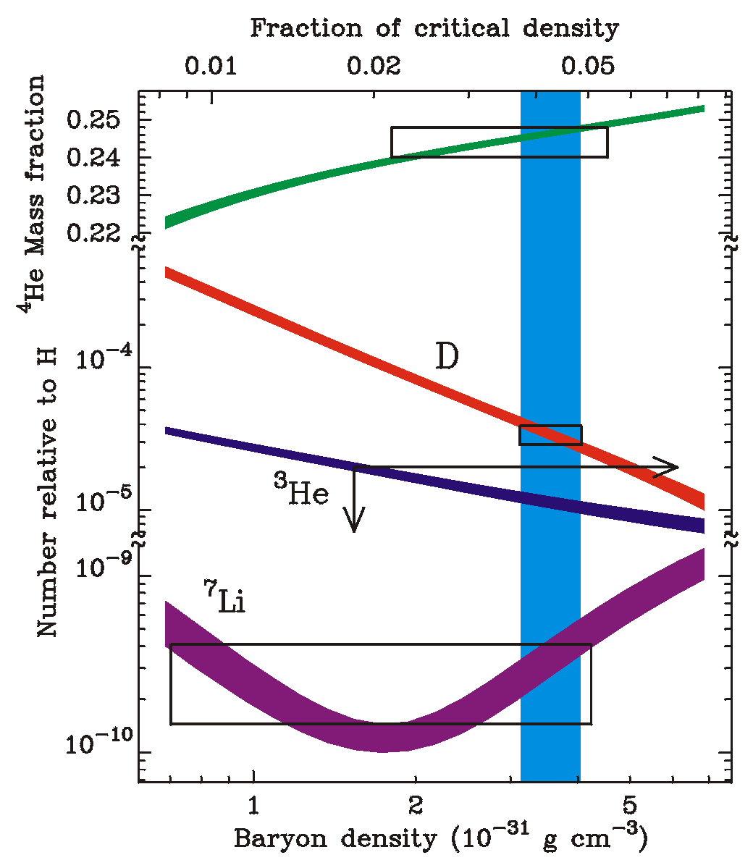
Primordial Nucleosynthesis
A prediction of the hot big bang is the production of light elements through nuclear reactions in the initial plasma
Notes:
A prediction of the hot big bang is the production of primordial elements through nuclear reactions in the initial plasma. Hydrogen, Helium, and trace amounts of Lithium are produced, 1 second after the big bang
[CLICK] [Plot of observational results: abundance vs. baryon fraction (bands are predictions, boxes observations, vertical band driven by D); agreement for baryon density much smaller than critical density of matter, leading to strong evidence for non-baryonic dark matter]

Slide 16
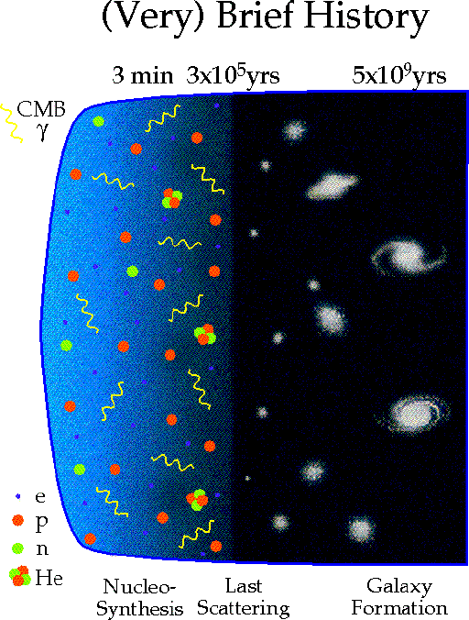
Notes:
The Big Bang model of cosmology gives us this picture of the evolution of the universe from a very hot and dense plasma, which was hot and dense enough to fuse nuclei, and later cooled enough to create neutral Hydrogen and produce the CMB radiation, and after enough time the first stars and galaxies formed. We will see in Lecture 3 that this model doesn’t make sense without something like inflationary expansion in the very early universe…

Slide 17
Big Bang Cosmology
Cosmological principle: the Universe is homogeneous and isotropic
(on very large scales)
The Big Bang: the Universe was very small, hot, and dense in the past
Hubble expansion (Lectures 1)
The Cosmic Microwave Background (Lecture 2)
Primordial Nucleosynthesis (or BBN) (Lecture 2)
Notes:
The big bang model is thus based on the cosmological principle and the observations of the Hubble expansion, the CMB, and Nucleosynthesis

