Slide 1
The Expanding Universe
Geometry
Kinematics, distances
Dynamics
Thermodynamics

Slide 2
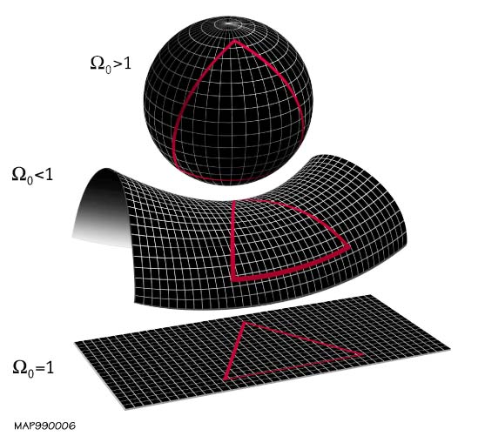
Geometry
A metric allows us to calculate the spacetime separation between 2 (4-D) points in a given coordinate system
3-dimensional space has three possible geometries:
Spherical
Hyperbolic
Euclidean
Possible geometries of 2-D surfaces
Notes:
A metric allows us to calculate the spacetime separation between two (4-D) points in a given coordinate system. For 3-D space, there are three types of curvature: spherical, hyperbolic, and flat (or Euclidean), represented here as 2-D surfaces curving into another dimension…

Slide 3
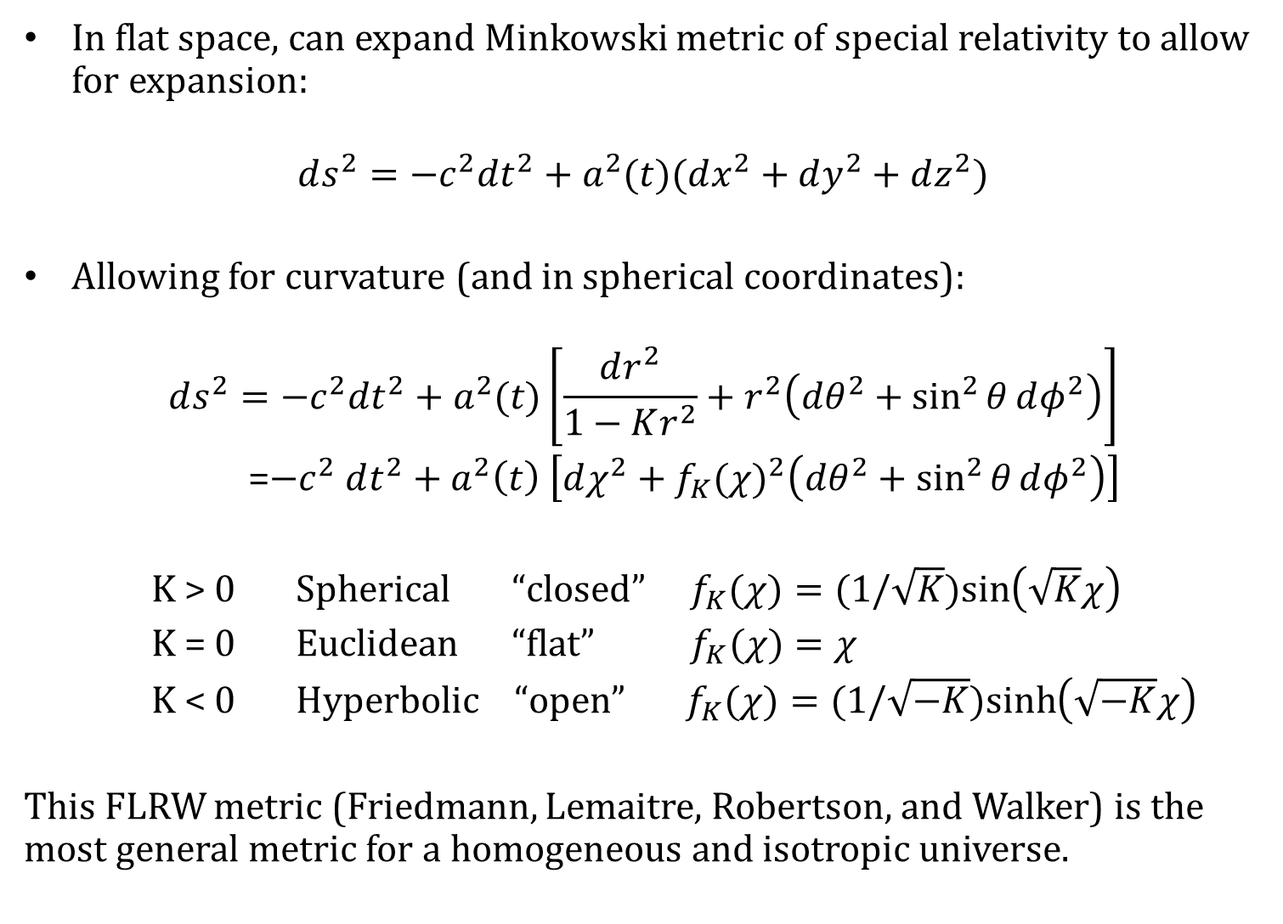
In flat space, can expand Minkowski metric of special relativity to allow for expansion:
$$ds^{2}=−c^{2}dt^{2}+a^{2}(t)(dx^{2}+dy^{2}+dz^{2})$$
Allowing for curvature (and in spherical coordinates):
$$ds^{2}=−c^{2}dt^{2}+a^{2}(t)\left[\frac{dr^{2}}{1−Kr^{2}}+r^{2}\left(dθ^{2}+\sin^{2}{θ}dφ^{2}\right)\right]$$
=$−c^{2} dt^{2}+a^{2}\left(t\right) \left[dχ^{2}+{f_{K}(χ)}^{2}\left(dθ^{2}+\sin^{2}{θ}dφ^{2}\right)\right]$
K > 0 Spherical “closed” $f_{K}(χ)=(1/\sqrt{K})sin\left(\sqrt{K}χ\right)$
K = 0 Euclidean “flat” $f_{K}(χ)=χ$
K < 0 Hyperbolic “open” $f_{K}(χ)=(1/\sqrt{−K})sinh\left(\sqrt{−K}χ\right)$
This FLRW metric (Friedmann, Lemaitre, Robertson, and Walker) is the most general metric for a homogeneous and isotropic universe.
Notes:
If space is flat, you can add a term to the Minkowski metric of special relativity to allow for expansion, parameterizing it by the scale factor, a, which grows over time. [CLICK] The metric where space is homogeneous and isotropic, with some constant curvature given by K, is given here (in spherical coordinates because we still like to think of ourselves as the center of the Universe), referred to variably as the RW, FRW, or FLRW metric for Friedmann, Lamaitre, Robertson, and Walker. The curvature constant tells you what kind of geometry you have in your metric, and I will get to later what the Omegas mean.
Write the metric on the board

Slide 4
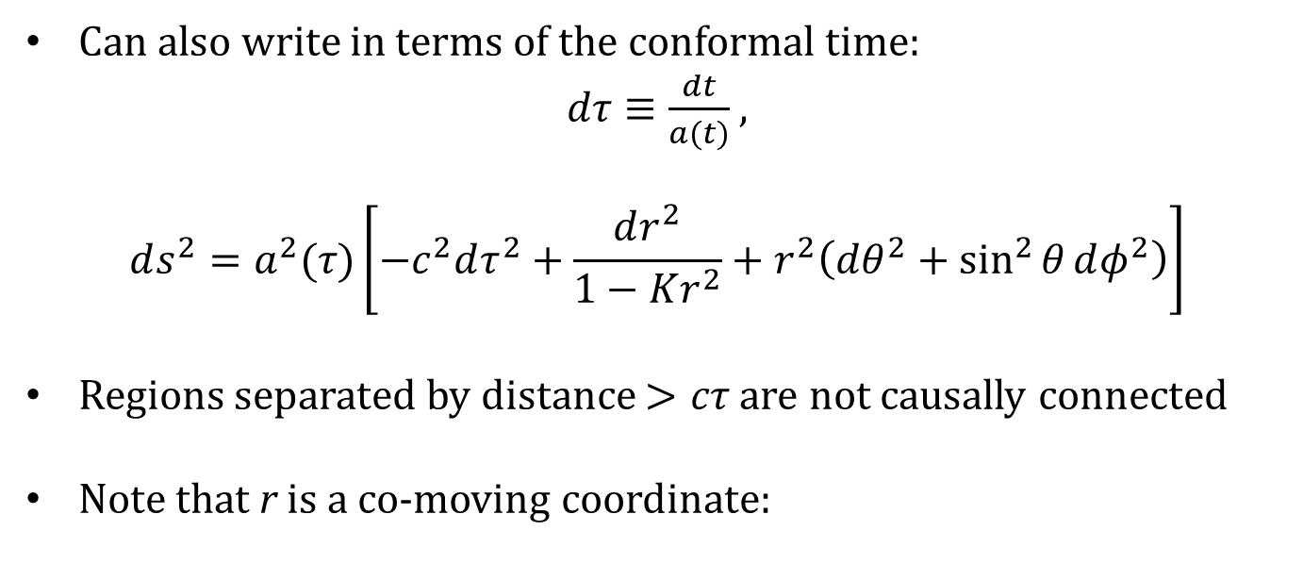
Can also write in terms of the conformal time:
$dτ≡\frac{dt}{a(t)}$ ,
$$ds^{2}=a^{2}(τ)\left[−c^{2}dτ^{2}+\frac{dr^{2}}{1−Kr^{2}}+r^{2}\left(dθ^{2}+\sin^{2}{θ}dφ^{2}\right)\right]$$
Regions separated by distance $>cτ$ are not causally connected
Note that r is a co-moving coordinate:
Notes:
The metric can also be written in terms of the conformal time, which is like a co-moving measure of time, as below. Regions separated by distances greater than the conformal distance are not causally connected. [CLICK] Note that the distance r is a co-moving coordinate, which means that it describes distances in addition to the expansion; if two objects move along with the expansion (called the Hubble flow), their co-moving distance does not change.

Slide 5






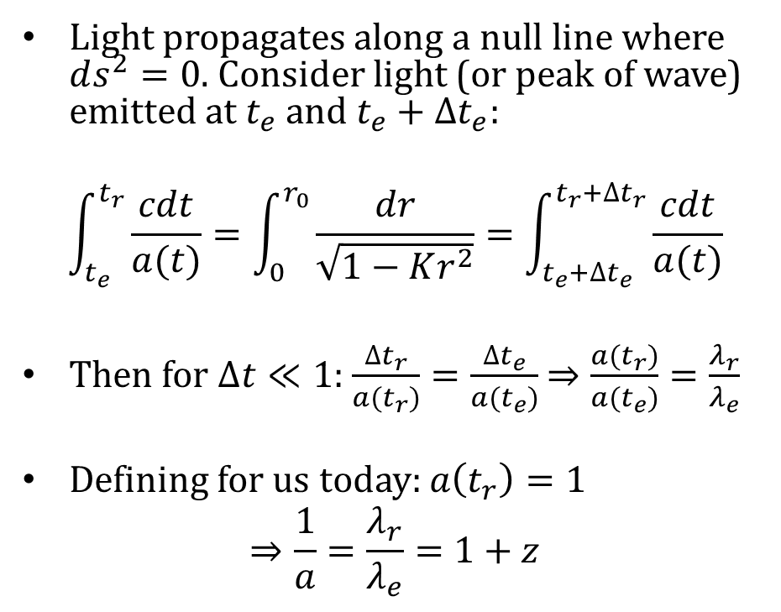

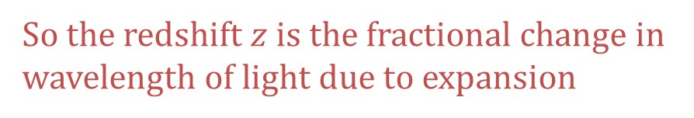
Kinematics
Light propagates along a null line where $ds^{2}=0$. Consider light (or peak of wave) emitted at $t_{e}$ and $t_{e}+∆t_{e}$:
$$\int_{t_{e}}^{t_{r}}{\frac{cdt}{a(t)}=\int_{0}^{r_{0}}{\frac{dr}{\sqrt{1−Kr^{2}}}=\int_{t_{e}+∆t_{e}}^{t_{r}+∆t_{r}}{\frac{cdt}{a(t)}}}}$$
Then for $∆t≪1$: $\frac{∆t_{r}}{a(t_{r})}=\frac{∆t_{e}}{a(t_{e})}$ $⇒\frac{a(t_{r})}{a(t_{e})}=\frac{λ_{r}}{λ_{e}}$
Defining for us today: $a\left(t_{r}\right)=1$
$$⇒\frac{1}{a}=\frac{λ_{r}}{λ_{e}}=1+z$$
$$t_{r}+Δt_{r}$$
$$λ_{r}∝∆t_{r}$$
$$t_{r}$$
$$t_{e}+Δt_{e}$$
$$λ_{e}∝∆t_{e}$$
$$t_{e}$$
So the redshift $z$ is the fractional change in wavelength of light due to expansion
$$r=0$$
Notes:
In this section I’ll define the different types of distance measures in cosmology, but we’ll start with the redshift.
Redshift: Light propagates along a null line, so the metric coordinate separation is 0. Consider light emission where one peak emitted at t_e, the next at t_e + delta t_e. since the metric separation is 0, the time integral is equal to the radial integral, equal again to the time integral for the second peak. [CLICK] If delta t very small, this gives that the ratio of the time difference between the peaks to the scale factor is equal at emission and reception; this time difference is proportional to the wavelength. [CLICK] We define the scale factor today = 1, and the ratio of the received to emitted wavelengths as 1 + z. [CLICK] So the redshift z is the fractional wavelength difference of light due to the expansion.

Slide 6
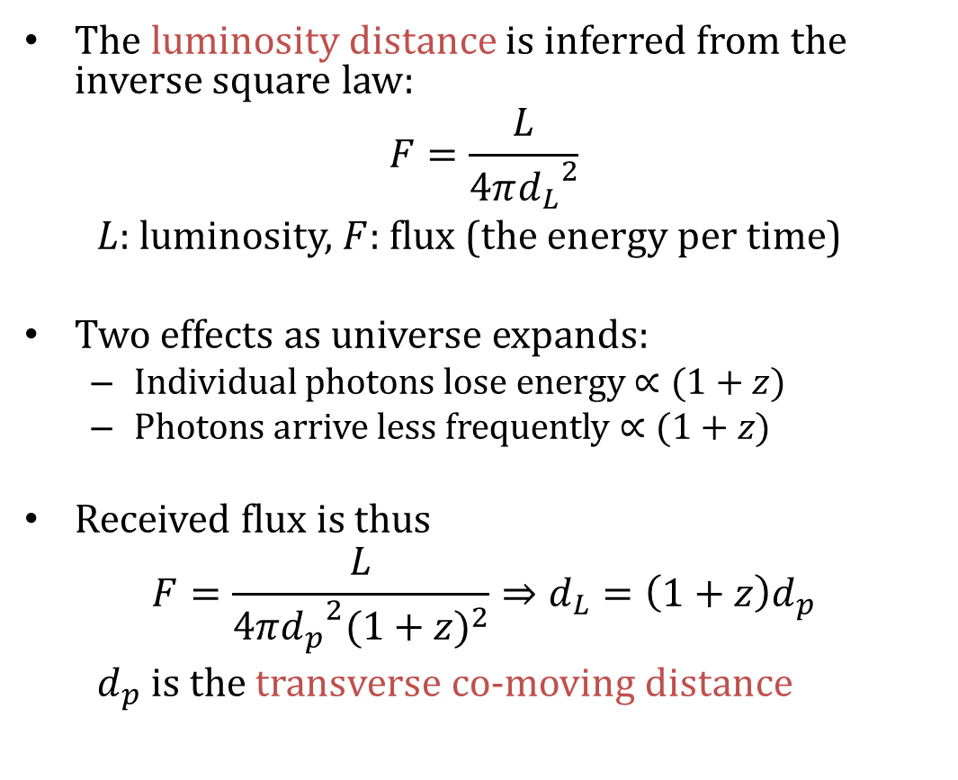
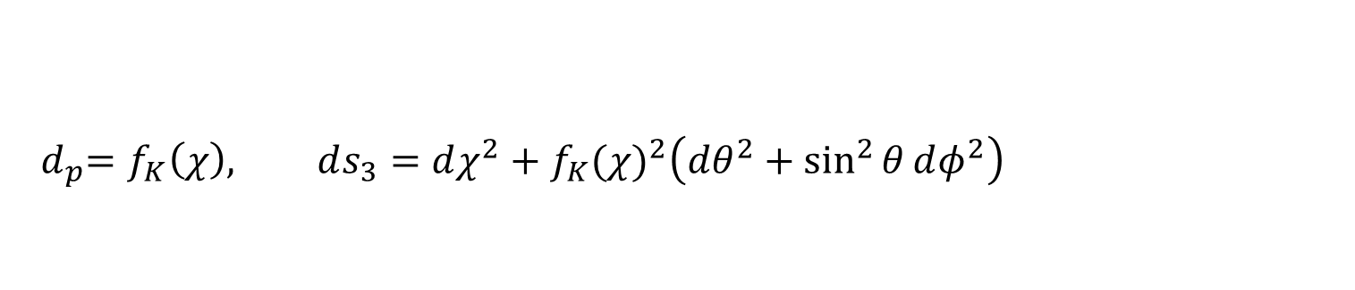

Distances
The luminosity distance is inferred from the inverse square law:
$$F=\frac{L}{4π{d_{L}}^{2}}$$
$L$: luminosity, $F$: flux (the energy per time)
Two effects as universe expands:
Individual photons lose energy $∝(1+z)$
Photons arrive less frequently $∝(1+z)$
Received flux is thus
$$F=\frac{L}{4π{d_{p}}^{2}{(1+z)}^{2}}⇒d_{L}=\left(1+z\right)d_{p}$$
$d_{p}$ is the transverse co-moving distance
$$d_{p}$$
$${{ d}_{p}=f}_{K}\left(χ\right), ds_{3}=dχ^{2}+{f_{K}(χ)}^{2}\left(dθ^{2}+\sin^{2}{θ}dφ^{2}\right)$$
Notes:
Luminosity distance: inferred from the inverse square law for light; F is flux, L is luminosity. The distance between the emitted light and the sphere is the transverse co-moving distance, if both were at the same redshift. For an observer at redshift 0, two effects as the universe expands: individual photons lose energy prop. to 1+z, and arrive less frequently prop. to 1+z. [CLICK] The received flux with respect to the proper motion distance (note it is not technically a “proper distance” and these can get confusing quickly) then gives a relation between luminosity distance and proper motion distance. For a flat universe, this is equal to the line-of-sight co-moving distance. [CLICK] I recommend looking at David Hogg’s “Distance measures in cosmology” for more details.

Slide 7



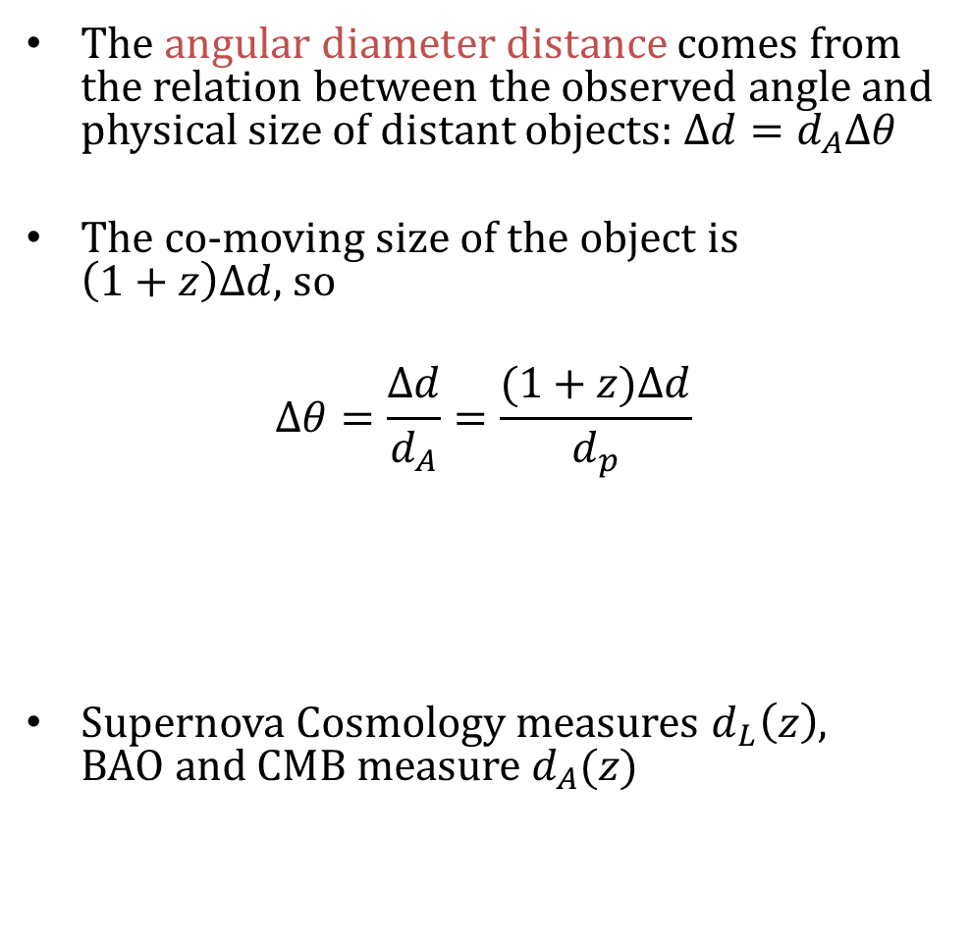
The angular diameter distance comes from the relation between the observed angle and physical size of distant objects: $Δd=d_{A}Δθ$
The co-moving size of the object is $\left(1+z\right)Δd$, so
$$Δθ=\frac{Δd}{d_{A}}=\frac{(1+z)Δd}{d_{p}}$$
Supernova Cosmology measures $d_{L}\left(z\right)$, BAO and CMB measure $d_{A}(z)$
$$Δd$$
$$d_{A}$$
$$Δθ$$
(see Hogg, “Distance measures in cosmology”, astro-ph/9905116)
Notes:
Angular diameter distance: infer the distance to an object from its angular size on the sky (using the small angle approximation). [CLICK] An object with physical size delta_d has co-moving size (1+z) delta_d, so again you get a factor of (1+z). [CLICK] Now we can relate both the angular diameter distance and luminosity distance to the proper motion distance and each other.

Slide 8

Hubble’s law
The line-of-sight co-moving distance to light emitted at time $t_{e}$ is
$$χ=\int_{t_{e}}^{t_{0}}{\frac{cdt}{a}=\int_{a_{e}}^{1}{\frac{cda}{Ha^{2}}}=\int_{0}^{z}{\frac{c dz}{H(z)}}}$$
For small redshifts and curvature, the distances can be expanded in terms of $z$
$d_{L}\sim d_{A}\sim χ\sim \frac{cz}{H_{0}}$
Near objects move according to Hubble’s law, $v=H_{0}d$, with $v=cz$
$O\left(z\right)$ corrections to the Hubble’s law
$d_{L}=\frac{cz}{H_{0}}\left[1+\frac{1}{2}\left(1−q_{0}\right)z+O(z^{2})\right], d_{A}=\frac{cz}{H_{0}}\left[1−\frac{1}{2}\left(3+q_{0}\right)z+O(z^{2})\right]$
$q_{0}={\left.\frac{1+z}{H}\frac{dH}{dz}\right|}_{z=0}=−{\left.\frac{\ddot{a}}{a}\right|}_{t_{0}}$ (deceleration parameter)

Slide 9
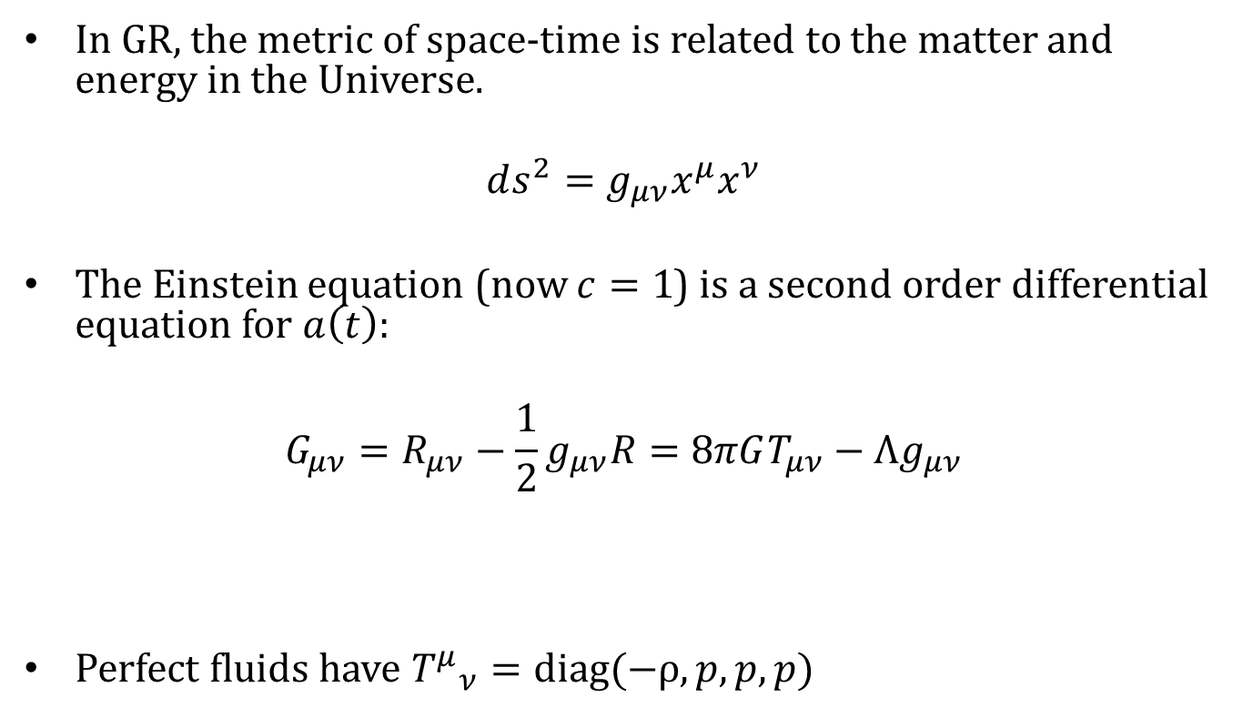
Dynamics
In GR, the metric of space-time is related to the matter and energy in the Universe.
$$ds^{2}=g_{μν}x^{μ}x^{ν}$$
The Einstein equation (now $c=1$) is a second order differential equation for $a\left(t\right)$:
$$G_{μν}=R_{μν}−\frac{1}{2}g_{μν}R=8πGT_{μν}−Λg_{μν}$$
Perfect fluids have ${T^{μ}}_{ν}=diag(−ρ,p,p,p)$
geometry
stuff
vacuum energy
Notes:
In GR, the metric of space-time is related to the matter and energy in the Universe. [Write out the metric here?] The Einstein equation (where we have put c = 1) is a second order differential equation for the evolution of the scale factor. [CLICK] It can be separated into the terms that describe the geometry or curvature of the metric and [CLICK] the terms that describe the “stuff” or matter: matter tells space-time how to curve, space-time tells matter how to move. [CLICK] The vacuum energy would be a new source term, if the dark energy is the cosmological constant, but you could just as well modify the LHS to account for acceleration (though not easily…). [CLICK] Many things in cosmology are considered perfect fluids (again, averaging) (technically, have no viscosity or heat flow), which has a simple form of the stress-energy tensor.

Slide 10
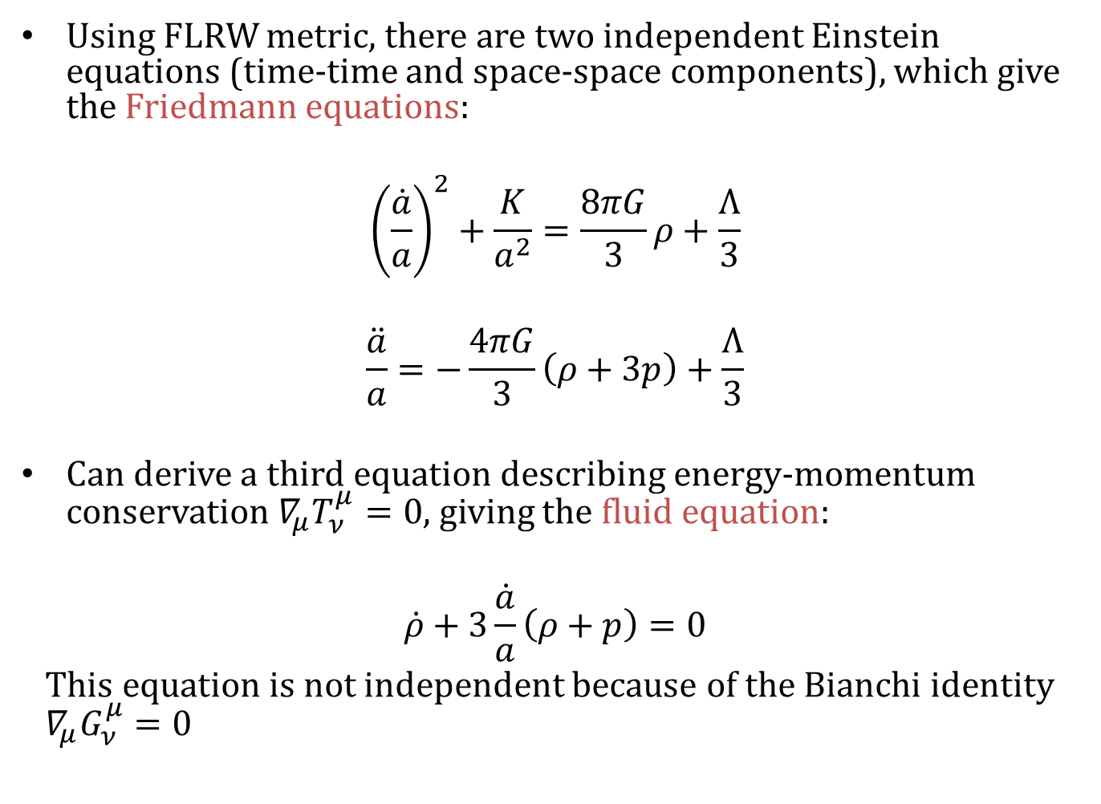
Using FLRW metric, there are two independent Einstein equations (time-time and space-space components), which give the Friedmann equations:
$${\left(\frac{\dot{a}}{a}\right)}^{2}+\frac{K}{a^{2}}=\frac{8πG}{3}ρ+\frac{Λ}{3}$$
$$\frac{\ddot{a}}{a}=−\frac{4πG}{3}\left(ρ+3p\right)+\frac{Λ}{3}$$
Can derive a third equation describing energy-momentum conservation ${∇_{μ}T}_{ν}^{μ}=0$, giving the fluid equation:
$$\dot{ρ}+3\frac{\dot{a}}{a}\left(ρ+p\right)=0$$
This equation is not independent because of the Bianchi identity ${{ ∇}_{μ}G}_{ν}^{μ}=0$
Notes:
The Einstein equations and the FLRW metric give the two independent equations, from the time-time and space-space components (assuming perfect fluid): the two Friedmann equations, or the second sometimes referred to as the acceleration equation. A third equation can be derived from the above which describes energy-momentum conservation, called the fluid equation. If these lectures had homework, there would be a lot of interesting problems to assign.
Write Friedmann and fluid equations on the board.

Slide 11
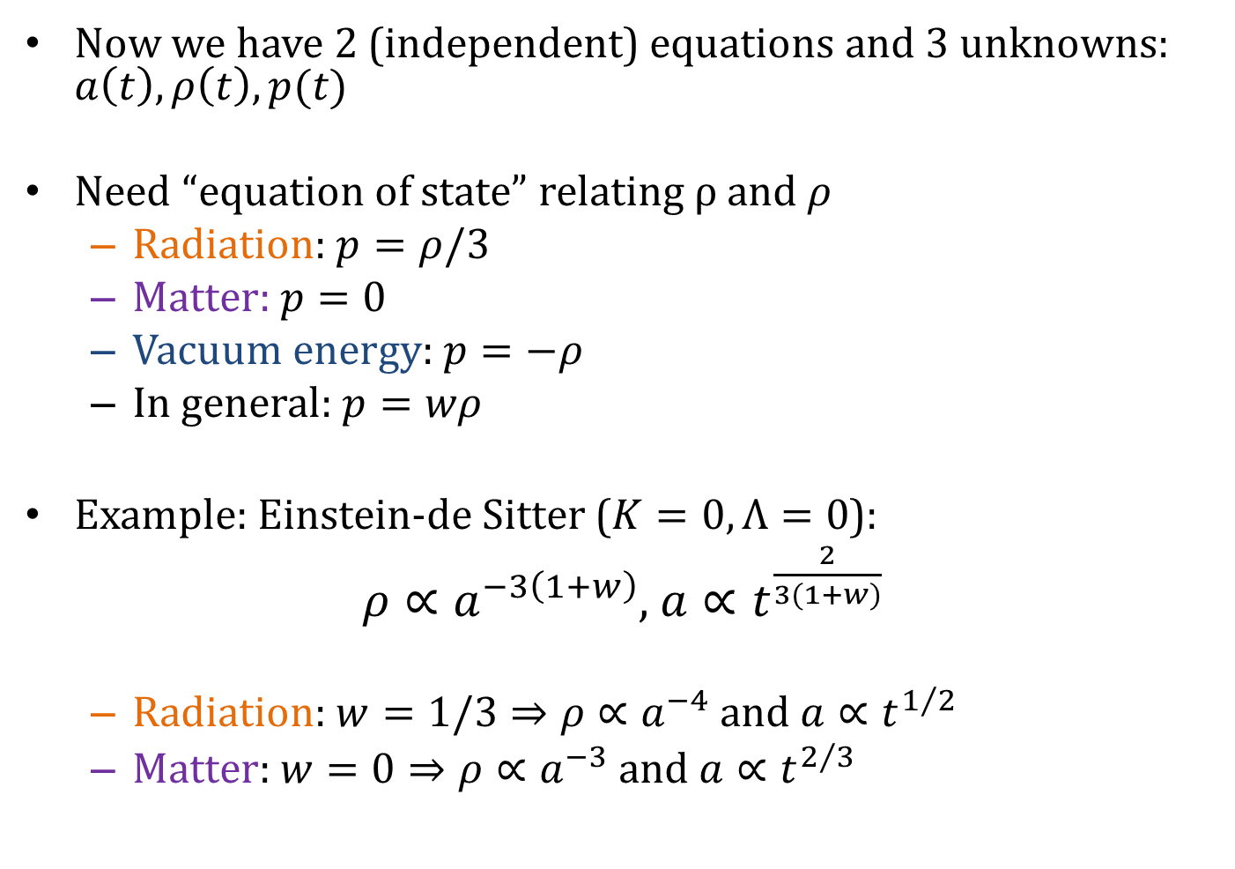
Now we have 2 (independent) equations and 3 unknowns: $a\left(t\right), ρ\left(t\right), p(t)$
Need “equation of state” relating ρ and $ρ$
Radiation: $p=ρ/3$
Matter: $p=0$
Vacuum energy: $p=−ρ$
In general: $p=wρ$
Example: Einstein-de Sitter ($K=0,Λ=0$):
$ρ∝a^{−3\left(1+w\right)}$, $a∝t^{\frac{2}{3(1+w)}}$
Radiation: $w=1/3⇒ρ∝a^{−4}$ and $a∝t^{1/2}$
Matter: $w=0⇒ρ∝a^{−3} \text{and} a∝t^{2/3}$
Notes:
Now we have 2 (independent) equations but 3 unknowns: the scale factor, density, and pressure. We need an equation of state to relate the density to the pressure, so we can solve the (now 3) equations. For radiation you can derive that p = rho/3, another interesting homework problem; matter is pressure-less, and the vacuum energy has w = -1. [CLICK] Another great homework problem is to derive the general form of the density and scale factor evolution equations for a generic equation of state.

Slide 12
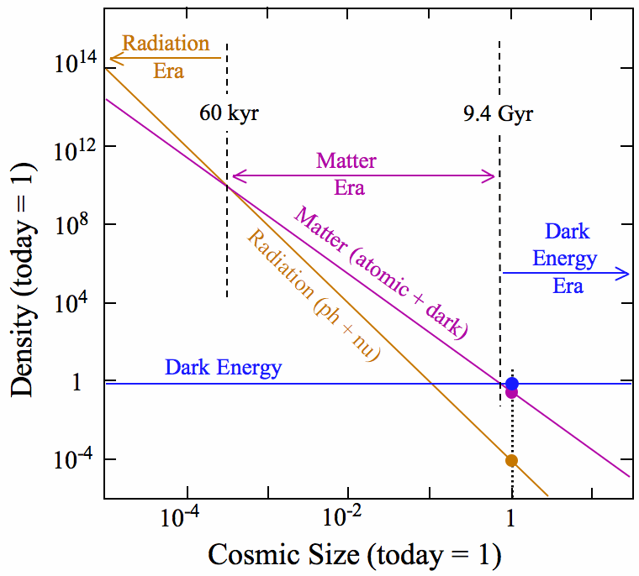
Notes:
Given the observed matter and radiation density today, we can use these relations for density evolution to determine when they dominated in the past and construct a picture of the overall evolution of the universe depending on which type of “stuff” was dominant at what times.

Slide 13
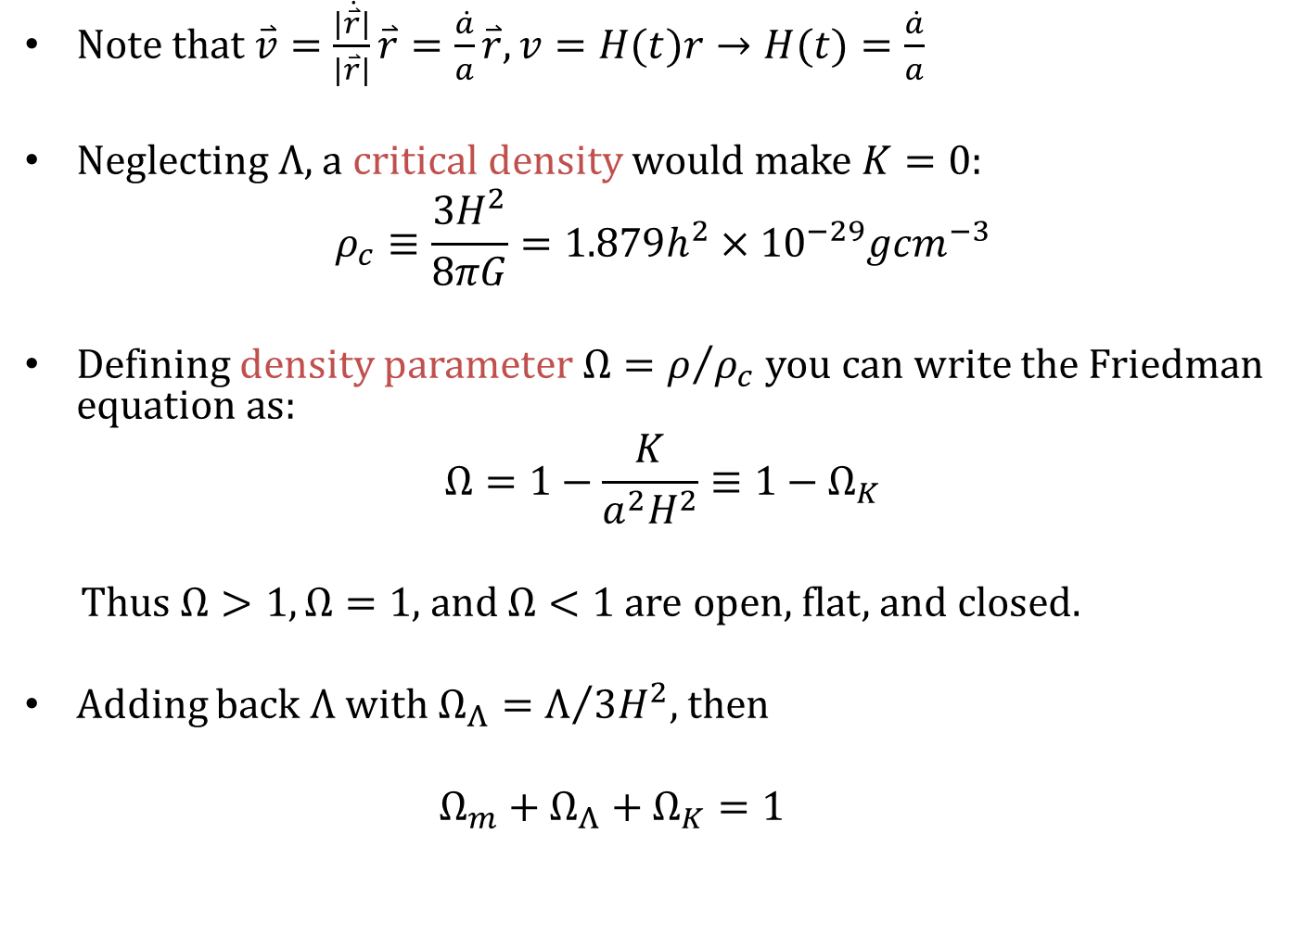
Note that $\overset{⃑}{v}=\frac{|\dot{\overset{⃑}{r}}|}{|\overset{⃑}{r}|}\overset{⃑}{r}=\frac{\dot{a}}{a}\overset{⃑}{r}, v=H(t)r→H(t)=\frac{\dot{a}}{a}$
Neglecting $Λ$, a critical density would make $K=0$:
$$ρ_{c}≡\frac{3H^{2}}{8πG}=1.879h^{2}×{10}^{−29}g{cm}^{−3}$$
Defining density parameter $Ω=ρ/{ρ_{c}}$ you can write the Friedman equation as:
$$Ω=1−\frac{K}{a^{2}H^{2}}≡1−Ω_{K}$$
Thus $Ω>1, Ω=1,$ and $Ω<1$ are open, flat, and closed.
Adding back $Λ$ with $Ω_{Λ}=Λ/{3H^{2}}$, then
$Ω_{m}+Ω_{Λ}+Ω_{K}=1$
Notes:
So we have these equations in terms of (a-dot / a), but given the definition of velocity we can see that Hubble’s constant, where v = H r, is exactly that. [CLICK] Neglecting lambda, we can define a critical density such that the curvature is zero. [CLICK] Then we divide density by the critical density to get a density parameter and re-write the Friedmann equation. Now we can see how the omegas, or energy density parameters, are related to the curvature of the Universe, where omega = 1 corresponds to the critical case of a flat universe. Including a cosmological constant again and defining its own energy density parameter, we see that the total density = 1 in a flat Universe.

Slide 14
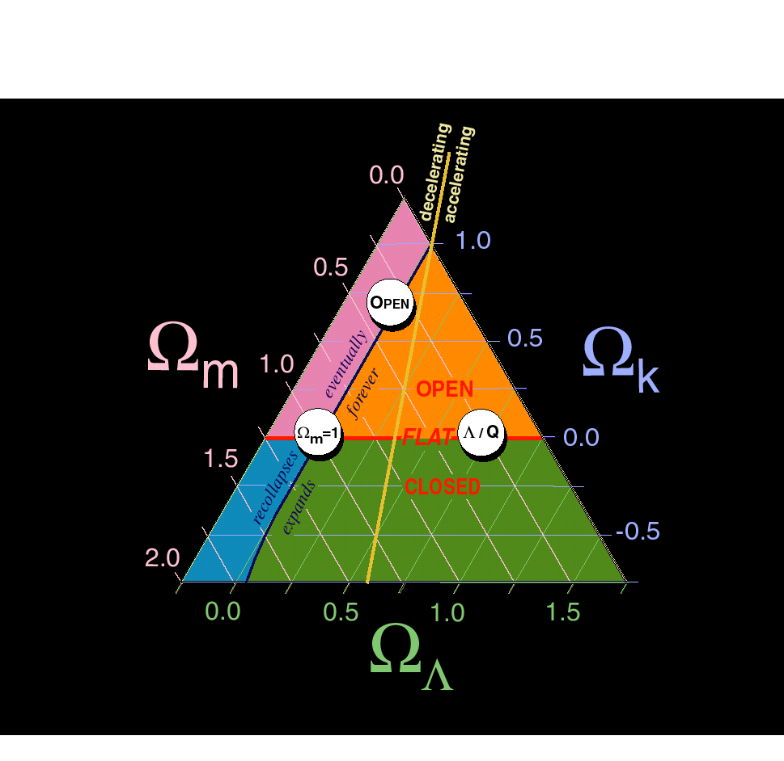
OPEN
Ω_{m}=1
Λ / Q

Slide 15
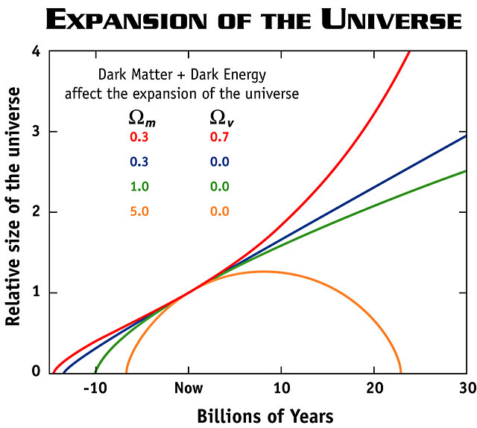
Notes:
That is one clue that we need something like a cosmological constant. Here is a plot of the size of the universe under different models. Omega_m =1, lambda = 0 is the “coasting” solution of a flat universe; a larger omega_m would mean the universe is decelerating and will eventually collapse back on itself (“big crunch”). The presence of dark energy (red line, but also the blue line) means the universe is accelerating and will end in a “big chill”.

Slide 16
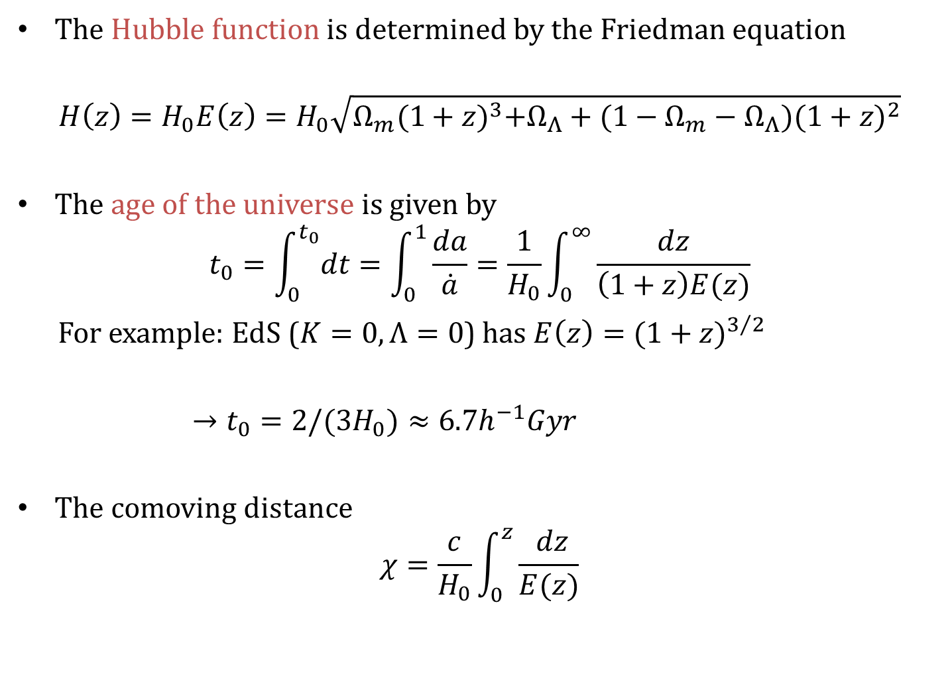
The Hubble function is determined by the Friedman equation
$$H\left(z\right)=H_{0}E\left(z\right)=H_{0}\sqrt{Ω_{m}{(1+z)}^{3}+Ω_{Λ}+(1−Ω_{m}−Ω_{Λ}){(1+z)}^{2}}$$
The age of the universe is given by
$$t_{0}=\int_{0}^{t_{0}}{dt}=\int_{0}^{1}{\frac{da}{\dot{a}}}=\frac{1}{H_{0}}\int_{0}^{∞}{\frac{dz}{\left(1+z\right)E(z)}}$$
For example: EdS ($K=0,Λ=0$) has $E\left(z\right)={(1+z)}^{3/2}$
$→t_{0}=2/(3H_{0})≈6.7h^{−1}Gyr$
The comoving distance
$$χ=\frac{c}{H_{0}}\int_{0}^{z}{\frac{ dz}{E(z)}}$$
Notes:
Proper distance: Using the metric, we can define the line-of-sight co-moving distance to light emitted at t_e. The integral can be in terms of t, a, or z; using this function for H(z) we can relate the co-moving distance to observables. [CLICK] For nearby objects, where z << 1, the integration simplifies and we recover Hubble’s law, v = H d. Very nearby objects move according to their peculiar velocity, and objects moving at v = H d are said to be in the Hubble flow. [CLICK] The age of the universe is just an integral over dt from t = 0 to today, which we can also write in terms of H(z). Most of the time you would solve this numerically, [CLICK] but for K=0 and lambda = 0 (Einstein-de Sitter universe) E(z) simplifies and you get that the universe is 6.7 Gyr, which is not old enough.

Slide 17

$$D_{H}=H_{0}^{−1}$$

Slide 18

$$D_{H}=H_{0}^{−1}$$

Slide 20
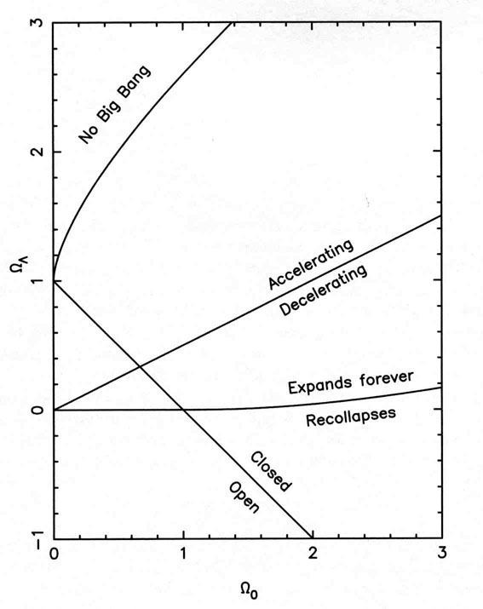
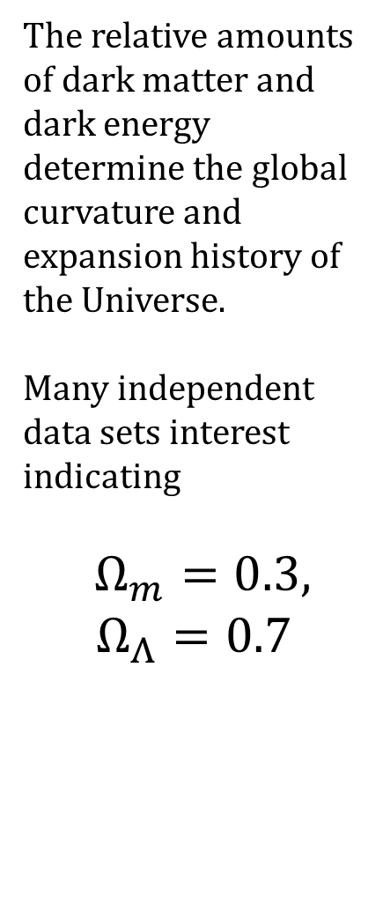
The relative amounts of dark matter and dark energy determine the global curvature and expansion history of the Universe.
Many independent data sets interest indicating
$Ω_{m}=0.3,$
$$Ω_{Λ}=0.7$$
Notes:
The relation between the matter and dark energy (CC) density parameters thus inform the global curvature, and thus the global expansion history, of the Universe. This line gives the flat solution, on the border of “open” and “closed”, which remember means hyperbolic and spherical, respectively. You can also figure out which solutions give you an accelerating or decelerating universe, and which will lead to a “big chill” or “big crunch” scenario for the future of the Universe. [CLICK] To put this in perspective of Bob’s observational lectures, here’s the plot you guys saw a few times, showing how precise the observations are compared to the theorists imaginings…

Slide 22
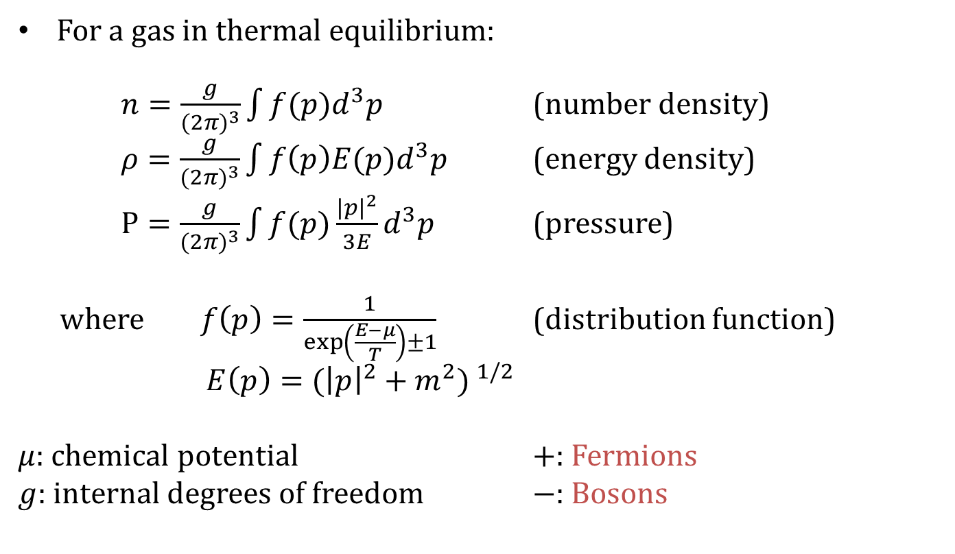

Thermodynamics
$$(ℏ=c=k_{B}=1)$$
For a gas in thermal equilibrium:
$n=\frac{g}{{(2π)}^{3}}\int{f(p)d^{3}p}$ (number density)
$ρ=\frac{g}{{(2π)}^{3}}\int{f\left(p\right)E(p)d^{3}p}$ (energy density)
$P=\frac{g}{{(2π)}^{3}}\int{f(p)\frac{{|p|}^{2}}{3E}d^{3}p}$ (pressure)
where $f\left(p\right)=\frac{1}{exp⁡\left(\frac{E−μ}{T}\right)±1}$ (distribution function)
$E\left(p\right)={({\left|p\right|}^{2}+m^{2}) }^{1/2}$
$μ:$ chemical potential $+:$ Fermions
$g:$ internal degrees of freedom $−:$ Bosons
Notes:
The expanding universe also affects the thermodynamics. First a little reminder, we have the number density, energy density, and pressure of a gas in thermal equilibrium (in particle physics units), depending on the distribution function and whether the gas is composed of fermions or bosons. Mu is the chemical potential, and g is the internal degrees of freedom.

Slide 23
Relativistic matter:
Non-relativistic matter:
(Boson)
(Fermion)
Notes:
For a gas of relativistic matter, with T >> m and T >> mu, the energy density simplifies and you get the Stefan-Boltzmann relation (right?), plus recall the equation of state for radiation. [CLICK] For non-relativistic matter, with m >> T, the energy density is just the mass times the number density, which has this form, and the pressure is negligible.

Slide 24
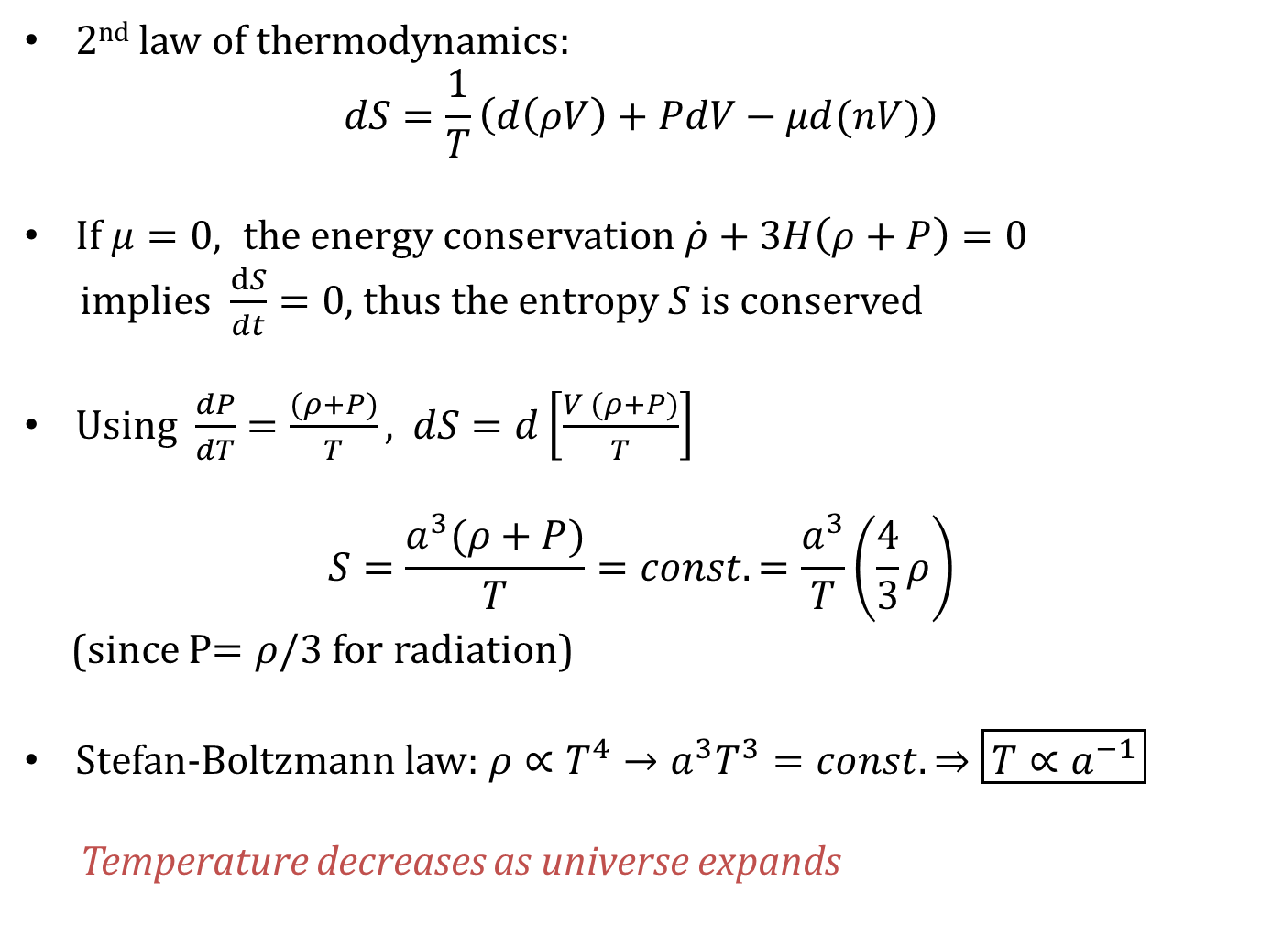
2nd law of thermodynamics:
$$dS=\frac{1}{T}\left(d\left(ρV\right)+PdV−μd(nV)\right)$$
If $μ=0, the energy conservation$ $\dot{ρ}+3H\left(ρ+P\right)=0$
implies $\frac{dS}{dt}=0$, thus the entropy $S$is conserved
Using $\frac{dP}{dT}=\frac{(ρ+P)}{T},$ $dS=d\left[\frac{V (ρ+P)}{T}\right]$
$$S=\frac{a^{3}(ρ+P)}{T}=const.=\frac{a^{3}}{T}\left(\frac{4}{3}ρ\right)$$
(since P$=ρ/3$ for radiation)
Stefan-Boltzmann law: $ρ∝T^{4}→a^{3}T^{3}=const.⇒\boxed{T∝a^{−1}}$
Temperature decreases as universe expands
Notes:
Again refreshing your undergraduate thermodynamics, the second law gives a relation between entropy, density, pressure, and temperature. When the expansion timescale is long compared to reactions that maintain thermal equilibrium, the gas undergoes adiabatic changes and the entropy per co-moving volume is constant. [CLICK] From the conservation of energy, if the chemical potential is 0, a constant entropy per co-moving volume implies a^3 (p+rho)/T = constant. For radiation, p = rho/3. [CLICK] We can then substitute the Stefan-Boltzmann law rho pro. to T^4 to get that the temperature decreases as the universe expands.

Slide 25

Decoupling
In expanding universe, particle can move at most $cH^{−1}$
Interaction rate for some thermal process is $Γ\left[s^{−1}\right]$
If interaction does not occur during Hubble time $\left(Γ^{−1}≫H^{−1}\right)$ the gas is no longer in thermal equilibrium
Decoupling when $Γ<H$
Notes:
Decoupling: In the next lecture we’ll get more into the details of the thermal history of the universe. One important concept is decoupling: in an expanding universe, a particle can move at most c/H, so if the interaction rate is too slow, the gas will no longer be in thermal equilibrium and decouple when gamma < H.

Slide 26
Freeze-out
In thermal bath, a number of massive particles are exponentially suppressed
If they decouple from the thermal bath,
the number density is just diluted by expansion
(precise treatment is given by Boltzmann eq.)
Notes:
Freeze-out: In thermal equilibrium, the number of massive (non-relativistic) particles has this form. Once they decouple from the thermal bath, the number density of particles is just diluted by the expansion. This means the number density of particles is no longer affected by equilibrium physics so it “freezes out” at decoupling.

Slide 27
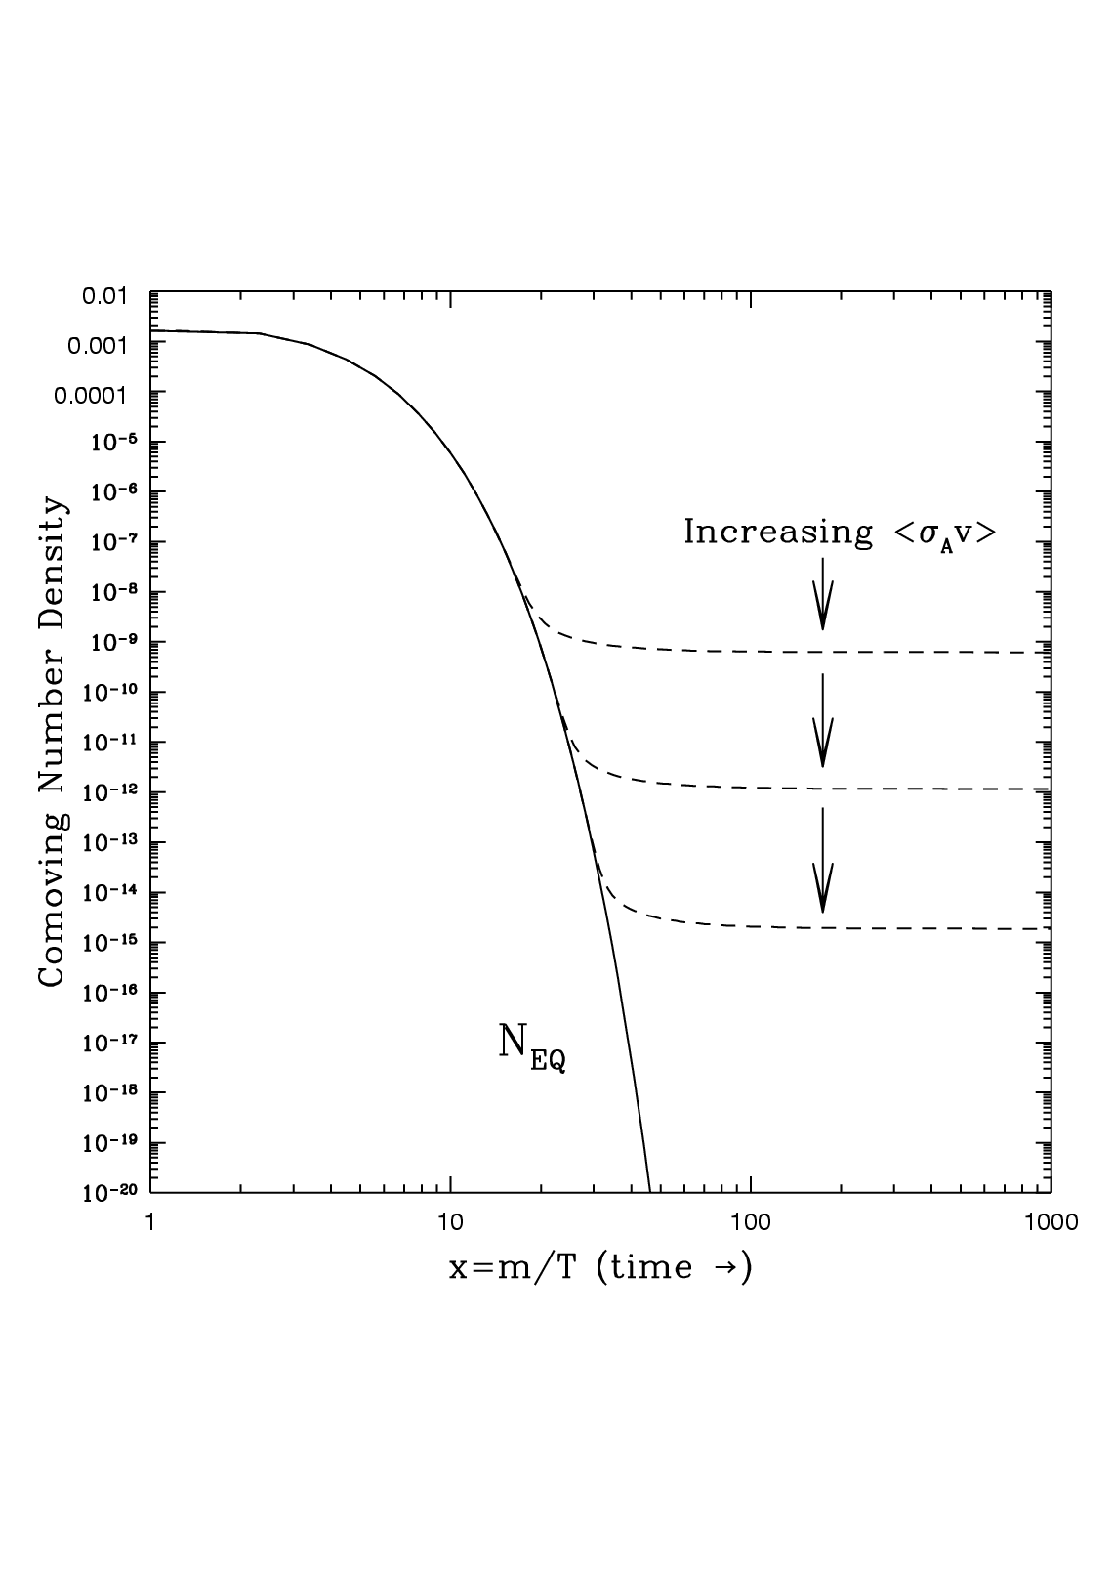
COSMOLOGY
PARTICLE
PHYSICS
decouping
: cross section
: average velocity
: number density
Notes:
The equations governing the change of the number density of particles thus involve a cosmology component describing the expansion (and dilution) and a particle physics component describing the reaction rates, given by the cross-section * velocity * equilibrium number density. This plot shows the evolution of the co-moving number density; depending on the reaction rate, freeze-out will at different times (parameterized by temperature).

Slide 28
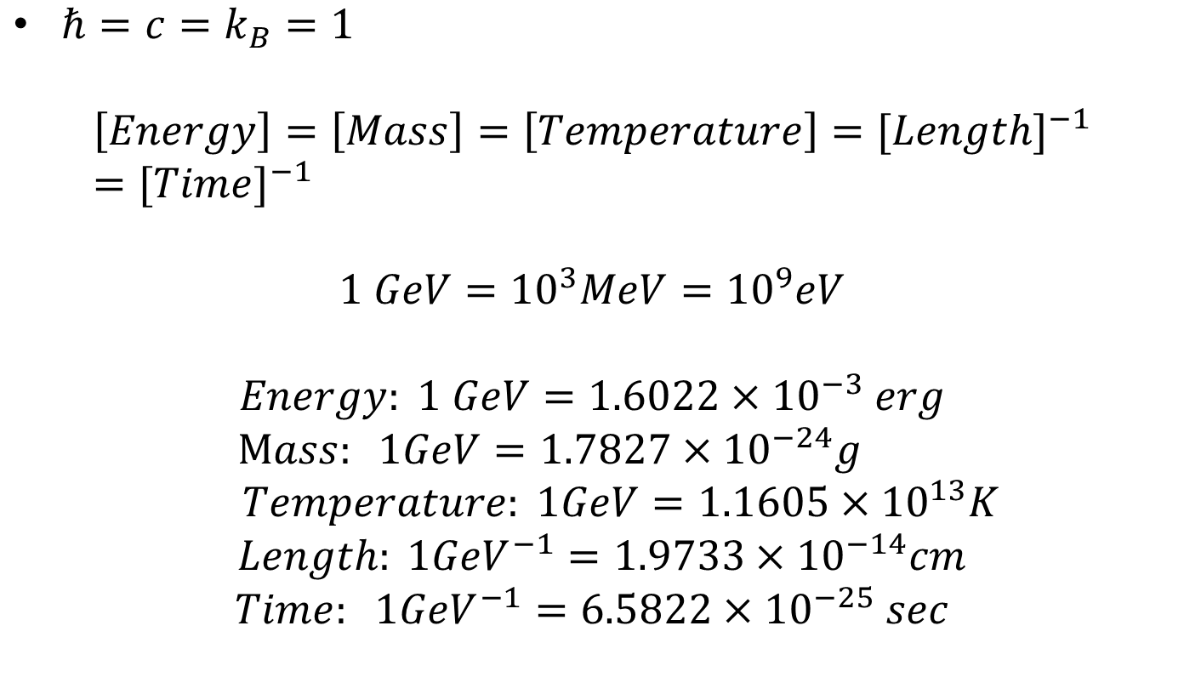
Natural unit
$ℏ=c=k_{B}=1$
$$\left[Energy\right]=\left[Mass\right]=\left[Temperature\right]={[Length]}^{−1}={[Time]}^{−1}$$
$$1 GeV={10}^{3}MeV={10}^{9}eV$$
$$Energy: 1 GeV=1.6022×{10}^{−3} erg$$
$Mass: 1GeV=1.7827×{10}^{−24}g$
$$Temperature: 1GeV=1.1605×{10}^{13}K$$
$$Length: 1{GeV}^{−1}=1.9733×{10}^{−14}cm$$
$$Time: 1{GeV}^{−1}=6.5822×{10}^{−25} sec$$

