Slide 1
The Early Universe
Thermal history
Nucleosynthesis
The CMB

Slide 2
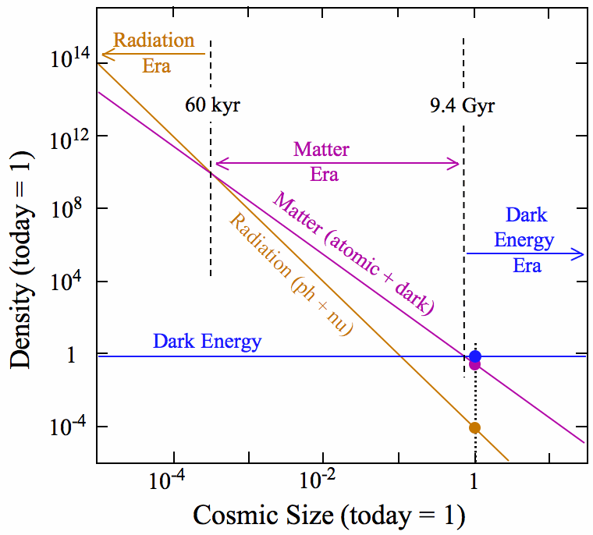
Notes:
Matter and Radiation evolution with scale factor -> different cosmological eras: Yesterday we derived how the energy density of matter and radiation evolve with the scale factor. (Initially radiation dominated, then matter, etc…) This lecture will focus on early times, mostly radiation dominated, though the period of matter-radiation equality happened between nucleosynthesis and recombination (formation of the CMB), given here in terms of omega-m h^2 (probably from WMAP). We can measure the density and temperature of CMB radiation today, also depending on h^2.

Slide 3
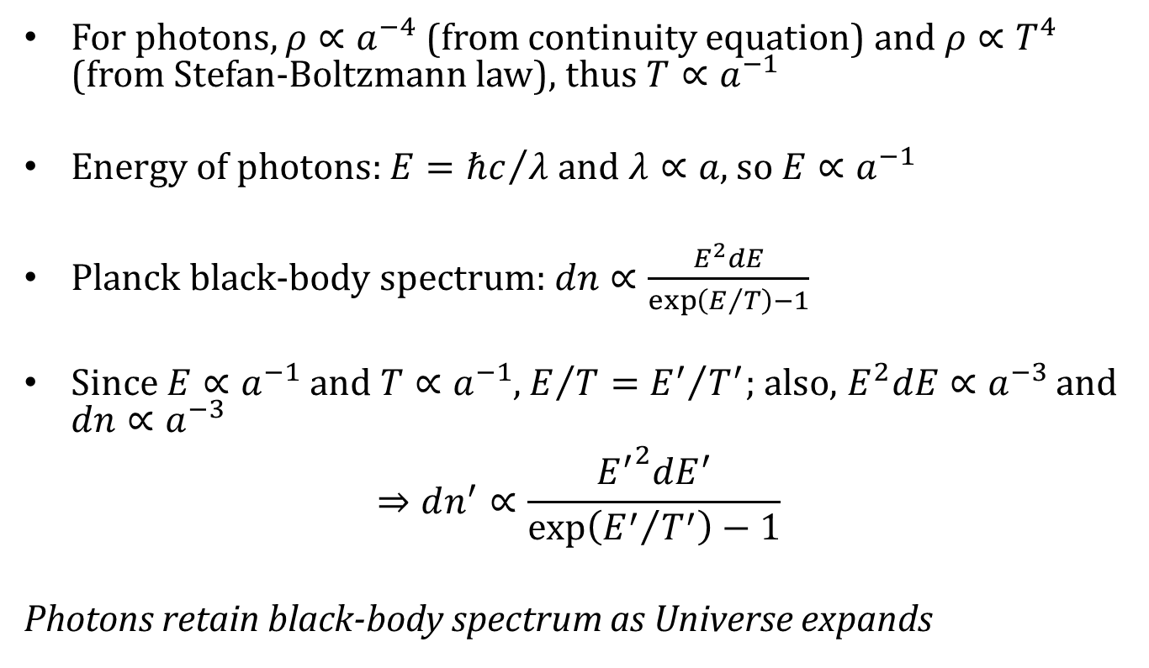
Thermal History
For photons, $ρ∝a^{−4}$ (from continuity equation) and $ρ∝T^{4}$ (from Stefan-Boltzmann law), thus $T∝a^{−1}$
Energy of photons: $E={ℏc}/λ$ and $λ∝a$, so $E∝a^{−1}$
Planck black-body spectrum: $dn∝\frac{E^{2}dE}{\exp\left(E/T\right)−1}$
Since $E∝a^{−1}$ and $T∝a^{−1}$, $E/T={E^{′}}/{T^{′}}$; also, $E^{2}dE∝a^{−3}$ and $dn∝a^{−3}$
$$⇒dn^{′}∝\frac{{E^{′}}^{2}dE^{′}}{\exp\left({E^{′}}/{T^{′}}\right)−1}$$
Photons retain black-body spectrum as Universe expands
Notes:
Can use temperature of radiation instead of scale factor as variable of evolution
As we saw Monday, the energy density of radiation scales with a^-4, and from the Stefan-Boltzmann law with T^4, so T scales with a^-1 or as the universe expands, the temperature of radiation decreases. [CLICK] We know the energy of photons scales inversely with wavelength, so the energy also scales with a^-1. [CLICK] The distribution function of CMB photons is given by the Planck blackbody spectrum. Again particle physics units, so c = k_B = 1. [CLICK] Since both E and T are proportional to a ^ -1, their ratio is constant as the universe expands. The number density dilutes by a factor of a^-3, and E^2dE is also proportional to a^-3, so [CLICK] as the universe expands, CMB photons (or any in thermal equilibrium) retain their blackbody spectrum.

Slide 4
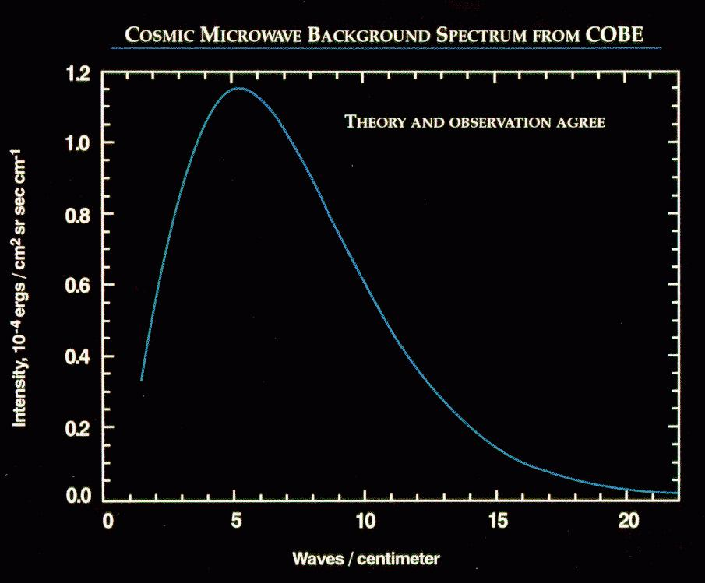
evidence Universe
was once hotter
than .1 eV
Notes:
Again we have a plot of the CMB spectrum from COBE showing its perfect blackbody spectrum, evidence that the universe was once hotter than 0.1 eV, which is actually the photon temperature at recombination (when the CMB was formed).

Slide 5
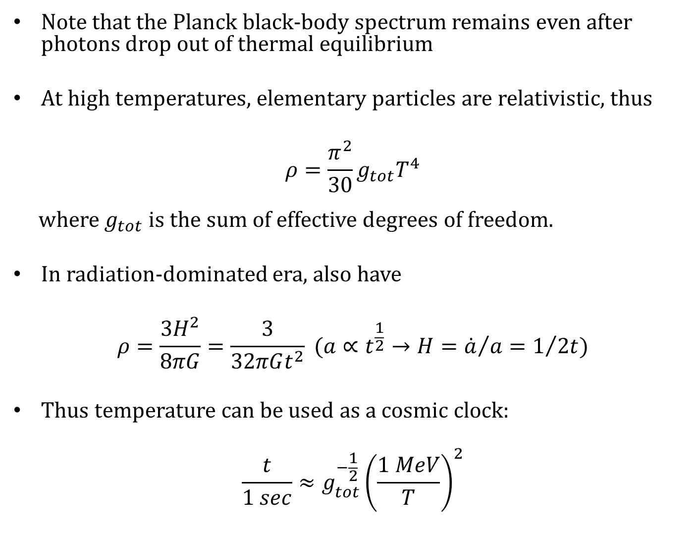
Note that the Planck black-body spectrum remains even after photons drop out of thermal equilibrium
At high temperatures, elementary particles are relativistic, thus
$$ρ=\frac{π^{2}}{30}g_{tot}T^{4}$$
where $g_{tot}$ is the sum of effective degrees of freedom.
In radiation-dominated era, also have
$$ρ=\frac{3H^{2}}{8πG}=\frac{3}{32πGt^{2}} (a∝t^{\frac{1}{2}}→H={\dot{a}}/a=1/{2t})$$
Thus temperature can be used as a cosmic clock:
$$\frac{t}{1 sec}≈g_{tot}^{−\frac{1}{2}}{\left(\frac{1 MeV}{T}\right)}^{2}$$
Notes:
So the Planck black-body spectrum remains after decoupling of CMB photons at z~1000. [CLICK] For relativistic thermal gas (including elementary particles at high enough temperatures) the energy density is proportional to g*T^4, where g is the total effective degrees of freedom of the relativistic particles. For example, g = 2 for photons because of the 2 spin polarizations. [CLICK] We can also solve the Friedmann equations in the radiation dominated era, where K = Lambda = 0, and use the scaling of the scale factor with time to solve for the Hubble parameter. [CLICK] Combining these, we get a relation between time since the Big Bang and the Temperature of the relativistic gas.

Slide 6
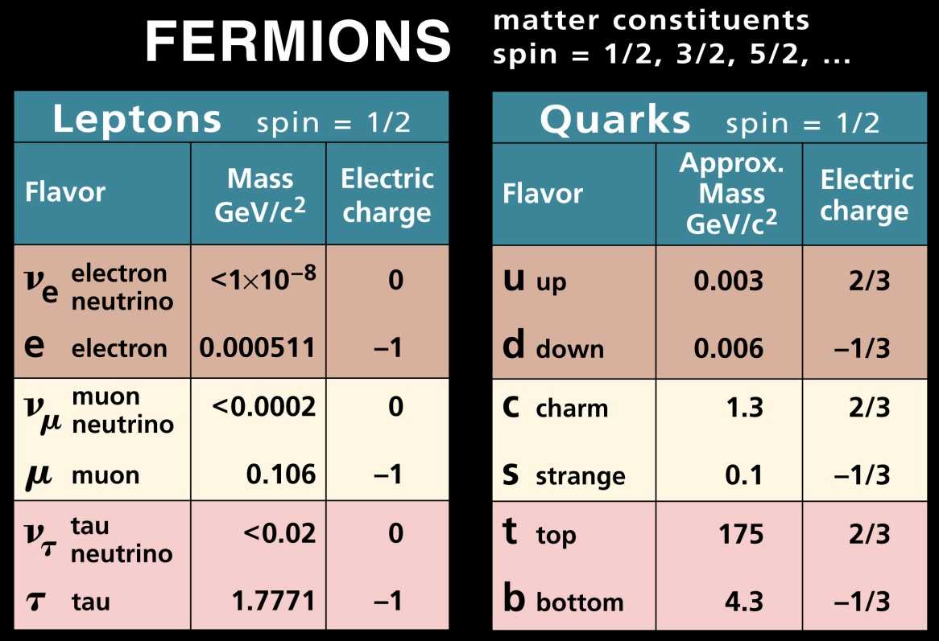
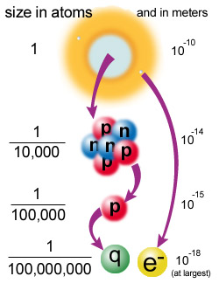
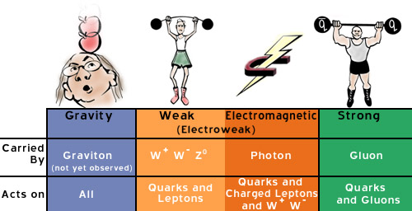
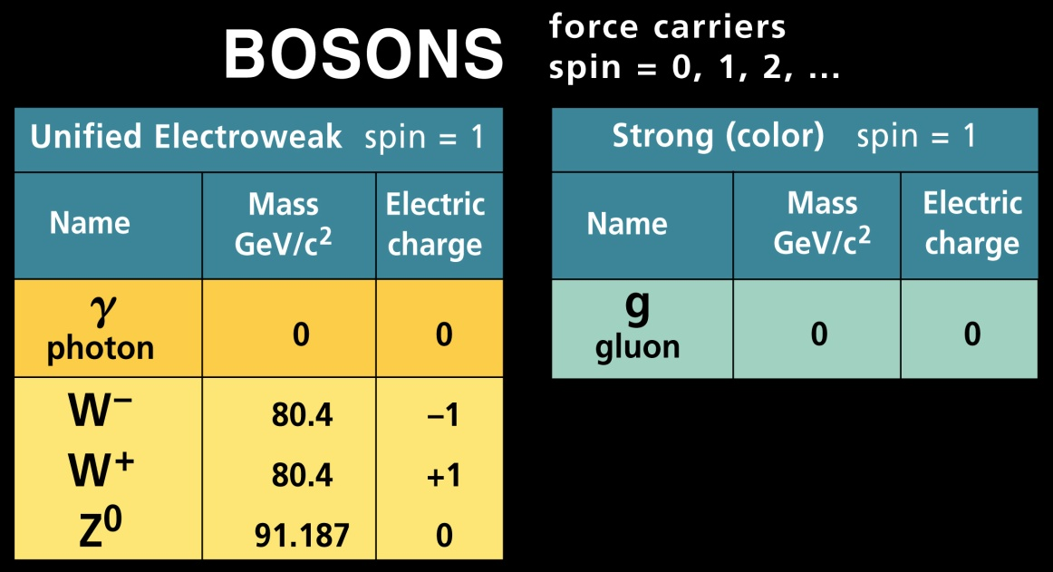
http://particleadventure.org/particleadventure/index.html
Notes:
Standard model of particle physics: Fermions that make up matter consisting of leptons and quarks, and Bosons are force carriers. Figure on the right gives a sense of scale of quarks and electrons that make up protons, neutrons, and atoms. Convert this scale into an energy or temperature and you effectively have time in early universe when they could have formed.

Slide 7
Thermal history of the Universe
TeV
GeV
MeV (1 sec)
eV (3000K)
meV(3K)
Neutrino decoupling
Recombination
Electro weak phase transition
Photon decoupling
e+ e- annihilation
Quark hadron phase transition
nucleosynthesis
quark
n,p
He,p
He,H
lepton
e+,e- neutrino
e-
photon

Slide 8
Quark hadron phase transition
Higgs, Gauge bosons quarks, leptons
e+,e- neutrino
photon
neutrino
photon

Slide 9


Electroweak phase transition
quarks and leptons (e.g. electron, neutrino)
QCD (quantum chromo-dynamics) phase transition
quark-gluon plasma confinement of quark
We assume there is an asymmetry between matter and anti-matter (baryogenesis)
proton
neutron
Notes:
Some of the earliest milestones are the electro-weak phase transition at the GUT scale, after which the universe consisted of free quarks and leptons (i.e. electrons and neutrinos) and of course the force carriers (photons and gluons). [CLICK] Then at the QCD phase transition, quarks become confined into protons and neutrons (and some other hadrons with two quarks), and there are no free quarks. (This probably what Ben was talking about, because the strong force increases with the distance between two quarks so accelerated expansion in the future couldn’t break up particles into constituent quarks.) In order for all of this to work, we have to assume that there is an asymmetry between matter and anti-matter, so that when these transitions happen there is enough matter left over to create the abundances we observe.

Slide 10
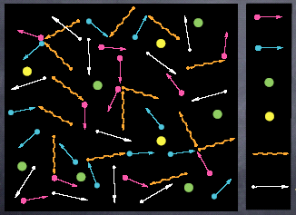
Electron
Positron
Proton
Neutron
Photon
Neutrino
Notes:
At this stage in the early universe there are electrons, positrons, neutrons, protons, photons, and neutrinos all in thermal equilibrium in the plasma.
(Credit goes to Kazuya who might have made these himself?)

Slide 11
Neutrino decoupling
Neutrino interacts via weak interaction:
Reaction rate:
Decoupling occurs when:
Notes:
Neutrino decoupling: neutrinos interact via the weak force by for example exchanging a W boson. The reaction rate is proportional to T^5, where this coupling constant (the Fermi constant) is proportional to the mass of the force carrier W boson. [CLICK] As I mentioned Monday, decoupling occurs when the reaction rate is less than the Hubble expansion parameter, so this occurs at a temperature of around 1.4 MeV.

Slide 12
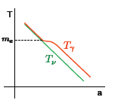

Electron-positron annihilation: $e^{+}+e^{−}→γ$
When the temperature drops below $T<m_{e}$, photon cannot produce $e^{+}, e^{−}$ ($m_{e}=0.5 MeV)$
Tiny amounts of electron remain (Lepton asymmetry)
Photon temperature changes due to $e^{+}+e^{−}→γ$
conservation of entropy $s=g T^{3}$
Thermal Bath:
Notes:
Electron-positron annihilation: Once the temperature drops below the mass of the electron, photons can no longer produce electrons and positrons. A tiny amount of electrons remain after they annihilate due to a Lepton asymmetry. [CLICK] The neutrinos have already decoupled from the thermal bath, and once electrons and positrons annihilate there are mostly photons left over. The annihilation dumps entropy density into the photons (entropy density conserved before, with electrons + positrons, and after with only photons), increasing their temperature with respect to the already decoupled neutrinos. (Constant entropy, where entropy density s = (2\pi^2/45)*g_eff*T^3; before annihilation, g_eff = 2+4*7/8 = 11/2 (2 spin photon + (2 spin electron + 2 spin positron)*7/8 fermion), after g = 2)

Slide 13
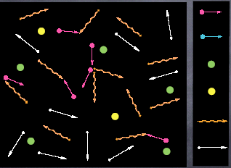
Electron
Proton
Neutron
Photon
Neutrino
Notes:
Now the thermal bath consists of free electrons, protons, neutrons, photons, and neutrinos (which have decoupled so are free-streaming).

Slide 14
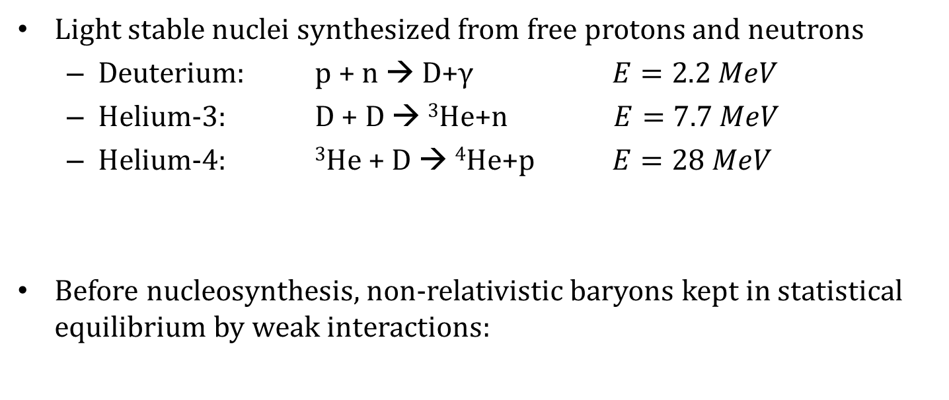
Nucleosynthesis
Light stable nuclei synthesized from free protons and neutrons
Deuterium: p + n → D+γ $E=2.2 MeV$
Helium-3: D + D → ³He+n $E=7.7 MeV$
Helium-4: ³He + D → ⁴He+p $E=28 MeV$
Before nucleosynthesis, non-relativistic baryons kept in statistical equilibrium by weak interactions:
scattering
decay
Notes:
Nucleosynthesis is the process by which light stable nuclei are synthesized from free protons and neutrons. Protons and neutrons combine to form deuterium, 4 He, 3 He, and 7 Li nuclei. [CLICK] Before nucleosynthesis, non-relativistic baryons are kept in statistical equilibrium by weak interactions: there is scattering of positrons off neutrons and of electrons off protons to change neutrons to protons and vice versa, and there is neutron decay in to a proton, electron, and anti-electron neutrino.

Slide 15
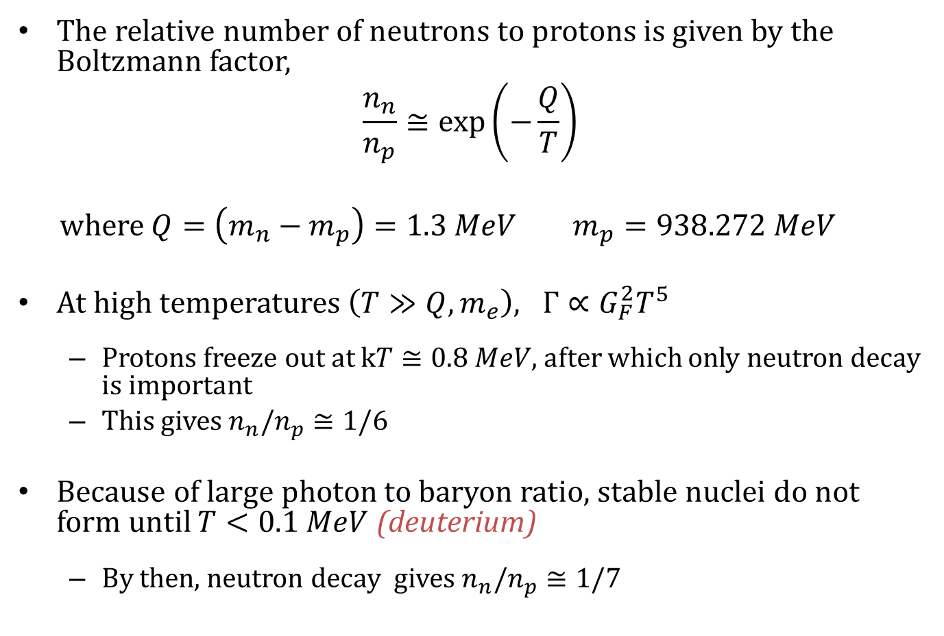
The relative number of neutrons to protons is given by the Boltzmann factor,
$$\frac{n_{n}}{n_{p}}≅\exp\left(−\frac{Q}{T}\right)$$
where $Q=\left(m_{n}−m_{p}\right)=1.3 MeV m_{p}=938.272 MeV$
At high temperatures $\left(T≫Q,m_{e}\right), Γ∝G_{F}^{2}T^{5}$
Protons freeze out at $kT≅0.8 MeV$, after which only neutron decay is important
This gives $n_{n}/n_{p}≅1/6$
Because of large photon to baryon ratio, stable nuclei do not form until $T<0.1 MeV$ (deuterium)
By then, neutron decay gives $n_{n}/n_{p}≅1/7$
Notes:
The relative number of neutrons to protons is given by the Boltzmann factor, where Q is the energy difference between neutrons and protons. [CLICK] At high temperatures, when it is greater than both the Q and the electron mass, the interaction rate is proportional to T^5 again related to the Fermi constant for weak interactions. Protons freeze-out at T ~ 0.8 MeV, after which only neutron decay is important, leaving the ratio of neutrons to protons at 1/6. [CLICK] Because of the large photon to baryon ratio, stable nuclei (i.e. deuterium) do not form until T < 0.1 MeV. By then, neutron decay gives a neutron to proton ratio of 1/7.

Slide 16
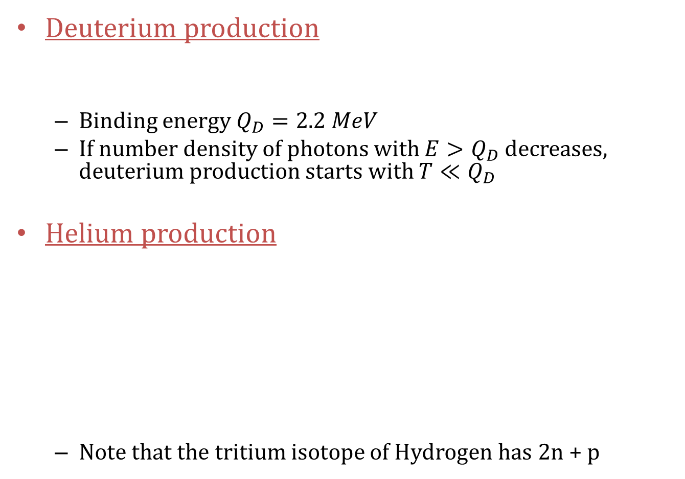
Deuterium production
Binding energy $Q_{D}=2.2 MeV$
If number density of photons with $E>Q_{D}$ decreases, deuterium production starts with $T≪Q_{D}$
Helium production
Note that the tritium isotope of Hydrogen has 2n + p
Notes:
Deuterium is produced when a neutron and proton fuse together, with a binding energy of 2.2 MeV. Once the number density of photons having energy > Q_D decreases, deuterium production starts, with T << Q_D. [CLICK] The next is Helium, and this is one of the possible pathways to fusing Helium which involves 3H or Tritium, 2 neutrons + 1 proton. Helium-4 has the largest binding energy so is the most stable.

Slide 17
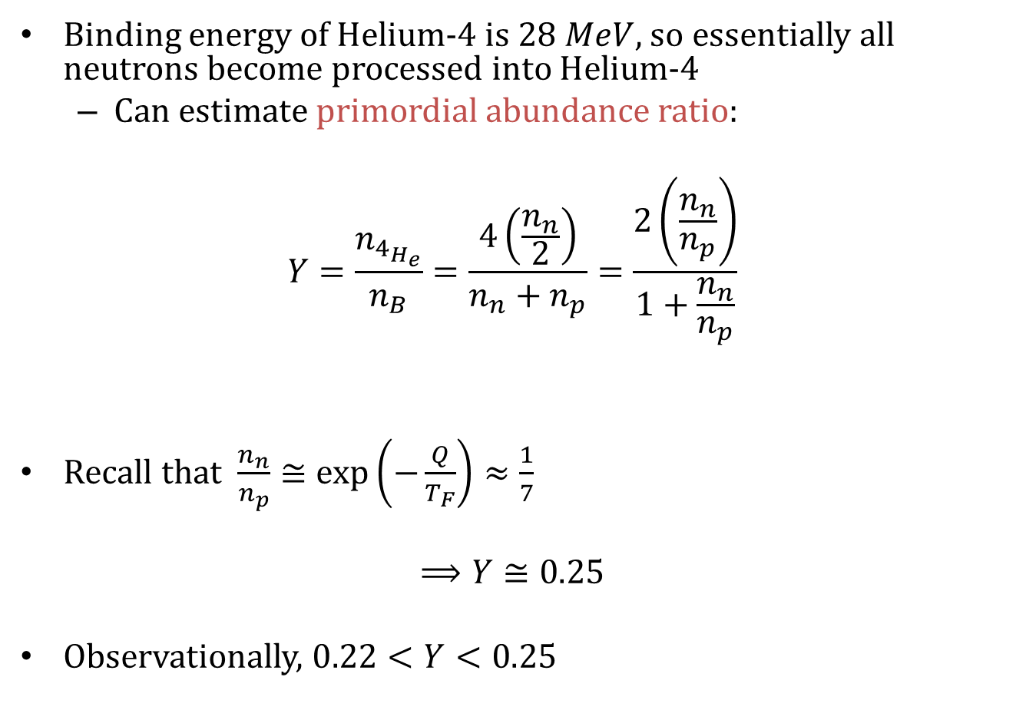
Binding energy of Helium-4 is $28 MeV$, so essentially all neutrons become processed into Helium-4
Can estimate primordial abundance ratio:
$$Y=\frac{n_{4_{H_{e}}}}{n_{B}}=\frac{4\left(\frac{n_{n}}{2}\right)}{n_{n}+n_{p}}=\frac{2\left(\frac{n_{n}}{n_{p}}\right)}{1+\frac{n_{n}}{n_{p}}}$$
Recall that $\frac{n_{n}}{n_{p}}≅\exp\left(−\frac{Q}{T_{F}}\right)≈\frac{1}{7}$
$$⟹Y≅0.25$$
Observationally, $0.22<Y<0.25$
Notes:
The binding energy of Helium 4 is 28 MeV, so essentially all neutrons end up in Helium 4. We can estimate the primordial abundance ratio (by mass) of Helium with respect to all baryons. Helium 4 contains two neutrons, so the number density of helium is half the number density of neutrons; since it weighs about 4 proton masses, the mass fraction is twice the neutron mass fraction. [CLICK] We have already estimated the neutron to proton fraction, so plugging that in gives a primordial abundance of Helium ~ 0.25. This agrees well with observations.

Slide 18
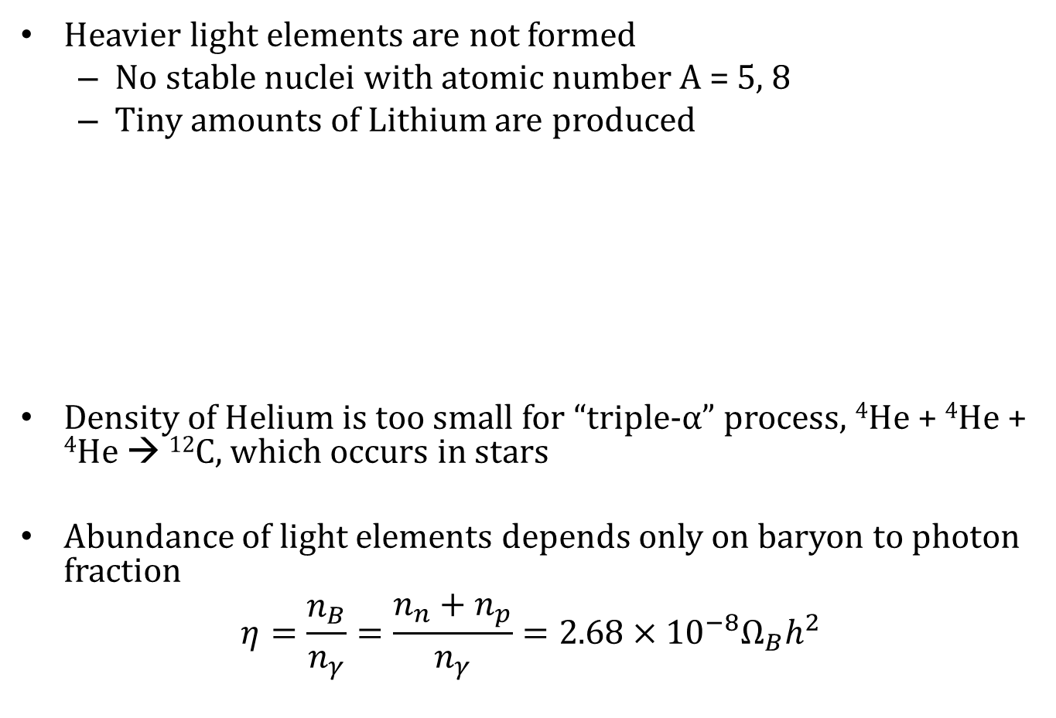
Heavier light elements are not formed
No stable nuclei with atomic number A = 5, 8
Tiny amounts of Lithium are produced
Density of Helium is too small for “triple-α” process, ⁴He + ⁴He + ⁴He → ¹²C, which occurs in stars
Abundance of light elements depends only on baryon to photon fraction
$$η=\frac{n_{B}}{n_{γ}}=\frac{n_{n}+n_{p}}{n_{γ}}=2.68×{10}^{−8}Ω_{B}h^{2}$$
Notes:
Heavier elements are not formed: there are no stable nuclei with atomic number 5 or 8, but tiny amount of 7 Li produced. [CLICK] Unlike in stars, where the density increases throughout the life cycle (once fusion stops, outer layers collapse to increase density of core and fuse element with higher atomic number), the density of helium is too small in the early universe to fuse for example Carbon through the triple-alpha process. And of course due to the expansion, the density decreases with time, so nothing further is produced until the first stars form. [CLICK] The abundance of the light elements depends only on baryon to photon fraction, which is also constrained by the CMB. This is because the baryon to photon fraction sets the temperature at which nuclei can form, halting neutron decay.

Slide 19
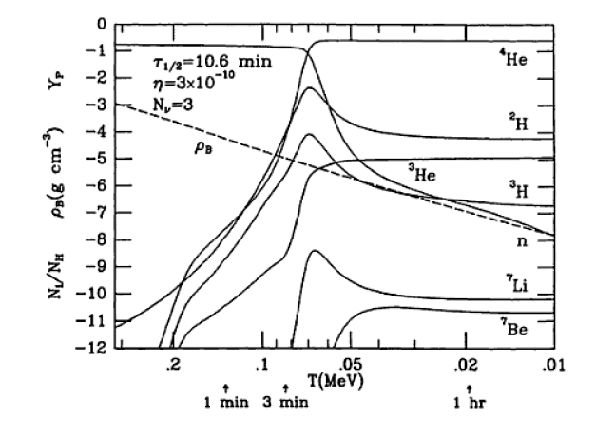
Evolution of light element abundances in the early universe
Notes:
This plot shows the fractional abundances of the light elements as they evolve (with time and temperature) in the early universe. This depends as I said on the baryon to photon fraction, and also on the number of neutrino species, here assumed to be 3. Nucleosynthesis increases the abundances of these, until the temperature and densities are too low and their abundances stabilize.

Slide 20
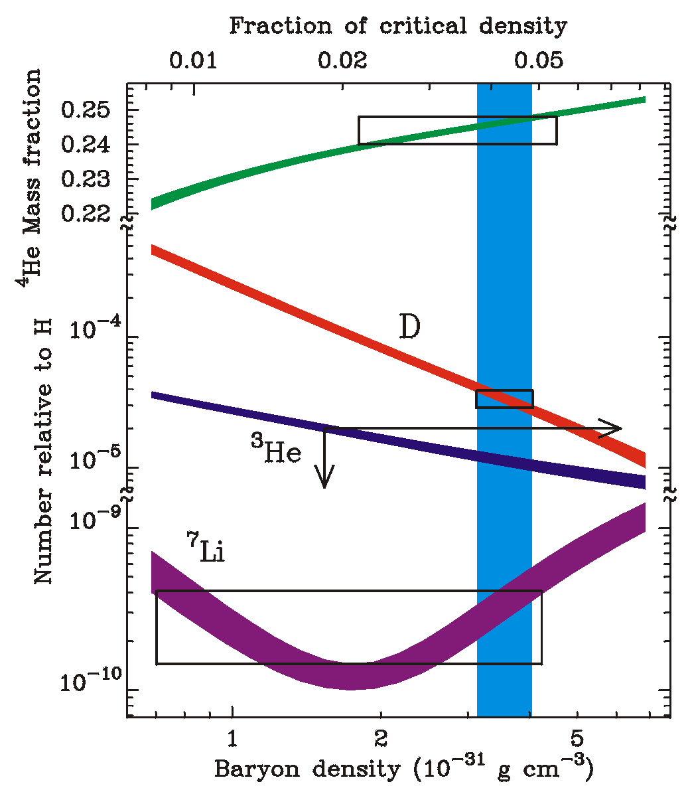
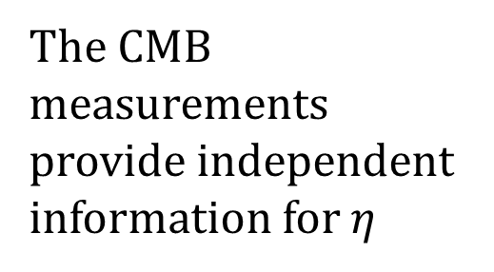
Observed abundances of Helium-3 and Deuterium constrain baryon/photon ratio:
The CMB measurements provide independent information for $η$
Notes:
Here again is the plot with the theoretical predictions of the mass fractions in the colored bands, as a function of baryon density on the bottom axis and fraction of critical density on the top axis. The observed abundances, given by the boxes, constrain the baryon photon ratio. Also, the CMB provides independent information for this ratio.

Slide 21
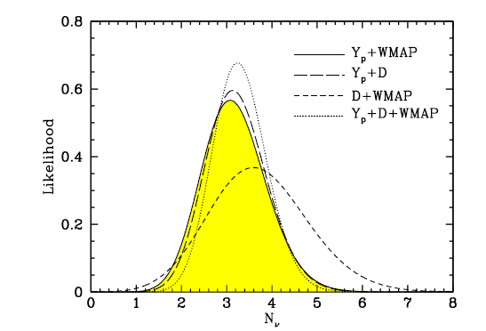
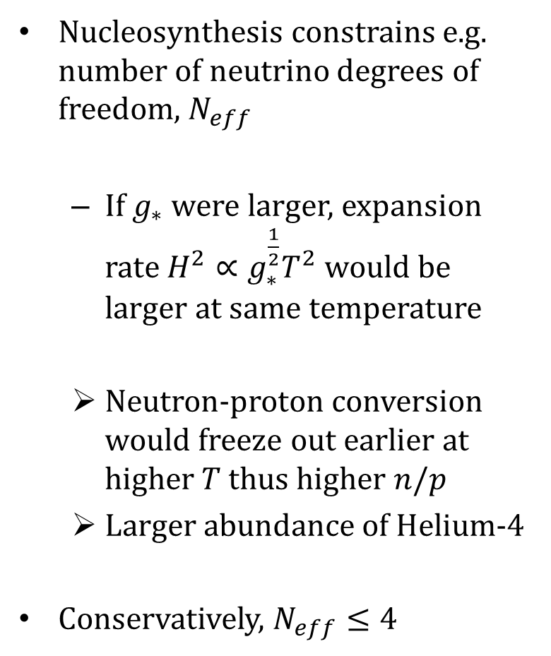
Nucleosynthesis constrains e.g. number of neutrino degrees of freedom, $N_{eff}$
If $g_{∗}$ were larger, expansion rate $H^{2}∝g_{∗}^{\frac{1}{2}}T^{2}$ would be larger at same temperature
Neutron-proton conversion would freeze out earlier at higher $T$ thus higher $n/p$
Larger abundance of Helium-4
Conservatively, $N_{eff}≤4$
Notes:
Nucleosynthesis constrains cosmology (e.g. number of neutrino species): If the neutrino degrees of freedom were larger than 3, then the expansion rate would be larger at the same temperature, thus neutron to proton conversion would freeze out earlier and at higher T thus higher neutron to proton ratio, which would result in a larger abundance of Helium 4. Due to observational constraints both from nucleosynthesis and the CMB, g < 4. Note that there are only 3 neutrino species in the standard model of particle physics, > 3 would need something else like sterile (right-handed) neutrinos.

Slide 22
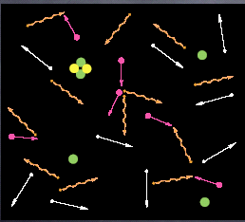
Now we have free-streaming neutrinos, interacting electrons and photons, and light nuclei
Notes:
After BBN, the universe consists of free-streaming neutrinos, interacting electrons and photons, and light stable nuclei.

Slide 23
Cosmic Microwave Background
The process of forming neutral hydrogen as a proton captures an electron is called recombination
As long as the reaction is in thermal equilibrium:
Define the ionization fraction:
Notes:
Proton captures electron to produce hydrogen + a photon at 13.6 eV. This process is called recombination (though it is a bit of a misnomer, since the electron and proton were never previously combined). [CLICK] In thermal equilibrium, the Boltzmann equation gives n_e*n_p/n_H. [CLICK] We will define the ionization fraction as the ratio of number density of electrons to all baryons, and use the fact that the net neutrality of the universe requires n_e = n_p.

Slide 24
The ionization fraction evolves according to the Saha equation,
Using the baryon to photon ratio, this can be rewritten as
Recombination occurs at 0.1 eV not 13.6 eV due to low baryon/photon ratio
80-100
1500
1000
Notes:
The ionization fraction evolves according to the Saha equation, basically the same as the Boltzmann equation we had before except now the number density of baryons is here in the denominator and we can write it in terms of the ionization fraction. [CLICK] We can rewrite it again, now in terms of the baryon to photon ratio, using the fact that the number density of photons is proportional to T^3. Because the baryon to photon ratio is so low, recombination takes longer to occur, at 0.1 eV instead of 13.6 eV – since there are so many ionizing photons around, any hydrogen atom produce will be instantaneously ionized until the baryon to photon ratio increases (and temperature decreases).

Slide 25
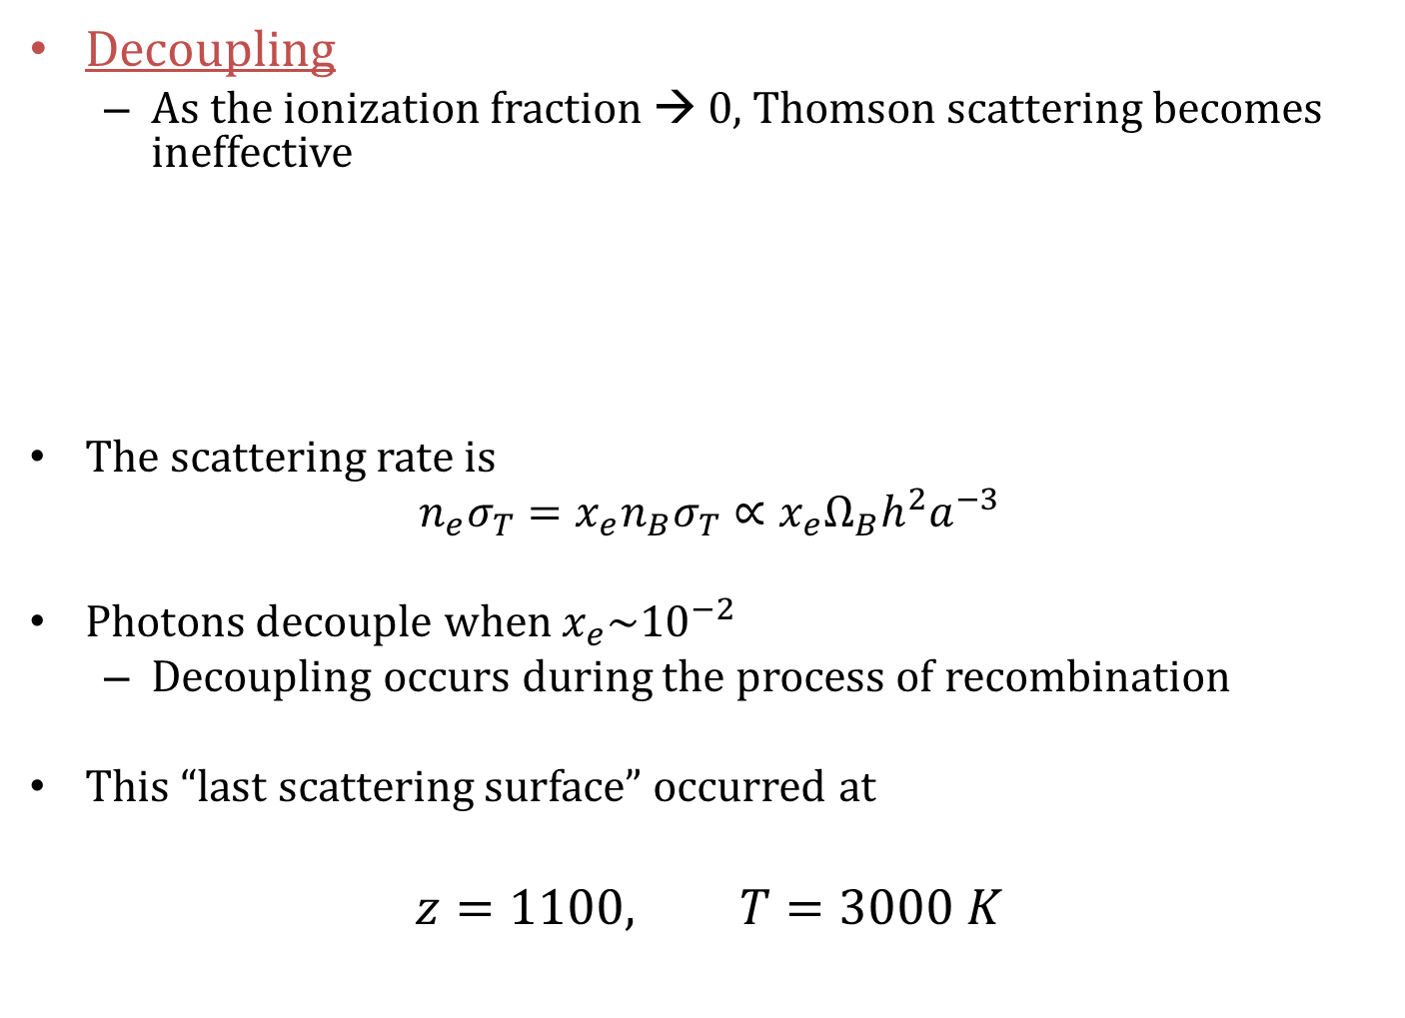
Decoupling
As the ionization fraction → 0, Thomson scattering becomes ineffective
The scattering rate is
$$n_{e}σ_{T}=x_{e}n_{B}σ_{T}∝x_{e}Ω_{B}h^{2}a^{−3}$$
Photons decouple when $x_{e}\sim {10}^{−2}$
Decoupling occurs during the process of recombination
This “last scattering surface” occurred at
$$z=1100, T=3000 K$$
Notes:
Decoupling of the CMB photons is not exactly the same as recombination of electrons to protons, though would be the same if recombination were instantaneous. Photon Thompson scatters off electron, becomes ineffective as ionization fraction goes to zero. The scattering rate for this interaction is just the electron density times the Thomson cross-section; we can write the electron density in terms of the baryon density times the ionization fraction, and then the baryon density is a function of the scale factor (using m_p*n_b/rho_c = omega_b*a^-3). Decoupling is defined to occur when the ionization fraction goes below 0.01, so it occurs during the process of recombination. This means the CMB photons can now free-stream so it’s called the “last scattering surface”.

Slide 26
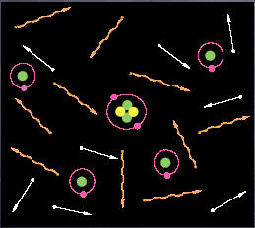
Now we have free-streaming neutrinos and photons, and atomic hydrogen and helium
Notes:
After decoupling, we have free-streaming neutrinos and photons and atomic hydrogen and helium.

Slide 27
evidence Universe
was once hotter
than .1 eV
Notes:
CMB blackbody spectrum, again…

Slide 28
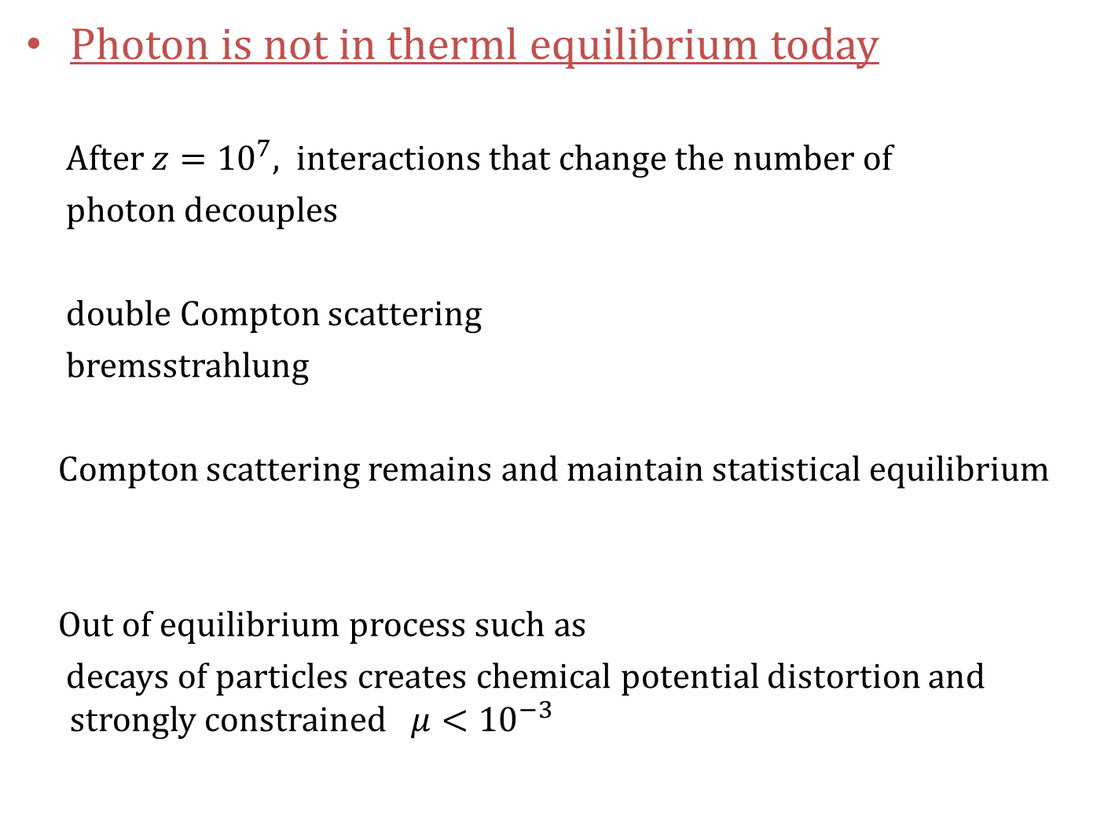
Photon is not in therml equilibrium today
After $z={10}^{7}$, interactions that change the number of
photon decouples
double Compton scattering
bremsstrahlung
Compton scattering remains and maintain statistical equilibrium
Out of equilibrium process such as
decays of particles creates chemical potential distortion and strongly constrained $μ<{10}^{−3}$

Slide 29

After ${z\sim 10}^{5}$ photon is not even in statistical equilibrium
Any change of the spectrum cannot be restored
ex. Suneyaev-Zeldovich effect
spectrum
Cluster of galaxy
frequency

Slide 30
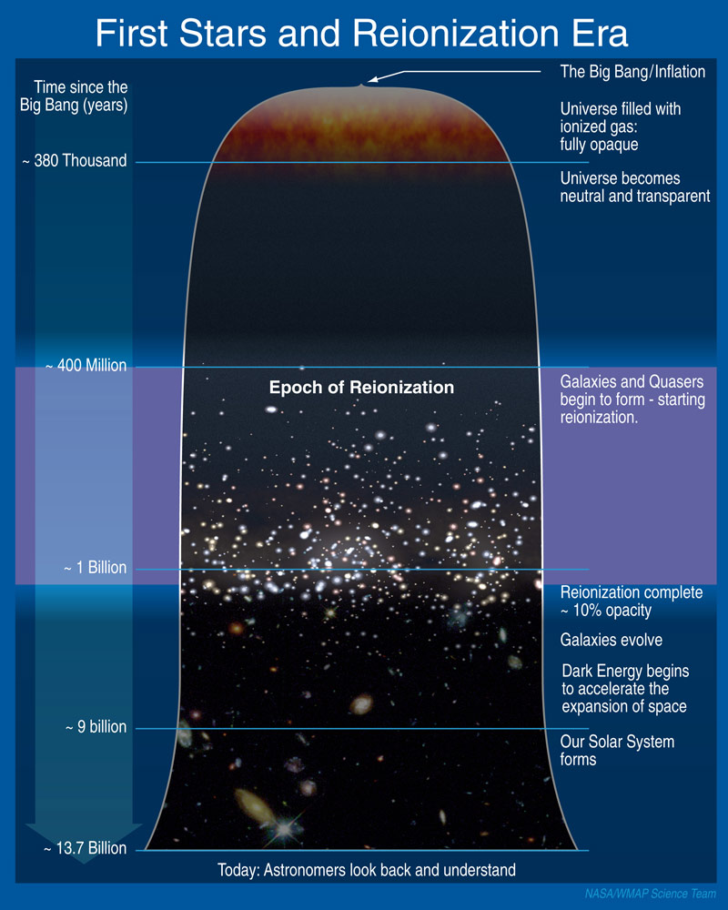
Reionization
First astronomical objects start to reionise neutral hydrogen
at 6 < z < 20.
The universe will remain transparent as the density of ionized hydrogen is low

Slide 31
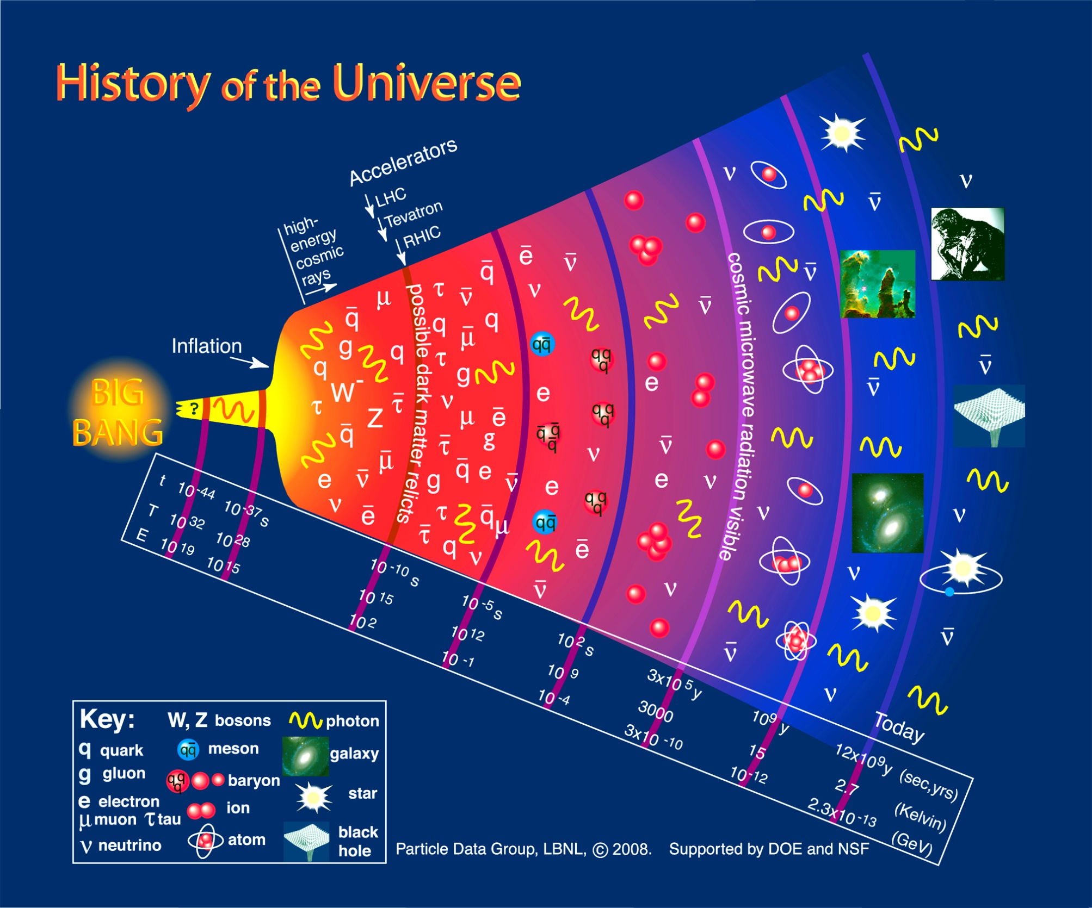
Notes:
Particle physics history of the early universe.

Slide 32
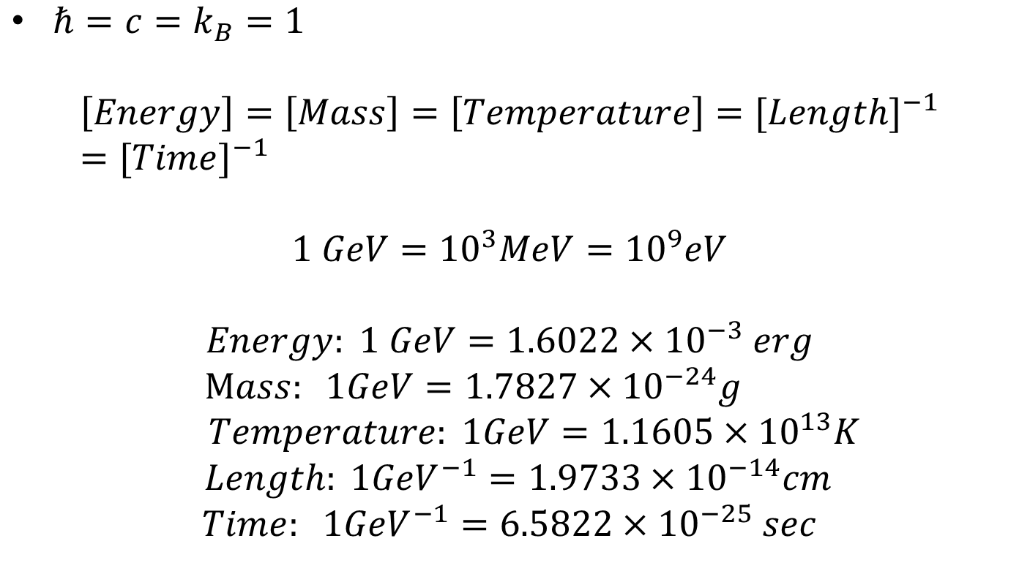
Natural unit
$ℏ=c=k_{B}=1$
$$\left[Energy\right]=\left[Mass\right]=\left[Temperature\right]={[Length]}^{−1}={[Time]}^{−1}$$
$$1 GeV={10}^{3}MeV={10}^{9}eV$$
$$Energy: 1 GeV=1.6022×{10}^{−3} erg$$
$Mass: 1GeV=1.7827×{10}^{−24}g$
$$Temperature: 1GeV=1.1605×{10}^{13}K$$
$$Length: 1{GeV}^{−1}=1.9733×{10}^{−14}cm$$
$$Time: 1{GeV}^{−1}=6.5822×{10}^{−25} sec$$

