Slide 1
Summary

Slide 2
The LCDM Model
The standard cosmological model, LCDM, explains observations consistently in a simple framework – but we do not understand its components
Need inflation or some other theory to explain flatness of geometry and smoothness of CMB
We haven’t detected dark matter and don’t know what it is (it’s outside the standard model of particle physics)
We don’t know what dark energy is or why the value of the cosmological constant is 120 orders of magnitude off
Notes:
We call this the Lambda CDM model. It explains observations consistently in a simple framework – but we do not understand its components
The big bang model has some problems which I will get into in detail. It can’t explain the observed flatness of the universe or the smoothness of the CMB, so we need something like inflation or some other theory of the early universe. Inflation is almost considered part of the standard model though of course there is no direct evidence or accepted consistent theory.
[CLICK] Observations point to dark matter being either completely cold or very nearly cold; it can’t (or all of it can’t) be hot, but it could be warm. There are some clues, but we haven’t directly or indirectly detected dark matter, and while there are many candidates from particle physics, dark matter is outside of their standard model
[CLICK] So far all observations of the accelerated expansion are consistent with the dark energy being a cosmological constant, but then our best prediction for its value is 120 orders of magnitude off. We don’t know what is the dark energy causing the accelerated expansion

Slide 3
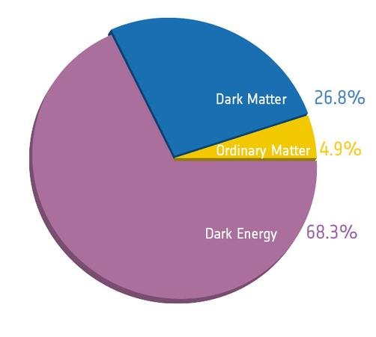

Slide 4
Standard cosmology
Big-Bang cosmology
Hubble’s law
Nucleosynthesis
Cosmic Microwave Background
Observational cosmology
SNe, BAO, CMB
Redshift distortions,
Weak lensing
Dark matter, dark energy
Initial conditions
(flatness, horizon problems)
Density perturbations
Inflation
Flat universe
Primordial fluctuations
(scale invariant spectrum)
Structure formation
Large scale structure
Galaxy formation and evolution
Stellar evolution

Slide 5
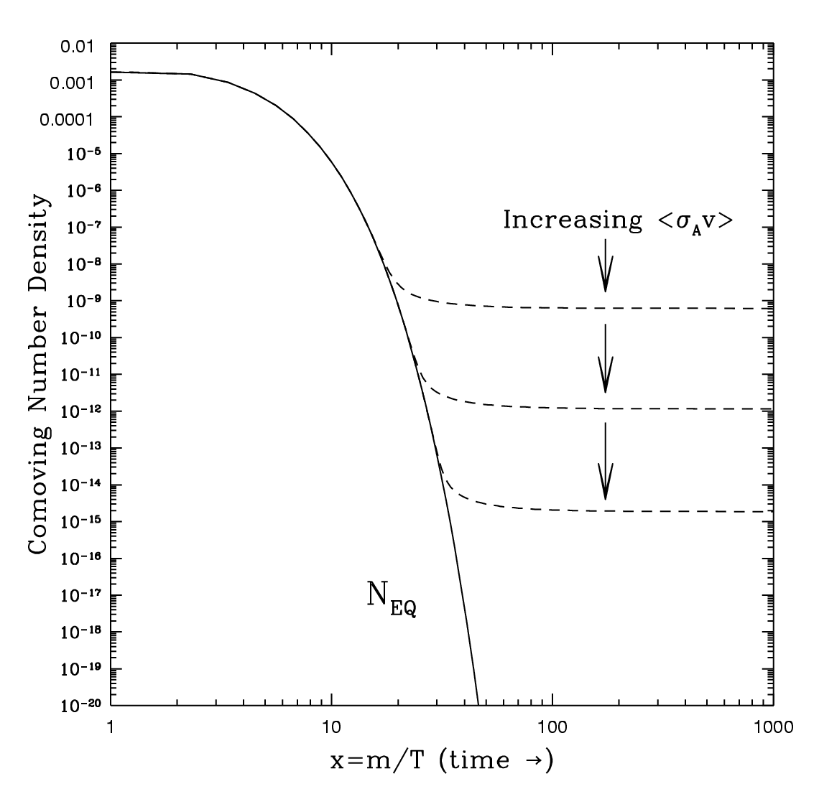

Dark Matter
WIMP = weakly interacting massive particle
SUSY predicts as lightest super-symmetric particle
But SUSY disfavored by LHC?
“WIMP miracle” – correct abundance requires cross-section which is roughly what’s expected for weak scale particle ~ 100 GeV
100 GeV predicts $Ω_{m}\sim 0.3$
Notes:
The best candidate for dark matter is a weakly interacting massive particle, which is predicted by many extensions of the standard model of particle physics. For example SUSY predicts it as the lightest supersymmetric partner. But it has yet to be found at the LHC, and they have also excluded some regions of SUSY parameter space. [CLICK] Another puzzle is the WIMP miracle: correct abundance via thermal production requires cross-section <sigma*v> ~= 3x10^-26 cm^3/s which is roughly what is expected for a new particle in the 100 GeV mass range that interacts via electroweak force. Again we have the co-moving number density of particles, which drops as the universe expands until the particles “freeze-out” stabilizing their abundance; the freeze-out time depends on the cross-section for interactions. The WIMP miracle is one of the reasons this type of dark matter candidate is favored.

Slide 6
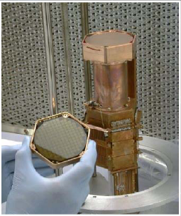
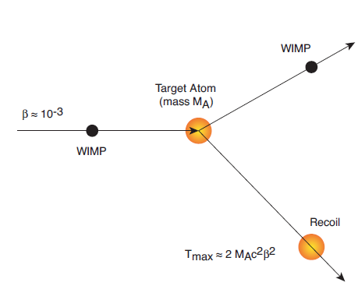

Direct detection:
CDMS
CoGeNT
Notes:
Direct detection: Many experiments trying to observed dark matter directly by getting it to interact with a target atom and observing the recoil of the target atom. They need low backgrounds to rule out mundane interactions so are often deep underground in special chambers. Though dark matter is supposed to only interact via gravity, it is at least weakly interacting, and given the weak cross-section there is a non-zero probability of a WIMP interacting with normal matter.

Slide 7
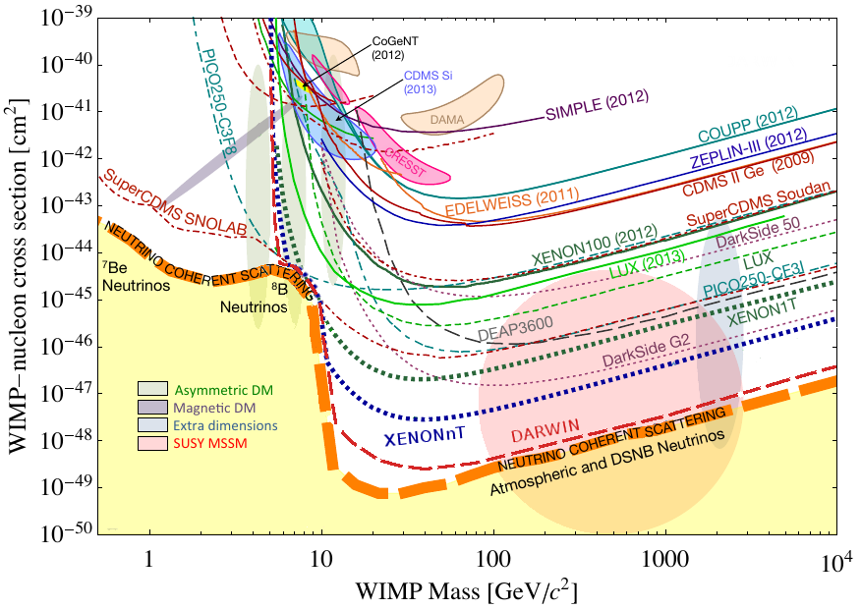
Confusing results…
detections
Exclusions
Notes:
But there are conflicting direct detection results. Different detectors are sensitive to different regions in the cross-section mass parameter space, but where they overlap, some have excluded regions where others have reported detections. Most believe this is a question of backgrounds; the detections are reported to be some sigma above their expected background, but if they get that wrong then the detection could go away. However, they are different experimental setups, so some theorists have tried to explain both with models such as atomic dark matter.

Slide 8
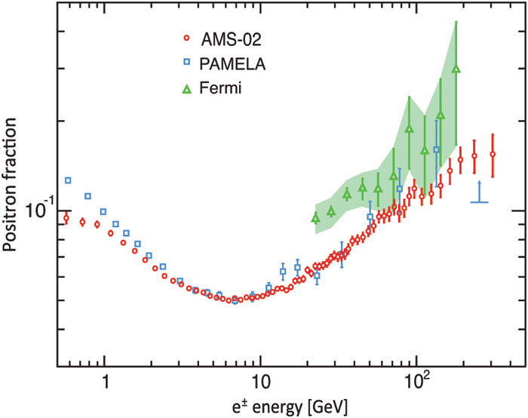
Indirect detection: Positron excess a hint of DM annihilation or local pulsars?
Notes:
Indirect detection: An excess of positrons has been observed now by several different experiments. The standard model predicts a positron fraction that continues to fall with energy, so the upturn at high energies could be due to dark matter annihilations. The best measurements are from the AMS which is on the ISS. But it could be that local pulsars in our galaxy are creating this excess by shooting out high energy relativistic particles… there is no evidence of a direction dependent signal, but maybe there is a positron background?

Slide 9
The LCDM Model
The standard cosmological model, LCDM, explains observations consistently in a simple framework – but we do not understand its components
Need inflation or some other theory to explain flatness of geometry and smoothness of CMB (Lecture 3)
We haven’t detected dark matter and don’t know what it is (it’s outside the standard model of particle physics)
(Observational cosmology)
We don’t know what dark energy is or why the value of the cosmological constant is 120 orders of magnitude off (Lecture 4)
Notes:
We call this the Lambda CDM model. It explains observations consistently in a simple framework – but we do not understand its components
The big bang model has some problems which I will get into in detail. It can’t explain the observed flatness of the universe or the smoothness of the CMB, so we need something like inflation or some other theory of the early universe. Inflation is almost considered part of the standard model though of course there is no direct evidence or accepted consistent theory.
[CLICK] Observations point to dark matter being either completely cold or very nearly cold; it can’t (or all of it can’t) be hot, but it could be warm. There are some clues, but we haven’t directly or indirectly detected dark matter, and while there are many candidates from particle physics, dark matter is outside of their standard model
[CLICK] So far all observations of the accelerated expansion are consistent with the dark energy being a cosmological constant, but then our best prediction for its value is 120 orders of magnitude off. We don’t know what is the dark energy causing the accelerated expansion

