Slide 1
IT8005 – Electronic Commerce
Mr.S.Jegadeesan
Assistant Professor
Department of IT
VCET,Madurai.
IT8005 - Electronic Commerce

Slide 2
Syllabus
UNIT I - INTRODUCTION TO E-COMMERCE AND TECHNOLOGY INFRASTRUCTURE 9
Working of Web - HTML Markup for Structure - Creating simple page - Marking up text - Adding Links - Adding Images - Table Markup - Forms - HTML5
UNIT II - BUILDING AN E-COMMERCE WEBSITE, MOBILE SITE AND APPS 9
Systematic approach to build an E-Commerce: Planning, System Analysis, System Design, Building the system, Testing the system, Implementation and Maintenance, Optimize Web Performance – Choosing hardware and software – Other E-Commerce Site tools – Developing a Mobile Website and Mobile App
UNIT III - E-COMMERCE SECURITY AND PAYMENT SYSTEMS 9
E-Commerce Security Environment – Security threats in E-Commerce – Technology Solutions: Encryption, Securing Channels of Communication, Protecting Networks, Protecting Servers and Clients – Management Policies, Business Procedure and Public Laws - Payment Systems
UNIT IV - BUSINESS CONCEPTS IN E-COMMERCE 9
Digital Commerce Marketing and Advertising strategies and tools – Internet Marketing Technologies – Social Marketing – Mobile Marketing – Location based Marketing – Ethical, Social, Political Issues in E-Commerce
IT8005 - Electronic Commerce

Slide 3
Syllabus
UNIT V - PROJECT CASE STUDY 9
Case Study : Identify Key components, strategy, B2B, B2C Models of E-commerce Business model of any e-commerce website - Mini Project : Develop E-Commerce project in any one of Platforms like Woo-Commerce, Magento or Opencart
TOTAL: 45 PERIODS
TEXT BOOK(S):
T1: Kenneth C.Laudon, Carol Guercio Traver ―E-Commerce, Pearson, 10th Edition, 2016
REFERENCES:
R1: http://docs.opencart.com/
R2: http://devdocs.magento.com/
R3: http://doc.prestashop.com/display/PS15/Developer+tutorials
R4: Robbert Ravensbergen, ―Building E-Commerce Solutions with WooCommerce‖, PACKT, 2nd Edition
IT8005 - Electronic Commerce

Slide 4
COURSE OUTCOMES
Upon Successful completion of this course, the learner will be able to
Develop websites using HTML, CSS and JS.
Developing an Ecommerce website, mobile applications.
Understanding Ecommerce Security and Payment Systems.
Understanding the Marketing Strategies in Ecommerce.
Understanding the Business models and developing a mini project case study.
IT8005 - Electronic Commerce

Slide 5
UNIT I
INTRODUCTION TO E-COMMERCE AND TECHNOLOGY INFRASTRUCTURE
IT8005 - Electronic Commerce

Slide 6
What is E-Commerce?
E-commerce (Electronic Commerce or Internet Commerce) refers a Bussiness model that allows a companies and individuals can buy and sell of goods or services using the internet.
Addition with that the transaction of the money and data to execute these services are executes using internet.
IT8005 - Electronic Commerce

Slide 7
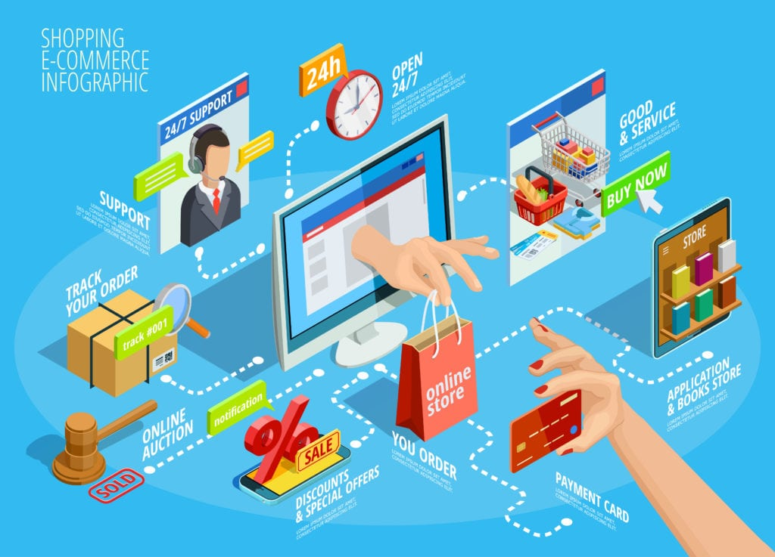
IT8005 - Electronic Commerce

Slide 8
Business models for the e-commerce
    Business to Business (B2B)- B2B model, both parties involved are businesses. Here, one company provides the other with products or services.
    Business to Customer (B2C)- B2C model represents a business that sells products or services to individual consumers.
IT8005 - Electronic Commerce

Slide 9
Business models for the e-commerce
    Customer to Customer (C2C)- C2C ecommerce happens when the two parties involved are consumers that trade with one another. They typically are marketplace platforms where individuals can communicate and agree on deals with each other.
    Customer to Business (C2B)- The C2B business model represents a transaction in which individuals create value for businesses.
IT8005 - Electronic Commerce

Slide 10
Working of Web
The web physically consists of the following :
  The personal computer at which you sit to the web.
  A web browser that is the software installed on your computer, which helps you to serf/browse the web.
  An internet connection which is provided by an ISP and which will connects you to the internet to reach to any website.
  A web server that is the computer on which a website is hosted.
  Routers and Switches which are the combination of software and hardware who takes your request and pass to appropriate web server.
IT8005 - Electronic Commerce

Slide 11
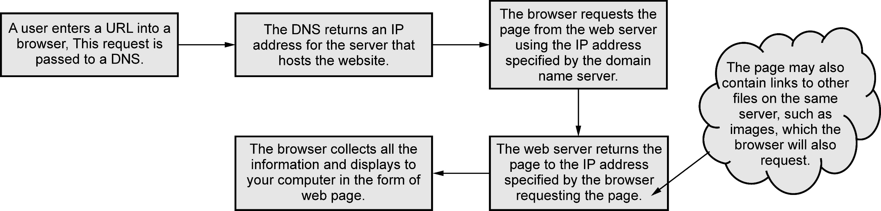
How the Web works?
IT8005 - Electronic Commerce

Slide 12
HTML Markup for Structure
Structure of an HTML Document
The <HTML> is a markup language which is used by the browser to manipulate text, images and other contents to display it in required format.
Basically two types of tags in HTML :
Paired Tags which come in a pair, that is they have both opening (<>) and closing (</>) tags.
Singular Tags which do not required to be closed.
IT8005 - Electronic Commerce

Slide 13
Example- Paired Tags
<!DOCTYPE HTML>
<html>
<head>
<title>My First HTML Page</title>
</head>
<body>
<p>This is some text...</p>
</body>
</html>
Opening tag
Closing tag
IT8005 - Electronic Commerce

Slide 14
Structure of an HTML Document
An HTML document is basically divided into two parts :
HEAD which contains the information about the HTML document like Title of the page, version of the HTML, Meta Data, etc.
Body which contains everything designer/user want to display on the Web Page.
IT8005 - Electronic Commerce

Slide 15
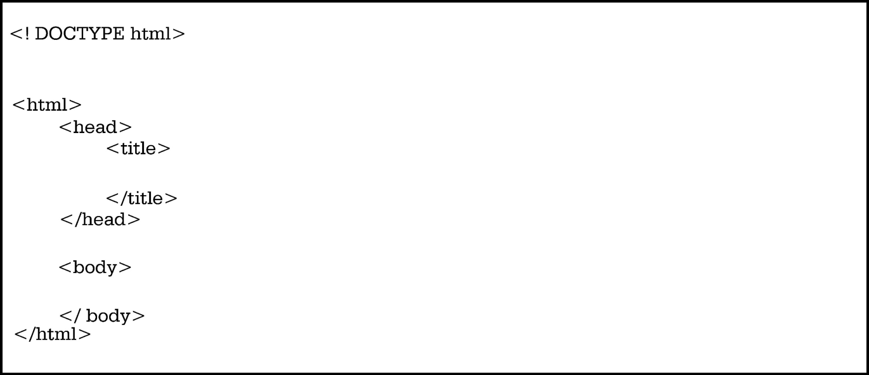
Example: Header
HTML header
HTML body
IT8005 - Electronic Commerce

Slide 16
Basic Tags of HTML
Heading Tags: (h1- h6)
<h1>Heading 1</h1>
<h2>Sub heading 2</h2>
<h3>Sub heading 3</h3>
Paragraph Tag :
<p>This is my first paragraph</p>
IT8005 - Electronic Commerce

Slide 17
Line Break Tag
Any text following <br /> tag, it starts from the next line.
<!DOCTYPE html>
<html>
<head>
<title>Line Break Example</title>
</head>
<body>
<p>Hello<br />
You are showing interest for reading this book.<br /> Thanks<br />
</p>
</body>
</html>
IT8005 - Electronic Commerce

Slide 18
Basic Tags of HTML
Centering Content
Use<center> to put the content in the center of the page
Horizontal Line
Use <hr> tag to break-up section of a document horizontally then horizontal lines are used
IT8005 - Electronic Commerce

Slide 19
HTML Element
  In the HTML file if the statement/code is in the form of a start tag, some content, and an end tag them that code/ statement is said as an HTML element.
<tag_name> some_content</tag_name>
Example: <h1>Heading 1</h1>
IT8005 - Electronic Commerce

Slide 20
HTML Attribute
The characteristics of an HTML element which is placed inside element’s opening tag are called an attribute.
Attribute provides additional information to the HTML element.
The most commonly used HTML attributes are
    ID
    Title
    Class
    Style
IT8005 - Electronic Commerce

Slide 21
Creating simple HTML Page
Step 1 : Creating the HTML page
Open any text editor like notepad or notepad++ of your computer and create a new file.
It is recommended to use Notepad on Windows Operating System, Text Edit on Mac and VI editor on Unix/Linux Operating System.
It is not recommended to use WordPad or word for HTML.
IT8005 - Electronic Commerce

Slide 22
Creating simple HTML Page
Step 2 : Prepare some HTML code in the newly created file.
<!DOCTYPE html>
<html>
<head>
<title>First HTML File</title>
</head>
<body>
<p>Hello World!<p>
</body>
</html>
IT8005 - Electronic Commerce

Slide 23
Creating simple HTML Page
Step 3 : Saving the file
The extension of your file must be .html.
To execute the file, double click on it.
It will open in the default web browser.
IT8005 - Electronic Commerce

Slide 24
HTML Elements Formatting
  Format elements of the HTML to display special type of text.
  Here are some commonly used tags for the same.
<b> - Bold text
<strong> - Important text
<i> - Italic text
<em> - Emphasized text
<mark> - Marked text
<small> - Smaller text
<del> - Deleted text
<ins> - Inserted text
<sub> - Subscript text
<sup> - Superscript text
IT8005 - Electronic Commerce

Slide 25
HTML Links
Links allow users to click and redirect from page to page.
Nowadays all the web pages almost contains the links.
All the HTML links are called as hyperlinks.
The HTML tag <a> tag defines hyperlink
Syntax: <a href="url">link text</a>
IT8005 - Electronic Commerce

Slide 26
The target Attribute in HTML Link
  Where to open the linked document is specified by the target attribute. The target attribute can be having one of the following values:
_self – Default. Opens the document in the same window/tab as it was clicked
_blank – Opens the document in a new window or tab
_parent – Opens the document in the parent frame
_top – Opens the document in the full body of the window
IT8005 - Electronic Commerce

Slide 27
HTML Link Example
<body>
<p>
<a href="https://technicalpublications.org/" target="_blank">Visit Technical Publications</a>
</p>
<p>If target="_blank", the link will open in a new browser window or tab.
</p>
</body>
IT8005 - Electronic Commerce

Slide 28
Use of Image as a LINK
To use image as a link, <img> tag is used inside the <a> tag
<body>
<p><a href="default.html">
<img src="TechnicalPublications.jpg" alt="Image as HTML Link" style="width:42px;height:42px;">
</a>
</p>
</body>
IT8005 - Electronic Commerce

Slide 29
HTML Images
  Any web page can be look attractive by adding the good images in the web page.
  To add an image in a web page, use the HTML <img> tag.
  It is an empty tag, it does not have a closing tag and it contains two attributes.
  These two required attributes are :
    src – used to specify the path to the image
    alt – used to specify and alternate text for the image
  The syntax for the <img> tag with these two attribute is:
<img src="url" alt="alternatetext">
IT8005 - Electronic Commerce

Slide 30
HTML Images
Example:
<body>
<h2>Alternative text</h2>
<p>The alt attribute should reflect the image content, so users who cannot see the image gets an understanding of what the image contains
</p>
<img src="tajmahal.jpg" alt="Taj Mahal - Agra" width="460" height="345">
</body>
IT8005 - Electronic Commerce

Slide 31
HTML Background Images
  use the HTML style attribute and the CSS background-
  image property to add a background image on the HTML
  elements.
  Example:
<body>
<p>A background image for a p element:</p>
<p style="background-image: url('tajmahal.jpg');color:white">
</body>
IT8005 - Electronic Commerce

Slide 32
Table Markup
  An HTML table defines by the <table> tag.
  A <tr> tag defines each table row,
  a <th> tag defines each table header
  a <td> tag defines each table data/cell.
  The text in <th> elements are by default bold and centered.
  Similarly the text in <td> elements are by default regular and left-aligned.
IT8005 - Electronic Commerce

Slide 33
HTML Tables :Example
<body>
<p><h2>Basic HTML Tables</h2></p>
<table style="width:100%">
<tr>
<th>Firstname</th>
<th>Lastname</th>
<th>Age</th>
</tr>
Continue…..
IT8005 - Electronic Commerce

Slide 34
HTML Tables :Example
<tr>
<td>Mihir</td>
<td>Mishra</td>
<td>30</td>
</tr>
</table>
</body>
IT8005 - Electronic Commerce

Slide 35
HTML Forms
HTML Forms are used to collect user input .
HTML <form> element is used.
The different types of inputs such as text field, checkboxes, radio buttons, etc. are contained by the HTML <form> element. So it is called the container for such types of the input.
IT8005 - Electronic Commerce

Slide 36
HTML Forms
  The various form elements are :
<input> <label>
<select> <textarea>
<button> <fieldset>
<legend> <datalist>
<output> <option>
<optgroup>
IT8005 - Electronic Commerce

Slide 37
HTML Forms
The <input> element
<form action="/htmlelementsformatting.html">
<label for="fname">First name:</label><br>
<input type="text" id="fname" name="fname"><br><br>
<input type="submit" value="Submit">
</form>
IT8005 - Electronic Commerce

Slide 38
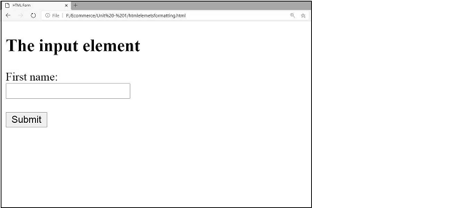
HTML Forms output
IT8005 - Electronic Commerce

Slide 39
The <select> element
<form action="/htmlelementsformatting.html">
<label for="cars">Choose a car:</label>
<select id="cars" name="cars">
<option value="WagonR">WagonR</option>
<option value="alto">Alto</option>
<option value="mghactor">MG Hactor</option>
<option value="audi">Audi</option>
</select>
<input type="submit">
</form>
IT8005 - Electronic Commerce

Slide 40
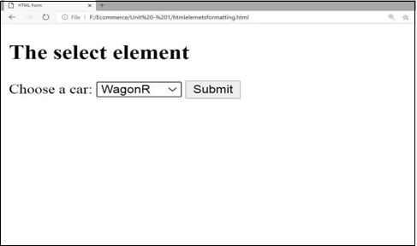
The <select> element: Output
IT8005 - Electronic Commerce

Slide 41
The <textarea> element
This element allows multi-line input field that is a text area. The rows attribute and the cols attribute specifies the visible number of lines in the text area and the visible width of a text respectively
Example:
<form action="/htmlelementsformatting.html">
<textarea name="message" rows="10" cols="30"> The cat was playing in the garden.
</textarea>
</form>
IT8005 - Electronic Commerce

Slide 42
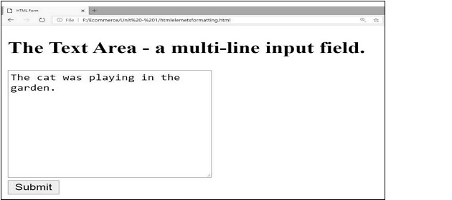
The <textarea> element- Output
IT8005 - Electronic Commerce

Slide 43
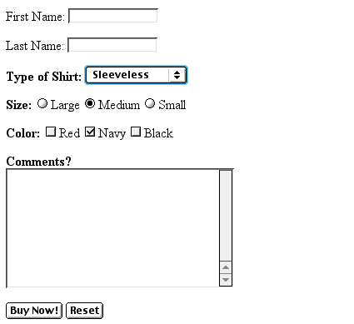
Example: Form
Text Box
Drop-down Menu
Radio Buttons
Checkboxes
Text Area
Reset Button
IT8005 - Electronic Commerce
Submit Button

Slide 44
Creating Text Boxes
To create a text box,
type <INPUT TYPE=“text” NAME=“name” VALUE=“value” SIZE=n MAXLENGTH=n>
The NAME, VALUE, SIZE, and MAXLENGTH attributes are optional
IT8005 - Electronic Commerce

Slide 45
Text Box Attributes
The NAME attribute is used to identify the text box to the processing script
The VALUE attribute is used to specify the text that will initially appear in the text box
The SIZE attribute is used to define the size of the box in characters
The MAXLENGTH attribute is used to define the maximum number of characters that can be typed in the box
IT8005 - Electronic Commerce

Slide 46

Example: Text Box
First Name: <INPUT TYPE="text" NAME="FirstName" VALUE="First Name" SIZE=20>
<BR><BR>
Last Name: <INPUT TYPE="text" NAME="LastName" VALUE="Last Name" SIZE=20>
<BR><BR>
Here’s how it would look on the Web:
IT8005 - Electronic Commerce

Slide 47
Creating Radio Buttons
To create a radio button,
type <INPUT TYPE=“radio” NAME=“name” VALUE=“data”>Label,
where “data” is the text that will be sent to the server if the button is checked and “Label” is the text that identifies the button to the user
IT8005 - Electronic Commerce

Slide 48
Example: Radio Buttons
<B> Size: </B>
<INPUT TYPE="radio" NAME="Size"
VALUE="Large">Large
<INPUT TYPE="radio" NAME="Size"
VALUE="Medium">Medium
<INPUT TYPE="radio" NAME="Size"
VALUE="Small">Small
IT8005 - Electronic Commerce

Slide 49
Creating Checkboxes
To create a checkbox,
type <INPUT TYPE=“checkbox” NAME=“name” VALUE=“value”>Label
group of radio buttons or checkboxes having the same name, the user will only be able to select one button or box at a time
IT8005 - Electronic Commerce

Slide 50
Example: Checkboxes
<B> Color: </B>
<INPUT TYPE="checkbox" NAME="Color" VALUE="Red">Red
<INPUT TYPE="checkbox" NAME="Color"
VALUE="Navy">Navy
<INPUT TYPE="checkbox" NAME="Color"
VALUE="Black">Black
IT8005 - Electronic Commerce

Slide 51
Creating a Reset Button
To create a reset button,
type <INPUT TYPE=“reset”>
The VALUE attribute can be used in the same way to change the text that appears on the button
IT8005 - Electronic Commerce

