Slide 1
Session 2 - Queries Across Rows and Tables
Grouping, joins, subqueries and an integrated report

Slide 2
Session 2 Route
Stage | Question
Aggregate / GROUP BY | What is one output row: an item, a group or a total?
JOIN | Which rows match, and which unmatched rows should stay?
Subquery / EXISTS | Is the requirement any, none or every?
Integrated query | Can joins multiply rows and distort counts?
Core practice is followed by optional challenges from the original deck.

Slide 3
9 - Basic SQL Statement Cont.

Slide 4
SELECT - Aggregate Functions
MIN() - returns smallest value within the selected column
MAX() - returns largest value within the selected column
SUM() - returns sum of all values in a numerical column
AVG() - returns average of all (unique) values in a numerical column
COUNT() - returns number of value in a column
  COUNT(*) counts rows.
  COUNT(column) counts only rows where that column is not NULL.
  COUNT(DISTINCT column) counts distinct non-NULL values.
NOTE:
Aggregate functions ignore null values (except for COUNT(*)).
DSITINCT means unique, it remove all repeated values at first.
year
1
1
2
3
3
COUNT(*)
5

Slide 5
Student Data for the Next Examples
The setup also contains programme and graduate_list (student_id = 1116).
student_id | name | year | prog_code
1111 | Chan Ada | 1 | CS
1112 | Ben Lee | 1 | DS
1113 | Chan Cara | 2 | CS
1114 | Dev Wu | 3 | EE
1115 | Eli Lin | 3 | NULL
1116 | Fay Ho | 4 | DS
Use lab_work.db. NULL denotes a missing value, not the literal text "NULL".
COUNT(*) -- 6
COUNT(prog_code) -- 5
COUNT(DISTINCT prog_code) -- 3

Slide 6
SELECT - Aggregate Functions
Count the number of rows
Select aggregate value with other columns
SELECT COUNT(*) FROM student;
SELECT year, COUNT(*) FROM student;

Slide 7
SELECT - GROUP BY
Select aggregate value with other columns
Aggregate functions are often used with GROUP BY clause of the SELECT statement.
GROUP BY clause splits result-set into groups of values and the aggregate function can be used to return a single value for each group.
SELECT year, COUNT(*)
FROM student
GROUP BY year;
year
1
1
2
3
3
4
year | COUNT(*)
1 | 2
2 | 1
3 | 2
4 | 1
M: Think backwards, what might the student relation looked like before projection?

Slide 8
SELECT - GROUP BY
SELECT year, COUNT(*)
FROM student
WHERE year < 4
GROUP BY year
HAVING COUNT(*) > 1;
Having and Where both function to express constraints on the records present in the final result set.
  They are different HOW?
  Key: operational semantics!
year
1
1
2
3
3
4
πyear(Student)
M: Can you achieve a SQL HAVING just by using WHERE? Or vice versa?

Slide 9
GROUP BY operational semantics!
πyear(Student)
year
1
1
2
3
3
year
1
1
2
3
3
4
SELECT year, COUNT(*)
FROM student
WHERE year < 4
GROUP BY year
HAVING COUNT(*) > 1;
1. Filter by
WHERE conditions
2. Grouping
3. Filter by
HAVING conditions
year | COUNT(*)
1 | 2
2 | 1
3 | 2
year | COUNT(*)
1 | 2
3 | 2

Slide 10
10 - Joining Tables

Slide 11
Join
Display from multiple tables
Schema
student (student_id, name, year, prog_code)
programme (programme_id, name)
SELECT programme.name, student_id
FROM student, programme
WHERE prog_code = programme_id;

Slide 12
Join
Use table alias
SELECT P.name, student_id
FROM student, programme P
WHERE prog_code = programme_id;
SELECT P.name, S.student_id
FROM student AS S
(INNER) JOIN programme AS P
ON S.prog_code = P.programme_id;
Inner Join

Slide 13
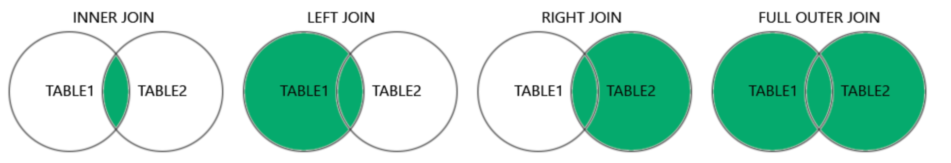
Different Types of SQL JOINs
(INNER) JOIN: Returns records that have matching values in both tables
LEFT (OUTER) JOIN: Returns all records from the left table, and the matched records from the right table
RIGHT (OUTER) JOIN: Returns all records from the right table, and the matched records from the left table
FULL (OUTER) JOIN: Returns all records when there is a match in either left or right table

Slide 14
LEFT JOIN
The LEFT JOIN keyword returns all records from the left table (table1), and the matching records from the right table (table2).
Syntax
SELECT column_name(s)
FROM table1
LEFT JOIN table2
ON table1.column_name = table2.column_name;

Slide 15
RIGHT JOIN
The RIGHT JOIN keyword returns all records from the right table (table2), and the matching records from the left table (table1).
Syntax
SELECT column_name(s)
FROM table1
RIGHT JOIN table2
ON table1.column_name = table2.column_name;
A RIGHT JOIN B
B LEFT JOIN A

Slide 16
FULL OUTER JOIN
The FULL OUTER JOIN keyword returns all matching records from both tables, and the unmatched records return with NULL.
Syntax
SELECT column_name(s)
FROM table1
FULL [OUTER] JOIN table2
ON table1.column_name = table2.column_name;

Slide 17
DEMO: Different Types of SQL JOINs
CREATE TABLE customers (
customer_id INT PRIMARY KEY,
customer_name VARCHAR(100) );
CREATE TABLE orders (
order_id INT PRIMARY KEY,
customer_id INT,
order_date DATE,
FOREIGN KEY (customer_id) REFERENCES customers(customer_id)
);

Slide 18
DEMO: Different Types of SQL JOINs
INSERT INTO customers (customer_id, customer_name) VALUES
(1, 'John Doe’),
(2, 'Jane Smith’),
(3, 'Bob Johnson’);
INSERT INTO orders (order_id, customer_id, order_date) VALUES
(1, 1, '2023-01-01’),
(2, 1, '2023-02-01');
Predict which customers or orders each join must retain.
Write SQL for different join types and think about their results.(5 mins)

Slide 19
DEMO: Different Types of SQL JOINs
LEFT JOIN
SELECT customers.customer_name, orders.order_date
FROM customers
LEFT JOIN orders
ON customers.customer_id = orders.customer_id;
RIGHT JOIN JOIN
SELECT customers.customer_name, orders.order_date
FROM customers
RIGHT JOIN orders
ON customers.customer_id = orders.customer_id;

Slide 20
DEMO: Different Types of SQL JOINs
OUTER JOIN
SELECT customers.customer_name, orders.order_date
FROM customers
FULL JOIN orders
ON customers.customer_id = orders.customer_id;
INNER JOIN
SELECT customers.customer_name, orders.order_date
FROM customers
(INNER) JOIN orders
ON customers.customer_id = orders.customer_id;

Slide 21
11 - Subquery

Slide 22
Subquery: a query inside a query
A subquery is a SELECT statement inside another SQL statement, usually enclosed in parentheses.
Inner query supplies | How the outer query uses it
One value | Compare with =, >, <, or another operator
A set of values | Check membership with IN or NOT IN
Matching rows | Test existence with EXISTS or NOT EXISTS
The inner query answers a supporting question. The outer query produces the requested final result.
Examples on the next pages use the existing lab_work.db tables.
22

Slide 23
One value: a scalar subquery
Example: find students in the highest year. The student years are 1, 1, 2, 3, 3, 4.
1. Inner query: SELECT MAX(year) FROM student; returns 4.
2. Outer condition: WHERE year = 4.
SELECT student_id, name, year
FROM student
WHERE year = (SELECT MAX(year) FROM student)
ORDER BY student_id;
Result: 1116 | Fay Ho | 4. The value comes from the data, so it does not need to be hard-coded.
23

Slide 24
Several values: IN
Example: find students in programmes whose names contain Science.
SELECT student_id, name
FROM student
WHERE prog_code IN (
SELECT programme_id FROM programme
WHERE name LIKE '%Science%'
)
ORDER BY student_id;
Inner result: {CS, DS}. IN checks whether each student's prog_code belongs to this set.
Result IDs: 1111, 1112, 1113, 1116. Repeated values in the inner result do not duplicate students.
24

Slide 25
NOT IN and missing values
Example: find students whose IDs are absent from graduate_list. Its current ID is 1116.
SELECT student_id, name
FROM student
WHERE student_id NOT IN (
SELECT student_id FROM graduate_list
)
ORDER BY student_id;
Result IDs: 1111–1115. This example uses a non-NULL student_id key.
NULL caution: 1113 NOT IN (1116, NULL) is unknown, not true. WHERE does not keep an unknown result.
25

Slide 26
Correlated subquery: the current row
Example: find students in the highest year within their own programme.
SELECT s.student_id, s.name, s.prog_code
FROM student AS s
WHERE s.year = (
SELECT MAX(s2.year) FROM student AS s2
WHERE s2.prog_code = s.prog_code
)
ORDER BY s.student_id;
s is the current outer student. s2 is the inner set of students. The condition uses s.prog_code to select the comparison group.
CS maximum = 2; DS maximum = 4; EE maximum = 3. Result IDs: 1113, 1114, 1116.
26

Slide 27
EXISTS: at least one matching row
Example: list programmes that have at least one student.
SELECT p.programme_id, p.name
FROM programme AS p
WHERE EXISTS (
SELECT 1 FROM student AS s
WHERE s.prog_code = p.programme_id
)
ORDER BY p.programme_id;
EXISTS is true when the inner query finds a matching row. SELECT 1 is a constant, not the first row or a row with ID 1.
Each programme appears once, even with many students. Result IDs: CS, DS, EE.
27

Slide 28
NOT EXISTS: no matching row
Example: list students who have no matching row in graduate_list.
SELECT s.student_id, s.name
FROM student AS s
WHERE NOT EXISTS (
SELECT 1 FROM graduate_list AS g
WHERE g.student_id = s.student_id
)
ORDER BY s.student_id;
For 1116: a matching row exists, so NOT EXISTS is false. For 1111: no match exists, so NOT EXISTS is true.
Result IDs: 1111–1115. The correlation condition makes the absence test specific to the current student.
28

Slide 29
Reading a subquery before writing SQL
Question to ask | What to identify
What should one final row represent? | Choose the outer table and output columns.
What supporting information is needed? | One value, a value set, or matching rows.
Does the inner query use the current outer row? | Find the alias reference and matching condition.
Which condition matches the requirement? | = / > for a value; IN for a set; EXISTS for any; NOT EXISTS for none.
Check a small inner result, then identify the outer rows that remain.
Next: switch to chinook.db for the original Q1–Q5 exercises.
29

Slide 30
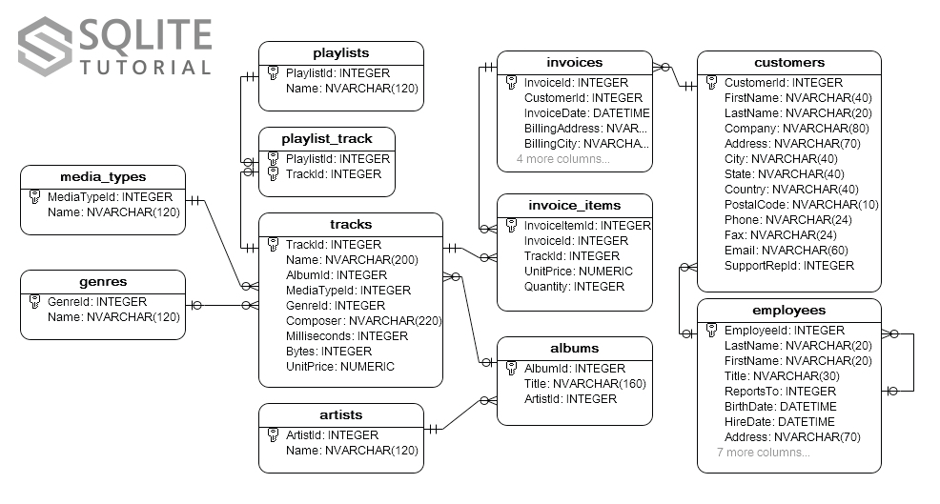
SQLite Example database
Open the unchanged chinook.db for the following queries.
DB for a digital media store, tables for artists, albums, invoices, customers, etc.,

Slide 31
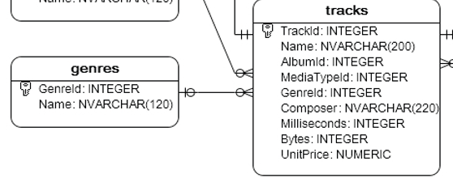
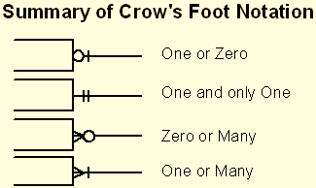
Q1: Basics
Tables: tracks, genres
Task:
  Find all Pop tracks (Genre).
  Tip: Genre Name = ‘Pop’
Try to solve it. (2 mins)
  Read Crow’s Foot Notation as additional fun hurdle to this lab…
  Genres to tracks is 1:M relation.
    One track has one genre
    One genre has many tracks
  Good Job! (?)

Slide 32
Demo1: Basics
Tables: tracks, genres
Task:
  Find all Pop tracks (Genre).
  Tip: Genre Name = ‘Pop’
Try it on SQLite. (2 min)
  SELECT t.Name
  FROM tracks t
  WHERE t.GenreId = ( SELECT GenreId FROM genres WHERE Name = 'Pop');

Slide 33
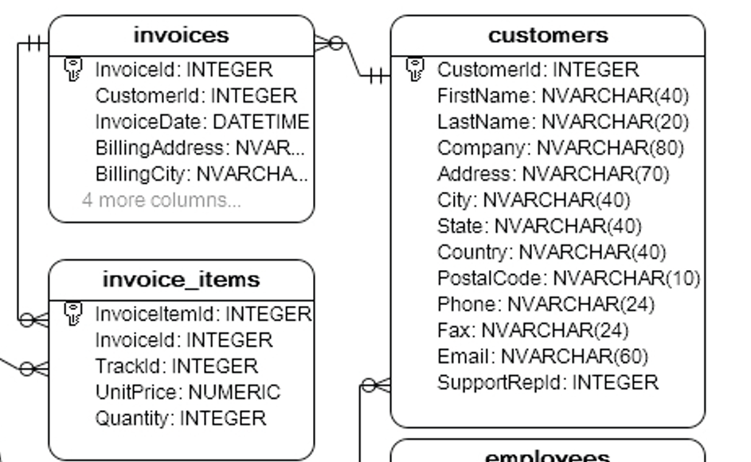
Q2: IN Operator
Tables: customers, invoices
Task: Find customers who have never placed an order.
Try to solve it. (3 mins)

Slide 34
Demo2: IN Operator
Tables: customers, invoices
Task: Find customers who
have never placed an order.
Try it on SQLite. (2 min)
  SELECT CustomerId,
  FirstName, LastName
  FROM customers
  WHERE CustomerId NOT IN (
  SELECT DISTINCT CustomerId FROM invoices
  );

Slide 35
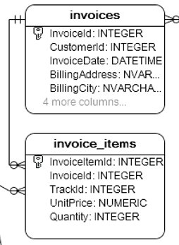
Q3: Correlated Subquery
  Tip: One invoice may include multiple invoice items.
Tables: invoice_items
Task: Find invoice items where
unit price is higher than average unit price of invoice.
Try to solve it. (3 mins)

Slide 36
Demo3: Correlated Subquery
  Tip: One invoice may include multiple invoice items.
Tables: invoice_items
Task: Find invoice items where
unit price is higher than average unit price of invoice.
Try it on SQLite. (2 min)
  SELECT ii.InvoiceLineId, ii.TrackId,
  ii.UnitPrice
  FROM invoice_items ii
  WHERE ii.UnitPrice > (
  SELECT AVG(UnitPrice)
  FROM invoice_items
  WHERE InvoiceId = ii.InvoiceId);

Slide 37
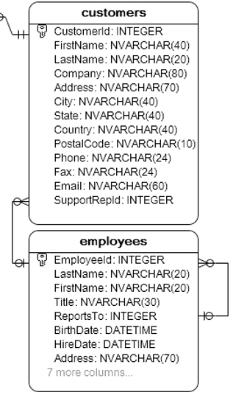
Q4: EXISTS
Tables: employees, customers
Task: Find employees who have
at least one customer in same country as employee
Try to solve it. (4 mins)

Slide 38
Demo4: EXISTS
Tables: employees, customers
Task: Find employees who have
at least one customer in same country as employee
Try it on SQLite. (2 min)
  SELECT EmployeeId, FirstName,
  LastName
  FROM employees e
  WHERE EXISTS (
  SELECT 1
  FROM customers c
  WHERE c.Country = e.Country);

Slide 39
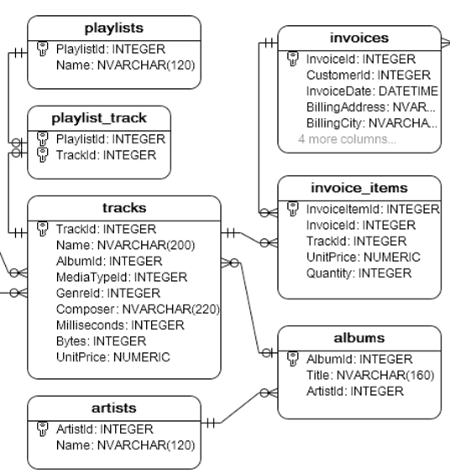
Q5: NOT EXISTS
Tables: artists, albums, tracks, invoice_items
Task: Find artists whose tracks have never been purchased by any customer.
Even if artist has albums and tracks, none of their tracks may appear in any invoice
Try to solve it. (5 mins)

Slide 40
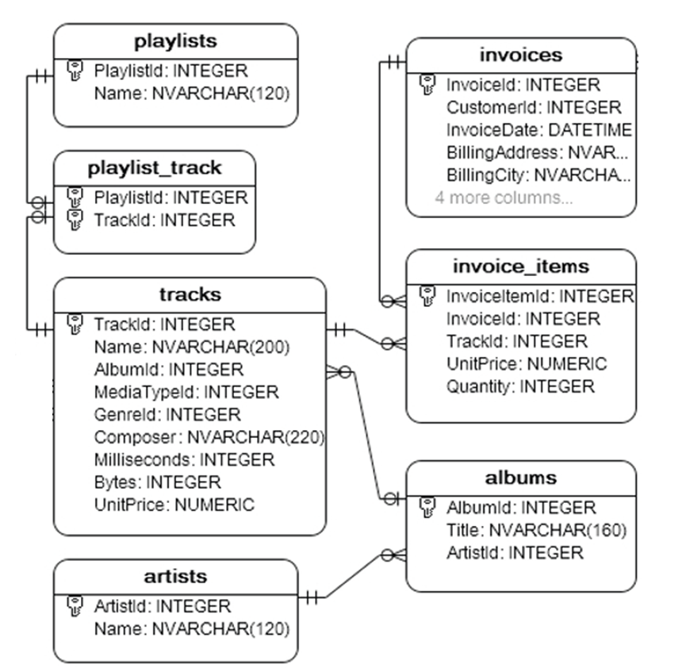
Demo5: NOT EXISTS
Tables: artists, albums, tracks, invoice_items
Task: Find artists whose tracks have never
been purchased by any customer.
  SELECT ArtistId, Name
  FROM artists a
  WHERE NOT EXISTS (
  SELECT 1
  FROM albums al
  JOIN tracks t ON al.AlbumId = t.AlbumId
  JOIN invoice_items ii ON t.TrackId = ii.TrackId
  WHERE al.ArtistId = a.ArtistId );

Slide 41
Demo5: Same Expression? Yes
Tables: artists, albums, tracks, invoice_items
Task: Find artists whose tracks have never been purchased by any customer.
  SELECT a.ArtistId, a.Name
  FROM artists a
  WHERE a.ArtistId NOT IN (
  SELECT DISTINCT al.ArtistId
  FROM albums al
  JOIN tracks t ON t.AlbumId = al.AlbumId
  JOIN invoice_items ii ON ii.TrackId = t.TrackId
  );

Slide 42
Demo5: Same Expression? Yes
Tables: artists, albums, tracks, invoice_items
Task: Find artists whose tracks have never been purchased by any customer.
  SELECT DISTINCT a.ArtistId,
  a.Name
  FROM artists a
  LEFT JOIN albums al ON al.ArtistId = a.ArtistId
  LEFT JOIN tracks t ON t.AlbumId = al.AlbumId
  LEFT JOIN invoice_items ii ON ii.TrackId = t.TrackId
  WHERE ii.TrackId IS NULL;

Slide 43
Conclusion
Subqueries nest queries to filter or manipulate data dynamically, using operators like IN to check list membership, ANY and ALL for set comparisons, and EXISTS/NOT EXISTS for presence checks.
  IN: Checks if a value is in a subquery result set.
  EXISTS: Verifies if a subquery returns any rows.
  NOT EXISTS: Ensures no rows are returned by a subquery.
  ANY: Compares a value against any in a subquery set.
  ALL: Compares a value against all in a subquery set.
Correlated queries, where the inner query depends on the outer, are ideal for row-by-row comparisons.

Slide 44
12 - Integrated Chinook Practice

Slide 45
Practice 18: Album and Track Counts
Database: chinook.db
1. For every artist, return ArtistId, Name, album_cnt(count) and track_cnt(count).
2. Keep artists with zero albums/tracks.
3. Order by track_cnt descending, then ArtistId.
Write, run and check: about 5 minutes.

Slide 46
Solution 18: Count Each Relationship Separately
SELECT a.ArtistId, a.Name,
(SELECT COUNT(*) FROM albums al
WHERE al.ArtistId = a.ArtistId) AS album_cnt,
(SELECT COUNT(*) FROM tracks t
JOIN albums al ON al.AlbumId = t.AlbumId
WHERE al.ArtistId = a.ArtistId) AS track_cnt
FROM artists a
ORDER BY track_cnt DESC, a.ArtistId;
Each scalar aggregate returns 0 when no matching row exists.

Slide 47
Solution 18: JOIN Alternative
SELECT a.ArtistId, a.Name,
COUNT(DISTINCT al.AlbumId) AS album_cnt,
COUNT(t.TrackId) AS track_cnt
FROM artists a
LEFT JOIN albums al ON al.ArtistId = a.ArtistId
LEFT JOIN tracks t ON t.AlbumId = al.AlbumId
GROUP BY a.ArtistId, a.Name
ORDER BY track_cnt DESC, a.ArtistId;
A two-track album occupies two joined rows. DISTINCT prevents counting that album twice.

Slide 48
Practice 19: Highest Price in Each Genre
Database: chinook.db
1. Find all tracks at the maximum UnitPrice within their genre.
2. Keep every tie. Return GenreName, TrackId, Name and UnitPrice.
Write, run and check: about 5 minutes.

Slide 49
Solution 19: Keep Every Maximum
SELECT g.Name AS GenreName,
t.TrackId, t.Name, t.UnitPrice
FROM tracks t JOIN genres g ON g.GenreId = t.GenreId
WHERE t.UnitPrice = (
SELECT MAX(t2.UnitPrice) FROM tracks t2
WHERE t2.GenreId = t.GenreId
)
ORDER BY g.GenreId, t.TrackId;
A bare Name / TrackId beside MAX does not return all tied tracks.

Slide 50
Practice 20: Purchased by a Canadian Customer
Database: chinook.db
1. Return tracks purchased by at least one customer from Canada.
2. Return TrackId and Name once, regardless of the number of purchases.
Write, run and check: about 4 minutes.

Slide 51
Solution 20: At Least One Purchase
SELECT t.TrackId, t.Name
FROM tracks t
WHERE EXISTS (
SELECT 1 FROM invoice_items ii
JOIN invoices i ON i.InvoiceId = ii.InvoiceId
JOIN customers c ON c.CustomerId = i.CustomerId
WHERE ii.TrackId = t.TrackId AND c.Country = 'Canada'
)
ORDER BY t.TrackId;
EXISTS filters each outer track once, so no DISTINCT is required.

Slide 52
Practice 21: Tracks and Sales per Artist
Database: chinook.db
1. For each artist, report total distinct tracks and sold_records.
2. sold_records means invoice_items rows, NOT distinct sold tracks or
SUM(Quantity).
3. Keep artists with zero tracks or zero sales.
Write, run and check: about 6 minutes.

Slide 53
Solution 21: First Count the Tracks
SELECT a.ArtistId, a.Name,
COUNT(t.TrackId) AS total_tracks
FROM artists a
LEFT JOIN albums al ON al.ArtistId = a.ArtistId
LEFT JOIN tracks t ON t.AlbumId = al.AlbumId
GROUP BY a.ArtistId, a.Name
ORDER BY a.ArtistId;
Before adding invoice_items, there is at most one joined row per track.

Slide 54
Solution 21: Then Count the Sales
SELECT a.ArtistId, a.Name,
COUNT(DISTINCT t.TrackId) AS total_tracks,
COUNT(ii.InvoiceLineId) AS sold_records
FROM artists a
LEFT JOIN albums al ON al.ArtistId = a.ArtistId
LEFT JOIN tracks t ON t.AlbumId = al.AlbumId
LEFT JOIN invoice_items ii ON ii.TrackId = t.TrackId
GROUP BY a.ArtistId, a.Name
ORDER BY a.ArtistId;
Repeated purchases multiply track rows. DISTINCT fixes track count; the sale-row key is
InvoiceLineId.

Slide 55
Session 2 Checkpoint
Use GROUP BY to define one result row per group.
Decide which side of a join must retain unmatched rows.
Distinguish no matches from a query error.
Translate any / none / every precisely.
When combining one-to-many relationships, check which counts need DISTINCT.

Slide 56
Optional Practice from the Original Deck
Use as extension work or replace selected core tasks; not required within 270 minutes

Slide 57
Practice 22: Choose Exactly One Maximum
Database: chinook.db
1. Return exactly one highest-priced track per genre.
2. Break price ties by choosing the smallest TrackId.
3. Explain why a bare column beside MAX does not guarantee this tie-break.
Write, run and check: about 5 minutes.

Slide 58
Solution 22: A Deterministic Tie-Break
SELECT g.Name AS GenreName, t.TrackId, t.Name, t.UnitPrice
FROM tracks t JOIN genres g ON g.GenreId = t.GenreId
WHERE t.TrackId = (
SELECT t2.TrackId FROM tracks t2
WHERE t2.GenreId = t.GenreId
ORDER BY t2.UnitPrice DESC, t2.TrackId
LIMIT 1
)
ORDER BY g.GenreId;
SQLite permits bare columns with MAX, but tied maximum rows can be chosen arbitrarily.

Slide 59
Practice 23: Purchased by Every Canadian Customer
Database: chinook.db
1. Find tracks purchased at least once by EVERY customer from Canada.
2. Repeated purchases by one customer do not compensate for another missing
customer.
3. Also explain the result if there are no Canadian customers.
Write, run and check: about 7 minutes.

Slide 60
Solution 23: No Missing Customer
SELECT t.TrackId, t.Name
FROM tracks t
WHERE NOT EXISTS (
SELECT 1 FROM customers c
WHERE c.Country = 'Canada' AND NOT EXISTS (
SELECT 1 FROM invoices i
JOIN invoice_items ii ON ii.InvoiceId = i.InvoiceId
WHERE i.CustomerId = c.CustomerId
AND ii.TrackId = t.TrackId
))
ORDER BY t.TrackId;
No Canadian customers means no counterexample, so all tracks qualify.

Slide 61
Solution 23: Read the Two NOT EXISTS
For one track, choose one Canadian customer.
The inner query searches for a purchase of that track by that customer.
The inner NOT EXISTS identifies a missing purchase.
The outer NOT EXISTS requires that no Canadian customer is missing it.
The supplied Chinook data returns no tracks; this is a valid empty result.

Slide 62
Practice 24: Sold-Track Ratio
Database: chinook.db
1. For each artist, calculate the percentage of distinct tracks purchased at least
once.
2. Round to 1 decimal place. For an artist with no tracks, return NULL.
3. Distinguish this percentage from the number of invoice rows.
Write, run and check: about 6 minutes.

Slide 63
Solution 24: Ratio with a Zero Denominator
SELECT a.ArtistId, a.Name,
ROUND(100.0 * COUNT(DISTINCT ii.TrackId)
/ NULLIF(COUNT(DISTINCT t.TrackId),0),1)
AS sold_ratio_pct
FROM artists a
LEFT JOIN albums al ON al.ArtistId = a.ArtistId
LEFT JOIN tracks t ON t.AlbumId = al.AlbumId
LEFT JOIN invoice_items ii ON ii.TrackId = t.TrackId
GROUP BY a.ArtistId, a.Name ORDER BY a.ArtistId;
100.0 ensures real division. NULLIF maps a zero denominator to NULL.

Slide 64
Practice 25: A Sold Flag for Every Track
Database: chinook.db
1. Return TrackId, Name, AlbumId and is_sold for every track.
2. is_sold is 1 if any invoice item refers to the track; otherwise it is 0.
3. Return one output row per track.
Write, run and check: about 4 minutes.

Slide 65
Solution 25: CASE with EXISTS
SELECT t.TrackId, t.Name, t.AlbumId,
CASE WHEN EXISTS (
SELECT 1 FROM invoice_items ii
WHERE ii.TrackId = t.TrackId
) THEN 1 ELSE 0 END AS is_sold
FROM tracks t
ORDER BY t.TrackId;
This complete query avoids duplicating a track that has several sales.

Slide 66
Practice 26: Last Person on the Bus
Database: lab_work.db
1. Queue contains Alice 250 kg (turn 1), Bob 175 (2), Cara 400 (3), Dan 200 (4).
2. The limit is 1000 kg. Boarding follows increasing turn and stops when the next
person would exceed the limit.
3. Return the last person who can board. Weights are positive and turns are
unique.
Write, run and check: about 6 minutes.

Slide 67
Solution 26: Running Total with a Self-Join
SELECT q1.person_name
FROM Queue q1
JOIN Queue q2 ON q2.turn <= q1.turn
GROUP BY q1.person_id, q1.person_name, q1.turn
HAVING SUM(q2.weight) <= 1000
ORDER BY q1.turn DESC
LIMIT 1;
Running totals: 250, 425, 825, 1025. Answer: Cara.

Slide 68
Practice 27: Top Three Distinct Salaries
Database: lab_work.db
1. Use Department and Employee from the setup.
2. Return employees in the top 3 DISTINCT salary levels within their department.
3. Include every employee tied at one of those levels.
Write, run and check: about 6 minutes.

Slide 69
Solution 27: Count the Higher Salary Levels
SELECT d.name AS Department, e1.name AS Employee,
e1.salary AS Salary
FROM Employee e1 JOIN Department d ON d.id = e1.departmentId
WHERE 3 > (
SELECT COUNT(DISTINCT e2.salary) FROM Employee e2
WHERE e2.departmentId = e1.departmentId
AND e2.salary > e1.salary
)
ORDER BY d.id, e1.salary DESC, e1.id;
IT: Ada, Ben, Cara, Dev. Sales: Fay, Gus. Ties may produce more than three employees.

Slide 70
Practice 28: Total Salary by Department
Database: lab_work.db
1. Calculate the TOTAL salary for every department, including empty Research.
2. Return zero for a department with no employees.
3. Write one GROUP BY solution and one correlated-subquery solution.
Write, run and check: about 5 minutes.

Slide 71
Solution 28: SUM with GROUP BY
SELECT d.id, d.name,
COALESCE(SUM(e.salary),0) AS total_salary
FROM Department d
LEFT JOIN Employee e ON e.departmentId = d.id
GROUP BY d.id, d.name ORDER BY d.id;
IT = 410000; Sales = 135000; Research = 0. MAX would answer a different question.

Slide 72
Solution 28: A Correlated SUM
SELECT d.id, d.name,
COALESCE((SELECT SUM(e.salary) FROM Employee e
WHERE e.departmentId = d.id),0) AS total_salary
FROM Department d
ORDER BY d.id;
SUM produces NULL for an empty group, so COALESCE supplies the requested zero.

Slide 73
Practice 29: Artists with At Least One Album
Database: chinook.db
1. Return ArtistId and Name for artists with one or more albums.
2. Express the query using EXISTS, IN and JOIN.
3. Explain why only the JOIN form needs DISTINCT here.
Write, run and check: about 5 minutes.

Slide 74
Solution 29: EXISTS and IN
SELECT a.ArtistId, a.Name FROM artists a
WHERE EXISTS (SELECT 1 FROM albums al
WHERE al.ArtistId = a.ArtistId)
ORDER BY a.ArtistId;
SELECT a.ArtistId, a.Name FROM artists a
WHERE a.ArtistId IN (SELECT ArtistId FROM albums)
ORDER BY a.ArtistId;

Slide 75
Solution 29: JOIN and Duplicate Rows
SELECT DISTINCT a.ArtistId, a.Name
FROM artists a
JOIN albums al ON al.ArtistId = a.ArtistId
ORDER BY a.ArtistId;
One artist can match several albums. DISTINCT restores one row per artist.

Slide 76
SQLite Reference Links
SQL language and data types: sqlite.org/lang.html and sqlite.org/datatype3.html
CLI dot-commands: sqlite.org/cli.html
Schema changes: sqlite.org/lang_altertable.html
Version changes: sqlite.org/releaselog/3_53_0.html
Sample database: sqlitetutorial.net/sqlite-sample-database/

