Slide 1
Welcome to the SQLite Labs
Intro to Database Systems
Two practical sessions: around 45*3 + 45*3 minutes
For course related Q/A, write to heguoxiong@whu.edu.cn
Session | Main work | Outcome
1 | Setup, tables, constraints, changes | Create and modify a working SQLite database
2 | Grouping, joins and subqueries | Write and explain multi-table queries
Notes:
Session 1 / Setup.

Slide 2
Classroom Workflow
Show some cases of SQL, then explain the output and give some practices.
Keep your SQL scripts and record the first error message.
CLI and DB Browser are two ways to access SQLite database files.
Practice answers follow the question slides. Ask for help after one independent attempt.
Feel free to raise questions whenever you want
Notes:
Session 1 / Setup.

Slide 3
1 - SQLite Setup
Session 1: use database files and run your first commands
Notes:
Session 1 / Setup.

Slide 4

Same Starting Line towards SQL
There are many DBMSs (DataBase Management Systems)
We will begin our journey with SQLite.
  A lightweight, self-contained, serverless relational database management system (RDBMS).
  "Lite" refers to minimal setup, administration, and resource requirements
Notes:
Session 1 / Setup.

Slide 5
Nice SQLite Properties
Self-contained
  Minimal support needed from OS or external libraries
  Suitable for embedded devices (e.g., smartphones, game consoles)
Serverless
  No separate server process required
  Applications interact directly with database files on disk
Zero-configuration
  No installation or configuration files needed
  No server processes to start or stop
Notes:
Comment on best

Slide 6
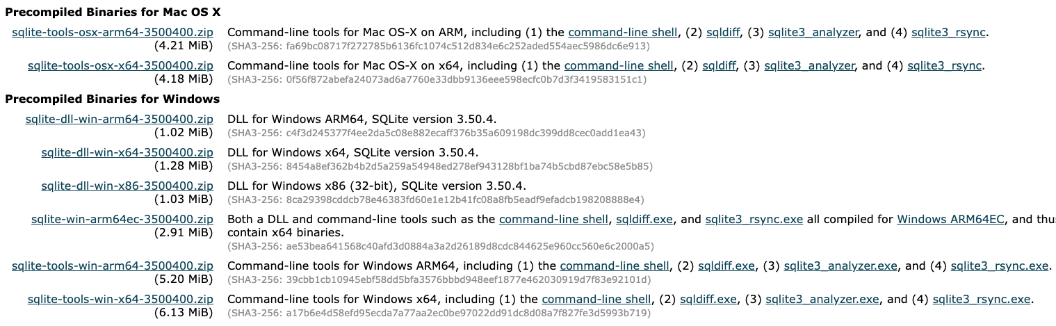
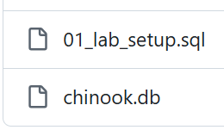
Installation (10 min)
The location of SQLite and database do not have to be the same.
Download SQLite https://www.sqlite.org/download.html
Download database: https://github.com/HAaron-hub/database-systems/tree/main/labs

Slide 7
SQLite Version Requirements
Core SQL is designed for SQLite 3.39 or later.
Feature | Minimum SQLite version | Classroom use
DROP COLUMN | 3.35.0 | Schema changes
RIGHT / FULL JOIN | 3.39.0 | Join practice
Direct NOT NULL / CHECK changes | 3.53.0 | Optional shortcut
DB Browser can embed a different engine version from your sqlite3 CLI.
Notes:
Session 1 / Setup. Sources: https://www.sqlite.org/lang_altertable.html ; https://www.sqlite.org/releaselog/3_39_0.html ; https://www.sqlite.org/releaselog/3_53_0.html

Slide 8
2 - Database Files and Commands
Notes:
Session 1 / Setup.

Slide 9

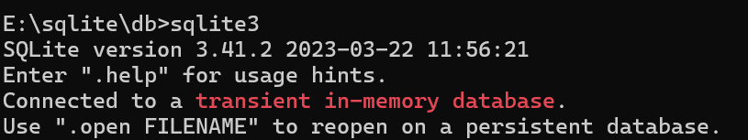
Opening SQLite
1 minute.
Open a terminal and change to the folder that contains the database files.
Open SQLite
Before you go, briefly show the TA that you’ve downloaded SQLite to receive your tutorial mark
Notes:
Session 1 / Setup. Sources: https://www.sqlite.org/cli.html

Slide 10
Opening and Inspecting a Database
A dot-command controls the sqlite3 program. It does not end with a semicolon.
.open lab_work.db
Open this file as main. A wrong path may create a new, empty database file.
.databases
Show every connected database and its exact file path.
.tables
List the tables in the current database.
.schema student
Show the CREATE statement that defines the student table.
SELECT COUNT(*) ...;
Run SQL in the database engine. The semicolon ends the SQL statement.
If .tables is unexpectedly empty, check .databases before doing anything else.
Notes:
Session 1 explanation. Source: https://www.sqlite.org/cli.html

Slide 11
Running the Setup Script
The setup file contains SQL statements that create and populate practice tables.
.read 01_lab_setup.sql
Read the named text file and execute its SQL in the current connection.
Run it once
Running the setup again may try to recreate tables or duplicate seed data.
SELECT COUNT(*)
Check that the setup produced the expected six student rows.
Path rule
If the script is in another folder, supply a relative or complete file path.
The .sql file is a script. lab_work.db is the database changed by that script.
Notes:
Session 1 explanation. Source: https://www.sqlite.org/cli.html

Slide 12
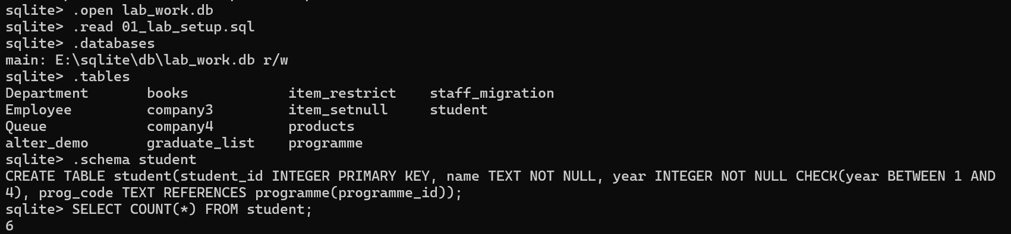
Opening the Two Lab Databases: 1. lab_work.db
5 minutes.
Create a NEW lab_work.db and run the supplied setup once.
.open lab_work.db
.read 01_lab_setup.sql
.databases
.tables
.schema student
SELECT COUNT(*) FROM student;
Expected: 6 students. Keep chinook.db separate for the music-store queries.
Notes:
Session 1 / Setup. Sources: https://www.sqlite.org/cli.html

Slide 13
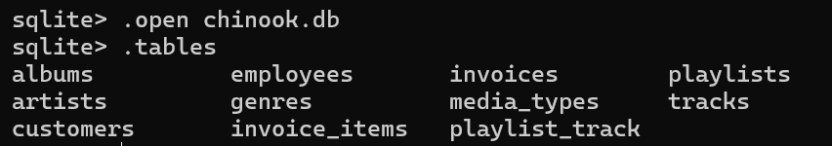
Opening the Two Lab Databases: 2. chinook.db
1 minute.
Download chinook.db here https://www.sqlitetutorial.net/sqlite-sample-database/
Open it with .open chinook.db, then use .tables.
Expected application tables include artists, albums, tracks and invoice_items.
Notes:
Session 1 / Setup. Sources: https://www.sqlitetutorial.net/sqlite-sample-database/

Slide 14
ATTACH: A Second Database in One Connection
ATTACH adds another database without replacing the database named main.
.open chinook.db
Open chinook.db as the main database for this connection.
ATTACH ... AS lab;
Connect lab_work.db and give it the temporary database name lab.
lab.student
The prefix selects the student table from the attached database lab.
DETACH DATABASE lab;
Remove the attached connection. The database file remains unchanged.
Use .databases to see the names main, temp and any attached database.
Notes:
Session 1 explanation. Source: https://www.sqlite.org/lang_attach.html

Slide 15
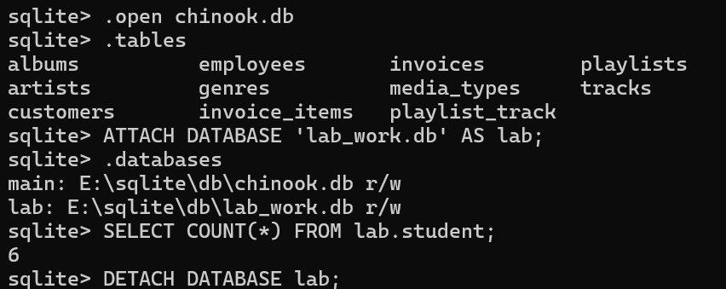
SQLite Shell Commands and SQL
5 minutes.
Dot-commands belong to sqlite3. SQL statements run in the database engine.
.open chinook.db
ATTACH DATABASE 'lab_work.db' AS lab;
.databases
SELECT COUNT(*) FROM lab.student;
DETACH DATABASE lab;
Use .open to replace the main connection; ATTACH adds another database to it.
Notes:
Session 1 / Setup. Sources: https://www.sqlite.org/cli.html

Slide 16
Output Commands and Their Scope
These dot-commands change how sqlite3 displays or saves query results.
.headers on
Include column names in the output.
.mode csv
Format subsequent query results as comma-separated values.
.once result.csv
Send only the next query result to this file, then return to the terminal.
.output result.csv
Send all following output to this file until the destination changes.
.output stdout
Restore output to the terminal window.
For one query, .once is safer because the redirection resets automatically.
Notes:
Session 1 explanation. Source: https://www.sqlite.org/cli.html

Slide 17
The sqlite> and ...> Prompts
The prompt shows whether sqlite3 is ready or waiting for more SQL text.
sqlite>
SQLite is ready for a new dot-command or SQL statement.
...>
The current SQL statement is incomplete, often because a semicolon, quote or parenthesis is missing.
;
Completes a SQL statement and asks SQLite to execute it.
Ctrl+C
Cancel unfinished input and return to the sqlite> prompt.
.quit
Close the sqlite3 program.
Dot-commands begin with a period and normally do not use a semicolon.
Notes:
Session 1 explanation. Source: https://www.sqlite.org/cli.html

Slide 18
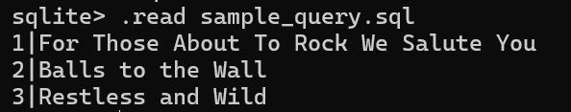
Reading a SQL File
Create the file in a text editor and save it as UTF-8.
-- Save this line in sample_query.sql:
SELECT AlbumId, Title FROM albums
ORDER BY AlbumId LIMIT 3;
-- At the sqlite3 prompt, run:
.read sample_query.sql
SQL statements end with a semicolon. Put each dot-command on its own line.
Notes:
Session 1 / Setup. Sources: https://www.sqlite.org/cli.html

Slide 19
Saving Query Output
3 minutes.
Run at the sqlite3 prompt while chinook.db is open.
.headers on
.mode csv
.output sample_output.csv
SELECT AlbumId, Title FROM albums ORDER BY AlbumId LIMIT 3;
.output stdout
For just the next query, use .once sample_output.csv instead.
Notes:
Session 1 / Setup. Sources: https://www.sqlite.org/cli.html

Slide 20
Practice 01: CLI Checkpoint
Database: chinook.db
1. List the open database files and the tables.
2. Inspect albums and return its first 2 rows by AlbumId.
3. Save those rows to CSV, then restore terminal output.
How to cancel an unfinished SQL statement？
Write, run and check: about 5 minutes.
Notes:
Session 1 / Setup. Allow 5 minutes for independent typing, execution and initial debugging. Review the following solution afterward.

Slide 21
Solution 01: CLI Checkpoint
.databases
.tables
.schema albums
.headers on
.mode csv
.once first_albums.csv
SELECT AlbumId, Title FROM albums ORDER BY AlbumId LIMIT 2;
.output stdout
At the ...> continuation prompt, Ctrl+C cancels the unfinished input. (“;” also works with errors)
.quit exits the CLI.
Notes:
Session 1 / Setup. Sources: https://www.sqlite.org/cli.html

Slide 22
3 - Output and Troubleshooting
Notes:
Session 1 / Setup.

Slide 23
DEMO: Formatting techniques on the terminal
Turn on/off the header of the output
  .header on OR .header off
Different outputting format on the terminal
  .mode column OR .mode csv OR .mode json
  OR any from below
Notes:
For TA: I WANT YOU TO demo all three and show results, use same chinook db

Slide 24
DEMO: Formatting techniques on the terminal
Width of the output
  .width NUM NUM -- Example: .width 12 -6
  .width -- resets width settings
Show all the format settings
  .show

Slide 25
DEMO: Other useful commands
To check all useful commands in SQL Lite (very useful)
  .help
Dump the database in an SQL text format
  .dump
Record the error log
  .log sample_log.txt
Time a query
  .timer on/off
For some other useful commands and usage you can refer to:
https://www.sqlite.org/cli.html
Notes:
For TA: I WANT YOU TO DEMONSTRATE ALL AND WHEN YOU’D USE IT with an example

Slide 26

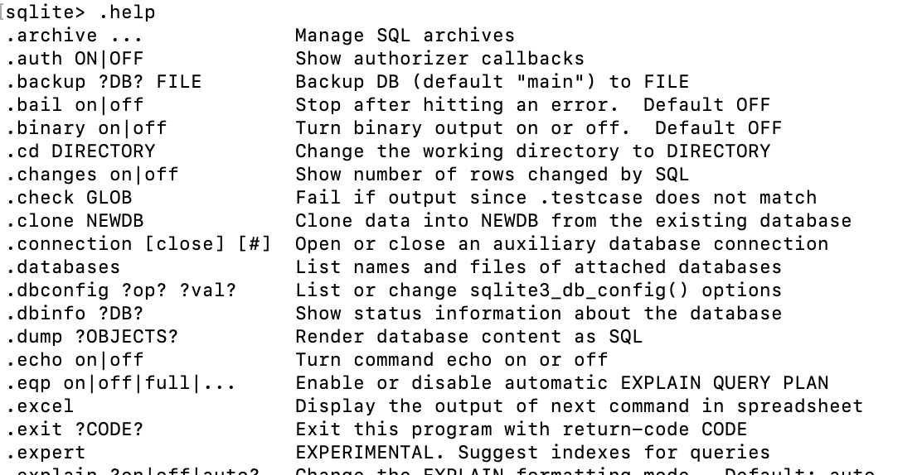
More commands?
Enter ".help" for usage hints:

Slide 27

Useful SQLite Shell Commands
5 minutes.
The diagnostic log is not a record of every SQL command you type.
.help
.schema albums
.log sample_log.txt
.timer on
SELECT COUNT(*) FROM tracks;
.timer off
.log off
.dump exports SQL text; .output redirects it to a file. Keep a copy of your own SQL script.
Notes:
Session 1 / Setup. Sources: https://www.sqlite.org/cli.html

Slide 28
4 - DB Browser for SQLite
Notes:
Session 1 / Setup.

Slide 29
Intro: DB Browser for SQLite (DB4S)
A high quality, visual, open-source tool designed for people who want to create, search, and edit SQLite or SQLCipher database files.
A different way to access the DBMS
  GUI (Graphical User Interface)
  CLI (Command Line Interface)
Notes:
Session 1 / Setup.

Slide 30
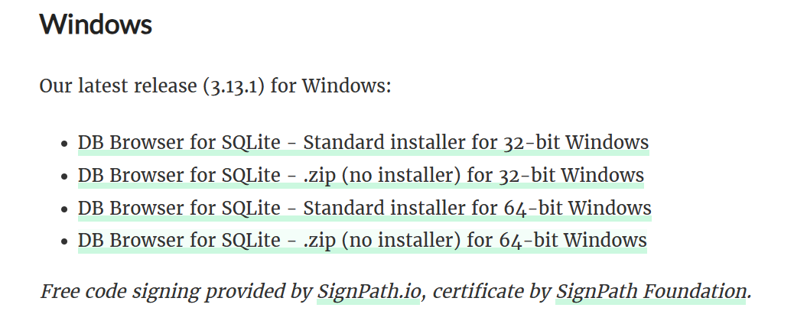
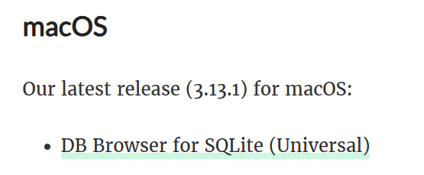
DB Browser Setup
10 minutes.
Download DB Browser https://sqlitebrowser.org/dl/.
Open the SAME lab_work.db or chinook.db used in the CLI.
Use Execute SQL to run SELECT sqlite_version();
The CLI and GUI versions can differ. Verify features in the tool you use.
OR:
brew install db-browser-for-sqlite
Notes:
Session 1 / Setup. Sources: https://github.com/sqlitebrowser/sqlitebrowser/wiki

Slide 31
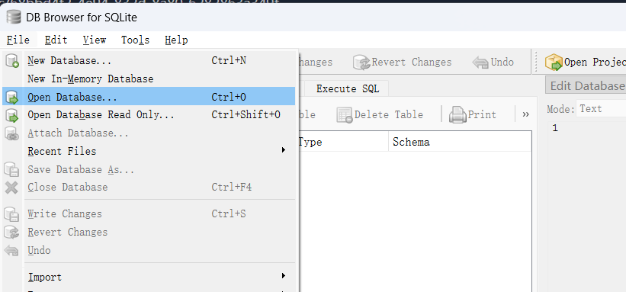
Demo: Access database via GUI
Open database file
[File] > [Open Database...] > select .db file
Use [File] > [Import] to import CSV or SQL files.
Notes:
Session 1 / Setup.

Slide 32
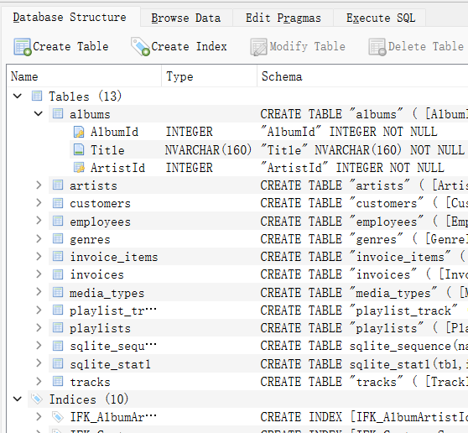
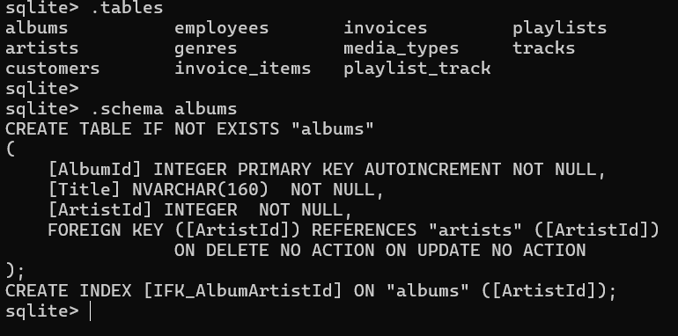
Demo: Access database via GUI
Inspect [Database Structure] tab
  should be the same as shown in command line
For more, refer to https://github.com/sqlitebrowser/sqlitebrowser/wiki
Notes:
Session 1 / Setup.

Slide 33
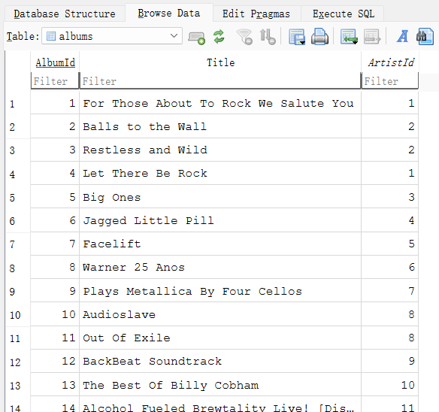
Demo: [Browse Data] tab
Browse Data shows rows in the selected table.
Sorting columns
  Click a column header to sort the table by the column values
  By multiple columns : Ctrl + click
Resizing columns width
Highlight columns
  Double click header
  Ctrl + Space (Windows)
For more, refer to https://github.com/sqlitebrowser/sqlitebrowser/wiki/Browse-Data
Notes:
Session 1 / Setup.

Slide 34
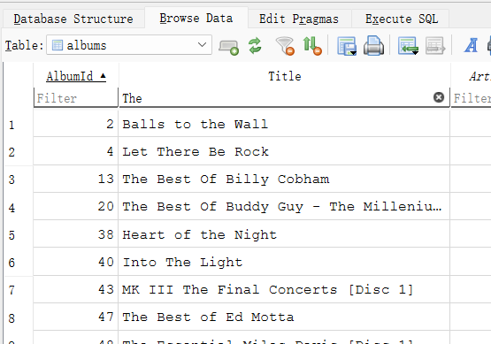
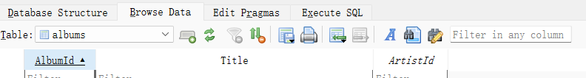
Demo: Filters in [Browse Data] tab
Using Filters to perform quick filters in current table
  default: sub-string match
  exact match: =
  wildcard: %
  operators: >, >=, <>
  range: 1~6
  Regular-expression
  Filters in any column
For more, refer to https://github.com/sqlitebrowser/sqlitebrowser/wiki/Using-the-Filters
Notes:
Session 1 / Setup.

Slide 35
One Database File, Two Connections
CLI and DB Browser can open the same file, but each program keeps its own connection.
Save or commit
The other program sees a change only after the writer completes its transaction.
Refresh
DB Browser may still show old rows until Browse Data is refreshed.
Write lock
Finish or revert GUI edits before the CLI writes, and finish CLI work before GUI edits.
Working copy
Use a copy of chinook.db so an accidental change can be discarded.
The file is shared. Connection state, transactions and the displayed rows are separate.
Notes:
Session 1 explanation. Source: https://www.sqlite.org/lockingv3.html

Slide 36
The Test Change Used in Practice 02
The practice adds one identifiable row, checks it in both tools, then removes it.
INSERT INTO albums ...
Add one row. Omitting AlbumId lets INTEGER PRIMARY KEY generate the ID.
last_insert_rowid()
Return the most recent generated row ID in this CLI connection.
DELETE ... WHERE ...
Remove only rows that satisfy the WHERE condition.
Automatic commit
Outside BEGIN, each successful statement commits and becomes visible after the GUI refreshes.
Do not run another INSERT in this connection before using last_insert_rowid() for the DELETE.
Notes:
Session 1 explanation. Sources: https://www.sqlite.org/lang_insert.html ; https://www.sqlite.org/c3ref/last_insert_rowid.html

Slide 37
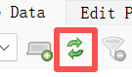
Case: CLI and GUI Share a File
Write, run and check: about 6 minutes.
Database: copy of chinook.db
1. Open a WORKING COPY of chinook.db in both tools.
2. From the CLI, add an album called Test album for ArtistId = 999.
INSERT INTO albums(Title, ArtistId) VALUES ('Test album', 999);
SELECT last_insert_rowid() AS new_album_id;
3. Refresh Browse Data in DB Browser and locate the new row.
4. Remove only that new row, then verify it disappeared.
DELETE FROM albums WHERE AlbumId = last_insert_rowid();
Notes:
Session 1 / Setup. Allow 4 minutes for independent typing, execution and initial debugging. Review the following solution afterward.

Slide 38
5 - Tables and Data Types
Work in lab_work.db for schema and update practice
Notes:
Session 1 / Tables and constraints.

Slide 39
Creating a SQLite Table
A table definition gives each column a name, declared type and constraints.
CREATE TABLE example (
id INTEGER PRIMARY KEY,
name TEXT NOT NULL,
price REAL CHECK (price > 0),
created_on TEXT DEFAULT CURRENT_DATE
);
CURRENT_DATE produces a UTC date in YYYY-MM-DD form.
Notes:
Session 1 / Tables and constraints. Sources: https://www.sqlite.org/lang_createtable.html ; https://www.sqlite.org/datatype3.html

Slide 40
How to Read a CREATE TABLE Statement
Read the statement from the table name down to each column rule.
CREATE TABLE example
Create a new table named example in the current database.
id INTEGER PRIMARY KEY
Column name, declared type and constraints appear in that order.
name TEXT NOT NULL
The column stores text and every row must supply a non-NULL value.
price REAL CHECK (...)
The CHECK expression must not evaluate to false for an inserted row.
Comma and semicolon
Commas separate definitions. The final semicolon ends the SQL statement.
The CREATE statement defines allowed data. It does not insert any rows.
Notes:
Session 1 explanation. Source: https://www.sqlite.org/lang_createtable.html

Slide 41
SQLite Types: Storage and Affinity
Concept | SQLite behavior
Storage classes | NULL, INTEGER, REAL, TEXT, BLOB
Declared type | Normally gives a preferred type (affinity)
BOOLEAN | No separate storage class; typically use 0 and 1
Dates | Store as TEXT, INTEGER or REAL by convention
VARCHAR(n), DECIMAL(p,s) | Length and decimal scale are not automatically enforced
These labs use INTEGER, REAL and TEXT. STRICT tables are an optional extension.
Notes:
Session 1 / Tables and constraints. Sources: https://www.sqlite.org/datatype3.html

Slide 42
Constraints Decide Whether a Row Is Accepted
SQLite evaluates the declared constraints when INSERT or UPDATE runs.
INTEGER PRIMARY KEY
Identifies one row uniquely and can generate an ID when the value is omitted.
NOT NULL
Rejects SQL NULL. An empty string is still a value.
DEFAULT
Supplies a value only when the column is omitted, not when NULL is written explicitly.
UNIQUE
Rejects a duplicate non-NULL value in that column or column group.
CHECK
Rejects false. A NULL result passes unless another constraint forbids NULL.
When an INSERT fails, read the first error message and identify the violated rule.
Notes:
Session 1 explanation. Source: https://www.sqlite.org/lang_createtable.html

Slide 43
Case: Employees Table
Database: lab_work.db
1. Create lab_employees with EmployeeID as INTEGER PRIMARY KEY.
2. FirstName, LastName and Email must not be NULL. Email must be UNIQUE.
3. Store HireDate as TEXT, defaulting to CURRENT_DATE.
4. Salary is REAL and defaults to 50000.
CREATE TABLE lab_employees (
EmployeeID INTEGER PRIMARY KEY,
FirstName TEXT NOT NULL,
LastName TEXT NOT NULL,
Email TEXT UNIQUE NOT NULL,
HireDate TEXT DEFAULT CURRENT_DATE,
Salary REAL DEFAULT 50000
);
Use .schema lab_employees or PRAGMA table_info(lab_employees); to inspect the definition.
Notes:
Session 1 / Tables and constraints. Allow 4 minutes for independent typing, execution and initial debugging. Review the following solution afterward.

Slide 44
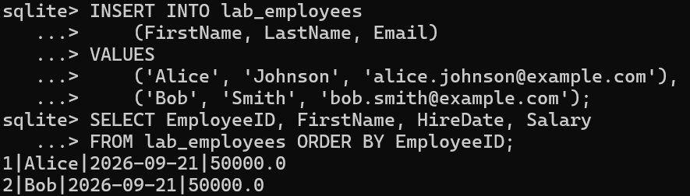
Inserting Multiple Rows
INSERT INTO lab_employees
(FirstName, LastName, Email)
VALUES
('Alice', 'Johnson', 'alice.johnson@example.com'),
('Bob', 'Smith', 'bob.smith@example.com');
SELECT EmployeeID, FirstName, HireDate, Salary
FROM lab_employees ORDER BY EmployeeID;
Each row gets an ID and the date/salary defaults. Run this INSERT once; repeating it violates
UNIQUE.
Notes:
Session 1 / Tables and constraints.

Slide 45
How INSERT Maps Values to Columns
The column list states exactly where each value will be stored.
INSERT INTO book
Choose the target table in the current database.
(title, isbn)
Name the destination columns. The order matters.
VALUES ('SQL Practice', ...)
Supply one value for each named column in the same order.
Omitted columns
SQLite uses a declared default; otherwise it uses NULL if the column allows it.
Multiple rows
Add comma-separated parenthesized value groups after VALUES.
A required column with no default must appear in the INSERT with a valid value.
Notes:
Session 1 explanation. Source: https://www.sqlite.org/lang_insert.html

Slide 46
Practice 04: Two CREATE TABLE Statements
5 minutes.
Database: lab_work.db
1. Create company and book using the specifications on the next slide.
2. Specify types and PRIMARY KEY, NOT NULL, UNIQUE, CHECK and DEFAULT
where needed.
3. Then inspect both table definitions.
Notes:
Session 1 / Tables and constraints. Allow 6 minutes for independent typing, execution and initial debugging. Review the following solution afterward.

Slide 47
Practice 04: Schema Specifications
5 minutes.
Use the name book consistently in this and the next practice.
Table | Columns and requirements
company | id: INTEGER PRIMARY KEY; name: required TEXT; address: optional TEXT; salary: required REAL > 0
book | book_id: INTEGER PRIMARY KEY; title: required TEXT; author and pub_date: optional TEXT; isbn: required UNIQUE TEXT; add_date: TEXT DEFAULT CURRENT_DATE
Example
CREATE TABLE lab_employees (
EmployeeID INTEGER PRIMARY KEY,
FirstName TEXT NOT NULL,
LastName TEXT NOT NULL,
Email TEXT UNIQUE NOT NULL,
HireDate TEXT DEFAULT CURRENT_DATE,
Salary REAL DEFAULT 50000
);
Notes:
Session 1 / Tables and constraints.

Slide 48
Solution 04: Company
CREATE TABLE company (
id INTEGER PRIMARY KEY,
name TEXT NOT NULL,
address TEXT,
salary REAL NOT NULL CHECK (salary > 0)
);
NOT NULL is required here: CHECK(salary > 0) alone would still permit NULL.
Table | Columns and requirements
company | id: INTEGER PRIMARY KEY; name: required TEXT; address: optional TEXT; salary: required REAL > 0
Notes:
Session 1 / Tables and constraints.

Slide 49
Solution 04: Book
CREATE TABLE book (
book_id INTEGER PRIMARY KEY,
title TEXT NOT NULL,
author TEXT,
pub_date TEXT,
isbn TEXT NOT NULL UNIQUE,
add_date TEXT DEFAULT CURRENT_DATE
);
pub_date and add_date use ISO date text. The default date is generated at insertion time.
Table | Columns and requirements
book | book_id: INTEGER PRIMARY KEY; title: required TEXT; author and pub_date: optional TEXT; isbn: required UNIQUE TEXT; add_date: TEXT DEFAULT CURRENT_DATE
Notes:
Session 1 / Tables and constraints.

Slide 50
Practice 05: Defaults and a Failed Insert
5 minutes.
Database: lab_work.db
1. Write one INSERT supplying all book columns.
book_id | title | author | pub_date | isbn | add_date
101 | SQLite Basics | Ada Chen | 2025-08-01 | 9780000000001 | 2026-09-01
2. Write one INSERT supplying only the required title and isbn.
title | isbn
SQLite Basics | 9780000000002
3. Attempt an INSERT supplying only book_id = 103.
book_id
103
4. Predict which statement fails and name the violated constraint.
Notes:
Session 1 / Tables and constraints. Allow 5 minutes for independent typing, execution and initial debugging. Review the following solution afterward.

Slide 51
Solution 05: Successful Inserts
INSERT INTO book
(book_id,title,author,pub_date,isbn,add_date)
VALUES
(101,'SQLite Basics','Ada Chen','2025-08-01',
'9780000000001','2026-09-01');
INSERT INTO book(title,isbn)
VALUES ('SQL Practice','9780000000002');
The second row gets an ID and current add_date; author and pub_date are NULL.
Notes:
Session 1 / Tables and constraints.

Slide 52
Solution 05: Expected Failure
-- Expected error: NOT NULL constraint failed: book.title
INSERT INTO book(book_id) VALUES (103);
-- Valid correction:
INSERT INTO book(book_id,title,isbn)
VALUES (103,'Query Patterns','9780000000003');
Both title and isbn are required. The error may report the first failed NOT NULL constraint.
Notes:
Session 1 / Tables and constraints.

Slide 53
6 - CHECK and Foreign Keys
Notes:
Session 1 / Tables and constraints.

Slide 54
Col. Constraints in SQLite
Sets additional restriction on the columns, the RDBMS will enforce the restrictions such that values that meet the conditions are permitted.
Constraints covered so far
  NOT NULL
  PRIMARY KEY
  UNIQUE
Constraints to mention today.
  CHECK (today)
  FOREIGN KEY (today)

Slide 55
What CHECK Can Enforce
CHECK expressions may compare multiple columns in the same row.
CHECK(price > 0) accepts NULL; add NOT NULL if NULL is forbidden.
CHECK(x IS NOT NULL) can test non-NULL, but NOT NULL states the intent clearly.
CHECK cannot contain a subquery, so use UNIQUE/PRIMARY KEY for uniqueness.
Notes:
Session 1 / Tables and constraints. Sources: https://www.sqlite.org/lang_createtable.html

Slide 56
CHECK: Read the Whole Definition
Already created by 01_lab_setup.sql. Inspect it rather than creating it again.
CREATE TABLE company3 (
id INTEGER PRIMARY KEY,
name TEXT NOT NULL CHECK (length(name) >= 5),
address TEXT,
salary REAL CHECK (salary > 0)
);
This example allows a NULL salary. Practice 04 company deliberately does not.
CREATE TABLE company (
id INTEGER PRIMARY KEY,
name TEXT NOT NULL,
address TEXT,
salary REAL NOT NULL CHECK (salary > 0)
);
Notes:
Session 1 / Tables and constraints.

Slide 57
CHECK Across Multiple Columns
Already created by the setup. REAL is adequate for this teaching example.
CREATE TABLE products (
product_id INTEGER PRIMARY KEY,
product_name TEXT NOT NULL,
list_price REAL NOT NULL,
discount REAL NOT NULL DEFAULT 0,
CHECK (list_price >= discount
AND discount >= 0 AND list_price >= 0)
);
For exact financial amounts, integer cents are an alternative to floating-point prices.
Notes:
Session 1 / Tables and constraints. Sources: https://www.sqlite.org/datatype3.html

Slide 58
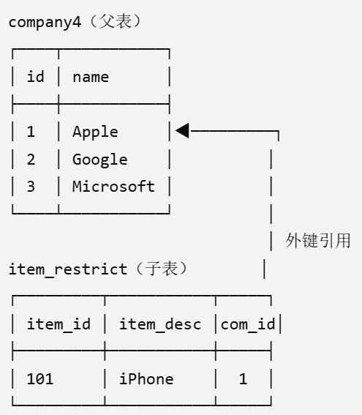
A Foreign Key Relationship
Both tables are already present in lab_work.db.
Parent
CREATE TABLE company4 (
id INTEGER PRIMARY KEY,
name TEXT NOT NULL
);
CREATE TABLE item_restrict (
item_id INTEGER PRIMARY KEY,
item_desc TEXT NOT NULL,
com_id INTEGER NOT NULL REFERENCES company4(id)
ON UPDATE RESTRICT ON DELETE RESTRICT
);
Foreign key reference
Child
The setup has parents 1, 2, 3 and one item referencing parent 1.
Notes:
Session 1 / Tables and constraints. Sources: https://www.sqlite.org/foreignkeys.html

Slide 59
Foreign Keys: Enable and Verify
Enable enforcement in EACH connection before starting a transaction.
PRAGMA foreign_keys = ON;
PRAGMA foreign_keys;
PRAGMA foreign_key_list(item_restrict);
PRAGMA foreign_key_check;
Open
Return open status 0/1
Return foreign key name
Check and return error
Expect 1 from foreign_keys and no rows from foreign_key_check. Do not rely on a default setting.
Notes:
Session 1 / Tables and constraints. Sources: https://www.sqlite.org/foreignkeys.html

Slide 60
A Routine for Predicting Constraint Results
Read the actual table definition, then test the proposed change in this order.
1. Required values
Does every NOT NULL column receive a non-NULL value?
2. Row checks
Does each CHECK expression evaluate to true or NULL?
3. Identity
Does the PRIMARY KEY or UNIQUE value already exist?
4. Relationships
Does every non-NULL foreign key match a parent row?
5. Parent changes
What does ON DELETE or ON UPDATE require for existing child rows?
A constraint error can be the expected result. Record which rule caused it.
Notes:
Session 1 explanation. Sources: https://www.sqlite.org/lang_createtable.html ; https://www.sqlite.org/foreignkeys.html

Slide 61
Practice 06: Constraint Predictions
Database: lab_work.db
1. For company3, try name = cool and salary = 10. Then try name = Alpha and
salary = 0.
2. Try name = Alpha and salary = NULL. Explain the result.
3. Insert an item_restrict row with com_id = 4.
4. Delete company4 id = 1, which has a child item.
Write, run and check: about 6 minutes.
Notes:
Session 1 / Tables and constraints. Allow 6 minutes for independent typing, execution and initial debugging. Review the following solution afterward.

Slide 62
Solution 06: Predict Before Running
INSERT INTO company3 VALUES(10,'cool','X',10);
-- Fails: length(name) >= 5.
INSERT INTO company3 VALUES(11,'Alpha','X',0);
-- Fails: salary > 0.
INSERT INTO company3 VALUES(12,'Alpha','X',NULL);
-- Succeeds: CHECK accepts a NULL result.
INSERT INTO item_restrict VALUES(10,'Test',4);
-- Fails: parent 4 does not exist.
DELETE FROM company4 WHERE id = 1;
-- Fails: RESTRICT protects the referenced parent.
Notes:
Session 1 / Tables and constraints. Sources: https://www.sqlite.org/foreignkeys.html ; https://www.sqlite.org/lang_createtable.html

Slide 63
A Routine for Predicting Constraint Results
Read the actual table definition, then test the proposed change in this order.
1. Required values
Q. Does every NOT NULL column receive a non-NULL value?
A. Every NOT NULL column must receive a non-NULL value.
2. Row checks
Q. Does each CHECK expression evaluate to true or NULL?
A. Every CHECK expression must evaluate to TRUE or NULL; FALSE causes a constraint error.
3. Identity
Q. Does the PRIMARY KEY or UNIQUE value already exist?
A. PRIMARY KEY and UNIQUE values must not duplicate an existing value.
4. Relationships
Q. Does every non-NULL foreign key match a parent row?
A. Every non-NULL foreign key must match an existing parent row.
5. Parent changes
Q. What does ON DELETE or ON UPDATE require for existing child rows?
A. Changes to a parent row must follow the specified ON DELETE or ON UPDATE action for existing child rows.
A constraint error can be the expected result. Record which rule caused it.
Notes:
Session 1 explanation. Sources: https://www.sqlite.org/lang_createtable.html ; https://www.sqlite.org/foreignkeys.html

Slide 64
Foreign Key Action: RESTRICT
A referenced parent cannot be deleted.
A referenced parent key cannot be updated.
An unrelated parent is not blocked by this child relationship.
The setup item_restrict row references company4 id = 1.
Notes:
Session 1 / Tables and constraints. Sources: https://www.sqlite.org/foreignkeys.html

Slide 65
Foreign Key Action: SET NULL
Already created by the setup, with an item referencing company4 id = 2.
com_id MUST allow NULL.
Foreign Key Action | Deleting Parent Record
RESTRICT | Not allowed
SET NULL | Allowed, but foreign key change to NULL
Notes:
Session 1 / Tables and constraints. Sources: https://www.sqlite.org/foreignkeys.html

Slide 66
7 - Changing a Table Schema
Notes:
Session 1 / Schema changes.

Slide 67
SQLite ALTER TABLE
ALTER TABLE allows you to modify the definition of existing table
  Add / drop columns
  Add / drop constraints
  Rename table or column
  Change column data types
  SQLite only supports a limited subset of ALTER TABLE
    rename, add/drop columns

Slide 68
Alter Table or Column Name
Rename Table
  ALTER TABLE old_table_name
  RENAME TO new_table_name;
Rename Column
  ALTER TABLE table_name
  RENAME COLUMN old_column_name TO new_column_name;
Adding a New Column
  ALTER TABLE table_name ADD column_name datatype [DEFAULT default_value];
  Newly added columns are filled with NULL values (default values).

Slide 69
Leading Question
We already have an existing table but need to make further alterations to its schema
  M: are there any limitations or possible restrictions when adding columns?
Notes:
Is the only option to delete the table and then rebuild it?
If so, that would necessitate a data migration.

Slide 70
Adding Columns
Some restrictions when adding new columns to an existing table in SQLite
  New column may not have a PRIMARY KEY or UNIQUE constraint
  New column with a NOT NULL constraint must have a default value
  New column with a REFERENCES clause must have a default value of NULL
Etc.
Migration: how to create a new column with a default value of CURRENT_TIME? (or CURRENT_DATE, CURRENT_TIMESTAMP)

Slide 71
Deleting Columns
Same context: make alterations to an existing schema (with data)
  M: are there any limitations or possible restrictions when removing columns?
Delete Column
  ALTER TABLE table_name DROP COLUMN column_name;
  M: When might the DROP COLUMN command fail? Try it (2 min)
Notes:
Try

Slide 72
Restrictions on DROP COLUMN
Column is PRIMARY KEY (or part of)
Column has UNIQUE constraint
Column used in FOREIGN KEY constraint
Column named in table or column CHECK constraint not associated with column being dropped (Recall last week's example)
  CREATE TABLE products (
  product_id INTEGER PRIMARY KEY,
  product_name TEXT NOT NULL,
  list_price DECIMAL (10, 2) NOT NULL,
  discount DECIMAL (10, 2) NOT NULL DEFAULT 0,
  CHECK (list_price >= discount AND discount >= 0 AND list_price >= 0)
  );

Slide 73
Change Column Attributes - ALTER TABLE
Same context: make alterations to an existing schema (already with data)
  M: are there any limitations or possible restrictions when updating columns?
SQL syntax for modifying the data type of a column:
  ALTER COLUMN column_name datatype;
Note: SQLite does not support modifying datatype of an existing column by ALTER TABLE.
  You can only implement it by rebuild.
    Create a new table and define new column data types you require
    Copy the data from the old table to the new table
    Delete old table
    Rename new table to name of old table

Slide 74
DEMO SQLite: Changing Col. Type
Goal: Changing publication_year from TEXT to INTEGER datatype
0. Initial table creation
  CREATE TABLE books(
  book_id INTEGER PRIMARY KEY,
  title TEXT NOT NULL,
  publication_year TEXT
  );
  INSERT INTO books (book_id, title, publication_year) VALUES (0, 'a', '2013');
  INSERT INTO books (book_id, title, publication_year) VALUES (1, 'b', '2014’);
View table structure:
  .schema <TABLE_NAME> or PRAGMA table_info(TABLE_NAME);

Slide 75
DEMO A SQLite: Changing Col. Type
Goal: Changing publication_year from TEXT to INTEGER datatype
1. Create new table and define new column data types you require
  CREATE TABLE books_new(
  book_id INTEGER PRIMARY KEY,
  title TEXT NOT NULL,
  publication_year INTEGER
  );

Slide 76
DEMO SQLite: Changing Col. Type
Goal: Changing publication_year from TEXT to INTEGER datatype
2. Copy data from old table to new table.
  INSERT INTO books_new (book_id, title, publication_year)
  SELECT * FROM books;
M: Think about potential pitfalls are here?

Slide 77
DEMO SQLite: Changing Col. Type
Goal: Changing publication_year from TEXT to INTEGER datatype
2. Copy data from old table to new table.
  INSERT INTO books_new (book_id, title, publication_year)
  SELECT book_id, title, CAST(publication_year AS INTEGER)
  FROM books;
M: When copying data, if the original column type is different from the new column type, you can use a type conversion (CAST) in INSERT INTO

Slide 78
DEMO SQLite: Changing Col. Type
Goal: Changing publication_year from TEXT to INTEGER datatype
3. Delete old table
DROP TABLE books;
4. Rename the new table to the name of the old table.
ALTER TABLE books_new RENAME TO books;
M: Success! In this case, we changed the data type only (a column attribute); constraints are also another type of column attribute. How might we change that?
Notes:
what

Slide 79
Summary of Table Modification - SQLite
Operation | Directly Supported? | Solution
Rename Table | Yes | ALTER TABLE RENAME TO
Rename Column | Yes | ALTER TABLE RENAME COLUMN.
Add Column | Yes | ALTER TABLE ADD COLUMN.
Remove Column | Yes | ALTER TABLE DROP COLUMN.
Change Data Type | No | Create a new table with the desired data type and migrate data (use CAST if necessary).
Add / Remove Constraints | No | Create a new table with the constraints and ensure data complies before migration.

Slide 80
8 - Querying and Updating Rows
Notes:
Session 1 / Basic queries and changes.

Slide 81
Student Data for the Next Examples
The setup also contains programme and graduate_list (student_id = 1116).
student_id | name | year | prog_code
1111 | Chan Ada | 1 | CS
1112 | Ben Lee | 1 | DS
1113 | Chan Cara | 2 | CS
1114 | Dev Wu | 3 | EE
1115 | Eli Lin | 3 | NULL
1116 | Fay Ho | 4 | DS
Use lab_work.db. NULL denotes a missing value, not the literal text "NULL".
Notes:
Session 1 / Basic queries and changes.

Slide 82
SELECT, WHERE and DISTINCT
SELECT student_id, name
FROM student
WHERE year > 1 AND name LIKE 'Chan%';
SELECT DISTINCT year FROM student ORDER BY year;
Expected: (1113, Chan Cara). Distinct years: 1, 2, 3, 4.
Notes:
Session 1 / Basic queries and changes.

Slide 83
ORDER BY
Use ORDER BY for a defined output order; ASC is the default.
SELECT student_id, name, year FROM student
ORDER BY student_id DESC;
SELECT name, year FROM student
ORDER BY name ASC, year ASC;
For a stable tie-break, add a unique key to the ORDER BY list.
Notes:
Session 1 / Basic queries and changes. Sources: https://www.sqlite.org/lang_select.html

Slide 84
UPDATE: Check the Target Rows
BEGIN;
UPDATE student SET name = 'XYZ', year = 2
WHERE student_id = 1111;
SELECT * FROM student WHERE student_id = 1111;
ROLLBACK;
Removing WHERE would update every row. ROLLBACK restores the dataset for later questions.
Notes:
Session 1 / Basic queries and changes.

Slide 85
DELETE: Rows versus the Table
BEGIN;
DELETE FROM student
WHERE student_id IN (SELECT student_id FROM graduate_list);
SELECT COUNT(*) FROM student; -- 5
ROLLBACK;
-- DELETE FROM student; removes all rows, not the schema.
SQLite has no TRUNCATE statement. Avoid assuming a fixed performance difference.
Notes:
Session 1 / Basic queries and changes. Sources: https://www.sqlite.org/lang_select.html

Slide 86
Views in SQLite
A view stores a SELECT definition; it is not a materialized temporary table.
CREATE VIEW year2_students AS
SELECT student_id, name FROM student WHERE year = 2;
SELECT * FROM year2_students;
DROP VIEW year2_students;
CREATE VIEW year2_students AS
SELECT student_id, name, year FROM student WHERE year = 2;
To change the definition here, DROP then CREATE the view.
Notes:
Session 1 / Basic queries and changes. Sources: https://www.sqlite.org/lang_createview.html

Slide 87
Practice 10: Filter, Update and Undo
Database: lab_work.db
1. Return CS students ordered by student_id.
2. Within a transaction, increase their year by 1.
3. Check the two changed rows, then ROLLBACK.
4. Verify that later practice still starts with the original six students.
Write, run and check: about 5 minutes.
Notes:
Session 1 / Basic queries and changes. Allow 5 minutes for independent typing, execution and initial debugging. Review the following solution afterward.

Slide 88
Solution 10: Filter, Update and Undo
SELECT student_id,name,year FROM student
WHERE prog_code = 'CS' ORDER BY student_id;
BEGIN;
UPDATE student SET year = year + 1 WHERE prog_code = 'CS';
SELECT student_id,year FROM student
WHERE prog_code = 'CS' ORDER BY student_id;
ROLLBACK;
During the transaction: (1111,2), (1113,3). After rollback: years 1 and 2.
Notes:
Session 1 / Basic queries and changes.

Slide 89
Session 1 Checkpoint
You can open the intended file and distinguish SQL from dot-commands.
You can create tables, insert rows and explain expected constraint failures.
You can migrate a simple schema without losing rows.
You can select, sort, update and delete rows with a clear target.
Save your scripts. Keep chinook.db unchanged for Session 2.
Notes:
Session 1 / Basic queries and changes.

