Slide 1
Machine learning in biology
Week 1: and an introduction to foundation models
Dr Haithem Afli
Department of Computer Science
Haithem.afli@mtu.ie
Notes:
Welcome. Establish three things in the first ten minutes: what the module is, that it is assessed entirely by coursework, and that there is no lab this week. Everything else can wait.

Slide 2
This lecture
Roughly two hours, with two short videos and one interactive activity.
• Part 1 Welcome and module orientation
• Part 2 Why machine learning for biology, healthcare and nutrition
• Part 3 What machine learning is: the vocabulary and the workflow
• Part 4 From a generic example to a biological one
• Part 5 Foundation models, conceptually
• Part 6 Cost, sustainability and choosing the right size of model
COMP9085 Machine Learning in Biology - Haithem.afli@mtu.ie · 2
Notes:
Retained from slide 2 of the original deck. Flag now that the credit-scoring example in Part 4 is deliberate and brief, and that it turns into a cancer-diagnosis problem within two slides.

Slide 3
Welcome and module orientation
Part 1 · What this module is, and how it works
COMP9085 Machine Learning in Biology - Haithem.afli@mtu.ie · 3

Slide 4
Your lecturer
• Dr Haithem Afli, Department of Computer Science, MTU
• Principal Investigator, national ADAPT Centre; ADAPT lead at MTU
• Lead of the Human-Centred AI research group
• Research: natural language processing, trustworthy and explainable AI, machine learning for biology and the social sciences
• Chair of the Computer Science postgraduate research board
• IEEE Senior Member; ACM and ACL member
• Several themes in this module, particularly Week 12 on trust and evaluation, come directly out of that research
COMP9085 Machine Learning in Biology - Haithem.afli@mtu.ie · 4
Notes:
Compressed from slide 3 of the original, which carried eleven logos. Keep it to ninety seconds; the point is credibility and where the module's opinions come from, not a CV.

Slide 5
The module
Code and title | COMP9085 Machine Learning in Biology
Credits and level | 5 credits, NFQ Level 9 (MSc)
Contact | 2 h lecture + 2 h laboratory each week
Independent study | About 3 h each week
Assessment | Coursework only. Project 1 (50%) and Project 2 (50%)
Examination | None
Reassessment | Resubmitted coursework only
Descriptor | courses.cit.ie · moduleId 15193
COMP9085 Machine Learning in Biology - Haithem.afli@mtu.ie · 5
Notes:
From slides 5 and 6. The descriptor link is on the website footer so students can find it later.

Slide 6
Learning outcomes
Unchanged from the approved module descriptor.
• LO1 Analyse machine learning workflows to facilitate pre-processing, dimensionality reduction and model selection
• LO2 Compare and apply appropriate machine learning algorithms to specific biological datasets
• LO3 Develop supervised machine learning models for classification tasks
• LO4 Develop unsupervised machine learning models for clustering tasks
• LO5 Evaluate the accuracy of predictive models using standard methods and interpret their results
COMP9085 Machine Learning in Biology - Haithem.afli@mtu.ie · 6
Notes:
Worth saying explicitly that these are the approved outcomes and that the foundation-model content sits inside LO2 and LO1 rather than replacing anything. Students sometimes ask whether the module has been rewritten; it has been modernised, and the outcomes are the same.

Slide 7
Assessment
Unchanged from the approved descriptor. Marks are for the reasoning, not for the tool: using a foundation model earns nothing on its own.
 | Weight | What it asks of you
Project 1: supervised biological machine learning | 50% | Build, tune and honestly evaluate a supervised model on biological or clinical data
Project 2: unsupervised biological machine learning | 50% | Find structure in unlabelled biological data, and show it is not an artefact
Written examination | None | The module is assessed entirely by coursework
COMP9085 Machine Learning in Biology - Haithem.afli@mtu.ie · 7
Notes:
Say the last sentence out loud. Every year a few submissions assume that calling a pretrained model is itself the contribution. The marks are for the justification, the evaluation and the honesty about limitations. Both briefs are on the website and on Canvas from today.

Slide 8
How the parts fit together
One copy of the teaching material, linked from Canvas, rather than two copies that drift apart.
Each week
Where things live
• Lecture, two hours. Slides on Canvas and the website beforehand, as PowerPoint and PDF
• Website: concepts, worked example, an interactive figure you manipulate, a self-check
• Laboratory, two hours, from Week 2
• One recommended reading, chosen because it is the most useful thing to read at that point
• Teaching material: the course website
• Announcements, submission and grades: Canvas
• Slides: both, as PPTX and PDF
• Your weekly check-in: your own browser, private to you
COMP9085 Machine Learning in Biology - Haithem.afli@mtu.ie · 8
Notes:
Emphasise that the website figures are live models, not screenshots. Students consistently under-use them because they assume they are pictures.

Slide 9
There is no laboratory in Week 1.
The first practical is in Week 2, once you have the decision-tree material to work with. Before then: install Python, watch the two videos, read Greener et al. (2022). None of it is assessed.
COMP9085 Machine Learning in Biology - Haithem.afli@mtu.ie · 9
Notes:
Say this twice. It appears on the website too. Students who miss it turn up to a lab that does not exist, or worse, assume they have missed an assessment.

Slide 10
Software and resources
Retained from the original resources slides.
• Python 3 with NumPy, pandas, scikit-learn, Matplotlib, seaborn
• Jupyter for the labs
• Nothing in this module needs a GPU
• Install before Week 2 so the first lab starts with the material
  – pip install numpy pandas scikit-learn matplotlib seaborn jupyter
• UCI Machine Learning Repository, CDC NHANES, openFDA and the NCI Genomic Data Commons are the main data sources
• The full list, with links, is on the resources page of the website
COMP9085 Machine Learning in Biology - Haithem.afli@mtu.ie · 10
Notes:
From slides 7 to 9. Do not spend long here; point at the resources page and move on. Offer help at the end of the lecture for anyone whose install fails.

Slide 11
Why machine learning for biology, healthcare and nutrition
Part 2 · The data, and why it is difficult
COMP9085 Machine Learning in Biology - Haithem.afli@mtu.ie · 11

Slide 12
The biological data landscape
Recognising which kind of problem you have decides everything downstream.
Five families of data, five different problems
Genomics
long discrete sequences
Proteomics
sequence with 3-D consequences
Medical imaging
high-dimensional pixel grids
Clinical records
sparse, irregular, confounded
Nutrition
self-reported, high error
→
→
→
→
COMP9085 Machine Learning in Biology - Haithem.afli@mtu.ie · 12
Notes:
Ask the room which of these they work with. It is usually a wide spread, and it sets up why the module keeps returning to 'what representation does this problem need'.

Slide 13
Why these domains are harder than the usual benchmarks
None of this is a reason not to do it. All of it is a reason to evaluate carefully.
• Small n, large p. Hundreds of samples, tens of thousands of features
• Labels are expensive, and are often a clinician's judgement rather than a measurement
• Rows are not independent: several samples come from one patient, one site, one batch
• Measurement error is substantial and systematic, not random noise
• The two kinds of error almost never cost the same
• Populations are unevenly represented, and the gaps are rarely recorded
• A model that is accurate and unusable is a common outcome
COMP9085 Machine Learning in Biology - Haithem.afli@mtu.ie · 13
Notes:
This slide is new. It is the honest framing that the original deck did not have, and it justifies why Weeks 3 and 12 exist.

Slide 14
Try this interactively
Watch: Biology Meets Computer Science
What is it about modern biological data that makes computation necessary rather than merely convenient?
Quanta Magazine · 3 min 46 s · on the Week 1 page
Open the week page on the
course website and scroll to
Interactive exploration.
COMP9085 Machine Learning in Biology - Haithem.afli@mtu.ie · 14
Notes:
Original slide 38. Play it here rather than at the end: it motivates the whole module before any algorithm appears. The website embeds the same video from Quanta's YouTube channel.

Slide 15
What machine learning is
Part 3 · Vocabulary, workflow, generalisation
COMP9085 Machine Learning in Biology - Haithem.afli@mtu.ie · 15

Slide 16
Machine learning
Fitting a function from data rather than specifying it by hand.
The data, not the programmer, determines the rule. Everything else in this module is a consequence of that one sentence.
COMP9085 Machine Learning in Biology - Haithem.afli@mtu.ie · 16
Notes:
From slide 12. Keep the definition this short; the vocabulary slides that follow do the work.

Slide 17
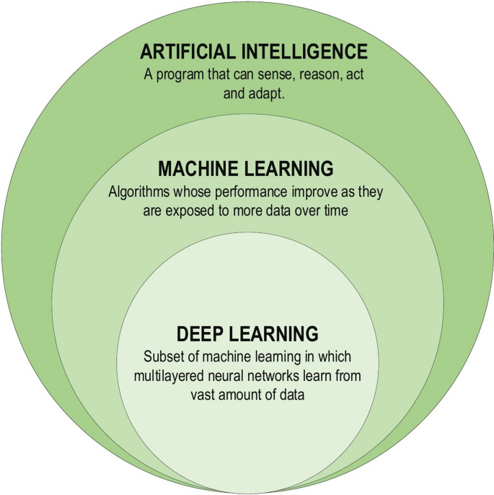
Where machine learning sits
Artificial intelligence contains machine learning, which contains deep learning. Foundation models are deep learning at a scale that changes what is practical, not a fourth ring.
Figure retained from the 2025/26 COMP9085 Week 1 deck (slide 11).
COMP9085 Machine Learning in Biology - Haithem.afli@mtu.ie · 17
Notes:
Retained from the original deck. The useful question to ask here: which ring does a decision tree live in? Answer: the middle one. Students often assume everything modern is deep learning, and eight of the twelve weeks are not.

Slide 18
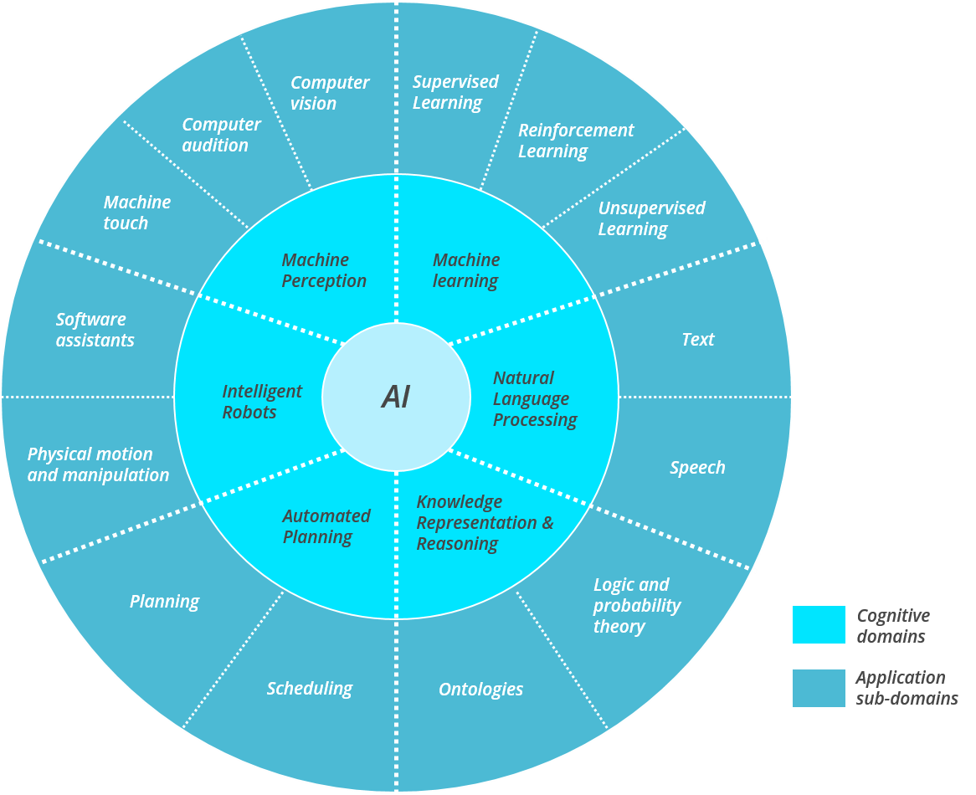
Artificial intelligence: the domains
Machine learning is one cognitive domain of AI among several. This module is the inner segment marked machine learning, and the application sub-domains it reaches in biology.
Figure retained from the 2025/26 COMP9085 Week 1 deck (slides 4 and 11).
COMP9085 Machine Learning in Biology - Haithem.afli@mtu.ie · 18
Notes:
Retained from the original deck; it is the clearest picture in it. Point out that supervised, unsupervised and reinforcement learning are siblings on this wheel, and that this module covers the first two.

Slide 19
Step 1: building a machine-learning solution
D = [(d₁, t₁), (d₂, t₂), ... , (dₙ, tₙ)]
M = Learn(D)
A training dataset D pairs each instance description d with its target value t. A learning algorithm consumes D and returns a model M.
d the descriptive features of one instance: the measurements you have
t the target feature: what you are trying to predict
D the training dataset, n such pairs
M the fitted model, the output of learning
COMP9085 Machine Learning in Biology - Haithem.afli@mtu.ie · 19
Notes:
Retained from slides 25 and 26 with the original notation. Students find the two-step framing genuinely clarifying, and it pays off in Week 3 when the split boundary matters.

Slide 20
Step 2: deploying a machine-learning solution
t = M(q)
A query instance q, described by the same features, is passed to the fitted model, which returns a prediction t.
q a new instance the model has never seen
M the model fitted in step 1
t the prediction: a class, or a value
COMP9085 Machine Learning in Biology - Haithem.afli@mtu.ie · 20
Notes:
Slides 30 and 31. Emphasise that building and deploying are distinct, because Week 3's leakage material is entirely about what may cross between them.

Slide 21
The vocabulary, precisely
• Feature (descriptive feature): an input column
• Label (target feature): what you are predicting
• Training data: the examples the algorithm learns from
• Model: the function produced by learning
• Prediction: the model applied to a new instance
• Generalisation: performance on data the model has never seen
• Evaluation: measuring generalisation honestly, which is harder than it sounds and is the subject of Weeks 3 and 12
COMP9085 Machine Learning in Biology - Haithem.afli@mtu.ie · 21
Notes:
Slide 40. This is the terminology that recurs every week.

Slide 22
The three task types you will build
LO3 is the first row, LO4 is the third. The second is supervised learning with a continuous target and is treated alongside it.
Task | The label is | A biological example | Weeks
Classification | one of a fixed set of classes | Is this breast-mass biopsy benign or malignant? | 2-6, 8, 10-11
Regression | a number on a continuous scale | Predict a patient's HbA1c from dietary recall data | 3, 10
Clustering | not given at all | Which tumour subtypes are present in this expression matrix? | 7, 9
COMP9085 Machine Learning in Biology - Haithem.afli@mtu.ie · 22
Notes:
Ask the room for a fourth example of each before showing the column. The distinction that causes the most trouble later is regression versus classification on a thresholded measurement: predicting HbA1c is regression, predicting diabetic or not from the same measurement is classification, and the choice changes the loss, the metric and the failure mode.

Slide 23
Generalisation is the only thing that matters.
A model that reproduces its training data perfectly and fails on a new patient has learned nothing useful. Week 3 measures this properly; Week 12 asks whether the measurement can be believed.
COMP9085 Machine Learning in Biology - Haithem.afli@mtu.ie · 23
Notes:
Slide 32 made this point with the Sean Murphy example. The statement stands on its own.

Slide 24
Categories of machine learning
Retained from slides 41 to 44, with the examples made biological.
By supervision
By what you are asking for
• Supervised: every example is labelled. Classification predicts a category, regression predicts a quantity
• Unsupervised: no labels. Find structure
• Semi-supervised: a little labelled data, a lot unlabelled. The common situation in biology
• Reinforcement: learning from interaction and reward. Not covered in this module
• Classification: benign or malignant
• Regression: serum vitamin D in nmol/L
• Clustering: are there subtypes in these tumours?
• Dimensionality reduction: 20,000 genes into a few useful axes
• Representation learning: learn the features rather than choose them
COMP9085 Machine Learning in Biology - Haithem.afli@mtu.ie · 24
Notes:
The right-hand column is the version students actually use when framing their own projects. Point at the ML Problem Classifier activity on the website.

Slide 25
Prediction is not explanation
A model can predict an outcome accurately while encoding no causal mechanism.
The two goals need different evidence. Conflating them is the most common error in applied biological machine learning, and it is the error this module works hardest to prevent.
COMP9085 Machine Learning in Biology - Haithem.afli@mtu.ie · 25
Notes:
New. This is the sentence to repeat in Weeks 9, 10 and 12.

Slide 26
Try this interactively
What type of ML problem is this?
Eight real biological scenarios. Classify each one, then read why the tempting wrong answer is tempting.
weeks/week01.html · Interactive exploration
Open the week page on the
course website and scroll to
Interactive exploration.
COMP9085 Machine Learning in Biology - Haithem.afli@mtu.ie · 26
Notes:
Run two or three scenarios live, take answers from the room, then let them finish it themselves. The RNA-seq subtype one and the ESM-2 embedding one produce the most useful arguments.

Slide 27
From a generic example to a biological one
Part 4 · Why we start with loans and finish with tumours
COMP9085 Machine Learning in Biology - Haithem.afli@mtu.ie · 27

Slide 28
A small, deliberately generic example
Six applicants. Can you write a rule that separates those who repay from those who default?
Applicant | Occupation | Age | Loan | Loan-salary ratio | Outcome
Pierre Lundi | professional | 36 | 20,000 | 3.22 | ?
Astrid Karlsson | professional | 41 | 15,000 | 4.64 | ?
Mary Smyth | industrial | 34 | 50,000 | 2.96 | ?
Heidi Fischer | industrial | 61 | 5,000 | 2.52 | ?
Klaus Haller | professional | 37 | 60,000 | 1.51 | ?
Luis Lopez | industrial | 33 | 6,000 | 5.25 | ?
COMP9085 Machine Learning in Biology - Haithem.afli@mtu.ie · 28
Notes:
Retained from slides 17 to 24, compressed from eight slides to two. Take answers. Someone will propose 'ratio above 3 means default' within a minute, and they will be roughly right.

Slide 29
Now make it twenty-five rows and seven features.
Do not attempt this by hand. The original slide carries the instruction: 'don't actually ask them to do this one - the point here is that this is hard!' That difficulty is the entire argument for machine learning.
COMP9085 Machine Learning in Biology - Haithem.afli@mtu.ie · 29
Notes:
The original speaker note on slide 34 reads exactly: "don't actually ask them to do this one - the point here is that this is hard!" Show the 25-row table for about ten seconds, let the room feel it become impossible, and move on. Do not let anyone start solving it.

Slide 30
Now change the columns and keep the structure
The machine-learning problem is identical. Everything around it is not.
The generic example | The biological version
Loan applicant | Breast-mass biopsy from one patient
Occupation, age, loan-salary ratio | Nuclear radius, texture, concavity: 30 measurements
Repaid or defaulted | Benign or malignant
A wrong decision costs money | A false negative is a missed cancer
Data is abundant and cheaply labelled | Labels need a pathologist or a five-year follow-up
Nobody asks who is in the dataset | Who is in the dataset determines who the model works for
COMP9085 Machine Learning in Biology - Haithem.afli@mtu.ie · 30
Notes:
This is the pivot of the whole lecture. The algorithm is the easy part; the surrounding judgement is the module. From Week 2 onwards every example is biological, clinical or nutritional.

Slide 31
The algorithms are the easy part.
Where the measurements came from, how reliable they are, who is in the data, what each error costs, and what you would have to show before anyone should act on the output. That is the module.
COMP9085 Machine Learning in Biology - Haithem.afli@mtu.ie · 31
Notes:
Pause here. This is the sentence students should leave with.

Slide 32
Feature engineering
Every method in Weeks 2 to 6 takes engineered features as given. Week 7 asks where they come from.
What it is deciding, by hand, which numbers describe the object well enough for a model to work with: amino-acid composition, molecular weight, nuclear radius, mean daily energy intake
Why it works a good feature encodes real domain knowledge, so a small model trained on little data can still succeed
Why it is the bottleneck the features fix a ceiling on what any downstream model can learn; no algorithm recovers information the features threw away
Who does it someone who knows the biology, which makes it slow, expensive and hard to transfer to a new problem
COMP9085 Machine Learning in Biology - Haithem.afli@mtu.ie · 32
Notes:
This slide is new and it is the hinge of the redesigned module. Make the ceiling point concrete: if you describe a protein only by how much of each amino acid it contains, you have discarded the order, and no classifier downstream can recover it. That is exactly the experiment on the Week 7 page.

Slide 33
Two proteins can have identical composition and opposite function.
Amino-acid composition is order-blind by construction. Any model built on it alone is at chance on any question that depends on order. Week 7 runs this comparison on real data and reports both numbers.
COMP9085 Machine Learning in Biology - Haithem.afli@mtu.ie · 33
Notes:
Do not give the numbers here. They are measured on the Week 7 page and students should meet them with the data in front of them. The point today is only that the ceiling exists.

Slide 34
Representation learning
Letting the model learn the description instead of specifying it.
The model is trained on a very large amount of unlabelled biological data first, with no task in mind, and learns a vector representation of each sequence. That vector is then used as the input to an ordinary classifier. Nobody chose what goes into it.
COMP9085 Machine Learning in Biology - Haithem.afli@mtu.ie · 34
Notes:
This is the one-sentence definition students should be able to repeat in Week 7. Emphasise the phrase 'no task in mind': the pretraining objective is not the task you care about, which is both why it generalises and why it can quietly fail.

Slide 35
Foundation models, conceptually
Part 5 · What they are, and where they fit
COMP9085 Machine Learning in Biology - Haithem.afli@mtu.ie · 35

Slide 36
Try this interactively
Watch: AlphaFold, the making of a scientific breakthrough
What information must a model learn about proteins before it can predict a structure at all? Where would that information come from?
Google DeepMind · 7 min 54 s · on the Week 1 page
Open the week page on the
course website and scroll to
Interactive exploration.
COMP9085 Machine Learning in Biology - Haithem.afli@mtu.ie · 36
Notes:
Original slide 45. Play it after the biological framing, not at the start: it lands far better once students know what CASP was and why a fifty-year-old problem mattered. Ask the question before pressing play.

Slide 37
AlphaFold, read carefully
A striking result and a careful reading of its limits are not in tension. Both are required.
• Predicting 3-D protein structure from sequence was open for fifty years
• AlphaFold 2 produced predictions competitive with experiment for many CASP14 targets (Jumper et al., Nature 2021)
• AlphaFold DB now covers over 214 million protein sequences, openly (Varadi et al., NAR 2024)
• It reports its own confidence as pLDDT: above 90 very high, 70 to 90 confident, 50 to 70 low, below 50 very low
• Very low pLDDT correlates with intrinsic disorder, so it is often information rather than failure
• It does not tell you what a protein does, or which conformation matters in a cell
• It is not a conventional supervised classifier: learned representations plus strong geometric assumptions
COMP9085 Machine Learning in Biology - Haithem.afli@mtu.ie · 37
Notes:
The last two bullets matter most. Students arrive believing AlphaFold 'solved protein folding' and that it is a big classifier. Neither is right, and correcting both here saves confusion in Week 7.

Slide 38
Three workflows, at a conceptual level
You are not expected to implement any of these this week.
Classical machine learning
Biological data
Feature engineering
by a human
Model training
Prediction
→
→
→
The foundation-model workflow
Sequence, image
or text
Pre-trained model
Representation
(embedding)
Downstream model
Prediction
→
→
→
→
Fine-tuning
Pre-trained model
Adaptation to your
biological task
Prediction
→
→
COMP9085 Machine Learning in Biology - Haithem.afli@mtu.ie · 38
Notes:
The point to land: the last box of the middle row is an ordinary supervised model. The foundation model changed the input representation, not the discipline. Week 7 is where this becomes concrete.

Slide 39
Foundation model
A large model pretrained with self-supervision on a broad corpus, intended to be adapted to many downstream tasks rather than built for one.
Note what is not in the definition. Size is not: ESM-2 is released as small as 8 million parameters and is still a foundation model. Architecture is not either.
COMP9085 Machine Learning in Biology - Haithem.afli@mtu.ie · 39
Notes:
Self-supervision is the word to dwell on: no human labelled the pretraining corpus, which is why it can be enormous.

Slide 40
Biological foundation models you will meet
Five names, one idea: biological input goes in, a fixed-length vector comes out, and an ordinary classifier goes on top.
Model | Trained on | Turns this into a vector | First met in
ESM-2 | protein sequences (UniRef) | an amino-acid sequence | Week 7
ProtT5 | protein sequences | an amino-acid sequence | Week 7
DNABERT-2 | genomic DNA | a DNA sequence | Week 7
Nucleotide Transformer | genomes across many species | a DNA sequence | Week 7
HyenaDNA | genomic DNA, very long context | a long DNA sequence | Week 11
COMP9085 Machine Learning in Biology - Haithem.afli@mtu.ie · 40
Notes:
Do not ask students to remember the names. Ask them to remember the shape of the pipeline, which is the same for all five. The names are on the foundation-models page of the website with citations, parameter counts and licences, so nobody needs to write them down. If asked which to use: Week 7 answers that with a measurement, not an opinion.

Slide 41
Foundation models do not replace machine-learning fundamentals. They build on them.
This is the argument of the whole module. It is why Weeks 2 to 6 are classical machine learning taught properly, and why the foundation-model weeks come afterwards rather than instead.
COMP9085 Machine Learning in Biology - Haithem.afli@mtu.ie · 41
Notes:
If students remember one sentence from Week 1, this is the one.

Slide 42
What is the simplest appropriate machine-learning approach for this biological problem, and what evidence do you have that it is appropriate?
The central question of the module. Both halves matter, and the second one is the hard part.
COMP9085 Machine Learning in Biology - Haithem.afli@mtu.ie · 42
Notes:
Every week returns to this. It is also, in effect, the marking rubric for both projects.

Slide 43
Cost, sustainability and model choice
Part 6 · Why the biggest model is not the default answer
COMP9085 Machine Learning in Biology - Haithem.afli@mtu.ie · 43

Slide 44
The carbon footprint of training large models
Retained from the original deck, and promoted from a closing remark to a model-selection criterion.
• Training large models has a measurable energy and carbon cost (Strubell, Ganesh and McCallum, ACL 2019)
• The full development cycle, including architecture search and retraining, is very much larger than a single training run
• “There's a big push to scale up machine learning to solve bigger and bigger problems, using more compute power and more data. As that happens, we have to be mindful of whether the benefits of these heavy-compute models are worth the cost of the impact on the environment.” Dan Jurafsky
• Inference at scale is not free either, and is often the larger lifetime cost
• Source: Stanford HAI, “AI's carbon footprint problem”
COMP9085 Machine Learning in Biology - Haithem.afli@mtu.ie · 44
Notes:
Slides 47 and 48. The original note reads 'And I'm quoting Dan Jurafsky here'. Keep the quotation; it does the work. The change from the original is that this is no longer a conscience-clearing slide at the end, it is an input to model choice.

Slide 45
Measured on the dataset this module uses throughout
Real measured results: UCI Breast Cancer Wisconsin (Diagnostic), 569 samples, 5-fold cross-validation. The simplest model wins.
Model | Accuracy | Cost
Majority-class baseline | 62.7% | None
Decision tree, depth 3 | 91.7% | A laptop, instantly
Random forest, 500 trees | 95.4% | A laptop, seconds
Logistic regression | 97.4% | A laptop, instantly
PCA (10) + logistic regression | 97.7% | A laptop, instantly
COMP9085 Machine Learning in Biology - Haithem.afli@mtu.ie · 45
Notes:
These are genuinely measured, by data/scripts/02_build_benchmarks.py in the course repository, and the website recomputes the same models live in the browser. Worth saying so: students assume numbers on slides are decorative.

Slide 46
A bigger model is not automatically a better scientific model.
Computational and environmental cost belong beside accuracy as a model-selection criterion, not as an afterthought. Week 12 returns to this with the full trust checklist.
COMP9085 Machine Learning in Biology - Haithem.afli@mtu.ie · 46
Notes:
Closing argument of the lecture, and it connects directly to Week 12.

Slide 47
Before Week 2
Next week: decision trees, entropy and information gain, on real diagnostic data.
• No lab this week. The first practical is in Week 2
• Install Python and the scientific stack
• Watch the two videos on the Week 1 page and answer the question attached to each
• Read Greener, Kandathil, Moffat and Jones (2022), “A guide to machine learning for biologists”, Nature Reviews Molecular Cell Biology
• Try the ML Problem Classifier activity on the website
• Fill in the weekly check-in; it takes a minute and it shapes the next lecture
COMP9085 Machine Learning in Biology - Haithem.afli@mtu.ie · 47
Notes:
The original slide 50 said 'Next Week: NumPy / Pandas Overview'. In the redesigned module that setup material moves into independent study, and Week 2 goes straight to decision trees, which is a better use of contact time.

Slide 48
References and further reading
Greener, J. G., Kandathil, S. M., Moffat, L. & Jones, D. T. (2022). A guide to machine learning for biologists. Nature Reviews Molecular Cell Biology 23:40-55. doi:10.1038/s41580-021-00407-0
Jones, D. T. (2019). Setting the standards for machine learning in biology. Nature Reviews Molecular Cell Biology 20:659-660. doi:10.1038/s41580-019-0176-5
Jumper, J. et al. (2021). Highly accurate protein structure prediction with AlphaFold. Nature 596:583-589. doi:10.1038/s41586-021-03819-2
Abramson, J. et al. (2024). Accurate structure prediction of biomolecular interactions with AlphaFold 3. Nature. doi:10.1038/s41586-024-07487-w
Varadi, M. et al. (2024). AlphaFold Protein Structure Database in 2024. Nucleic Acids Research 52(D1):D368-D375. doi:10.1093/nar/gkad1011
Strubell, E., Ganesh, A. & McCallum, A. (2019). Energy and Policy Considerations for Deep Learning in NLP. ACL 2019. arXiv:1906.02243
Wolberg, W., Mangasarian, O., Street, N. & Street, W. (1993). Breast Cancer Wisconsin (Diagnostic). UCI Machine Learning Repository. doi:10.24432/C5DW2B
Videos: Quanta Magazine, “Biology Meets Computer Science”; Google DeepMind, “AlphaFold: The making of a scientific breakthrough”
COMP9085 Machine Learning in Biology - Haithem.afli@mtu.ie · 48

Slide 49
Questions
Next week: Decision trees and explainable biological prediction. The first laboratory runs in Week 2.
Dr Haithem Afli · haithem.afli@mtu.ie
COMP9085 Machine Learning in Biology - Haithem.afli@mtu.ie · 49
Notes:
Offer to stay for installation problems. Remind them once more that there is no lab this week.

