Slide 1
Decision trees
Week 2: and explainable biological prediction
Dr Haithem Afli
Department of Computer Science
Haithem.afli@mtu.ie
Notes:
Open with the question, not the algorithm: a pathologist has measured a breast-mass biopsy and wants to know whether it is malignant. By the end of the two hours the room will have built a model that answers it, looked inside the model, and found the reasons not to trust it yet.

Slide 2
This lecture
• Act 1 Why trees? From Guess Who to biological samples
• Act 2 How does a tree choose? Entropy and information gain
• Act 3 From idea to algorithm: ID3, thresholds, and what scikit-learn actually does
• Act 4 Real biological data: a tree fitted to 398 diagnostic cases
• Act 5 Can we trust the tree? Depth, overfitting, pruning, validation
• Act 6 From model to application: deploy it, and interrogate it
COMP9085 Machine Learning in Biology - Haithem.afli@mtu.ie · 2
Notes:
Say that Acts 1 to 3 are the same material as last year, tightened. Acts 4 to 6 are new and they are where the module differs from a textbook treatment: the tree on the screen in Act 4 is fitted to real data in front of them, and in Act 6 they put a case into it themselves.

Slide 3
Where Week 2 sits
One method, taken all the way from intuition to a working application.
 | Week | What it adds
Before | 1 | What machine learning is; why biological data is hard; foundation models, conceptually
This week | 2 | The first real model: grow one, read it, break it, prune it, deploy it
Next | 3 | Whether the number you just reported can be believed: leakage, baselines, cross-validation
Later | 10 | Many trees at once: bagging, random forests, feature importance
COMP9085 Machine Learning in Biology - Haithem.afli@mtu.ie · 3
Notes:
Students ask every year why we spend a whole week on one of the simplest models. The answer: it is the only model in the module you can read completely, so every question about trust can be asked here concretely before the models get opaque.

Slide 4
Why trees?
Part 1 · From Guess Who to biological samples
COMP9085 Machine Learning in Biology - Haithem.afli@mtu.ie · 4

Slide 5
The biological problem
Wisconsin Diagnostic Breast Cancer: 569 cases, 30 features, 212 malignant and 357 benign.
• A fine-needle aspirate is taken from a breast mass and imaged
• The boundary of each cell nucleus in the image is traced
• Ten measurements are computed per nucleus: radius, texture, perimeter, area, smoothness, compactness, concavity, concave points, symmetry, fractal dimension
• Each is summarised across the image three ways: its mean, its standard error, and its worst (largest) value
  – Ten measurements x three summaries = 30 features per case
• The label is the diagnosis: benign or malignant
COMP9085 Machine Learning in Biology - Haithem.afli@mtu.ie · 5
Notes:
Ask where the numbers come from before you say. Someone always answers 'a scan'; the real answer is that a human traced the nuclei, which is the first place error enters. REAL DATA: UCI Breast Cancer Wisconsin (Diagnostic), loaded in the lab with sklearn.datasets.load_breast_cancer.

Slide 6
The features are already meaningful numbers.
Nobody needs a pretrained encoder to turn a nuclear radius into a number: a pathologist already did. That is why Week 2 is a classical machine-learning week, and it is the first case the module makes for choosing the simplest appropriate method.
COMP9085 Machine Learning in Biology - Haithem.afli@mtu.ie · 6
Notes:
This is the course argument arriving early. Foundation models earn their place when the raw input is a sequence, an image or text and nobody has engineered features for it. Here somebody has. Week 7 gives them the other case.

Slide 7
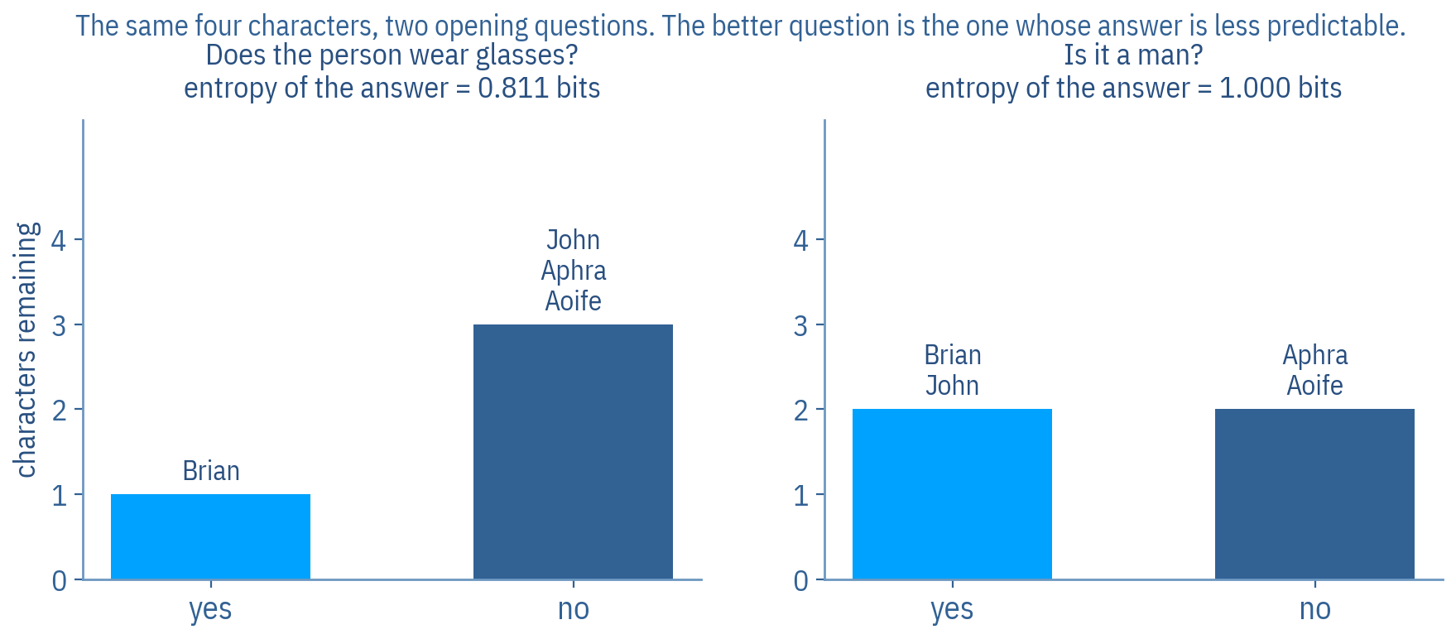
Anyone for a game of Guess Who?
Four characters, described by three binary features. Which question would you ask first: does the person wear glasses, or is it a man?
The entropies are computed from these four characters.
COMP9085 Machine Learning in Biology - Haithem.afli@mtu.ie · 7
Notes:
Original slides 3 and 4. Play it properly: two volunteers, one picks a character, the other asks yes/no questions from the feature list only. Then put the two opening questions to the room and take a vote before showing the figure. The original speaker note asks for a poll here; do that if the room is large.

Slide 8
The four characters
Man | Long hair | Glasses | Name
Yes | No | Yes | Brian
Yes | No | No | John
No | Yes | No | Aphra
No | No | No | Aoife
COMP9085 Machine Learning in Biology - Haithem.afli@mtu.ie · 8
Notes:
Leave this up while they argue. The glasses question splits 1 / 3; the man question splits 2 / 2. That asymmetry is the whole idea, and they can see it in the table before any mathematics.

Slide 9
So which question should we start with?
• On average, an answer to "is it a man?" gives you more information than an answer to "does the person wear glasses?"
• It needs fewer follow-up questions
• This is not because of the literal message of the answers, yes or no
• It is to do with how the answer splits the domain into different sized sets, and the likelihood of each possible answer
COMP9085 Machine Learning in Biology - Haithem.afli@mtu.ie · 9
Notes:
Original slide 9, close to verbatim. The sentence that matters is the last one: informativeness is about the sizes of the resulting sets and how likely each answer is, not about the answer itself.

Slide 10
Find the features whose answers are least predictable, and ask about those first.
The big idea, from original slide 10. Everything in Act 2 is one way of measuring "least predictable", and everything in Act 3 is the algorithm that uses it.
COMP9085 Machine Learning in Biology - Haithem.afli@mtu.ie · 10
Notes:
Original slide 10. If a student remembers one sentence from Act 1, this is it. It also previews why the maths is about probabilities rather than about the features themselves.

Slide 11
Root, interior nodes, leaves
A decision tree produces a prediction by testing a series of descriptive feature values. The root is where the first test happens; interior nodes hold further tests; leaves specify the prediction.
The path a query follows
Root node
Age ≤ 50?
Interior node
Chest Pain ≤ 2.5?
Interior node
Cholesterol ≤ 252?
Leaf node
low / high
→
→
→
COMP9085 Machine Learning in Biology - Haithem.afli@mtu.ie · 11
Notes:
Original slides 13 to 16 were four animation states of one picture. Name the three parts and move on: the vocabulary matters, the animation did not.

Slide 12
One query travelling through the tree
Follow a path based on the descriptive feature values of a query to make a prediction.
• Age: 62
• Cholesterol: 311
• Chest Pain: 4
• Blood Pressure: 130
  – Age ≤ 50? No, so take the right branch
  – Chest Pain ≤ 2.5? No, so take the right branch
  – The leaf says: high risk
COMP9085 Machine Learning in Biology - Haithem.afli@mtu.ie · 12
Notes:
Original slide 18, same query values. Walk it on the board with your finger. Note that Blood Pressure is never tested: the tree did not need it for this case. Students find that surprising and it is worth ten seconds. In Act 4 we do exactly this on a real held-out biopsy.

Slide 13
But we can build many trees
Both give similar predictions for query instances. Which would you choose?
Tree (a)
Tree (b)
• Tests Age first, then Chest Pain
• Three tests deep on the longest path
• Uses three of the four features
• Tests Blood Pressure first
• Five tests deep on the longest path
• Uses all four features, some of them twice
COMP9085 Machine Learning in Biology - Haithem.afli@mtu.ie · 13
Notes:
Original slides 19 to 22. Take a vote, as the original note asks. Almost everyone picks (a), and almost nobody can say why without prompting. Let the silence sit before the next slide.

Slide 14
Inductive bias
• Apply the same approach as in Guess Who: prefer simpler trees that use fewer tests
• This preference is an example of inductive bias: a set of assumptions that define the model selection criteria of a learning algorithm
• Restriction bias limits the set of models the algorithm can express
• Preference bias orders the models the algorithm can express
• Decision-tree learning uses a preference bias
• Inductive bias is necessary for generalisation
COMP9085 Machine Learning in Biology - Haithem.afli@mtu.ie · 14
Notes:
Original slides 23 and 24. The last line is the one worth labouring: without a preference, any tree that fits the training data is as good as any other, and there are very many of them. The bias is not a flaw, it is what makes learning possible at all.

Slide 15
How do we create simple trees?
By testing the most informative features early.
Informative features split the dataset into pure sets with respect to the target. So all we need is a computational measure of the purity of a set. That measure is entropy.
COMP9085 Machine Learning in Biology - Haithem.afli@mtu.ie · 15
Notes:
Original slide 25. This is the hinge from Act 1 into Act 2, and it is worth pausing on the word 'pure': a set is pure when everything in it has the same label, which is exactly when you no longer need to ask anything.

Slide 16
How does a tree choose?
Part 2 · Entropy, and information gain
COMP9085 Machine Learning in Biology - Haithem.afli@mtu.ie · 16

Slide 17
Shannon's entropy
H(S) = − Σ p(c) · log₂ p(c)
A weighted sum of the logs of the probabilities of each category in a set. High probability gives low entropy; low probability gives high entropy. Multiplying the log by −1 produces that mapping.
S the set of labels at a node
p(c) the proportion of the set carrying class c
log₂ base 2, so entropy is measured in bits
H = 0 every element has the same label: the set is pure
H = 1 two classes, split exactly evenly: maximum uncertainty
COMP9085 Machine Learning in Biology - Haithem.afli@mtu.ie · 17
Notes:
Original slides 26 and 28. Do not rush the minus sign: probabilities are below 1, their logs are negative, and the minus makes entropy positive. Ask the room what H is for a set where every case is malignant, before you show the glossary.

Slide 18
Pure and mixed nodes, on real cases
REAL DATA. Computed on the 398 training cases by data/scripts/06_build_week02.py.
A node containing | Benign | Malignant | Entropy | Reading
all 398 training cases | 250 | 148 | 0.952 bits | close to maximally uncertain
the left branch of the root | 241 | 19 | 0.377 bits | mostly benign, some doubt left
the right branch of the root | 9 | 129 | 0.348 bits | mostly malignant
a pure leaf of the fitted tree | 0 | 113 | 0.000 bits | no uncertainty at all
COMP9085 Machine Learning in Biology - Haithem.afli@mtu.ie · 18
Notes:
Point at the last row: entropy zero means that if you drew a case from that leaf at random you would know its label without looking. That is what the algorithm is driving towards, and it is also, as Act 5 shows, exactly what it can overdo.

Slide 19
Worked example: heart-disease risk
Thirteen patients. Every entropy on the next slides is computed from this table, so you can check any of them by hand.
ID | Age | Chest pain | Blood pressure | Cholesterol | Risk
1 | 53 | 3 | 135 | 160 | High
2 | 52 | 2 | 140 | 216 | Low
3 | 32 | 3 | 110 | 250 | Low
4 | 52 | 2 | 150 | 215 | Low
5 | 53 | 2 | 130 | 220 | Low
6 | 60 | 1 | 120 | 291 | High
7 | 49 | 2 | 140 | 238 | Low
8 | 55 | 4 | 140 | 268 | High
9 | 24 | 4 | 100 | 253 | Low
10 | 39 | 2 | 160 | 147 | Low
11 | 35 | 1 | 140 | 167 | Low
12 | 49 | 2 | 142 | 207 | Low
13 | 31 | 2 | 120 | 273 | Low
COMP9085 Machine Learning in Biology - Haithem.afli@mtu.ie · 19
Notes:
The original worked example runs on 25 instances but prints only these 13, so the figures in the old deck cannot be verified from the slide. Recomputing on the printed rows fixes that. The conclusion does not change: Age still wins the root. See docs/WEEK02_SOURCE_MAPPING.md for both sets of numbers.

Slide 20
One split, worked in full
H(S) = − (3/13) log₂(3/13) − (10/13) log₂(10/13) = 0.779 bits
That is the entropy before we ask anything: 3 high-risk and 10 low-risk patients in 13. Now split on Age at 52.5 and measure what is left.
remainder the weighted average entropy of the two partitions, 0.250 bits
information gain 0.779 − 0.250 = 0.530 bits
weighted each partition counts in proportion to how many patients land in it
COMP9085 Machine Learning in Biology - Haithem.afli@mtu.ie · 20
Notes:
Original slides 35 to 44, condensed. Do this one on the board as well as on the slide. The weighting is the step students skip: a very pure partition holding two patients is worth less than a slightly less pure one holding eleven.

Slide 21
All four features, compared
Entropy before any split: 0.779 bits. Age separates these patients almost cleanly; blood pressure hardly separates them at all, so the ordering matches clinical intuition.
Feature | Best threshold | Entropy after | Information gain
Age | ≤ 52.5 | 0.250 bits | 0.530 bits
Cholesterol | ≤ 260.5 | 0.573 bits | 0.207 bits
Chest Pain | ≤ 2.5 | 0.656 bits | 0.123 bits
Blood Pressure | ≤ 141.0 | 0.678 bits | 0.101 bits
COMP9085 Machine Learning in Biology - Haithem.afli@mtu.ie · 21
Notes:
Original slides 38 to 57 worked through each feature in turn over twenty slides. The arithmetic is identical each time, so one worked example and this table teach it. Ask which row wins before revealing: Age, as in the original deck. Blood pressure barely helps, which is worth a sentence, because a feature can be clinically important and still be a poor first question.

Slide 22
Information gain
The entropy before partitioning, minus the average entropy of the partitions after it.
When building a tree you can work with the remainder directly and never compute the gain; the gain is the more intuitive quantity to talk about, because it answers "how many bits of uncertainty did that question remove?"
COMP9085 Machine Learning in Biology - Haithem.afli@mtu.ie · 22
Notes:
Original slides 55 to 57, including the original's own remark that you can just use entropy directly. Both forms appear in the literature and in the lab, so name both.

Slide 23
Workshop: which feature belongs at the root?
Six patients, three binary descriptive features. Which feature gives the partitions with the lowest average entropy? Five minutes, in pairs.
ID | Obese | Smoker | Drinks alcohol | Cancer risk
1 | true | false | true | low
2 | true | true | true | high
3 | true | false | true | low
4 | false | true | true | high
5 | false | true | false | low
6 | false | true | true | high
COMP9085 Machine Learning in Biology - Haithem.afli@mtu.ie · 23
Notes:
Original slides 58 and 59, the in-class workshop, with the lecturer's own table. Categorical features make the arithmetic easy: no thresholds to search. Walk round while they work; the usual error is forgetting to weight the partitions by size. Reveal on the next slide.

Slide 24
Workshop: the answer
Entropy before the split: 1.000 bit (3 high, 3 low). Smoker wins, with an information gain of 0.459 bits.
Split on | Level | Counts | Entropy | Weighted | Gain
Smoker | true | 3 high, 1 low | 0.811 | 0.541 | 0.459
 | false | 0 high, 2 low | 0.000
Drinks alcohol | true | 3 high, 2 low | 0.971 | 0.809 | 0.191
 | false | 0 high, 1 low | 0.000
Obese | true | 1 high, 2 low | 0.918 | 0.918 | 0.082
 | false | 2 high, 1 low | 0.918
COMP9085 Machine Learning in Biology - Haithem.afli@mtu.ie · 24
Notes:
Answer: Smoker, gain 0.459 bits. Two things to draw out. First, Smoker does not split these six perfectly: patient 5 smokes and is low risk, so the partition still carries 0.811 bits. Students expect a clean answer and do not get one, which is realistic. Second, Obese gains almost nothing here, which surprises people, and is a good moment to say that a feature can matter clinically and still be a poor question to ask first.

Slide 25
From idea to algorithm
Part 3 · ID3, thresholds, and what scikit-learn actually does
COMP9085 Machine Learning in Biology - Haithem.afli@mtu.ie · 25

Slide 26
The ID3 algorithm
• Iterative Dichotomiser 3
• Attempts to create the shallowest tree that is consistent with the data it is given
• Builds the tree recursively and depth-first, from the root down to the leaves
  – Choose the best descriptive feature to test, using entropy
  – Add a root node labelled with that feature
  – Partition the training data using the test
  – Grow a branch from the node for each partition
  – Repeat on each branch, with that partition in place of the full dataset and the selected feature excluded from further testing
COMP9085 Machine Learning in Biology - Haithem.afli@mtu.ie · 26
Notes:
Original slides 60 and 61, close to verbatim. The word to stress is 'recursively': the same procedure applies to each partition, which is why one paragraph describes a tree of any size. The exclusion of a used feature is an ID3 property, and the next-but-one slide explains why scikit-learn does not do it.

Slide 27
Stopping rules
The three situations in which standard ID3 stops.
• All of the instances in the dataset have the same classification: return a leaf labelled with that classification
• The set of features left to test is empty: return a leaf labelled with the majority class of the dataset
• The dataset is empty: return a leaf labelled with the majority class of the dataset at the parent node that made the recursive call
COMP9085 Machine Learning in Biology - Haithem.afli@mtu.ie · 27
Notes:
Original slide 76. Ask which of the three fires most often in practice: the first. The third is the awkward one and it is worth asking why an empty partition can arise at all.

Slide 28
Applying it to the heart-disease set
The point is the recursion, not the bookkeeping.
• Age wins the root, as the table showed
• The Age ≤ 52.5 partition is pure: every patient in it is low risk, so it becomes a leaf immediately
• The other partition is mixed, so the procedure recurses on it
• Within that partition the entropies are recomputed, on those patients only, and a new winning feature is chosen
• The recursion continues until one of the three stopping rules fires
• In the original deck this produced a tree testing Age, then Cholesterol, then Chest Pain
COMP9085 Machine Learning in Biology - Haithem.afli@mtu.ie · 28
Notes:
Original slides 62 to 74 walked every partition. That is valuable the first time you meet it and tedious the second; the lab reproduces it computationally. If the room is following well, do one level of the recursion live on the board.

Slide 29
Using the tree
• Age: 59 Cholesterol: 225 Chest Pain: 4 Blood Pressure: 142
• The tree returns a prediction for this query
• Note that there was no example in the training data with exactly this combination of feature values
• The model has generalised: it is applying a rule learned from other patients to one it has never seen
• That is the whole point, and it is also where every failure in this module begins
COMP9085 Machine Learning in Biology - Haithem.afli@mtu.ie · 29
Notes:
Original slide 75, same query. The third bullet is the one to dwell on. Ask: on what grounds should we believe the answer? Nobody has a good answer yet, which is the right state to be in going into Act 5.

Slide 30
Handling continuous features
Answered with a measurement on the next slide.
• In all the examples so far, the threshold for a continuous feature was set to the mean value of that feature
• This is not always the best approach
• It is typical to calculate the average partition entropy using every potential threshold
• Then choose the threshold that gives the lowest average entropy in the resulting partitions
  – Candidate thresholds sit midway between adjacent observed values: 12.3, 13.7, 15.1, 16.8, 18.2 and so on
COMP9085 Machine Learning in Biology - Haithem.afli@mtu.ie · 30
Notes:
Original slides 77 to 81. The original deck raises this honestly and then says the mean happened to win on its data. On WDBC it does not, and the next slide shows by how much. Do not let anyone leave thinking the threshold is the mean.

Slide 31
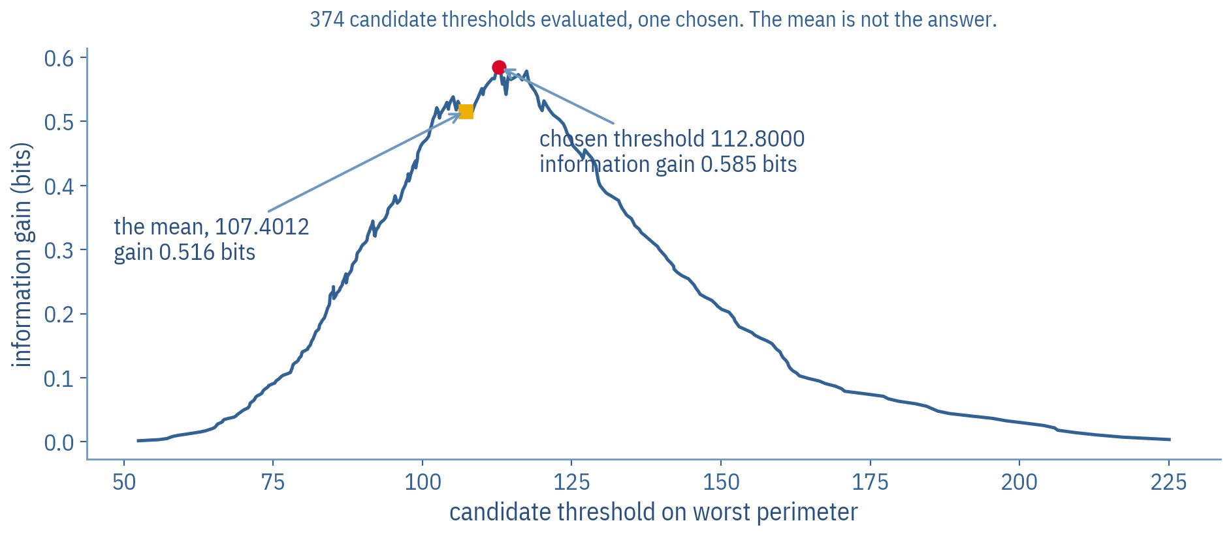
Every candidate threshold, evaluated
374 candidate thresholds on worst perimeter. The algorithm takes 112.8, worth 0.585 bits. The mean, 107.4, would have been worth 0.516.
REAL DATA. Computed on the 398 WDBC training cases by data/scripts/06_build_week02.py.
COMP9085 Machine Learning in Biology - Haithem.afli@mtu.ie · 31
Notes:
This slide is new and it settles the question original slide 79 leaves open. The mean is a reasonable guess and it is 0.069 bits worse here. Ask why the curve is so ragged: each candidate moves one patient across the boundary, so the gain jumps whenever that patient's label differs from its neighbour's.

Slide 32
ID3 is not what scikit-learn runs
Both are decision-tree learners. They are not the same algorithm, and the lab uses the second one.
ID3, as taught above
sklearn DecisionTreeClassifier
• Chooses splits by information gain
• Historically associated with categorical features
• Splits a categorical feature into one branch per level, so a node can have many children
• Removes a feature from consideration once it has been used
• No built-in pruning in the standard formulation
• CART-style recursive binary splitting: every node has exactly two children
• criterion='gini' by default, criterion='entropy' available
• Handles continuous features by searching thresholds, as above
• A feature can be tested again further down the same path
• Supports pre-pruning (max_depth, min_samples_leaf) and cost-complexity post-pruning (ccp_alpha)
COMP9085 Machine Learning in Biology - Haithem.afli@mtu.ie · 32
Notes:
This slide is new and it matters for the lab and for both projects. Saying 'sklearn implements ID3' is wrong and students repeat it in reports. We set criterion='entropy' throughout the module so the splitting criterion matches the lecture, but the tree structure is still CART: strictly binary, and features can recur down a path. Point out that both of those differences are visible in the tree on the next slide.

Slide 33
Real biological data
Part 4 · A tree fitted to 398 diagnostic cases
COMP9085 Machine Learning in Biology - Haithem.afli@mtu.ie · 33

Slide 34
The experiment, stated before it is run
Write the protocol down before you see a number. Week 3 is about what happens when you do not.
Decision | What it is, and why it is fixed now
Dataset | Wisconsin Diagnostic Breast Cancer, 569 cases, 30 features
Source | sklearn.datasets.load_breast_cancer (UCI)
Classes | 212 malignant, 357 benign
Majority baseline | 62.7 per cent: predict benign for everything
Split | stratified 70 / 30, random_state=42
Training / held out | 398 cases / 171 cases
Model | DecisionTreeClassifier(criterion='entropy', max_depth=3)
Provenance | REAL benchmark data. Not a clinical system
COMP9085 Machine Learning in Biology - Haithem.afli@mtu.ie · 34
Notes:
The baseline is the line everyone forgets. 62.7 per cent is what you get for free by always saying benign, so any model has to beat that before it has done anything at all. Ask the room to commit to a guess for the tree's accuracy before you show it.

Slide 35
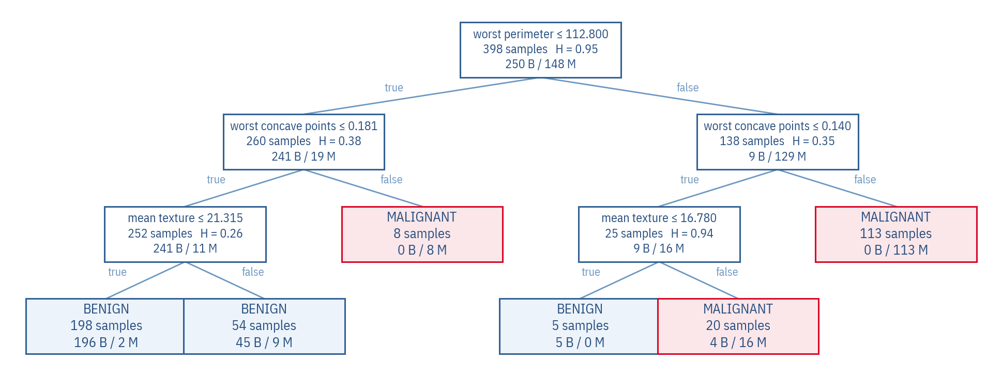
The actual fitted tree
Each node: the split, the training cases reaching it, the entropy, and the benign / malignant counts. The fitted object, not a drawing of one.
REAL DATA. criterion='entropy', max_depth=3, random_state=42. Training accuracy 96.2 per cent, held-out accuracy 91.8 per cent.
COMP9085 Machine Learning in Biology - Haithem.afli@mtu.ie · 35
Notes:
Give them thirty seconds of silence to read it before you say anything. Then: the root is worst perimeter at 112.8, gaining 0.585 bits, which is the number Act 2 was about. Note that it is binary everywhere and that a feature recurs on a path, both CART properties from the previous slide. The website renders this same exported tree and lets them change the depth.

Slide 36
The root split, checked by hand
H(before) = 0.952 H(after) = 0.367
information gain = 0.585 bits
worst perimeter ≤ 112.8. The left partition holds 260 cases at 0.377 bits; the right holds 138 at 0.348 bits.
checked the same arithmetic as the heart-disease example, on 398 cases instead of 13
biologically perimeter of the largest nucleus in the image: larger nuclei are associated with malignancy
but association in this dataset, not a mechanism, and not a diagnostic threshold
COMP9085 Machine Learning in Biology - Haithem.afli@mtu.ie · 36
Notes:
The third glossary line is the important one and it recurs in Act 6. The tree has found a real statistical regularity in 398 biopsies from one institution in the 1990s. That is not the same as a clinical decision rule, and students write it up as though it were.

Slide 37
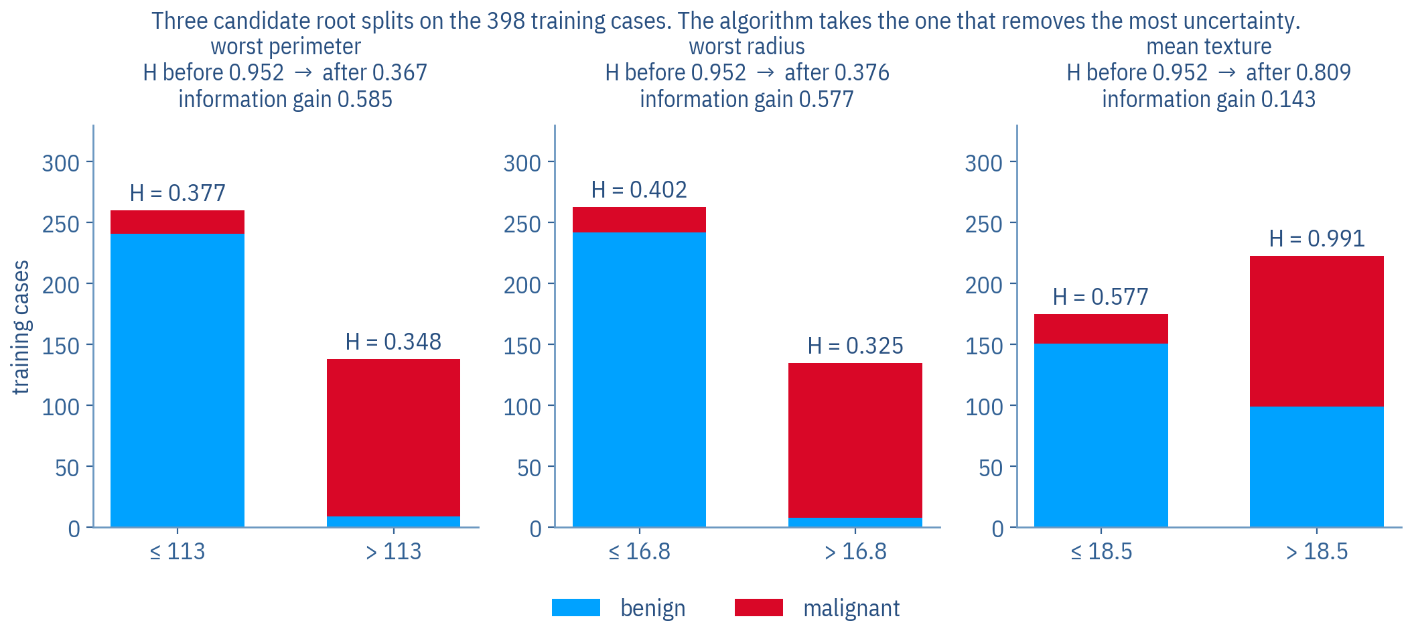
Three candidate splits at the root
The algorithm evaluated every feature at every threshold and took the first of these. Mean texture is a perfectly sensible biological measurement and a poor first question.
REAL DATA. Computed on the 398 training cases.
COMP9085 Machine Learning in Biology - Haithem.afli@mtu.ie · 37
Notes:
This is the Guess Who slide again, on real data, and it is worth saying so explicitly: glasses versus is-it-a-man has become mean texture versus worst perimeter. Same question, same measure, forty minutes apart.

Slide 38
One real held-out case
The same move as the heart-disease query, on a real biopsy the model has never seen.
• Case test-006 from the held-out set, truly malignant
• worst perimeter = 152.200, threshold 112.800 → false
• worst concave points = 0.163, threshold 0.140 → false
• Leaf: MALIGNANT, built from 113 training cases, 0 benign and 113 malignant
COMP9085 Machine Learning in Biology - Haithem.afli@mtu.ie · 38
Notes:
Ask the question before showing the next slide: why did this case reach this leaf? The answer is that two tests were enough; the other 28 features were never consulted. Students find that unsettling, correctly.

Slide 39
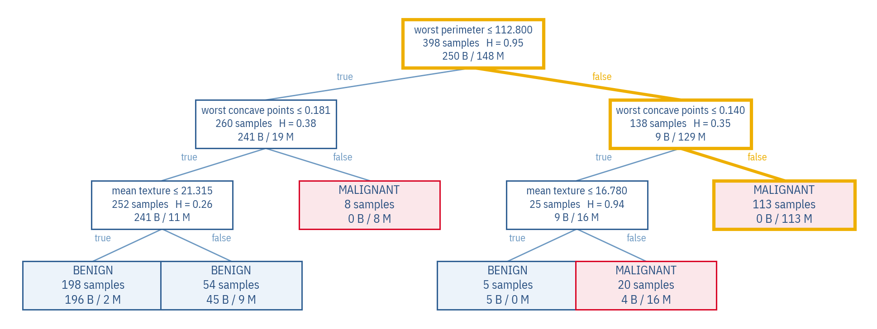
The path, on the tree
Two tests, and the case lands in a leaf built from 113 training cases, all of them malignant.
REAL DATA. The same fitted tree, the same held-out case.
COMP9085 Machine Learning in Biology - Haithem.afli@mtu.ie · 39
Notes:
Call this the decision path, not the reasoning and not the explanation. It is the sequence of learned splits this input followed. It does not establish causality and it is not a clinical justification. That wording appears on the website and in the lab too, deliberately.

Slide 40
Can we trust the tree?
Part 5 · Depth, overfitting, pruning, validation
COMP9085 Machine Learning in Biology - Haithem.afli@mtu.ie · 40

Slide 41
Overfitting
And the measurement that shows it happening.
• In a decision tree, overfitting involves splitting the data on an irrelevant feature
• The likelihood increases as a tree gets deeper, because the resulting classifications are based on smaller and smaller subsets as the dataset is partitioned after each test in the path
  – The unrestricted tree on this data reaches depth 8 with 16 leaves
  – It classifies 100.0 per cent of the training cases correctly
  – On the held-out cases it gets 94.2 per cent
COMP9085 Machine Learning in Biology - Haithem.afli@mtu.ie · 41
Notes:
Original slide 82, verbatim in the first two bullets. A tree that is perfect on its training data has memorised it: there is a leaf for every awkward case. Ask whether 94.2 per cent held-out is actually bad. It is not, and that is the interesting part: overfitting here costs accuracy but does not destroy it. What it destroys is the tree's readability.

Slide 42
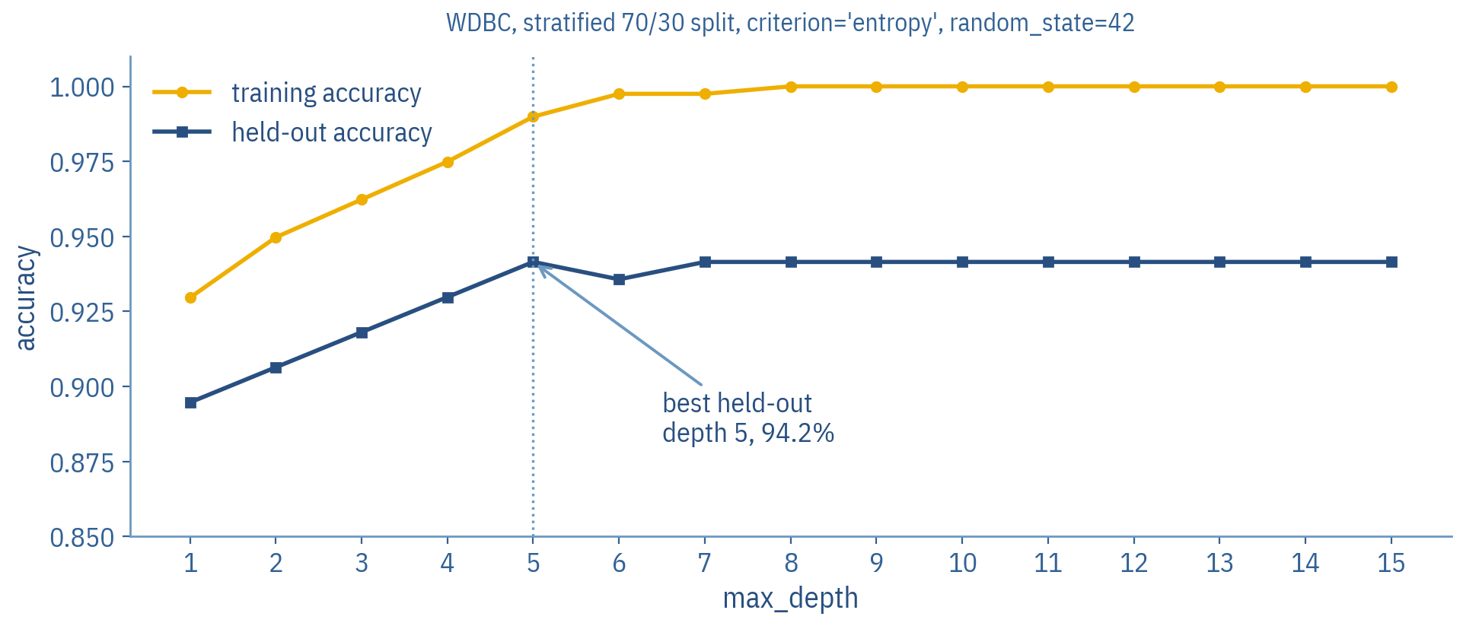
Depth against performance, measured
Training accuracy climbs to 100 per cent. Held-out accuracy reaches 94.2 per cent at depth 5 and never improves on it again: every extra split after that buys training accuracy and nothing else. The gap between the curves is the overfitting.
REAL DATA. Every point is a tree fitted on the same 398 cases and scored on the same 171.
COMP9085 Machine Learning in Biology - Haithem.afli@mtu.ie · 42
Notes:
Walk left to right. At depth 1 the tree is a single question and already beats the 62.7 per cent baseline. The curves separate from about depth 5; after that the training curve runs to 100 per cent while the held-out curve is flat, dipping at depth 6 and recovering. Point out that dip: it is one case in 171, which is what noise looks like, and it is a good reason not to read a single accuracy to three decimal places. Ask what they would report as this model's accuracy, take the answer 94.2 per cent, and then break it on the next slide but one.

Slide 43
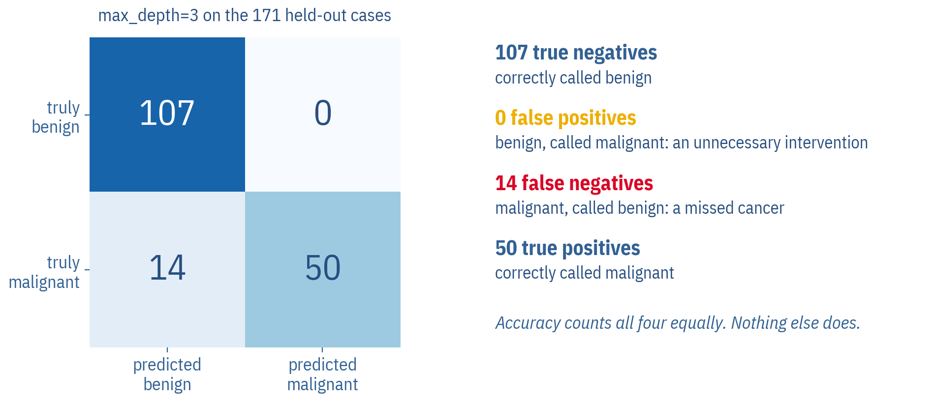
Where the errors are
Accuracy 91.8 per cent hides the shape of the errors. This tree makes 14 false negatives and 0 false positives, and those two numbers do not cost the same thing.
REAL DATA. max_depth=3 on the 171 held-out cases.
COMP9085 Machine Learning in Biology - Haithem.afli@mtu.ie · 43
Notes:
This is the slide that changes how they read accuracy. 14 malignant cases were called benign. In a screening context that is the error that matters, and a model chosen on accuracy alone will happily trade it away. Week 4 gives them sensitivity and specificity; Week 12 gives them the rest.

Slide 44
Pruning
• Pre-pruning: stop the recursive partitioning early, typically using rules about the number of instances allowed at a leaf
  – max_depth, min_samples_leaf, min_samples_split
• Post-pruning: let the algorithm grow the tree as much as it likes, then prune away the branches that cause overfitting
  – A common approach: evaluate on a validation set as the tree grows, and prune back when training and validation performance diverge
  – scikit-learn's version is cost-complexity pruning, ccp_alpha
• Advantages: smaller trees are easier to interpret, and generalisation improves when there is noise in the training data
COMP9085 Machine Learning in Biology - Haithem.afli@mtu.ie · 44
Notes:
Original slides 83 to 85. Both approaches are in the lab. The honest framing: pre-pruning is cheap and blunt, post-pruning is principled and needs data you have to set aside. Neither is free.

Slide 45
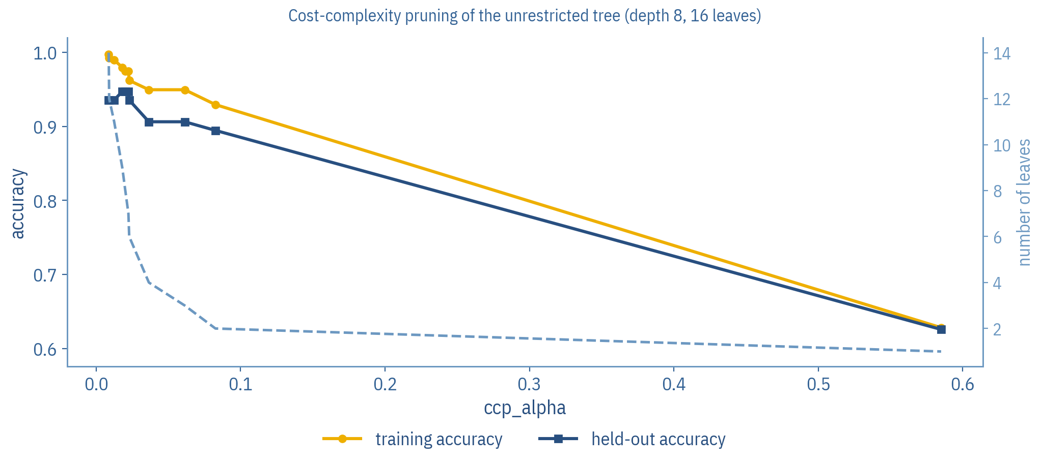
Pruning, measured on the same split
Raising ccp_alpha removes leaves. Training accuracy falls steadily; held-out accuracy rises first, peaking at 94.7 per cent with 9 leaves, then collapses when the tree is cut too far.
REAL DATA. Cost-complexity pruning of the unrestricted tree.
COMP9085 Machine Learning in Biology - Haithem.afli@mtu.ie · 45
Notes:
The shape is the point: there is a middle, and you cannot find it by looking at the training curve. Then ask the awkward question, which the next slide answers: we just picked ccp_alpha by looking at the held-out set. What is wrong with that?

Slide 46
We just chose a hyperparameter by looking at the test set. That number is no longer an honest estimate.
Every time you look at the final test set and change something, you fit a little of it. Split three ways: train, validate, and a final test set you touch exactly once. The lab does it properly.
COMP9085 Machine Learning in Biology - Haithem.afli@mtu.ie · 46
Notes:
This is the sentence Week 3 is built on and the most common error in both projects. Say plainly that the 94.2 per cent on the earlier slide is optimistic for exactly this reason, and that the honest protocol is in Task 8 of the lab.

Slide 47
Decision trees: advantages and disadvantages
Advantages
Disadvantages
• Interpretable
• Handle both categorical and continuous descriptive features
• Can model interactions between descriptive features, though pre-pruning diminishes this
• Relatively robust to the curse of dimensionality
• Relatively robust to noise, if pruning is used
• Trees become large when dealing with continuous features
• Very expressive and sensitive to the dataset, so they can overfit when there are many features
• Eager learner, so they are exposed to concept drift
COMP9085 Machine Learning in Biology - Haithem.afli@mtu.ie · 47
Notes:
Original slide 88, verbatim. Connect the first advantage to Act 6: interpretability is the reason this model can be deployed and interrogated in a lecture theatre, and it is not the same thing as being right.

Slide 48
A model can be interpretable and still be wrong.
You can read every rule this tree uses. That tells you what it does. It tells you nothing about whether what it does is correct, whether the data it learned from represents the patients you care about, or what happens when the measurements come from a different laboratory.
COMP9085 Machine Learning in Biology - Haithem.afli@mtu.ie · 48
Notes:
The sentence to leave them with from Act 5. It is also the bridge into the deployment sequence: they are about to see the model being used, and this is the frame to see it through.

Slide 49
From model to application
Part 6 · Deploy it, then interrogate it
COMP9085 Machine Learning in Biology - Haithem.afli@mtu.ie · 49

Slide 50
What deployment actually means
The model does not change. What changes is that a person who did not fit it is now acting on its output. On the Week 2 page you can enter measurements or load one of four real held-out cases, and out-of-range values are flagged against the actual dataset range.
The notebook
Fit on 398
cases
Score on 171
held out
Read the
tree
→
→
The application
A new case
arrives
The same fitted
tree evaluates it
Prediction and
decision path
Someone decides
what to do
→
→
→
COMP9085 Machine Learning in Biology - Haithem.afli@mtu.ie · 50
Notes:
The gap between the two rows is where most harm in applied ML happens: the person in the last box did not see the split, does not know the baseline, and has no idea the training data came from one institution. Demonstrate the interface for about five minutes. Load the malignant example, show the path, then raise worst perimeter slightly and watch the prediction flip at the threshold. Then type in something absurd, 900 for worst perimeter, and show the out-of-range warning rather than a confident answer. Students remember the second demonstration longer than the first.

Slide 51
Try this interactively
Decision Tree Builder, Entropy Visualiser and the Deployment demonstration
Change the depth and the leaf size and watch the tree and the held-out accuracy change. Drag the split point and watch the entropy and information gain update. Then put a case through the tree and read its decision path.
weeks/week02.html · Interactive exploration
Open the week page on the
course website and scroll to
Interactive exploration.
COMP9085 Machine Learning in Biology - Haithem.afli@mtu.ie · 51
Notes:
Three activities on one page, all driven by the same exported tree. Run the builder in the lecture: ask for a prediction before you move the depth slider, because most of the room expects deeper to be better, and watching the held-out number fall while the training number rises does more work than the curve on the earlier slide did. Use the entropy visualiser back in Act 2 instead if the room struggled with the weighting: dragging the threshold and seeing the weighted average move is the fastest way to make it concrete.

Slide 52
Decision path is not an explanation
The same wording appears on the website and in the lab.
• Call it the decision path
• Do not call it the reasoning, or why the model thinks this
• The path shows the sequence of learned splits the tree used for this input
• It does not establish causality
• It does not provide a clinical explanation
• It is a faithful account of what the model did, and nothing more
COMP9085 Machine Learning in Biology - Haithem.afli@mtu.ie · 52
Notes:
Worth being firm here. Interpretable models invite the slide from 'this is what it did' to 'this is why it is true', and the language does the sliding. If a student writes 'the model reasoned that...' in a project, this is the slide to point at.

Slide 53
Should we trust this result?
Producing a prediction is not the end of machine learning. It is the point at which these questions start.
• Was the model validated, and on data it never saw during fitting?
• Was the final test set kept separate, and looked at once?
• Is the dataset representative of the patients this would be used on?
• Has any external validation been done, on another institution's data?
• Could dataset shift change the result: different scanner, different laboratory, different population?
• Are the features appropriate, and are they available at the moment the decision must be made?
• What are the consequences of a false positive, and of a false negative? They are not the same.
• Is this model clinically validated? No.
COMP9085 Machine Learning in Biology - Haithem.afli@mtu.ie · 53
Notes:
Put this to the room as eight questions and take answers. For our tree: validated on a held-out split, yes; test set kept clean, no, we peeked when choosing depth; representative, unknown and probably not, it is one institution in the 1990s; external validation, none; shift, very likely; consequences, asymmetric and we optimised as though they were not. Week 12 is this slide expanded into two hours.

Slide 54
Training a model is not the end of machine learning.
You have to inspect it, validate it, understand its behaviour, and know the limits of its predictions. That is what the rest of this module is about, and it is what both projects are marked on.
COMP9085 Machine Learning in Biology - Haithem.afli@mtu.ie · 54
Notes:
The sentence of the week. It is also, almost word for word, the marking criterion for both projects.

Slide 55
Exit ticket, and the laboratory
Diagnostic Model Auditor: decision trees on real biological data. Two hours.
• Write down, in one sentence each:
  – Why did the tree ask about worst perimeter first?
  – What would make you doubt 91.8 per cent held-out accuracy?
  – What is the difference between the decision path and an explanation?
• In the laboratory you become the auditor: grow a tree, break it, prune it, trace a case, deploy it, and write the model card that says what it must not be used for
COMP9085 Machine Learning in Biology - Haithem.afli@mtu.ie · 55
Notes:
Collect the exit tickets if the room is small enough; the third question is the one that separates students who have understood the week from students who have followed it. The lab notebook and its HTML version are on the Week 2 page.

Slide 56
Summary
• A decision tree makes predictions from sequences of tests on the descriptive feature values of a query
• Entropy measures the impurity of a set; information gain measures how much a test reduces it
• ID3 is the standard conceptual algorithm; scikit-learn's DecisionTreeClassifier is CART-style and is not the same thing
• Continuous features are handled by searching candidate thresholds, not by taking the mean
• Deeper is not better: on this data the held-out curve reaches its best at depth 5 and never improves on it, while training accuracy runs to 100 per cent
• Pruning trades training accuracy for generalisation and readability
• Interpretability tells you what a model did, not whether it is right
COMP9085 Machine Learning in Biology - Haithem.afli@mtu.ie · 56
Notes:
Original slide 87 covered the first and third lines. The rest are the week's additions. If you are short of time, the lines that must be said aloud are the third and the last.

Slide 57
References and further reading
Quinlan, J. R. (1986). Induction of decision trees. Machine Learning 1(1), 81-106. doi:10.1007/BF00116251
Breiman, L., Friedman, J., Olshen, R. and Stone, C. (1984). Classification and Regression Trees. Wadsworth.
Street, W. N., Wolberg, W. H. and Mangasarian, O. L. (1993). Nuclear feature extraction for breast tumor diagnosis. IS&T/SPIE International Symposium on Electronic Imaging. doi:10.1117/12.148698
Shannon, C. E. (1948). A mathematical theory of communication. Bell System Technical Journal 27(3), 379-423.
Pedregosa, F. et al. (2011). Scikit-learn: machine learning in Python. JMLR 12, 2825-2830.
Mitchell, M. et al. (2019). Model cards for model reporting. FAT* '19, 220-229. doi:10.1145/3287560.3287596
COMP9085 Machine Learning in Biology - Haithem.afli@mtu.ie · 57
Notes:
Street et al. is the paper that produced the WDBC features; worth naming, because it is where the thirty numbers came from and it is not a clinical trial. The model-card paper is the template for Task 10 of the lab.

Slide 58
Questions
Next week: the complete workflow, and why the number you just reported may not survive contact with an honest protocol.
Dr Haithem Afli · haithem.afli@mtu.ie
COMP9085 Machine Learning in Biology - Haithem.afli@mtu.ie · 58
Notes:
End on the open question: we chose the depth by looking at the test set. Week 3 is about what that costs and how to avoid it.

