Slide 1
Safer SSO
By Landon Dixon, Avery Overberg, Hilmir Arnarsson, Carter Strate
‹#›

Slide 3


The Problem
Demonstrate a cybersecurity vulnerability that comes with using SSO
Implement ways to mitigate said problem
Landon Dixon
Notes:
Mention identity-account inconsistency threat here I think,
Summarize research paper, lots of ip’s

Slide 4
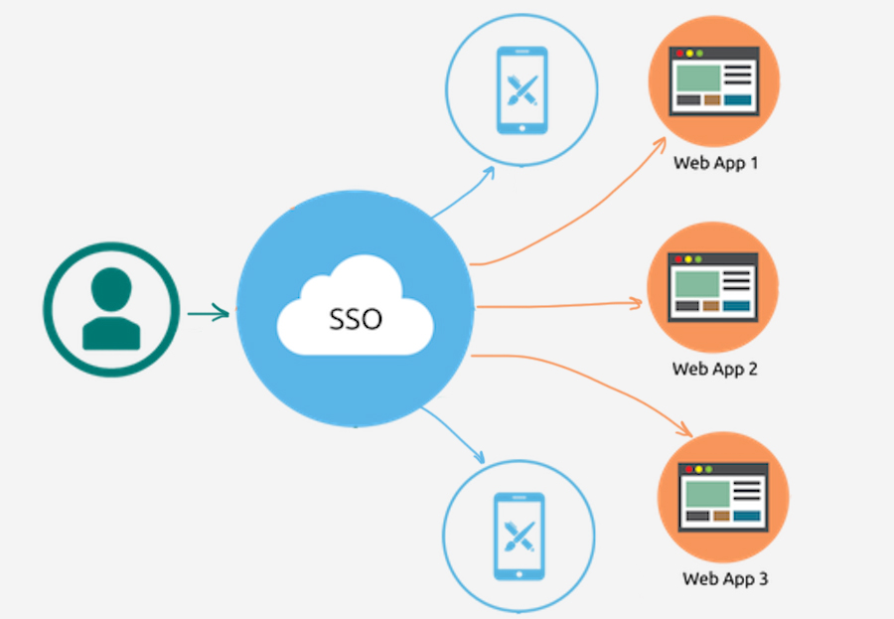
What is SSO
Allows users to sign in once and gain access to multiple services
Landon Dixon
Notes:
Image link, https://ceaksan.com/tr/single-sign-on-sso-nedir/sso-single_sign-on.jpg
Use mines as an example, we use sso
Brief breakdown of the tokens and what not maybe

Slide 5
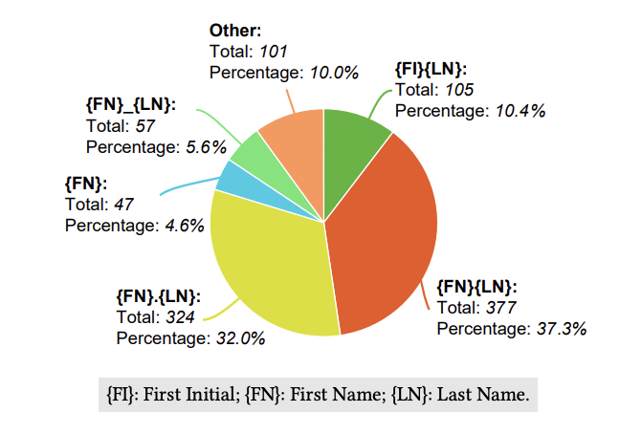
Background
Identity-account inconsistency threat
Many service providers do not check anything more than emails
Many Identity providers allow users to reuse emails
Common naming conventions for emails
Landon Dixon
Notes:
80% of researched sps failed, were vulnerable,

Slide 6
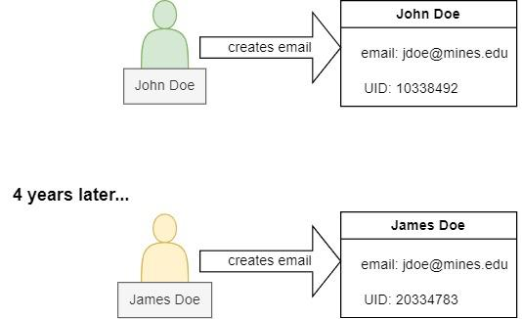
John Doe creates an account with an Identity Provider (IdP)
He is assigned a UUID linked to his email
Avery Overberg

Slide 7
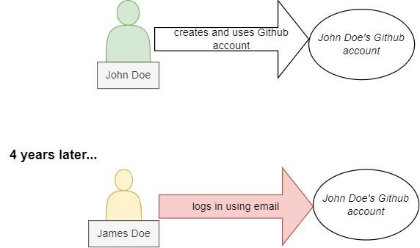
John Doe creates gitHub account (SP) using the IdP’s SSO
Avery Overberg

Slide 8

John Doe retires
Avery Overberg

Slide 9
James Doe makes email with the recycled username jdoe@mines.edu through the same IdP as before
IdP generates a new UUID for James
Avery Overberg

Slide 10
James Doe uses the IdP’s SSO feature to log in to Github
SP only checks for an email match and does not verify the UUID
SP gives James unauthorized access to John Doe’s Github account
Avery Overberg

Slide 11
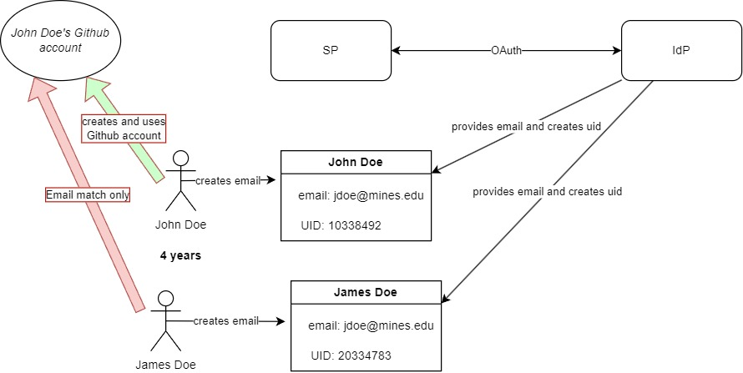
(STATE DIAGRAM)
When emails get reused, and service providers only look at the email, not the uid, a different user can gain access to someones data from said service provider. An attacker could make an email that matches the victims, then log in using this to certain service providers and get the victims data.
Put each step on one slide or animate it so that they pop up
Avery Overberg
Notes:
This is the all the steps put together

Slide 12
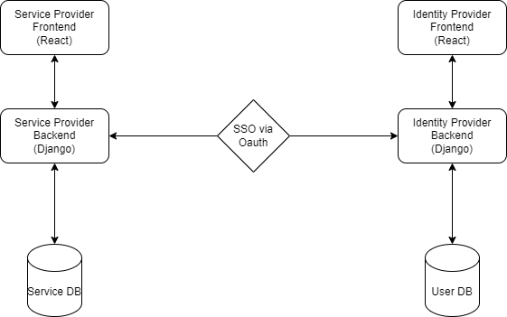
System Architecture
Hilmir Arnarsson

Slide 13
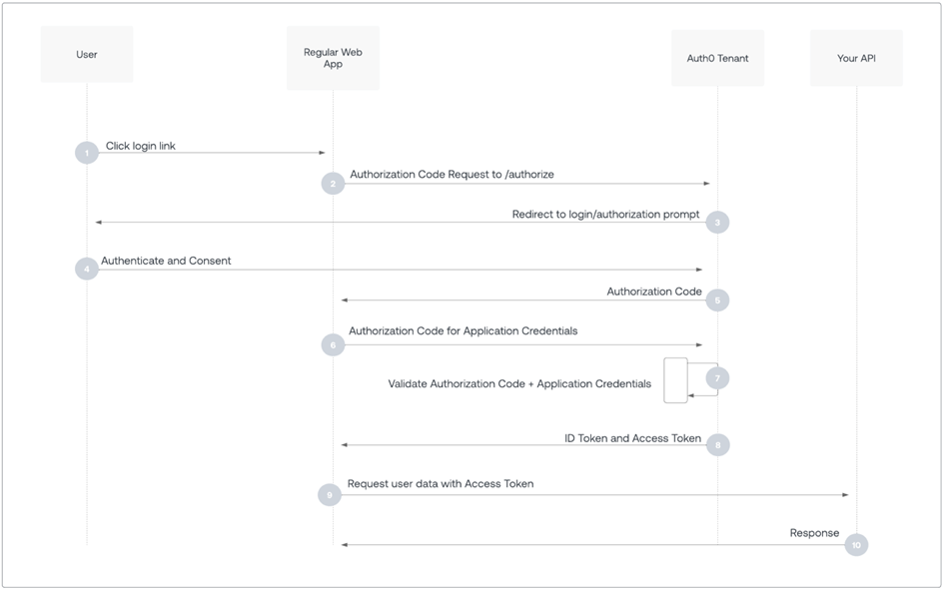
OAuth 2.0 and OIDC explanation
Hilmir Arnarsson

Slide 14

Plans to Mitigate
Identity Provider Side:
Trivial solution, prevent the reuse of usernames
john.doe@mines.edu
jane.doe@mines.edu
jdoe2@mine.edu
Service Provider Side:
Use hash/primary key using username, Universal Unique User Id, and creation date for identifier (current most viable solution)
Utilize Public Key Infrastructure and a Certificate Authority Chain to authenticate users (long term project)
Use Blockchain authentication for the authentication of users (long term project)
Carter Strate

Slide 15
Questions?
‹#›

