Slide 1

The Problem
Forced Social Isolation raise many type of issues
Health and Psychological issues
Reduce the social isolation issues and raise health prevention
Depression for isolation policies

Slide 2


The Solution: HAtH!
distributed, modular open framework
Based upon freemium model and Arduino
Sensors, automation and data
High customization for different needs
Suitable for public and private organizations (SMEs) as well as personal area Prevention and monitoring Health
Easy interaction between everyone

Slide 3
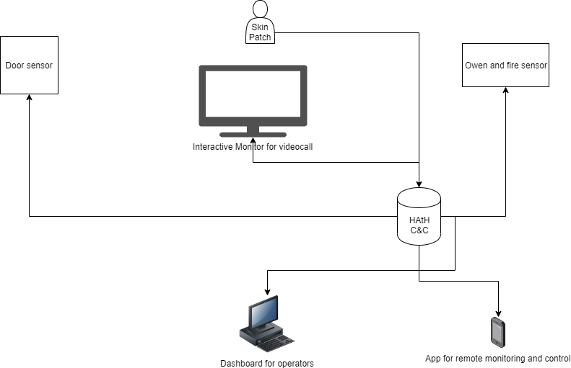
Example of basic HAtH implementation

Slide 4

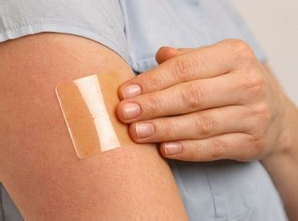
HAtH: NASA Resources
Maps and Pollution
Sensors products
Isolation and human behavioural data
Skin patches
Automation products

Slide 5
HAtH: The complete HAtH solution Team
Giovanni Caria entrepreneur IT sec​
Giovambattista Vieri entrepreneur IT aerospace​
Alex Innocenzi, Code Developer ​​
Fabrizio Marchese, physicist​
Paola Perinelli sw tester​
Karolina Jahn sw tester ​

