Slide 1
LVOOP Introduction
Introduction to object oriented programming with LabVIEW
Dr. Holger Brand, GSI

Slide 2
Agenda
Prerequisites
Motivation: Standard handling of configuration data
Insertion: LabVIEW dataflow concept
LVOOP
Classes and Objects
Inheritance
Pros and Cons
Application
Example: Object oriented handling of configuration data
References

Slide 3
Prerequisites
LabVIEW Basics 1 & 2
Project Explorer
Libraries
Dataflow concept
Is knowledge about object oriented programming necessary?
No!
LabVIEW-Classes enables a developer to define his own data types, that provide much more abilities than (strict) type-definitions.
Experience with conventional OO programming languages, e.g. C++ or Java, is maybe confusing.

Slide 4
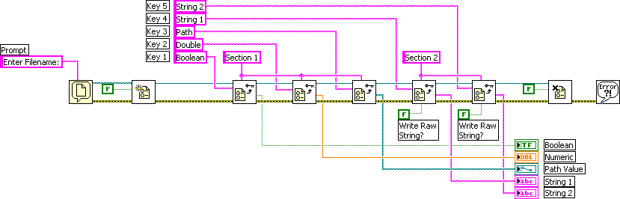
Example: Configuration from ini-file
Simple example: Read Configuration File.vi
Explicit reading of simple LabVIEW data types
[Section 1]
Boolean=True
Double=123
Path=“F:\tmp"
[Section 2]
String 1=“one"
String 2=“two"

Slide 5
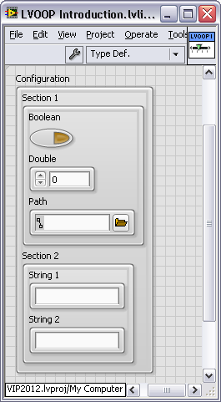
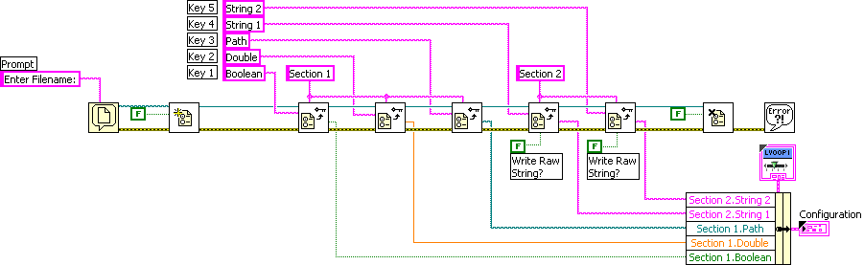
Configuration with Type Definitions
Configuration is Cluster of Clusters
Each cluster is a separate type definition (.ctl)
Configuration
Section 1
Section 2
Pros:
One output wire left only!
Change of type definition applies to all callers.

Slide 6
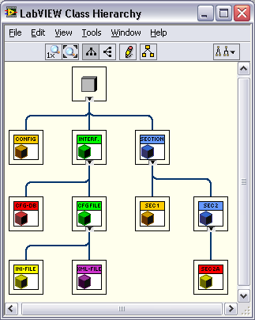
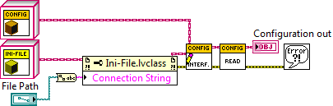
Goals with LVOOP
Extensibility: e.g. device parameters
Many devices of the same type
Many different device types
Some similar, but slightly different, device models
Different storage options
Database, Registry
Ini-, XML-File
Ansatz for solution: Configuration-Class
Derived classes of Section describe different device types and models .
Derived classes of Interface implement the special access to storage media.
[Sec_0]
ClassPath="C:\...\Classes\Section 1\Section 1.lvclass"
Boolean = TRUE
Double = 1.230000
String = "Null"
[Sec_1]
ClassPath="C:\...\Classes\Section 1\Section 1.lvclass"
Boolean = False
Double = 2.340000
String = “One"
[Sec_2]
ClassPath="C:\...\Classes\Section 2\Section 2.lvclass"
String 1 = “Two_1"
String 2 = “Two_2"
[Sec_2a]
ClassPath="C:\...\Classes\Section 2a\Section 2a.lvclass"
String 1 = “Two_a_1"
String 2 = “Two_a_2"
Path = "/F/tmp"
I32 = -345
U32 = 456
Notes:
Inhalt der Ini-Datei in Textfeld!

Slide 7
Insertion: LabVIEW Dataflow
No variables are existing in LabVIEW
There are data sources and data sinks!
A priori it is not clear from where data is originating! E.g.:
From front panel controls in case of interactive mode.
From calling VI as parameter via connector pane.
Local and global variables are not really variables with respect to common sense, but different places in memory which are copied by LabVIEW Runtime-Engine asynchronously. This can lead to unintentional race conditions.
Copies of data are created at wire forks.
The compiler is responsible to maintain a minimum number of copies to be used.
Therefore LabVIEW is inherent thread-save!
LabVIEW provides several options to transport data safely with respect to data flow without race conditions between different threads, VIs or loops.
Queues, Notifications, FGV optionally protected by Semaphore etc.
That’s all true for LabVIEW Objects, too!

Slide 8
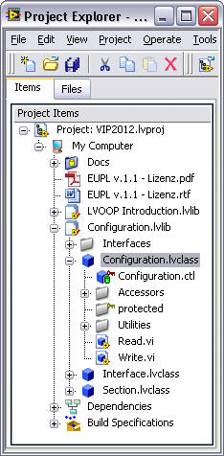
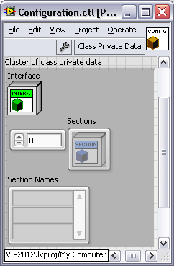
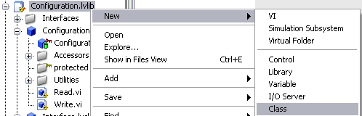

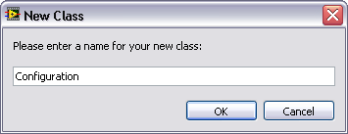
LVOOP Objects and Classes
An Object is an Instance of a Class.
Comparison: Class: cooking recipe -> Object: real meal
A LabVIEW Class has following properties:
Attributes are defined in Cluster of Class Private Data.
Methods are VIs, that read or modify attributes.
Data-Access-VIs (Accessors): read or write
Other VIs, that modify attribute data.
Access Scope: (Who is allowed to call VIs?)
Private (Community): VIs of that class only (and friends)
Protected: VIs of that class and derived classes
Public: All VIs. These VIs provide the public interface!

Slide 9
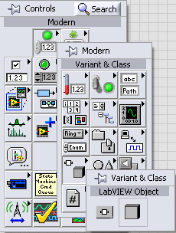
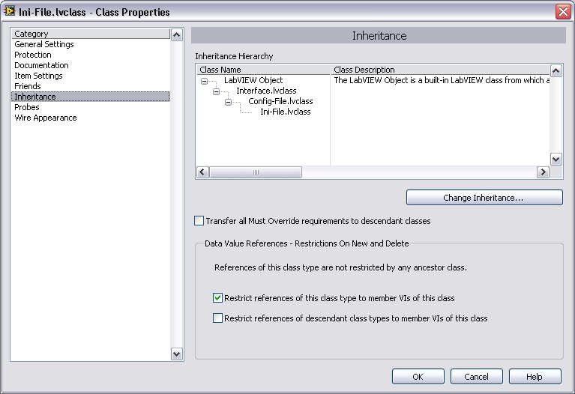
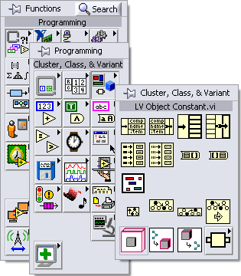
LVOOP Inheritance
Every user class is derived from a base class
LabVIEW Object is the ultimate ancestor class
Empty cluster of class private data
No methods
A Class
inherits properties of its ancestor class
Attributes: Access via accessor-VIs
Methods: protected and public
extends the ancestor class with
new attributes
new methods
specializes methods of ancestor class
overrides Dynamic Dispatch-VIs with Override-VIs.

Slide 10
Pros of LVOOP Classes (in comparison to type definitions)
Encapsulation
Attribute data is always private. It can be changed by class methods only.
The internal data structure is hidden.
Access rights: Public, Protected, Private, Community (friend)
Modularity
Each class has its own clearly defined responsibility.
The public interface should be well defined.
It should be modified with very good reason, only!
Eases testability.
Extensibility
Derived classes extend the attributes and methods of their ancestor class.
Specialization
Derived classes special the behavior of their ancestor class.
LabVIEW Objects behave exactly like other LabVIEW data types
They are following the dataflow paradigm!

Slide 11


LVOOP Cons and Solutions
There are no real cons.
(Copy-) Constructors and Destructors are not existing.
They are simply not necessary.
LabVIEW Objects behave the same as other LabVIEW data types.
Attributes are always private.
They cannot be displayed or changed directly on the front panel.
XControls are the solution for this problem.
XControls can also be used as probes.
Polymorphic class-VIs are not supported.
Parameters could be implemented as derived class of a common ancestor class.
Parameters as Variant.
Especially Variant-Attributes.
Multiple inheritance is not supported.
An alternative is the Composition design pattern
References to Objects
Dataflow: Single Element Sized Queue
Data Value Reference
Danger of deadlocks

Slide 12
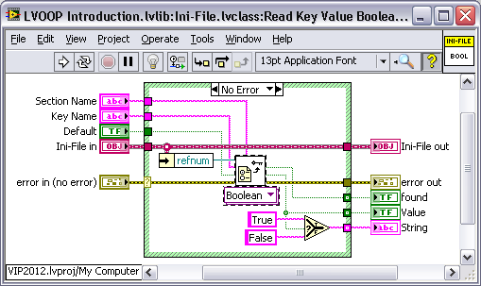


LVOOP Application
Possible cases for the application of LVOOP classes:
Cluster or type definitions, which become potentially extended, can be replaced with classes.
Derives classes add attributes to the ancestor class.
Replacement of data type dependent (e.g. Enumeration) Case-Structures by dynamic dispatching.
Dependent of the objects class the correct corresponding Overwrite-VI is called.
Development of generic frameworks
The application layer uses base classes only.
Details are implemented in derived classes.

Slide 13
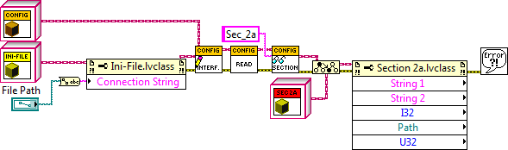
LVOOP Example: Read configuration
[Sec_2]
ClassPath="C:\...\Classes\Section 2\Section 2.lvclass"
String 1 = „Two_1"
String 2 = „Two_2"
[Sec_2a]
ClassPath="C:\...\Classes\Section 2a\Section 2a.lvclass"
String 1 = „Two_a_1"
String 2 = „Two_a_2"
Path = "/F/tmp"
I32 = -345
U32 = 456

Slide 14
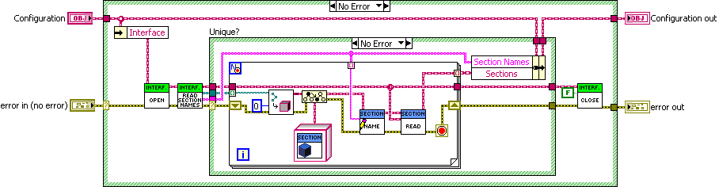
LVOOP Example: Read configuration
Factory Pattern

Slide 15
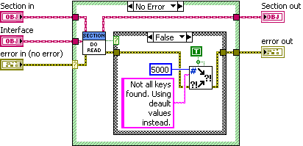
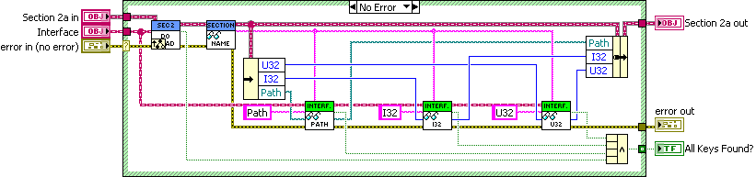
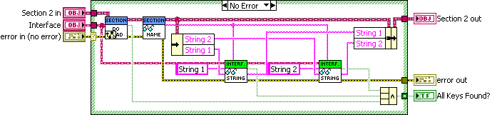
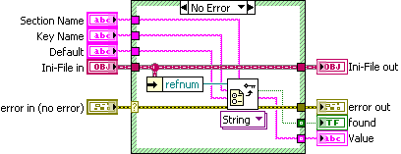
LVOOP Example: Read Section
Section class (public, static) (Channeling Pattern)
Derived class (protected, override)
Ancestor class
Ini-File class (public, overwrite)

Slide 16
References
LabVIEW Menue>Help>LabVIEW Help... -> Contents -> Fundamentals -> LabVIEW Object-Oriented Programming
LabVIEW Menue>Help> Find Examples -> Browse by Task -> Fundamentals -> Object-Oriented
LabVIEW Object-Oriented Programming: The Decisions Behind the Design
LabVIEW Object-Oriented Programming FAQ
Applying Common OO Design Patterns to LabVIEW
HGF Baseclass Library
Mobile Agent System
Actor Framework
Measurement Abstraction and Model-View-Controller (MVC) Project with Actor Framework in LabVIEW
Thanks to Stephen Mercer for his contributions to web documents & discussions

Slide 17
Got curious about LVOOP?
Programming concept: Actors Object oriented approach – Actor Framework Template
Hands-On-Course: Opportunity to gain experience in LVOOP.
Create classes in LabVIEW Project
Attributes
Methods
Access rights
Inheritance
Dynamic Dispatching
Overwriting
Simple design patterns
NI Actor-Framework

