Slide 1
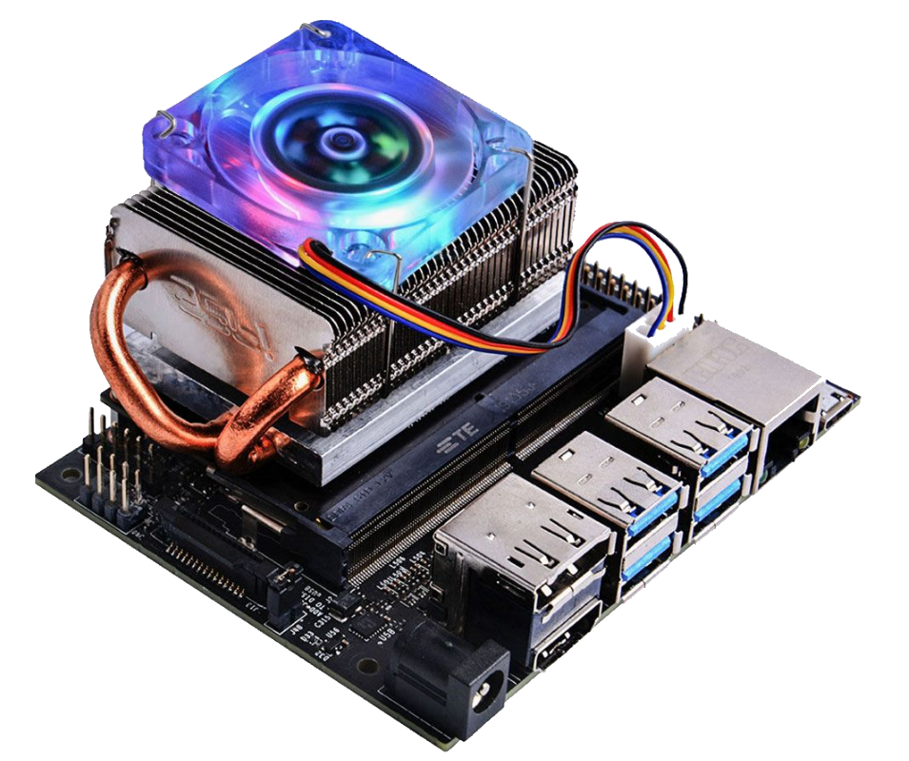




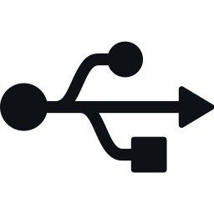



Jetson Nano 2GB
WHAT IS A JETSON? · NVIDIA, 2020
A $60 mini computer built to teach AI and robotics. No longer sold, still very capable.
CPU
4-core ARM Cortex-A57, 1.43 GHz
GPU
128-core NVIDIA Maxwell, CUDA
RAM
2 GB LPDDR4, shared with GPU
VIDEO
H.264 / H.265 hardware encoder
I/O
Gigabit LAN, 3× USB, HDMI
POWER
5 V USB-C, about 5–10 W
My use: DATV on QO-100
OS
Ubuntu 18.04 + JetPack 4.6
Its hardware H.265 encoder feeds an ADALM-Pluto
Notes:
What is a Jetson Nano 2GB: NVIDIA's $60 AI learning kit from 2020, now end of life. Key point for DATV: the hardware H.264/H.265 video encoder, which feeds the ADALM-Pluto for QO-100.

Slide 2




Turn an unused Jetson Nano
into a DATV transmitter
READY-TO-FLASH SD CARD IMAGE · HB9IIU
Never managed to make it work? Now it has a job.
Works out of the box with a Pluto
3 clicks
ADALM-Pluto running Evariste's (F5OEO) firmware
USB camera is optional
Plug in a webcam for live pictures, or run without one
to go on air
1
Select source
Demo video included
Something to transmit from the very first boot
2
Pick a free BATC slot
Add your own videos
3
Start stream
Upload clips from any browser to a USB drive
Notes:
Many of us have a Jetson Nano 2GB lying in a drawer - I did too, and never really got it working. This SD card image turns it into a DATV transmitter: flash it, connect a Pluto with Evariste's firmware, and you're ready. A USB camera is optional, a demo video is included, and you can upload your own clips from the web UI. Going on air takes three clicks: select a source, pick a free slot on the BATC spectrum, start stream.

Slide 3
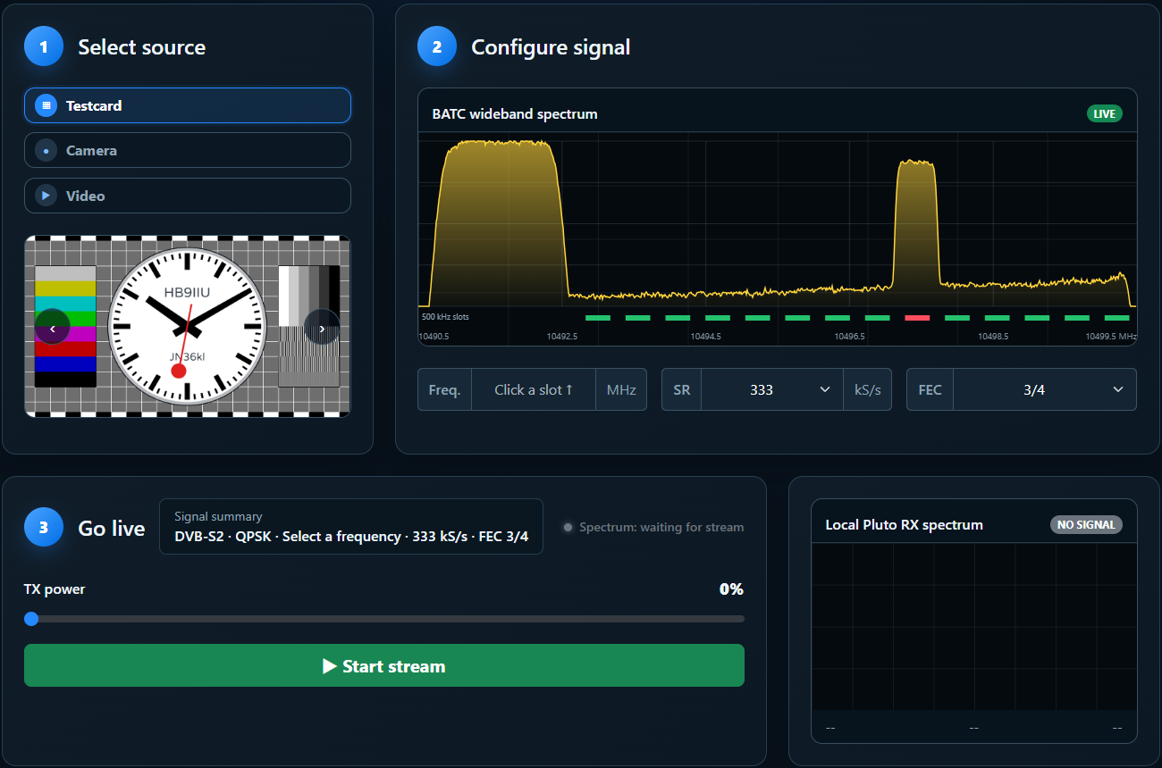
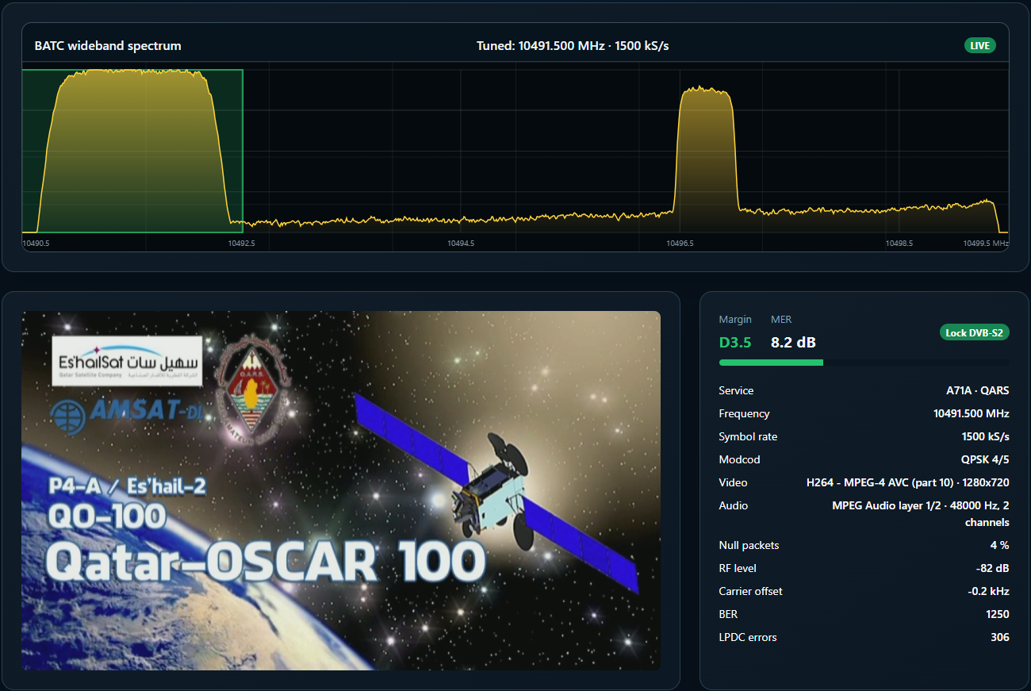
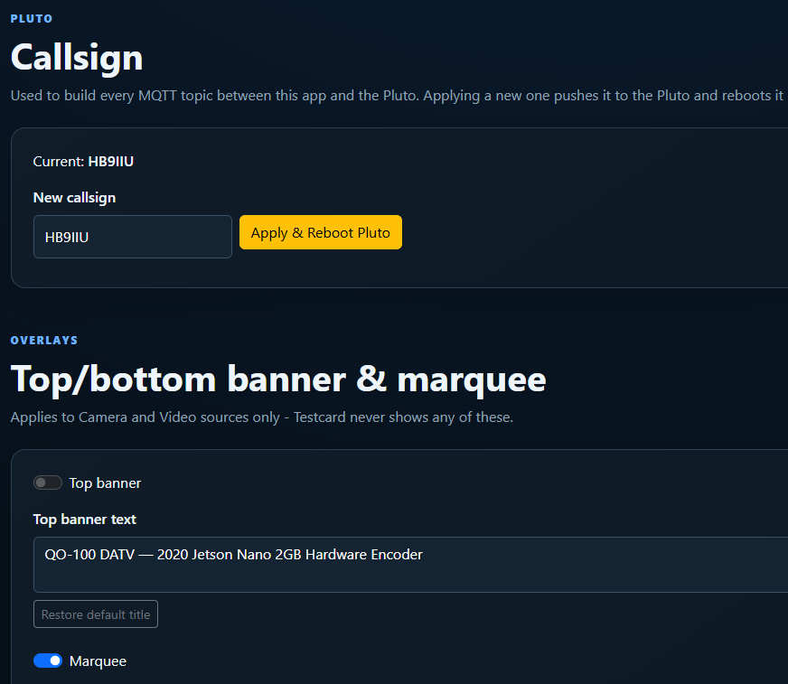
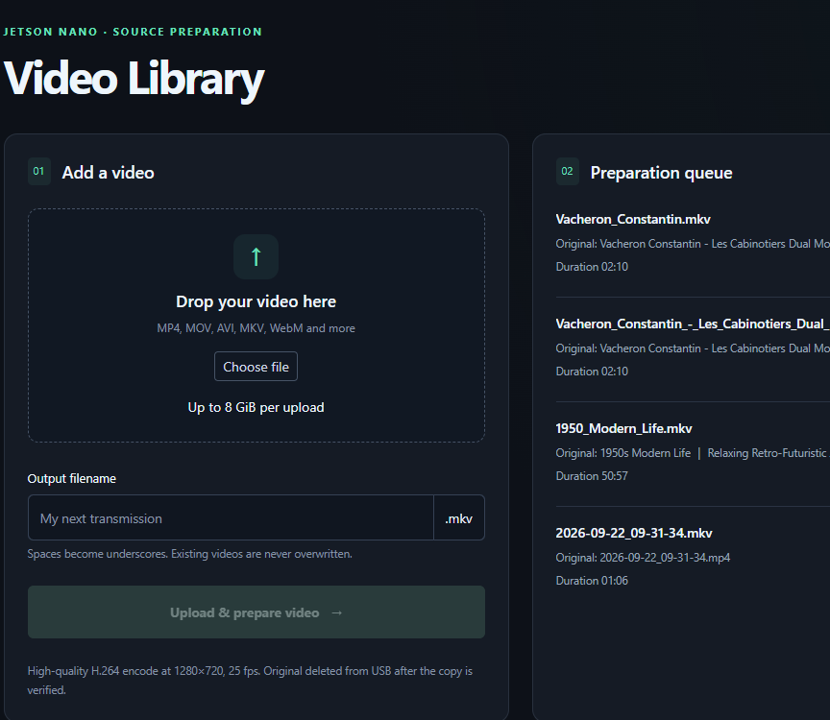
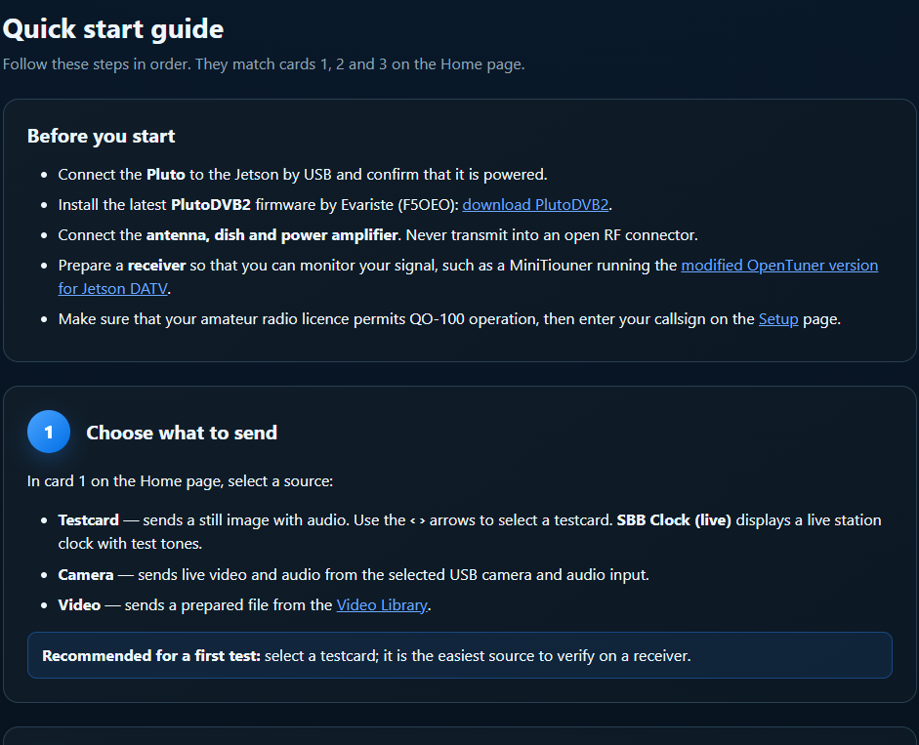





One web app, five pages
JETSON DATV · WEB UI · ANY BROWSER
Open http://jetson-nano.local and you have the whole station.
Home
RX
Setup
Video Library
Help
Pick a source and a slot, go on air
Watch QO-100 via OpenTuner
Callsign, overlays, tuner, USB
Upload and prepare clips
Quick start and troubleshooting
Notes:
The whole station is one web app with five pages, reachable from any browser on the local network. The header always shows whether the Pluto is connected and whether OpenTuner is online.

Slide 4
Home: three steps to air
HOME PAGE · SELECT · CONFIGURE · GO LIVE
The page is built around three clicks.
1
Select source
Testcard, camera or a prepared video, with live preview
2
Configure signal
Click a free green slot on the live BATC spectrum. SR 333 / 500 kS/s, FEC 3/4 or 2/3
3
Go live
Start stream, then raise TX power while the local Pluto RX spectrum confirms the signal
Notes:
The Home page follows the three cards: 1 select a source, 2 click a free green slot on the live BATC wideband spectrum and choose symbol rate and FEC, 3 start the stream and raise TX power while watching the local Pluto RX spectrum. SR 333 and FEC 3/4 are good defaults.

Slide 5
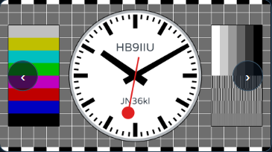
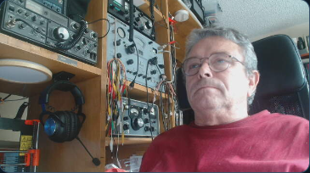
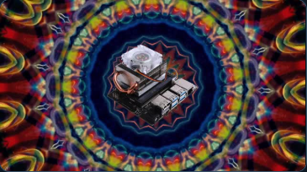



Three things to send
TESTCARD · CAMERA · VIDEO
Something to transmit from the first boot, camera or not.
Testcard
Camera
Video
Test cards with tone, or the live SBB station clock
Any USB webcam plus its microphone or another audio input
Clips from the Video Library, demo clip included
Camera and Video can add a top banner, a scrolling marquee and a live callsign / clock bottom banner.
Notes:
Three kinds of source. Testcard: still cards with a tone, or the live SBB station clock showing callsign and locator. Camera: any USB webcam with its microphone or another audio input. Video: clips prepared in the Video Library; a demo clip is included. Camera and Video can carry a top banner, a scrolling marquee and the live callsign/clock bottom banner.

Slide 6
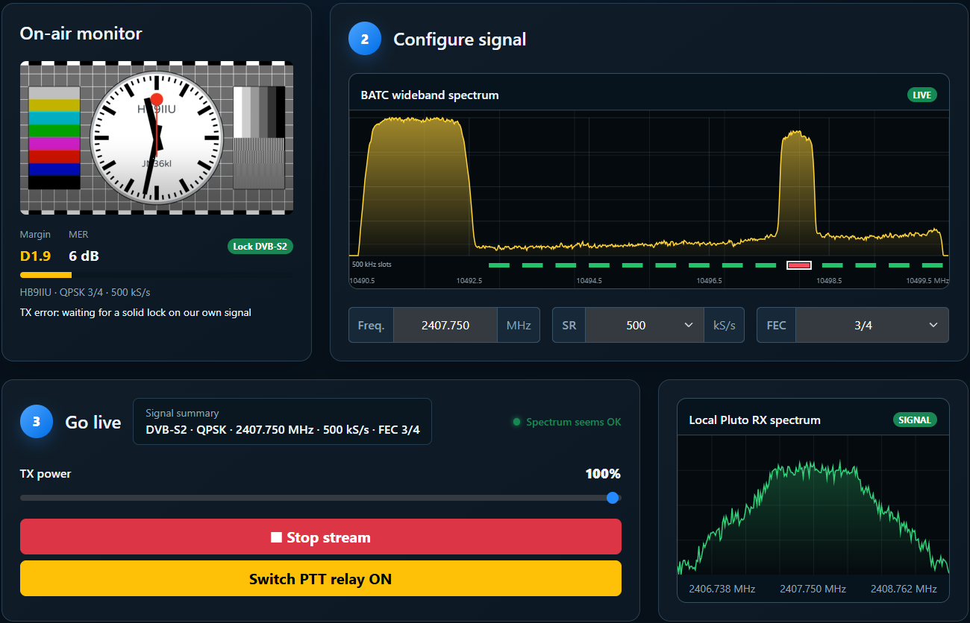




On air: see your own signal
ON-AIR MONITOR · LOCAL RX SPECTRUM · PTT RELAY
Know what reaches the satellite, not just what leaves the Pluto.
On-air monitor
Your picture back via QO-100, MER and lock
Local Pluto RX spectrum
Confirms the Pluto is really transmitting
PTT relay
You switch it on once the signal looks stable
TX frequency correction
Measured on your own signal, lands in the slot
Notes:
While transmitting, card 1 becomes the On-air monitor: your own signal received back through QO-100 by OpenTuner, with margin, MER and lock. The local Pluto RX spectrum shows the Pluto really transmits. The optional PTT relay (physical pin 18) switches the power amplifier: you switch it on once the local spectrum looks stable, because the Pluto can spike at start. It switches off automatically when the stream stops. The Pluto's own frequency error is measured on your signal and applied from the next start.

Slide 7


RX: watch QO-100 in the browser
OPENTUNER · MINITIOUNER · OPTIONAL
Click any signal on the spectrum to tune the receiver.
Click to tune
Pick any signal on the BATC spectrum
Live video and receiver data
MER, margin, modcod, service name
Auto-tune on TX
OpenTuner follows you on every stream start
Beacon auto-calibration
LNB error measured and tracked by itself
Notes:
Optional: a MiniTiouner with the modified OpenTuner sends received video and receiver data to the Jetson. On the RX page, click a signal on the spectrum to tune. On every stream start OpenTuner is retuned to your own signal. When locked on the beacon, the LNB frequency correction calibrates itself and follows drift with temperature.

Slide 8
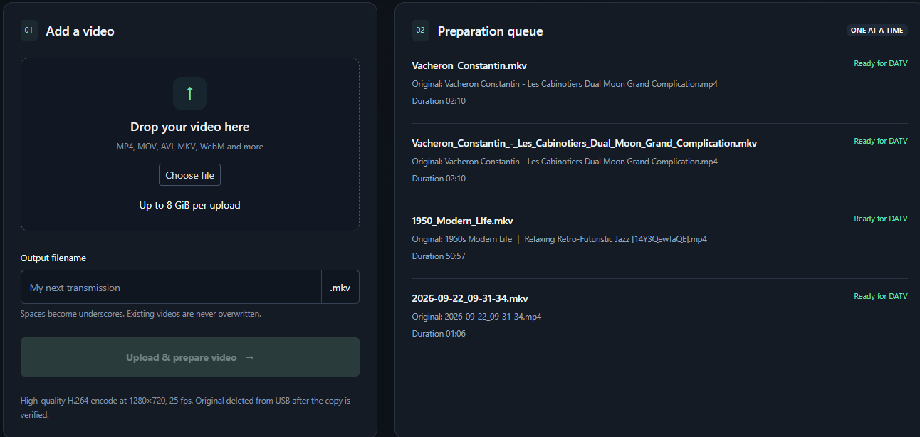



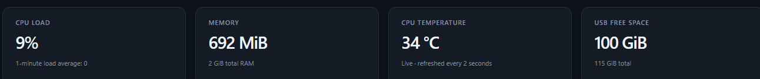
Video Library: your own clips
UPLOAD · AUTO-CONVERT · USB DRIVE
Drop a file in the browser; the Jetson makes it DATV-ready.
Drop any format
MP4, MOV, AVI, MKV, WebM, up to 8 GiB
Prepared automatically
H.264, 1280×720, 25 fps
Kept on a USB drive
Preview, delete, then pick it under Video
Live system stats
CPU, memory, temperature, free space
Notes:
The Video Library takes almost any video file from the browser, up to 8 GiB, and prepares it for DATV: high-quality H.264 at 1280x720, 25 fps, one at a time. Files live on a USB drive, can be previewed and deleted, and appear under Video on the Home page once ready. Live CPU, memory, temperature and free-space tiles show how the Jetson is doing.

Slide 9

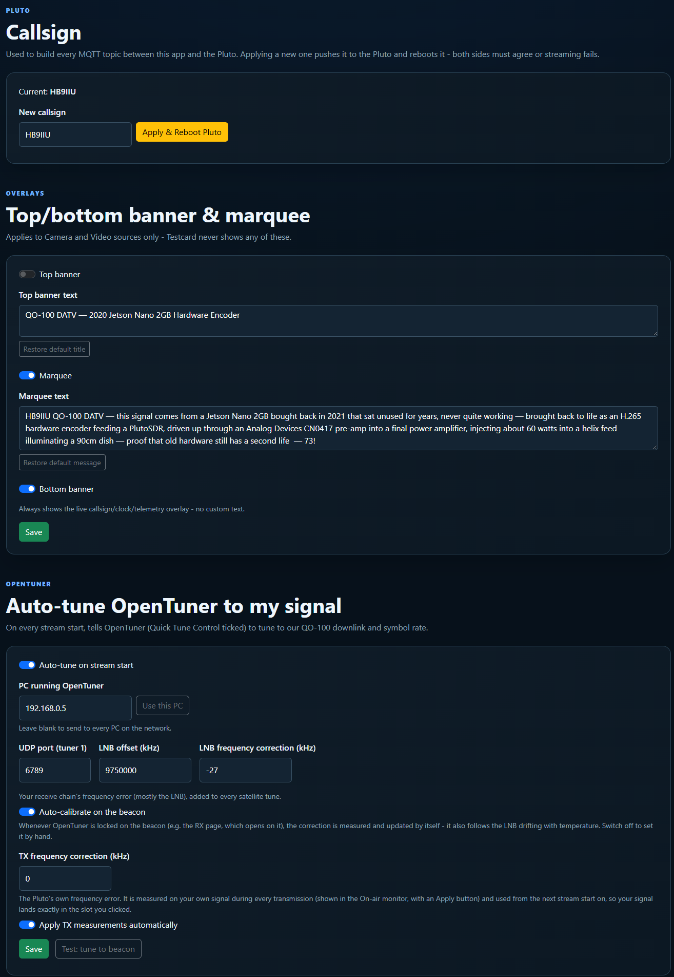


Setup: set once, forget
CALLSIGN · OVERLAYS · OPENTUNER · USB
One page for everything that isn't per transmission.
Callsign
Sent to the Pluto too, so both sides always agree
Banners and marquee
Your own text over Camera and Video
OpenTuner and corrections
Auto-tune, LNB offset, RX and TX frequency correction
USB video key
Choose the drive that holds your prepared videos
Restart app
Picks up updates in about five seconds
Notes:
Setup holds everything you set once: the callsign (pushed to the Pluto, which reboots), the overlay texts, OpenTuner auto-tune with LNB and TX frequency correction, the USB drive used for videos, and a restart button for the app.

Slide 10
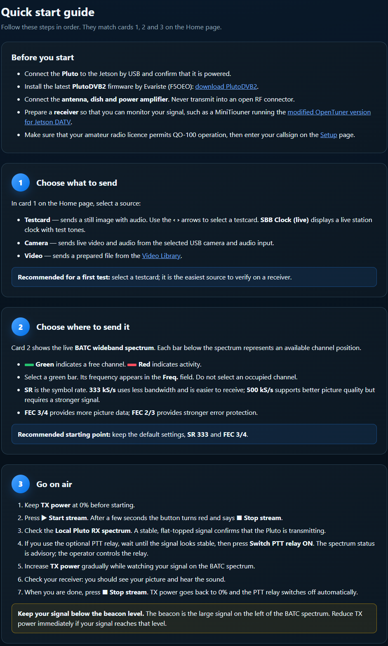




Help is built in
QUICK START · WIRING · TROUBLESHOOTING
No manual to hunt for: it ships with the app.
Before you start
PTT relay wiring
Firmware, antenna, PA, receiver, licence
Physical pin 18, 3.3 V logic relay module
OpenTuner setup
Troubleshooting
Quick Tune, Jetson Stream, beacon test
Every status message explained
On QO-100
Free channel only · stay below the beacon · keep tests short
Notes:
A full Help page is built in: quick start matching the Home cards, a before-you-start checklist, PTT relay wiring, how to add videos and set up OpenTuner, troubleshooting, and good operating practice on QO-100.

Slide 11






Get the SD card image
FREE DOWNLOAD · RASPBERRY PI IMAGER · 32 GB CARD
Scan the code, flash the card, boot the Jetson.
Download the image
Latest jetson.img.xz linked on GitHub, about 5 GB
Use a 32 GB microSD card
Tested and working on a fresh 32 GB card
Flash with Raspberry Pi Imager
Choose OS › Use custom › jetson.img.xz (no unzip)
Boot and open the web UI
Scan for the latest image
Power up, then browse to http://jetson-nano.local
github.com/HB9IIU/HB9IIU-Jetson-DATV-transmitter
Notes:
Project page and latest image: https://github.com/HB9IIU/HB9IIU-Jetson-DATV-transmitter
Flash with Raspberry Pi Imager (Choose OS > Use custom) onto a 32 GB microSD card. Tested and working.

