Slide 1
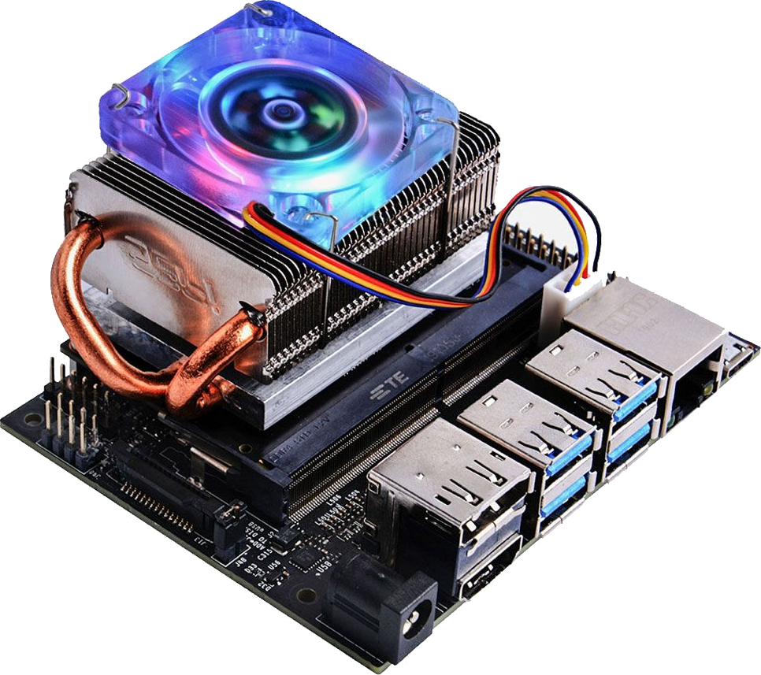








Jetson Nano 2GB
WHAT IS A JETSON? · NVIDIA, 2020
A $59 mini computer built to teach AI and robotics. No longer sold, still very capable.
CPU
4-core ARM Cortex-A57, 1.43 GHz
GPU
128-core NVIDIA Maxwell, CUDA
RAM
2 GB LPDDR4, shared with GPU
VIDEO
H.264 / H.265 hardware encoder
I/O
Gigabit LAN, 3× USB, HDMI
POWER
5 V USB-C, about 5–10 W
My use: DATV on QO-100
OS
Ubuntu 18.04 + JetPack 4.6
Its hardware H.265 encoder feeds an ADALM-Pluto
Notes:
What is a Jetson Nano 2GB: NVIDIA's $59 AI learning kit from 2020, now end of life. Key point for DATV: the hardware H.264/H.265 video encoder, which feeds the ADALM-Pluto for QO-100.

Slide 2




Got a Jetson Nano 2GB in a drawer?
READY-TO-FLASH SD CARD IMAGE · HB9IIU
Never managed to make it work? Turn it into a DATV transmitter.
Works out of the box with a Pluto
3 clicks
ADALM-Pluto running Evariste's (F5OEO) firmware
USB camera is optional
Plug in a webcam for live pictures, or run without one
to go on air
1
Select source
Demo video included
Something to transmit from the very first boot
2
Pick a free BATC slot
Add your own videos
3
Start stream
Upload more clips from any browser via the web UI
Notes:
Many of us have a Jetson Nano 2GB lying in a drawer - I did too, and never really got it working. This SD card image turns it into a DATV transmitter: flash it, connect a Pluto with Evariste's firmware, and you're ready. A USB camera is optional, a demo video is included, and you can upload your own clips from the web UI. Going on air takes three clicks: select a source, pick a free slot on the BATC spectrum, start stream.

Slide 3

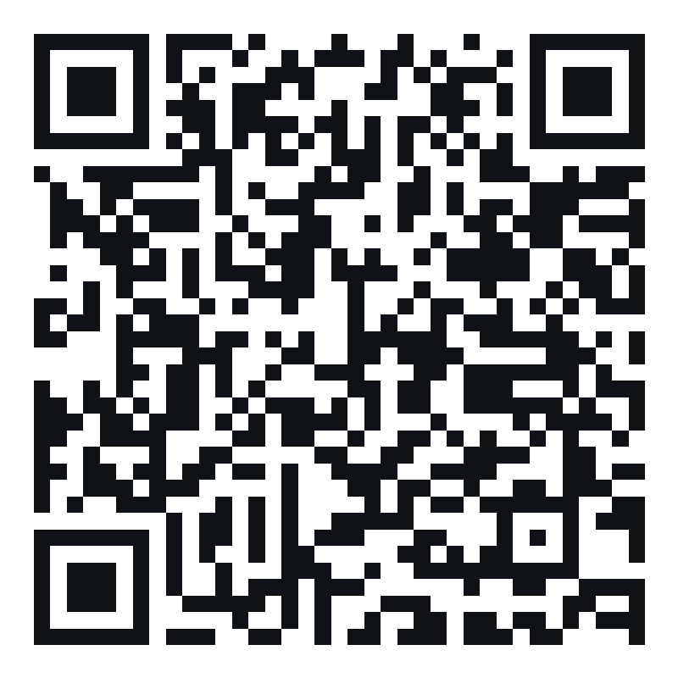



Get the SD card image
FREE DOWNLOAD · RASPBERRY PI IMAGER · 32 GB CARD
Scan the code, flash the card, boot the Jetson.
Download the image
Scan the QR code: jetson.img.xz, about 5.6 GB
Use a 32 GB microSD card
Tested and working on a fresh 32 GB card
Flash with Raspberry Pi Imager
Choose OS › Use custom › jetson.img.xz (no unzip)
Boot and open the web UI
Scan to download
Power up, then browse to http://jetson-nano.local
Google Drive · jetson.img.xz
Notes:
Download link: https://drive.google.com/file/d/1KOO9mWcRhIP5yVT3PENrq5p7Ek5pGANZ/view?usp=sharing
Flash with Raspberry Pi Imager (Choose OS > Use custom) onto a 32 GB microSD card. Tested and working.

