Slide 1


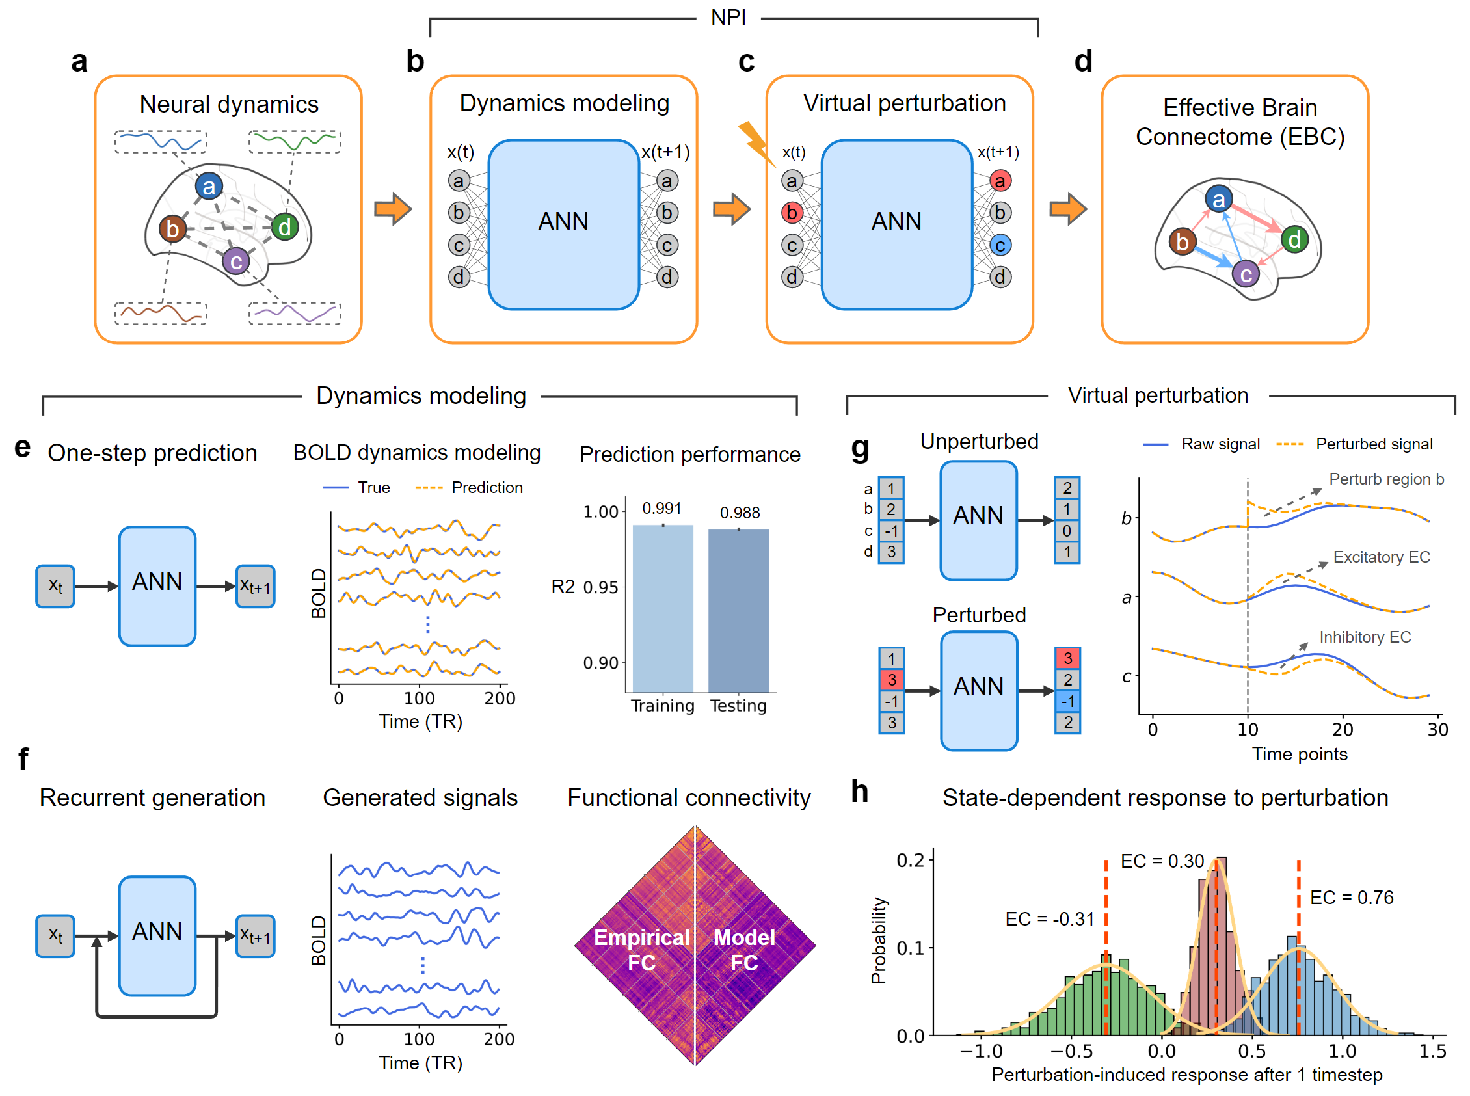
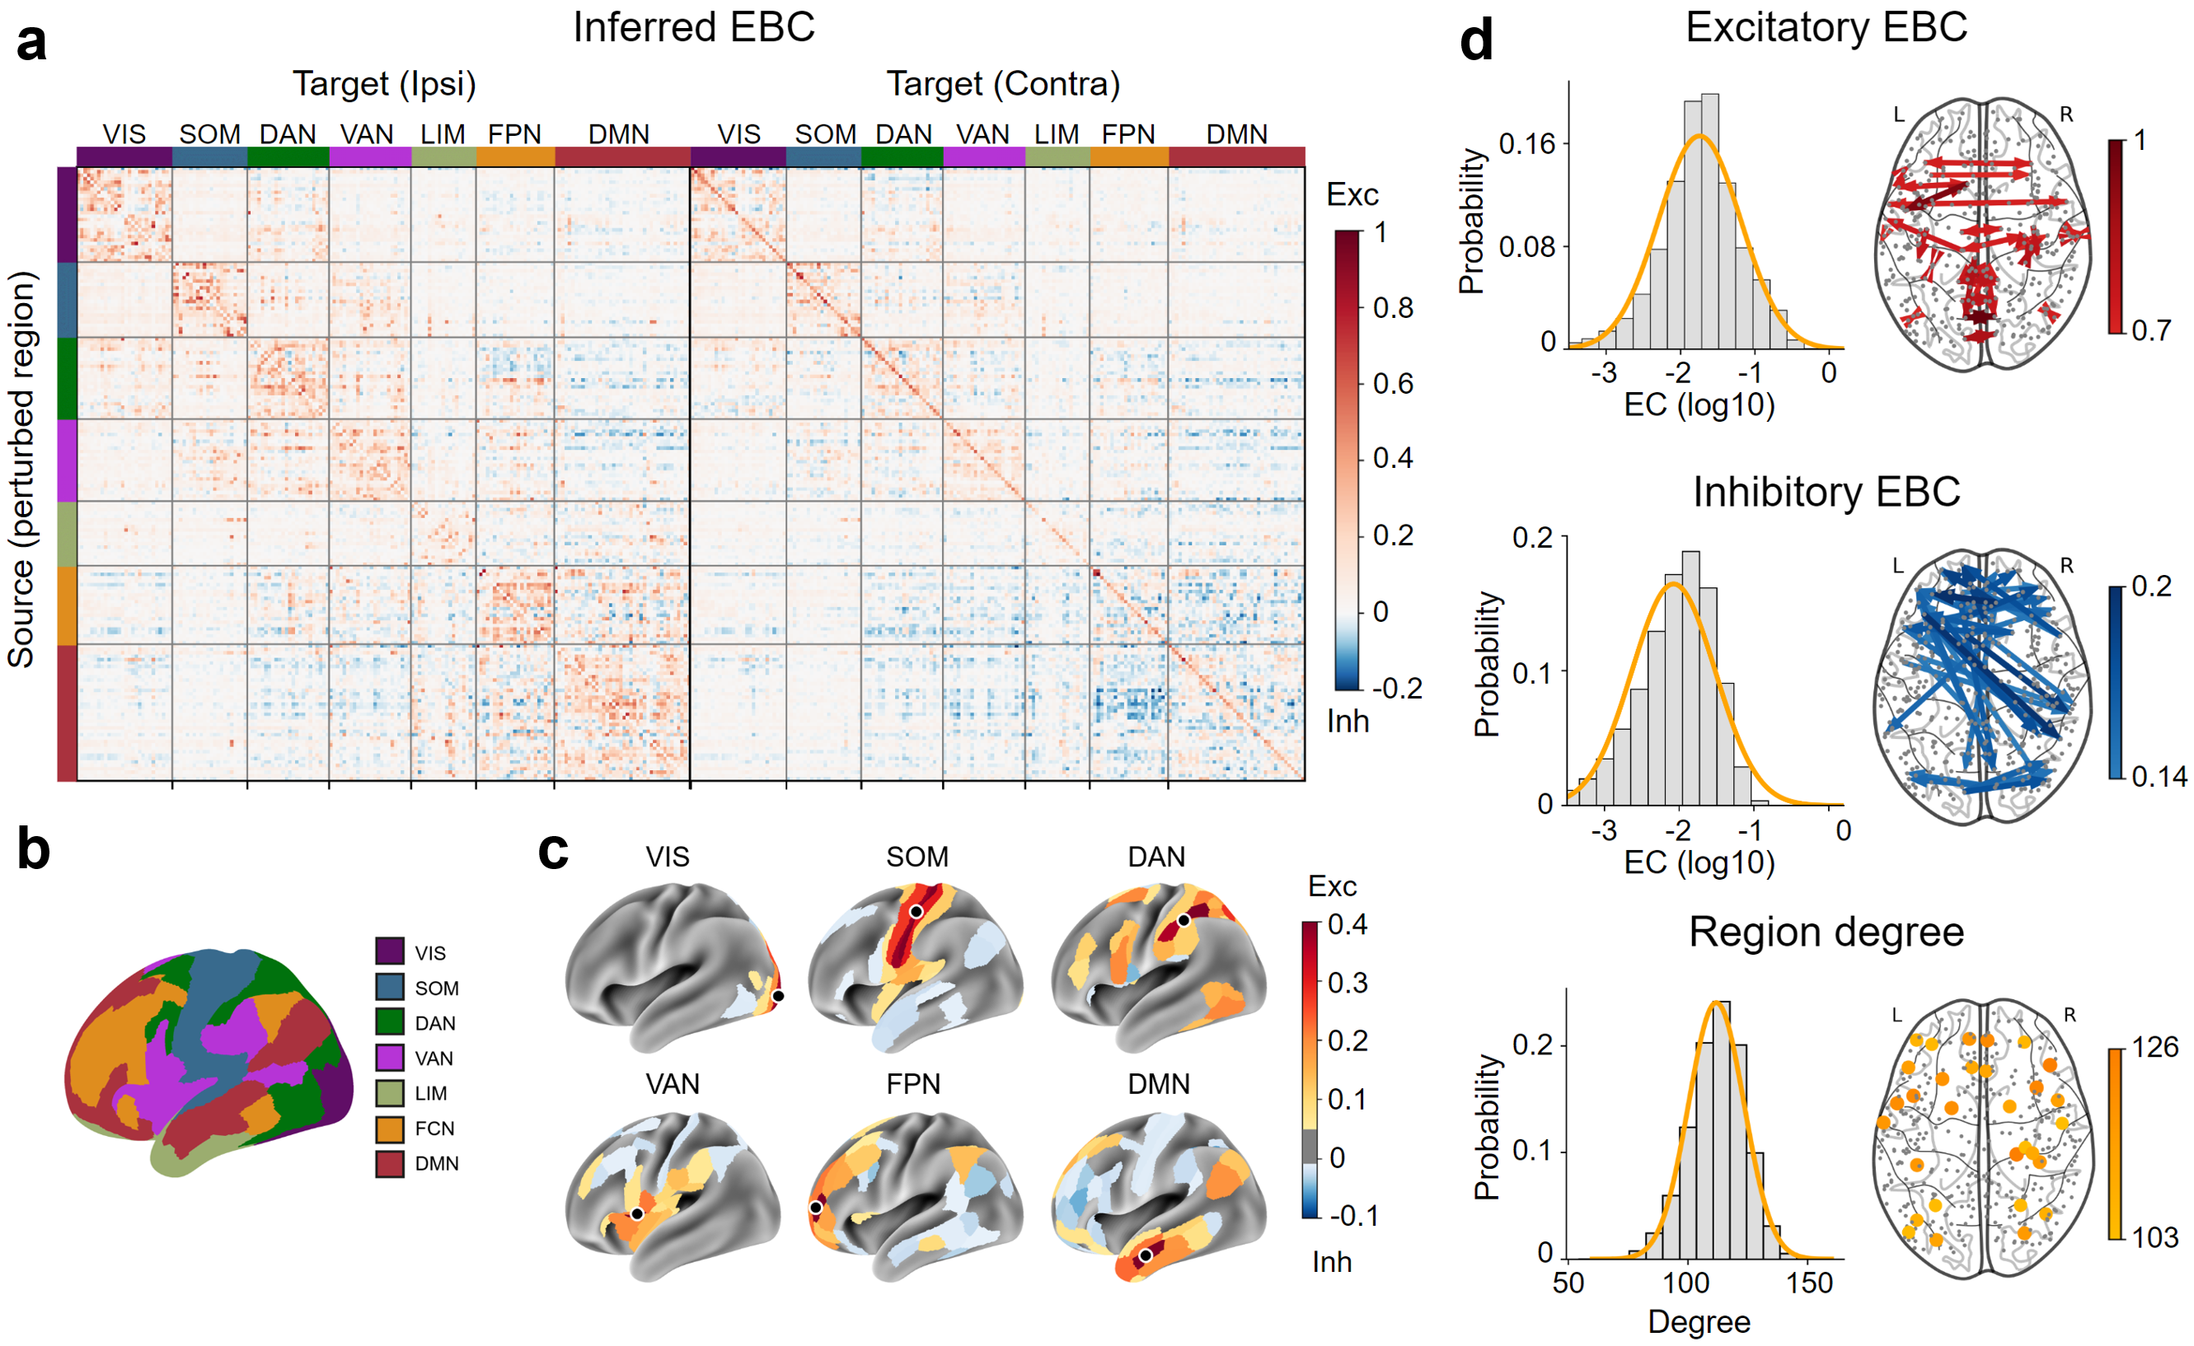
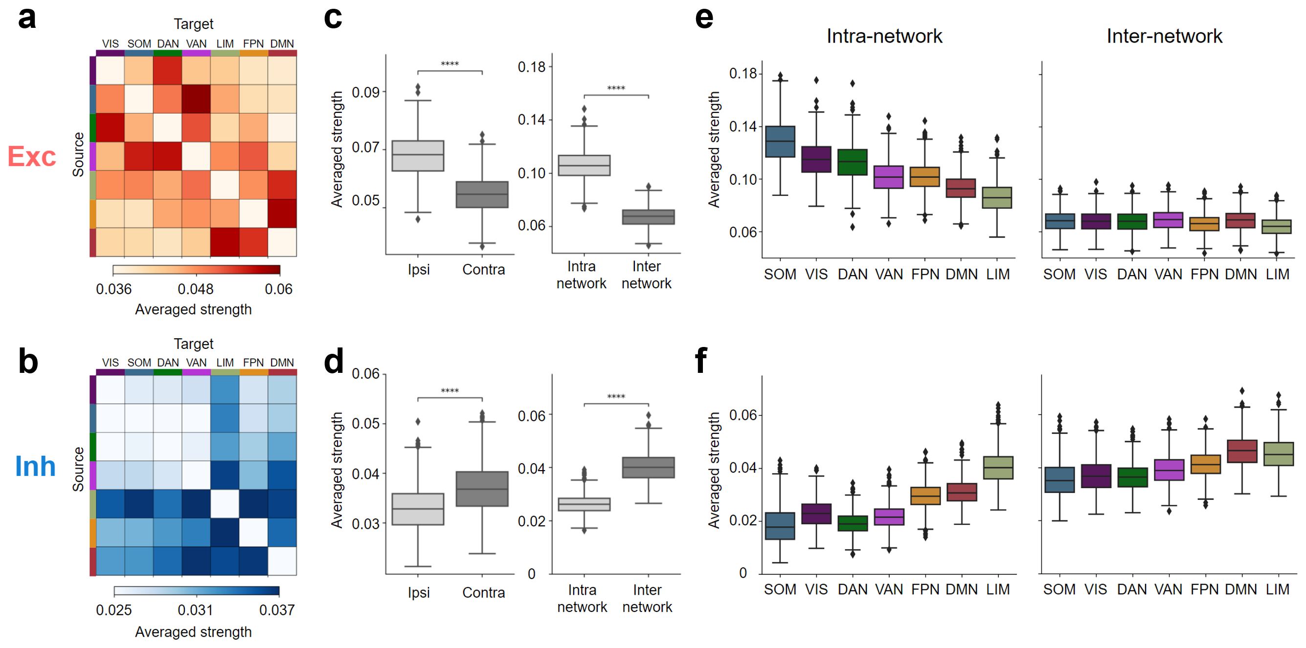
The Fourth International Workshop on Human Brain and Artificial Intelligence (HBAI 2024)
Mapping the whole-brain effective connectome with excitatory-inhibitory causal relationship
Zixiang Luo¹, Zhichao Liang¹, Chenyu Xu², Changsong Zhou³, and Quanying Liu¹
1 Department of Biomedical Engineering, Southern University of Science and Technology, 2 Department of Electrical and Computer Engineering, Iowa State University, 3 Department of Physics, Hong Kong Baptist University
Introduction
Framework
Understanding the large-scale causal relationship among brain regions is crucial for elucidating the information flow that the brain integrates external stimuli and generates behaviors [1,2]. Despite the availability of neurostimulation and computational methods to infer causal relationships among a limited number of regions, these approaches are not capable of mapping the causal network of the entire brain, also known as the effective brain connectome (EBC). To address this gap, we propose a data-driven framework called Neural Perturbational Inference (NPI) and map the human EBC for the first time.
NPI uses an artificial neural network trained with human neural data to learn large-scale neural dynamics as a surrogate brain. By perturbing each region of the surrogate brain and observing the resulting responses in all other regions, the human EBC is obtained. This connectome captures the directionality, strength, and excitatory-inhibitory distinction of brain-wide causal relationships. The human EBC offers a comprehensive macroscopic organization of information flow in the brain and has great potential to guide the target selection for personalized treatments of neural disorders.
Results
Fig 1. The Neural Perturbational Inference (NPI) framework for mapping effective brain connectome
The NPI framework consists of two main steps:
Dynamics modelling: An artificial neural network (ANN) model is trained to capture the brain dynamics in terms of predicting the next brain state x(t+1) given the current brain state x(t). The ANN accurately captures neural dynamics in fMRI in terms of one-step prediction and FC recovery.
Virtual perturbation: The ANN is then served as a surrogate brain to be perturbed. After perturbing a source region, a higher response in the target region indicates a stronger EC from the source region to the target region. Perturbing all regions in turn offers EBC.
The effective brain connectome (EBC)
EBC provides the whole-brain ECs with directionality, strength, and excitatory-inhibitory distinction.
78% connections in EBC are significant.
The strength of both excitatory and inhibitory EC follows a log-normal distribution.
Excitatory EC has higher strengths within-networks and within-hemispheres. The inhibitory EC has higher strengths inter-networks and inter-hemispheres.
The strength of intra-network excitatory and inhibitory EC follows an opposite hierarchy.
Fig 2. The human effective brain connectome (EBC)
References
[1] Reid, A. T. et al. Advancing functional connectivity research from association to causation. Nat Neurosci 22, 1751–1760 (2019).
[2] Park, H.-J. & Friston, K. Structural and Functional Brain Networks: From Connections to Cognition. Science 342, 1238411 (2013).
Fig 3. The organization of excitatory and inhibitory ECs across functional networks

