Slide 1
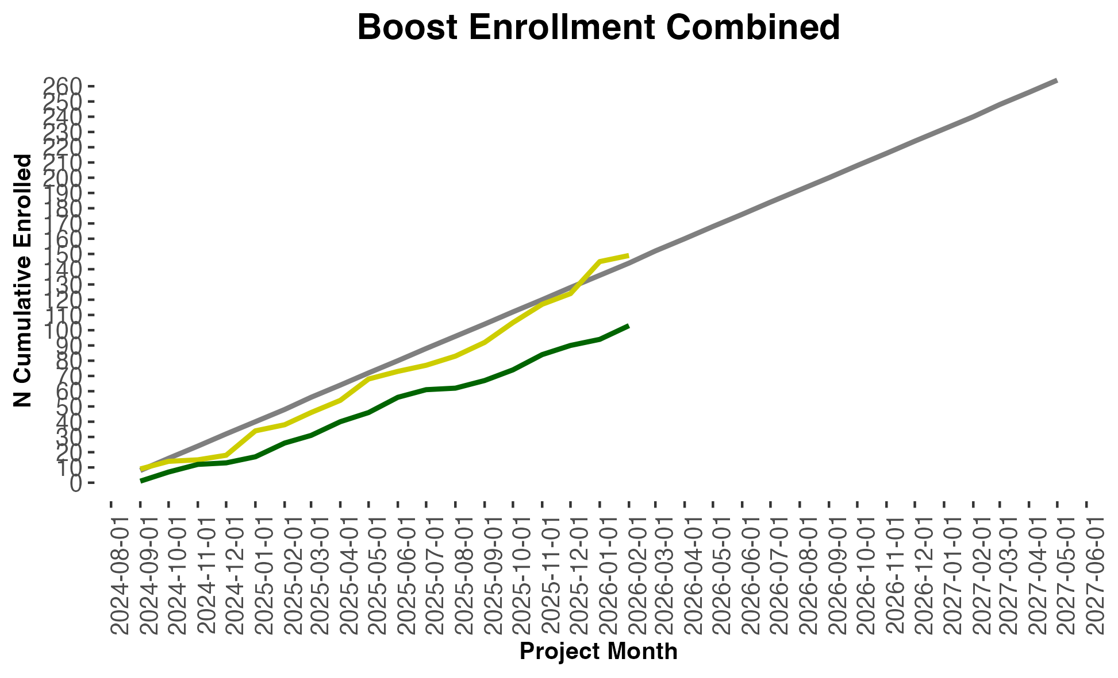
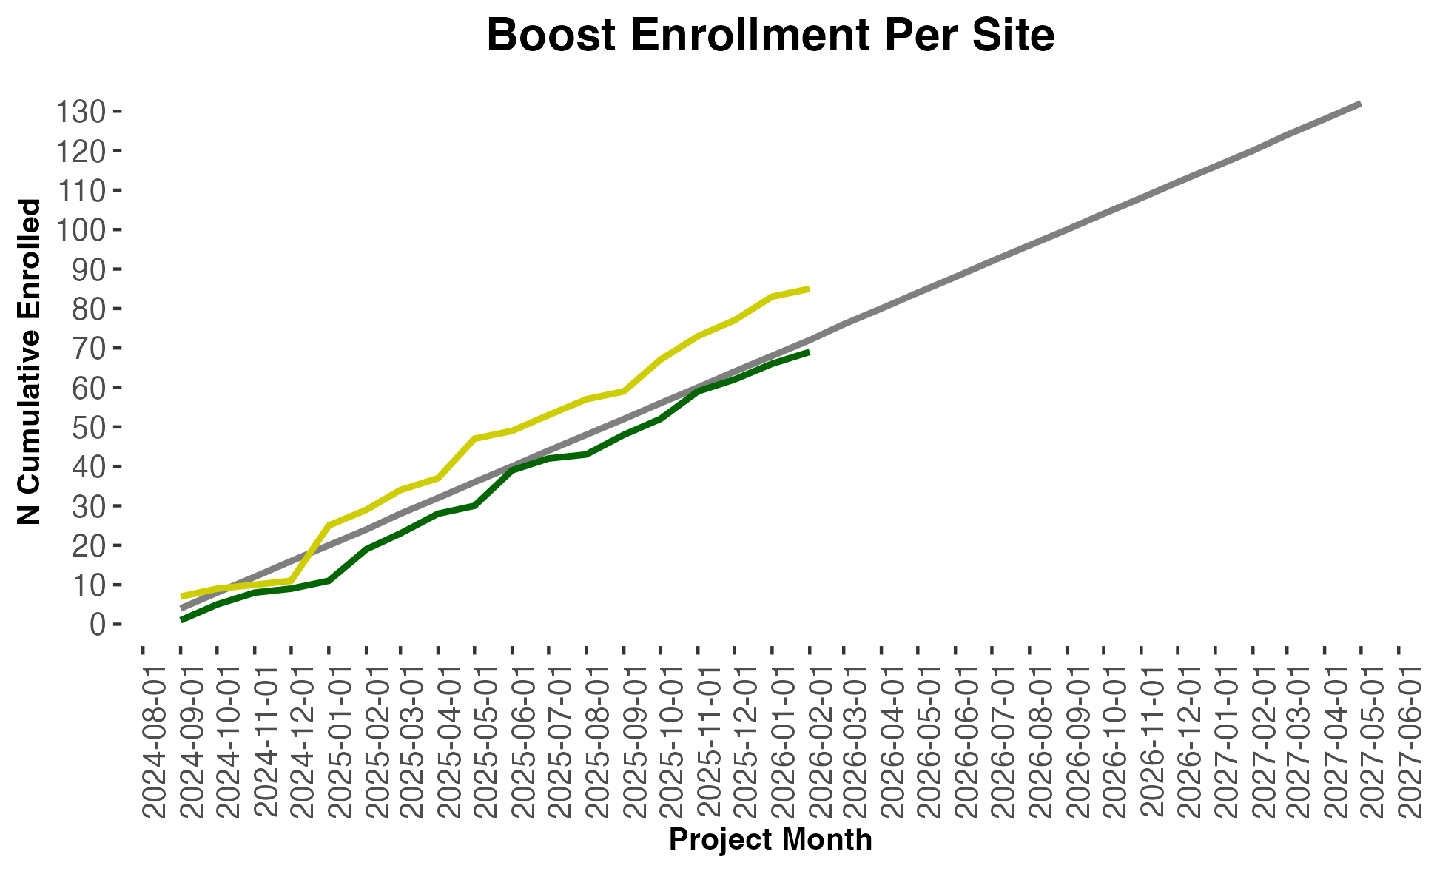
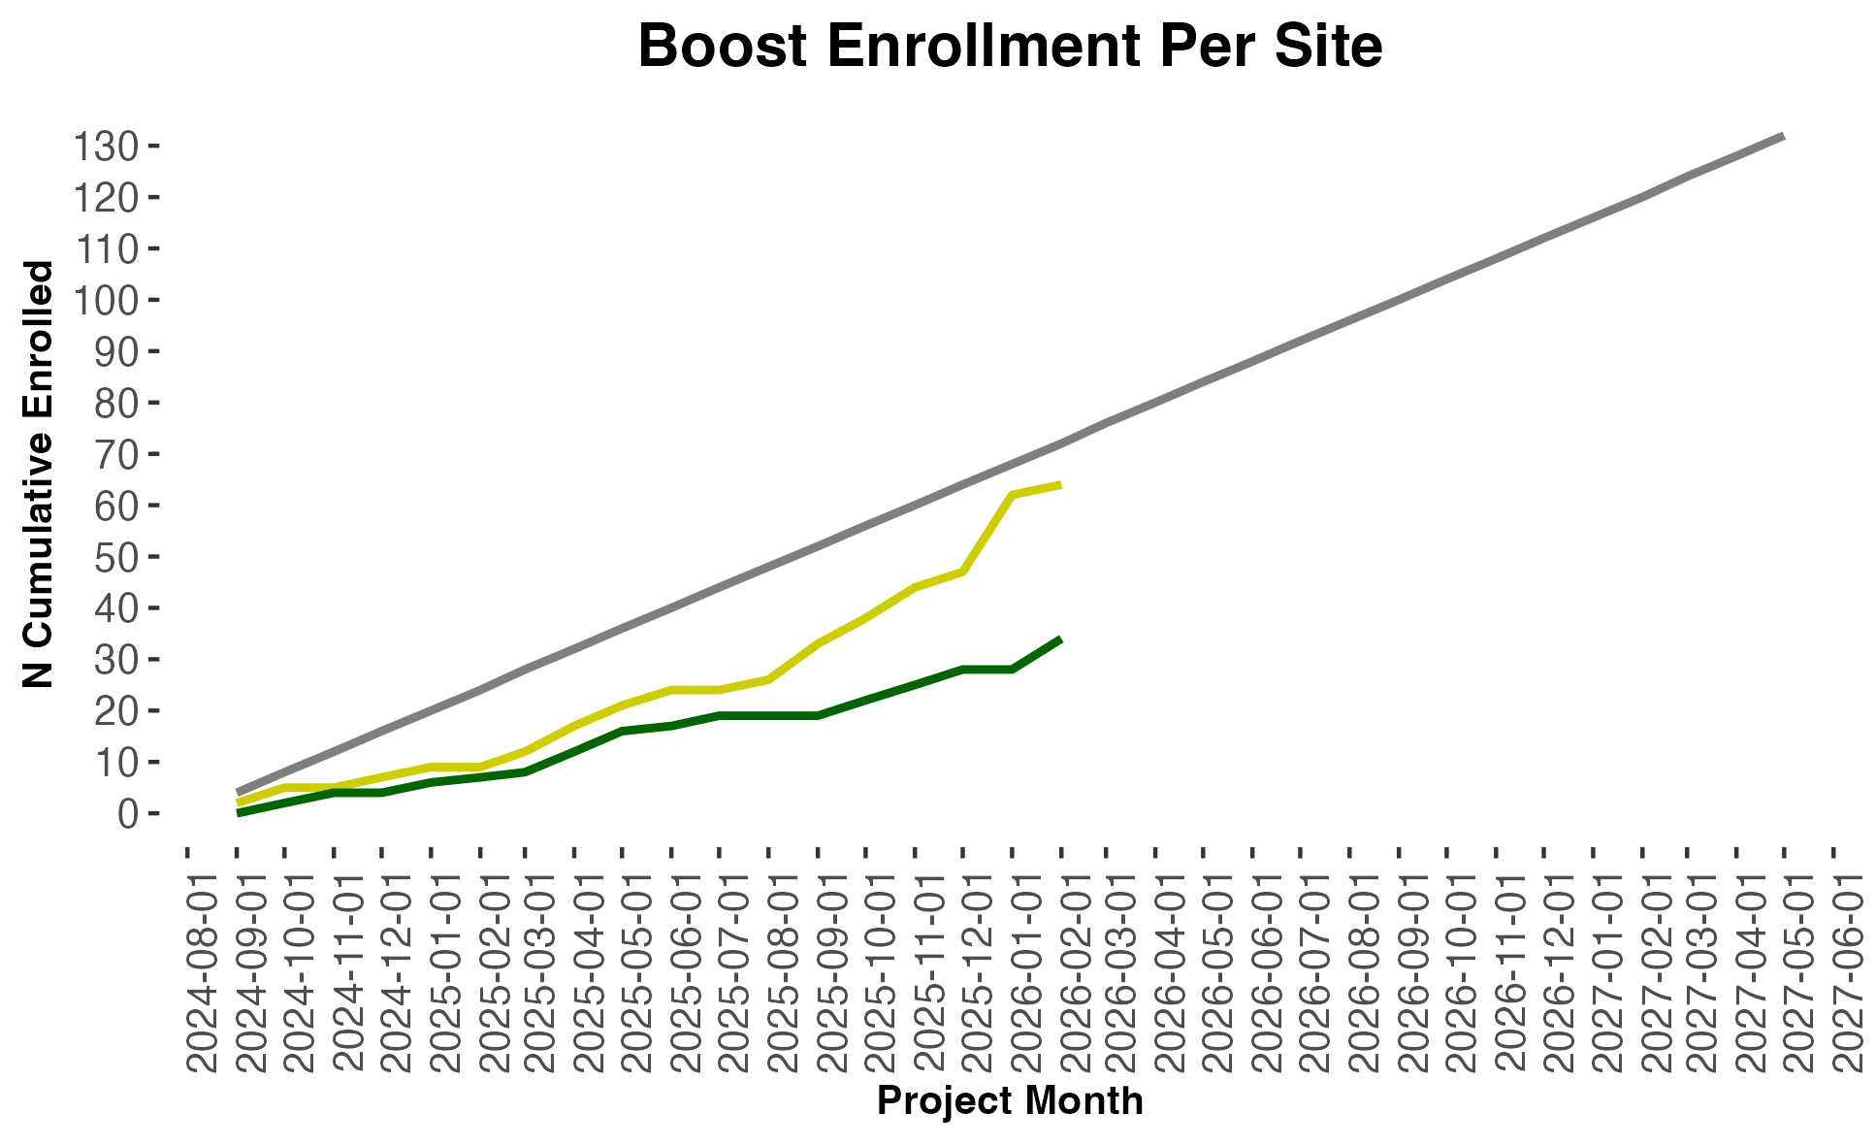
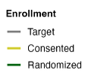
Figure 1
Iowa
Northeastern

Slide 2
Table 1
Site | Supervised | Unsupervised
UI (n=31) | 91.70% | 79.10%
NE (n=10) | 92.30% | 83.7%
Total | 91.90% | 80.2%

Slide 3
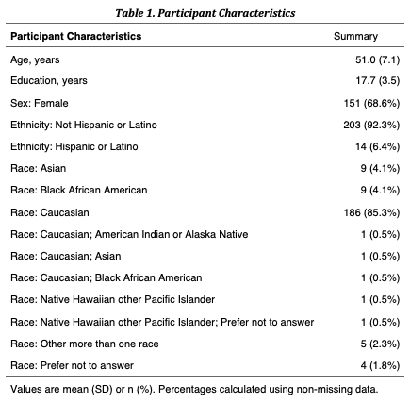
Table 2

Slide 4
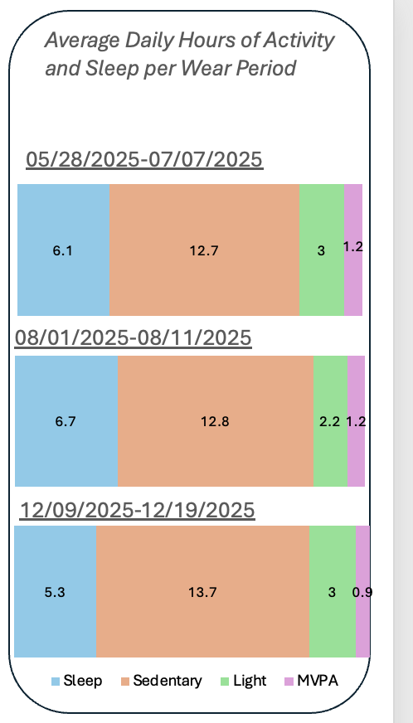
Figures 2+ in progress
Iowa
Northeastern
Any workflow figures that help show our process/pipeline for actigraph data prep?
Wear period 1
Wear period 1
Wear period 2
Wear period 2
One graph for observational data set that is a separate figure?
Wear period 3
Wear period 3

