Slide 1
49ers Racing Post-Processing Data
testsim
Powered by Nayak

Slide 2
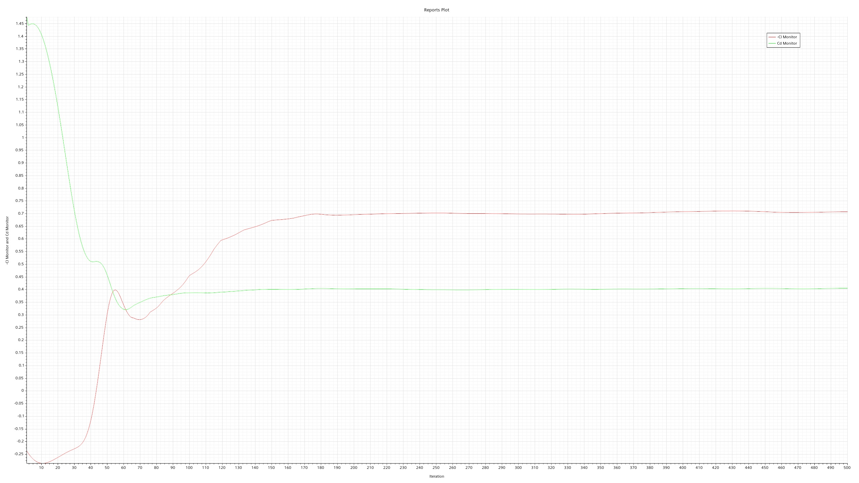
Cd and -Cl
Cd and -Cl

Slide 3
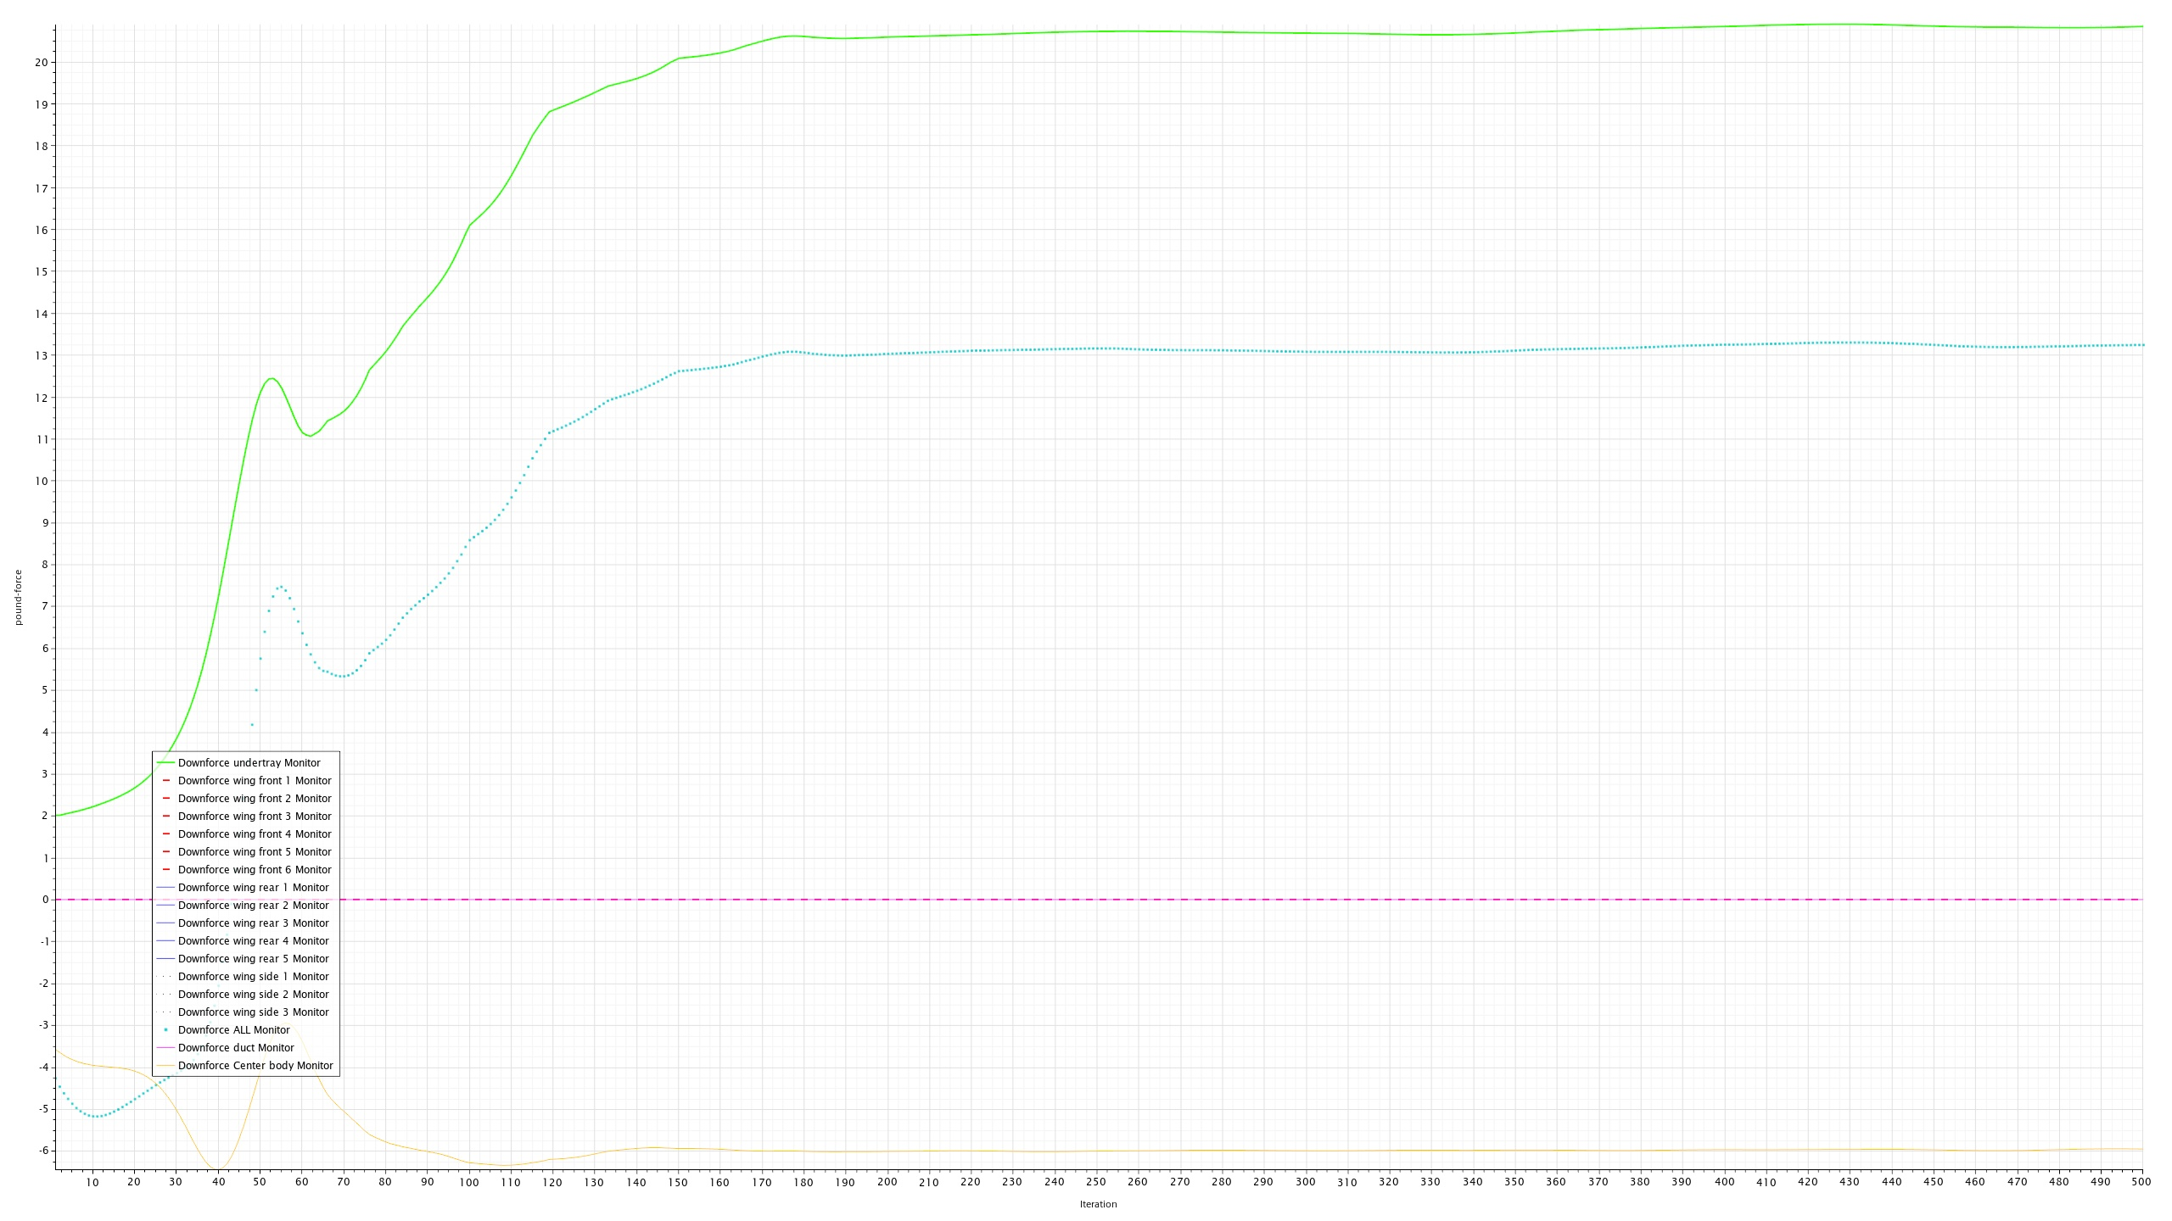
Downforce plots
Downforce plots

Slide 4
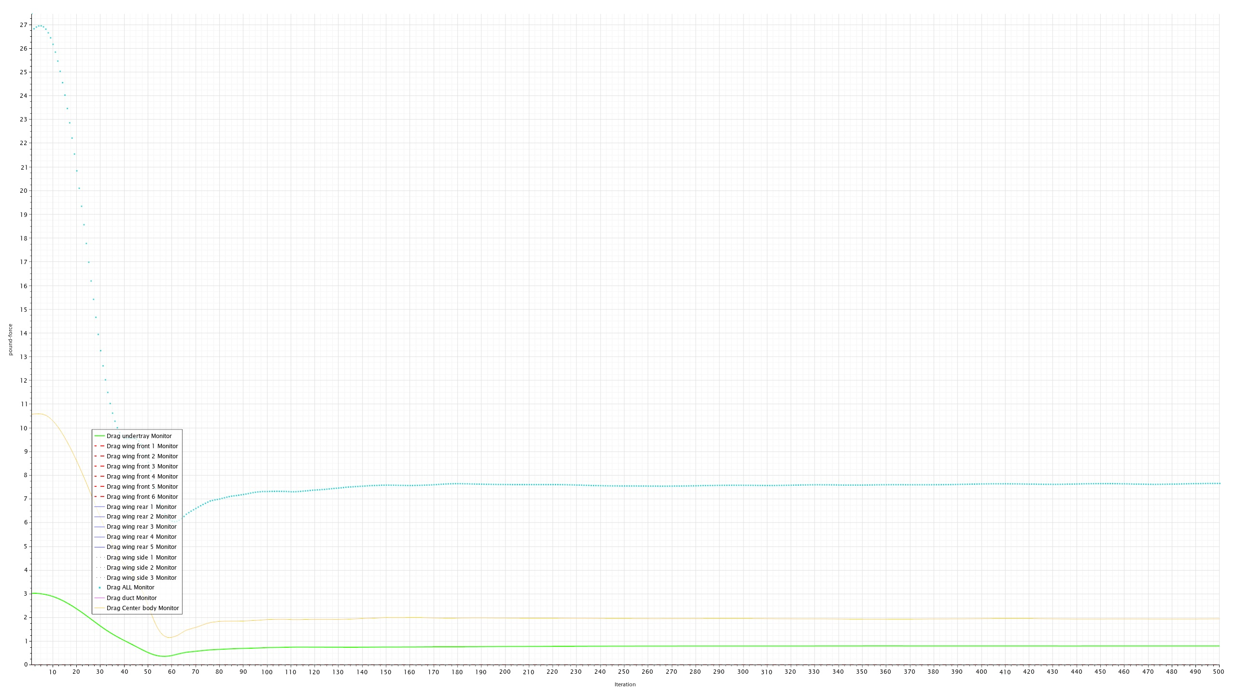
Drag plots
Drag plots

Slide 5
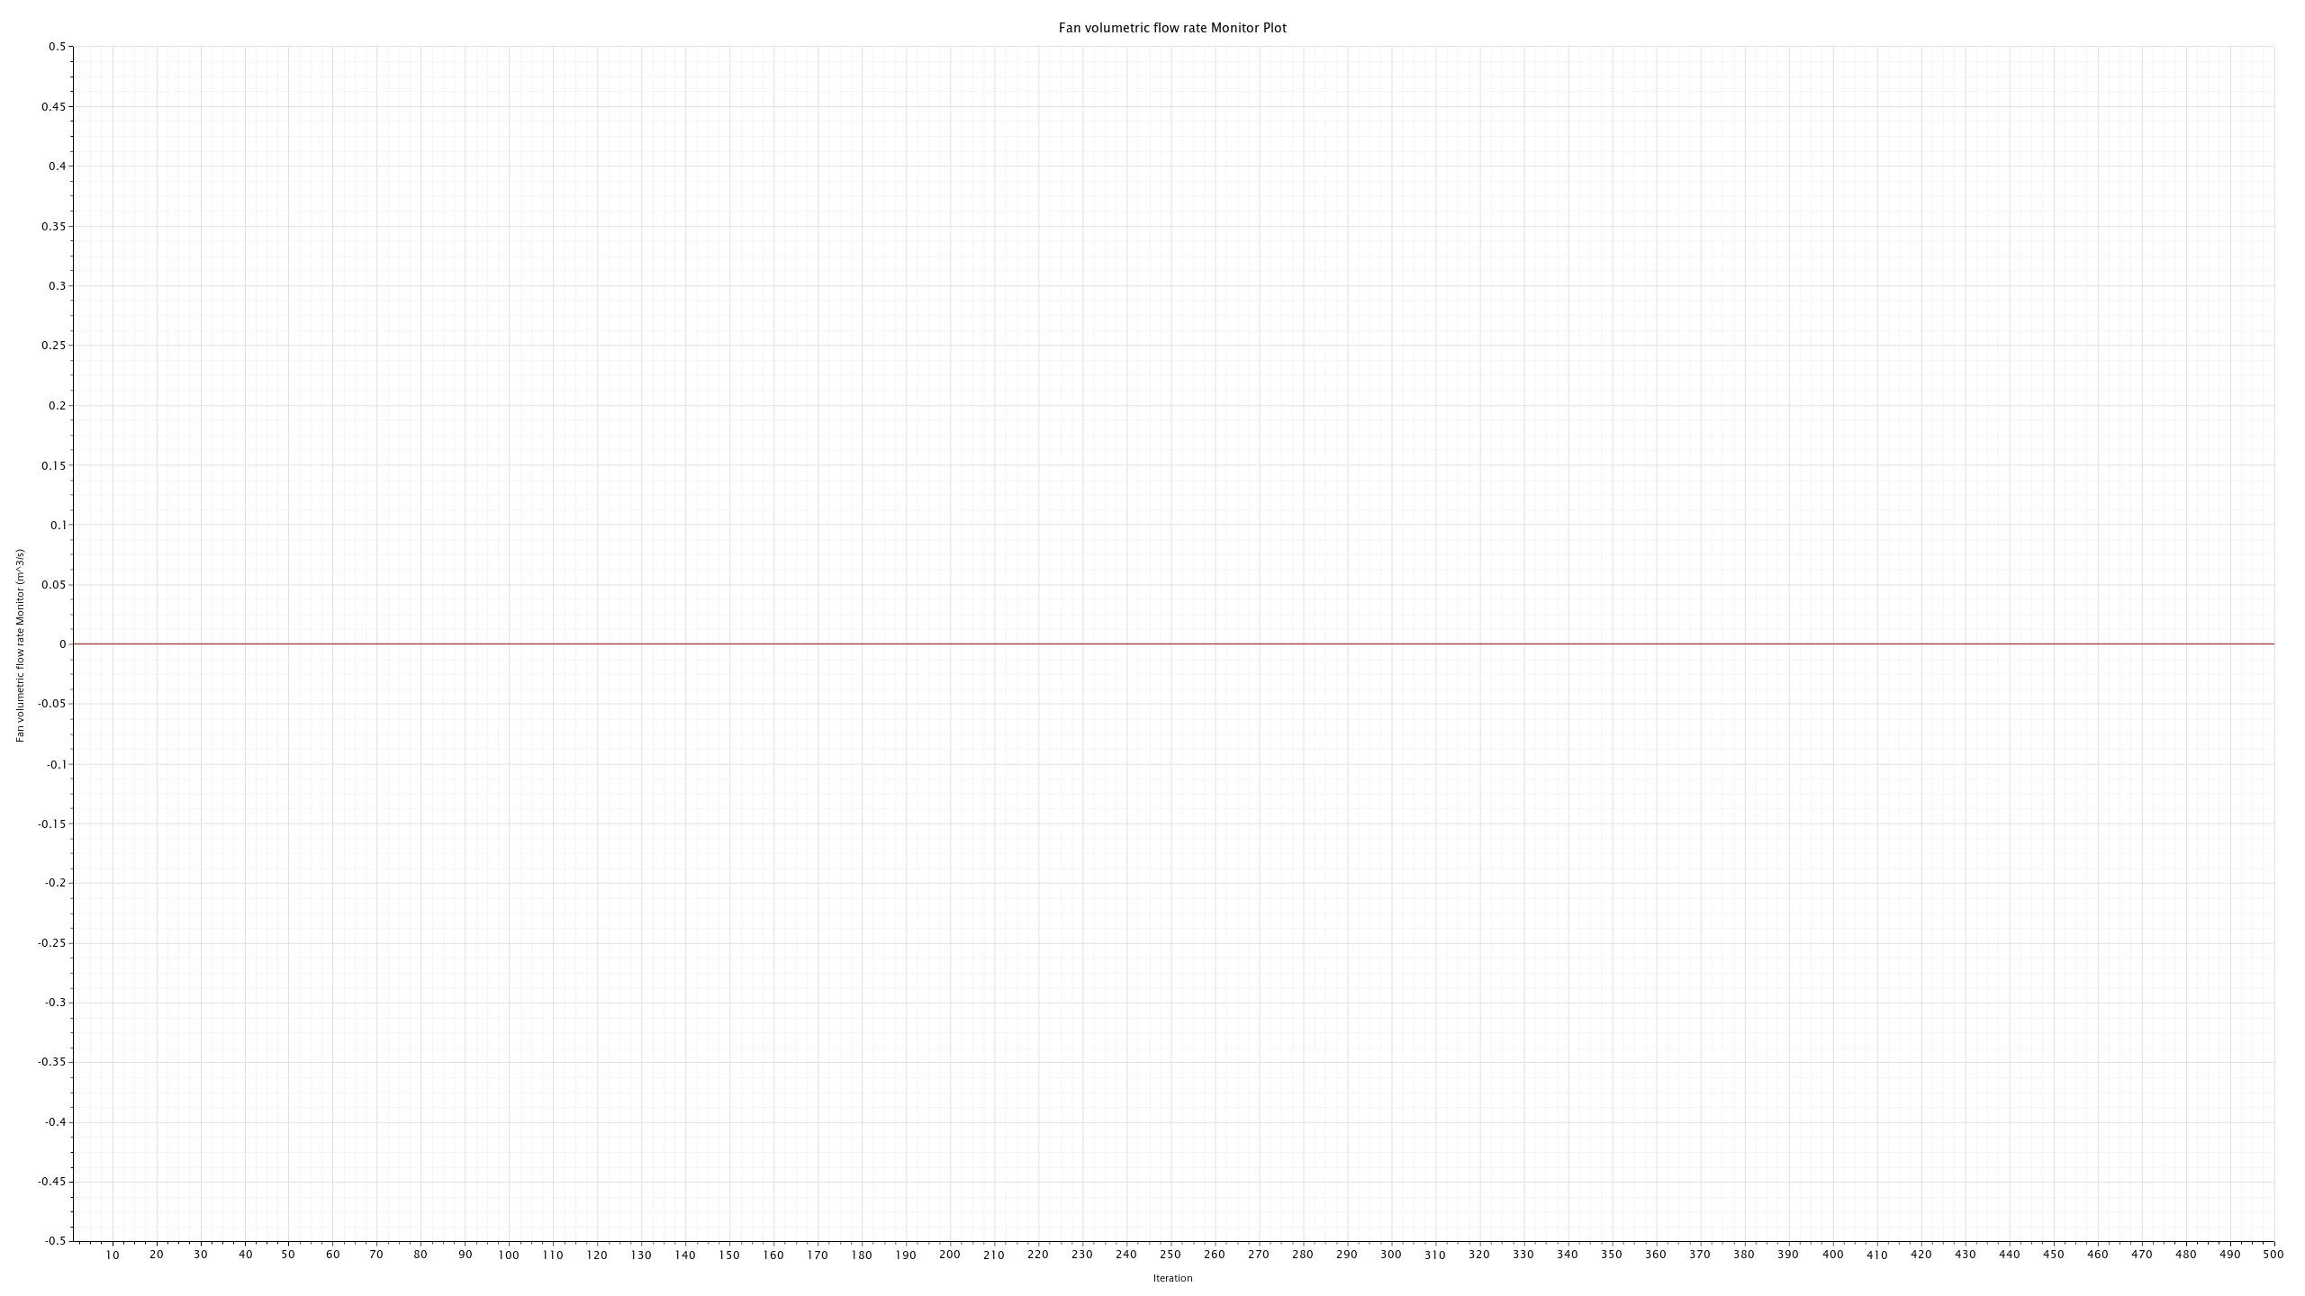
Fan volumetric flow rate Monitor Plot
Fan volumetric flow rate Monitor Plot

Slide 6
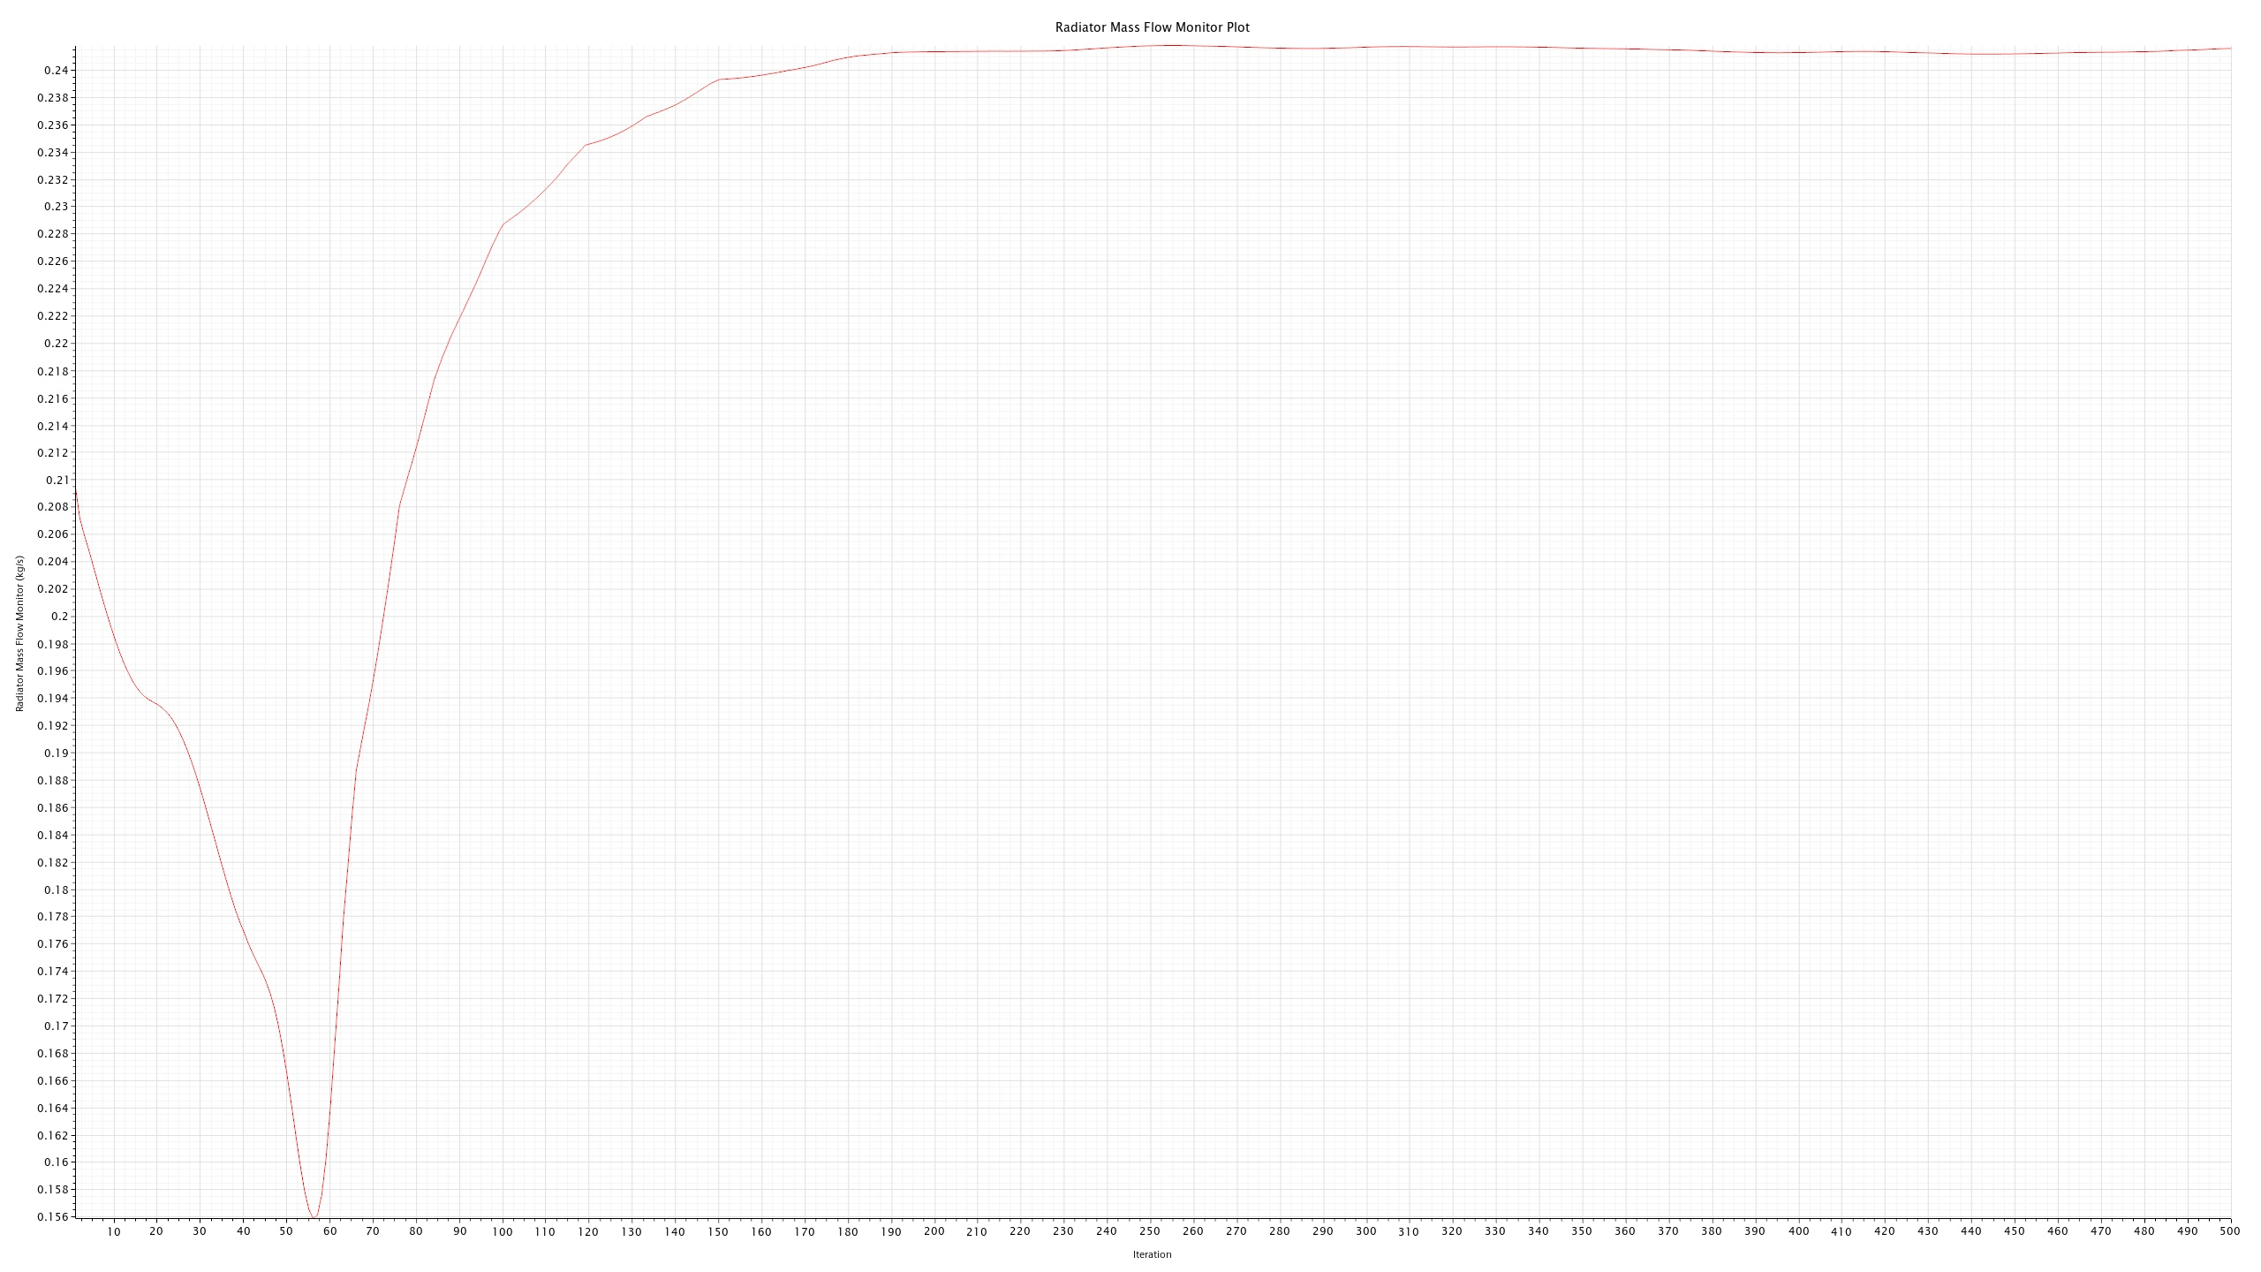
Radiator Mass Flow
Radiator Mass Flow

Slide 7
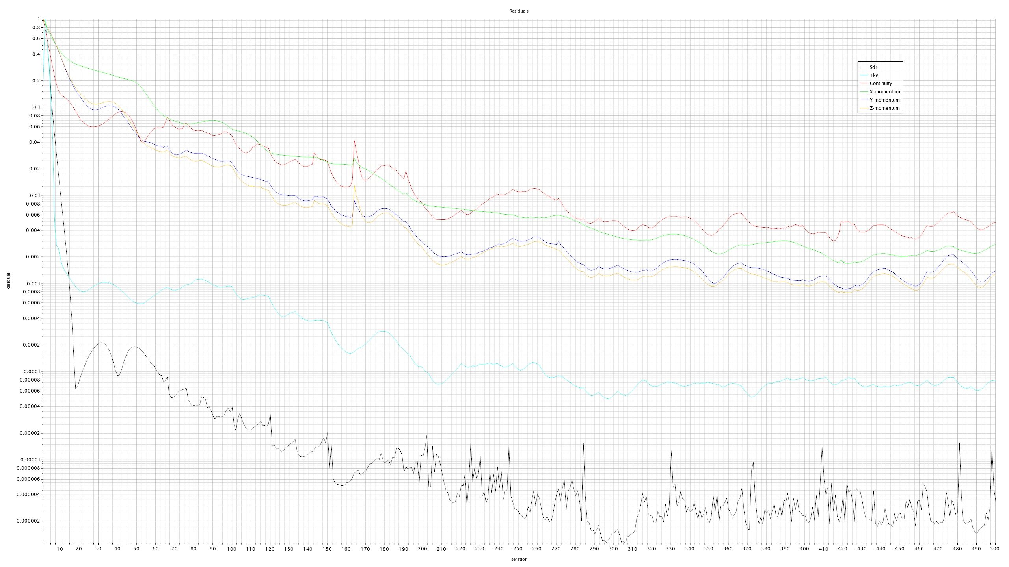
Residuals
Residuals

Slide 8
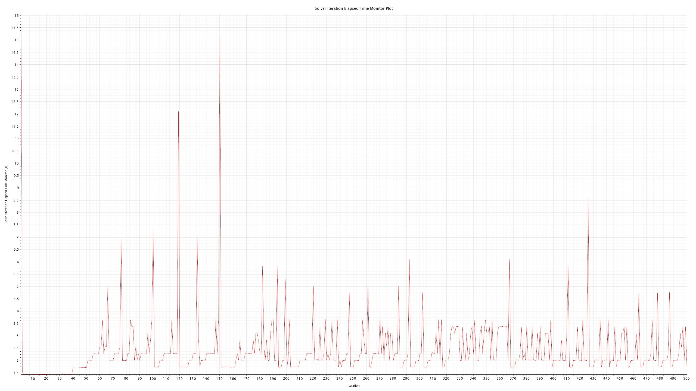
Solver Iteration Elapsed Time Monitor Plot
Solver Iteration Elapsed Time Monitor Plot

Slide 9

Surface Average Fan Velocity Monitor Plot
Surface Average Fan Velocity Monitor Plot

Slide 10
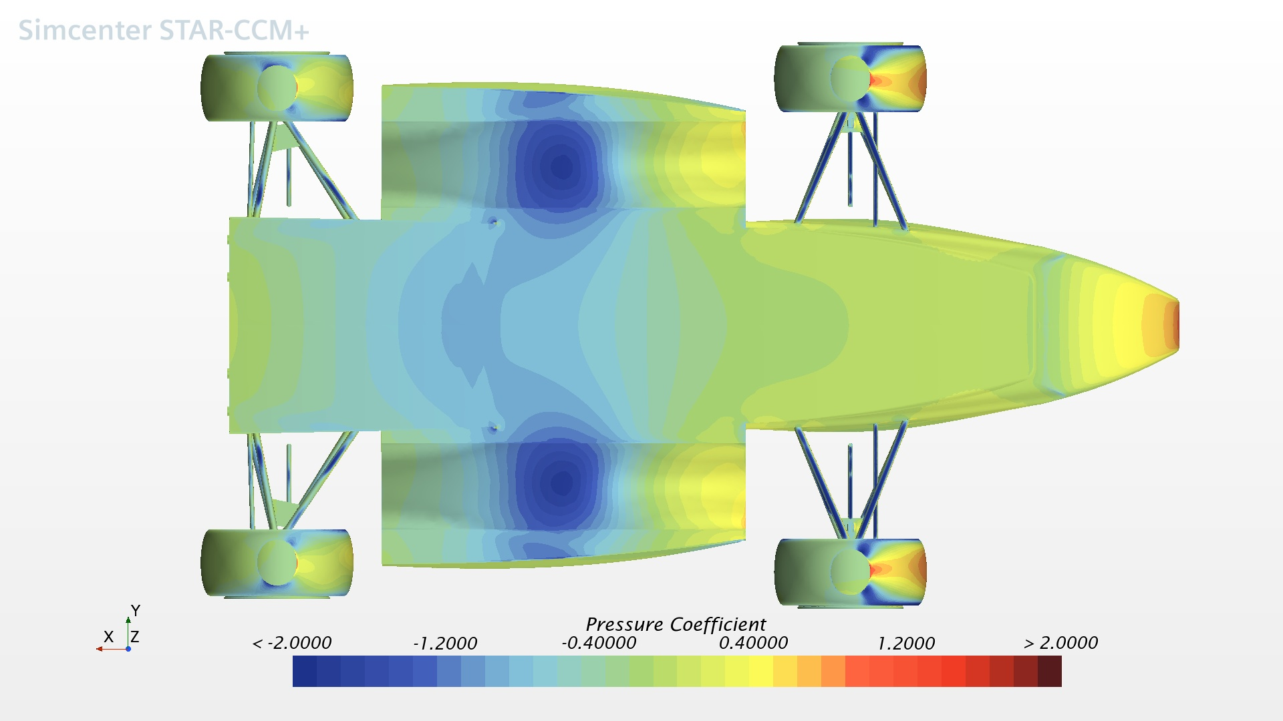
Coefficient of Pressure (Bottom View)
Coefficient of Pressure (Bottom View)

Slide 11
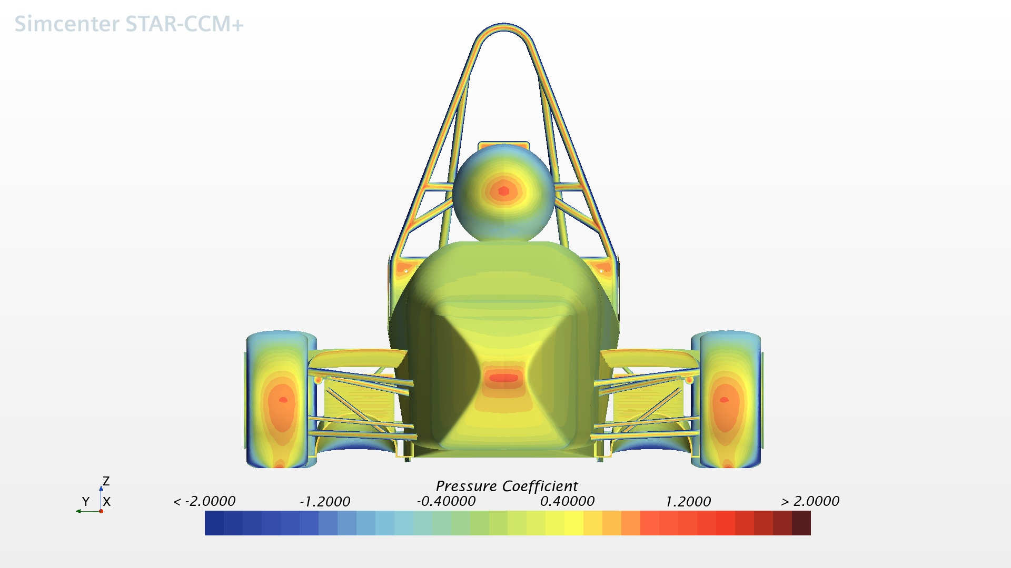
Coefficient of Pressure (Front View)
Coefficient of Pressure (Front View)

Slide 12
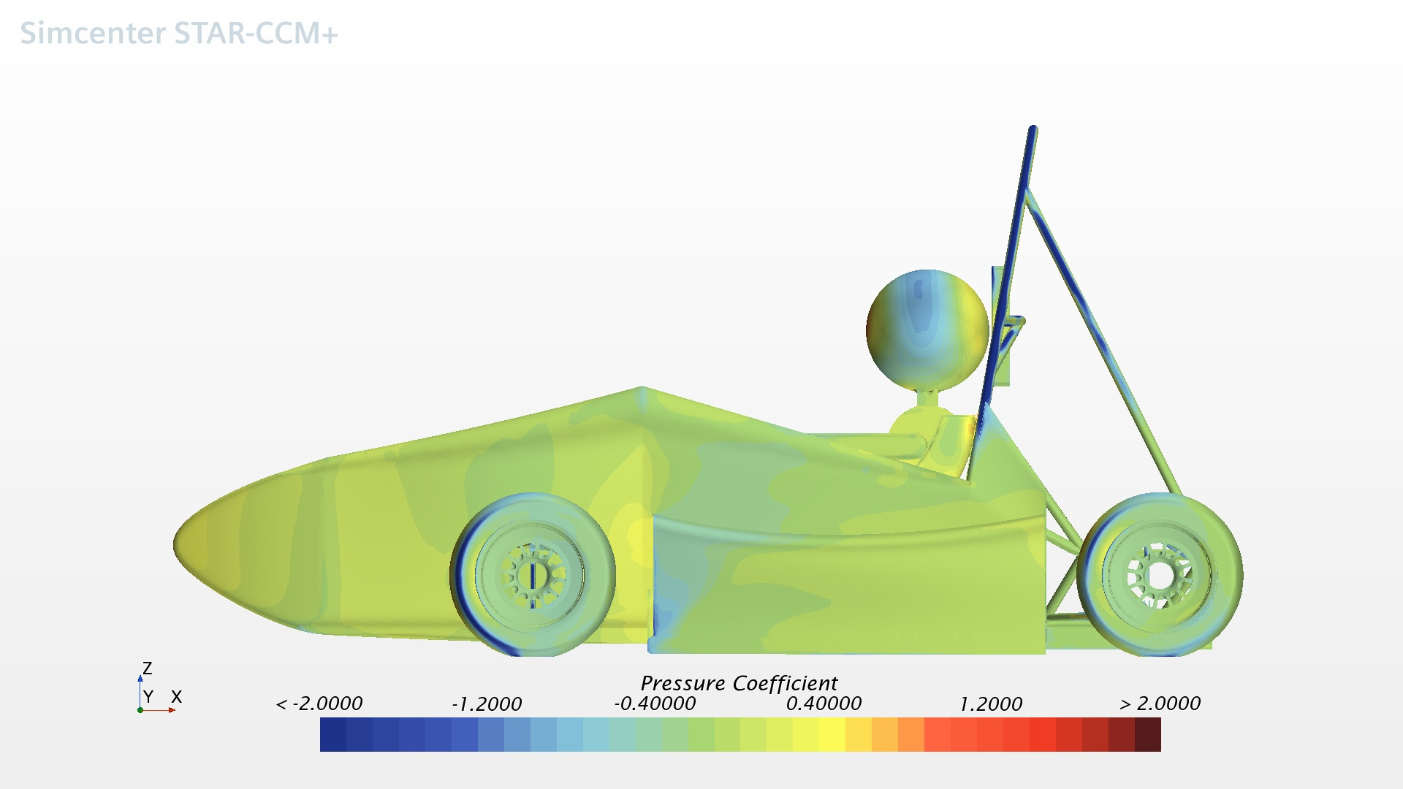
Coefficient of Pressure (Side View)
Coefficient of Pressure (Side View)

Slide 13
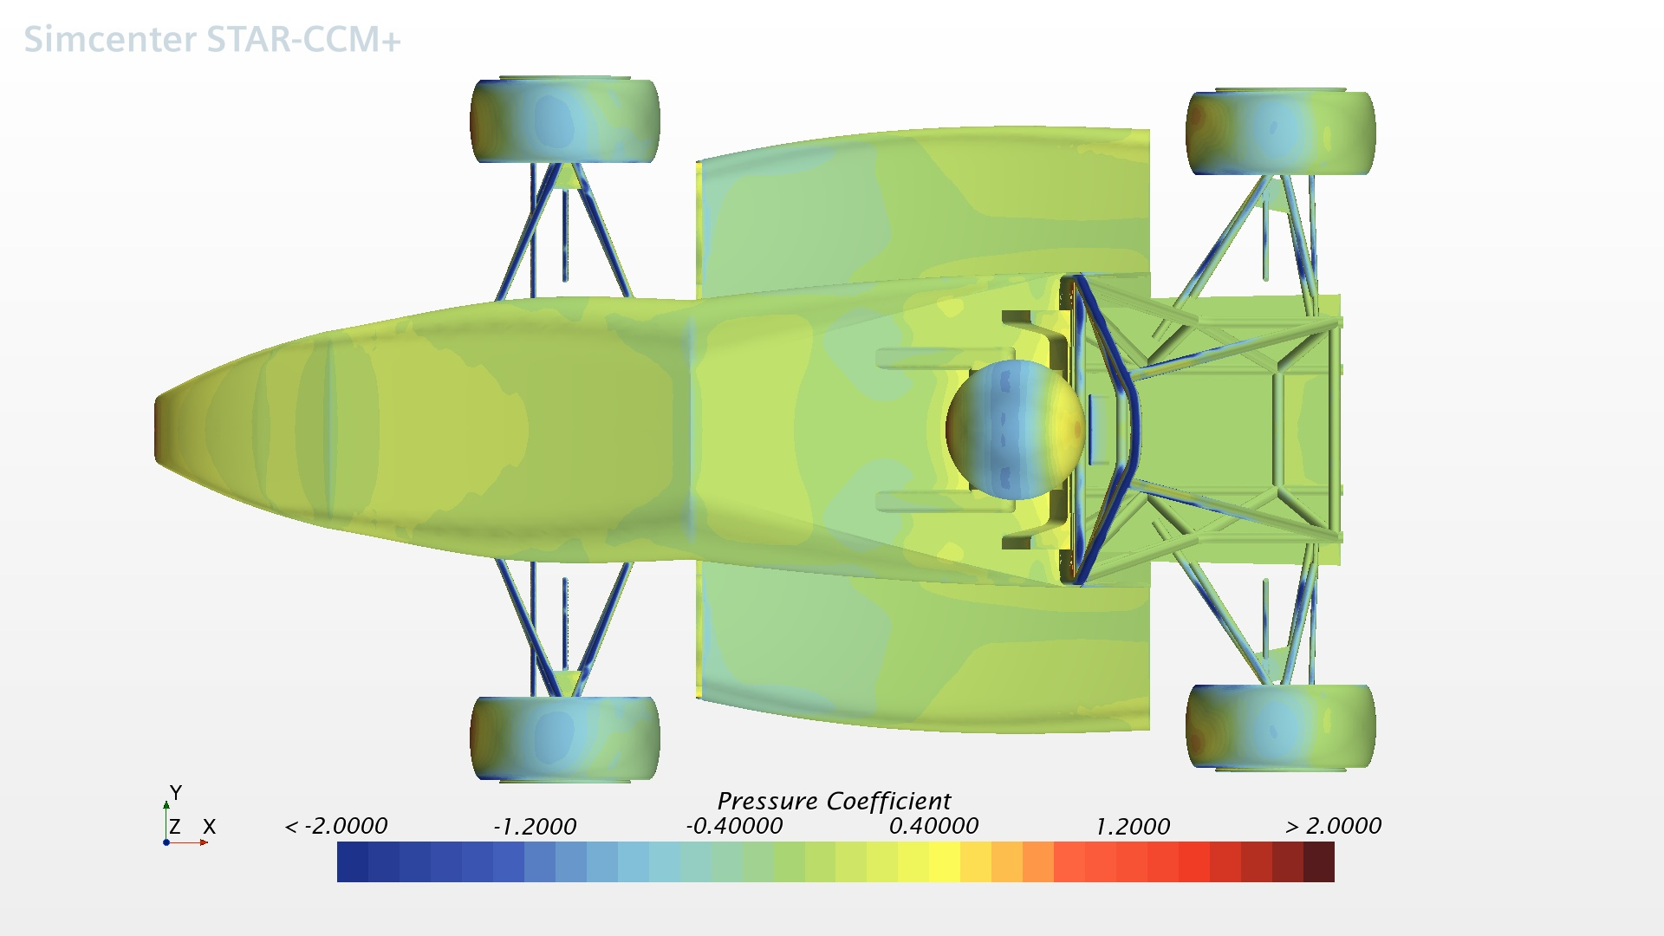
Coefficient of Pressure (Top View)
Coefficient of Pressure (Top View)

Slide 14
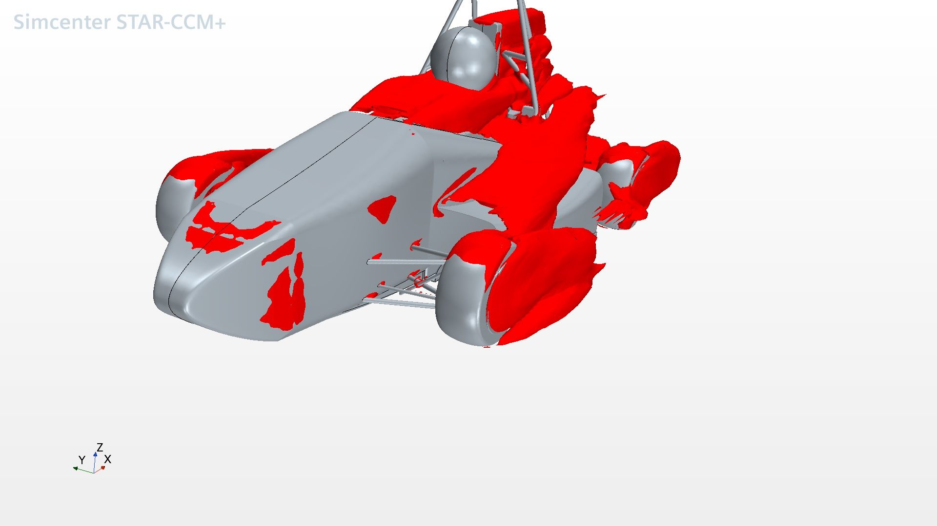
Copy of Turbulent Kinetic Energy
Copy of Turbulent Kinetic Energy

Slide 15
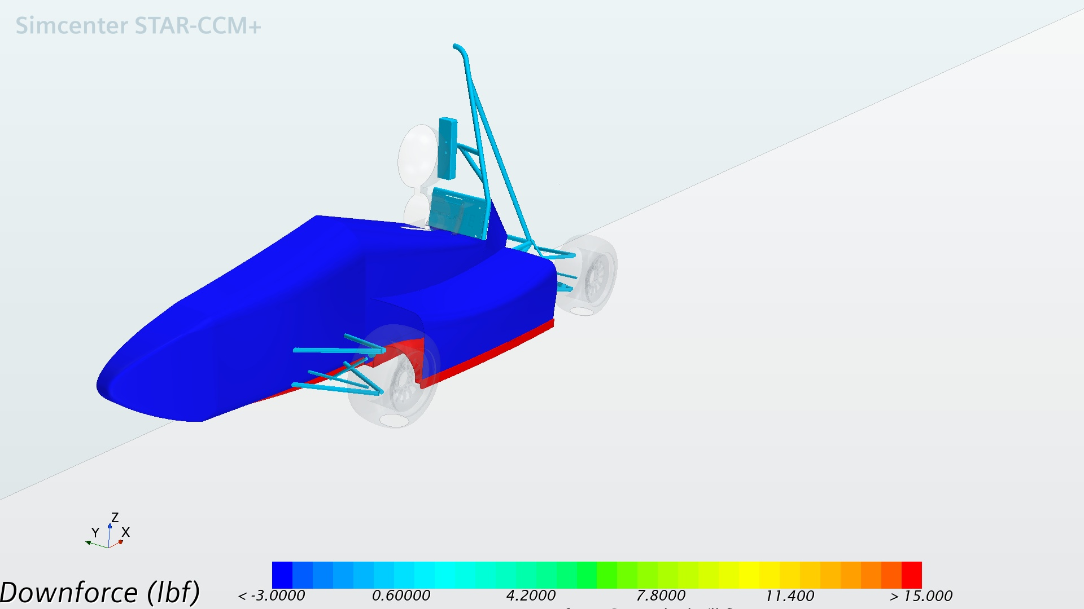
Downforce scene (from reports)
Downforce scene (from reports)

Slide 16
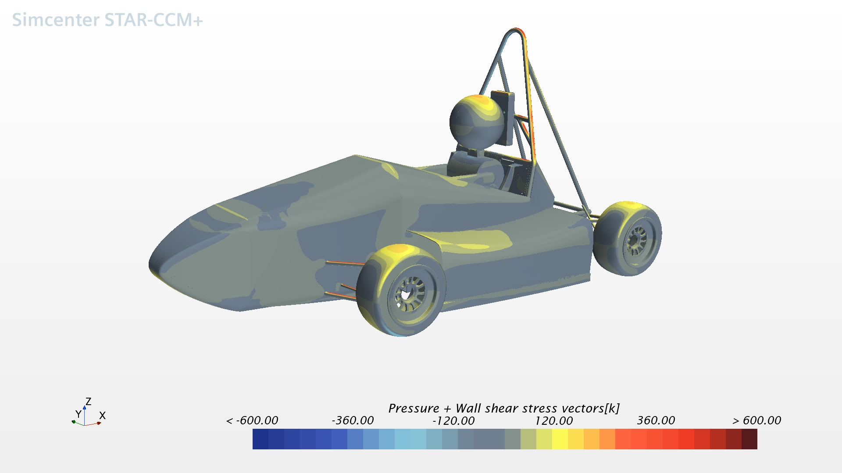
Downforce
Downforce

Slide 17
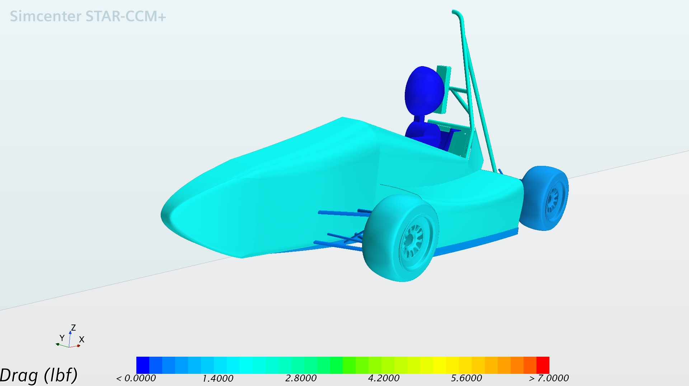
Drag scene (from reports)
Drag scene (from reports)

Slide 18
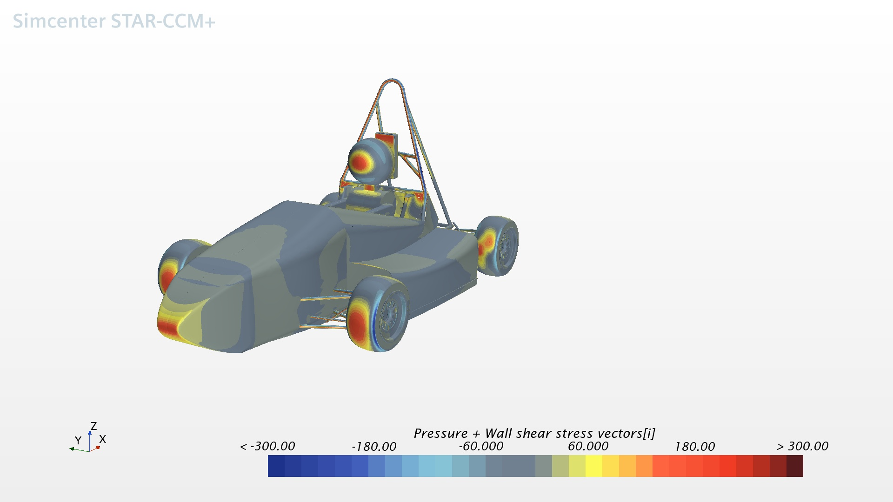
Drag
Drag

Slide 19
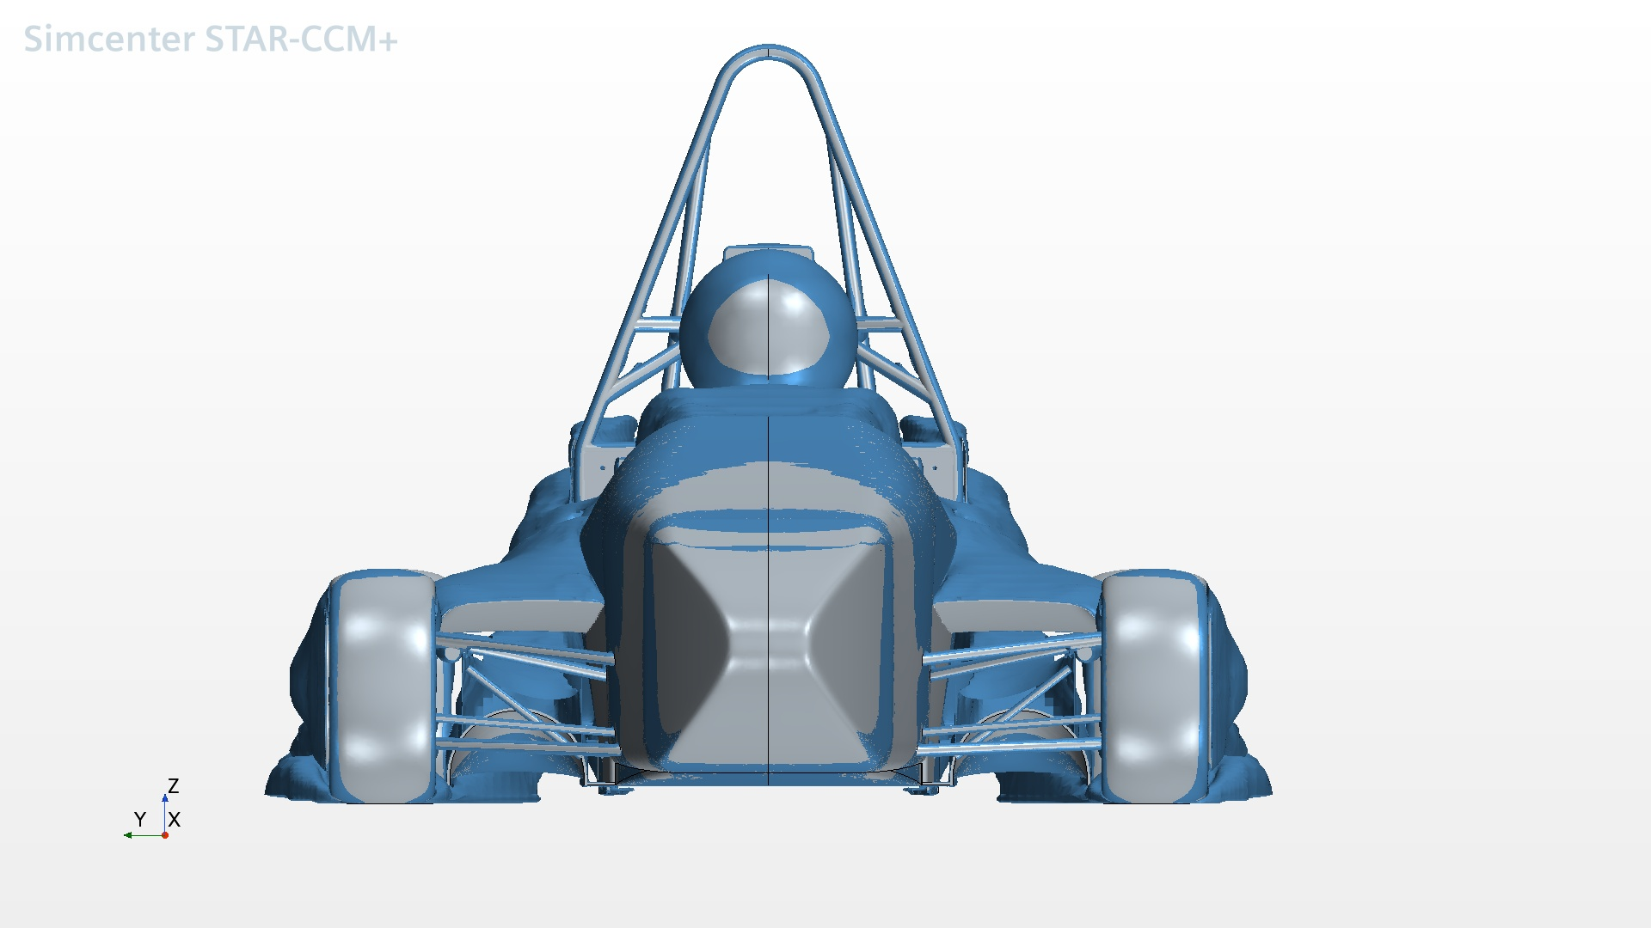
Flow Separation (Front View)
Flow Separation (Front View)

Slide 20
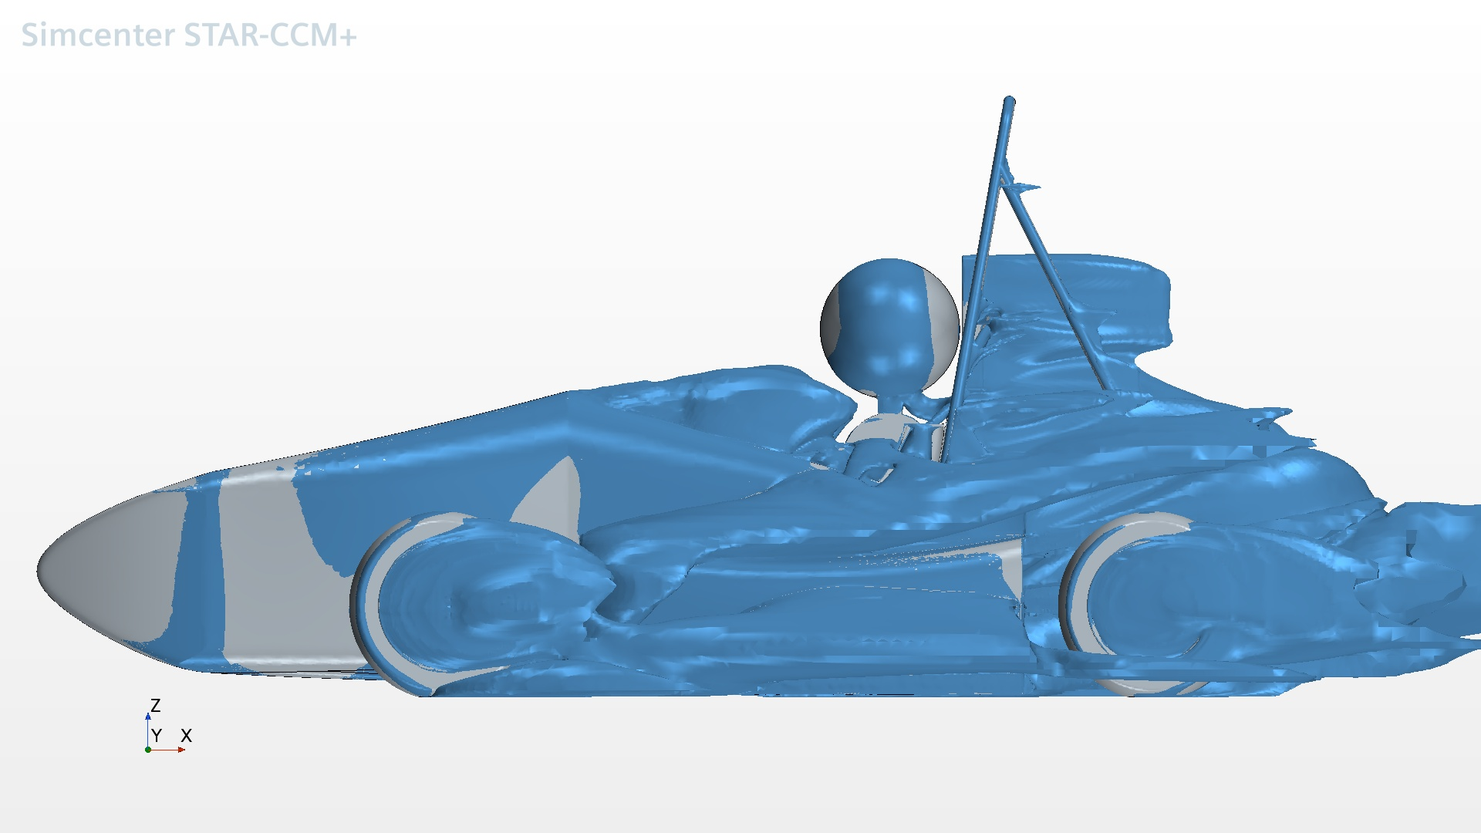
Flow Separation (Side View)
Flow Separation (Side View)

Slide 21
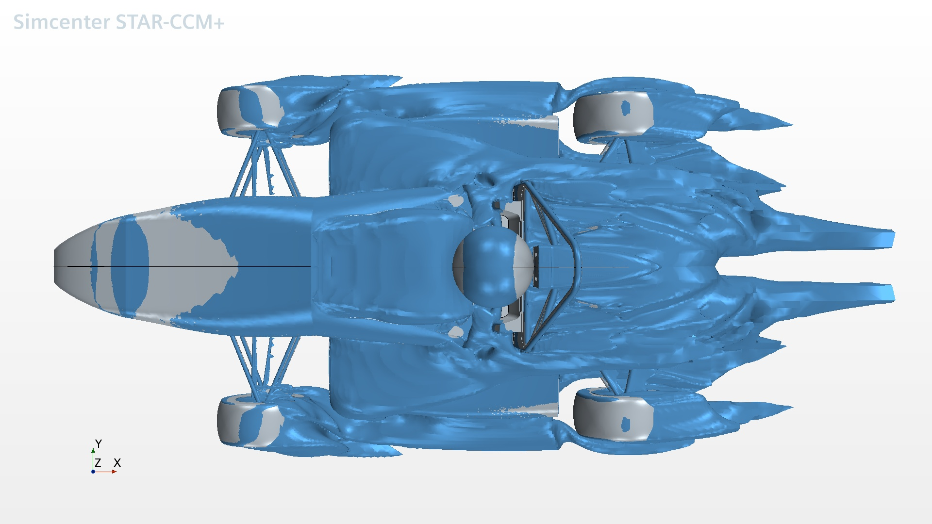
Flow Separation (Top View)
Flow Separation (Top View)

Slide 22
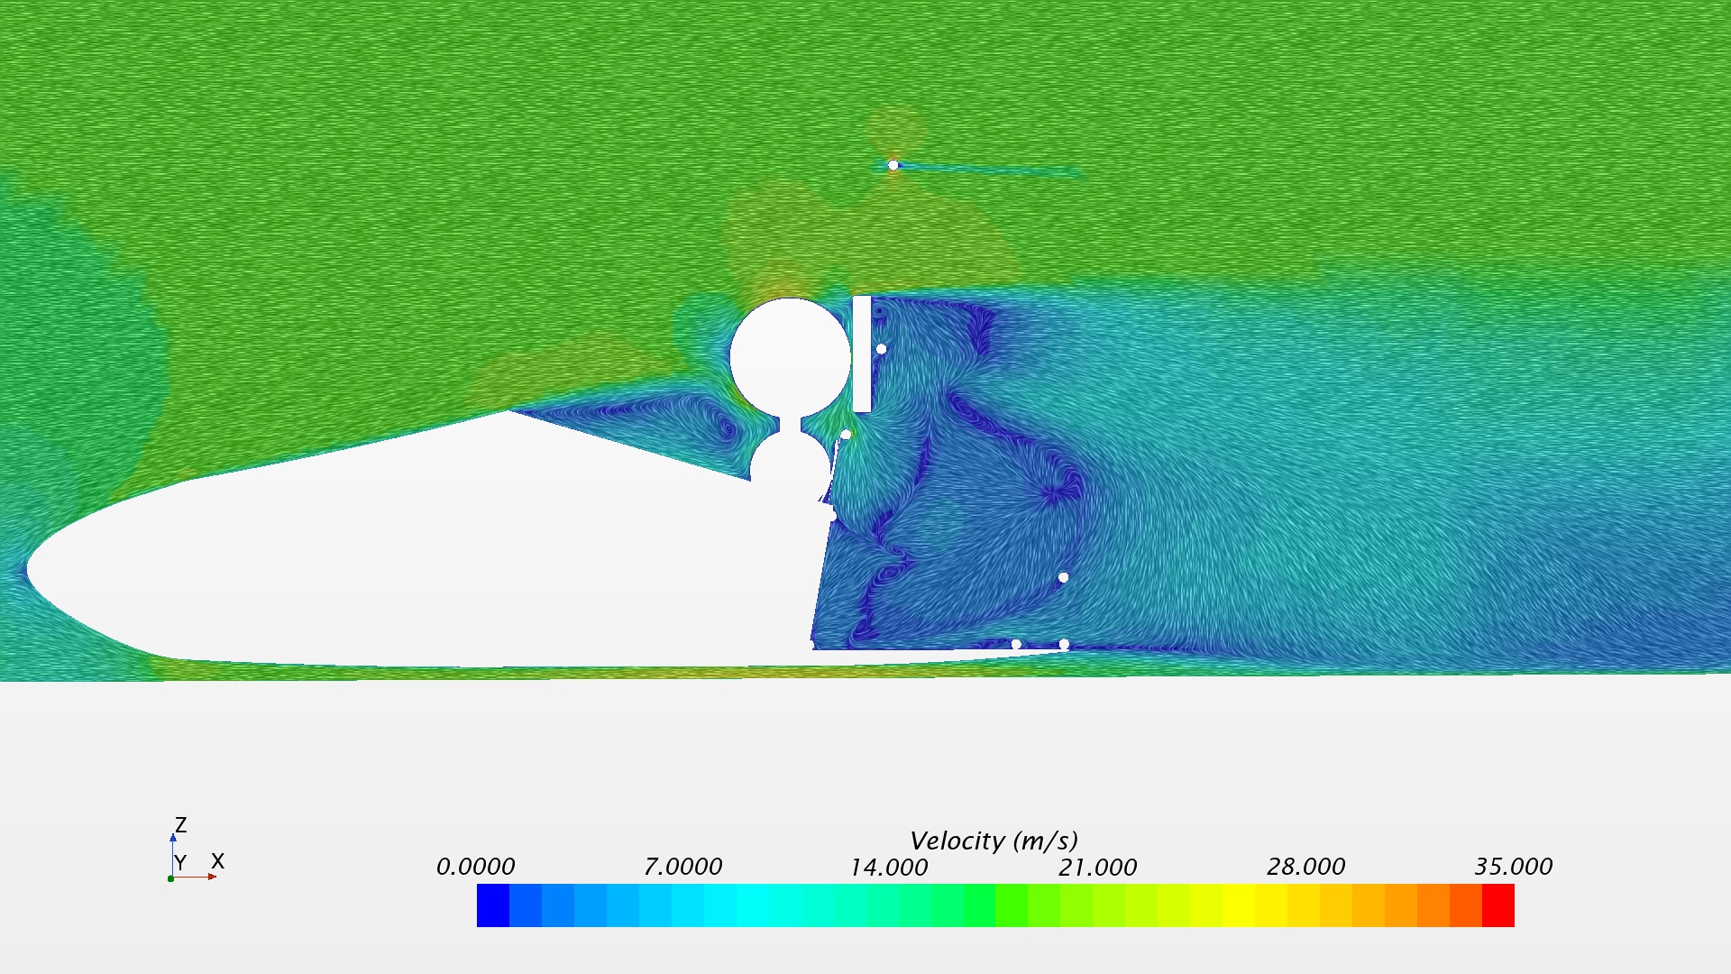
Force vectors
Force vectors

Slide 23
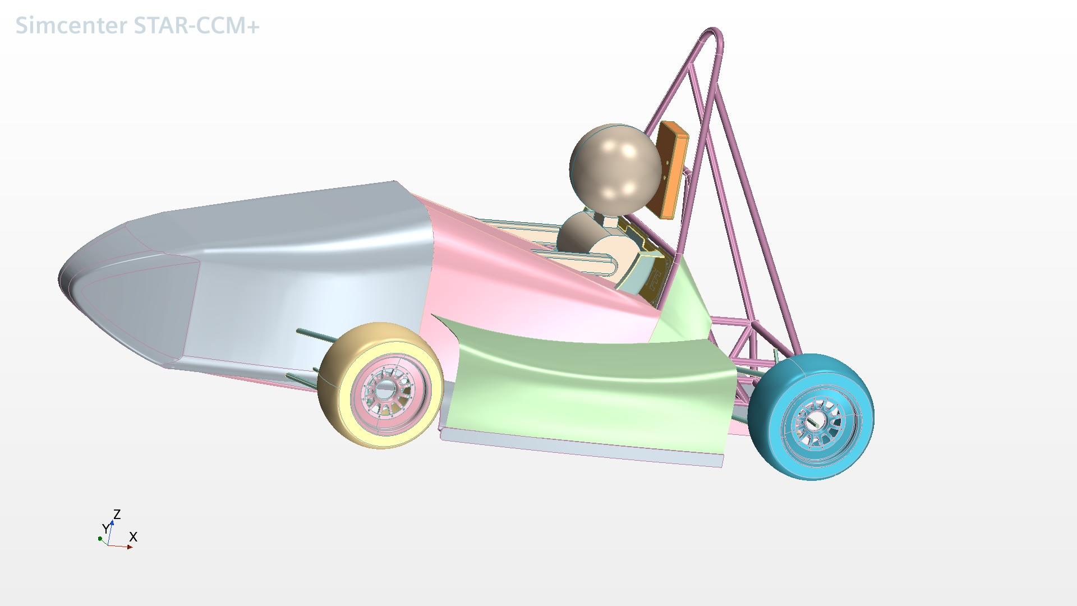
Geometry
Geometry

Slide 24
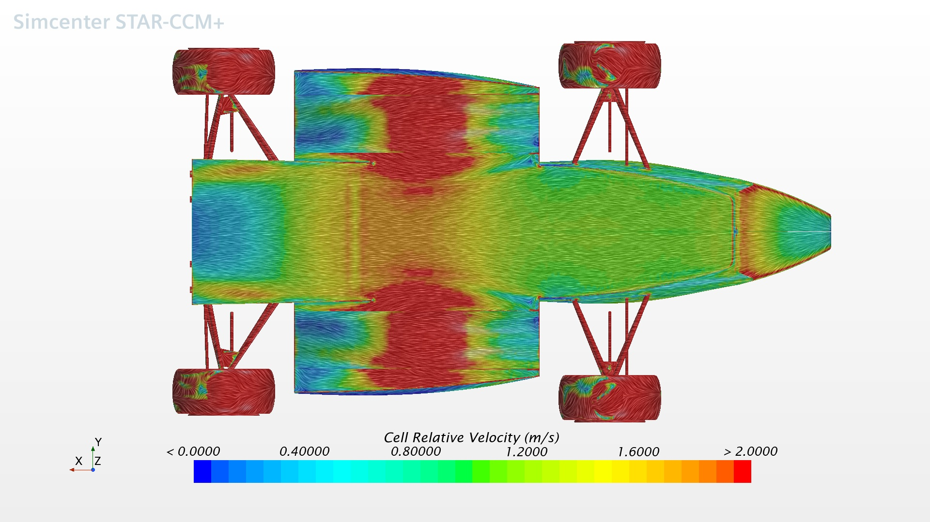
Oil Streaks (Bottom View)
Oil Streaks (Bottom View)

Slide 25
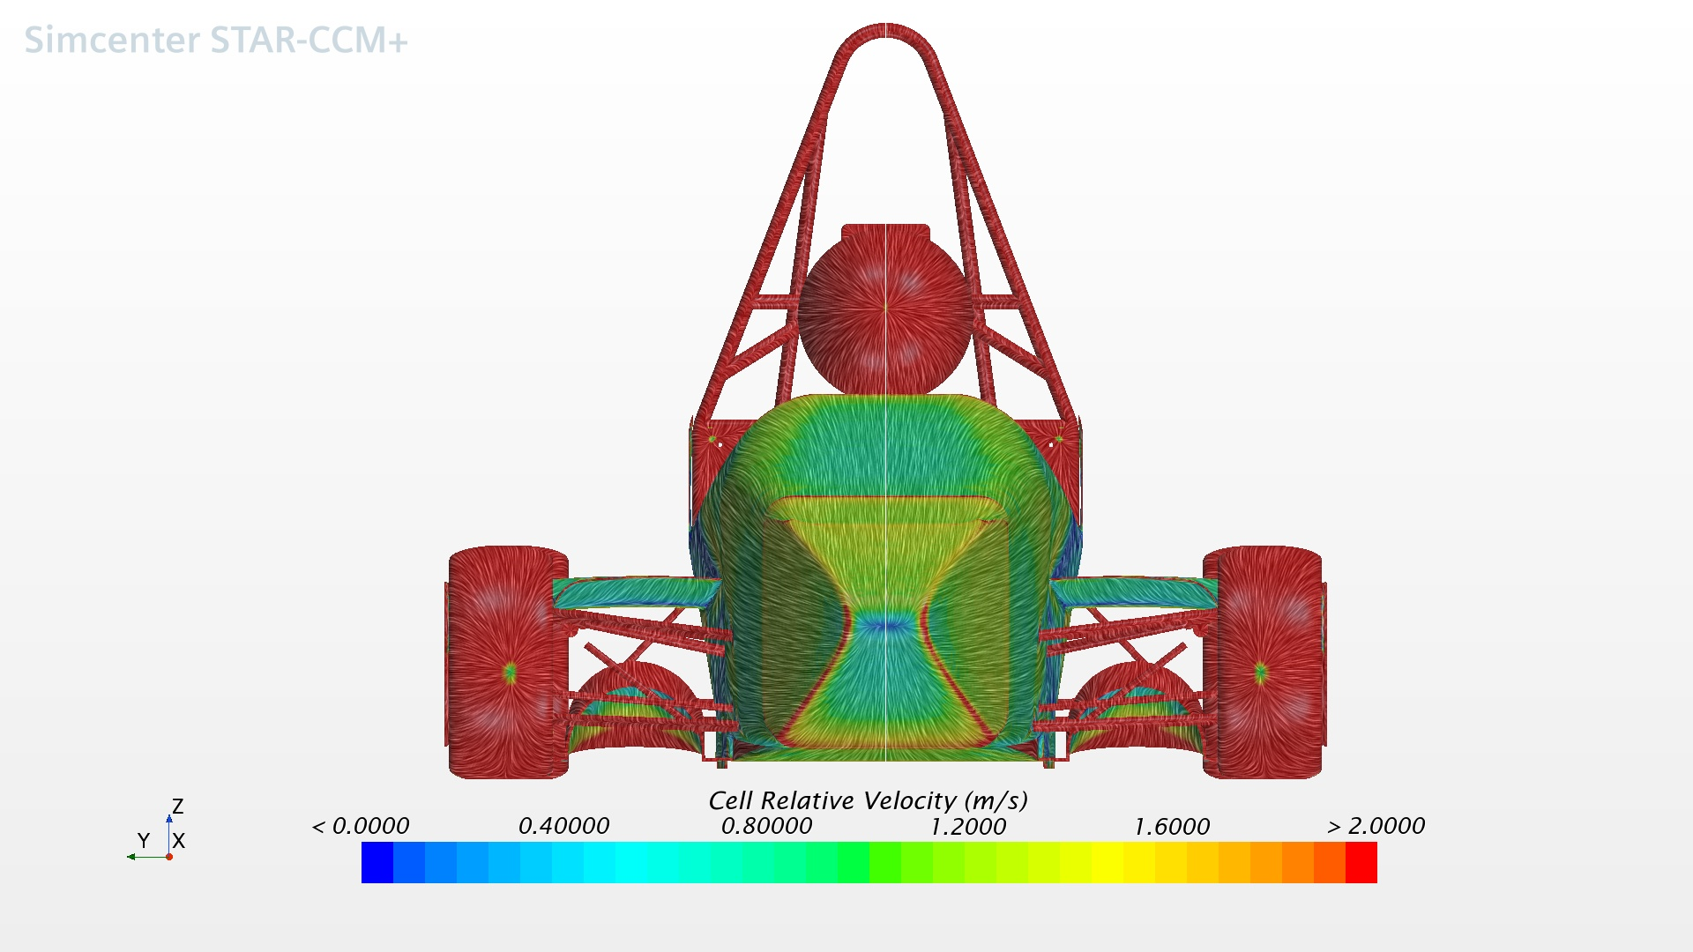
Oil Streaks (Front View)
Oil Streaks (Front View)

Slide 26
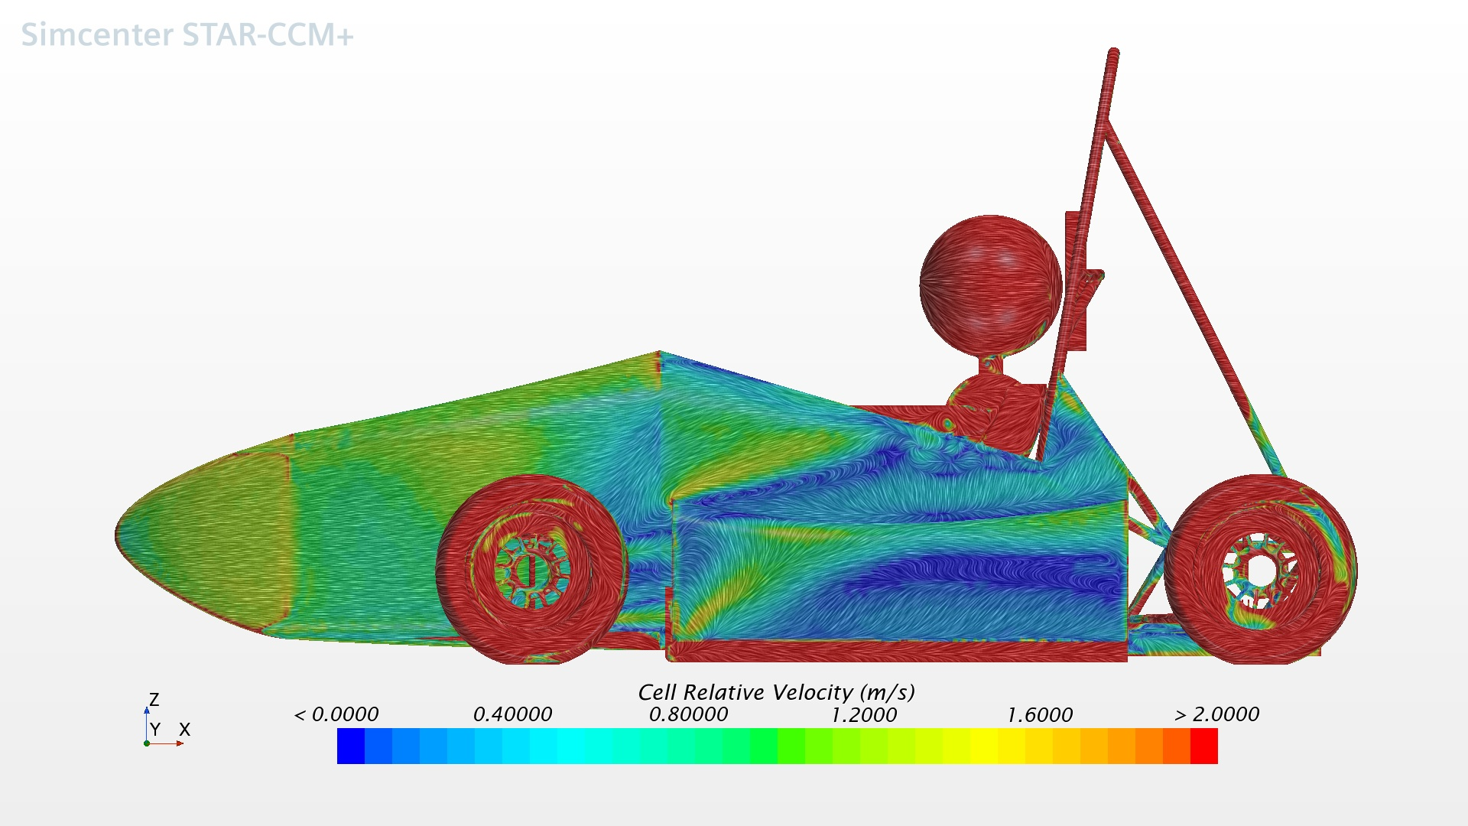
Oil Streaks (Side View)
Oil Streaks (Side View)

Slide 27
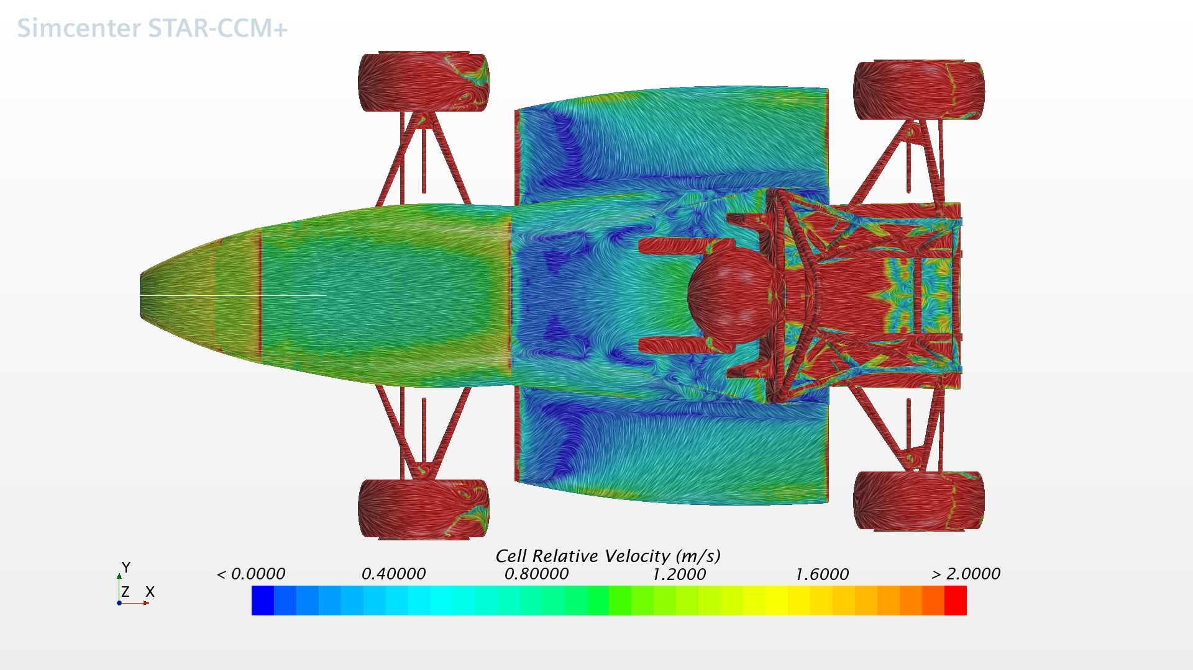
Oil Streaks (Top View)
Oil Streaks (Top View)

Slide 28
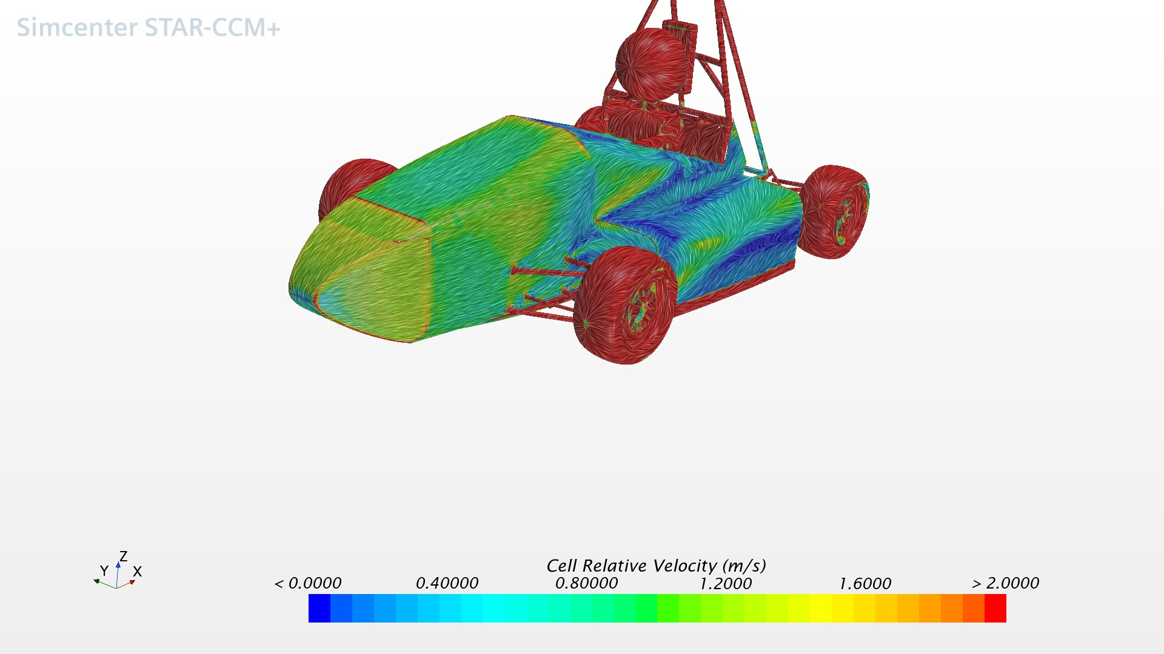
Oil streaks
Oil streaks

Slide 29
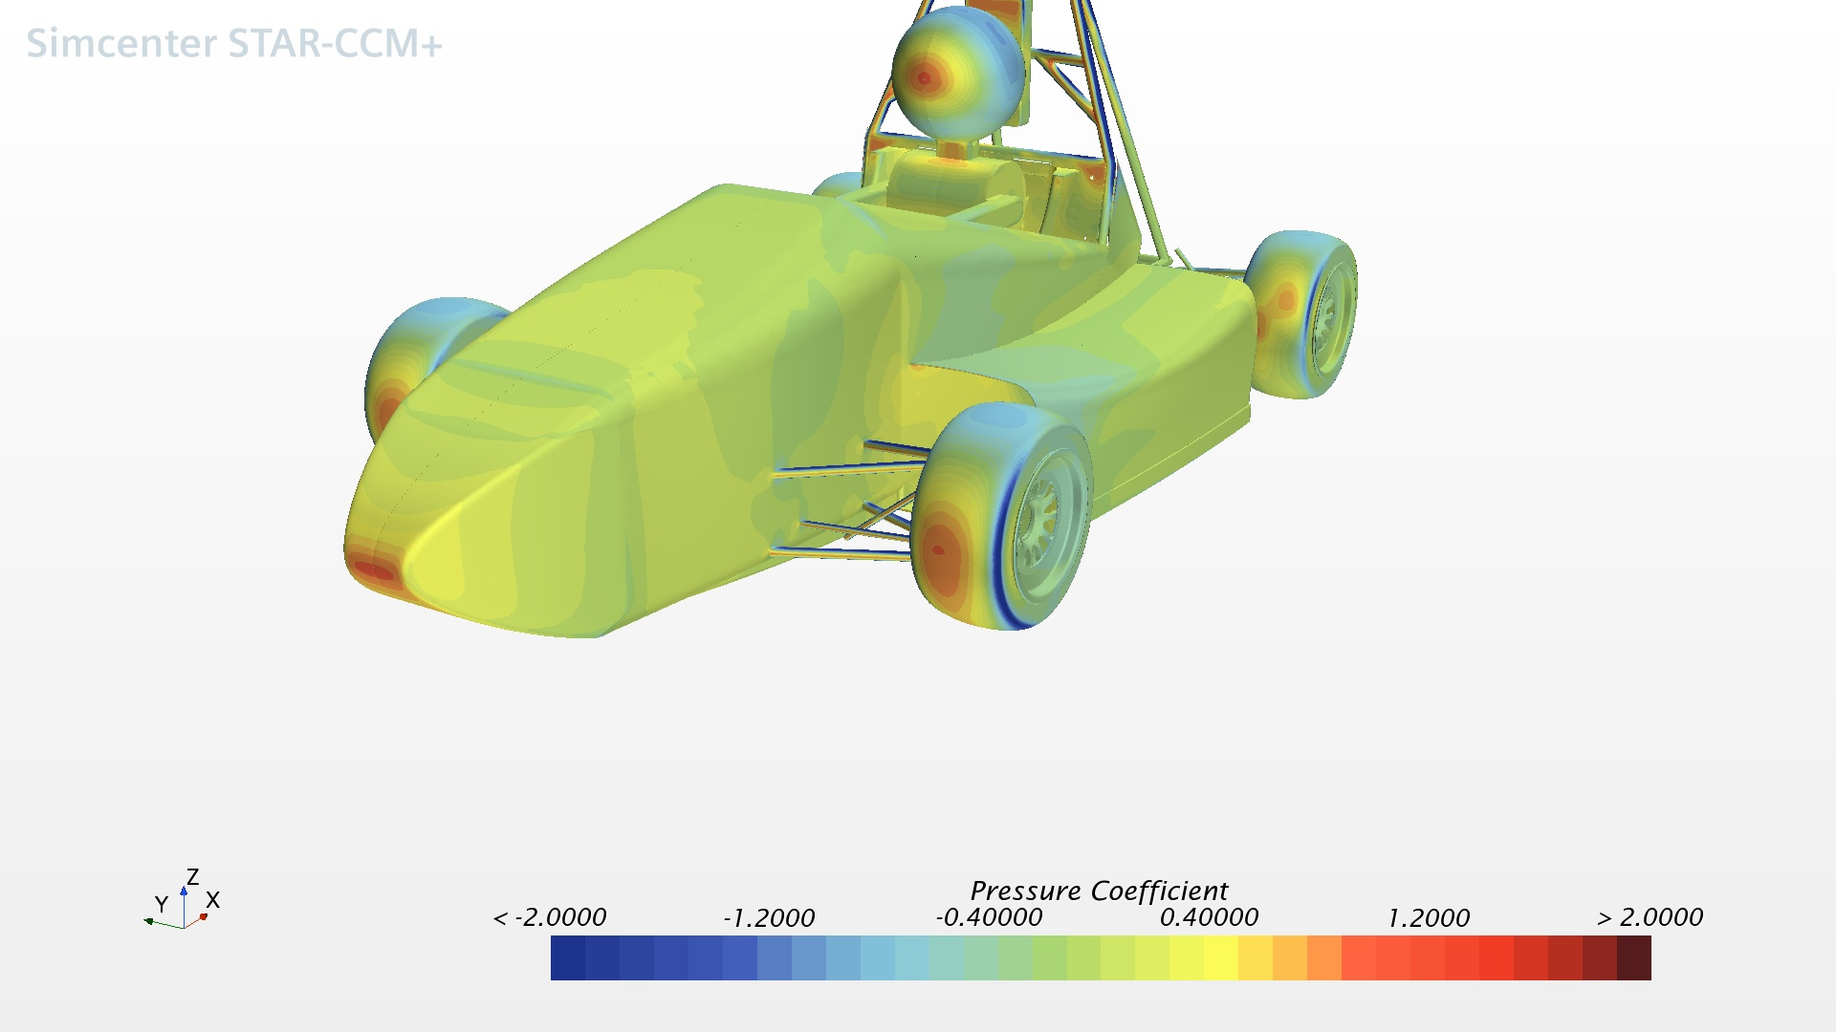
Pressure Coefficient
Pressure Coefficient

Slide 30
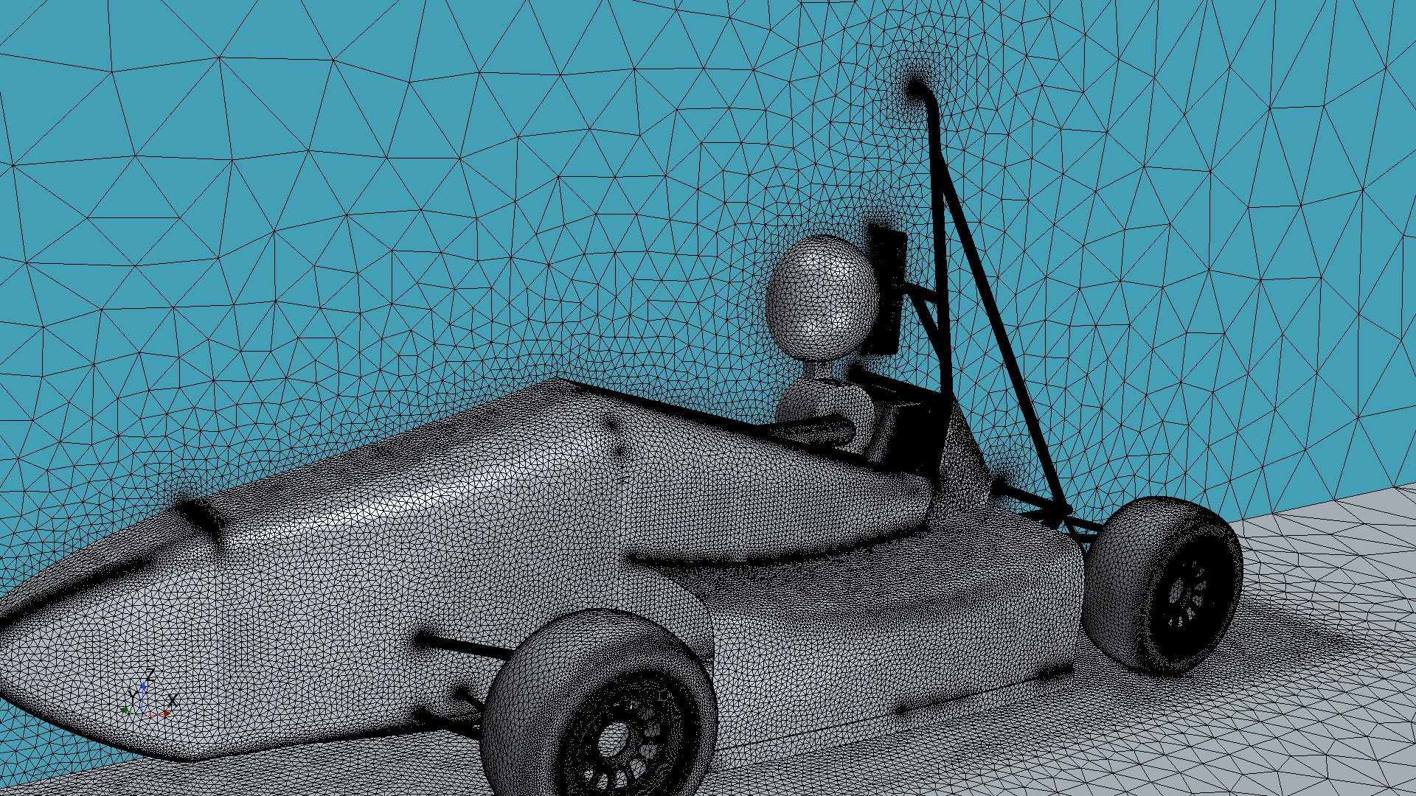
Remeshed surface
Remeshed surface

Slide 31
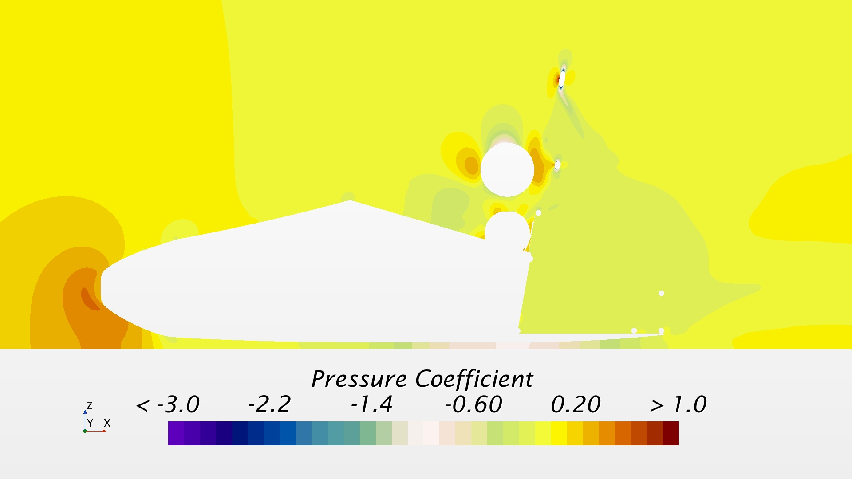
Scalar cross section pressure y=-0.091m (driver's left eye)
Scalar cross section pressure y=-0.091m (driver's left eye)

Slide 32
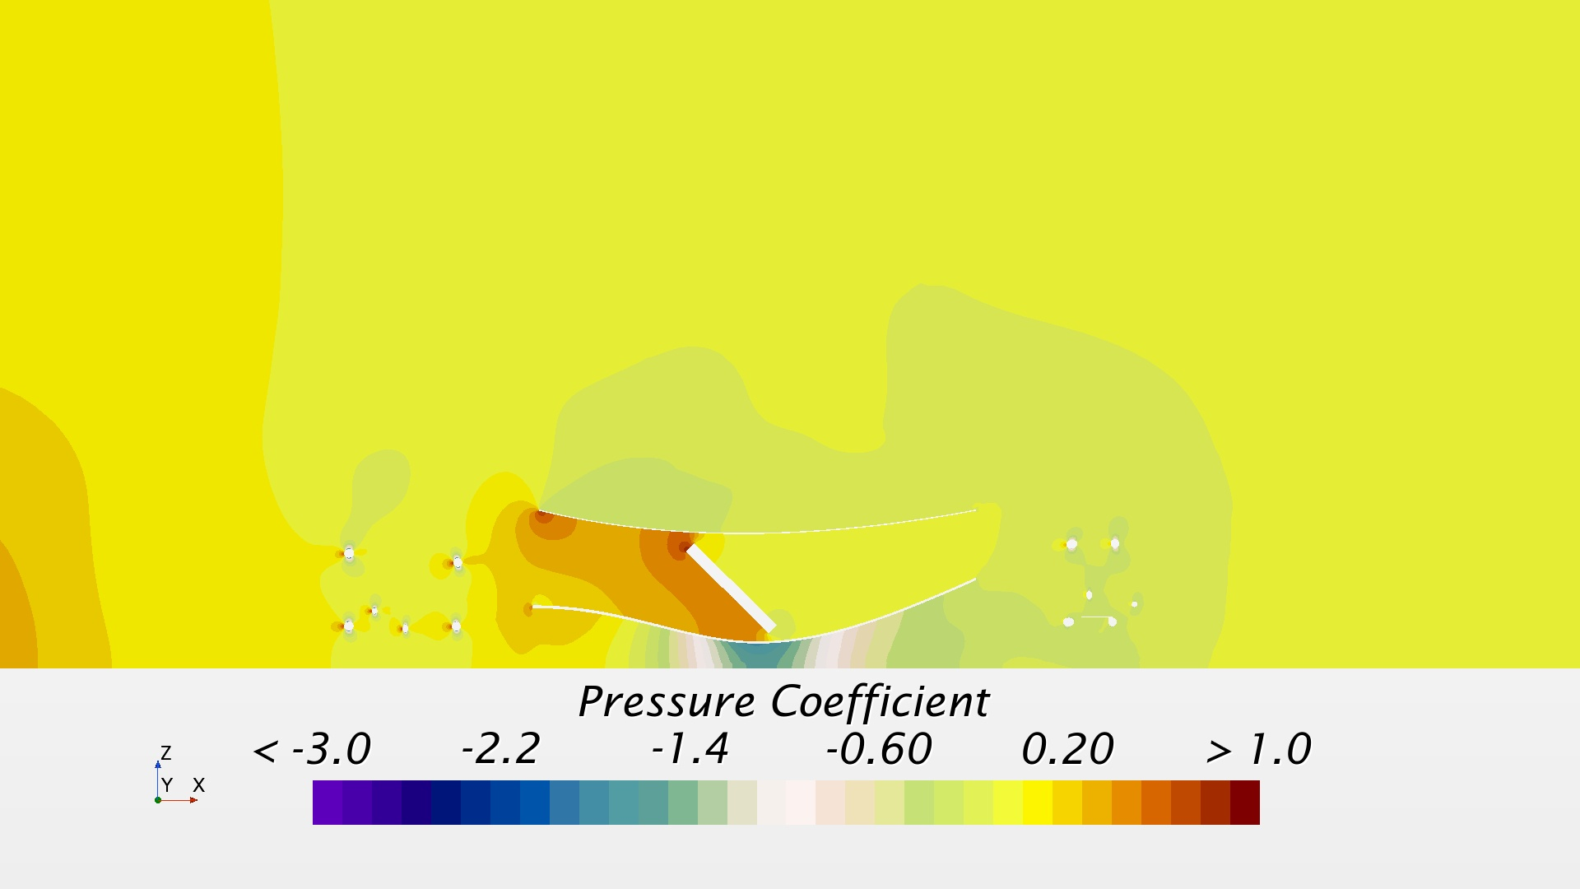
Scalar cross section pressure y=-0.32m (through duct, angled)
Scalar cross section pressure y=-0.32m (through duct, angled)

Slide 33
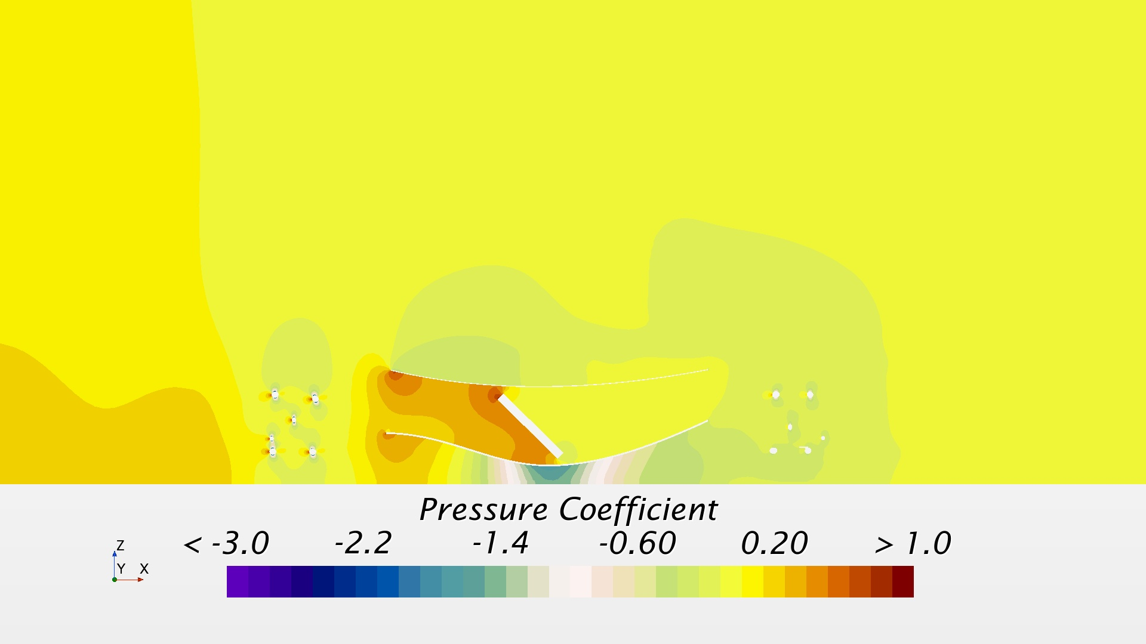
Scalar cross section pressure y=-0.46m (between wheel and center body)
Scalar cross section pressure y=-0.46m (between wheel and center body)

Slide 34
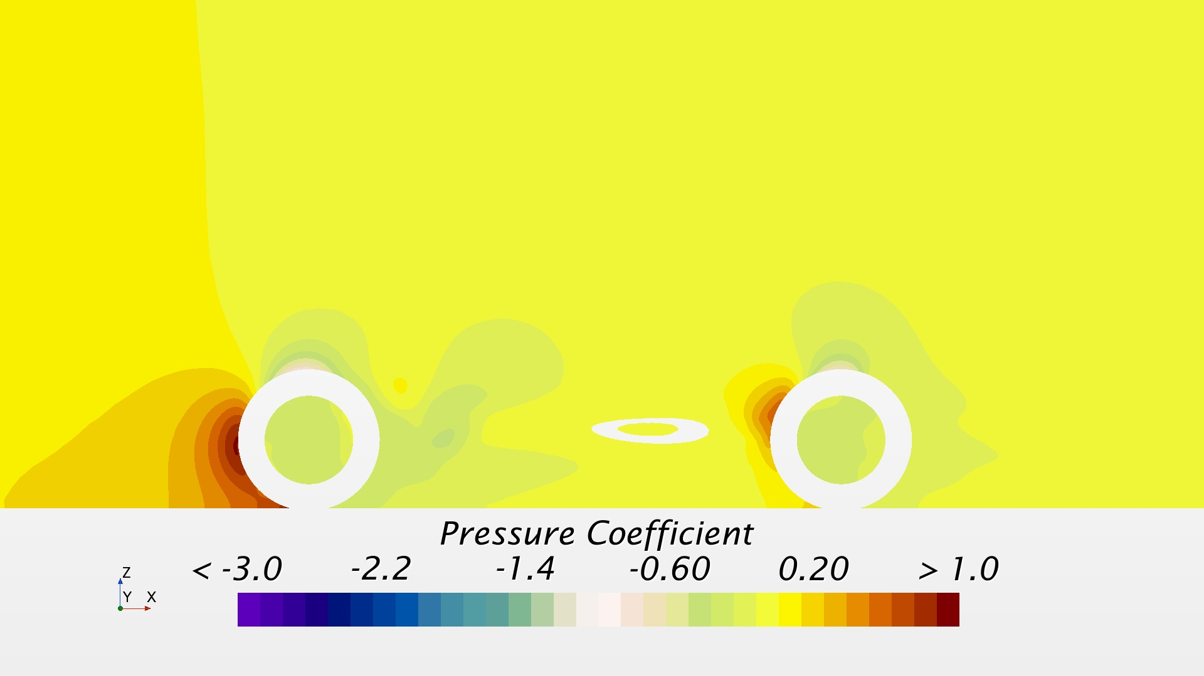
Scalar cross section pressure y=-0.64m (through wheels)
Scalar cross section pressure y=-0.64m (through wheels)

Slide 35
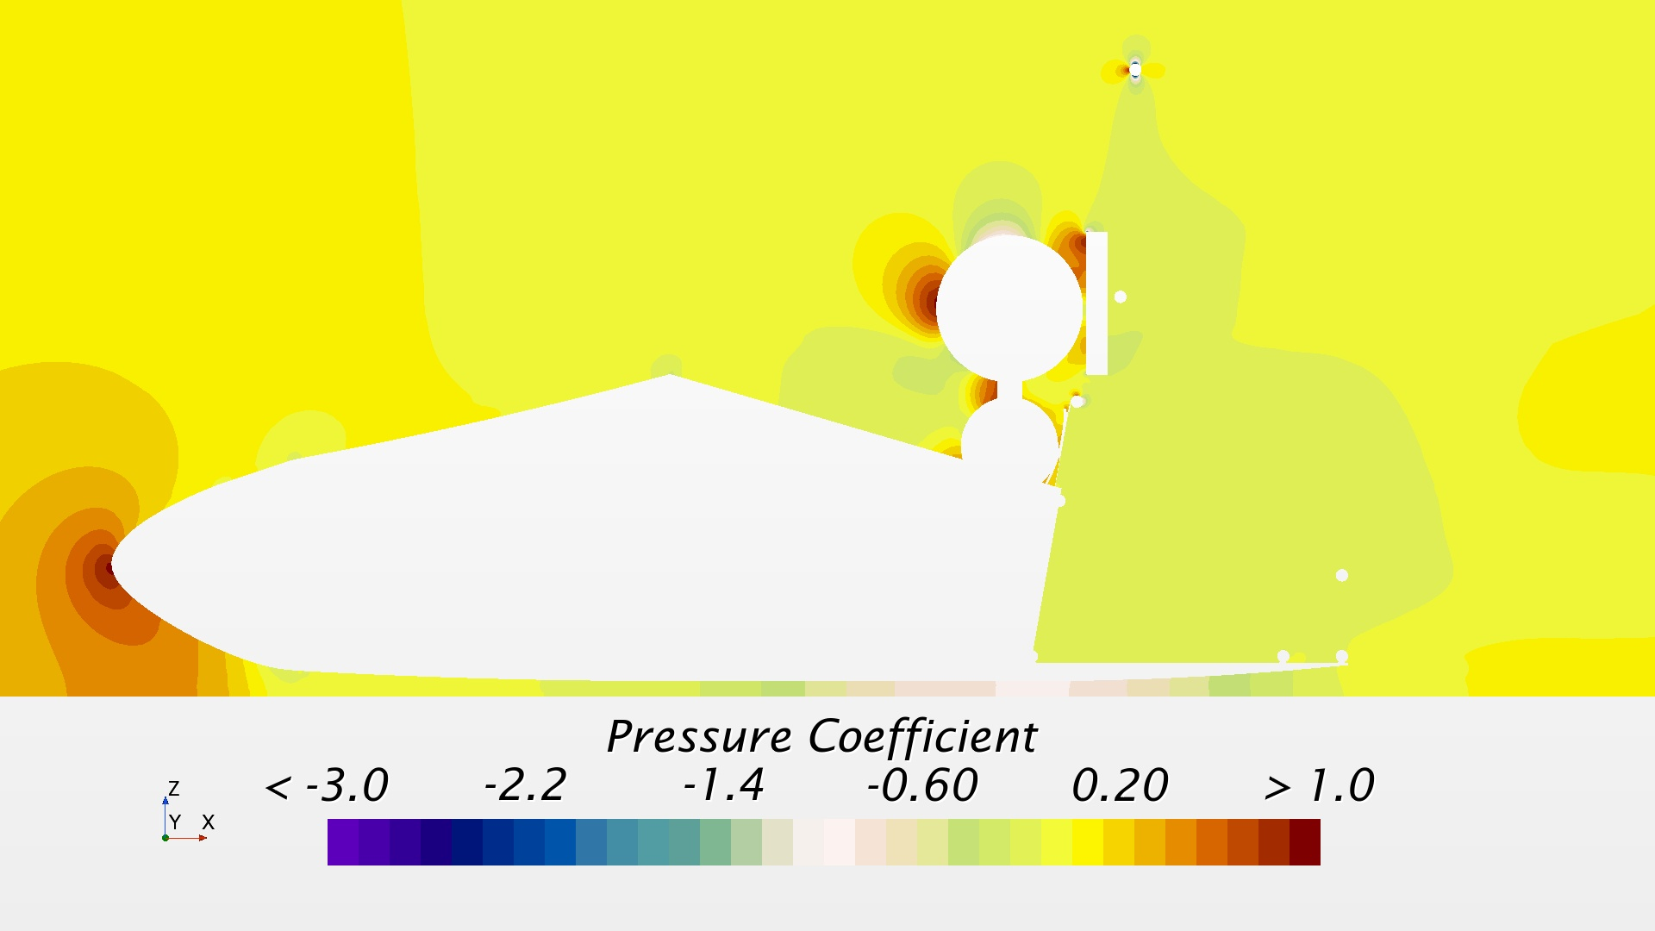
Scalar cross section pressure y=0m
Scalar cross section pressure y=0m

Slide 36
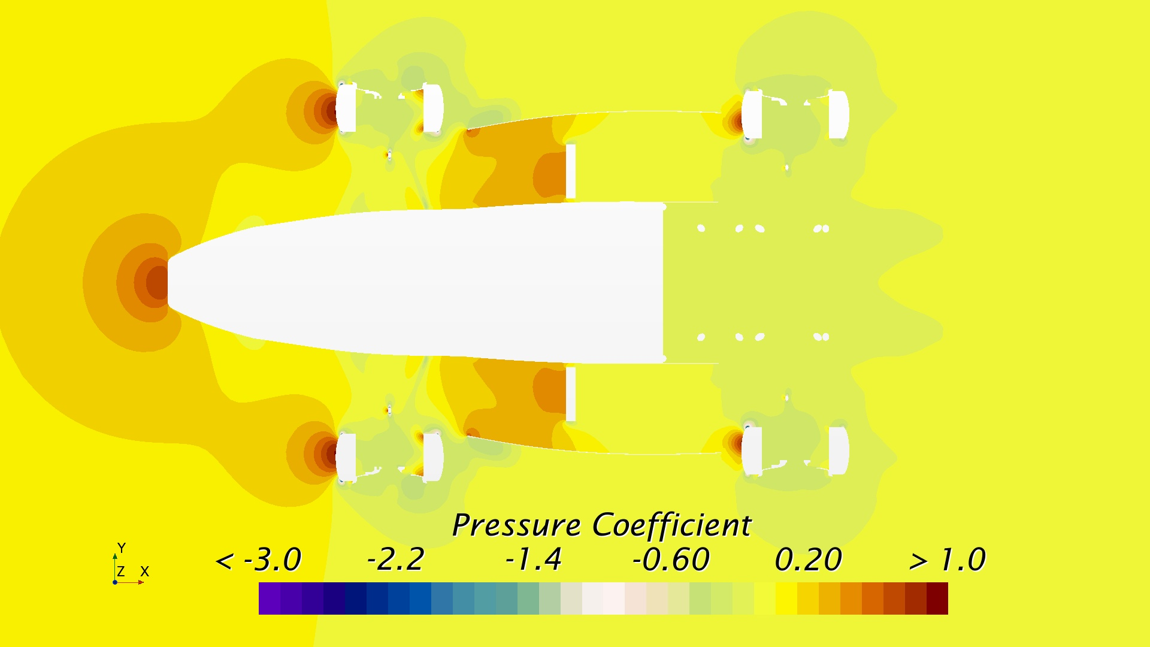
Scalar cross section pressure z=0.06m (mid way up through wheel)
Scalar cross section pressure z=0.06m (mid way up through wheel)

Slide 37
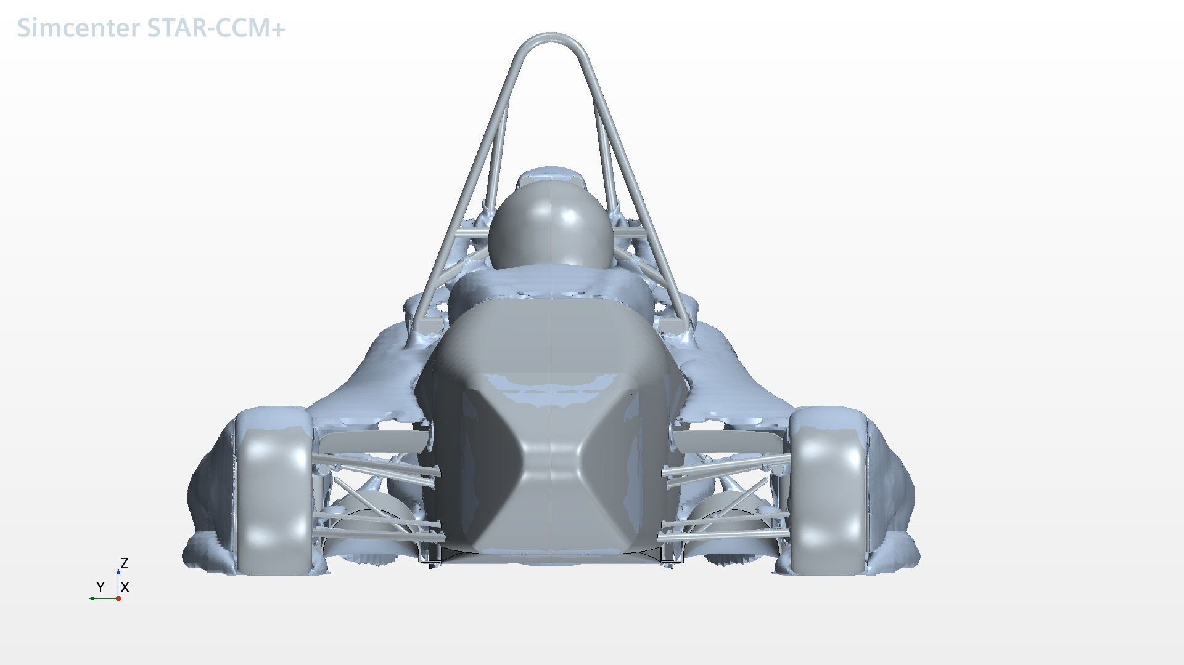
Turbulent Flow (Front View)
Turbulent Flow (Front View)

Slide 38
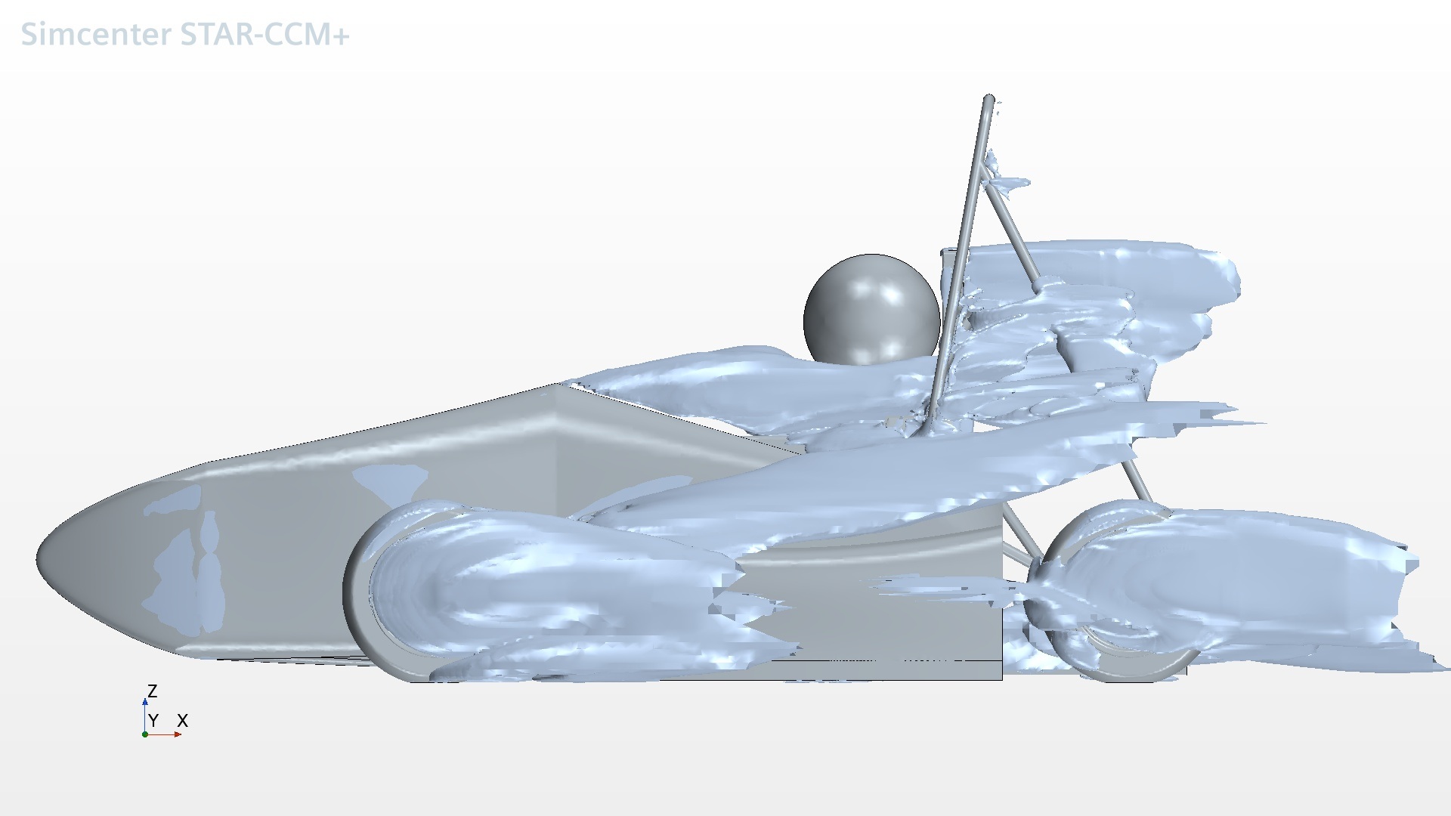
Turbulent Flow (Side View)
Turbulent Flow (Side View)

Slide 39
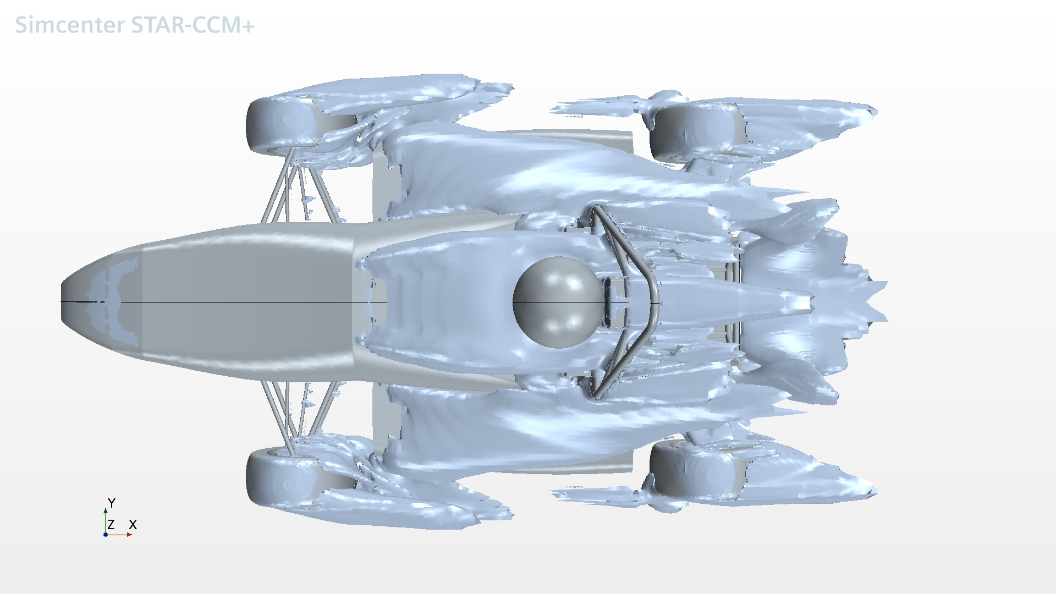
Turbulent Flow (Top View)
Turbulent Flow (Top View)

Slide 40
Turbulent Kinetic Energy
Turbulent Kinetic Energy

Slide 41
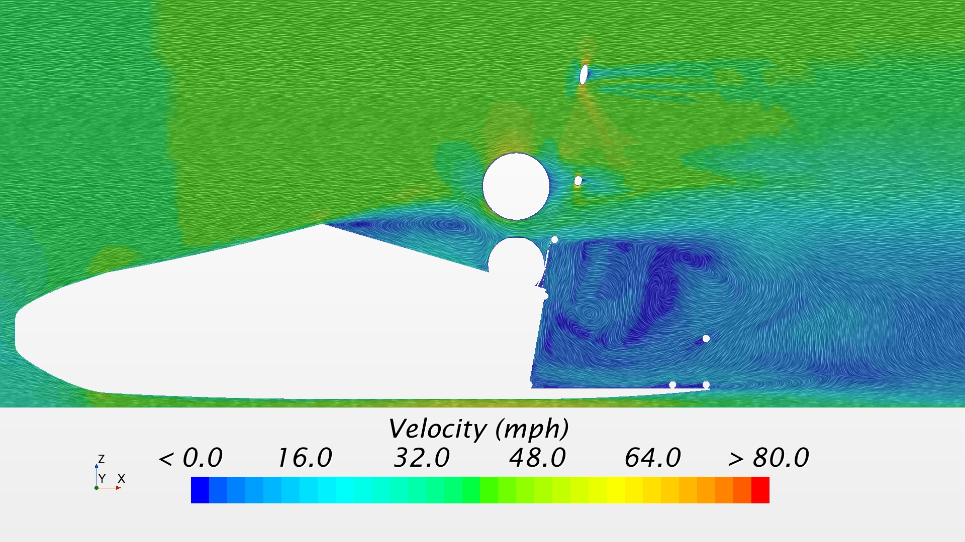
Vector velocity cross section y=-0.091 (driver's left eye)
Vector velocity cross section y=-0.091 (driver's left eye)

Slide 42
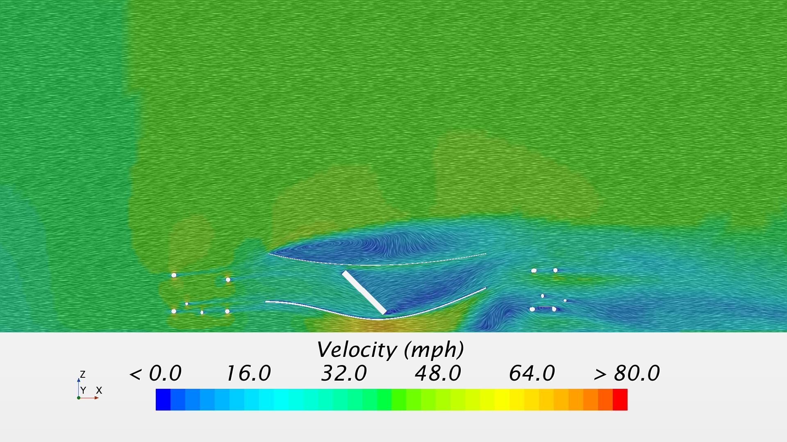
Vector velocity cross section y=-0.32m (through duct, angled)
Vector velocity cross section y=-0.32m (through duct, angled)

Slide 43
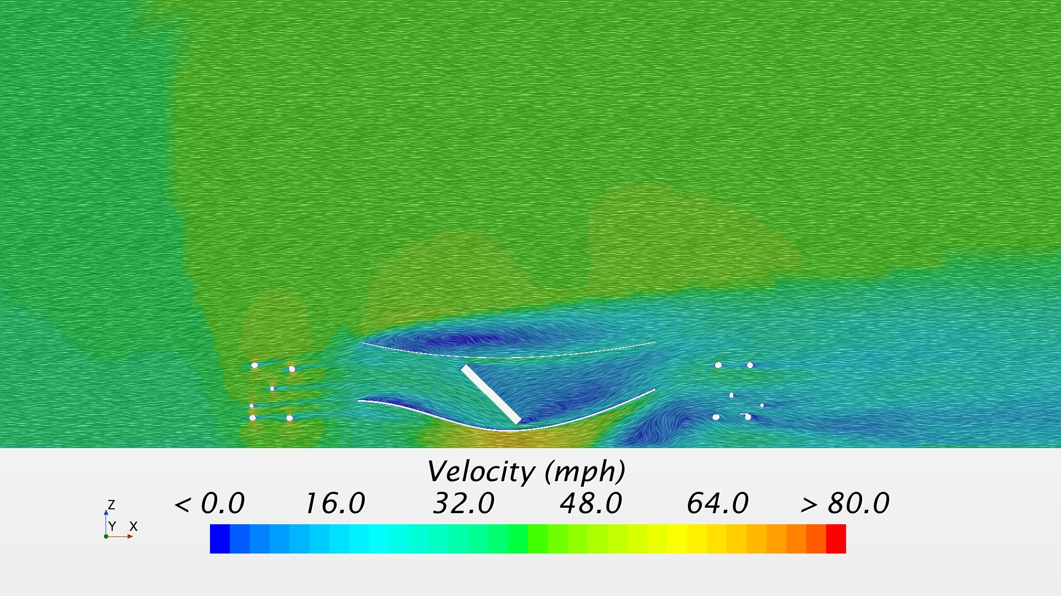
Vector velocity cross section y=-0.46m (between wheel and center body)
Vector velocity cross section y=-0.46m (between wheel and center body)

Slide 44
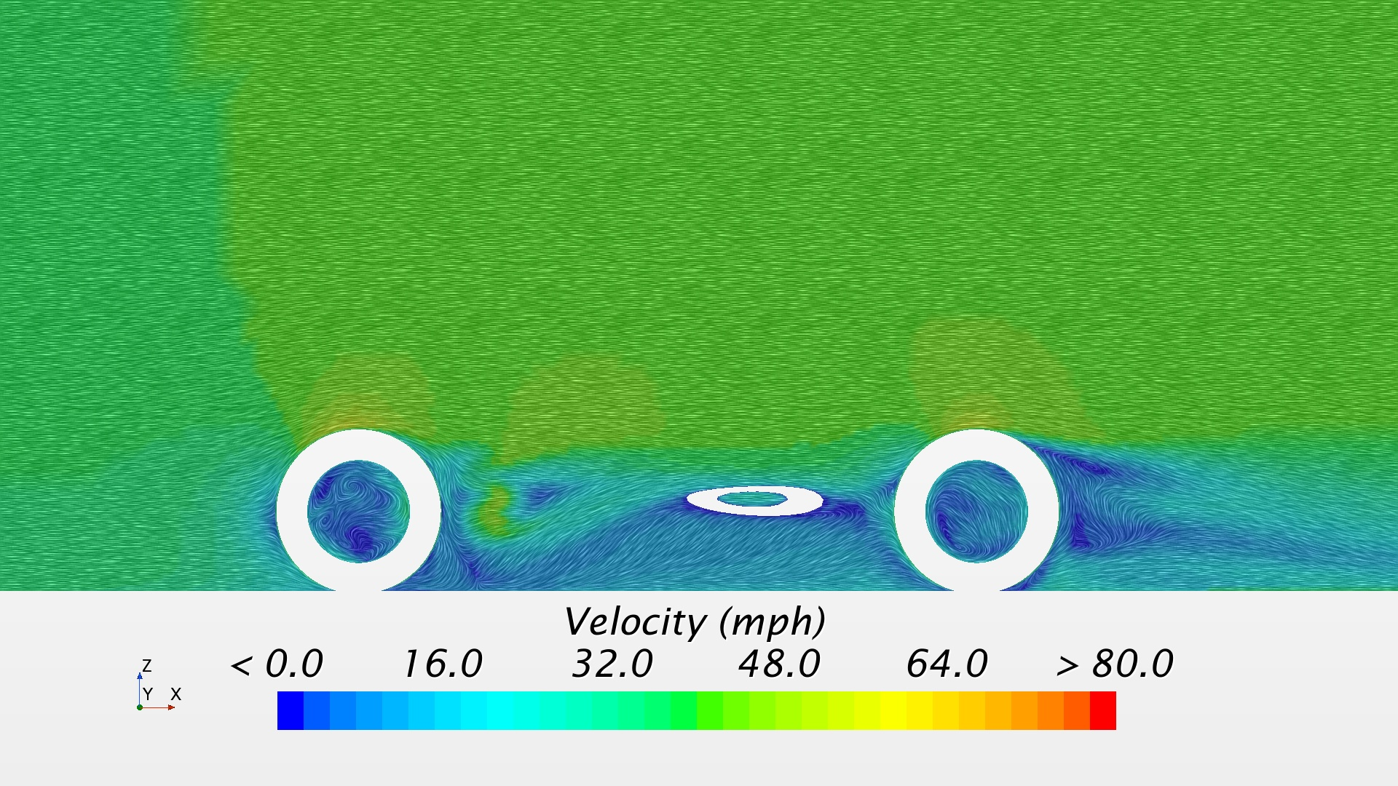
Vector velocity cross section y=-0.64m (through wheels)
Vector velocity cross section y=-0.64m (through wheels)

Slide 45
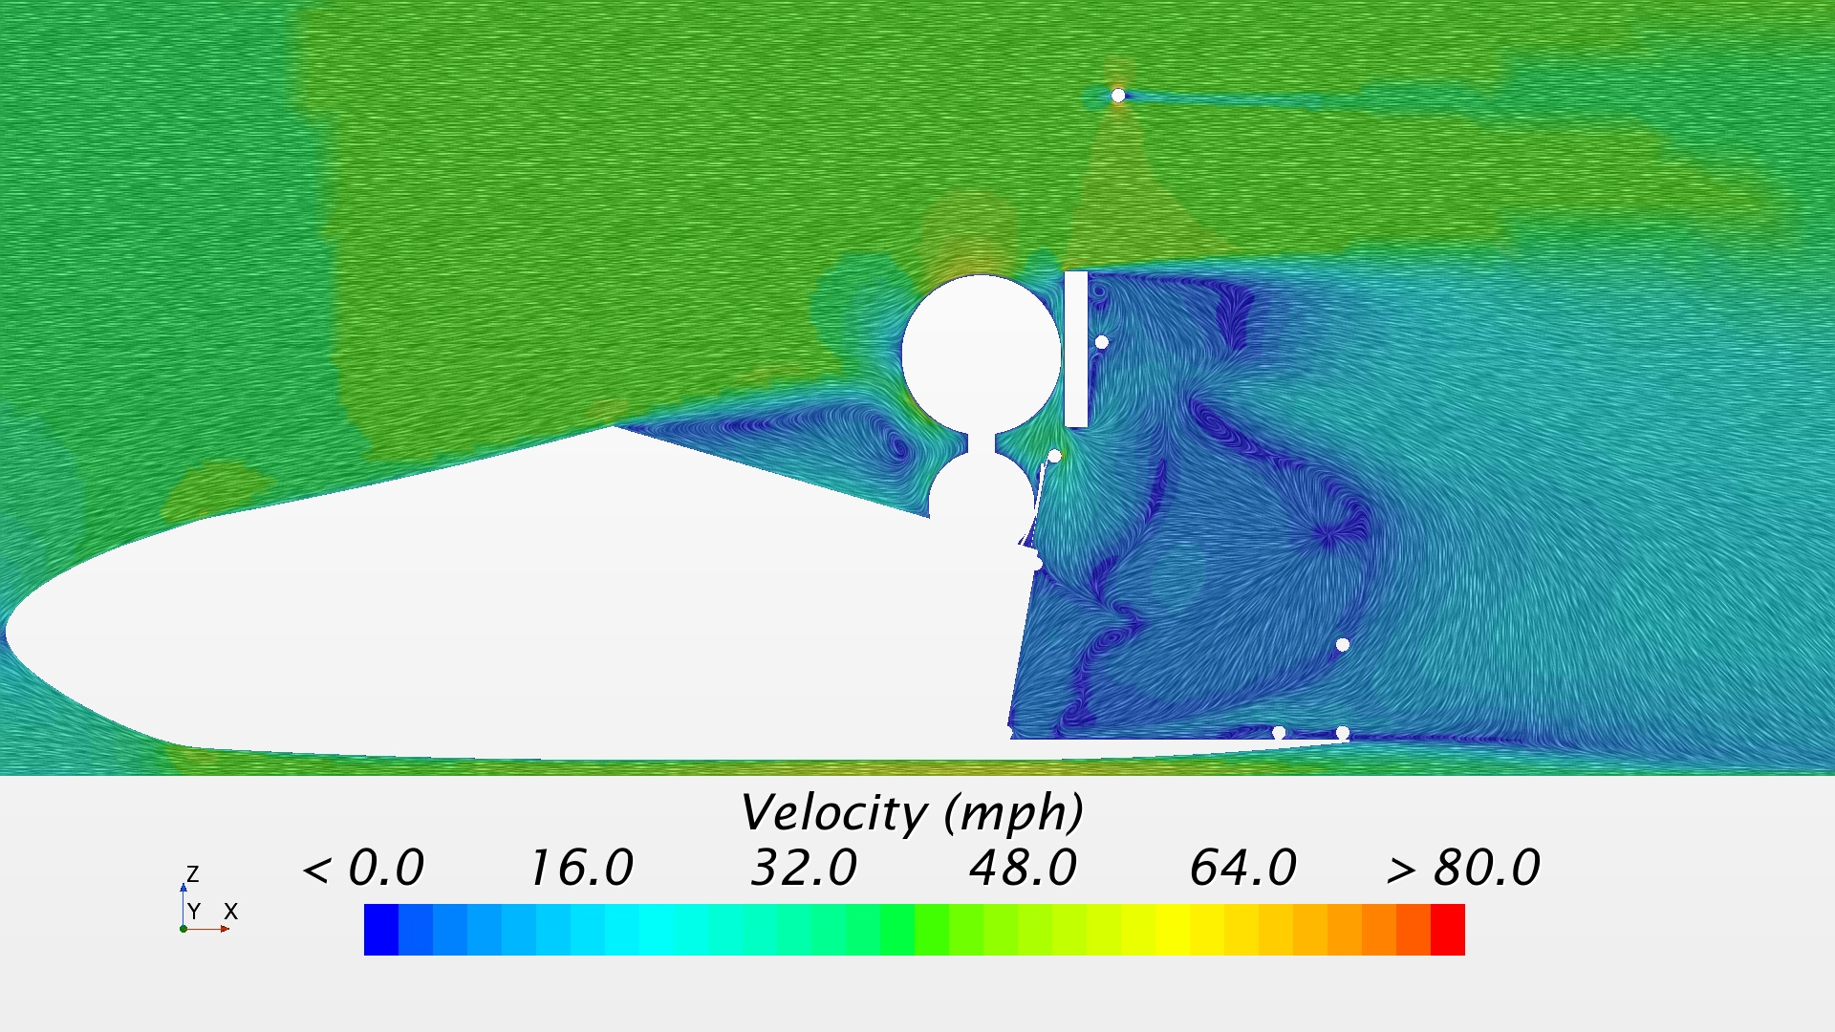
Vector velocity cross section y=0m
Vector velocity cross section y=0m

Slide 46
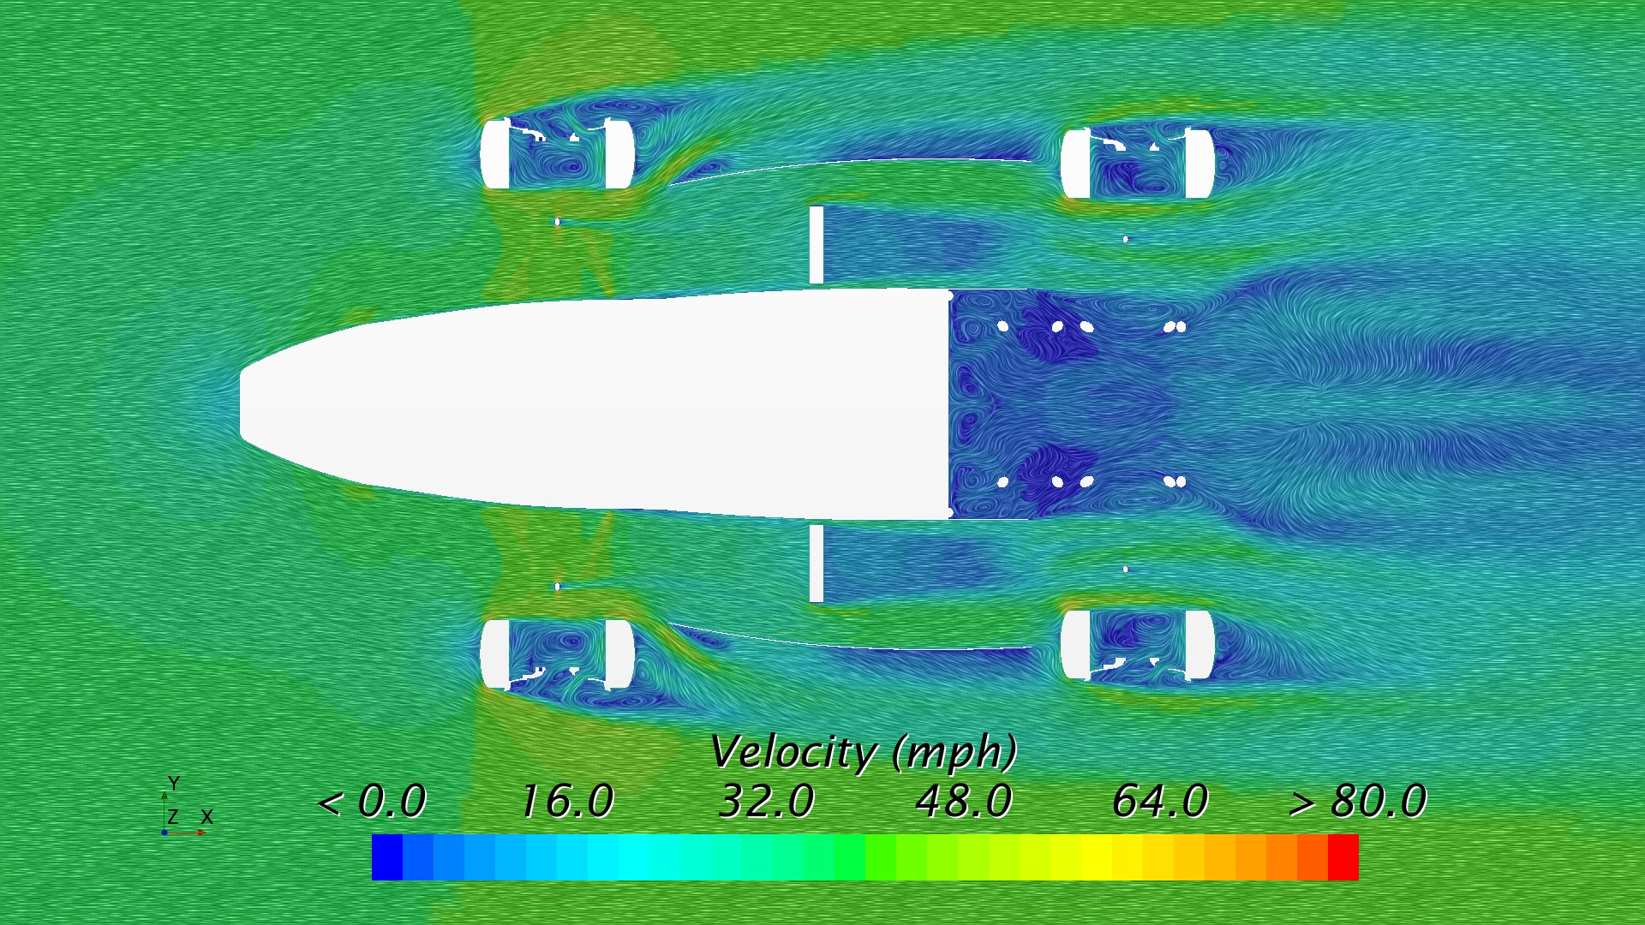
Vector velocity cross section z=0.06m (mid way up through wheel)
Vector velocity cross section z=0.06m (mid way up through wheel)

Slide 47
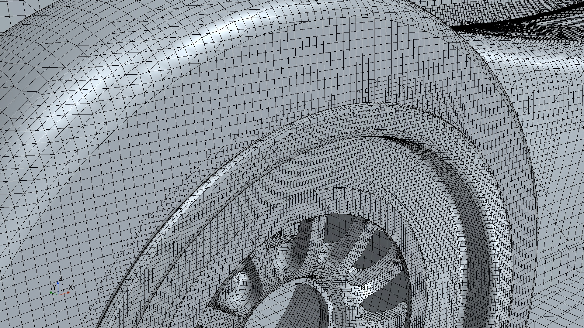
Volume mesh
Volume mesh

Slide 48
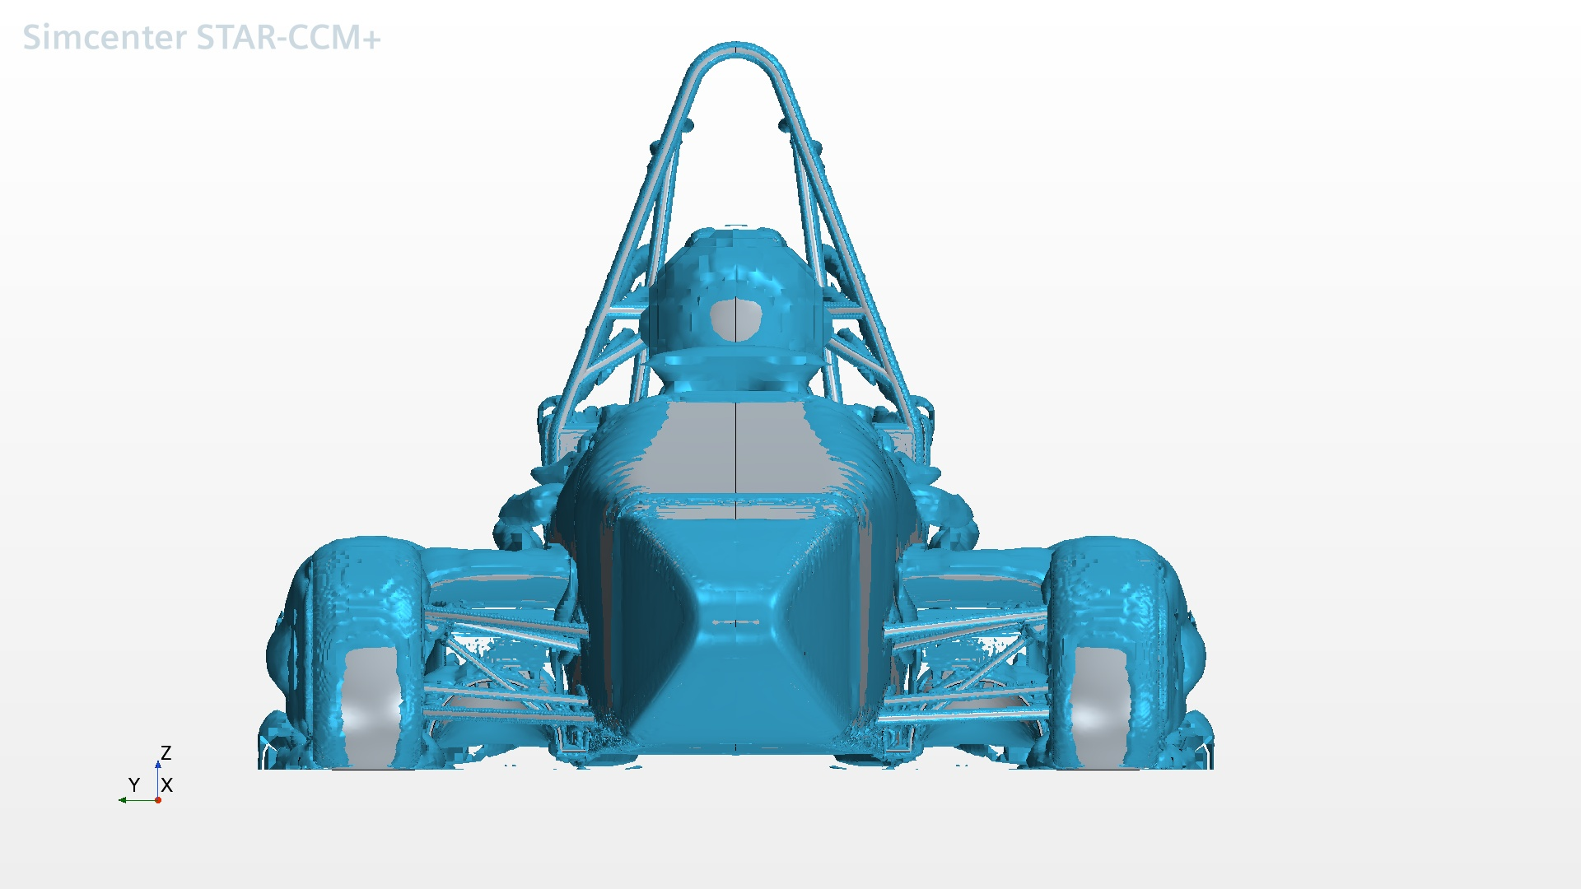
Vorticies (Front View)
Vorticies (Front View)

Slide 49
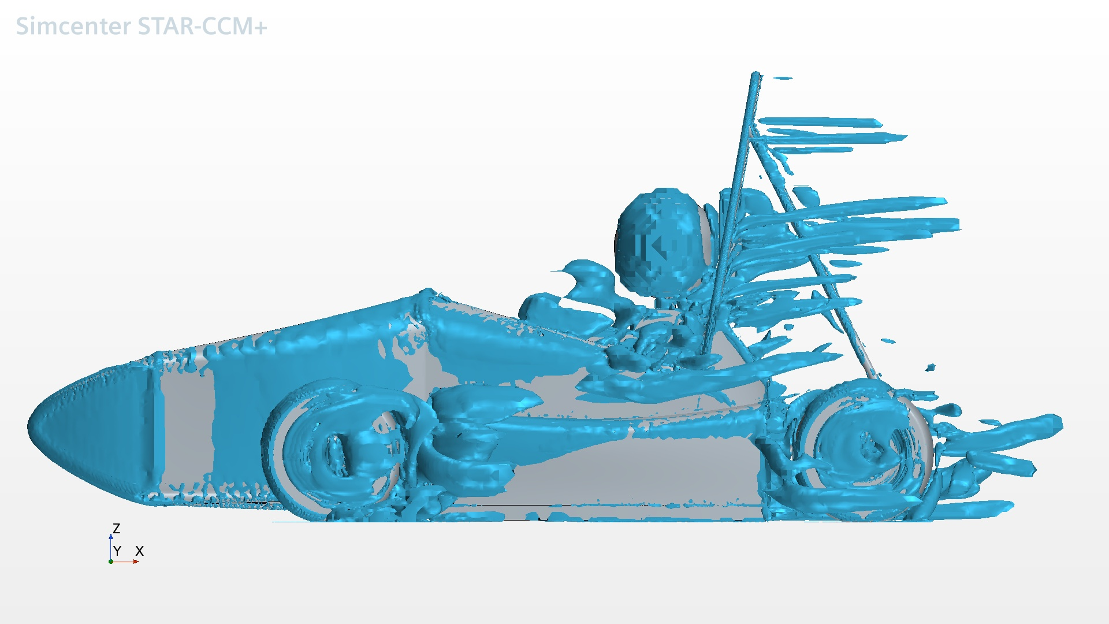
Vorticies (Side View)
Vorticies (Side View)

Slide 50
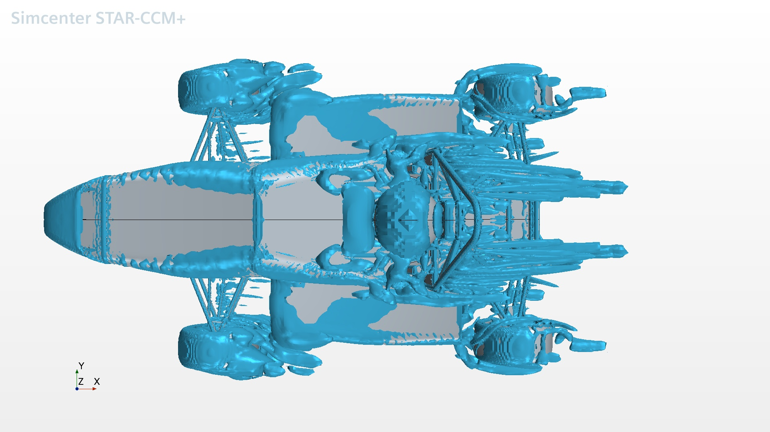
Vorticies (Top View)
Vorticies (Top View)

