Slide 1

A Presentation on “Application For Consumers”
Presented By: Harpalsinh Bhati
ER. No.: CS 49
Branch : Cyber Security
Project ID: 057

Slide 2
Problem ID : PID057
Challenge Title : Application For Consumer
Name of the Department : Food, Civil Supplies and
Consumer Affairs
Department
Users : Citizens of Gujarat
Expected Outcomes : Redress complaint within short
time
Impact : Consumers can be protected

Slide 3
T I M E L I N E
Designing Provisional GUI
Testing
Specification Requirement Gathering
Implementation of gathered data

Slide 4
I N T R O D U C T I O N O F P R O J E C T
PROBLEMS WITH
PREVIOUS SITE
MY SOLUTION
Not User Friendly
User Friendly
The complaining process is complex for users.
The users can easily file the complaint.
Privacy
Privacy
The user data is not protected.
The user data is protected.
Live Complaint Resolver
Live Complaint Resolver
The user complaint are not reviewed for weeks.
The user complaint will get resolved within 24hr.

Slide 5
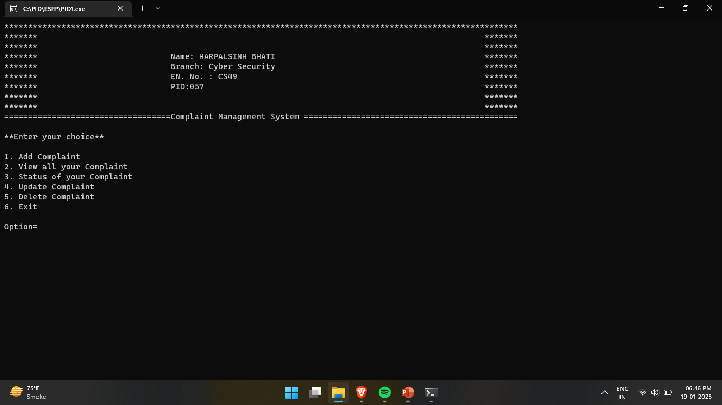
I M P L E M E N T A T I O N

Slide 6
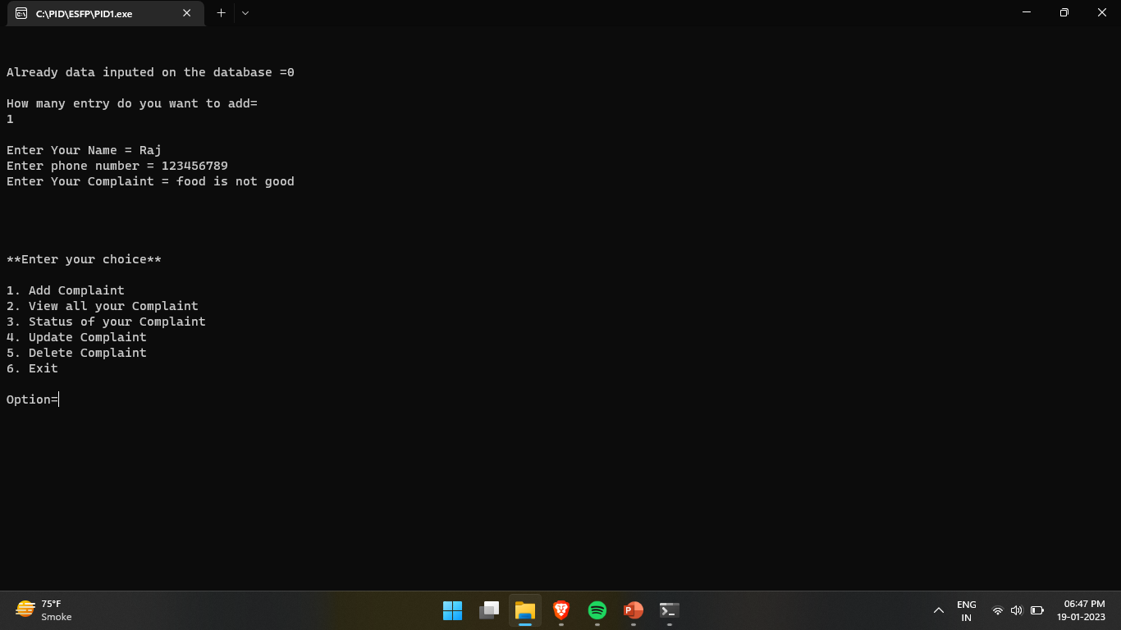

Slide 7

T H A N K S F O R W A T C H I N G

