Slide 1
BMW Financial Health Analysis
A project by: Boubacar, Houcine, Nancy and Tomos

Slide 2
Summary:
Project definition. What is financial health?
Initial exploration. How did we choose our tools?
What data do we need?
Extract-Transform-Load. The Data Warehouse.
Calculating measures.
Conclusions.

Slide 3
Problem description. What is financial health?
We identified target KPI's:
Existing KPI :
Income Statement : Revenues, Cost of Sales, Gross Profit, Net Profit.
Balance Sheet : Current & Non-Current Assets, Equity, Current & Non-Current Liabilities.
Cash-Flow : Change Cash & Equivalent, Start & End Cash & Equivalent.
Calculated KPI by Measures:
Growth Revenue Rate, Margin Rate, Global Profitability Rate
Fixed Asset Ratio, Financial Autonomy Ratio, Net Debt Ratio, Profitability of Equity
*Y = Year

Slide 4
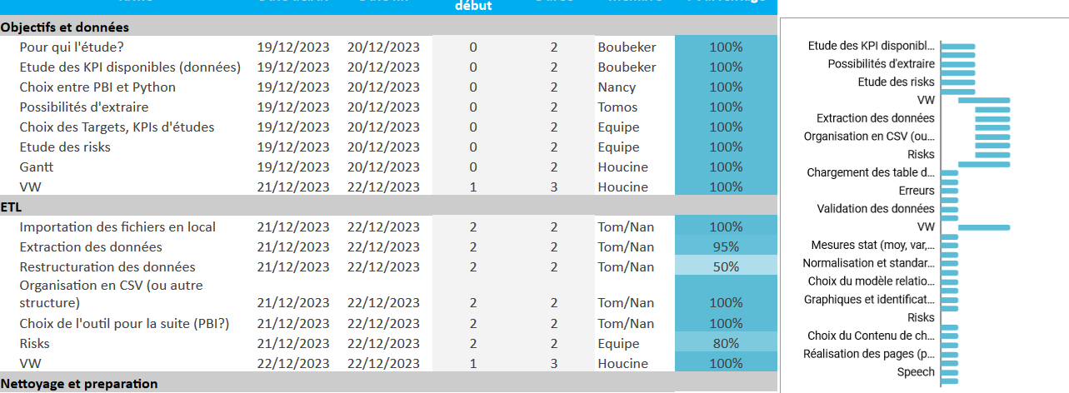
Initial exploration. How did we choose our tools?
Used an agile working methodology.
Used gantt chart to track progress and risk.
Kept a shared document to keep records and to use as a kanban board.

Slide 5
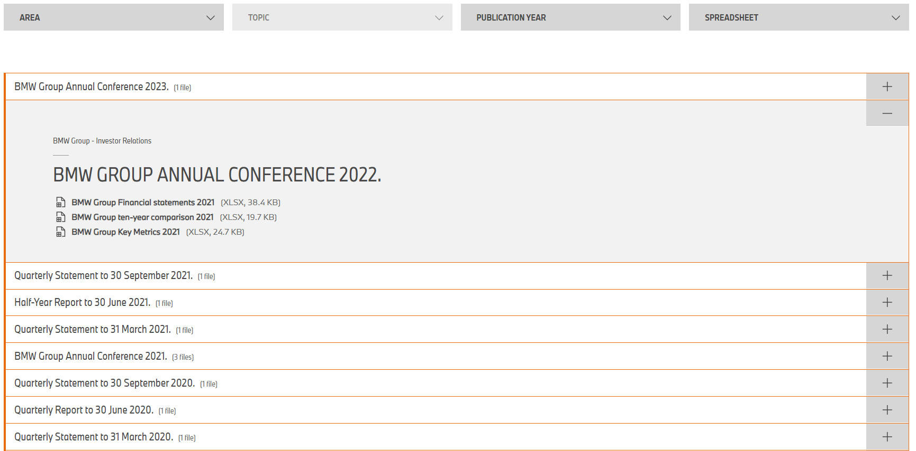
Initial exploration. How did we choose our tools?
Excel files
Pertinent information
BMW Website

Slide 6
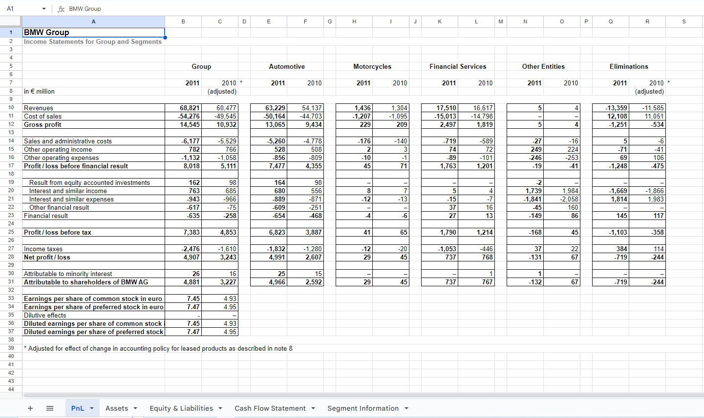
Initial exploration. How did we choose our tools?
Ex. 2011
Inconsistent spacing
Inconsistent naming

Slide 7
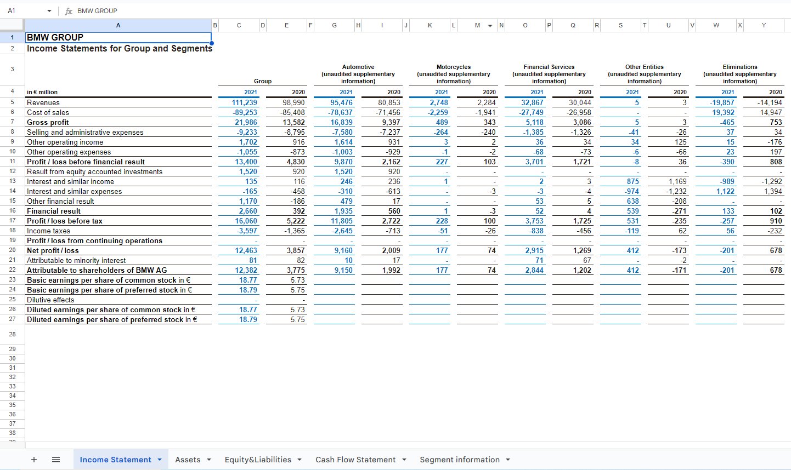
Initial exploration. How did we choose our tools?
Ex. 2021
Inconsistent spacing
Inconsistent naming

Slide 8
Initial exploration. How did we choose our tools?
Given team experience we chose a hybrid approach.
Excel for data initial cleaning. (Only 10 files)
Python for preparing raw fact-tables.
Power BI for final cleaning and visualization.

Slide 9
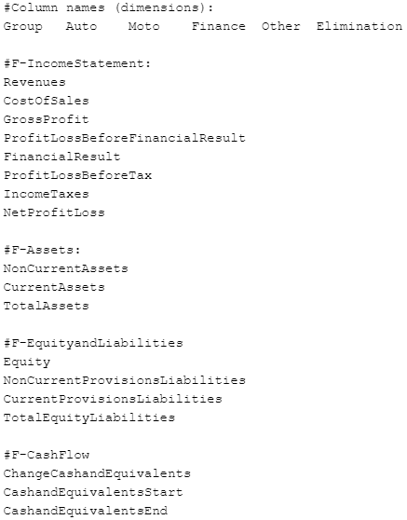
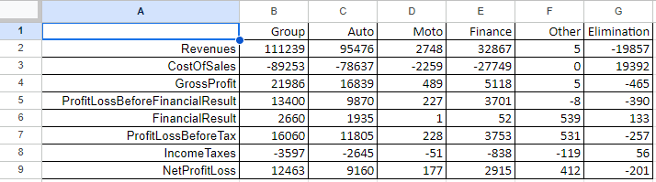
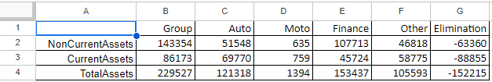
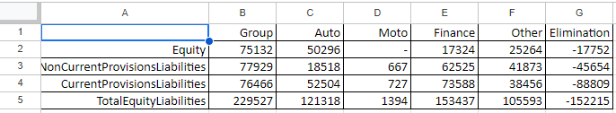
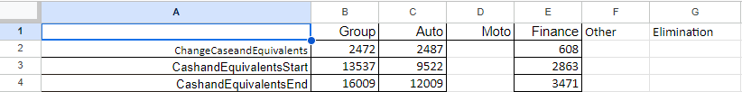
What data do we need?
We used excel to clean the data…

Slide 10
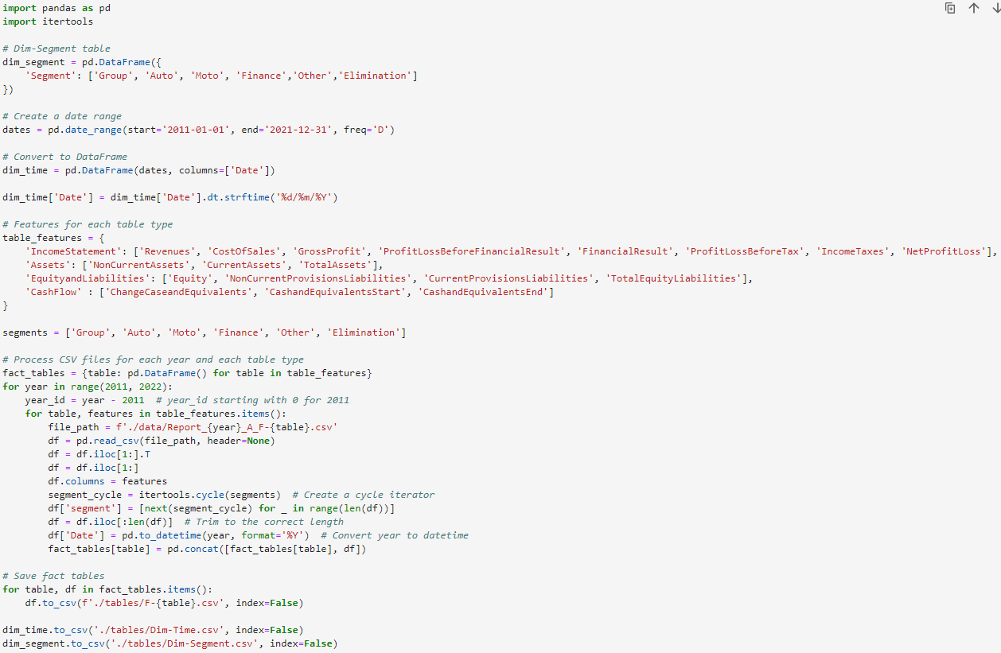
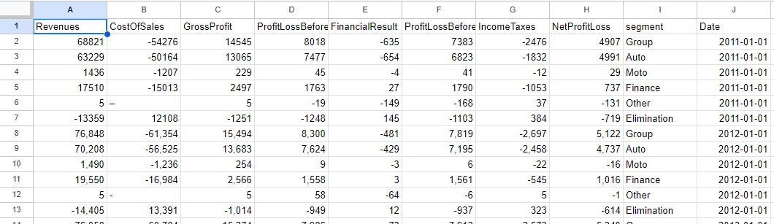
Extract-Transform-Load. The Data Warehouse.
This produces four fact-tables to be used in Power BI.
E.g. F-Income_Statement:

Slide 11
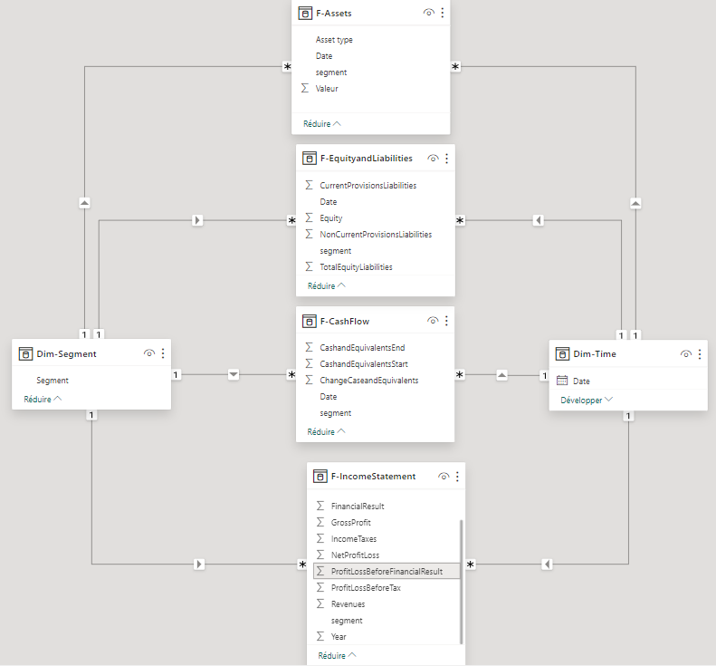
Extract-Transform-Load. The Data Warehouse.
Four fact-tables:
F-IncomeStatement
F-Assets
F-EquityandLiabilities
F-CashFlow
Two dimension-tables:
Dim-Time
Dim-Segment
A constellation schema!

Slide 12
Calculating measures.
We identified target KPI's:
[ Growth Revenue Rate ] = [ Revenues(Y) - Revenues(Y-1) ] / [ Revenues(Y-1) ]
[ Gross Profit ] = [ Revenues ] - [ Cost of Sales ]
[ Margin Rate ] = [ Gross Profit ] / [ Cost of Sales ]
[ Global Profitability Rate ] = [ Net Profit ] / [ Revenues ]
*Y = Year

Slide 13
Calculating measures.
We identified target KPI's:
[ Fixed Asset Ratio ] = [ Non-Current Assets ] / [ Total Assets ]
[ Financial Autonomy Ratio ] = [ Equity ] / [ Total Equity and Liabilities ]
[ Net Debt Ratio ] = [ Current + Non-Current Provisions and Liabilities ] [ Total Equity ]
[ Profitability of Equity ] = [ Net Profit ] / [ Equity ]

Slide 14
Conclusions.
BMW is in very good financial health and forecasts predict that this will continue.
Now let us show you our dashboard…

