Slide 1
FastAPI Tutorial : 2023 Winter Programming Camp
01. Lecture01
Changbeom Choi

Slide 2
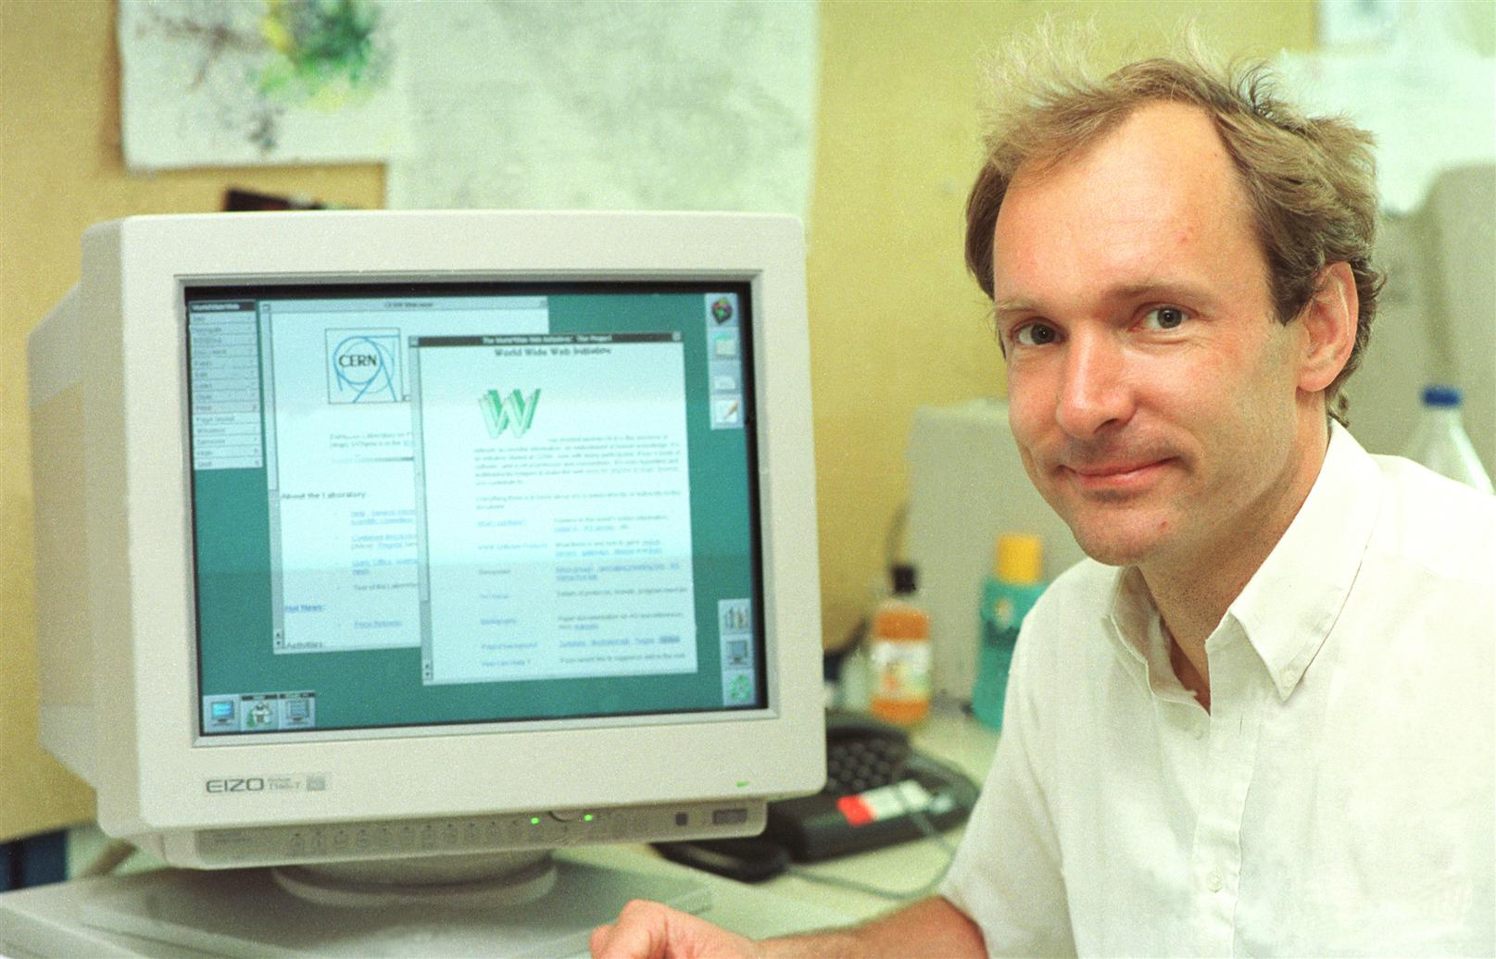
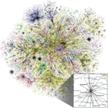
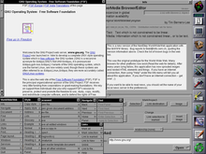
Introduction to Web Service
Be Diligent
History of Web
Tim Berners-Lee invented the World Wide Web (WWW) in 1989
The Web was originally conceived and developed to meet the demand for automated information-sharing between scientists in universities and institutes around the world.
Tim wrote the proposal for the world wide web. The document described a "hypertext project" called "WorldWideWeb" in which a "web" of "hypertext documents" could be viewed by “browsers”.
Web: inter-related
Hypertext documents: links topics to related information and graphics, which can be accessed by a point-and-click method.
Browsers: a software application for accessing information on the World Wide Web.
Tim Berners-Lee, pictured at CERN (Image: CERN)
Visualization of Routing Path
World first browser WorldWideWebs

Slide 3

Introduction to Web Service (1/2)
Be Diligent
Server-Client Architecture
What to request?
Client
Server
Request
Response
What to respond?

Slide 4


Introduction to Web Service (2/2)
Be Diligent
Server-Client Architecture
Client
Request:
- Location of the web page
Server
Hyper Text Transfer Protocol
Response
- Actual Contents

Slide 5
Hyper Text Transfer Protocol (HTTP) – (1/2)
HTTP is a protocol that clients and servers use on the web to communicate.
HTTP is a stateless protocol i.e HTTP supports only one request per connection. This means that with HTTP the clients connect to the server to send one request and then disconnects. This mechanism allows more users to connect to a given server over a period of time.
The client sends an HTTP request and the server answers with an HTML page to the client, using HTTP.
How to manage multiple requests?
How to manage multiple clients?
Web Server handles it.

Slide 6
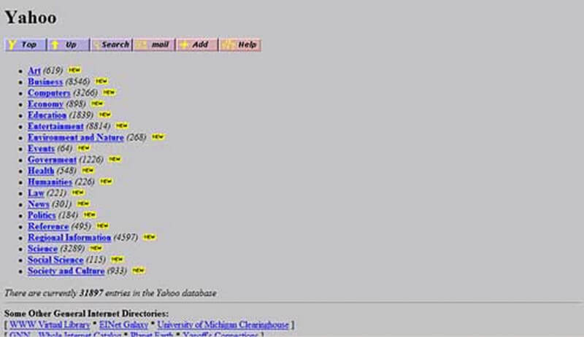


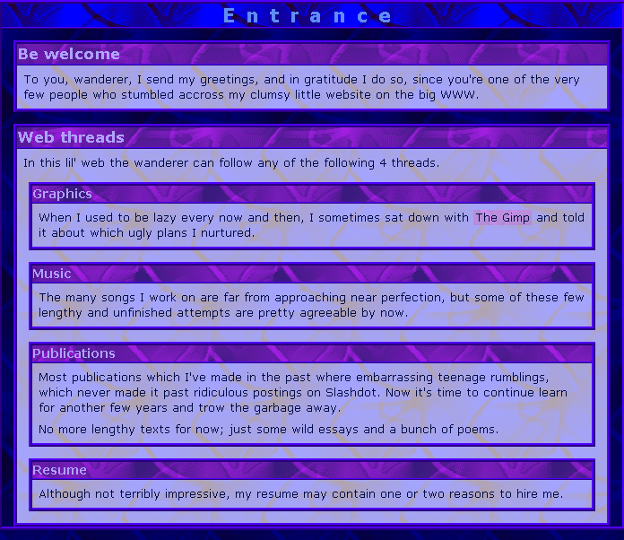
Hyper Text Transfer Protocol (HTTP) – (2/2)
Hyper Text Transfer Protocol
Static Web pages
Client
HTTP Requests
Server
Internet
Web Browser
Web Server Program
HTTP Response
Serves static webpages

Slide 7
HTTP Methods
HTTP request can be made using a variety of methods, but the ones you will use most often are Get and Post
The method name tells the server the kind of request that is being made, and how the rest of the message will be formatted.
Name | Description
OPTIONS | Request for communication options that are available on the request/response chain.
GET | Request to retrieve information from server using a given URI.
HEAD | Identical to GET except that it does not return a message-body, only the headers and status line.
POST | Request for server to accept the entity enclosed in the body of HTTP method.
DELETE | Request for the Server to delete the resource.
CONNECT | Reserved for use with a proxy that can switch to being a tunnel.
PUT | This is same as POST, but POST is used to create, PUT can be used to create as well as update. It replaces all current representations of the target resource with the uploaded content.

Slide 8
Difference between GET and POST requests
GET Request | POST Request
Data is sent in header to the server | Data is sent in the request body
Get request can send only limited amount of data | Large amount of data can be sent.
Get request is not secured because data is exposed in URL | Post request is secured because data is not exposed in URL.
Get request can be bookmarked and is more efficient. | Post request cannot be bookmarked.

Slide 9
General Difference between PUT and POST methods
POST to a URL creates a child resource at a server defined URL while PUT to a URL creates/replaces the resource in its entirety at the client defined URL.
POST creates a child resource, so POST to /books will create a resources that will live under the /books resource. Eg. /books/1. Sending the same post request twice will create two resources.
PUT is for creating or replacing a resource at a URL known by the client.
PUT must be used for CREATE when the client already knows the url before the resource is created.
PUT replaces the resource at the known url if it already exists, so sending the same request twice has no effect. In other words, calls to PUT are idempotent.

Slide 10
Web Framework & Flask & FastAPI(1/3)
Web Application Framework
Represents a collection of libraries and modules
Enables a web application developer to write applications without having to bother about low-level details such as protocols, thread management etc.
Web Server Gateway Interface (WSGI)
A standard for Python web application development.
WSGI is a specification for a universal interface between the web server and the web applications.
Flask
A web application framework written in Python.
Based on the Werkzeug WSGI toolkit and Jinja2 template engine
FastAPI
A high-performance, web framework for building APIs with Python 3.7+ based on Python type hints.

Slide 11
Web Framework & Flask & FastAPI(3/3)
Flask (Con’t)
A micro framework.
Aims to keep the core of an application simple yet extensible.
Flask supports the extensions to add such functionality to the application
Werkzeug
A WSGI toolkit, which implements requests, response objects, and other utility functions.
Enables building a web framework on top of it.
Jinja2
Jinga2 is a popular templating engine for Python.
A web templating system combines a template with a certain data source to render dynamic web pages.

Slide 12
Web Framework & Flask & FastAPI(3/3)
FastAPI(Con’t)
Fast
Very high performance, on par with NodeJS and Go
Fast to code
Increase the speed to develop features by about 200% to 300%.
Fewer bugs
Reduce about 40% of human (developer) induced errors.
Intuitive
Great editor support. Completion everywhere. Less time debugging.
Easy
Designed to be easy to use and learn. Less time reading docs.
Short
Minimize code duplication. Multiple features from each parameter declaration. Fewer bugs.
Robust
Get production-ready code. With automatic interactive documentation.
Standards-based
Based on (and fully compatible with) the open standards for APIs: OpenAPI (previously known as Swagger) and JSON Schema.

Slide 13
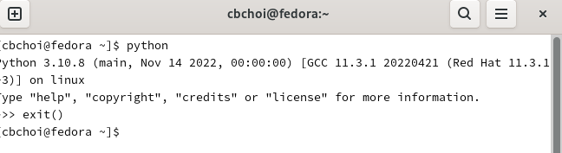
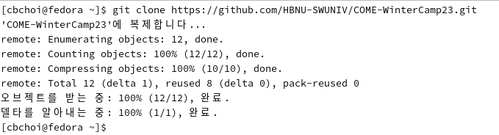
Environment Setting
Check Python Version
~] python
Clone Github Repository
~] git clone https://github.com/HBNU-SWUNIV/COME-WinterCamp23.git

Slide 14
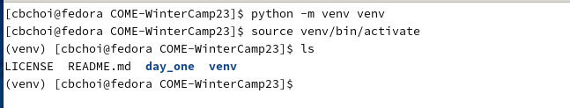
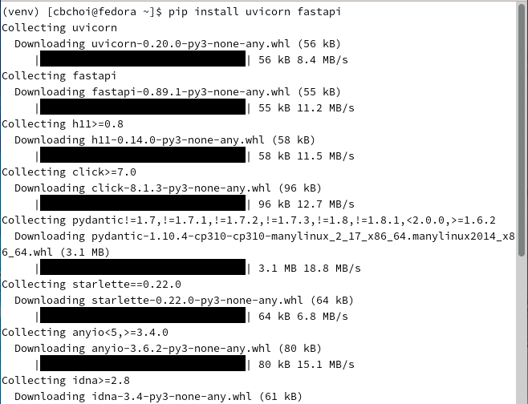
Environment Setting
Create Virtual Environment
COME-WInterCamp23] python –m venv venv
COME-WInterCamp23] source venv/bin/activate
Install Web Application Framework
COME-WInterCamp23] pip install fastapi uvicorn

Slide 15
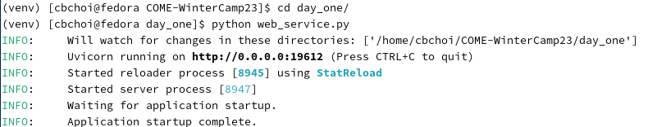
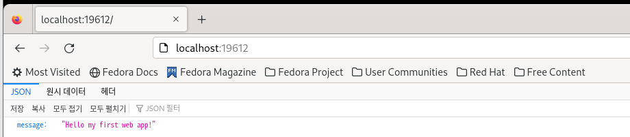
Environment Setting
Test
COME-WInterCamp23] cd day_one/practicum
practicum] python web_service.py

Slide 16
Reference
Be Diligent
A short history of the Web, https://home.cern/science/computing/birth-web/short-history-web
Hypertext, https://en.wikipedia.org/wiki/Hypertext
World First Web Browser, https://en.wikipedia.org/wiki/WorldWideWeb
Introduction to Web, https://www.studytonight.com/servlet/introduction-to-web.php
Flask Tutorial, https://www.tutorialspoint.com/flask/flask_tutorial.pdf
FastAPI, FastAPI (tiangolo.com)

