Slide 1
Introduction to Artificial Intelligence
CH. 1 Introduction
Department of AI
HBU
Dep. of AI HBU

Slide 2
Menu
1.1 Definition of AI
1.2 Beginning and development of AI
1.3 Research areas in AI
1.4 Main schools in AI
1.5 Applications of AI
1.6 Conclusion
Dep. of AI HBU

Slide 3
Artificial Intelligence
Artificial intelligence (AI) refers to the simulation of human intelligence in machines that are programmed to think like humans and mimic their actions. The term may also be applied to any machine that exhibits traits associated with a human mind such as learning and problem-solving.
https://www.investopedia.com/terms/a/artificial-intelligence-ai.asp
Dep. of AI HBU

Slide 4
人工智能
4 aspects of IA giving by Stuart Russell and Peter Norvig:
Humanoid Thinking method | Rational thinking system
Humanoid Behavior method | Rational behavior system
Dep. of AI HBU

Slide 5
Humanoid Thinking method
Kurzwell believed that AI is a technology to finish the task, which need intelligence.
The famous example: Turing test.
Application:
  proving theorem
  Deep blue
  disease diagnosis
Dep. of AI HBU

Slide 6
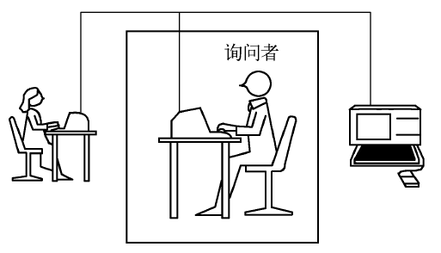
Turing test
https://www.bilibili.com/video/BV1Ei4y1b7Ci
Dep. of AI HBU

Slide 7
Rational thinking system
Bellman proposed that AI is an automation related with human thinking, decision, problem solving and learning.
Main model of RTS--- theory of human thinking。
Two methods for the theory: introspection and Psychological tests.
Dep. of AI HBU

Slide 8
Rational behavior system
Nilsson believe that AI is an agent which is rational behavior system.
In rational behavior system, AI focus on inference. The inference for correction is one part of rational agent.
Dep. of AI HBU

Slide 9
Menu
1.1 Definition of AI
1.2 Beginning and development of AI
1.3 Research areas in AI
1.4 Main schools in AI
1.5 Applications of AI
1.6 Conclusion
Dep. of AI HBU

Slide 10
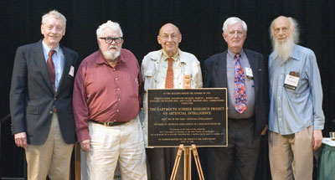
Dartmouth Conference
1956 SUMMER, Dartmouth US, Two month
J. McCarthy, M. Minsky, N. Lochester (IBM), C.E. Shannon
A. Samual (IBM), H.A. Simon (CMU), A. Newell (CMU),
T. More (Prinston), R. Solomonoff (MIT), O. Selfridge (MIT)
Rockefeller Foundation supported the conference.
https://computerhistory.org/events/1956-dartmouth-workshop-its-immediate/
Dep. of AI HBU

Slide 11

Development process of AI
The process of AI: Creation of AI, Symbolic intelligence, and Data intelligence.
Creation of AI(1956-1976年)
Symbol intelligence(1976-2006年)
Data intelligence （2006年-现在）
史忠植 人工智能导论：绪论

Slide 12
Creation of AI
1956，Chomsky N: Formal Language Theory
1958, J. McCarthy proposed LISP, one AI language.
1965, J.A. Robinson's resolution Principle
1965年，Feigenbaum和Lederberg J: DENDRAL。
1972-1976年，Feigenbaum: MYCIN, one expert system for medicine.
史忠植 人工智能导论：绪论
Notes:
"I don't see that human intelligence is something that humans can never understand.“ J. McCarthy.
DENDRAL是世界上第一例成功的专家系统

Slide 13
Symbol intelligence
1975，Simon and Newell: Turing Prize and proposed “Physical Symbol System Hypothesis” 。
1977， Feigenbaum proposed novel concept: knowledge engineering 。
1984，Learning theory was proposed by Leslie Valiant
1993，Shoham Y proposed agent-oriented programming.
1995，Russell S and Norvig P published《AI》
2011，Judea Pearl won Turing Prize for probabilistic and causal reasoning algorithms
史忠植 人工智能导论：绪论

Slide 14
Data Intelligence
2006，Geoffrey Hinton proposed deep belief network, the beginning of DL.
2016，Cambricon proposed Cambricon-X for DL.
2018年， The Troika in AI: Geoffrey Hinton, Yann LeCun, Yoshua Bengio won Turing Award.
https://vectorinstitute.ai/team/geoffrey-hinton/
史忠植 人工智能导论：绪论
Notes:
http://www.cambricon.com/index.php?m=content&c=index&a=lists&catid=148

Slide 15
Menu
1.1 Definition of AI
1.2 Beginning and development of AI
1.3 Research areas in AI
1.4 Main schools in AI
1.5 Applications of AI
1.6 Conclusion
Dep. of AI HBU

Slide 16
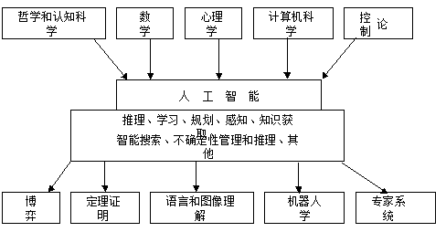
Research areas in AI
Dep. of AI HBU

Slide 17
Research areas in AI
  Cognition modeling
  Knowledge representation
  Automatic reasoning
  Machine learning
Dep. of AI HBU

Slide 18
Cognition
Cognition: the mental action or process of acquiring knowledge and understanding through thought, experience, and the senses.。
American psychologist, Houston, listed 5 types of cognition:
(1） an information processing；
(2) a symbolling operation；
(3) problem solving；
(4) thought；
(5) an interrelated activity 。
Dep. of AI HBU

Slide 19
Cognition Modeling
Cognition is a complex process.
Cognition modeling is the technology to model cognition of human to research thought. By using computer, input information is connected with output by classification, operation, storage, recognition, ect.
Dep. of AI HBU

Slide 20
Knowledge representation
A knowledge representation (KR) is most fundamentally a surrogate, a substitute for the thing itself, used to enable an entity to determine consequences by thinking rather than acting, i.e., by reasoning about the world rather than taking action in it.
https://groups.csail.mit.edu/medg/ftp/psz/k-rep.html
Dep. of AI HBU

Slide 21
Automatic reasoning
演绎推理(deductive reasoning)
归纳推理(inductive reasoning)
反绎推理(abductive reasoning)
Dep. of AI HBU

Slide 22
自动推理
Automated reasoning is the area of computer science that is concerned with applying reasoning in the form of logic to computing systems. If given a set of assumptions and a goal, an automated reasoning system should be able to make logical inferences towards that goal automatically.
https://searchenterpriseai.techtarget.com/definition/automated-reasoning#:~:text=Automated%20reasoning%20is%20the%20area%20of%20computer%20science,to%20make%20logical%20inferences%20towards%20that%20goal%20automatically.
Dep. of AI HBU

Slide 23
正向推理
正向推理又叫向前推理、数据驱动的推理，
从已知的数据/条件/中间结论出发推导出新的结论
1. A → G1
2. A′ → G1
3. B → G2
4. B′ → G2
5. G1 & G2 → G
Dep. of AI HBU

Slide 24
反向推理
反向推理又叫向后推理、面向目标的推理，从结论（目标）出发推导结论（目标）的前提条件。
1. G → G1 & G2
2. G1 → A
3. G1 → A′
4. G2 → B
5. G2 → B′
Dep. of AI HBU

Slide 25
Machine learning
Machine learning is a branch of artificial intelligence (AI) focused on building applications that learn from data and improve their accuracy over time without being programmed to do so.
Machine learning focuses on applications that learn from experience and improve their decision-making or predictive accuracy over time.
Dep. of AI HBU

Slide 26
Machine learning
Step 1: Select and prepare a training data set
Step 2: Choose an algorithm to run on the training data set
Step 3: Training the algorithm to create the model
Step 4: Using and improving the model
Environ-ment
Learning Unit
Knowledge data
Executing Unit
feedback
Dep. of AI HBU

Slide 27
Main topics on Top Conf.
  Automated Reasoning
  Case-based Reasoning
  Cognitive Modelling
  Constraint Satisfaction
  Distributed AI
  Computer Game Playing
  Knowledge-based Applications
  Machine Learning
  Natural Language Processing
  Planning and Scheduling
  Qualitative Reasoning and Diagnosis
Dep. of AI HBU

Slide 28
Main topics on Top Conf.
  Robotics and Perception
  Search
  Software Agents
  Temporal Reasoning
  Uncertainty and Probabilistic Reasoning
  Neural Networks
  Genetic Algorithms
  Fuzzy Logic
  Philosophy of AI
  Knowledge Representation
  Knowledge Acquisition and Expert Systems
Dep. of AI HBU

Slide 29
Menu
1.1 Definition of AI
1.2 Beginning and development of AI
1.3 Research areas in AI
1.4 Main schools in AI
1.5 Applications of AI
1.6 Conclusion
Dep. of AI HBU

Slide 30
AI研究的主要学派
Symbolisms
Connectionism
Actionism
Dep. of AI HBU

Slide 31
Symbolisms vs Connectionism
Symbolic AI represents information through symbols and their relationships. Specific Algorithms are used to process these symbols to solve problems or deduce new knowledge.
Connectionist AI represents information in a distributed, less explicit form within a network. Biological processes underlying learning, task performance, and problem solving are imitated.
Dep. of AI HBU

Slide 32
Symbolisms vs Connectionism
One of the paradigms in symbolic AI is propositional calculus.
In propositional calculus, features of the world are represented by propositions.
Relationships between features (constraints) are represented by connectives.
Dep. of AI HBU

Slide 33
Actionism
An artistic movement emphasizing the physical act or process of creation over the finished work
Dep. of AI HBU

Slide 34
Menu
1.1 Definition of AI
1.2 Beginning and development of AI
1.3 Research areas in AI
1.4 Main schools in AI
1.5 Applications of AI
1.6 Conclusion
Dep. of AI HBU

Slide 35
Application of AI
  Expert System
  Data Mining
  Natural Language Processing
  Robot
  Pattern Recognition
  Internet
  Security
  Game
Dep. of AI HBU

Slide 36
Menu
1.1 Definition of AI
1.2 Beginning and development of AI
1.3 Research areas in AI
1.4 Main schools in AI
1.5 Applications of AI
1.6 Conclusion
Dep. of AI HBU

Slide 37
小 结
Knowledge representation, reasoning, learning, searching and uncertain of knowledge is the main research in AI. The main applications of AI includes expert system, data mining, NLP, Robot, PR, Internet and security.
The main methods in AI are symbolic method and connective methods
Dep. of AI HBU

Slide 38
展 望
AI is future of most research areas in Computer Science.
Dep. of AI HBU

Slide 39
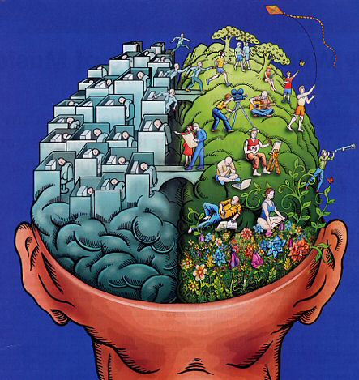
Thank You
Dep. of AI HBU
Notes:
NN 1
10-00
Elene Marchiori

