Slide 1
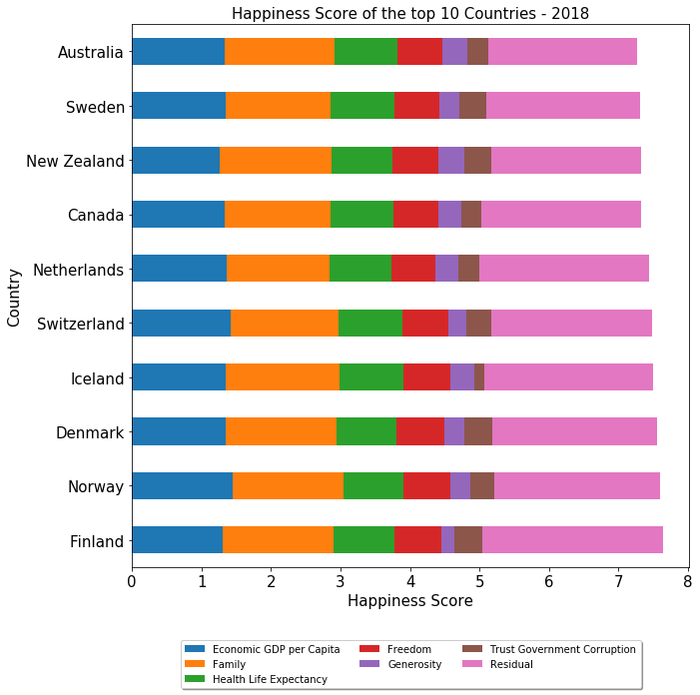
World Happiness Report Data Analysis (2015 - 2018)
Purpose of this project is to find happiest countries in the world and analyze world happiness report to understand the factors contributing to happiness score.
This project also tries to relate happiness score of countries with external elements to identify and understand possible trends.
According to 2018 happiness report, Finland is ranked as happiest country with a happiness score of 7.632 and United States is ranked as 18th.
In 2018, 7 countries in top ten are from Western Europe, 2 of them are Australia and New Zealand and 1 country (Canada) from North America.
‘Economic GDP per Capita’ and ‘Family’ are major contributors toward happiness score.
External factors ‘World Unemployment Rate’ and ‘Economic Freedom Data’ is analyzed to explore the relationship between happiness score and these factors.

Slide 2
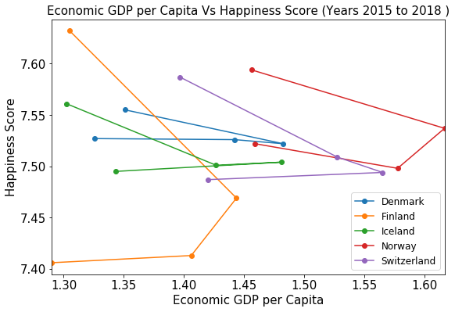
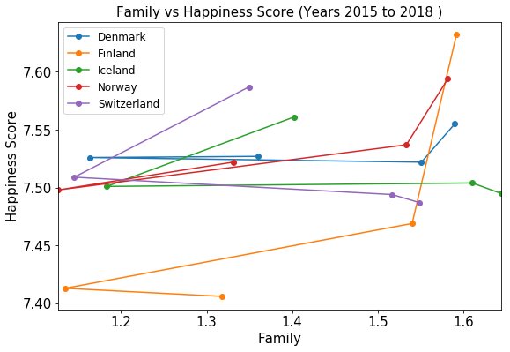
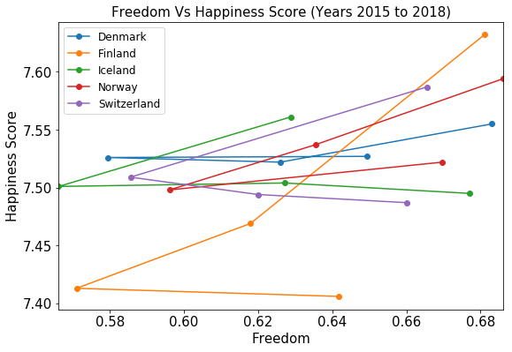
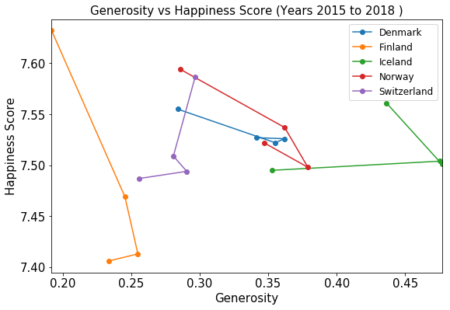
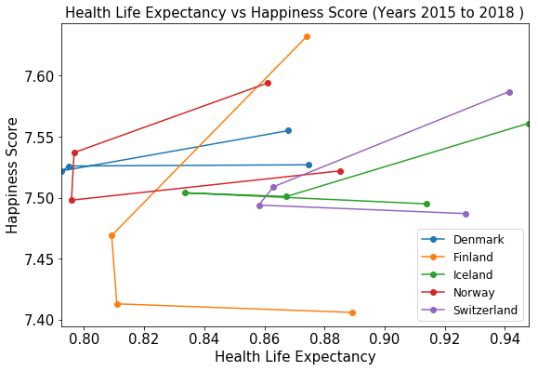
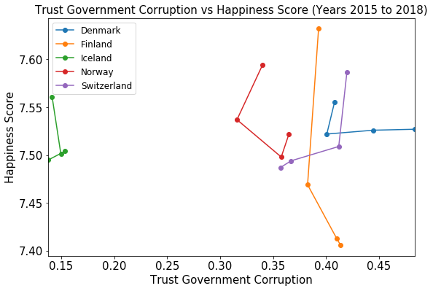
Analyzing Individual Factors Contributing to Happiness Score (2015 - 2018)
Analyzing individual factors of top 5 countries
Family, Freedom and Health Life Expectancy contributes positively towards happiness score.
Economic GDP per Capita is a major contributor but it is not a strong deciding factor for happiness score in case of top 5 countries.
Generosity and ‘Trust Government Corruptions’ does not provide any conclusive trends towards happiness score .

Slide 3
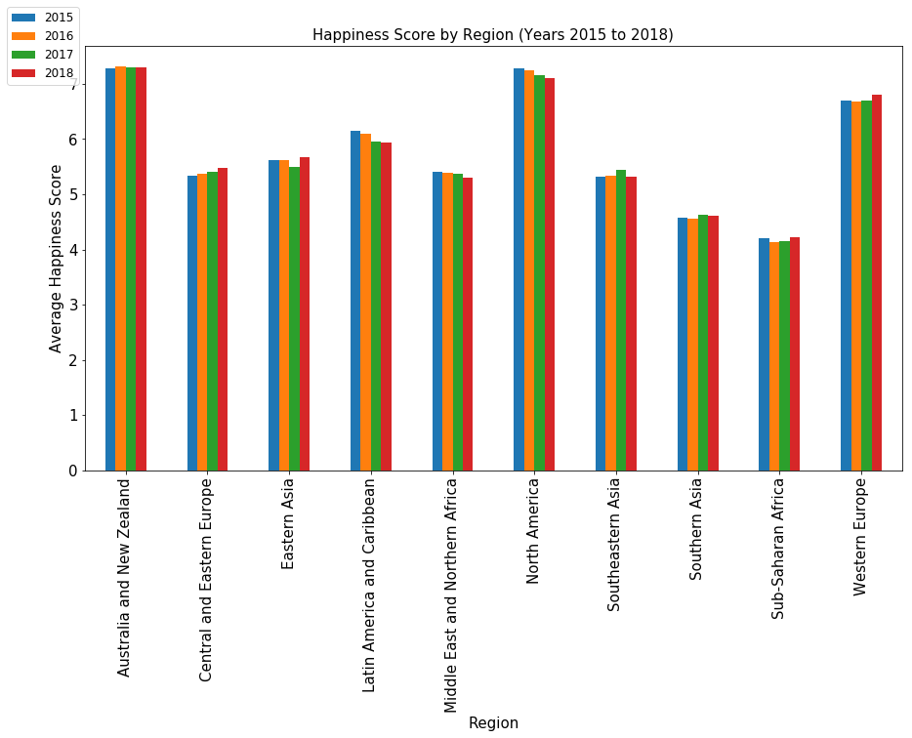
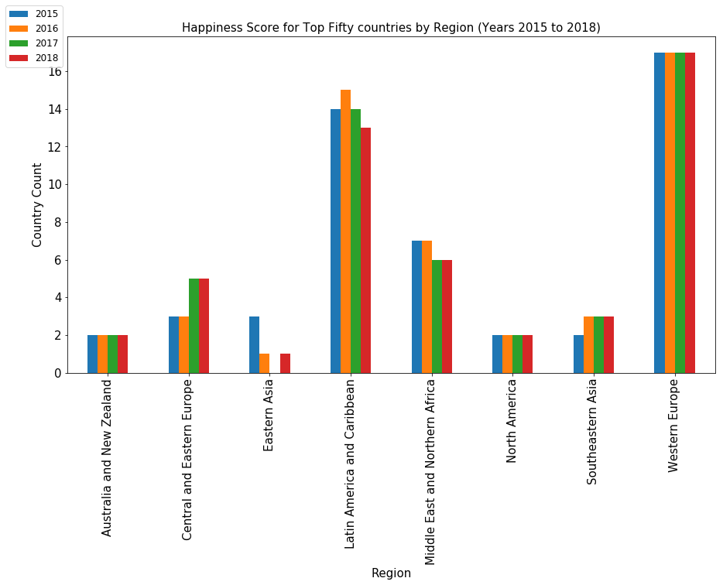
Analyzing Happiness Score By Region(2015- 2018)
Australia and New Zealand, North America and Western Europe are the happiest regions.
Sub-Saharan Africa and Southern Asia are the least happy regions.
Happiness score in Central and Eastern Europe increase over the years while North America, Latin America and Caribbean see a decrease
Australia and NZ [2 out of 2] and North America [2 out of 2] are constantly in top 50 in last 4 years.
Western European countries represent most number [17 out of 21], followed by Latin America and Caribbean countries.
None of the countries from Southern Asia and Sub-Saharan Africa made into top 50 in last 4 years.

Slide 4
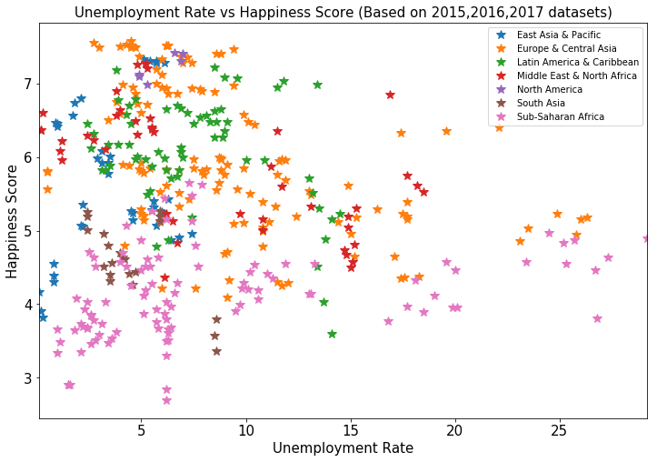
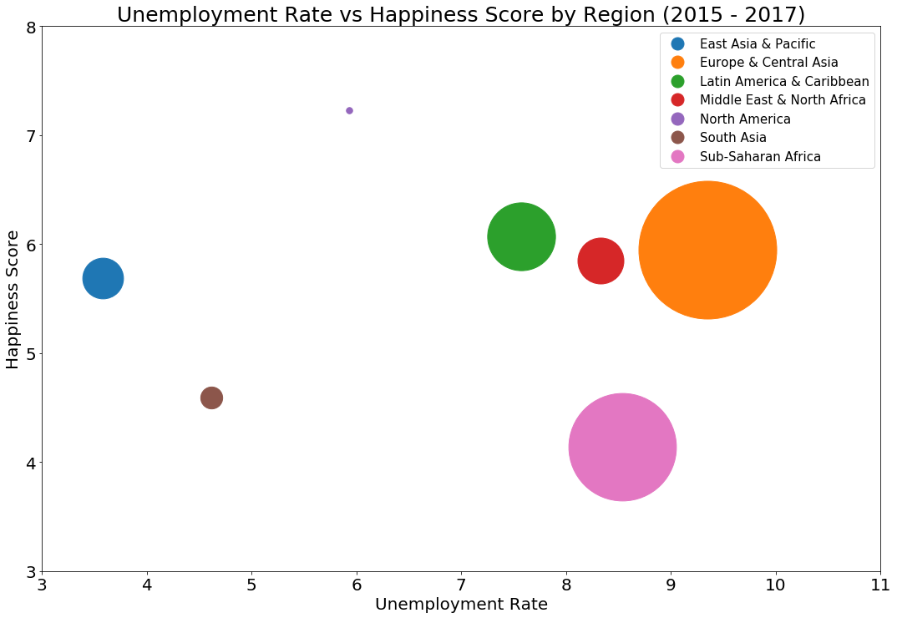
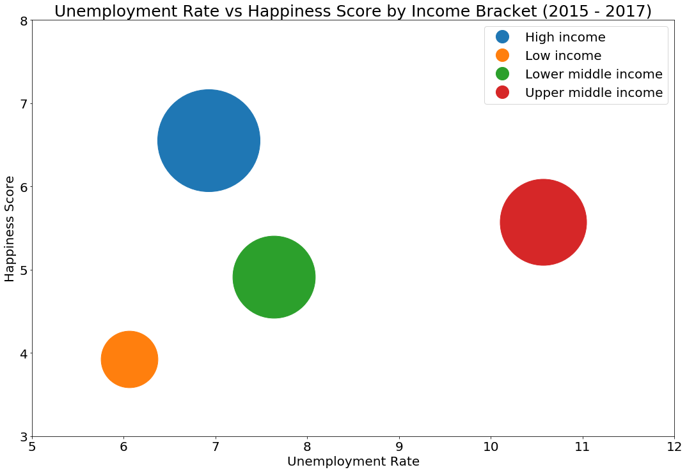
Analyzing Happiness Score Based on Unemployment Rate (2015 - 2017)
Happiness score is inversely proportional to unemployment rate.
North American countries have highest happeniness score with considerably lower unemployment rate.
East Asia & Pacific have better happiness score and lowest unemployment rate.
Sub-Saharan African is the least happy region and unemployment rate is comparatively high.
Countries in high income bracket have highest happiness scores.
Low income countries have lower happiness score regardless of low unemployment rate.

Slide 5
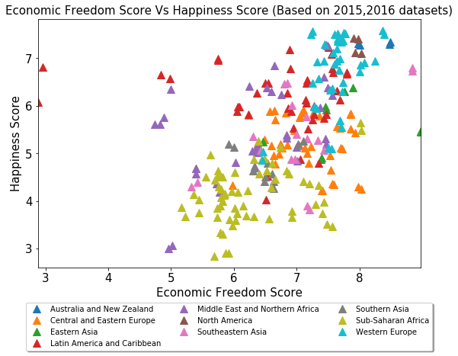
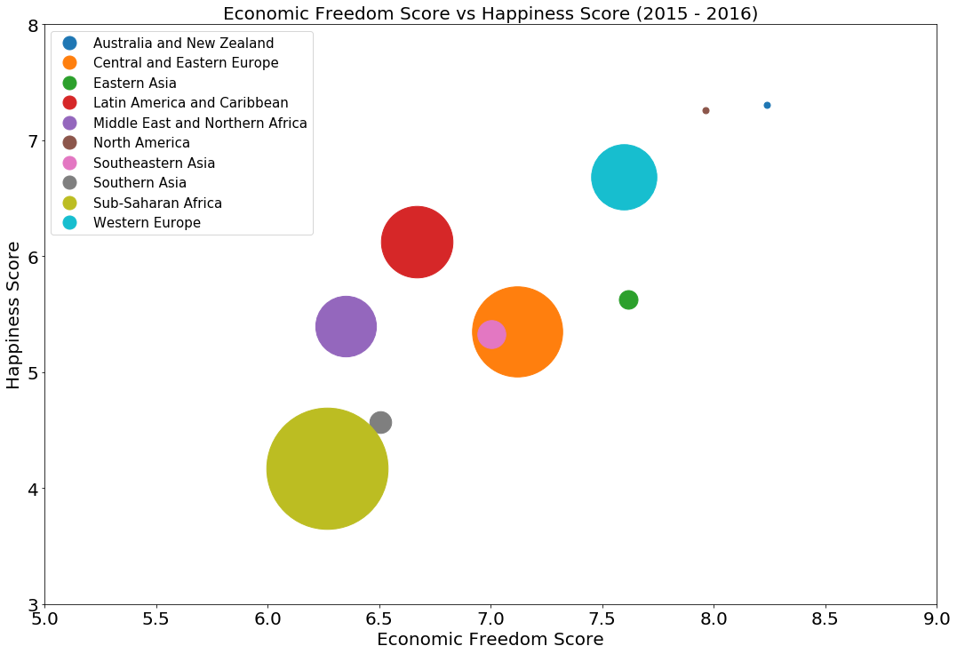
Analyzing Happiness Score Based on Economic Freedom(2015 -2016)
The economic freedom is an important factor contributing to the happiness score of a country.
North America, Australia and New Zealand are happiest regions with best economic freedom.
Western European region have highest happiness score and have comparatively good economic freedom.
Sub-Saharan Africa is the least happiest region with lowest economic freedom.

Slide 6
CONCLUSION
Family , Economic GDP per Capita , Health Life Expectancy , Social Freedom, Economic Freedom, Generosity, Corruption are some of the major factors influencing the world happiness score.
Countries which have lower unemployment rate and high income have higher happiness score.
Economic Freedom increases the world happiness rate.
Happiest countries are in the Western Europe.
Australia and New Zealand, North America and Western Europe are the happiest regions.
Sub-Saharan Africa and Southern Asia are the least happy regions.
As per the latest report Finland is the happiest country in the world.
Considering last 4 years happiness report, top five countries are always from Western Europe

