Slide 1












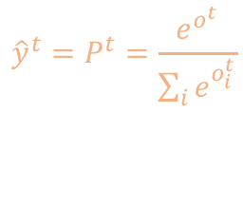


Target characters
i m a d
Probability Distribution
0.2
0.3
0.1
0.4
0.5
0.1
0.2
0.2
0.1
0.6
0.2
0.1
0.4
0.1
0.2
0.3
$${\hat{y}}^{t}=P^{t}=\frac{e^{o^{t}}}{{\sum_{i}{e}}^{o_{i}^{t}}}$$
$$o^{1}$$
$$o^{2}$$
$$o^{3}$$
$$o^{4}$$
3
3.4
2.3
3.7
5
3.4
4.1
4.1
1
2.8
1.7
1
2
0.6
1.3
1.7
Output layer
$$o^{t}=W_{hy}h^{t}+b_{y}$$
$$h^{1}$$
$$h^{2}$$
$$h^{3}$$
$$h^{4}$$
0.7
0.5
-0.3
0.5
-0.8
0.6
0.2
-0.5
-0.1
-0.2
0.9
0.4
Hidden layer
$$h^{0}=0$$
$$h^{1}$$
$$h^{2}$$
$$h^{3}$$
$$h^{t}=tanh(W_{hh}h^{t−1}+W_{xh}x^{t}+b)$$
0
0
0
0
0
0
1
0
0
0
0
1
1
0
0
0
Input layer (One-hot vector)
Input characters
0 i m a

Slide 2



















$${\hat{y}}^{1}$$
$${\hat{y}}^{2}$$
$${\hat{y}}^{3}$$
$${\hat{y}}^{T_{X}}$$
Softmax
Softmax
Softmax
Softmax
Sample
Sample
Output
Output
Output
Output
$$h^{1}$$
$$h^{2}$$
$$h^{3}$$
$$h^{T_{x}}$$
RNN cell
$$h^{1}$$
RNN cell
$$h^{2}$$
RNN cell
$$h^{3}$$
$$h^{T_{x}}$$
-1
RNN cell
$$h^{1}$$
$$h^{0}=0$$
$$h^{1}$$
…..
One-hot vector
One-hot vector
One-hot vector
One-hot vector
$$x^{1}$$
$$x^{2}$$
$$x^{3}$$
$$x^{T_{X}}$$

Slide 3


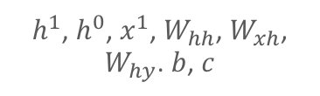













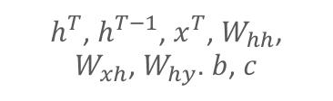

${\hat{y}}^{1}$, $y^{1}$
$h^{1}$, $h^{0}$, $x^{1}$, $W_{hh}$, $W_{xh}$, $W_{hy}$. $b$, $c$
${\hat{y}}^{T}$, $y^{T}$
$h^{T}$, $h^{T−1}$, $x^{T}$, $W_{hh}$, $W_{xh}$, $W_{hy}$. $b$, $c$
$$∇_{o^{1}}ℒ$$
$$∇_{o^{t}}ℒ$$
$∇_{h^{1}}ℒ={{W^{T}}_{hy} . ∇}_{o^{1}}ℒ$ +$dh_{next}$
$∇_{h^{T}}ℒ={{W^{T}}_{hy} . ∇}_{o^{T}}ℒ$ + $dh_{next}$
Parameters’ gradients:
Parameters’ gradients:
$$dh_{next}$$
$∇_{W_{hh}}ℒ$, $∇_{W_{xh}}ℒ$, $∇_{W_{hy}}ℒ$
$$dh_{next}$$
……..
$$dh_{next}$$
$∇_{W_{hh}}ℒ$, $∇_{W_{xh}}ℒ$, $∇_{W_{hy}}ℒ$
$$dh_{next}$$
$$∇_{b}ℒ,∇_{c}ℒ$$
$$∇_{b}ℒ,∇_{c}ℒ$$
RNN cell
RNN cell
$$∇_{x^{1}}ℒ$$
$$∇_{x^{T}}ℒ$$

