Slide 1
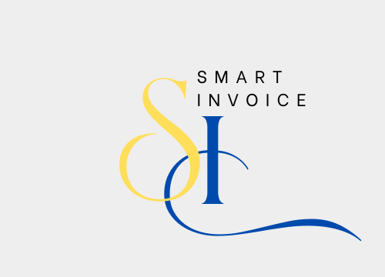
PROJECT INTRODUCTION

Slide 2

ABOUT US
Smart Invoice is a modern web application designed to help businesses manage customer information and invoices seamlessly. It provides features for adding, editing, and deleting customer details, as well as viewing information effortlessly. With tax calculations and invoice management capabilities, Smart Invoice offers an elegant and user-friendly interface to enhance daily business operations efficiently. Our goal is to save time and effort while ensuring maximum productivity for businesses.

Slide 3

PROJECT BENEFITS
•- Improved efficiency in managing operations.
•- Accurate financial reports for decision-making.
•- Seamless management of invoices and inventory.
•- User-friendly interface.
•- Data security** to protect sensitive information.
.

Slide 4
PROJECT GOALS
01
•- Simplify invoice management.
05
•- Provide tools for financial data analysis.
02
Improve inventory tracking
03
•- Generate accurate financial reports.
04
•- Enhance customer account management.

Slide 5

•Feel free to ask any questions or provide feedback about the project.

