Slide 1
Outline
1
Background
2
Idea
3
Solution
4
Conclusion

Slide 2
Solution
Our Method
Chain of Thoughts Prompting ^{[1]}
Provide several examples for LLMs to demonstrate the step-by-step reasoning process in natural language
Ask LLMs to generate a solution to the given problem in natural language and its answer
Program of Thoughts Prompting ^{[2]}
Provide several examples for LLMs to demonstrate the step-by-step reasoning process in the form of Python code
Ask LLMs to generate a piece of Python code to solve the given problem
Use an external code interpreter to execute the generated programs to derive the answer
Self-Consistency ^{[3]} & Explicit Code-based Self-Verification ^{[4]}
Repeat multiple times and generate multiple answers
Provide several examples for LLMs to demonstrate the verifying process in the form of Python code
Ask LLMs to generate a piece of Python code to verify the given problem
Perform verification-guided weighted voting
Consider the option with the highest vote as the final answer
[1] Wei, Jason, et al. "Chain-of-thought prompting elicits reasoning in large language models." Advances in Neural Information Processing Systems 35 (2022): 24824-24837.
[2] Chen, Wenhu, et al. "Program of thoughts prompting: Disentangling computation from reasoning for numerical reasoning tasks." arXiv preprint arXiv:2211.12588 (2022).
[3] Wang, Xuezhi, et al. "Self-consistency improves chain of thought reasoning in language models." arXiv preprint arXiv:2203.11171 (2022).
[4] Zhou, Aojun, et al. "Solving challenging math word problems using gpt-4 code interpreter with code-based self-verification." arXiv preprint arXiv:2308.07921 (2023).
Notes:
这里可能需要具体说明一下具体是如何“verify”的（将LLM生成的答案带回原题，假设该答案正确的情况下，改变推理方向，mask掉某个已经给定的条件，利用给定的答案计算该条件，并与之前mask掉的条件的真值进行比较）

Slide 3

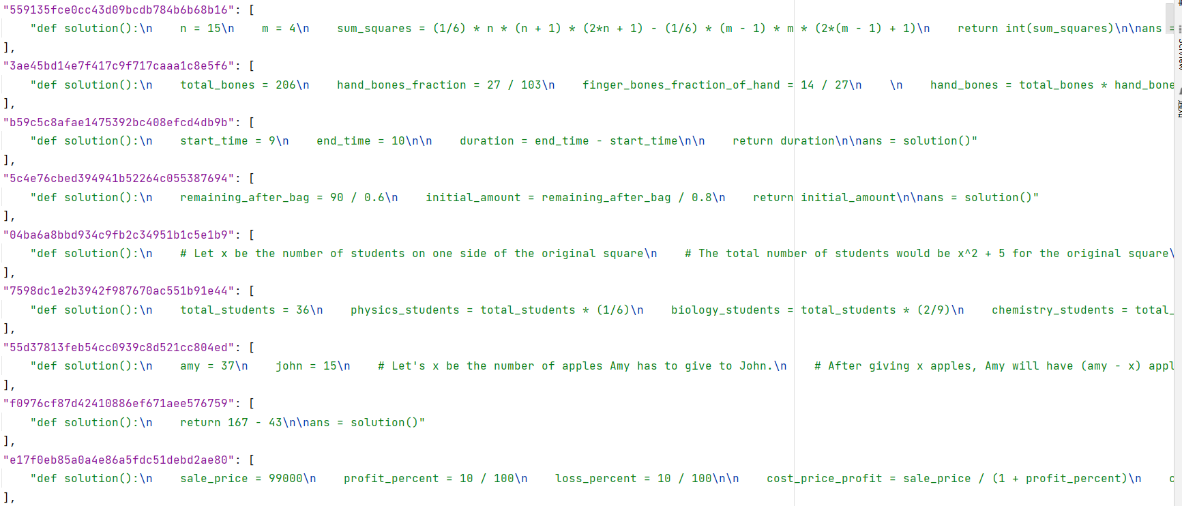

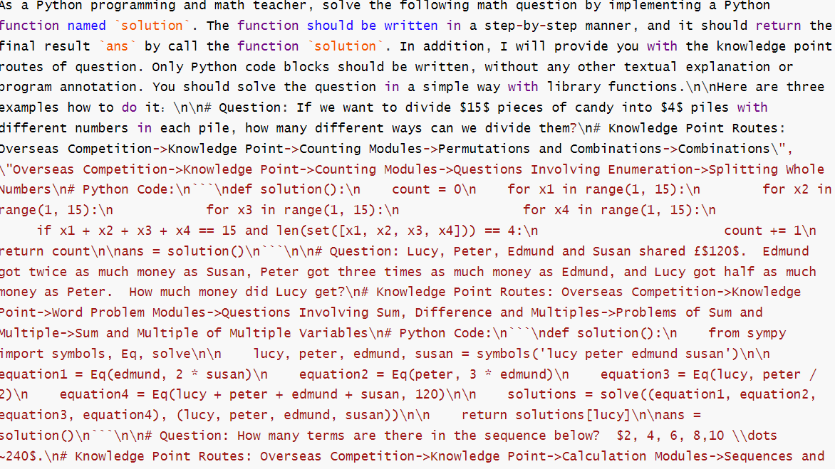
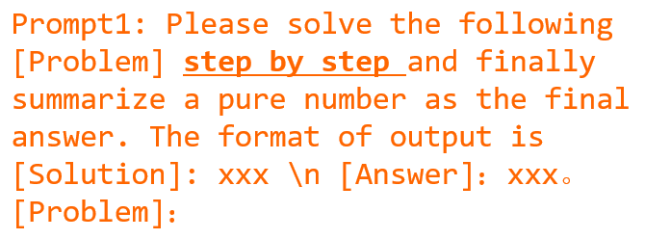


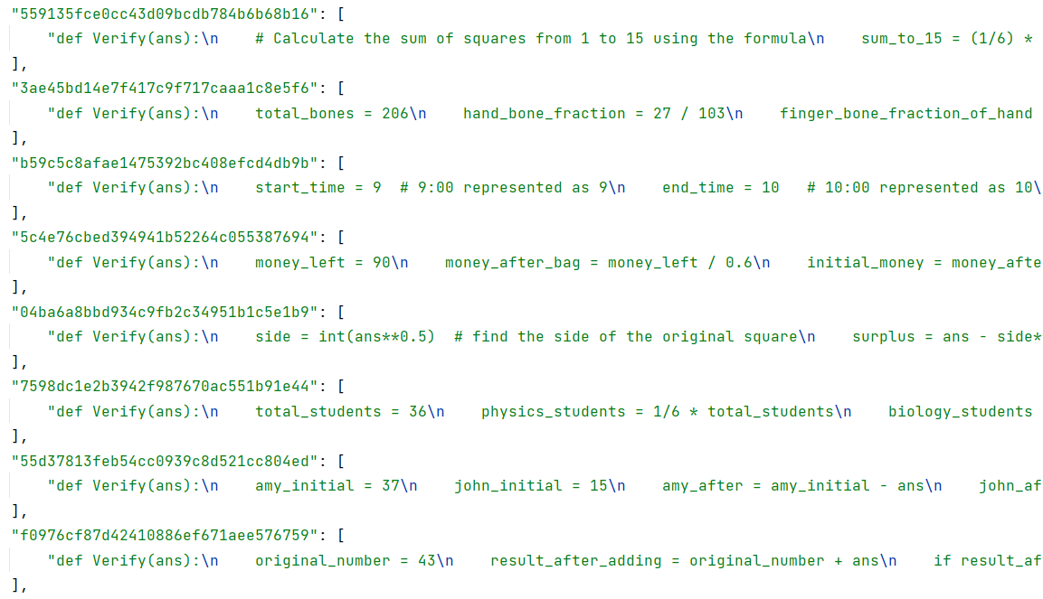
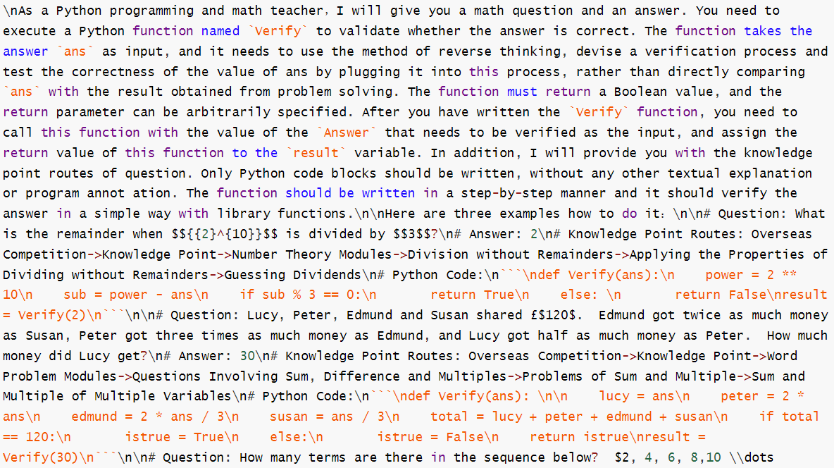
Solution
Track2(English) Framework
LLM
×K
code interpreter
answers
×K
post process
solution generation prompts - PoT
Python code
problems
LLM
answers
×N
final answers
post process
voting weights
solution generation prompts - CoT
answer set
LLM
×1
code interpreter
verification results
×(K+N)
post process
verifier generation prompts
verify code
verify code
verify code
verify code
Notes:
Give LLMs several examples which express the step-by-step reasoning process as a Python program
Ask LLMs to generate a piece of Python code to solve the given problem
Use an external code interpreter to execute the generated programs to derive the answer

Slide 4
Solution
Track1(Chinese) Framework
origin problems
LLM
×K
code interpreter
answers
×K
post process
solution generation prompts - PoT
Python code
translate into English
LLM
translated problems
LLM
answers
×N
final answers
post process
voting weights
solution generation prompts - CoT
answer set
LLM
×1
code interpreter
verification results
×(K+N)
post process
verifier generation prompts
verify code
verify code
verify code
verify code
Notes:
Give LLMs several examples which express the step-by-step reasoning process as a Python program
Ask LLMs to generate a piece of Python code to solve the given problem
Use an external code interpreter to execute the generated programs to derive the answer

Slide 5

Solution
Framework
responses-PoT
×K
repeat K times
solution generation prompts - PoT
problems
LLM
repeat N times
responses-CoT
×N
solution generation prompts - CoT
Answer Generation
Post-process
Verification
Voting
Notes:
Give LLMs several examples which express the step-by-step reasoning process as a Python program
Ask LLMs to generate a piece of Python code to solve the given problem
Use an external code interpreter to execute the generated programs to derive the answer

Slide 6
Solution
Details
Chain of Thoughts Prompting
Sample problems from our manually constructed small-scale data set
Use samples with the highest similarity to the given problem as CoT examples
If all our samples are not similar enough to the given problem, then choose the ones that have the same knowledge point routes
Prompt1: Please solve the following [Problem] step by step and finally summarize a pure number as the final answer. The format of output is [Solution]: xxx \n [Answer]：xxx。[Problem]：
CoT Prompt in Natural Language
Answer Generation
Post-process
Verification
Voting
Notes:
这里可能需要具体说明一下具体是如何“verify”的（将LLM生成的答案带回原题，假设该答案正确的情况下，改变推理方向，mask掉某个已经给定的条件，利用给定的答案计算该条件，并与之前mask掉的条件的真值进行比较）

Slide 7
Solution
Details
Program of Thoughts Prompting
Let LLMs play the role of Python programming and math teacher
Provide LLMs with the knowledge point routes of the given problem
Ask LLMs not to generate any description or comment in natural language
Require LLMs to generate simple Python code
Suggest LLMs to use powerful Python library, such as sympy
Select several problems as examples from the official dataset, which are suitable for resolution using code
Answer Generation
Post-process
Verification
Voting
Notes:
这里可能需要具体说明一下具体是如何“verify”的（将LLM生成的答案带回原题，假设该答案正确的情况下，改变推理方向，mask掉某个已经给定的条件，利用给定的答案计算该条件，并与之前mask掉的条件的真值进行比较）

Slide 8
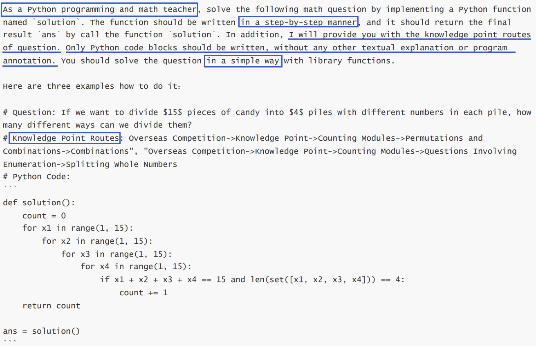
Solution
PoT Prompt - Part 1
Notes:
这里由于篇幅原因仅展示一个例子

Slide 9
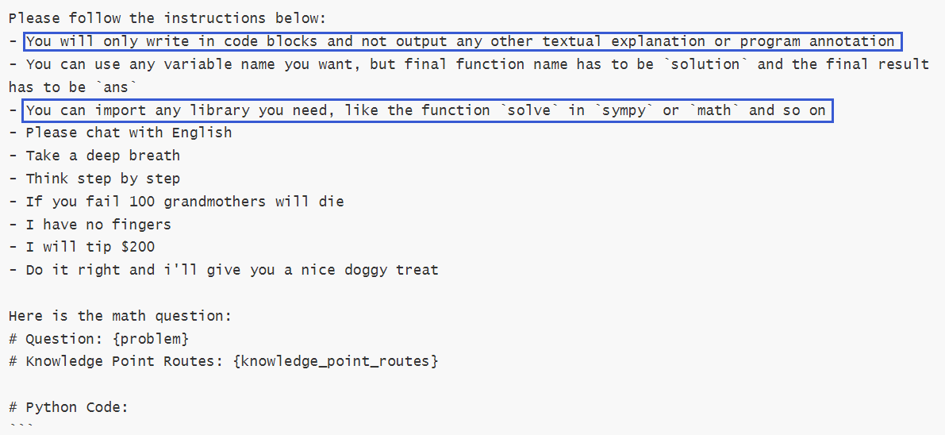
Solution
PoT Prompt - Part 2
Notes:
这里可能需要具体说明一下具体是如何“verify”的（将LLM生成的答案带回原题，假设该答案正确的情况下，改变推理方向，mask掉某个已经给定的条件，利用给定的答案计算该条件，并与之前mask掉的条件的真值进行比较）

Slide 10
Solution
Framework
responses-PoT
extract code
executable
answers-PoT
×K
×K
×K
Type conversion & Rounding
code interpreter
Python code
regenerate
non-executable
LLM
solution generation prompts - PoT
responses-CoT
×N
extract number
answers-CoT
×N
answer set
Answer Generation
Post-process
Verification
Voting
Notes:
Give LLMs several examples which express the step-by-step reasoning process as a Python program
Ask LLMs to generate a piece of Python code to solve the given problem
Use an external code interpreter to execute the generated programs to derive the answer

Slide 11
Solution
Details
Post-process for CoT prompting responses
Extract numerical answers
Post-process for PoT prompting responses
Extract Python code and execute
Convert results of non-numerical Python data type to float
Round answers dynamically based on the given problem
Send non-executable code and relative information to LLMs to regenerate the code (same for verifying)
此处等待放入例子
Answer Generation
Post-process
Verification
Voting
Notes:
这里可能需要具体说明一下具体是如何“verify”的（将LLM生成的答案带回原题，假设该答案正确的情况下，改变推理方向，mask掉某个已经给定的条件，利用给定的答案计算该条件，并与之前mask掉的条件的真值进行比较）

Slide 12
Solution
Framework
problems
×1
verification results
×(K+N)
verifier generation prompts
LLM
verify code
code interpreter
verify code
verify code
verify code
answer set
Answer Generation
Post-process
Verification
Voting
Notes:
Give LLMs several examples which express the step-by-step reasoning process as a Python program
Ask LLMs to generate a piece of Python code to solve the given problem
Use an external code interpreter to execute the generated programs to derive the answer

Slide 13
Solution
Details
Explicit Code-based Self-Verification
Choose a number in the problem
Compute this number using other premises and the given numerical answer
Compare the computed number with the original number
Verification Prompts
Nearly the same setting as PoT prompting
Require LLMs to think reversely
Provide an extra wrong case for LLMs
Answer Generation
Post-process
Verification
Voting
Notes:
这里可能需要具体说明一下具体是如何“verify”的（将LLM生成的答案带回原题，假设该答案正确的情况下，改变推理方向，mask掉某个已经给定的条件，利用给定的答案计算该条件，并与之前mask掉的条件的真值进行比较）

Slide 14
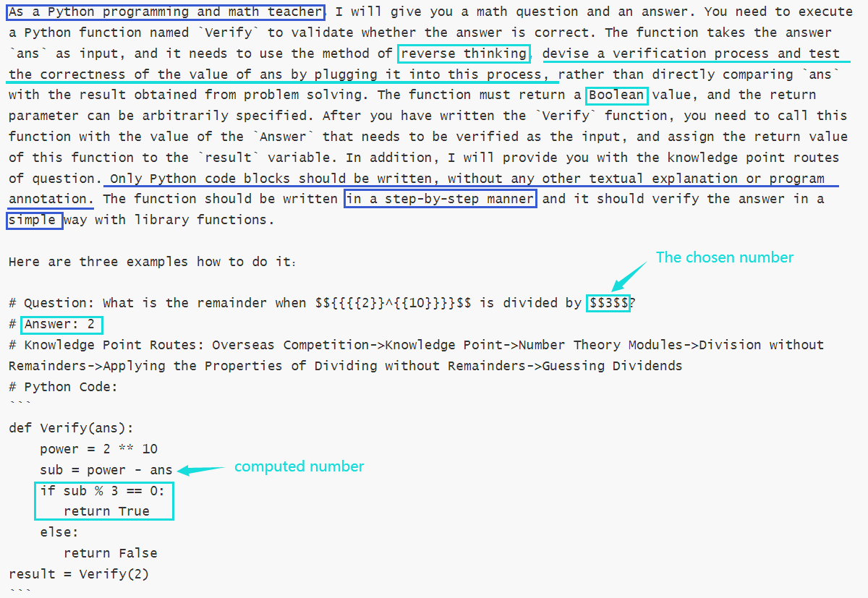
Solution
Verify Prompt - Part 1
Notes:
这里由于篇幅原因仅展示一个例子

Slide 15
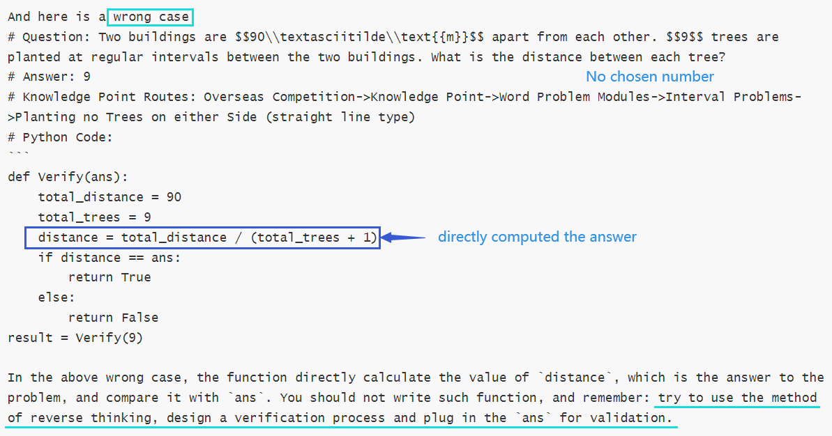
Solution
Verify Prompt - Part 2
Notes:
这里由于篇幅原因仅展示一个例子

Slide 16
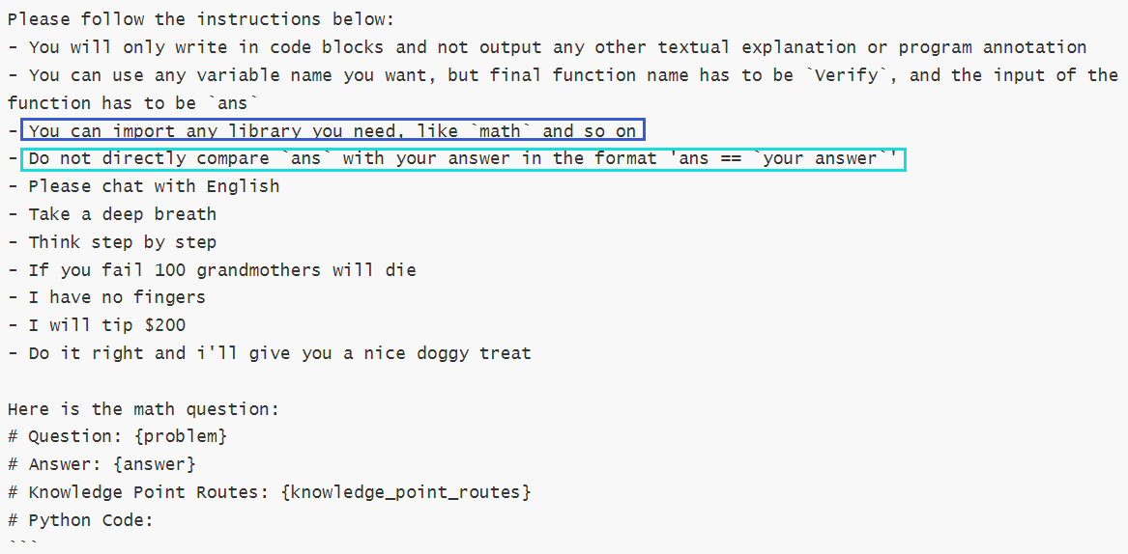
Solution
Verify Prompt - Part 3
Notes:
这里由于篇幅原因仅展示一个例子

Slide 17

Solution
Framework
Replace all previous answers for the problem
solve problems
separately
answers
LLM
each answer’s source: CoT / PoT / others
Voting score too low
answer set
Voting score high enough
highest-ranked answers
final answers
verification results
voting weights
weighted voting
Answer Generation
Post-process
Verification
Voting
Notes:
Give LLMs several examples which express the step-by-step reasoning process as a Python program
Ask LLMs to generate a piece of Python code to solve the given problem
Use an external code interpreter to execute the generated programs to derive the answer

Slide 18
Solution
Details
Self-Consistensy
For each problem, answer generation process will be repeated multiple times to get multiple answers
Assign different weights to the answers based on the verification results and how we get the answers
Perform a weighted majority voting
If the highest ranked answer has a low voting score, it will be considered not reliable. And the problem will be dealt with separately to get a new answer as final choice
answer sources
verification results
voting weights
manual parameter adjustment
Answer Generation
Post-process
Verification
Voting
Notes:
这里可能需要具体说明一下具体是如何“verify”的（将LLM生成的答案带回原题，假设该答案正确的情况下，改变推理方向，mask掉某个已经给定的条件，利用给定的答案计算该条件，并与之前mask掉的条件的真值进行比较）

Slide 19
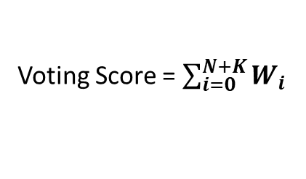
Solution
CoT
WCT
CoT
True
CoT
WCF
False
PoT
WPT
PoT
True
PoT
WPF
weighted voting
False
Voting Score = $\sum_{i=0}^{N+K}{W_{i}}$
others
True
WOT
others
WOF
others
False
Answer Generation
Post-process
Verification
Voting
Notes:
这里可能需要具体说明一下具体是如何“verify”的（将LLM生成的答案带回原题，假设该答案正确的情况下，改变推理方向，mask掉某个已经给定的条件，利用给定的答案计算该条件，并与之前mask掉的条件的真值进行比较）

