Slide 1

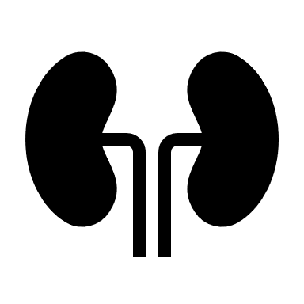








Strengthening Prevention and Control of Diabetes
Health Impact
1.5 Million Deaths Directly Caused by Diabetes
Heart Attacks Kidney Failure 1 Million Blind
Prevention Measures
Healthy Diet
Exercise
No
Tobacco
Use
Medication
Regular Screening + Treatment
Those at High Risk
Ages 18-30
Low- and Middle-Income Countries
https://www.who.int/news-room/fact-sheets/detail/diabetes

