Slide 1

SAMSUNG PRISM
Generative AI
Hackathon
3rd Edition 2026 – 27
Theme ID - Theme 02: Smart Guided Troubleshooting Engine
Team Name - Indie
College Name – Vellore Institute of Technology
Member 1 - Arav, arav3singh@gmail.com (LLM enrichment and plan structuring)
Member 2 - Geetika Rupani, geetika.rupani2024@vitstudent.ac.in (catalog and deeplink matching)
Member 3 - Harshit, harshit.hc0723@gmail.com (backend, cache, validation, Docker)
Member 4 - Asmi, asmichaudhary06@gmail.com(frontend, evaluation, demo)
Submission GitHub link - github.com/HC-2307/Smart-Guided-Troubleshooting-Engine
Notes:
Opening slide for the 3rd edition of the PRISM Generative AI Hackathon. Replace the SAMSUNG PRISM pill with the official PRISM logo image if you have the asset. Confirm the academic year label (2026-27) before circulating.

Slide 2
Theme
Problem statement, in our words
~15 min
Customers describe device problems vaguely: “my phone gets hot and the battery dies fast”.
Today an agent turns each complaint into steps by hand, about 15 minutes per scenario across millions of calls, and the customer still has to hunt through Settings to act on the advice.
Our goal: one API call turns the complaint into an ordered, safe plan, with the exact Settings screen one tap away for every step, and paraphrased questions answered from a cache in milliseconds.
spent by an agent today to translate one complaint into steps
1 API call
complaint in, ordered steps and catalog deeplinks out, as pure JSON
Non-negotiables in the Theme 2 spec
≤ 300 ms
Zero URLs in output
Catalog-only deeplinks
No invented steps
target for repeated and paraphrased questions served from cache
Pure JSON
≥ 80% paraphrase cache hits
Cold P95 ≤ 8 s

Slide 3
Existing Solutions & Gaps
Existing approach | Why it falls short here
Support chatbots / plain LLM answers | Hallucinate settings paths and links; no deeplinks; free text, not a contract
FAQ / keyword search in Settings | The user must already know the right words; no ordering, no troubleshooting flow
Semantic caches (GPTCache, MeanCache) | One similarity threshold: “front camera blurry” and “rear camera blurry” look alike, so a wrong plan is served confidently
Verified caches (vCache, Krites) | Need online feedback or an extra LLM judge call per hit: more cost, not deterministic
JSON-schema validation / guardrails | Check types and topics, not graded rules; miss a real catalog deeplink that does the opposite of the step (Enable → Disable)
The gap: nothing combines LLM understanding with catalog-guaranteed actions, rule-level output guarantees and a cache that stays safe on near-duplicate complaints.

Slide 4
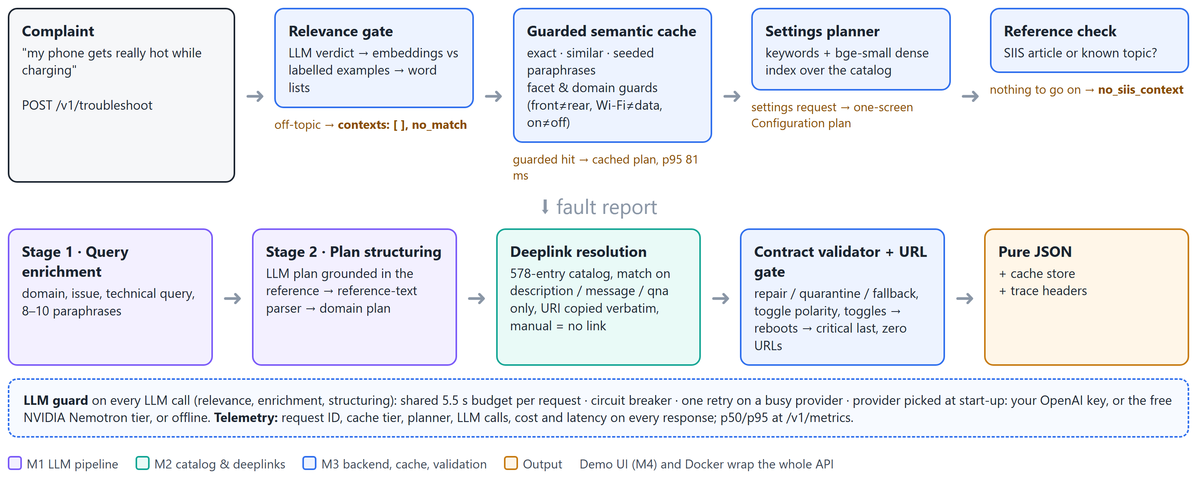
Our Solutions & Architecture Diagram
The LLM plans · the catalog decides the deeplink · the validator enforces the contract
Notes:
The LLM plans, the catalog decides the deeplink, the validator enforces the contract.
1. The relevance gate refuses off-topic questions: LLM when available, then embeddings, then word lists.
2. The guarded semantic cache answers paraphrases in milliseconds but refuses near-miss hits (front vs rear camera, Wi-Fi vs mobile data, on vs off).
3. The settings planner answers requests like 'my phone time is in 24 hrs' with a one-screen Configuration plan built only from the catalog.
4. A two-stage LLM engine does the rest: enrichment, then plan structuring grounded in Samsung's reference article; without an LLM the steps are parsed from the article.
5. M2 matches every action to the 578-entry catalog on its descriptive fields and copies the URI verbatim.
6. The contract validator repairs or quarantines anything off-spec, fixes on/off polarity, orders toggles to critical, and blocks any URL.
7. The LLM guard keeps every request under 8 s with a slow, busy or missing provider.

Slide 5
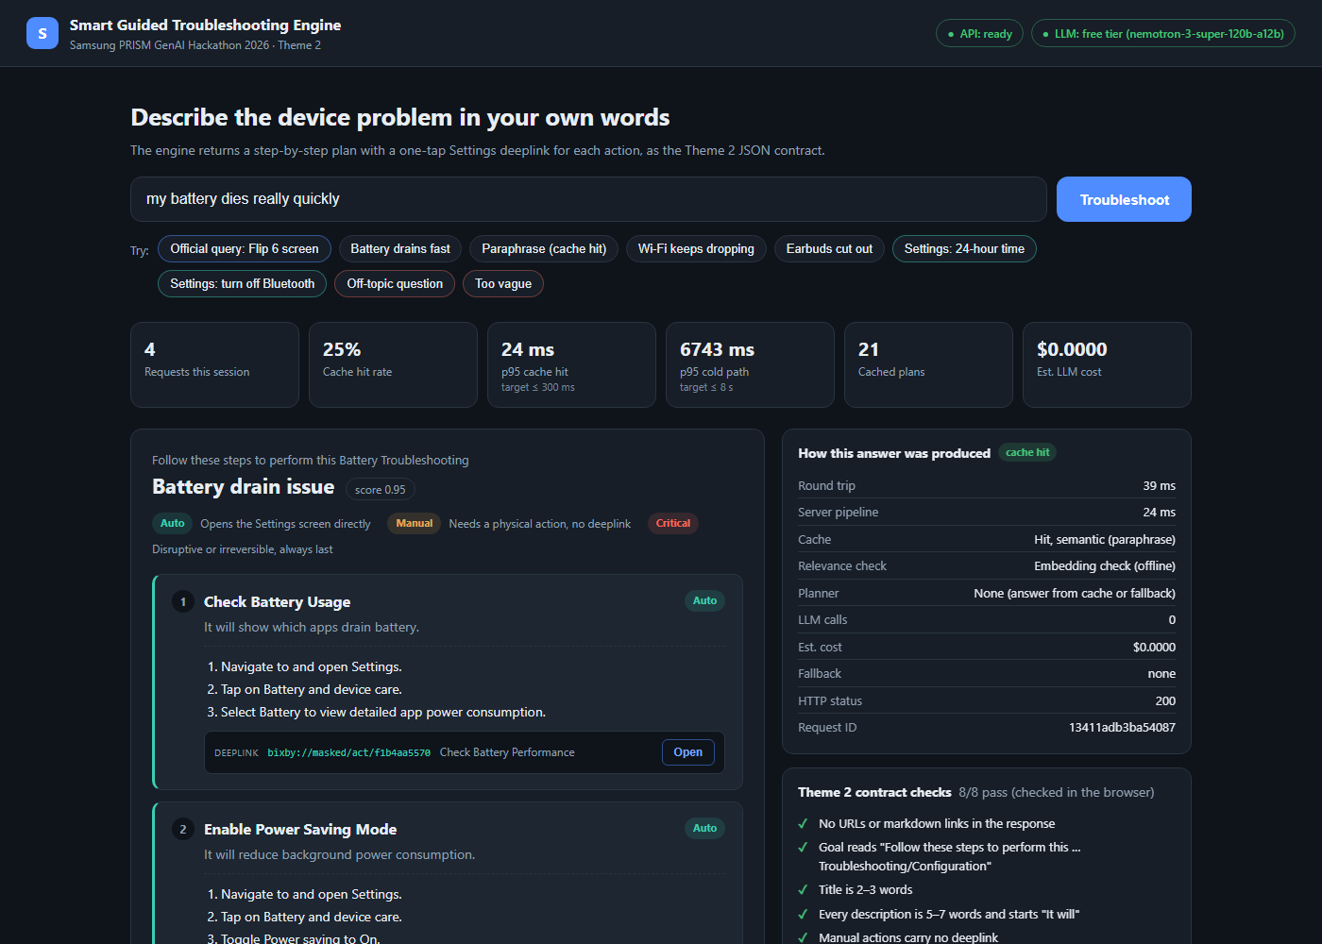
Demo & Product Walkthrough
1
./start.sh asks for an OpenAI or free NVIDIA key
no key at all runs the full offline pipeline
2
Official query: Flip 6 screen flickers
reference-grounded plan, catalog deeplink on each step
3
“battery drains fast”, then a paraphrase
second answer is a cache hit in tens of milliseconds
4
“my phone time is in 24 hrs”
one-screen Configuration plan: Switch Time Format
5
Off-topic and too-vague questions
refused with no_match / no_siis_context, nothing invented
6
Side panel
cache tier, relevance check, planner, LLM calls, cost, latency, contract checks
Demo UI: a paraphrase served from the semantic cache, with the trace panel and contract checks
Demo video: [YouTube / Drive link]

Slide 6
Tools and tech stack used
API
Python · FastAPI · Uvicorn · Pydantic v2
LLMs
OpenAI gpt-4o-mini (own key) or NVIDIA Nemotron super-120b (free tier) via the OpenAI SDK · json_repair
A
L
Embeddings
fastembed + BAAI bge-small-en-v1.5 on CPU, baked into the Docker image
Cache & similarity
NumPy · catalog-IDF similarity · trigram blend · facet guards · atomic JSON persistence
E
C
Frontend
HTML · CSS · JavaScript, served by nginx
DevOps
Docker · Docker Compose · start scripts for bash and PowerShell
F
D
Quality
pytest (433 tests) · benchmark, robustness, load, typo and deeplink-audit scripts
AI assistance
Antigravity AI (M1) · Claude Code (M3), declared per feature in the AI disclosure form
Q
A

Slide 7
Impact & Use case
80.4%
81 ms
0
of held-out paraphrases answered from cache, with 0 LLM calls and 0 wrong hits
p95 for a cached answer under 16 concurrent users
invented deeplinks: 74/74 delivered links come from Samsung's catalog
For customers
For Samsung support
Where it plugs in
Self-service fixes in seconds instead of a support call
Every step opens the right Settings screen
Destructive steps like a factory reset always come last
Removes the ~15 min an agent spends per complaint
Data-driven (catalog + reference articles), so it scales to 10k+ scenarios
Cost tracked per query; repeats cost nothing
Samsung Members / Bixby “fix my phone”
Call-centre agent assist
Search inside Settings

Slide 8
Innovation highlights, results and limitations
Innovation highlights
Results (measured)
Limitations
Guarded semantic cache: facet and domain guards plus the spec’s own paraphrases as keys; 64.3% → 80.4% held-out hits, 0 wrong
Toggle-polarity check: catches a catalog link that does the opposite of the step (Enable → Disable)
Catalog-only Configuration plans for settings requests
Graceful degradation: a valid plan or a controlled refusal under 8 s, LLM fast, busy or missing
Observable: every answer explains how it was produced
Metric | Result | Target
Official queries on contract | 20/20, 0 repairs | —
Paraphrase cache hits | 80.4%, 0 wrong | ≥ 80%
Cache hit P95, 16 users | 81 ms | ≤ 300 ms
Cold P95, live free LLM | 6.5 s | ≤ 8 s
URL leaks / non-catalog links | 0 / 0 | 0
Off-topic refused | 15/15 LLM, 29/30 offline | —
Throughput, warm | 261 req/s, 0 errors | —
Automated tests | 433 passing | —
Offline mode can accept look-alikes (“my laptop battery drains fast”)
Misspelt queries without topic words may get a generic plan, mostly offline; they never change the answer for the correct spelling
8 of 19 unusual settings phrasings miss the settings planner
5 of 20 reference articles cannot be parsed
Free-tier LLM is slow (~5–6 s cold); cache is single-process

Slide 9
What’s next
01
02
03
Closed loop
Read device state after a safe step via validation deeplinks; drop later destructive steps once the cause is confirmed
Hardware vs software triage
A defect missing from a screenshot is a panel fault: route to service, not software steps
Shared cache
Redis for multi-worker deployment; per-category thresholds learned from real traffic
04
05
06
Wider settings coverage
Catalog QnA embeddings and user-phrased aliases for the settings requests we still miss
Typos and languages
One LLM rewrite shared by every routing stage; Hindi and other languages through translation
On-device integration
Samsung Members or Bixby, where bixby:// deeplinks open the screen directly

Slide 10
Brownie points slide( differentiation)
Runs without a paid key
Free NVIDIA key or a fully deterministic offline mode; no key ever stored in the repo
✓
One command
start.sh / start.ps1 ask for a key, then Docker brings up API and UI
✓
Judge-friendly UI
Plan, deeplinks, trace, contract checks and raw JSON on one screen; shareable ?q= links
✓
Honest evaluation
Held-out splits, hard negatives, ablations, load, adversarial and typo tests; misses reported, not hidden
✓
Engineering hygiene
433 automated tests, a deeplink audit and a feature-level AI disclosure
✓

Slide 11
Checklist- Updated on Public GitHub
Working prototype code — public or shared GitHub repo: Y
README with reproducible setup instructions: Y (README.md, start.sh / start.ps1, Docker)
Demo video, max 5 minutes (YouTube or Drive link): [add link]
Presentation file (PPT or PDF): Y

Slide 12
Thank you
Organised by the Language AI Team and the PRISM Team, Samsung R&D Institute India
Notes:
Closing slide. Add the Google Form URL and a contact email before sharing. Edition 2 organising team for reference: Language AI - Sourabh Tiwari, Gaurav, Sanjeeth Pothireddy, Gorang Maniar; PRISM - Binny Lakra, Prakhar Chandrakar, Vishu Kumar; Kick-off and mentors - Giridhar Jakki, Deepraj Prabhakar Patkar (Language AI), Srimanu Prasad Nagaraju, Ashish Kumar (Tech Strategy).

