Slide 1
Security Awareness
By: Bronwyn Nelson

Slide 2
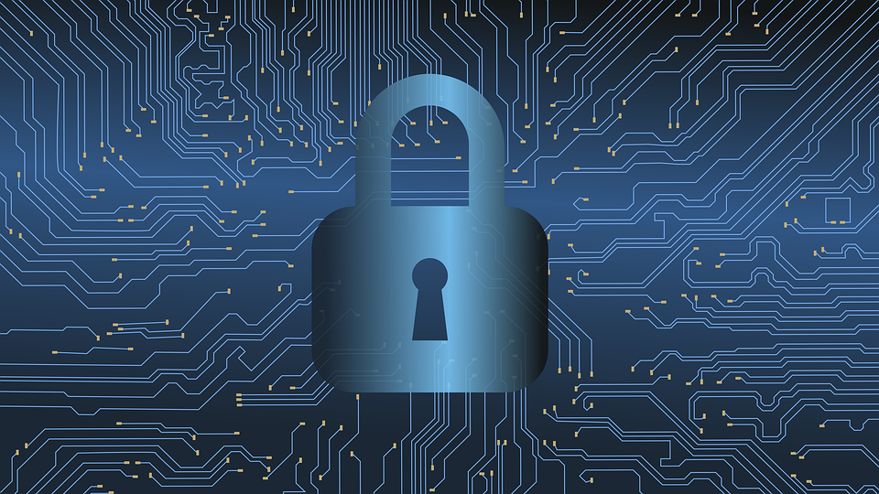
What is Security?
This is described as sacrificing convenience for the sake of safety.
Security can be kept more secure with these six defenses; confidentiality, integrity, availability, authentication, authorization, accounting.

Slide 3
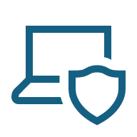
What is Cybersecurity?
Cybersecurity protects the integrity, confidentiality, and availability of information on the devices that store, manipulate, and transmit information through products, people, and procedures.
This helps to prevent identity theft, data theft, personal information stolen, and other sensitive information that a hacker would find on your accounts.

Slide 4
Who Is Responsible For This?
Threat agents are people or elements that have the ability to carry out a cyber threat.
Threat actors are individuals or entities who are responsible for cyber attacks against users.
Some cybercriminals include script kiddies, brokers, insiders, cyberterrorists, hactivists, or state actors.
Vulnerability is a weakness that can be exploited.

Slide 5
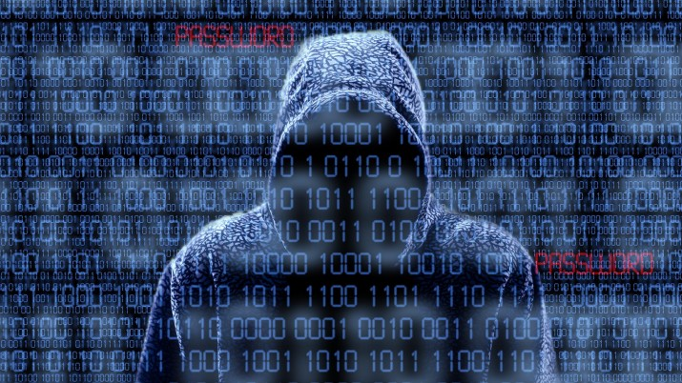
Types of Attacks
Password attacks
Social engineering
Phishing
Social network risks
Malware
This Photo by Unknown Author is licensed under CC BY-NC-ND

Slide 6
Password Attacks
Attackers use the most common and easiest passwords used and try hacking hundreds of people’s accounts with them. If they don’t access it using these generic passwords, they usually move on, unless you’re a target to them.
Strong passwords are a must. Two-factor authentication is also important and can make your accounts more secure.

Slide 7
Social Engineering Attacks
This involves someone impersonating someone. They could pretend to be a bank, a credit card, a popular business, your employer, federal cooperations.
If someone reaches out pretending to be someone, they might ask for personal information, credit card numbers, social security numbers, addresses, or other sensitive information.
They might act in a sense of urgency to receive this information.
You should always be careful of who you’re talking to and who you’re giving your information to.

Slide 8

Phishing
There are ways to make sure you don’t fall for impersonations of someone or a company.
There are some signs that can help decide if they are hackers.
A sense of urgency for the information, asking for money or trying to give money, spelling errors, wrong names, suspicious links or attachments.

Slide 9


Social Networking Risks
Social networking risks include what you post online.
You should always be careful what friend requests you accept. Some could be trying to hack and gain access to your life.
This is why you should never post too much of your personal life on your social medias if you are friends with people you do not know personally.
This Photo by Unknown Author is licensed under CC BY

Slide 10
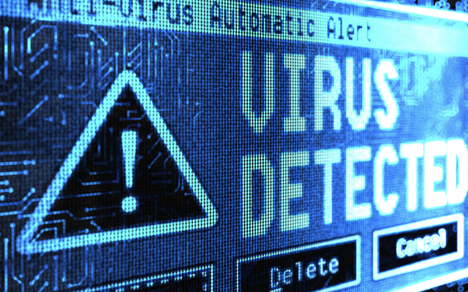
Malware
Malware is a software that enters a computer system without user’s knowledge or consent and then proceeds to perform unwanted and harmful actions.
There is ransomware, blocker ransomware, crytomalware.
This Photo by Unknown Author is licensed under CC BY-SA-NC

Slide 11
Types of Malware
Keylogger: silently captures every key stroke that a user makes on their computer.
Spyware: software downloaded without the consent or control of user
PUPS, Trojans, RATs: unwanted software, sometimes masquerades as something else
file-based and fileless viruses: malicious code either attached to a file or not
Worm: uses a computer network to replicate
Bot: infected computer that’s places under remote control of the attacker
Backdoor: access to a computer system without normal security
Logic bomb: dormant malicious code in a program, that waits to be triggered
Rootkit: hides its presence and other malwares presence on the computer

Slide 12
Defenses
Managing defenses
Antimalware software
Firewall
Data backups
Regular cloud backups
Two-factor authentication
Strong passwords

Slide 13
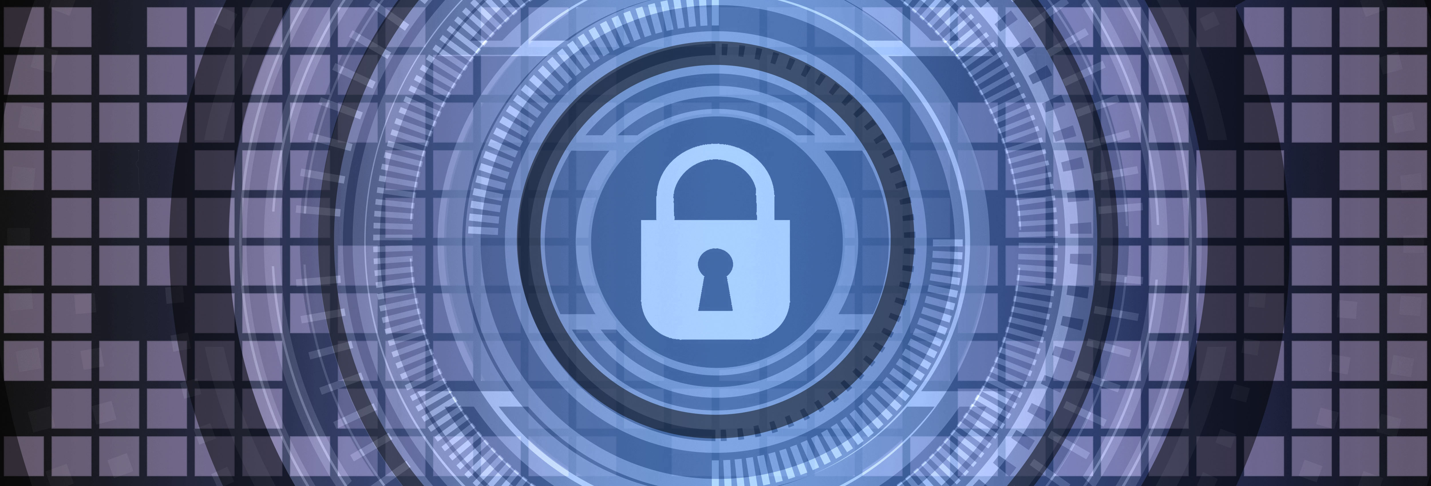
Awareness
This Photo by Unknown Author is licensed under CC BY-SA-NC
Everyone should know these things when having a device that connects to the internet. Anyone could be a victim, but to prevent this, you need to know what to look for and how to stay safe.

Slide 14
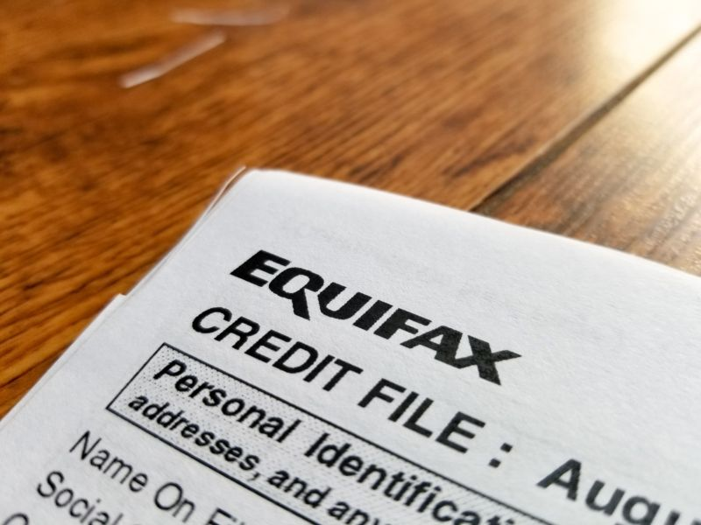
The Equifax Breach
In 2017, hackers exploited the web application of Equifax. This incident had a loss of personal data of 147 million customers. Not only does this reveal person information of millions of people but causes damage to their reputation and financial losses.
These hackers had access to about 209,000 credit card details and social security numbers of some clients.
This Photo by Unknown Author is licensed under CC BY-SA

Slide 15
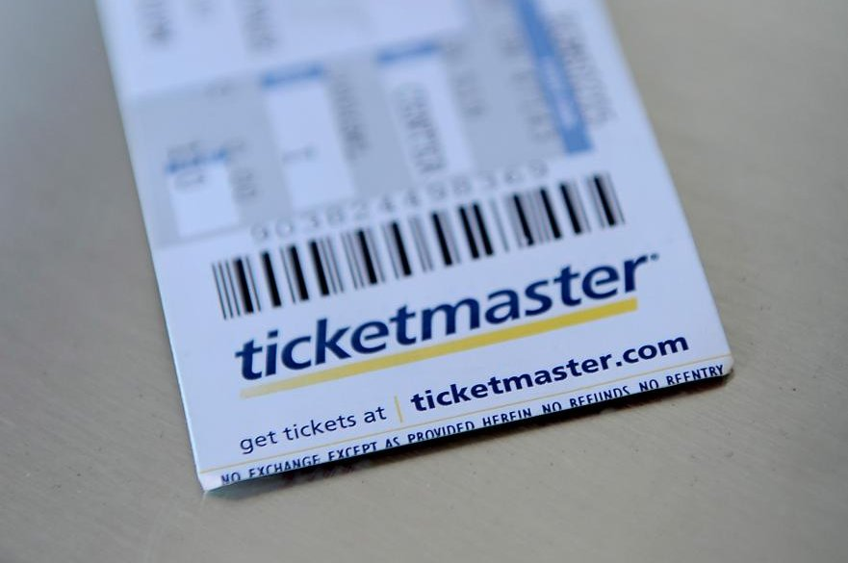
Ticketmaster Data Breach
The end of 2024, Ticketmaster had a data breach that affected millions of customers. The hackers stole names, email addresses, phone numbers, and even partial payment information. The hacker was traced back to a third-party system, that was for ticket processing. Ticketmaster had to review all third-party connections and strengthen its security overall.
This Photo by Unknown Author is licensed under CC BY-SA-NC

