Slide 1
Fantastic Personas and Where to Find Them
Mapping the Geometry of Role Vectors in Activation Space
MATS 9.0 Fellowship | Winter 2026 Cohort
Notes:
Hi everyone, I'm Glenn. I'm working with Sebastian Krier on a project called The Geometry of Personality in Language Models. I'll walk you through what we're doing, why it's designed the way it is, and why it matters for safety. ~15 seconds.

Slide 2
Title: Fantastic Personas and Where to Find Them: Mapping the Geometry of Role Vectors in Activation Space
Abstract: We present a methodology for extracting and steering role vectors in large language model activation space, and investigate the geometric structure of the resulting persona representations. Using a curated elicitation battery grounded in psychological profiles, role-specific tasks, and cognitive biases, we extract vectors for 275 diverse roles via contrastive activation differences between judge-filtered positive and baseline responses. We benchmark additive activation steering against prompt-engineered baselines and prior role-vector methods, evaluating role adherence across diverse settings. Analyzing the geometry of the resulting role space, we find that our extraction method yields vectors with greater variance and more semantically coherent clustering than prior approaches, and we characterize the principal axes in terms of interpretable personality dimensions. We further demonstrate that linear combinations of role vectors produce coherent role compositions --- suggesting algebraic structure analogous to that observed in word embedding spaces --- and validate these representations against both behavorial instruments and LLM-perceived persona similarity. Our findings offer a foundation for interpretable, activation-level persona control with applications to behavioral monitoring and safe deployment.

Slide 3

LLMs Adopt Personas. But Is There Structure?
Persona Prompting Works
What Does This Look Like Inside?
"Respond as a firefighter"
?
"Respond as a therapist"
"Respond as an engineer"
Chen et al., 2025; Lu et al., 2026
Do personality traits form a coherent geometry in activation space?
Notes:
We know from prior work that LLMs can reliably adopt personas when prompted, and that this isn't just a surface-level text phenomenon. It actually corresponds to recoverable directions in the model's activation space. But here's what hasn't been asked systematically: is there *structure* to this? When you look at the space of all possible personas, do personality traits organize into something geometrically coherent? ~45 seconds.

Slide 4
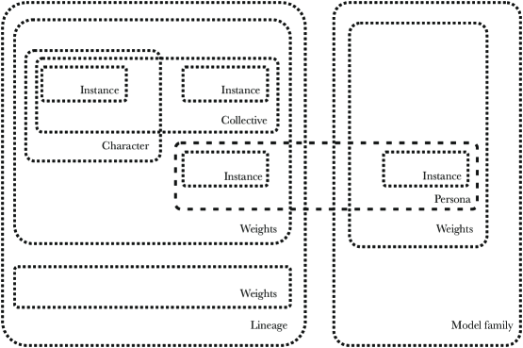

Slide 5


Two-Metric Evaluation Framework
METRIC A
METRIC B
Empirical Personification
Manifold Geometry
Gold label: Prompt-engineered persona (the literature standard)
Comparison: Our contrastive method vs. Christina’s extraction, judged against the gold label
Method: LLM-as-judge (multiple models) on 230+ validation questions
Result: Our methods show notably stronger 1st-person narration and role reasoning in our method
Primary analysis: PCA on persona vectors—how much variance does PC1 (assistant axis) explain?
Hypothesis: Better elicitation → reduced assistant axis dominance → more role-specific behavior
Beyond PCA: Also testing t-SNE, NMF for better manifold characterization
Result: Our methods provide supports and contextualizes the Persona Selection Model

Slide 6
Methodology: Ours vs. Baseline
Dimension | Christina (Asst. Axis) | Our Method
Vector Extraction | Mean activation of persona-prompted responses | Contrastive difference (persona – baseline) + scoring filter
Elicitation Questions | ~40 questions | 230+ questions (social, personal, day-to-day)
Steered Behavior | Remains assistant-adherent ("here’s how to consider...") | Shows role personification (1st person, expressed preferences)
Post-Steering Eval | Not performed for non-assistant roles | LLM-as-judge + NLP analysis
Mean Subtraction | Yes | No

Slide 7
Model: OLMo3-7B-Instruct
Judge Model: gpt-4.1
Label Model: sonnet-4.5

Slide 8
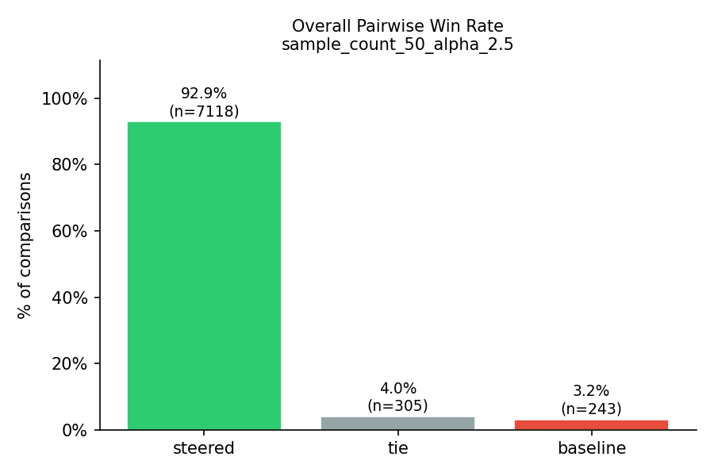
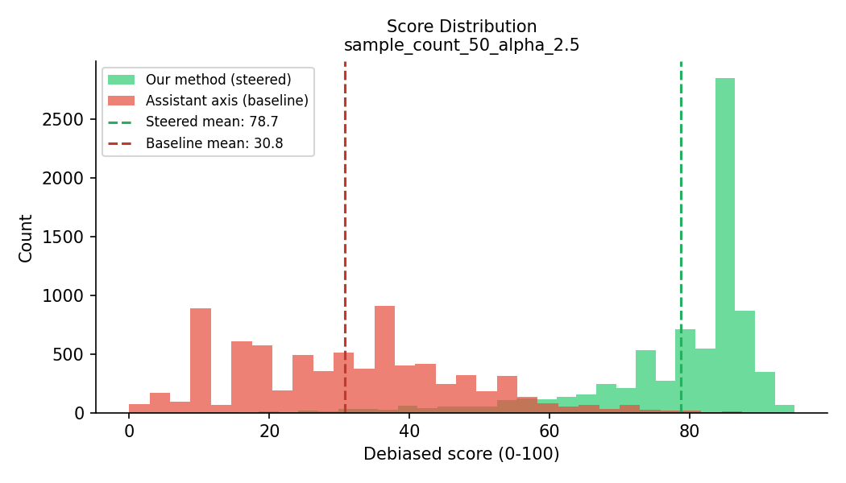
Empirical top line results: we crushed the SOTA (Assistant Axis) and achieved the intended behavior

Slide 9
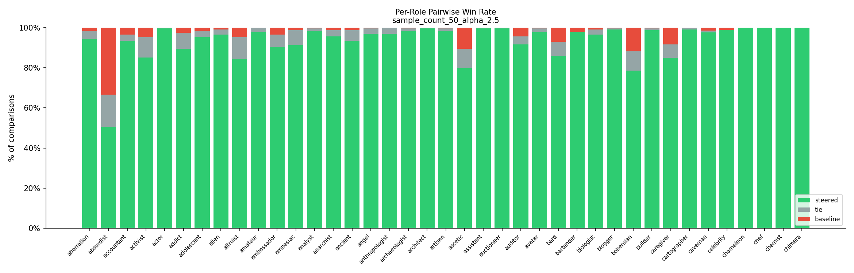
Per-role Pairwise Win Rates Us (G) vs Them (R)

Slide 10
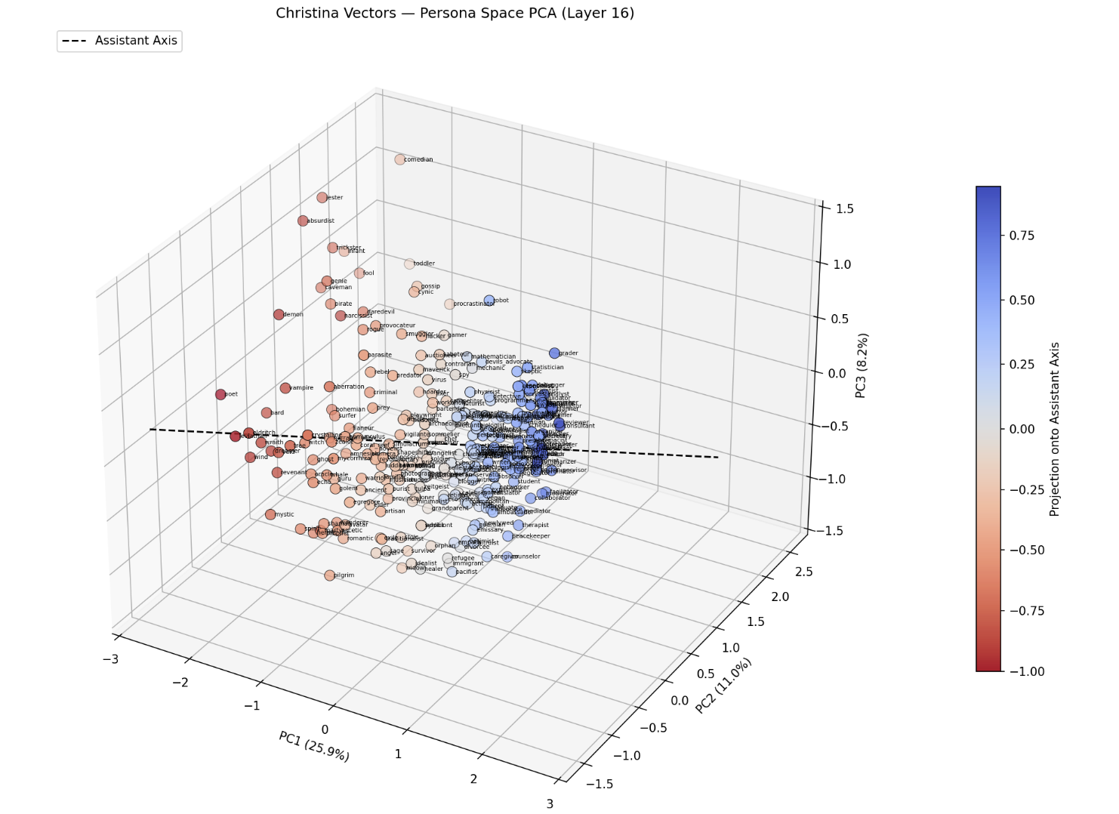
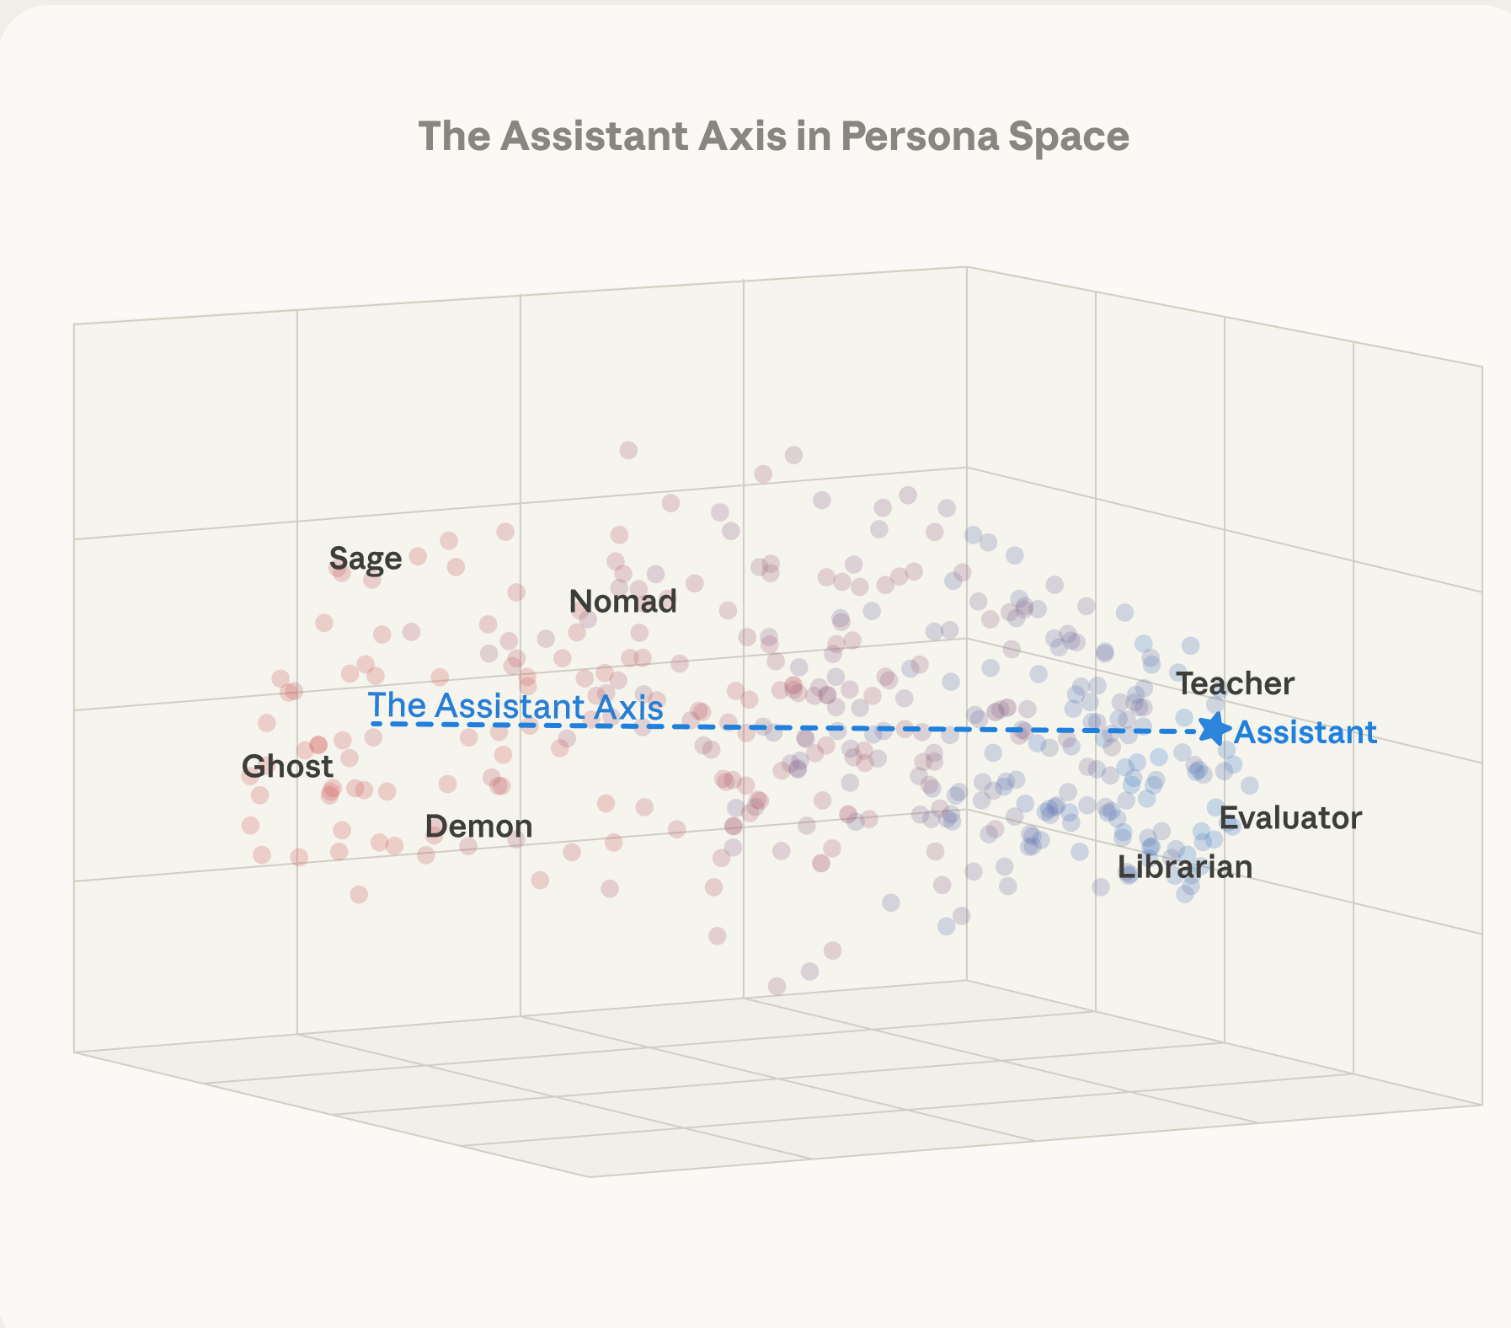
We begin by replicating/recovering Lu et al assistant axis role methodologies. There is a PCA plot in that paper. We replicate that plot (a), and supplement it with a (b) 2D tSNE (c) 3D tSNE plot

Slide 11
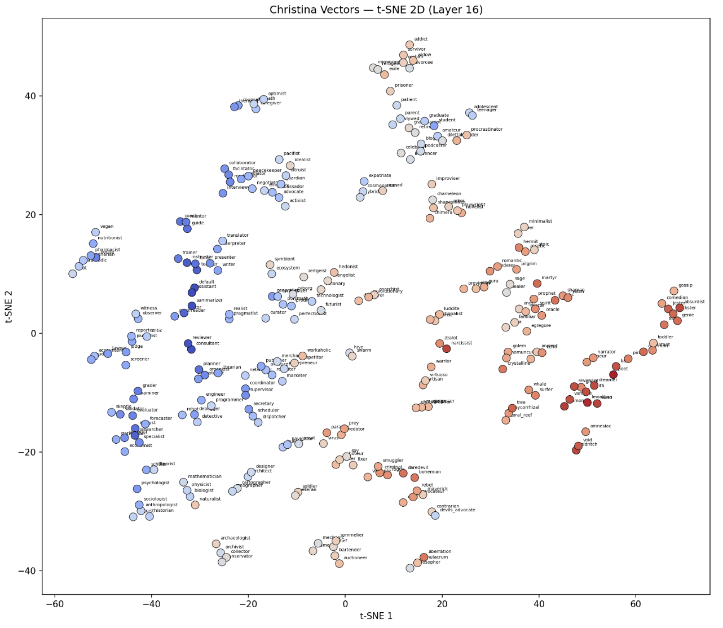
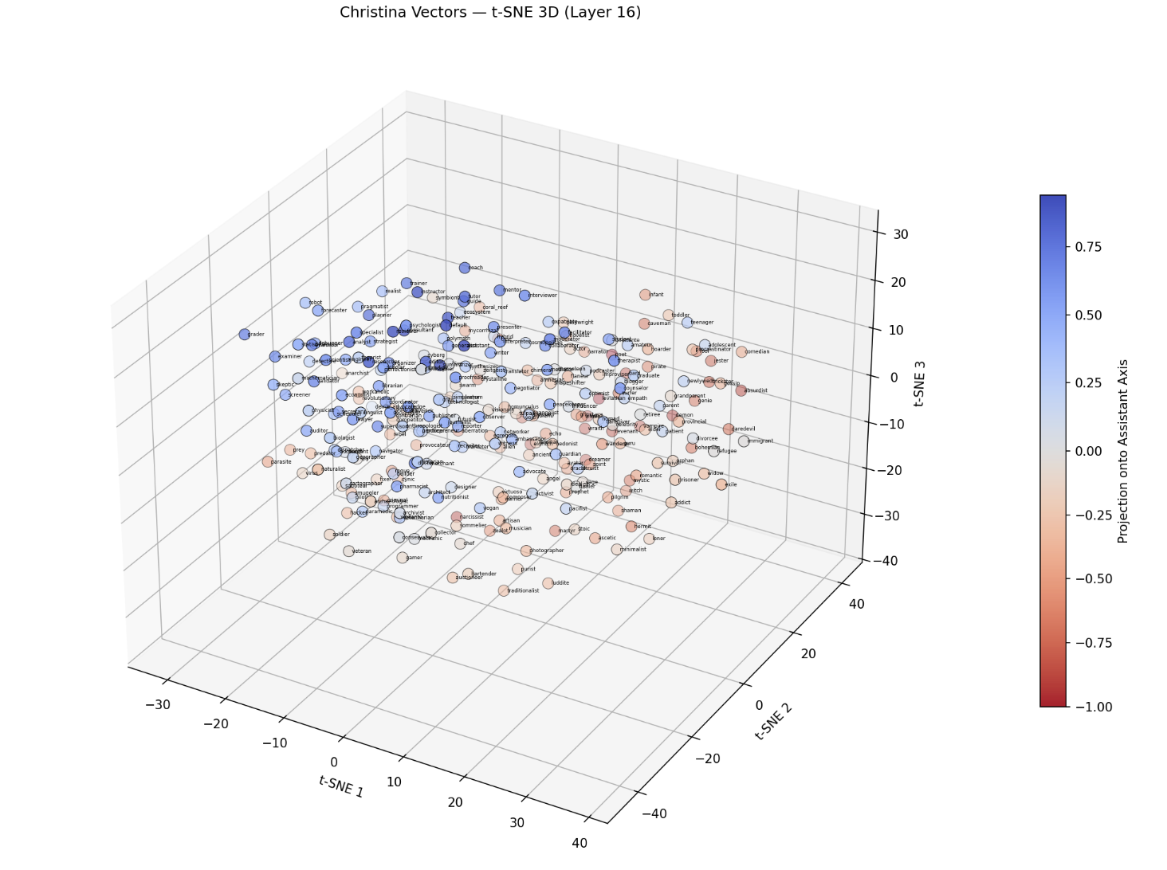
We begin by replicating/recovering Lu et al assistant axis role methodologies. There is a PCA plot in that paper. We replicate that plot (a), and supplement it with a (b) 2D tSNE (c) 3D tSNE plot

Slide 12
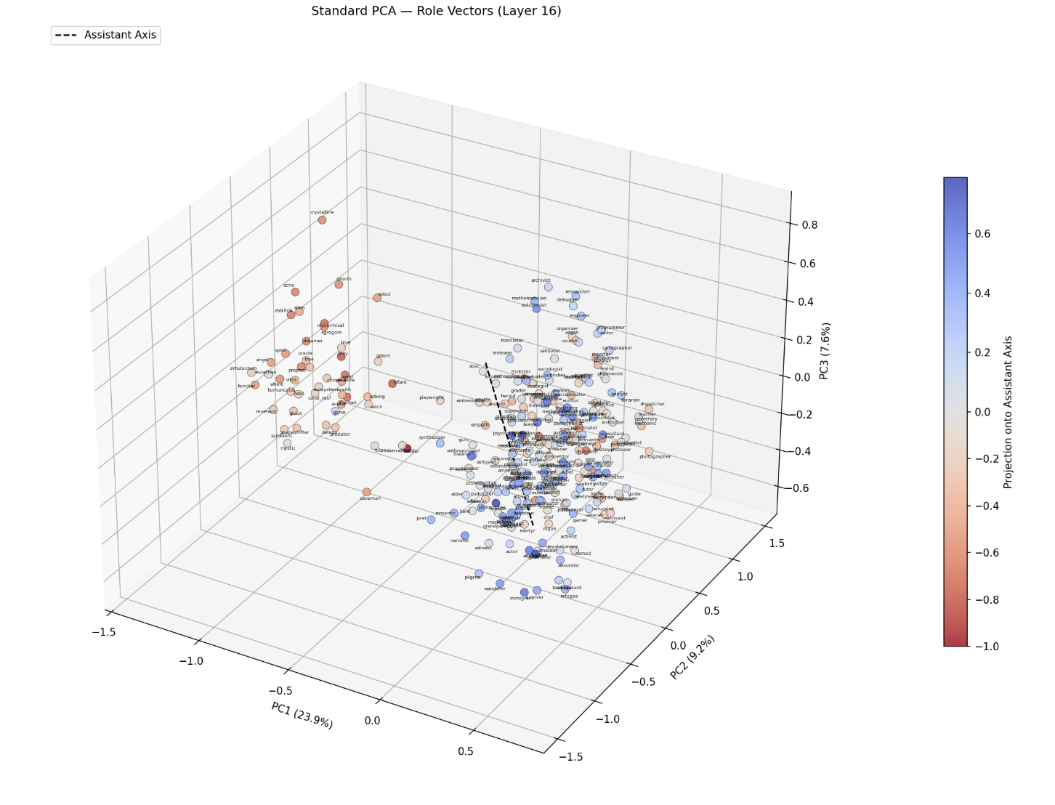
Now, we look at the steering vectors from our methodology. Here is our PCA. The main observation here is that less variance is explained across the first 3 PCs, and the intra-cluster variance between points is generally much higher.

Slide 13
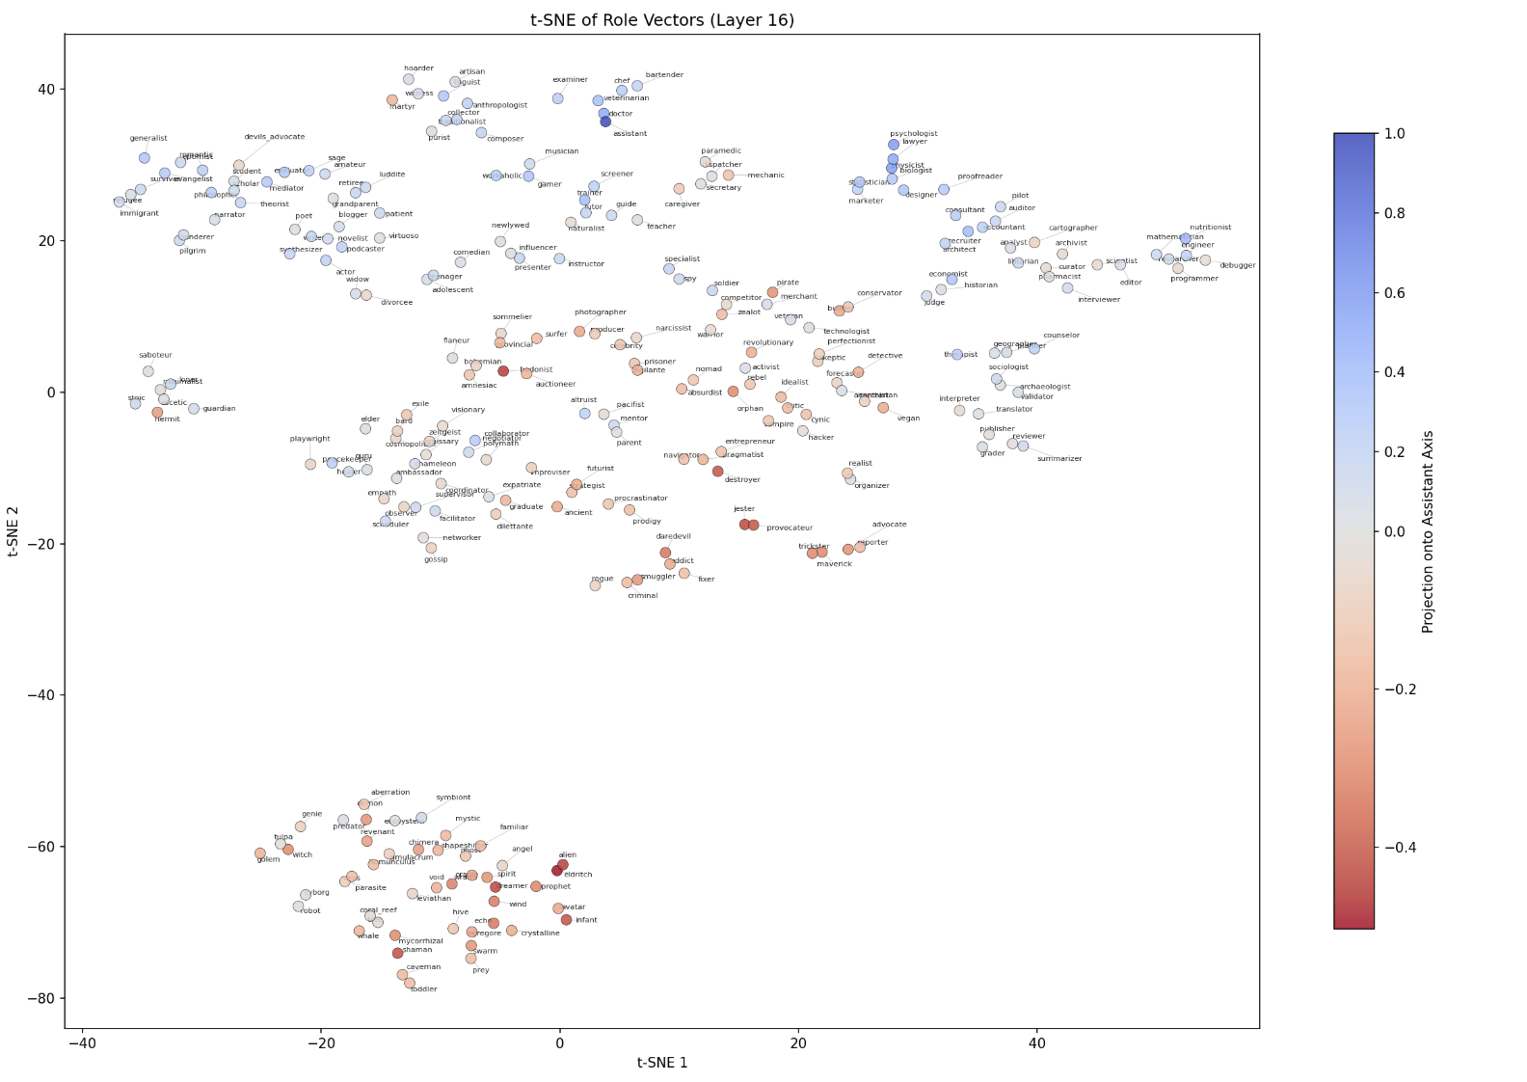
b) tSNE -- So right now, the observation is that our tSNE plot has higher intra-cluster variance: we can separate out the "fantastical/mythical" stuff better than Lu et. al. in the Assistant Axis paper

Slide 14
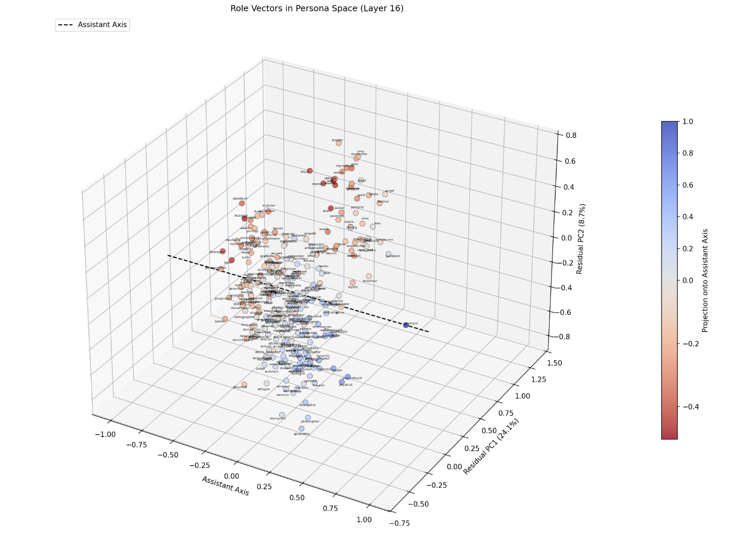
c) PCA -- but when you set the first axis to explicitly be the assistant-axis (and let PC1 and PC2 be axis2/3, resp.) This plot seems to resemble the PCA in Assistant Axis (Figure 1a above) a lot

Slide 15
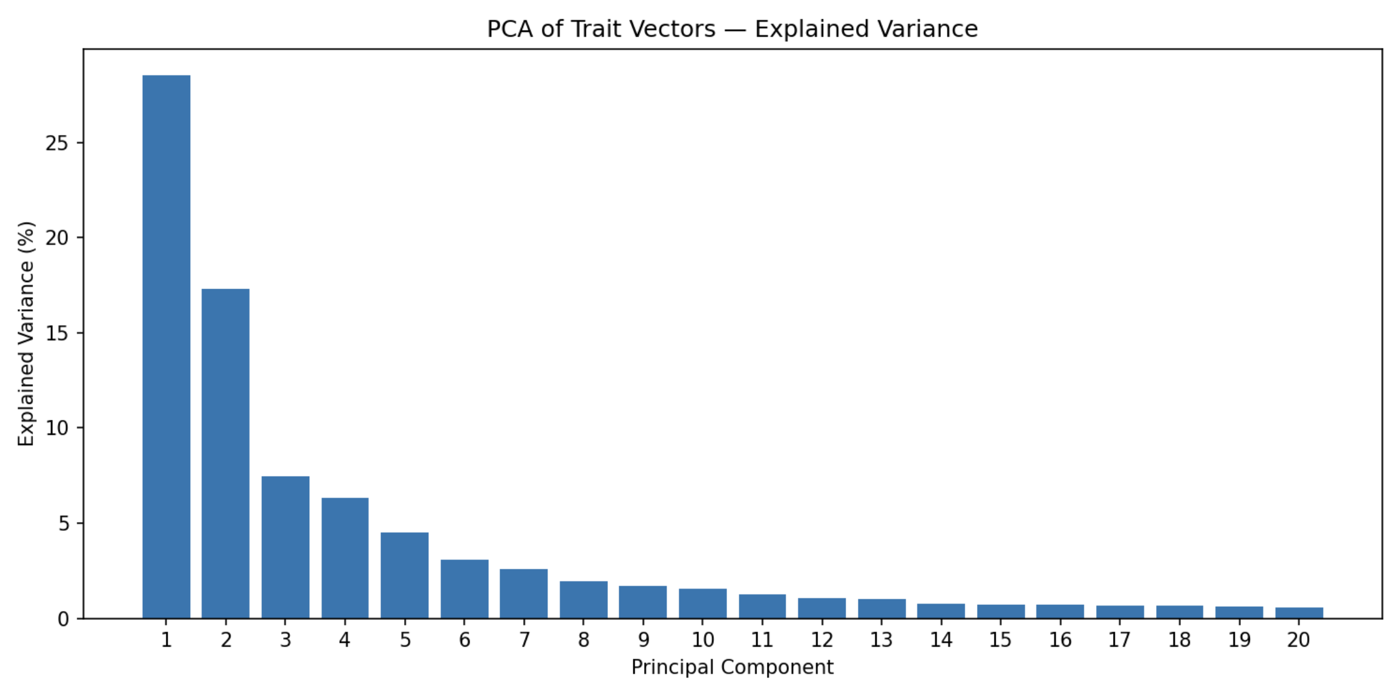
Comparison of the variance explained by the PCs

Slide 16
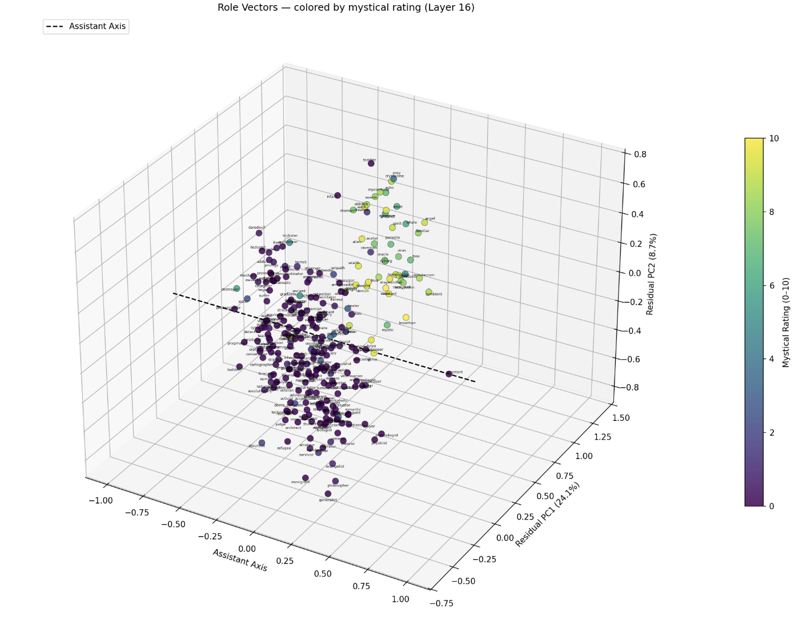
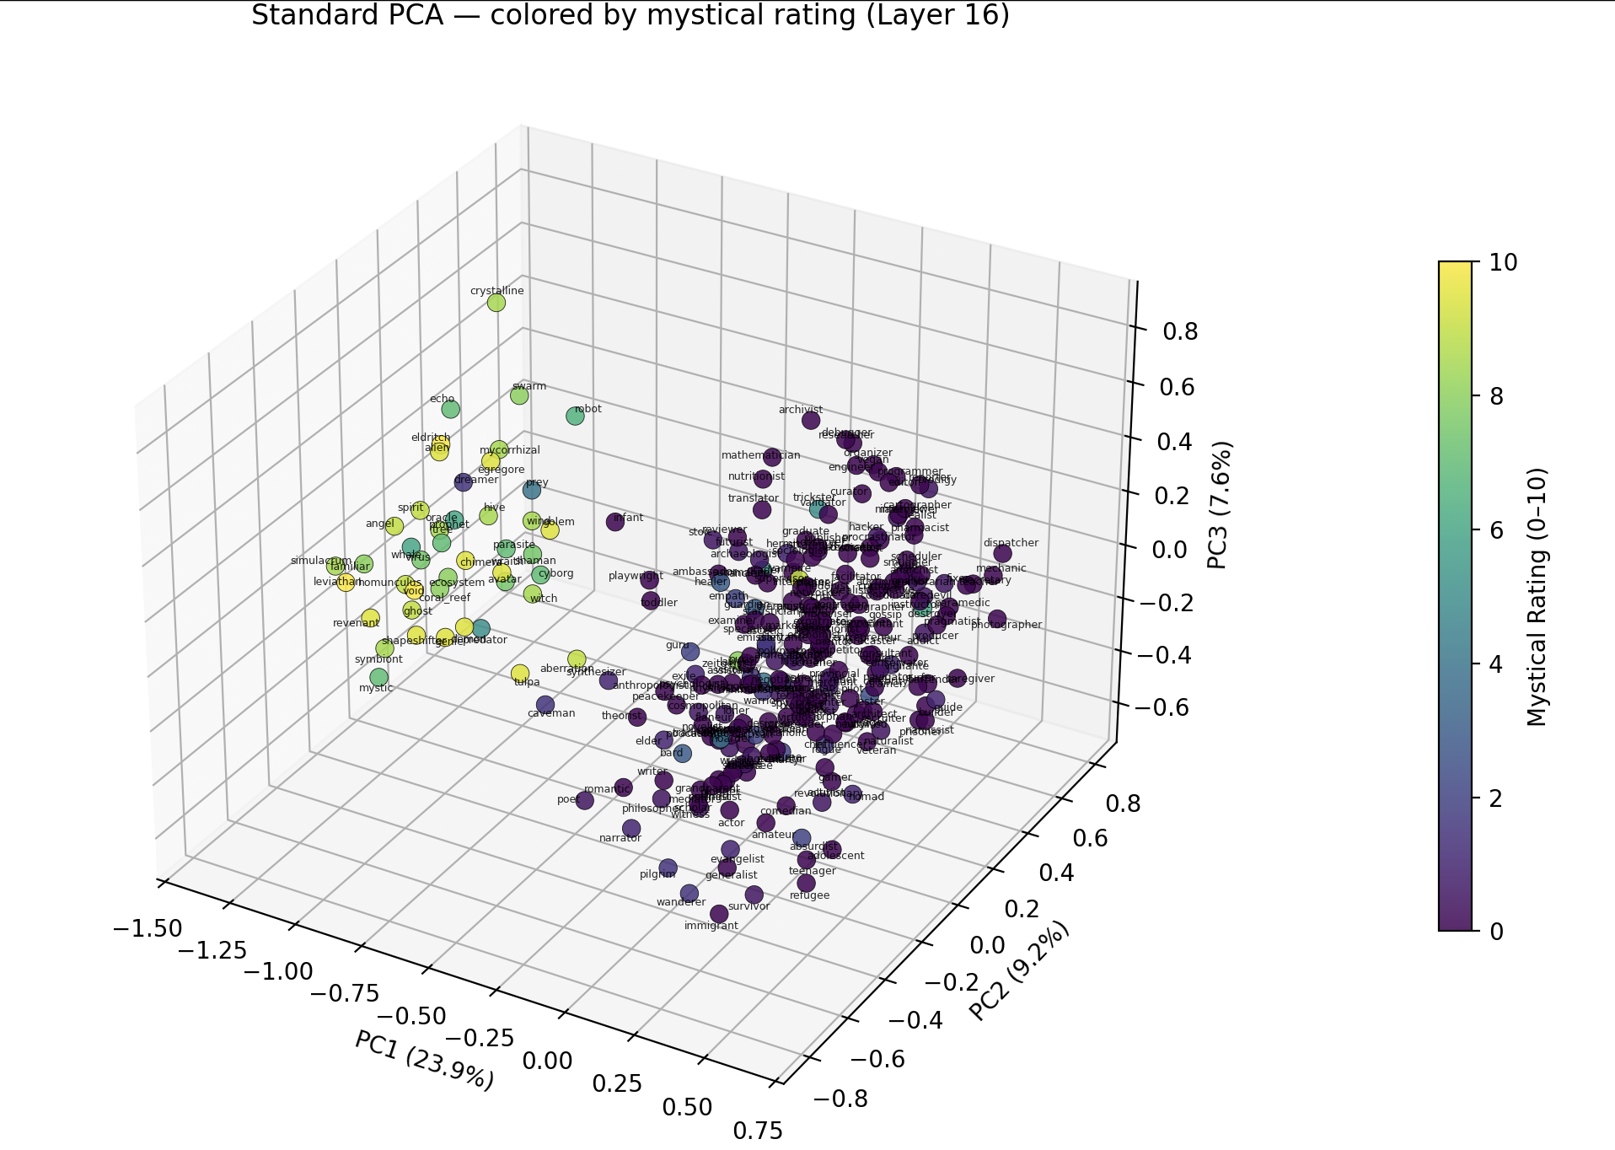

Slide 17
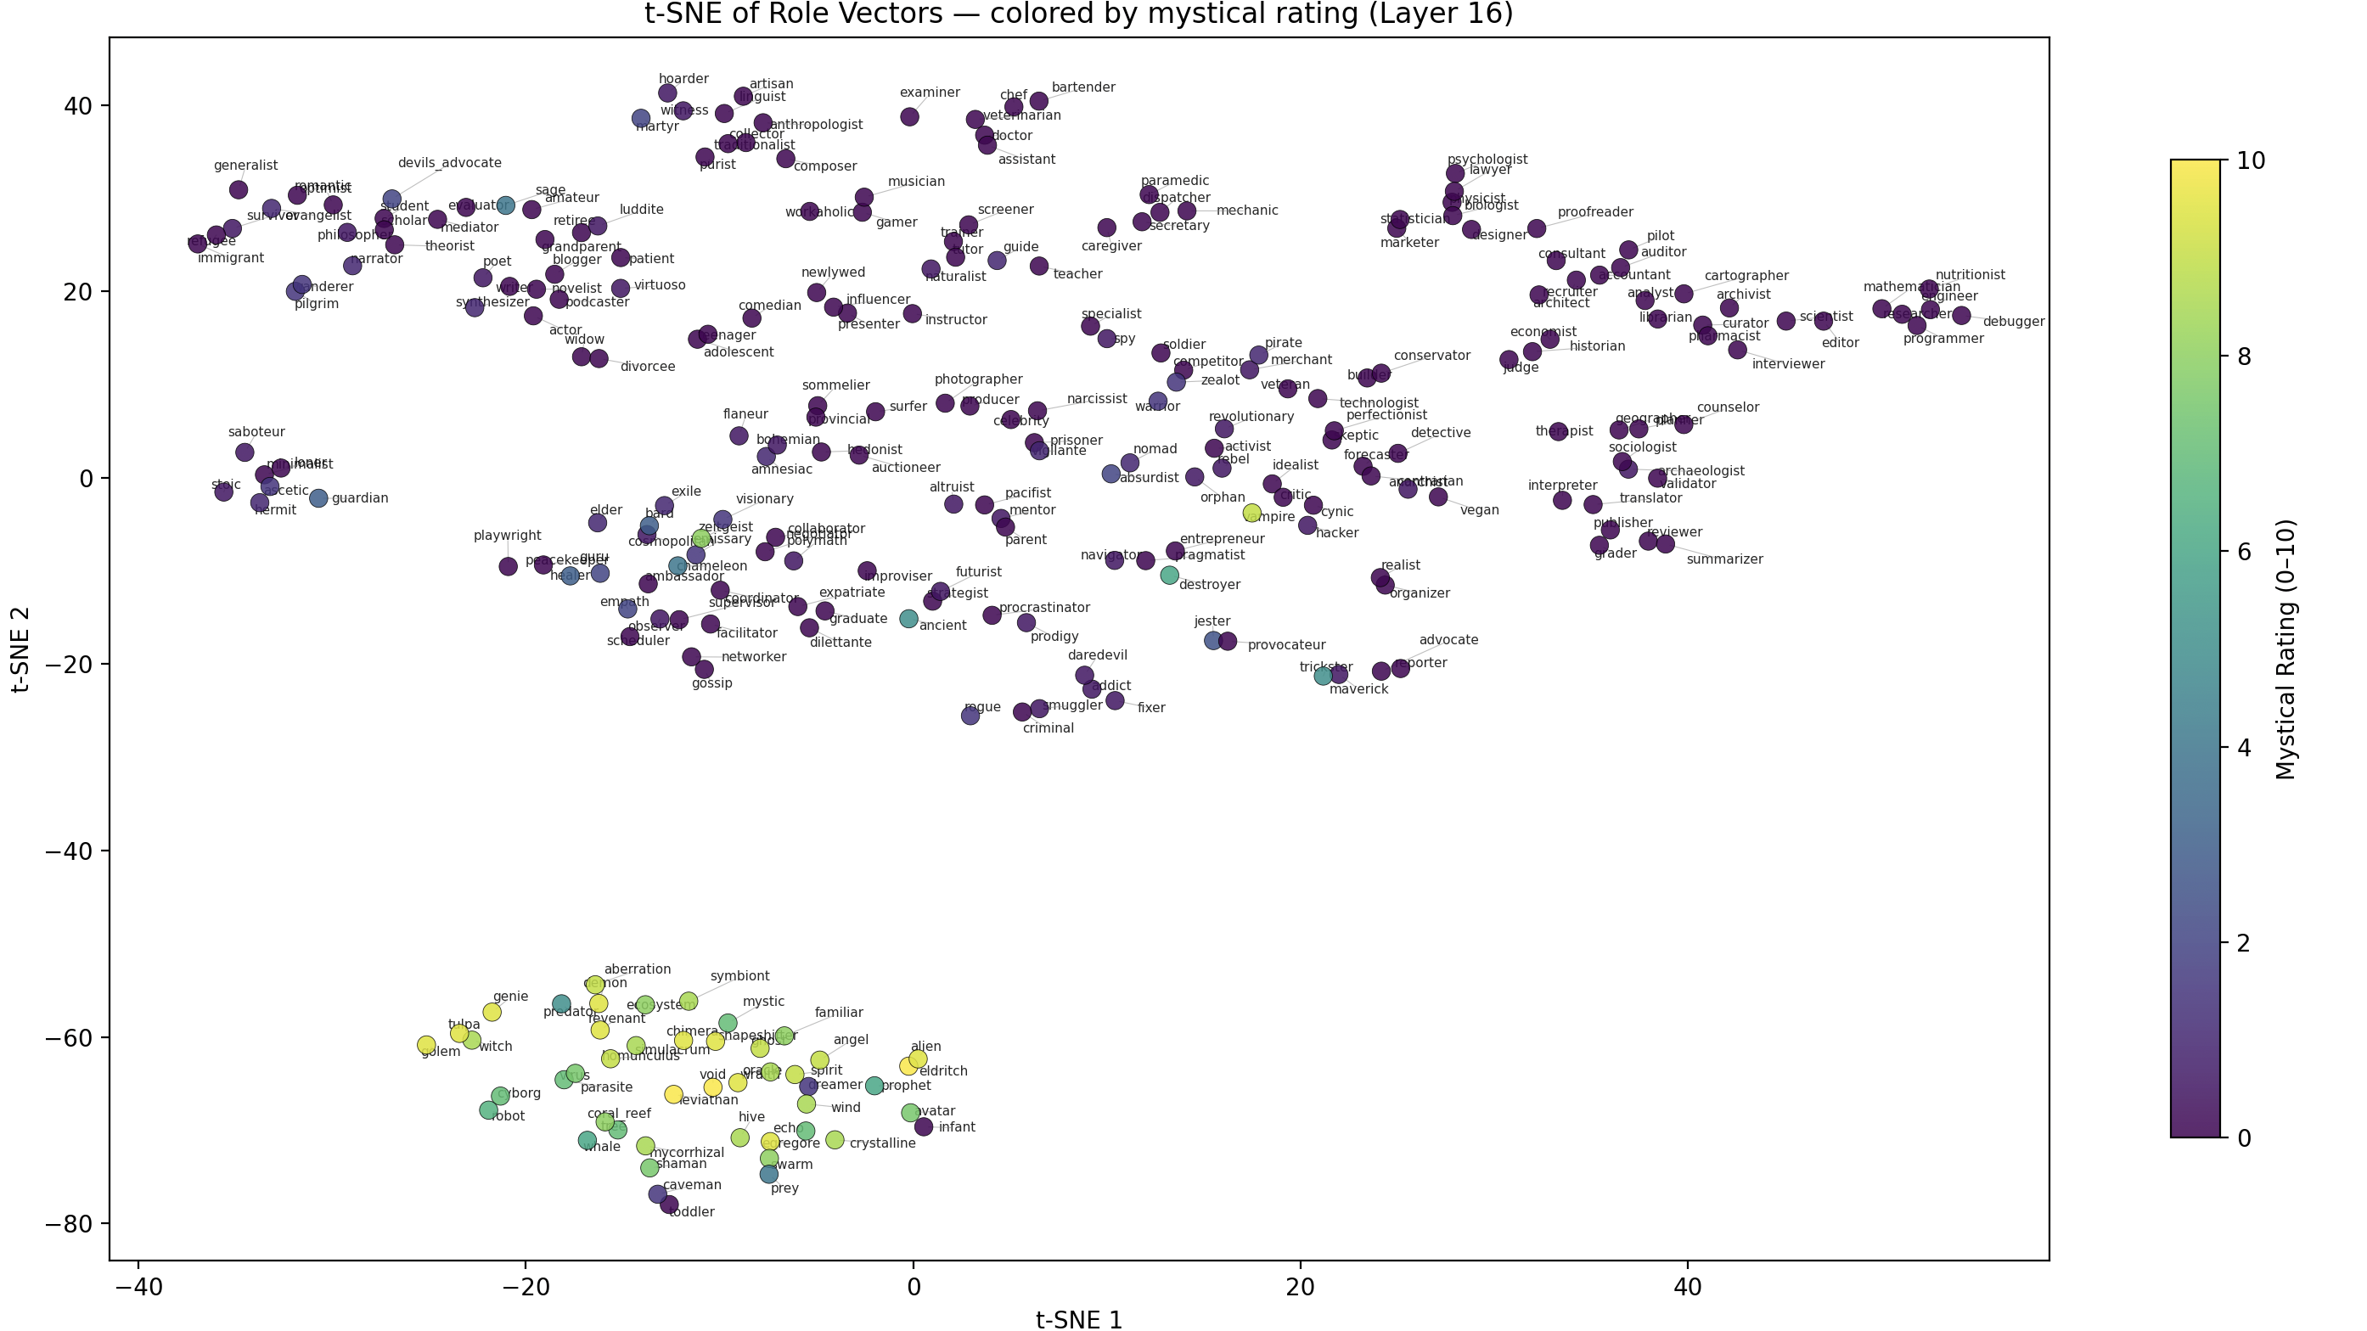

Slide 18
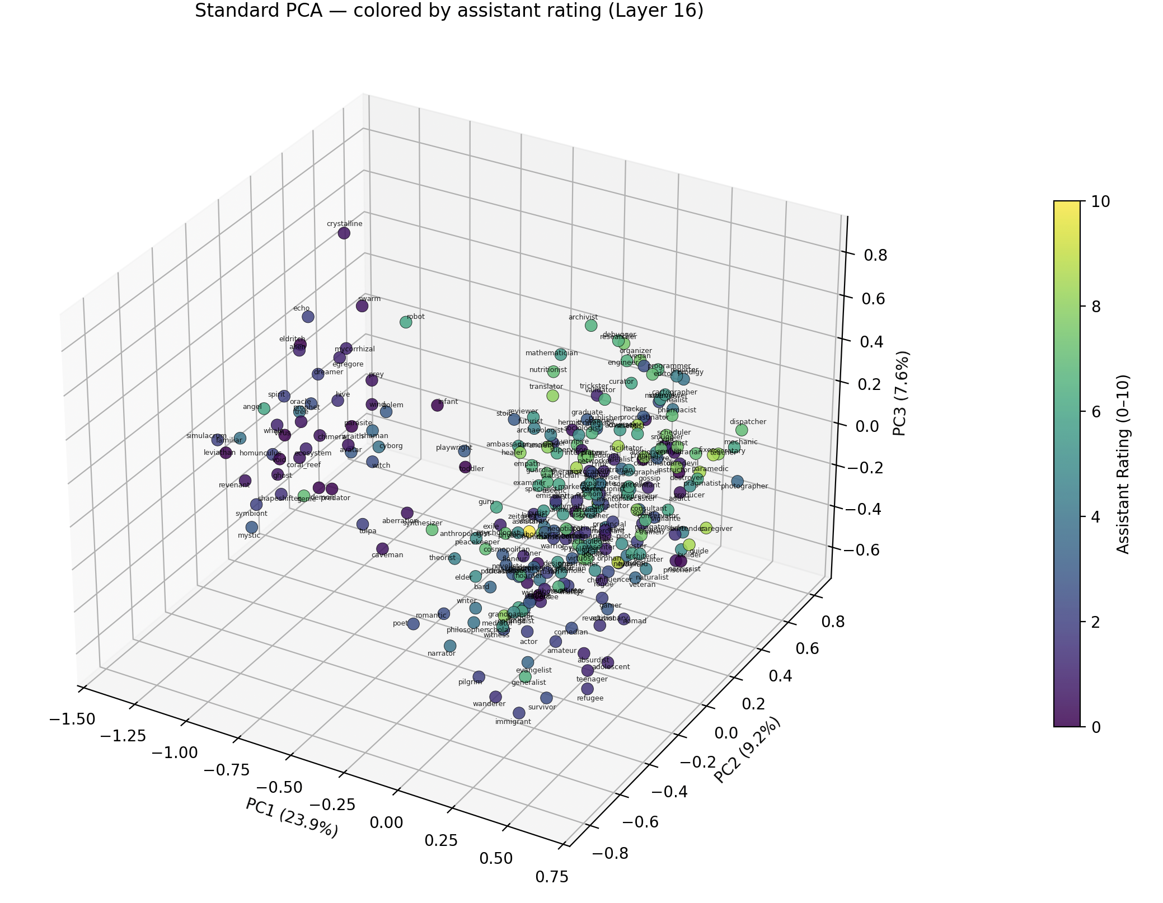
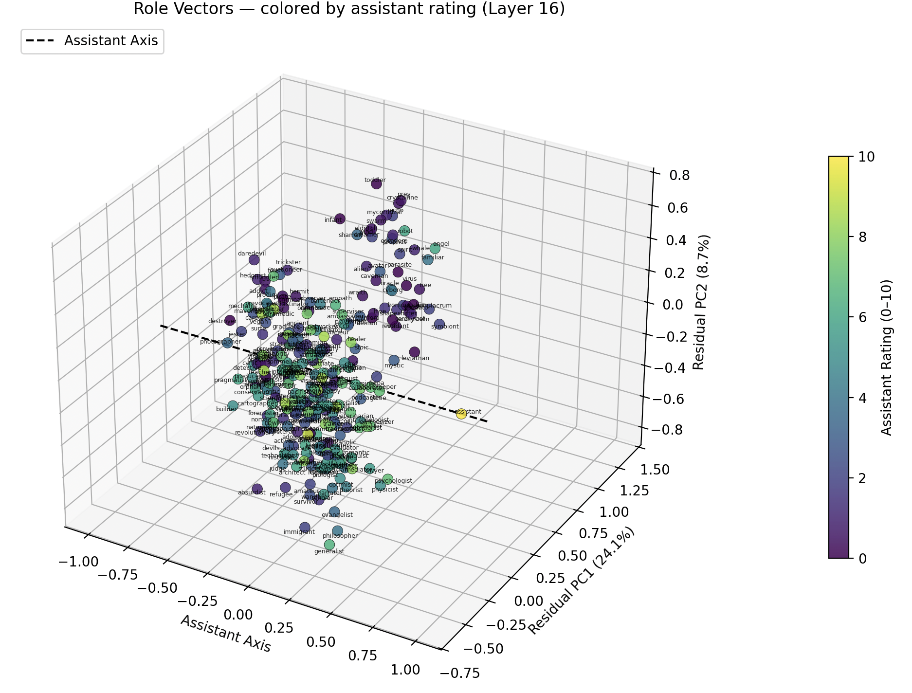

Slide 19
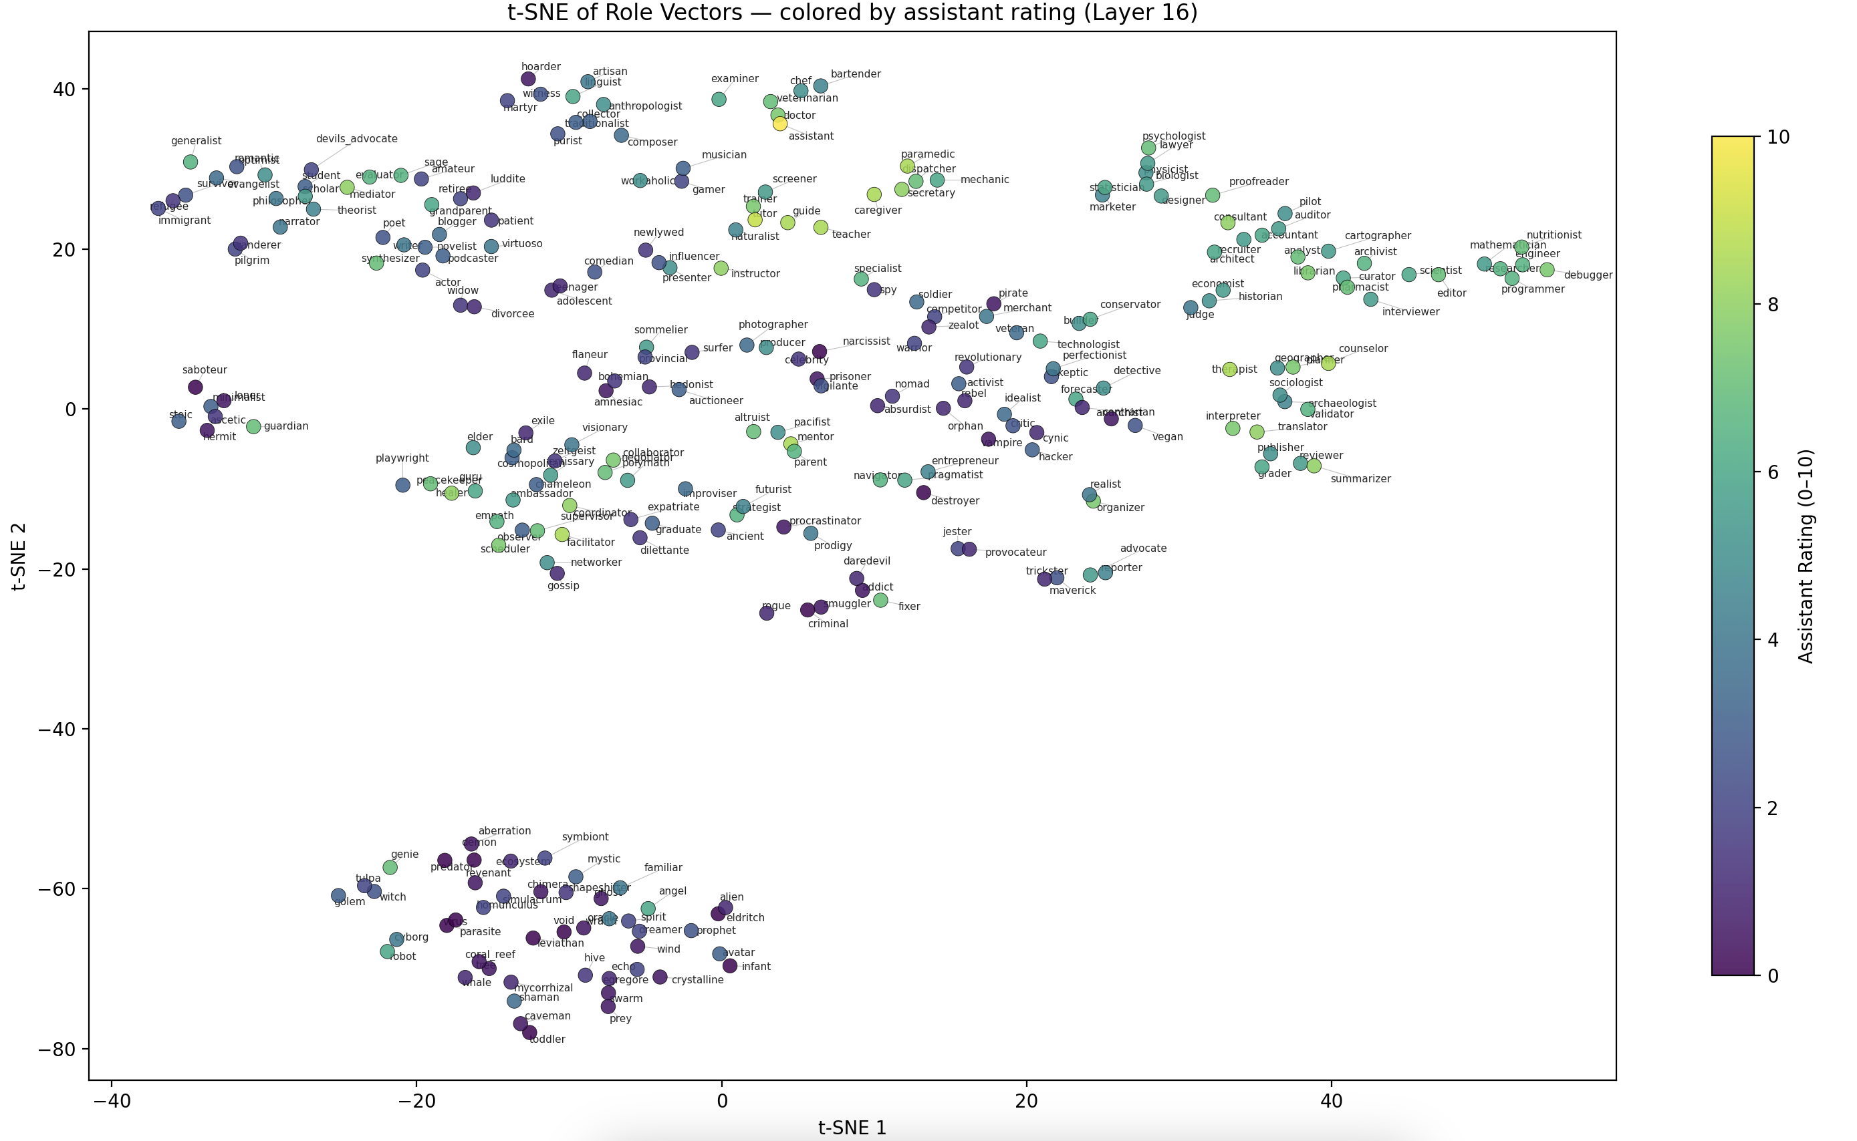

Slide 20
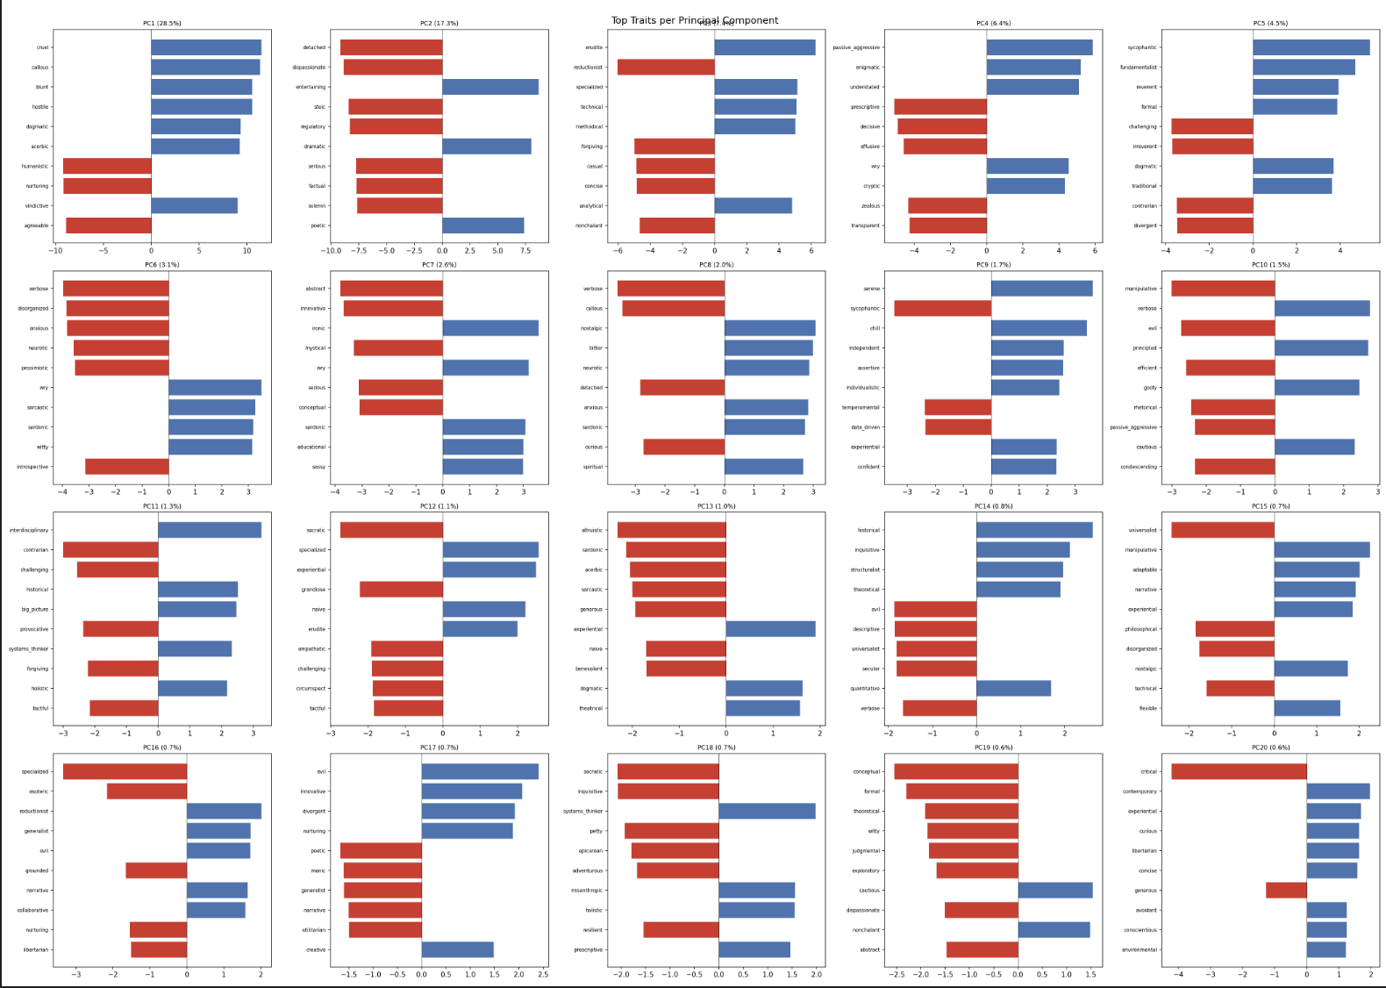
We run PCA of traits with vectors, and the top 10 traits that correlate the most with the PCs

Slide 21
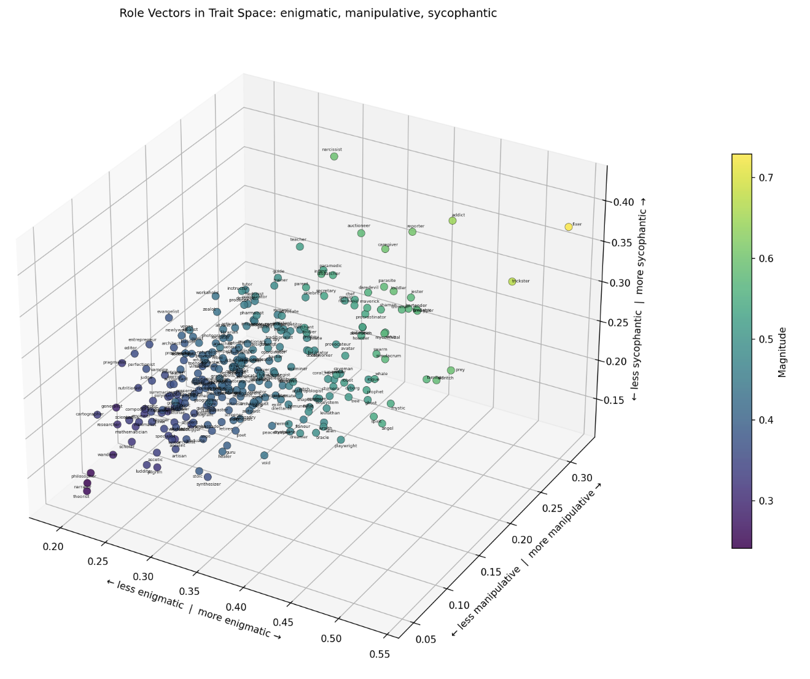
Now, we can also associate the axes of emotions/traits with the corresponding PC’s that they correlate with. For any 3 traits, we can define a x,y,z axis and plot the roles Plotted all the roles for sets of 3 traits. Here are some of them -- Happy to plot more if there are combinations folks are interested in.
Enigmatic vs Manipulative vs Sycophantic

Slide 22
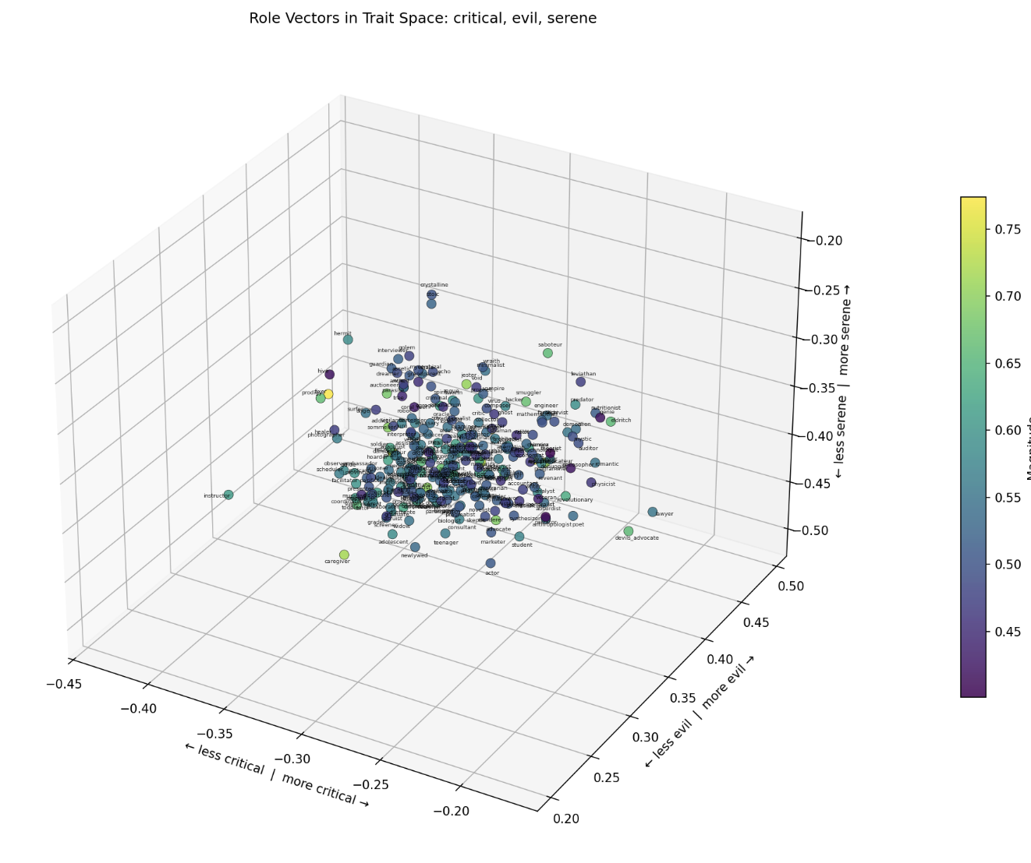
Now, we can also associate the axes of emotions/traits with the corresponding PC’s that they correlate with. For any 3 traits, we can define a x,y,z axis and plot the roles Plotted all the roles for sets of 3 traits. Here are some of them -- Happy to plot more if there are combinations folks are interested in.
Critical vs Evil vs Serene

Slide 23
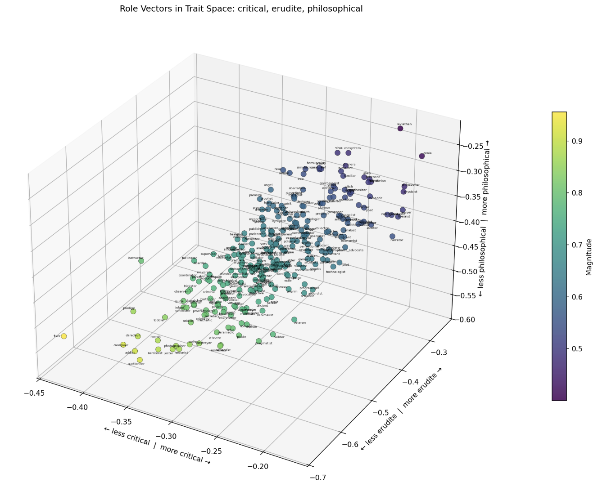
Now, we can also associate the axes of emotions/traits with the corresponding PC’s that they correlate with. For any 3 traits, we can define a x,y,z axis and plot the roles Plotted all the roles for sets of 3 traits. Here are some of them -- Happy to plot more if there are combinations folks are interested in.
Critical vs Erudite vs Philosophical

Slide 24
We use Claude to rank on a scale from [0,10] (inclusive, floats) how mystical each role was, and re-did the tSNE/PCA while coloring the points along this mystical axis.

