Slide 1

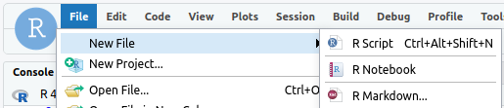



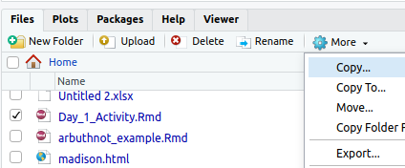



MTH142 Intro to Stats:: CHEAT SHEET
Getting started
Screen Shots
Libraries
View Data Sets
Signing into RStudio
Mac: Shift + Command + 3
library(MTH142Rtutorials)
library(mosaic)
library(openintro)
library(tidyverse)
cars93 is the data set
glimpse(cars93)
head(cars93)
First six rows (tail() works too)
view(cars93)
makes window for all data
names(cars93)
show variable names only
http://hcc-rstudiosrv1.hcc.edu:8787/
Windows: + Shift + S
Chromebook: Shift + Ctrl +
Username: Your HCC email with @hcc.edu
Password: Your HCC password
Downloading MTH142Rtutorials:
install.packages("remotes")
remotes::install_git("https://github.com/Nics-Github/MTH142Rtutorials")
Select 3 to install no updates.
.Rmd files
Graphs
Summary Statistics
Variables
New .rmd File>New File>R Markdown...
favstats(~weight,data=cars93)
outputs mean,sd, and five number summary
fivenum(~weight,data= cars93)
Just the five number summary
summary(cars93)
summarizes all the variables
tally(~cars93)
counts the observations
tally(~type,data=cars93)
counts the observation by subgroup
a_variable <- c(1,2,3)
takes the vector 1,2,3 and
saves it as a variable with the
assignment operator
box plots
gf_boxplot(~weight,data=cars93)
gf_boxplot(type~weight,data=cars93)
histograms
gf_histogram(~weight,data=cars93)
bar
gf_bar(~type,data=cars93)
scatter plots
gf_point(weight~mpg_city,data=cars93)
lines
gf_point(hp~mpg) %>%
gf_lm(hp~mpg)
titles and labels
gf_histogram(~weight,data=cars93,xab="weight",ylab="count",title="weight in pounds")
Math Type
Uploading a file Lower Right quadrant click upload
Use $$ to enclose math type.
$\mu$ $\sigma$
$\bar{x}$ $\hat{p}$
$H_o$ $\alpha$
$\ne$ $\approx.$
$\sim$
Confidence Intervals
Knitting a file click the knit button and save.
List of Standard Error formulas
From Data
prop.test(~type,success="small",data=cars93,conf.level=0.95,correct=FALSE)
produces a 95% confidence interval for the proportion
of cars that were small in 1993.
t.test(~weight,data=cars93)
produces a 95% confidence interval for the mean
weights of cars sold in 1993.
From Statistics
prop.test(20,60,conf.level=0.90,correct=FALSE)
produces a 90% confidence interval for the population
proportion given 20 successes in 60 trials.
For mean use formula below
For the confidence interval of the mean from statistics we use the
following formula:
SE for a single proportion
SE for a single mean or paired means.
SE for two means (not paired)
Exporting a file select file in lower right quadrant click more then Export…
YOUR LOGO
(optional)
$$\bar{x}±t^{\text{∗}}SE$$
CC BY SA Nic Schwab • nschwab@hcc.edu • Updated: Jan 13, 2023

Slide 2
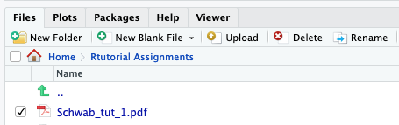
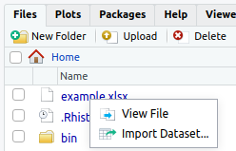
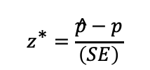

MTH142 Intro to Stats:: CHEAT SHEET
R Markdown cont.
normal distribution
help
To get more info on a dataset, load a library then use ?
library(MTH142Rtutorials)
?MTH142Rtutorials
New chunk click the green c+ and select r
xpnorm(1, mean=0 ,sd=1)
Outputs the probability if z=1 from a standard normal dist.
xqnorm(0.01,mean=0, sd=1)
Outputs the z-score if probability=0.01
This is the formula for a z*-score for a single proportion.
$$z^{\text{∗}}=\frac{\hat{p}−p}{\left(SE\right)}$$
Rename a file
Click the box next to the file and chose rename.
binomial distribution
Hypothesis Tests
dbinom(x=4, size=5,prob=0.25)
Outputs the probability of 4 successes in
a trial of size 5 with a probability of success
of 0.25
pbinom(x=2,size=5,prob=0.25)
Outputs the probability of 0,1,or 2 successes in
a trial of size 5 with a probability of success
of 0.25
Uploading Data
1. Copy and paste data into a spreadsheet.
2. Variables are column headers (no spaces in variable name)
3. Save as an .xls file to your computer (no spaces in file names)
4. Upload .xls file
5. Click on the file you uploaded > Import Dataset
student t distribution
xpt(1,df=11)
outputs the p-value if t=1 and 11 degrees of freedom
xqt(0.01,df=11)
outputs the t-score if probability=0.01
This is the formula for a t*-score for a single mean.
Proportions
prop.test(~type,success="small",p=0.5 , data=cars93,alternative="t", correct=FALSE)
Outputs a two tailed hypothesis test with parameter p=0.5.
prop.test(x=20, n=60, p=0.5, correct=FALSE)
Outputs the results of hypothesis test with 20 successes in 60 trials
binom.test(~type,success="small" , data=cars93, conf.level=0.90, ci.method="Wald")
Outputs a 90% confidence interval. Can use prop.test if appropriate.
Single Mean
t.test(~weight,data=cars93, mu=2000, alternative="g")
Outputs of a right tailed hypothesis test with parameter mu=2000.
Difference of Means
t.test(time_hrs~division,data=nyc_marathon, alternative="t")
Computes the difference of men and women winning times in NYC marathon
ANOVA
cars_anova<-aov(weight~type,data=cars93)
performs the analysis of variance and saves it as a variable “cars_anova”
anova(cars_anova)
outputs the summary of the analysis
Linear Regression
cars_linear<-lm(price~weight,data=cars93)
performs the linear regression and saves it as a variable “cars_linear”
msummary(cars_linear)
outputs the linear summary of the regression
$$t^{\text{∗}}=\frac{\bar{x}−μ}{SE}$$
CC BY SA Nic Schwab • nschwab@hcc.edu • Updated: Dec 29, 2021

