Slide 1

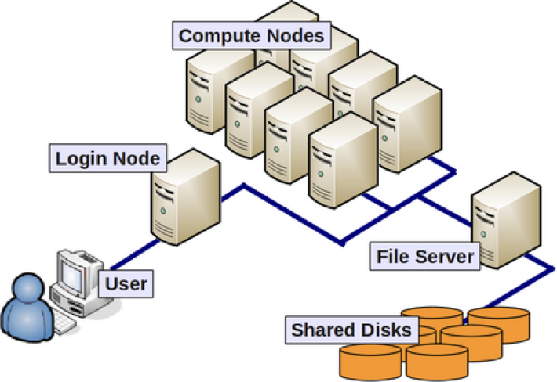

Cutting-Edge Bioinformatics in a High-Performance Computing Environment
István Nagy-Szepesi
João Carlos Sequeira
Maria Kavoosi
Scientific Computing Advanced Core Facility

Slide 2
Workshop overview
1st day – Introduction to Linux and the Shell environment
The Linux filesystem, nice command-line utilities, remote access to a Linux server
2nd day - Running bioinformatics tools for data processing and analysis
Step by step, from raw sequencing data to differential analysis of gene expression between two health conditions
3rd day – Using a workload manager to handle large-scale datasets
How to submit data analyses to Slurm
4th day – Results interpretation, Q & A, What comes next
Convert experimental results into translational results

Slide 3
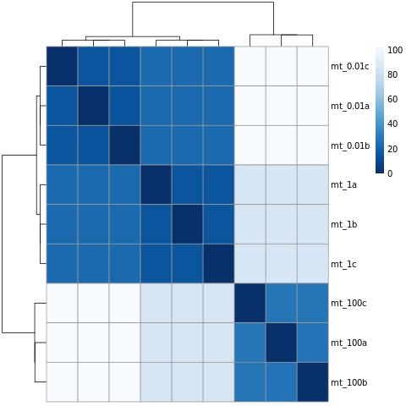
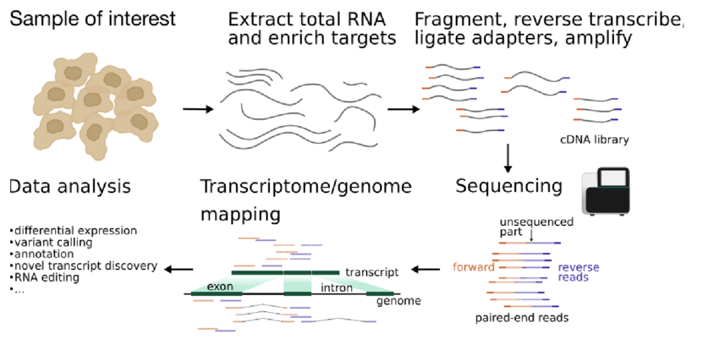
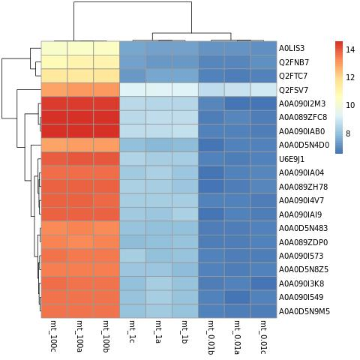
Quick overview of the bioinformatics pipeline
We will be running, step by step, a pipeline for estimating gene expression, and statistically identify differential expression of genes between two medical conditions.
Bioinformatics results, and their translational into medicine
Bioinformatics data analysis
Image from: https://doi.org/10.7287/peerj.preprints.27283

Slide 4
Before the workshop – FileZilla installation
Go to: https://filezilla-project.org/
Select your OS -> “Download FileZilla Client”.
Or just chose from the list here:
Windows 64 bits (most of current Windows)
Windows 32 bits
MacOS ARM64 (more modern Macs)
MacOSX
Linux 64 bits (most Linuxes)
Linux 32 bits
And follow the instructions of the installer

Slide 5
Before the workshop – testing access to Puli
Go to: https://puli.hcemm.eu/
Input the credentials provided by email.
If they work, you are all set!
Otherwise, please email us:
maria.kavoosi@hcemm.eu
joao.sequeira@hcemm.eu

Slide 6
See you at the workshop!
And for any questions, don’t hesitate contacting:
Maria.Kavoosi@hcemm.eu
Joao.Sequeira@hcemm.eu
Istvan.Szepesi-Nagy@hcemm.eu
6

