Slide 1


Cutting-Edge Bioinformatics in a High-Performance Computing Environment
Results interpretation &
What comes next
István Szepesy-Nagy
João Carlos Sequeira
Maria Kavoosi
Scientific Computing Advanced Core Facility

Slide 2
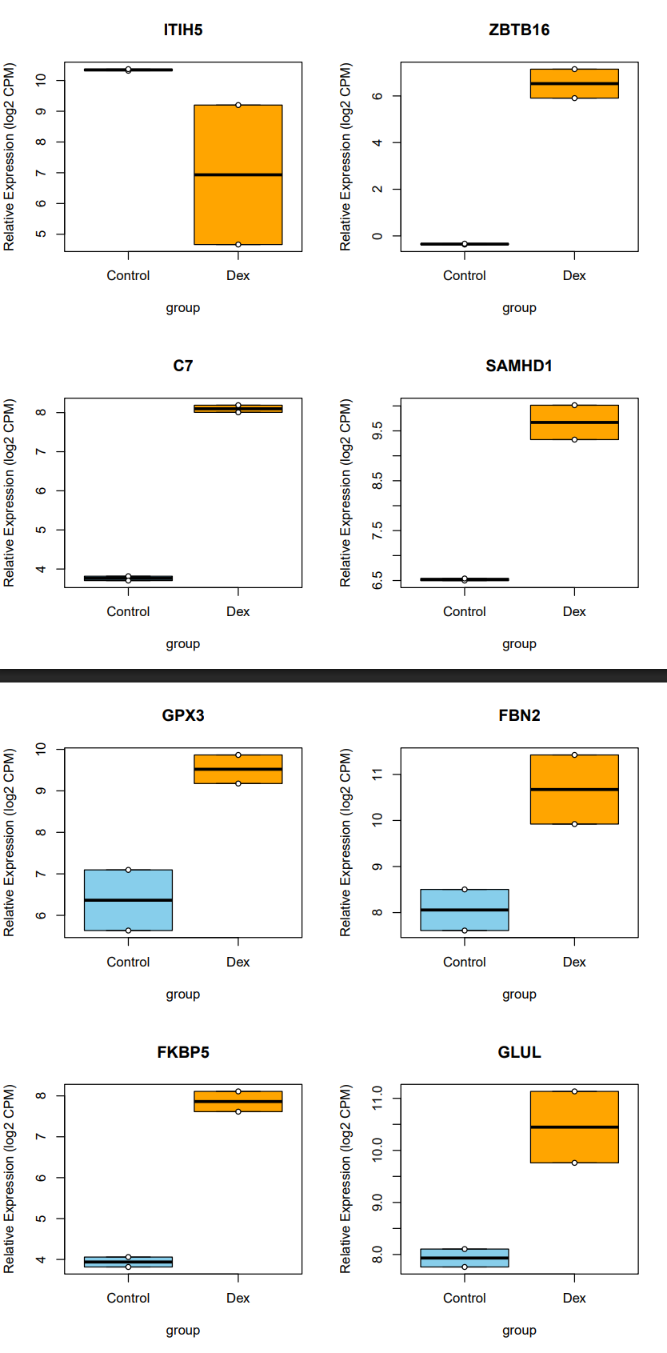
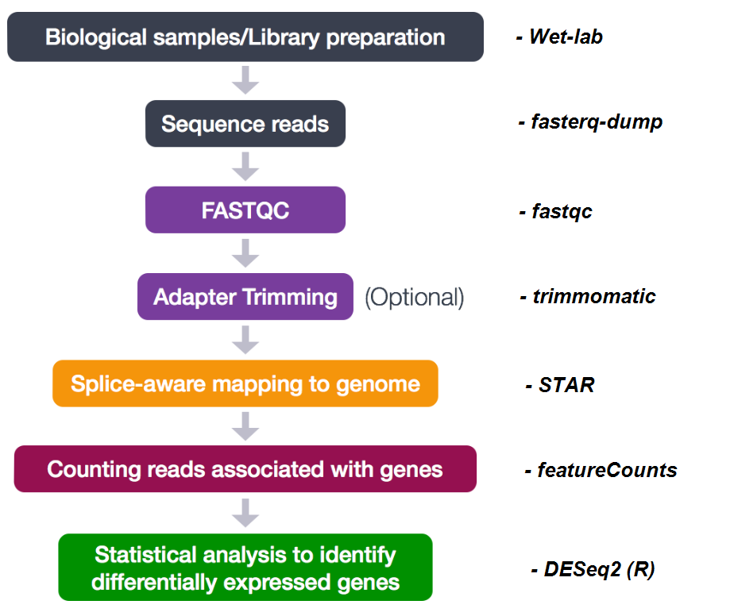
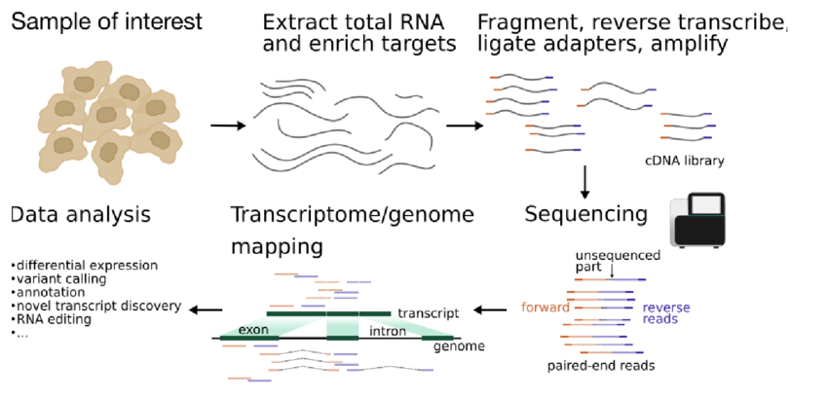
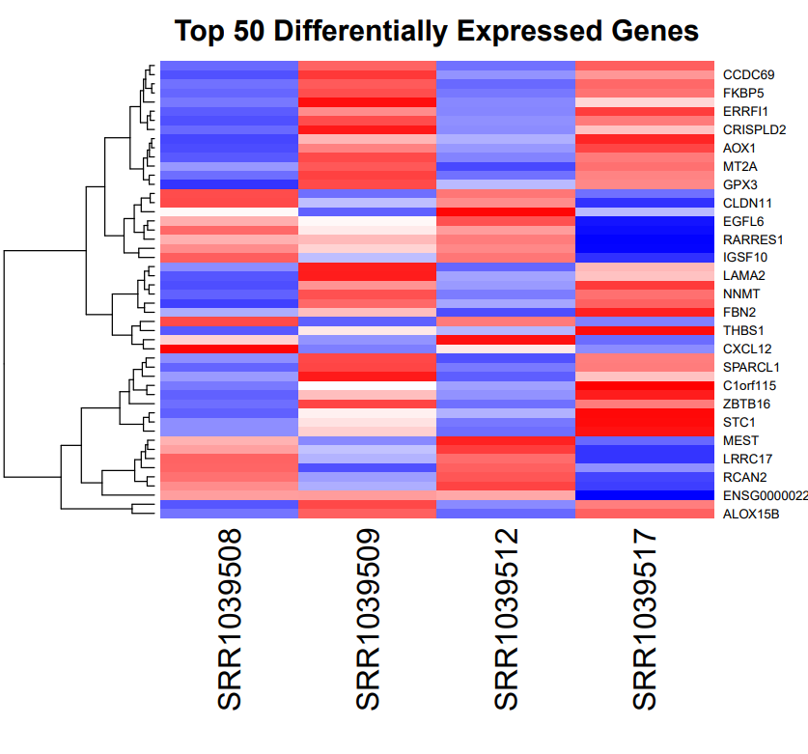
Question and Answers
Bioinformatics data analysis

Slide 3
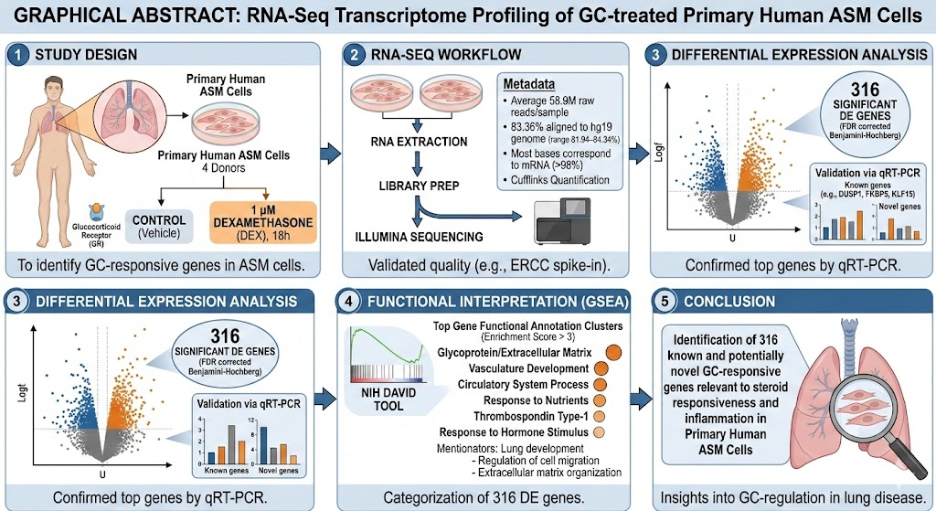
Case study
Analysis of RNA-seq data from human airway smooth muscle cells
Human Airway Smooth Muscle Cells (ASM) treated with Dexamethasone.

Slide 4
Case study
Analysis of RNA-seq data from human airway smooth muscle cells
Human Airway Smooth Muscle Cells (ASM) treated with Dexamethasone.

Slide 5
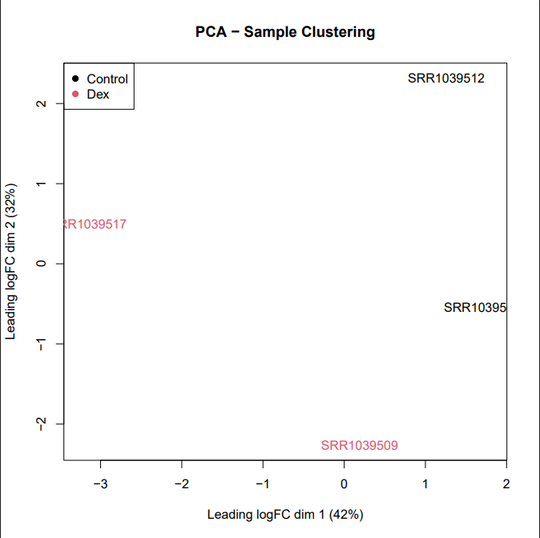
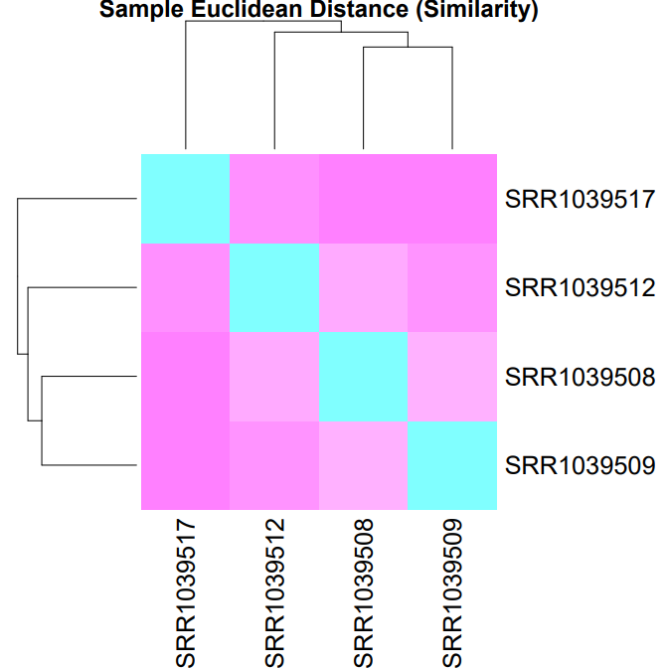
Global Differential Expression (DE) Response to Dexamethasone
Results interpretation
Glucocorticoid (steroid hormones) Treatment Drives Strong Transcriptomic Changes
Separation between Control and Dexamethasone-treated samples (PCA result)
Heatmap of top 50 DE genes shows strong clustering by treatment group
Large number of significantly changed (adj.p < 0.05) genes
Himes et al., 2014, doi:10.1371/journal.pone.0099625. eCollection 2014.
Notes:
You can say:
Glucocorticoids are anti-inflammatory steroid hormones used to treat asthma. They work by entering airway smooth muscle cells and changing gene expression. Our RNA-seq analysis shows how dexamethasone reprograms these cells at the transcriptional level, inducing anti-inflammatory genes like CRISPLD2.

Slide 6
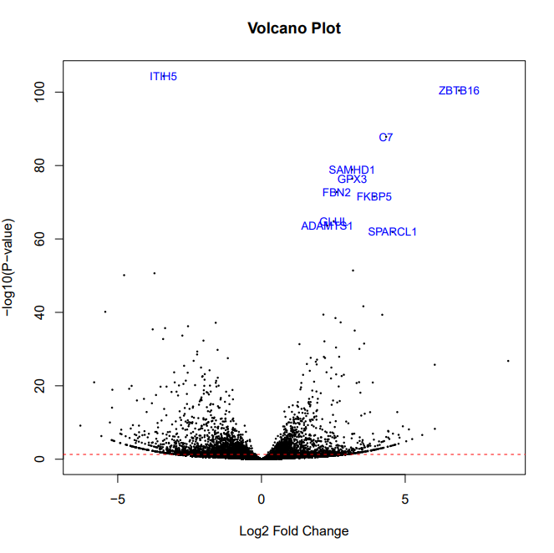
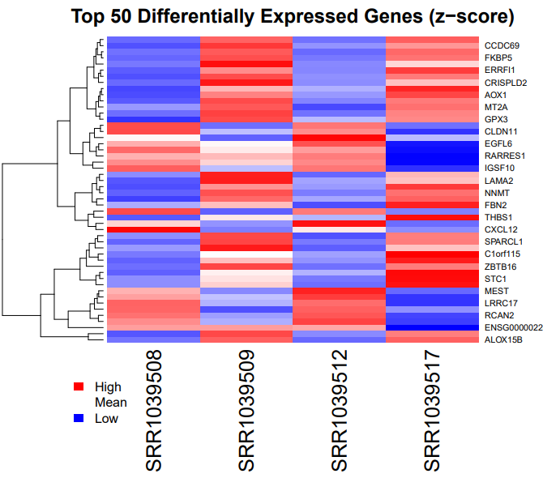
Global Differential Expression (DE) Response to Dexamethasone
Results interpretation
Glucocorticoid (steroid hormones) Treatment Drives Strong Transcriptomic Changes
Separation between Control and Dexamethasone-treated samples (PCA result)
Heatmap of top 50 DE genes shows strong clustering by treatment group
Large number of significantly changed (adj.p < 0.05) genes
Notes:
You can say:
Glucocorticoids are anti-inflammatory steroid hormones used to treat asthma. They work by entering airway smooth muscle cells and changing gene expression. Our RNA-seq analysis shows how dexamethasone reprograms these cells at the transcriptional level, inducing anti-inflammatory genes like CRISPLD2.

Slide 7
Global Differential Expression (DE) Response to Dexamethasone
Known Glucocorticoid Targets Are Strongly Upregulated
FKBP5 – classical glucocorticoid receptor target
ZBTB16
C7
GPX3
SAMHD1
FBN2
GLUL
CRISPLD2 (from original paper)
Notes:
You can say:
Glucocorticoids are anti-inflammatory steroid hormones used to treat asthma. They work by entering airway smooth muscle cells and changing gene expression. Our RNA-seq analysis shows how dexamethasone reprograms these cells at the transcriptional level, inducing anti-inflammatory genes like CRISPLD2.

Slide 8
Global Differential Expression (DE) Response to Dexamethasone
Known Glucocorticoid Targets Are Strongly Upregulated
FKBP5 – classical glucocorticoid receptor target
ZBTB16
C7
GPX3
SAMHD1
FBN2
GLUL
CRISPLD2 (from original paper)
Dex
Untreated
Notes:
You can say:
Glucocorticoids are anti-inflammatory steroid hormones used to treat asthma. They work by entering airway smooth muscle cells and changing gene expression. Our RNA-seq analysis shows how dexamethasone reprograms these cells at the transcriptional level, inducing anti-inflammatory genes like CRISPLD2.

Slide 9
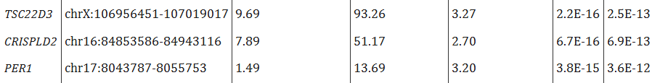
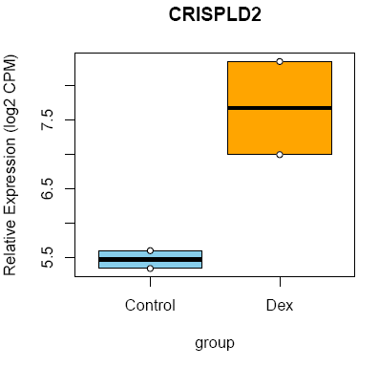
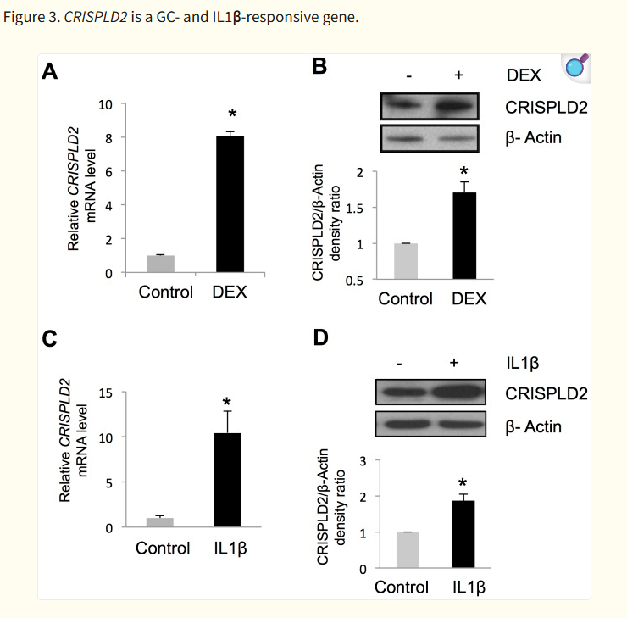
Global Differential Expression (DE) Response to Dexamethasone
CRISPLD2 as a Key Glucocorticoid-Responsive Gene
Strong upregulation on Dexamethasone treatment
Himes et al., 2014
Notes:
You can say:
Glucocorticoids are anti-inflammatory steroid hormones used to treat asthma. They work by entering airway smooth muscle cells and changing gene expression. Our RNA-seq analysis shows how dexamethasone reprograms these cells at the transcriptional level, inducing anti-inflammatory genes like CRISPLD2.

Slide 10




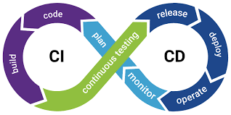

What comes next
Register to keep using Puli.
Join HCEMM’s bioinformatics network at GitHub: https://github.com/HCEMM/
Future workshops
Galaxy: a graphical interface for bioinformatics
Reproducible and structured analysis with workflow managers
Continuous integration and deployment in biotools deveopment

Slide 11
Thank you for your attention!
11

