Slide 1
Trolling

Slide 2
Topics
Basic information
Game mechanics
Platform, target audience
Characters
Story
Demo
Similar games
Questions

Slide 3
Basic information
Genre
Idea
Team

Slide 4
Game mechanics
3D (2D) 3rd person runner
Basic moves to sides and jumping
Interaction with other objects (destroying, usage, upgrades)
Collecting objects
Enemies
Portals
Interesting visual and sound experience

Slide 5
Platform, target audience
PC
Possibly other platforms
Target audience - people with likeness in animated worlds with interesting and funny story

Slide 6
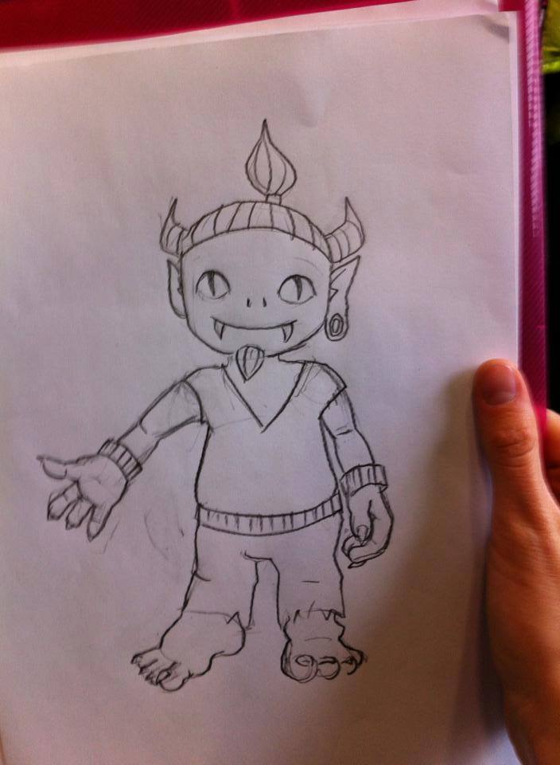
Characters
Only working names for now
Juma – main character
Friend – advisor
Main Enemy
Level enemies

Slide 7
Story
Start (tutorial level)
Troll is taken from his world
Trying to find his way home
And possibly save the world from the main enemy
Sub-bosses

Slide 8
Demo

Slide 9
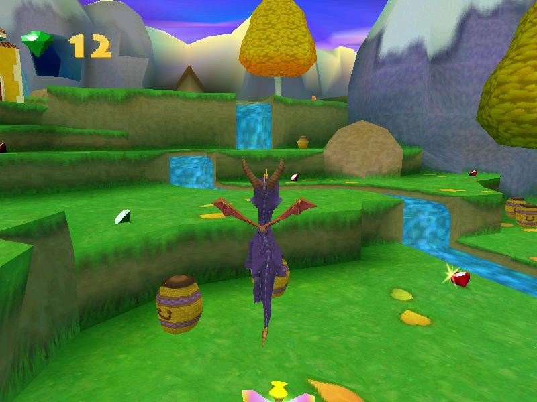
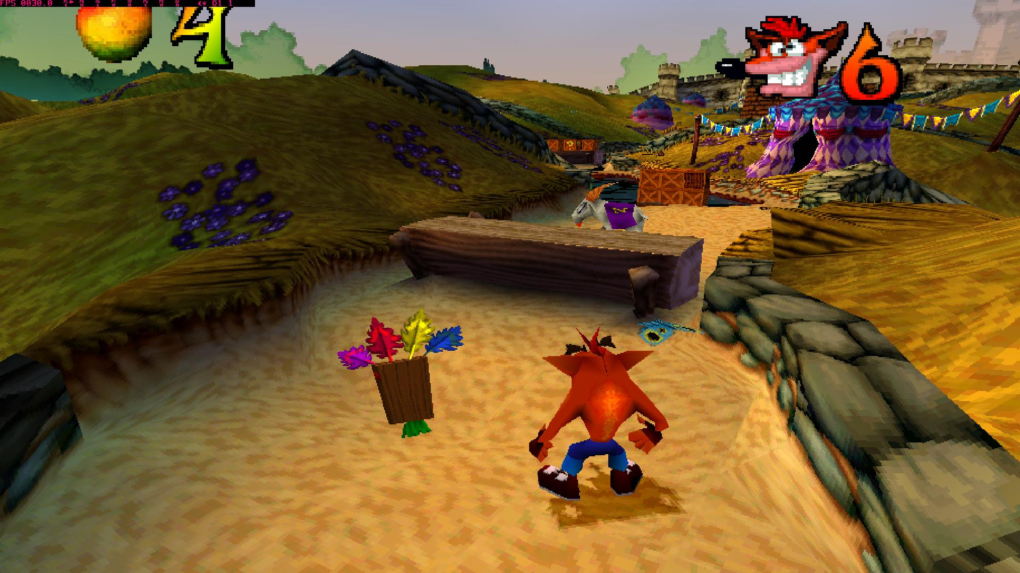
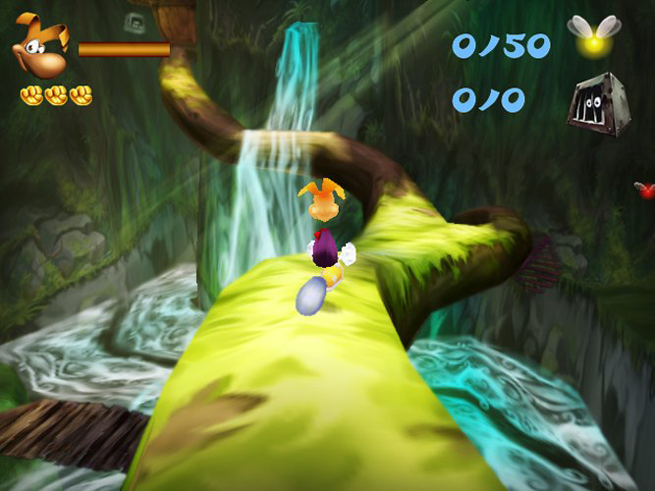
Similar games
Crash Bandicoot – main source of inspiration
Rayman
Spyro
Sly Copper

Slide 10
Questions

