Slide 1
E-Learning Platform - Microservices Architecture
System Design, Architecture, and Deployment Overview

Slide 2
Introduction
The E-Learning Platform is a scalable, microservices-based solution for schools.
It supports:
- Role-based access control (Admin, Teacher, Student)
- Content storage and retrieval
- Video conferencing for live classes.

Slide 3
Introduction
Quiz Creation and automated grading
File uploads for assignment and notes
Real time notifications.
Analysis and performance tracking.

Slide 4
High-Level Architecture
The platform uses:
- Frontend: React.js (web) + React Native (mobile)
- Backend: Multiple microservices (Node.js / Python FastAPI)
- Storage: AWS S3 for files, PostgreSQL for relational data
- Video: WebRTC-based video service

Slide 5
High Level Architecture
Messaging: RabbitMQ/Kafka for async events
Authetication: Oauth2+ JWT
Deployments: Kubernetes(EKS+GKE+AKS)
CI/CD: Github actions+ Helm

Slide 6
Microservices Overview
Core Microservices:
1. Auth Service – Manages user authentication and tokens
2. User Service – Manages profiles, roles, permissions
3. Course Service – Handles course creation, updates
4. Content Service – Manages uploaded content

Slide 7
Microservices Overview
Video Services: LIVE Classes, Video Steaming
Quiz Service: Quizzes , Grading
Notification Service: Emails, Push Notification
Analytics Service: Reports and insights

Slide 8
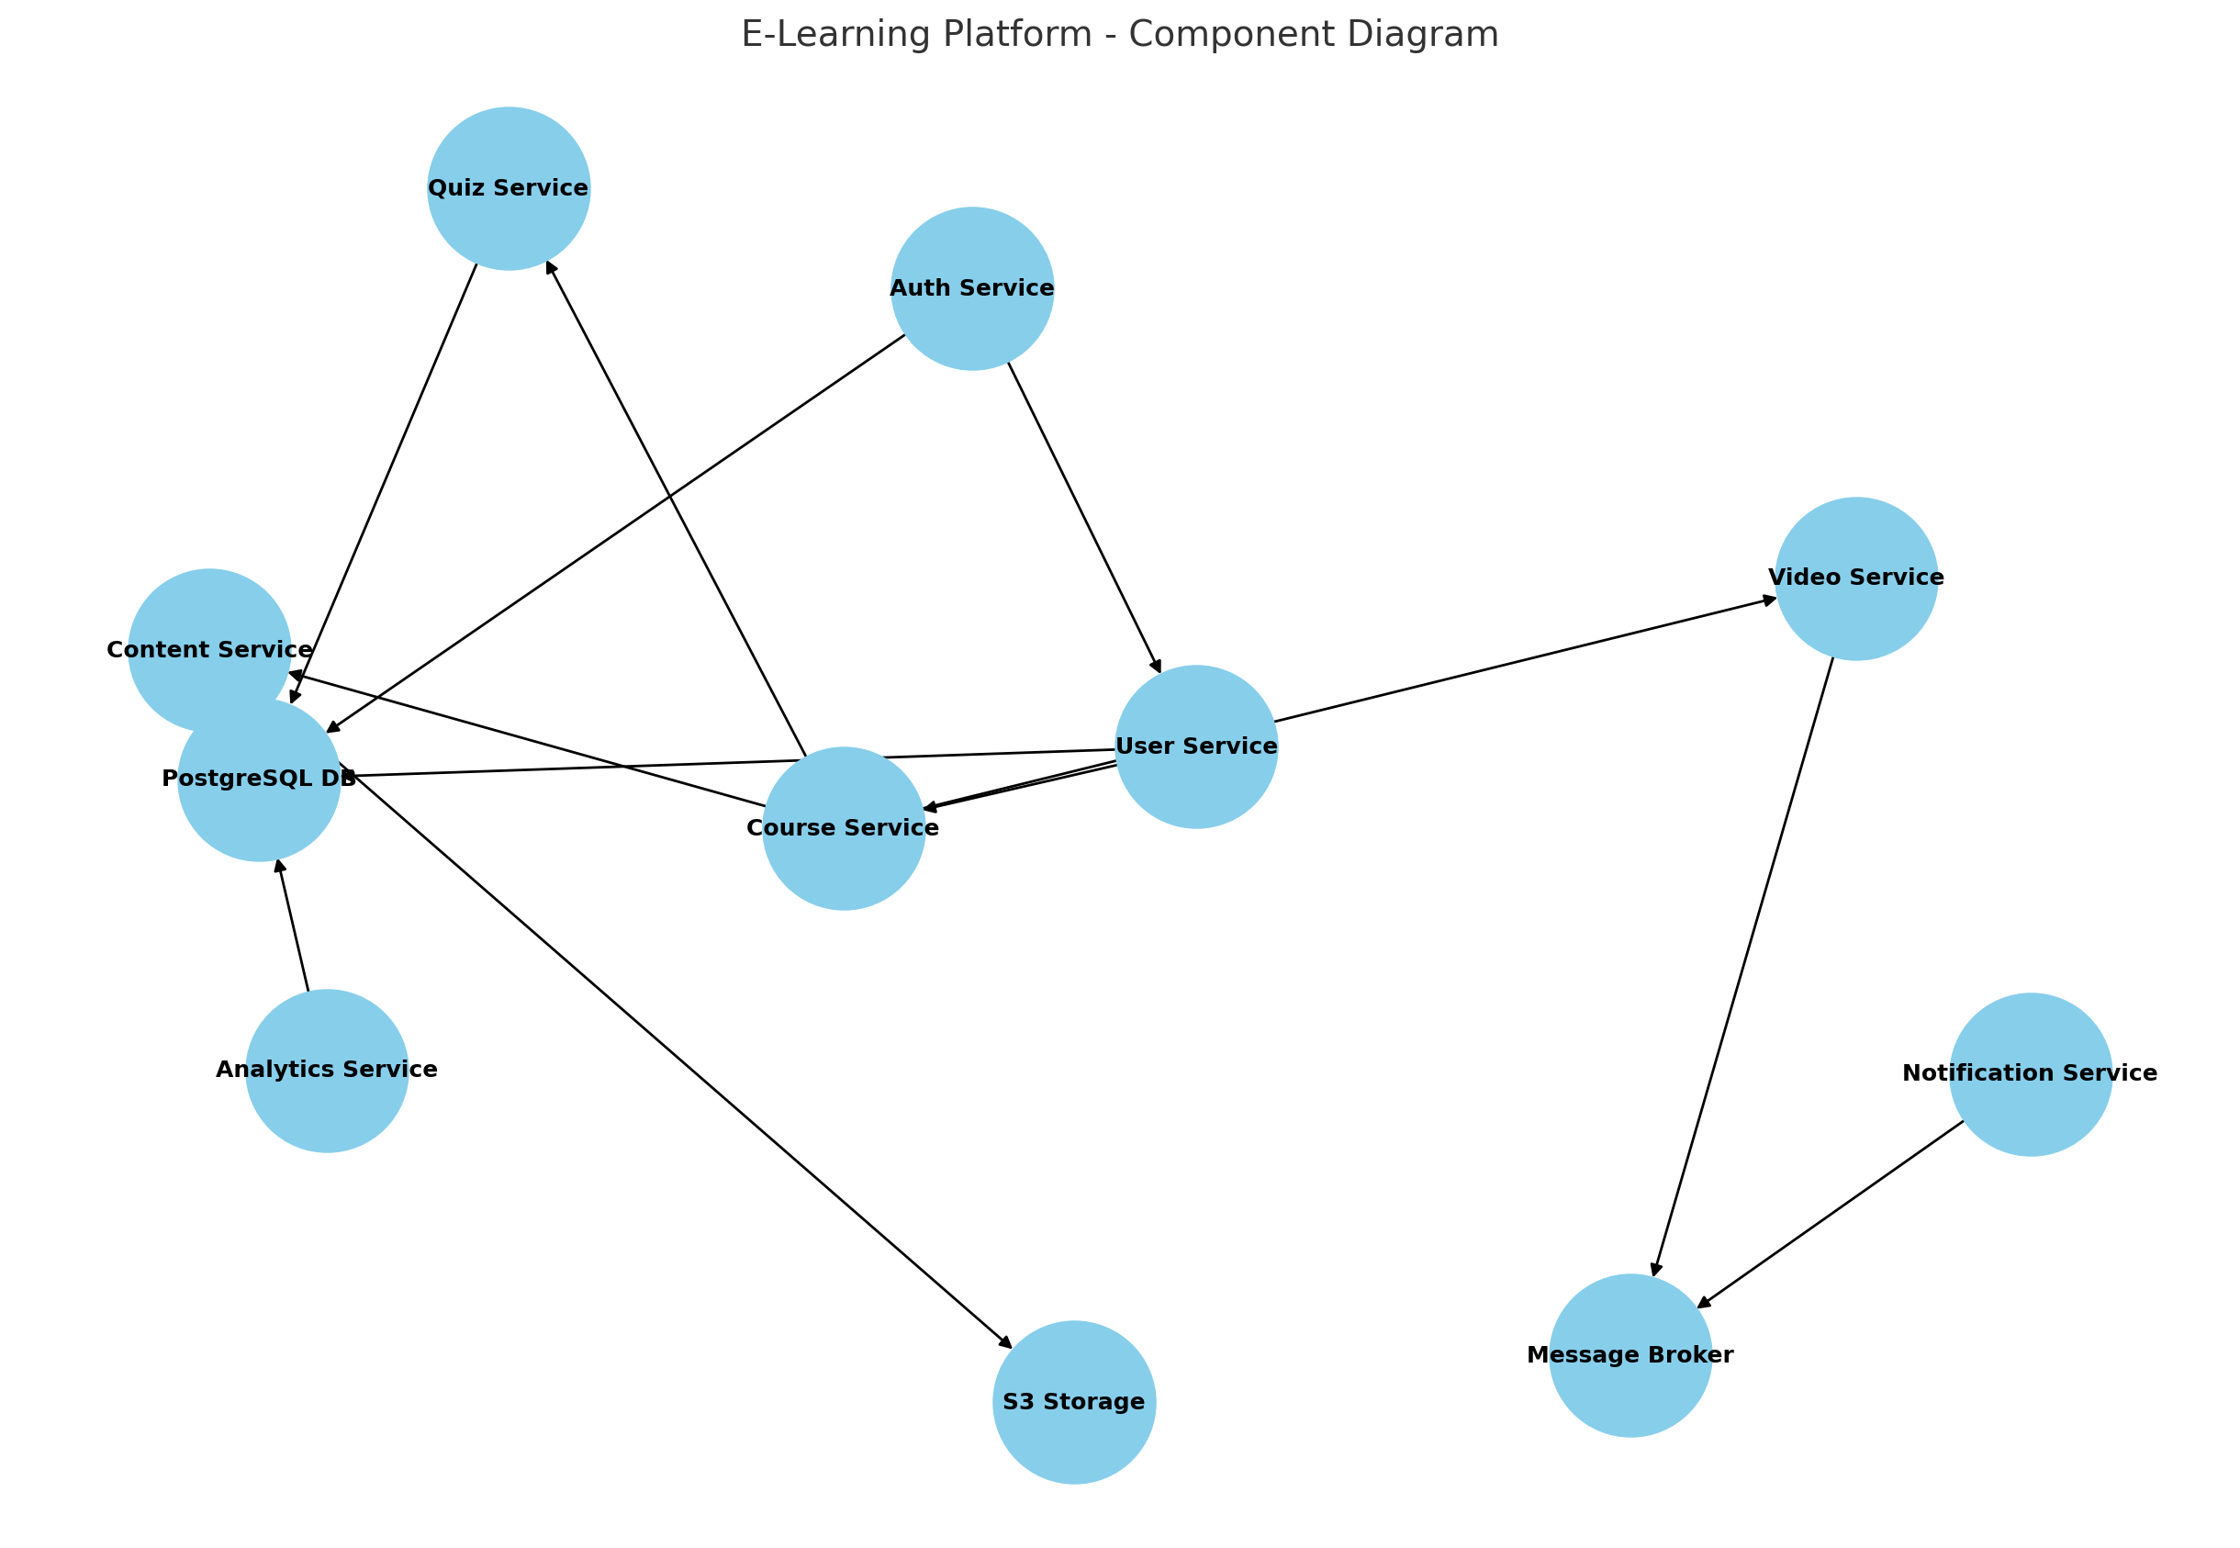
UML Diagrams

Slide 9
Database Schema
Database: PostgreSQL
Main Tables:
- users
- roles
- courses
- contents
- quizzes

Slide 10
Database Schema
quiz_results
notifications
analytics_logs

Slide 11
API Structure
OpenAPI 3.0 (Swagger) Specification:
- Auth: /login, /register, /refresh
- Users: /users, /users/{id}
- Courses: /courses, /courses/{id}
- Content: /content, /content/{id}
- Video: /video/start, /video/end
- Quiz: /quiz, /quiz/{id}, /quiz/{id}/submit
- Notifications: /notify, /subscribe
- Analytics: /analytics, /analytics/{id}

Slide 12
Kubernetes Deployment
Deployment Flow:
1. Dockerize each microservice
2. Push images to container registry
3. Deploy using Helm charts
4. Expose services via Ingress
5. Use HPA for auto-scaling

Slide 13
Terraform Infrastructure
Terraform creates:
- Kubernetes Cluster (EKS/GKE/AKS)
- S3 Buckets for content
- RDS PostgreSQL for relational data
- IAM roles and permissions

Slide 14
CI/CD Pipeline
Pipeline Stages:
1. Code checkout
2. Build & test
3. Docker build & push
4. Helm upgrade/install
5. Post-deployment verification

Slide 15
Scalability & Security
Scalability:
- Kubernetes HPA
- CDN for static content
- Async event processing
Security:
- HTTPS everywhere
- JWT & RBAC
- Encrypted data storage

