Slide 1
DSA project Semester 2 2019
Nhu Dinh Nam – ITITIU16114
Do Thai Anh Huy – ITITIU
Le Gia Vy – ITITIU
Tang Minh Khoi – ITITIU

Slide 2



Introduction to 2048 game

Slide 3
Feature and structure.
Feature
in one file HTML only.
Undo and redo function using Stack
Change its color (each point has special color to easily realize).
Structure
Javascript is put in <script> tag in HTML.
Using external CSS

Slide 4

Github Repository
https://github.com/HCMIU-CSE-DSA2019/2048

Slide 5
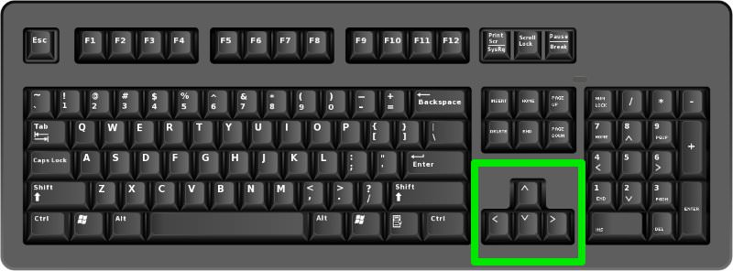
User guide
Using up, down, left, right array key to play game.
The user has to slide numbered tiles on a 4x4 grid in order to merge them into a tile of a higher value.
Merge tiles up to 2048 to win

Slide 6
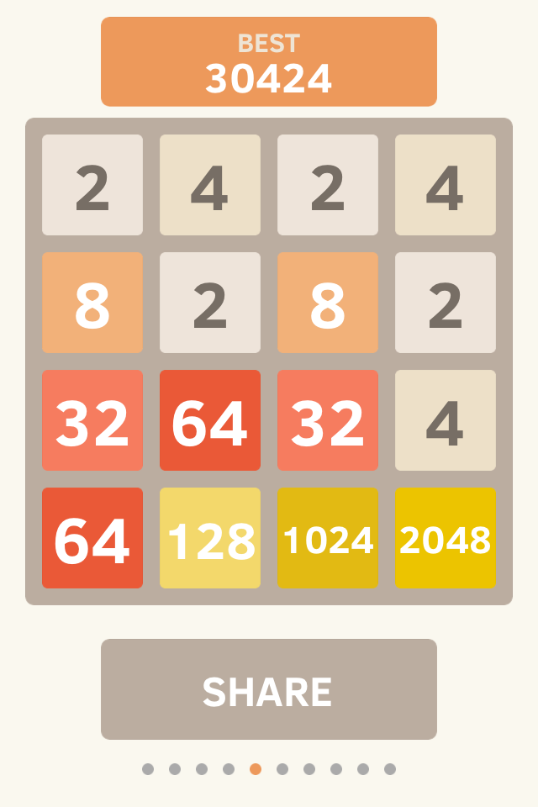
Win
Win if you can make a 2048 tile

Slide 7
Score.
How to calculate score.

Slide 8
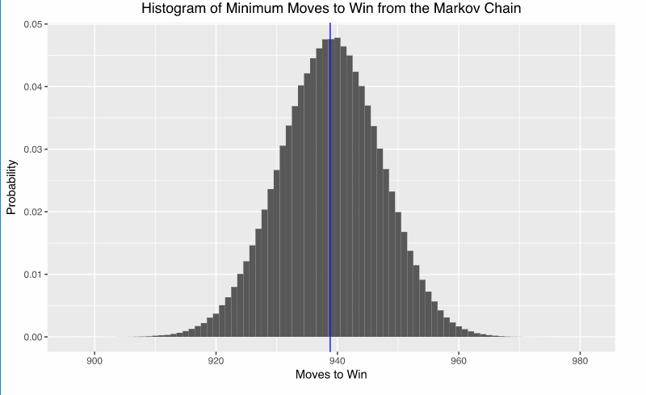
Minimum steps to win 2048 game
Using Makov Chain to find down the minimum steps to win the game.

Slide 9
Implementation

Slide 10
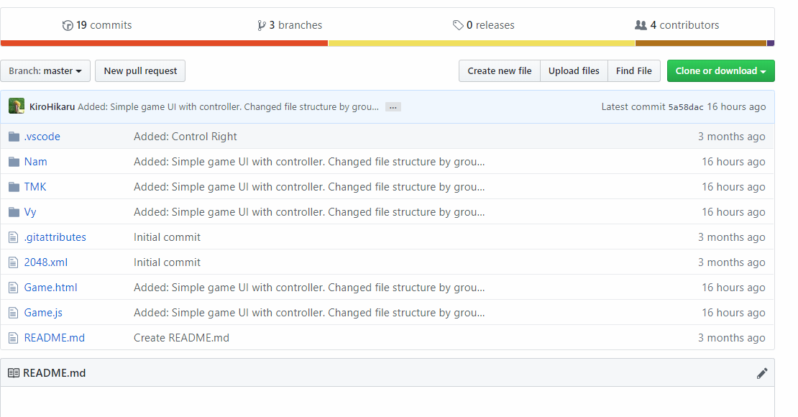
Install in other computer.
We share source code on github.
Another can clone it through link or download zip file.

Slide 11
Thank you for listening

