Slide 1
Haptic Collaborative Game
Instructions

Slide 2
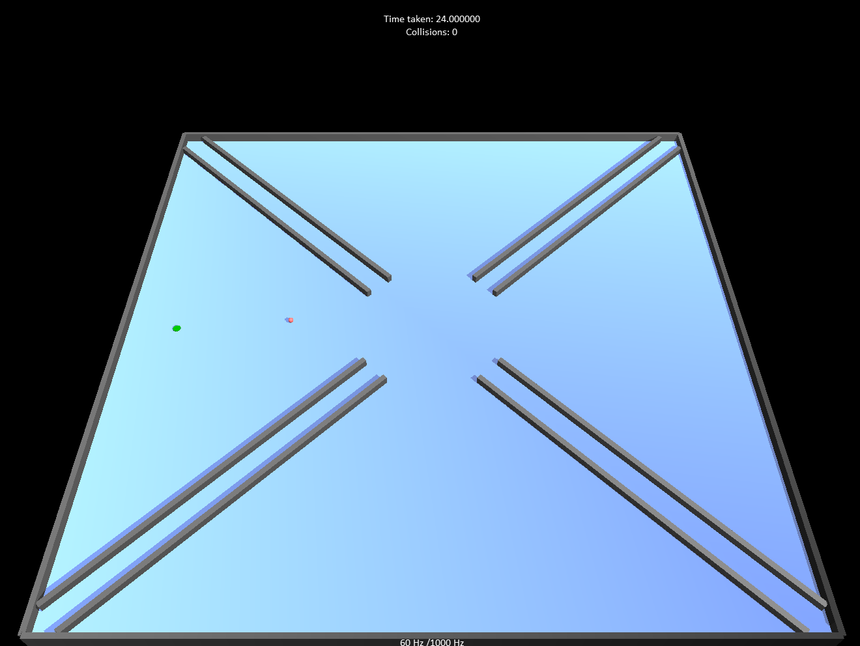
The Game
You are asked to move a ball to reach a series of checkpoints, represented as green circles at different locations in the scene.
In each game, you will visit 8 targets.
You need to move the ball as fast as possible without touching the walls and obstacles in the scene.
You will see a timer on top of the board that shows how well you perform.
The timer will run faster if you collide into an obstacle, so avoid hitting the walls.

Slide 3
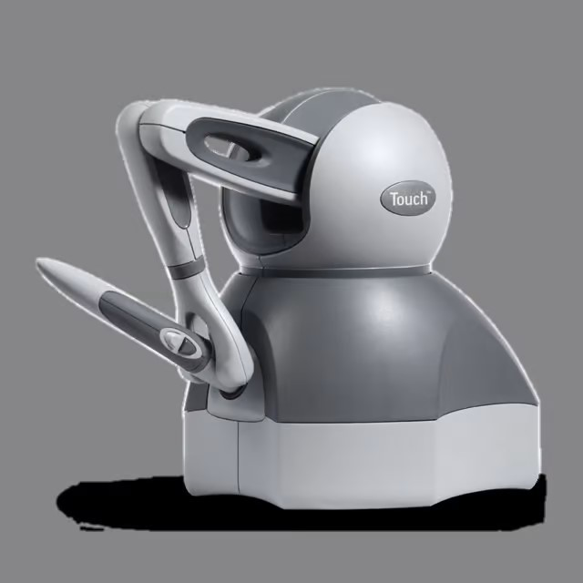
The device
To control the ball, you will use a haptic device
To move the ball left and right, move the pen left and right.
To move the ball up and down the plane, pull and push on the pen.
Pushing the buttons or moving the pen up or down will not have any effect in this study.
Please handle the device with your dominant hand

Slide 4
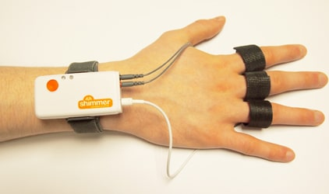
Skin Conductance Sensor
During the study you will be asked to wear a set of sensors to monitor your skin conductance level.
These will be similar to those that exist in smart watches and their use has no adverse effects.
Please place the electrodes at the base of your fingers of your non-dominant hand as instructed by the experimenter.

Slide 5
Experimental protocol
This experiment aims to investigate different control paradigms where the computer may take on different levels of autonomy.
You will play the game under different control conditions, where the robot will be able to take over the control from you and hand it back when appropriate. However how that decision is done may change across conditions.
You will play a practice game to see an example of robot control takeover.
After the practice, you will take a minute long GSR baseline reading before the experiment begins.

Slide 6
Experimental protocol
Consent -- Demographics questionnaire
Practice session – blank scene or an easier scene where there is no guidance – they finish at their own time no longer than 5 minutes
Baseline GSR close your eyes think of holiday
Session A – 5 trials x 8 targets
Questionnaire
B,C,D

