Slide 1
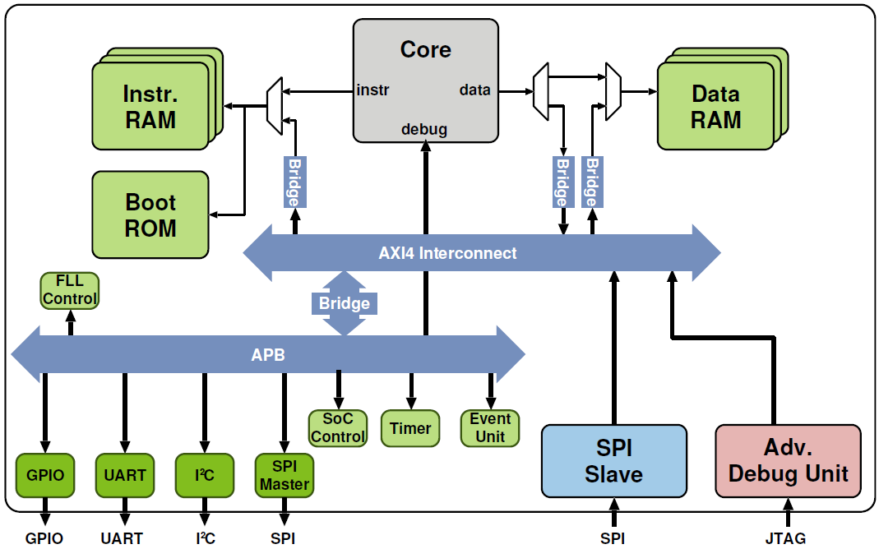
core_data
data_mem
core_instr
core_lsu
instr_mem
instr_ram_wrap
axi_instr
core_axi
axi_mem
peripherals
instr_slave
core_master
data_slave
slaves[2]
masters[2]
dbg_master
debug

Slide 2
ZYNQ / PS
LÓGICA
PROGRAMABLE
AXI3/PS Interconnect
AXI Converters
ARM
Cortex
A9
RiscV
RV32IMC
SPI Ctrl.
DDR Ctrl.
USB
ETHERNET
data
instr
ACP
debug
I/O
I/O
BRIDGE
JTAG 1
BRIDGE
AXI4 Interconnect
BRIDGE
FLASH 16MB
DDR3 1GB
APB
Adv
Debug
Unit
GPIO
UART
I²C
SPI
Master
Timer
Events
JTAG 2
I/O
I/O
I/O
I/O

