Slide 1



‘Best Way For Long Way’
Team Name: HCTP180

Slide 2

What We Do?
We presenting a seamless driving experience for long way truck drivers by our location recommendation engine.
Source: https://www.mercedes-benz.com/wp-content/uploads/sites/3/2018/08/01-mercedes-benz-trucks-2017-actros-1851-bm-963-3400x1440.jpg

Slide 3
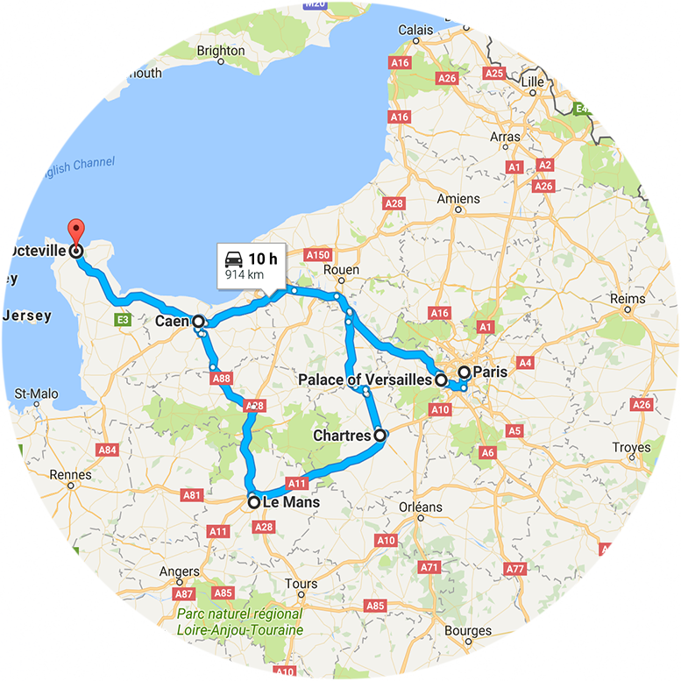

What are truck drivers pain points and needs at long way trips?
Maintenance points for truck health in emergency situations
Gas stations for fuel level
Social networking with other truck drivers in common meeting places.
Personal needs (nutrition, sleep etc.)
Planning for the best route
Driving alone
Source https://komarjohari.files.wordpress.com/2014/09/14c985_014.jpg

Slide 4




What MyWay really do to solve these issues?

Slide 5
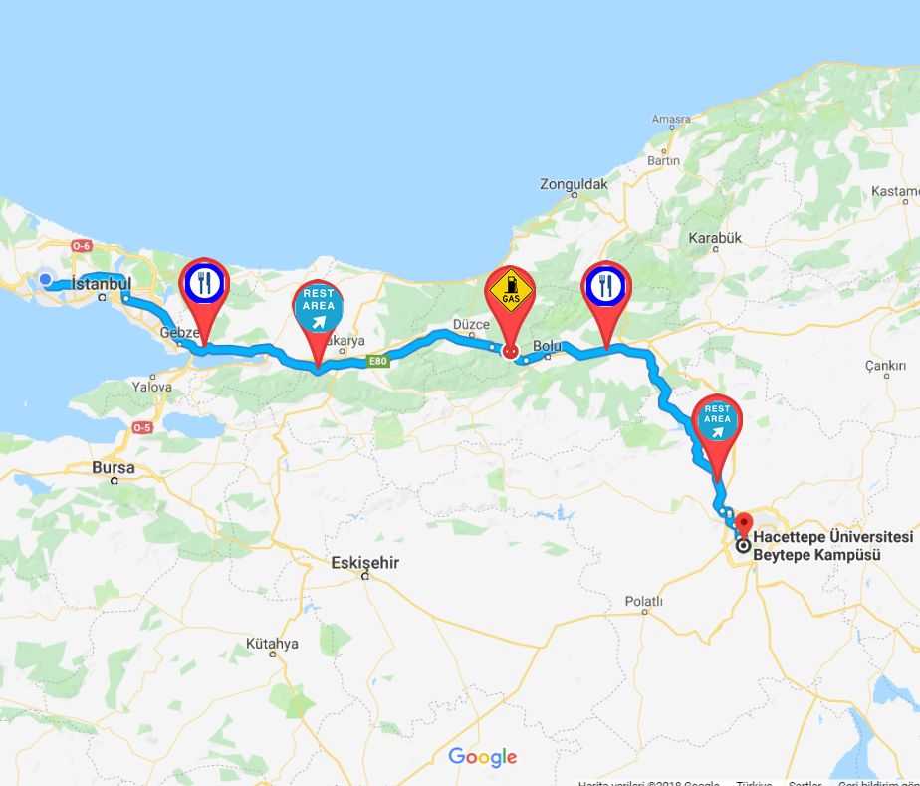
Here is some location examples that includes stop over places, restaurants, rest areas, gas stations and available service points.

Slide 6


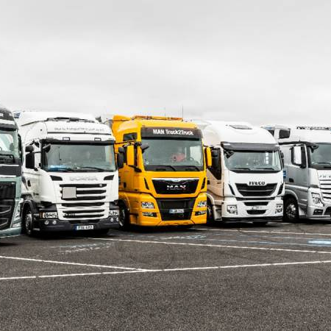
ADVANCED FEATURES OF MYWAY
Rate Places and Leave A Feedback
Recognize Sleep State & Fatigue Level
Define Common Meetıng Points For Drıvers
Source:
https://www.news-medical.net/news/20180305/Study-identifies-new-learning-approach-for-artificial-intelligence.aspx
https://www.acea.be/automobile-industry/trucks-vans-buses
https://www.hyatt.com/en-US/hotel/oregon/hyatt-place-eugene-oakway-center/eugzo

Slide 7

Benefits of MyWay
Let MyWay to offer best stop over locations for you wherever you go.
Offers a social trucking network
Just focus on the road and enjoy your drive.
Drivers feel happy and satisfied.
Applicable and sustainable solution.
Source: https://www.andamur.com/en/andamur-hints-to-find-job-as-a-truck-driver/

Slide 8
Thanks for listening.

