Slide 1


MSF Teleconsultation User Guide V2

Slide 2
Table of Contents
Signing In
Navigating the Platform
Create a Consultation Appointment
Consultation Details, Appointment Links and Pre-consultation Chat
Start a Consultation
Screen Sharing
Chat
Leave/End a Call
Finalize a Consultation
Consultation Log
Appointment Views
Update Platform Language

Slide 3
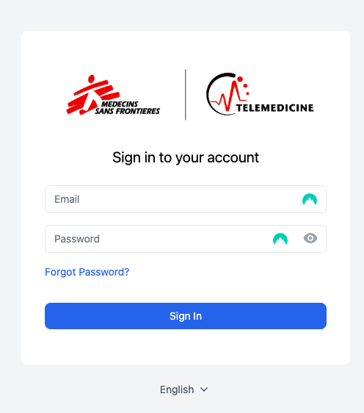
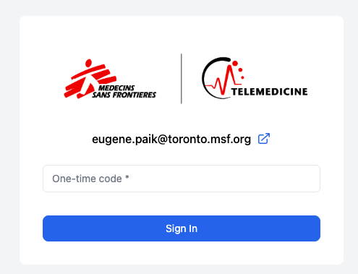
Signing In
Open the MSF Video Consultation platform on your device browser: https://msf.connect.hcw-at-home.com/
Enter your email
Enter your password
Click on ”Sign In”
Enter your verification code and click on “Sign In”

Slide 4
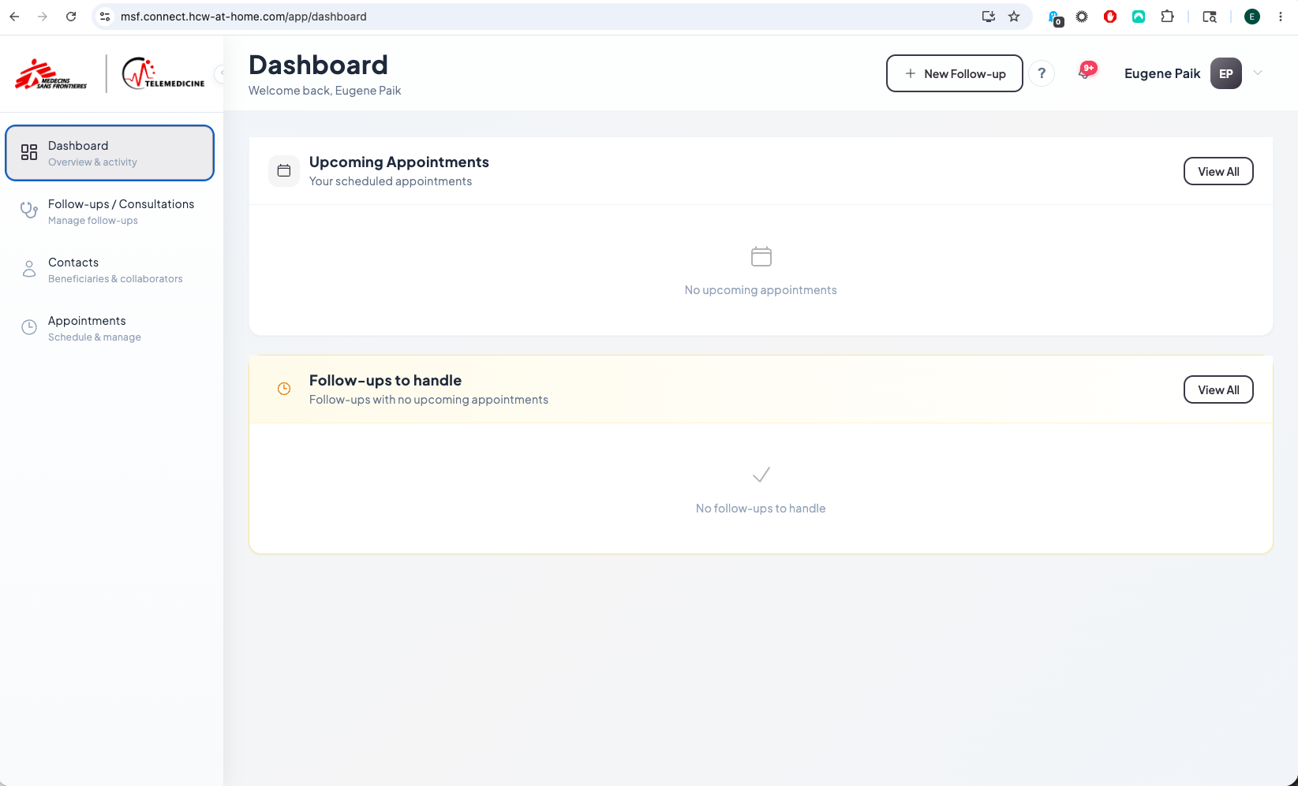
Navigating the Platform
Dashboard – home screen with upcoming appointments and follow-ups
Follow-ups / Consultations – List of upcoming, current and past follow ups/consultations
Appointments / Reminders – List or Calendar view of appointments and reminders

Slide 5
Consultations
There are 2 different types of consultations that can be created with a few key differences:
Follow-up: A follow-up appointment allows you to create an appointment that includes the possibility to chat with participants before the consultation and enter additional consultation notes that can be viewed by the patient and any invited colleagues. The 24 hour to delete time period also does not begin immediately after the end of the consultation but rather once you close the follow-up.
Regular Appointment: A regular appointment does not have any shared consultation notes and does not allow you to have any pre-chat or chat during the consultation and will follow the standard 24 hour deletion once the consultation has been concluded. This is NOT recommended

Slide 6
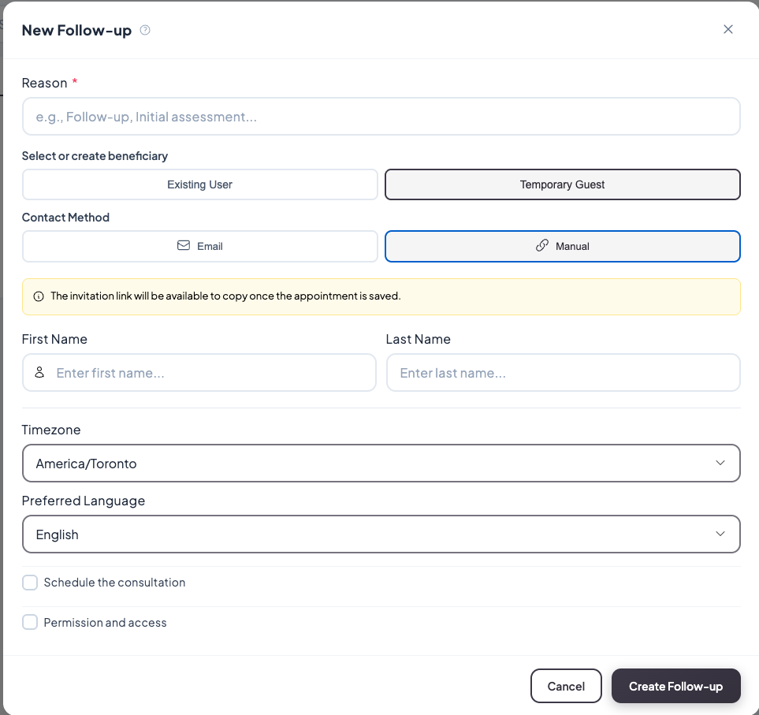
Create a Consultation Appointment
1. Click on “+ New Follow-up”
2. Enter a Reason for the Follow-Up
3. Select Temporary Guest and Manual
4. Enter an identifier for the patient (can be any alphanumeric text)
5. Tick “Schedule the consultation”

Slide 7
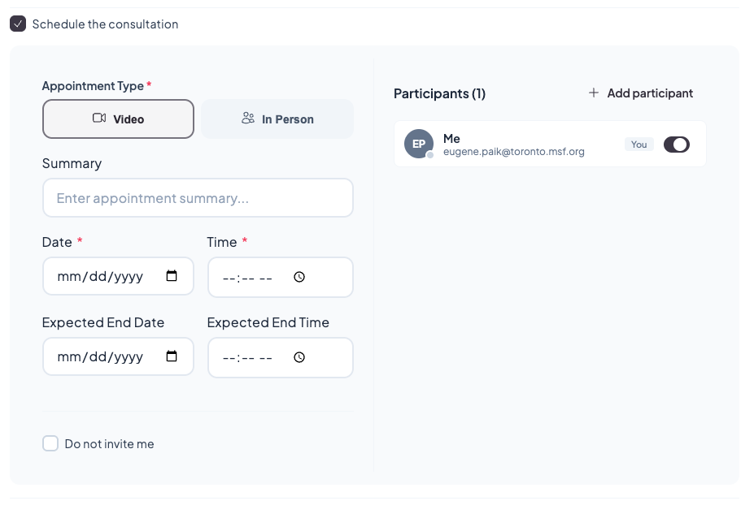
Create a Consultation Appointment
1. Select ”Video”
2. Select the Date and Time

Slide 8
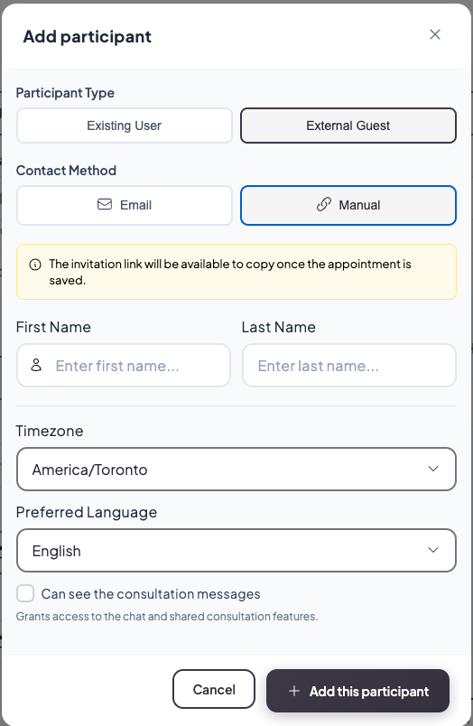
Create a Consultation Appointment
1. Select ”External/Temporary Guest”
2. Select “Manual” if you will manually share the appointment link or Select “Email” if you will send invite via email
3. Enter an identifier for the invitee - please note that you do not need to enter an actual name
4. Timezone will adjust automatically and you can set the preferred language but if using the Manual option, this will not matter
5. Tick “Can see the consultation messages” if you would like to be able to chat with the invitee pre-consultation and during the consultation
6. Select “+ Add this participant” – you can add as many participants as required

Slide 9
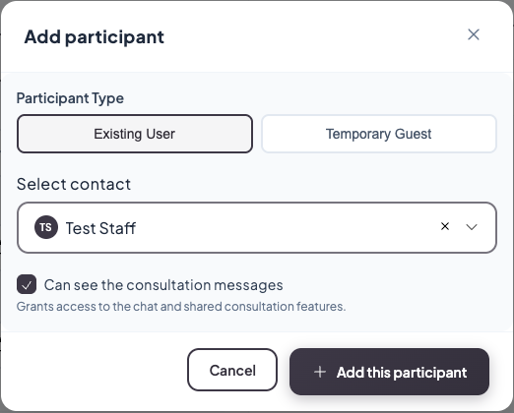
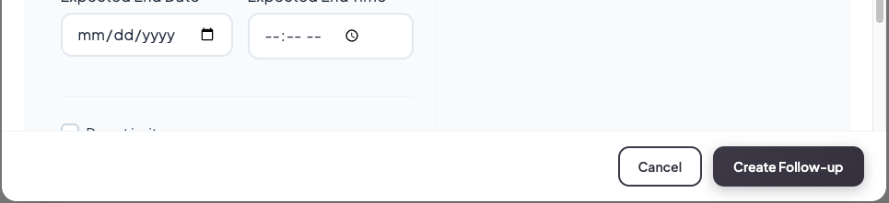
Create a Consultation Appointment
1. To add existing project colleagues with an account on the platform, select ”Existing User”
2. Select contact from the drop down list
3. Tick “Can see the consultation messages”
4. Select “+ Add this participant”
5. Select “Create Follow-up” once all participants have been added

Slide 10
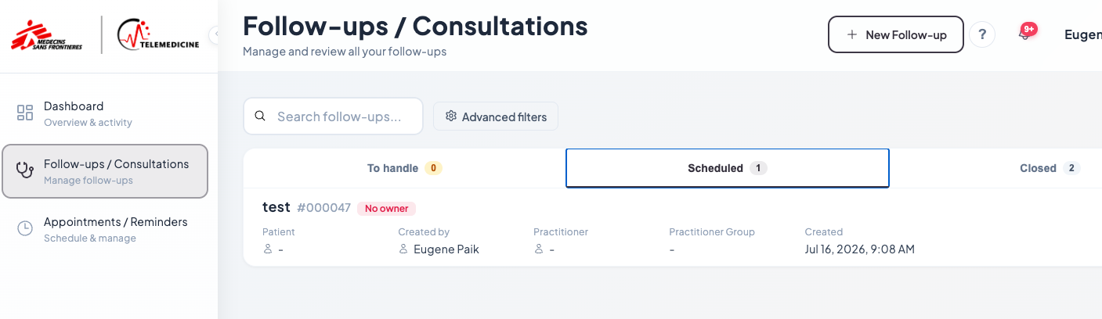
Consultation Details, Appointment Links and Pre-Consultation Chat
1. After creating the Follow-up go to Follow-ups/Consultations and Scheduled
2. Click on the consultation to open the Follow-Up details

Slide 11
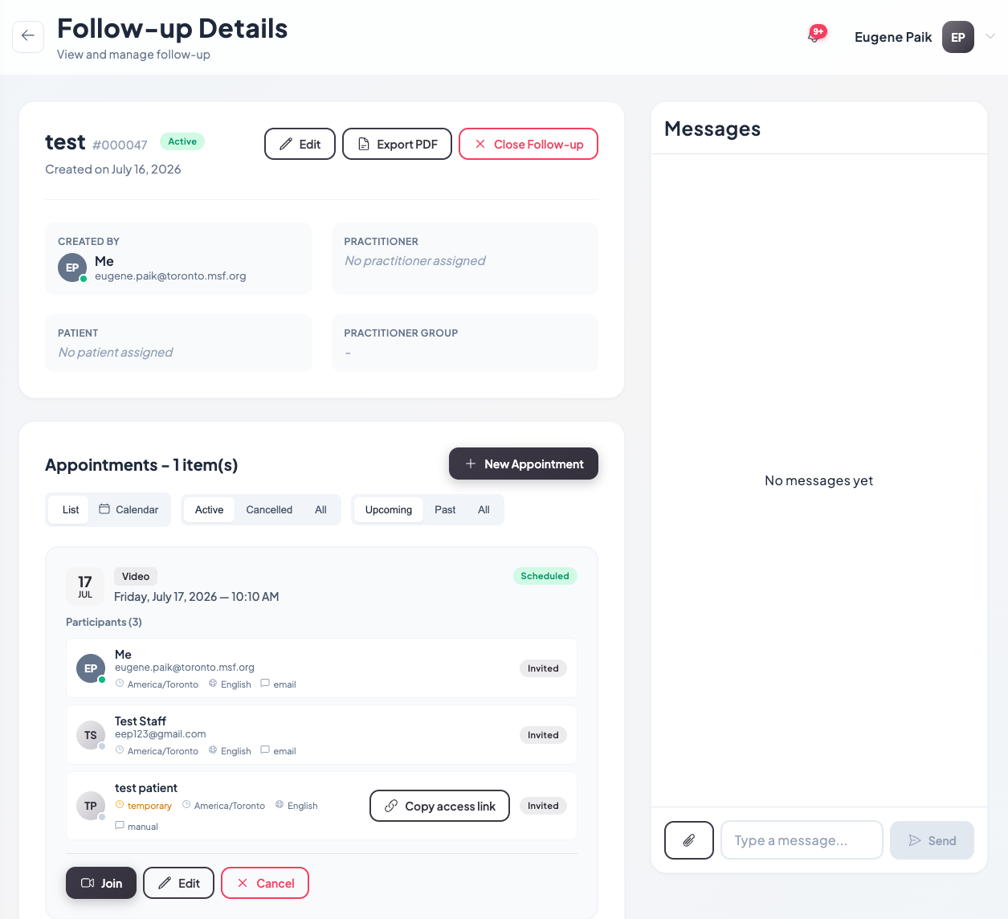
Consultation Details, Appointment Links and Pre-Consultation Chat
1. Follow Up Details – See the summary of the details entered when creating the consultation
4. Pre-consultation chats can be sent and viewed here if activated when creating the follow-up
2. Appointment/Call Participants and Links – you can edit participants, copy the appointment links for participants and start the call here
3. Edit or Cancel an appointment

Slide 12
Start a Call
1. Click Join to start the call

Slide 13
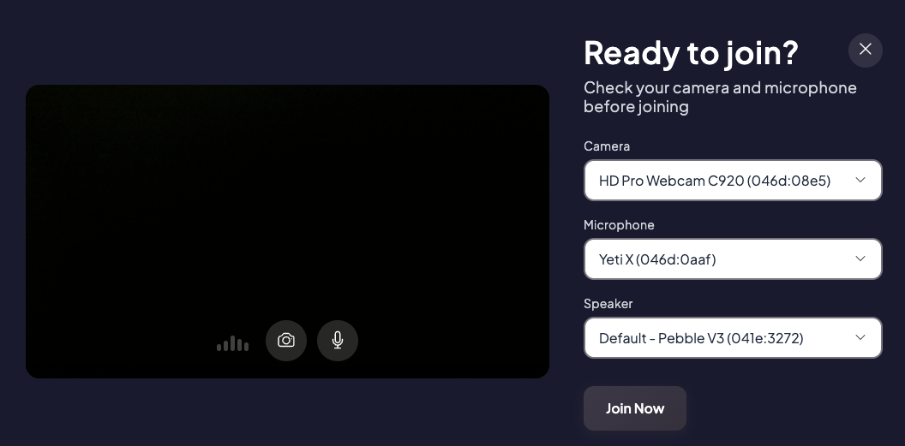
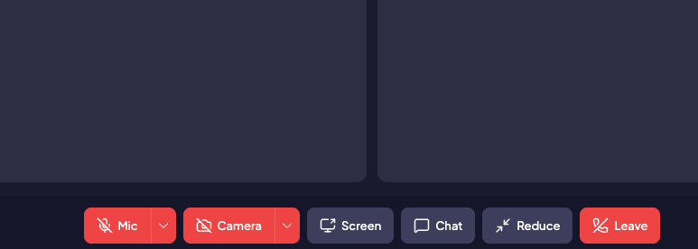
Start a Call
1. Confirm your device settings and click ”Join Now”
Mute/Unmute
Enable/Disable video
Share screen
Open Chat
Minimize Call Window (will not hang up the call)
End Call

Slide 14
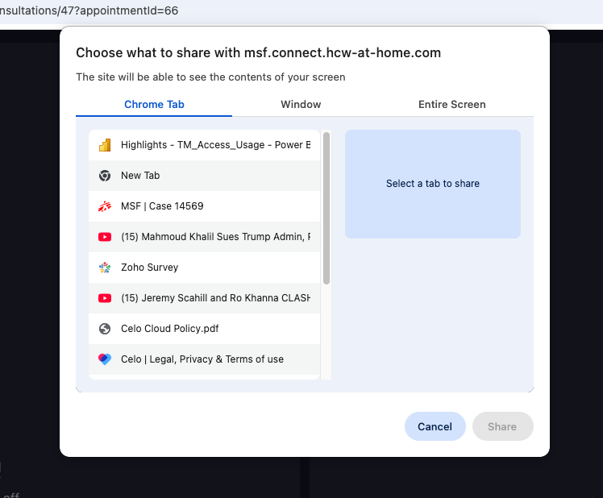
Screen Sharing
1. Select “Screen”
2. Select what you would like to share and click Share
Note: You may need to adjust your device permissions to allow screen sharing of certain applications

Slide 15
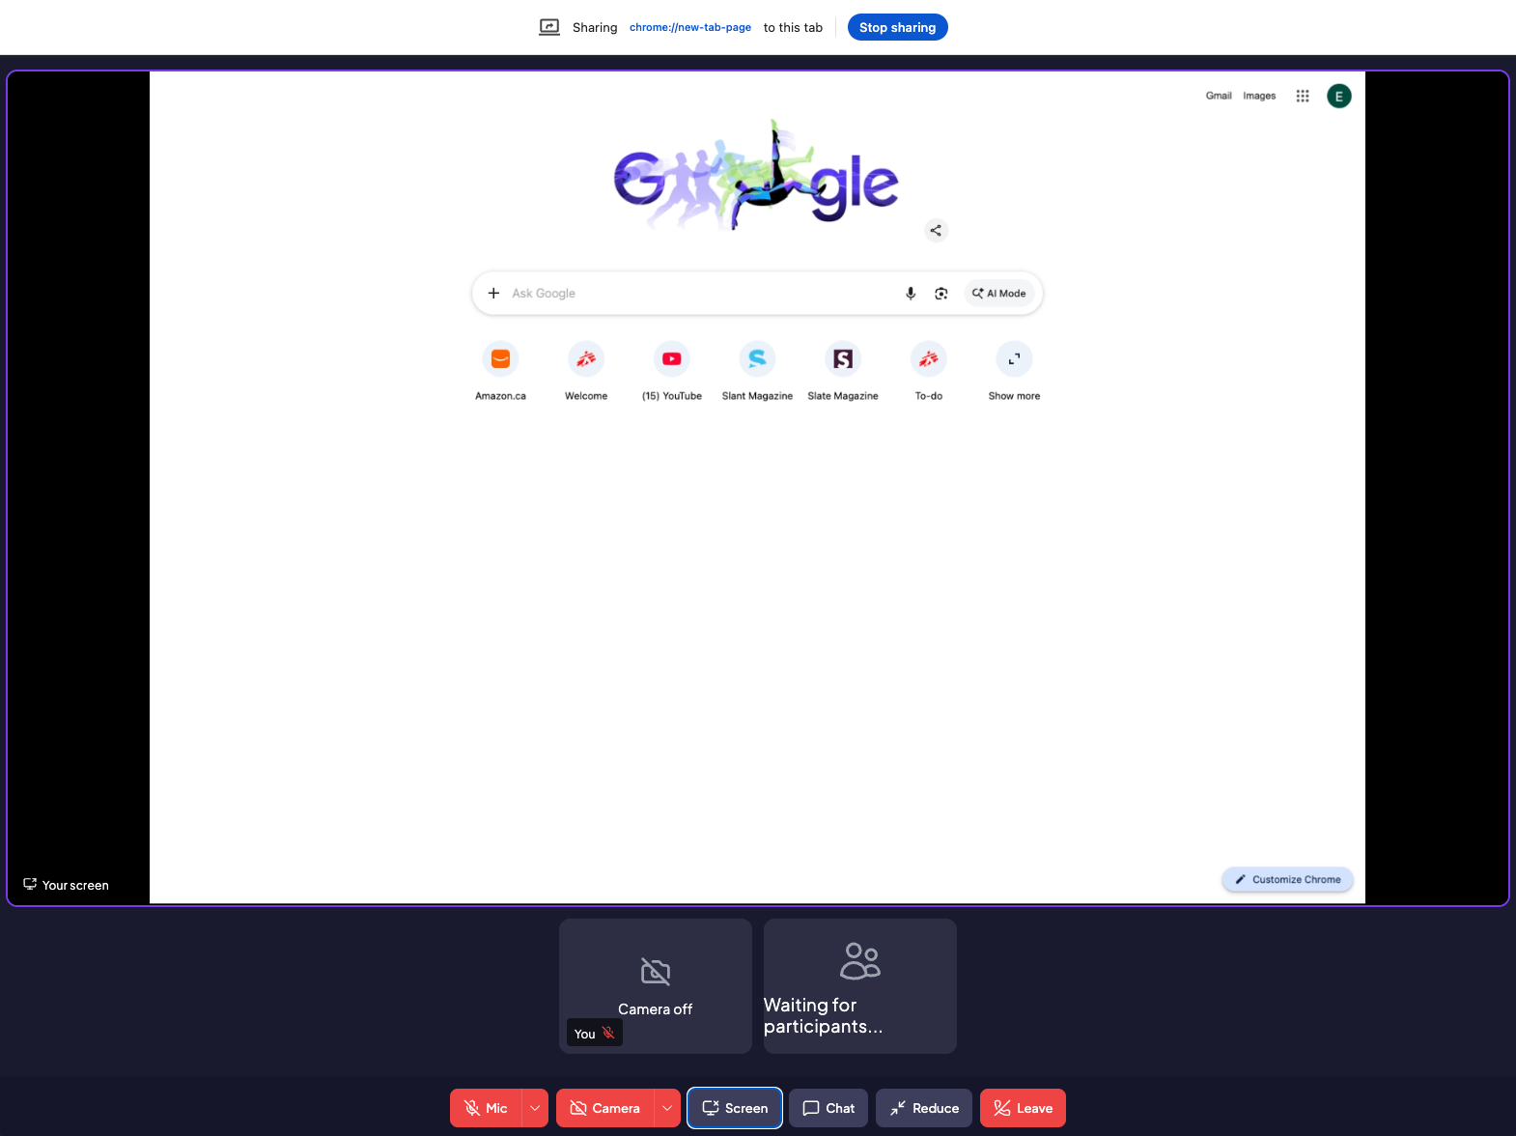
Screen Sharing
3. You should now see the screen that you are sharing within the call
4. Click “Stop Sharing” to end screen sharing

Slide 16
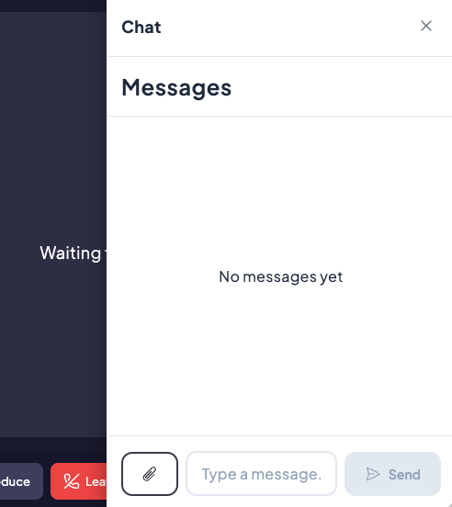
Chat
1. You can start a chat in the Follow-Up menu if pre-consultation chats are activated or start/continue during a call by clicking on ”Chat”
2. Send messages and attachments in the chat window
Note: Maximum file size is 10MB

Slide 17
Leave/End Call
1. Click on “Leave” to leave the call. The consultation will end once all participants have left the call.

Slide 18
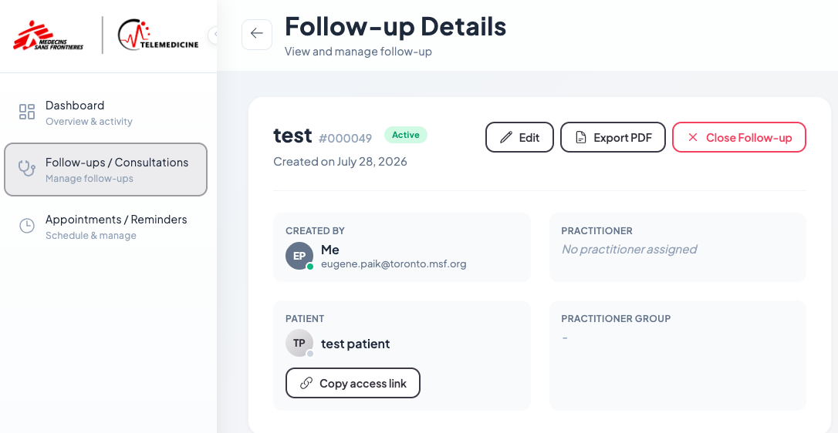
Finalize Consultation
1. Once you have finalized and completed a follow-up/consultation, click on ”Close Follow-up.” This will begin the 24 hour countdown before the consultation is deleted permanently from the system
2. During the 24 hour period, you can save some consultation details by clickin on “Export to PDF”

Slide 19
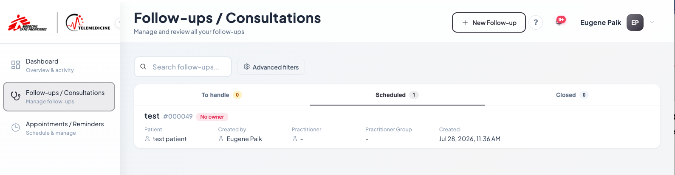
Consultation Log
You can view your current, scheduled and closed (for 24hours) follow-ups in the Follow-ups/Consultation menu by moving between the 3 tabs on the screen.
You can then view the details and associated appointment details by clicking on the specific consultation

Slide 20
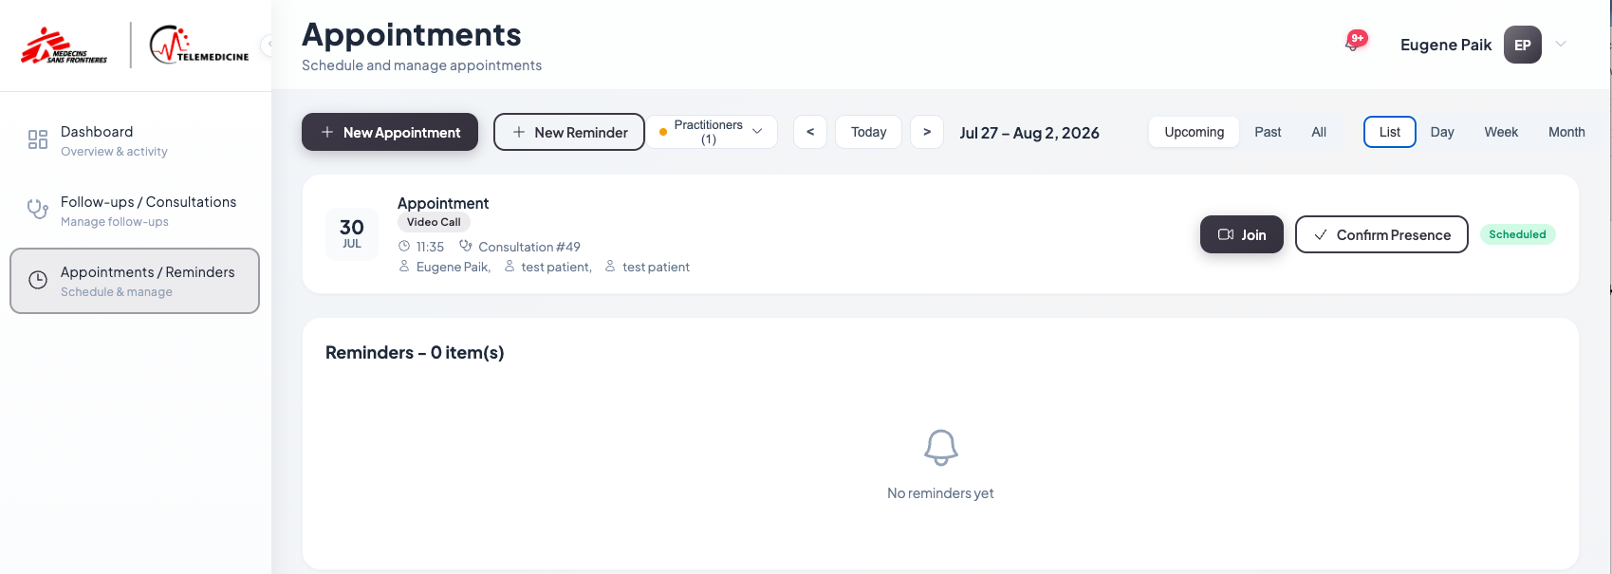
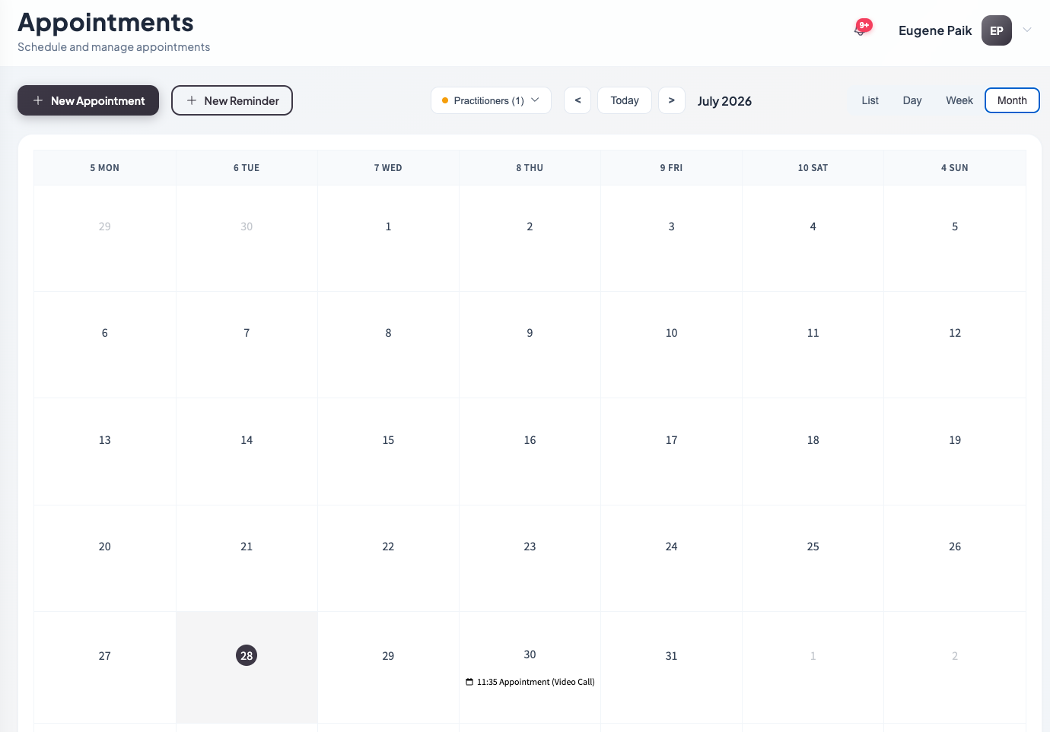
Appointment Views
Appointments can be viewed in a list view or a daily/weekly/monthly calendar view.
Go to the Appointments/Reminders menu and select the view that you prefer:

Slide 21
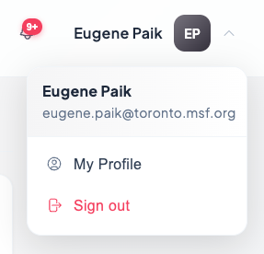
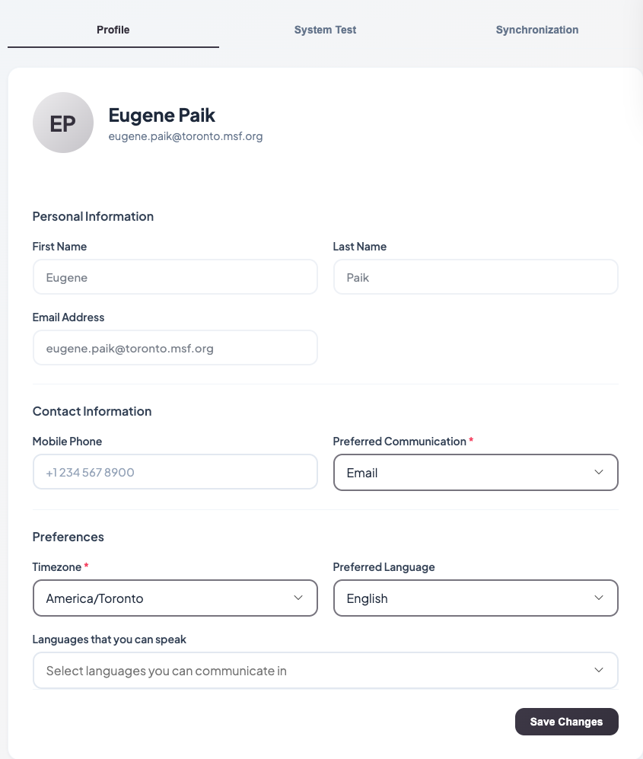
Update Platform Language
1. Select your name in the upper right corner of the platform to open the menu and select My Profile
2. Select your Preferred Language from the drop-down menu. Click on Save Changes.

