Slide 1


Cybersecurity Awareness Chatbot
A console-based chatbot designed to educate users about online safety. It simulates real-life cybersecurity scenarios and provides practical guidance.
Presented by Naoyuki Christopher Higaki
ST10462415
PROG6221
Notes:
‹#›

Slide 2
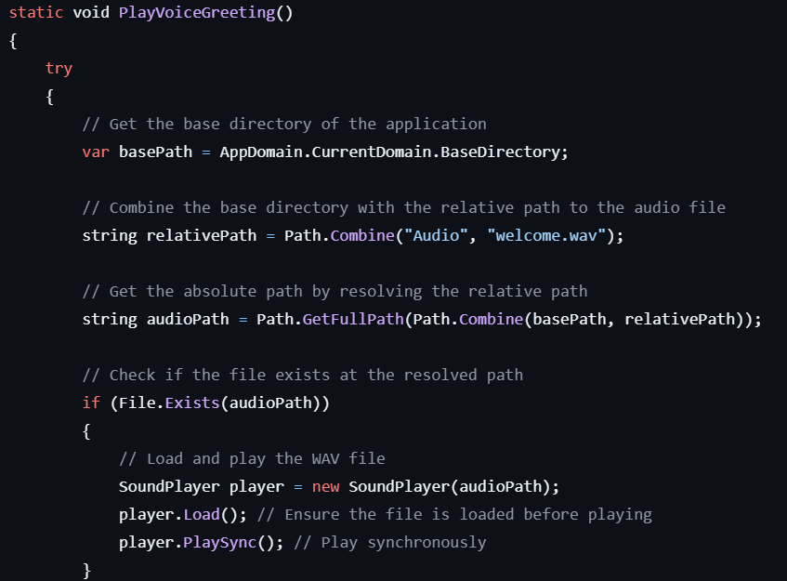
Voice Greeting
1
Personalized Touch
Plays a welcome message using 'System.Media.SoundPlayer'.
2
Error Handling
Checks if the audio file exists; displays an error if missing.
3
Engaging
Adds a personalized touch, making the chatbot more engaging.
Notes:
‹#›

Slide 3
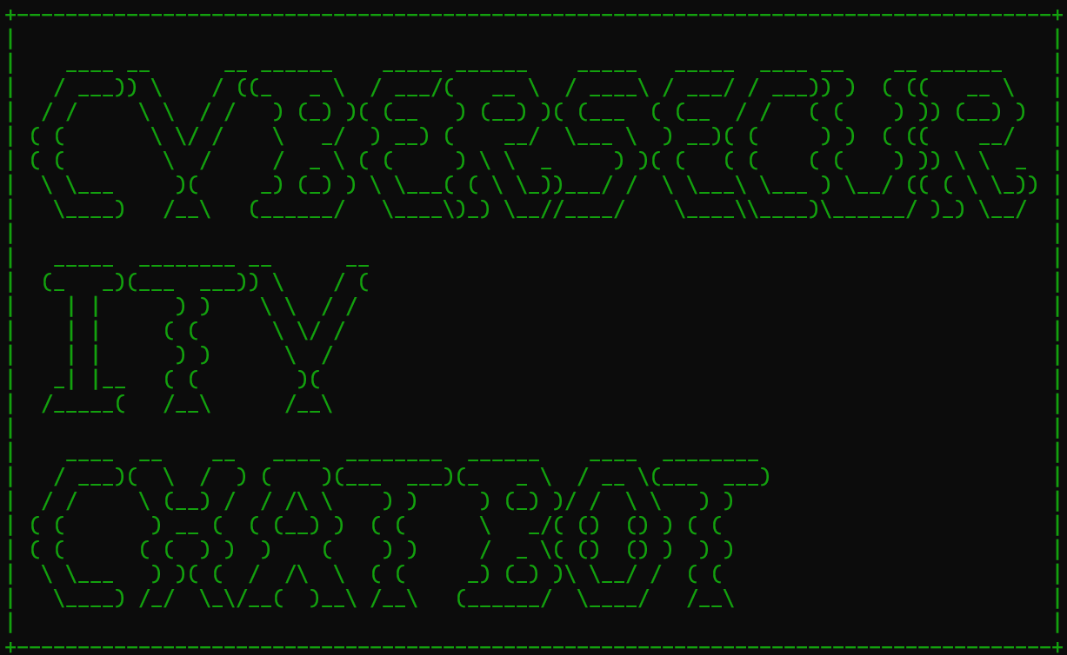
ASCII Art Display
Visual Appeal
Text Color
Displays a cybersecurity-themed logo when the chatbot starts.
Uses 'Console.ForegroundColor' to set text color to cyan.
Professionalism
Enhances the visual appeal and professionalism of the chatbot.
Notes:
‹#›

Slide 4


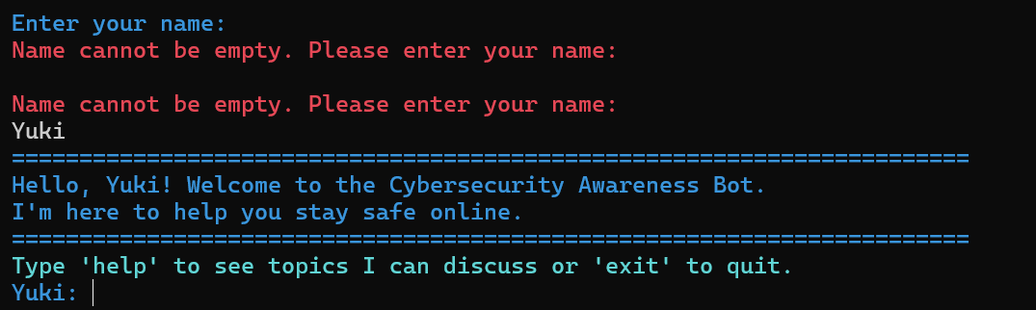
User Interaction
Personalized
Input Validation
Welcoming
Asks the user for their name and welcomes them.
Displays a personalized welcome message.
Validates the input to ensure it's not empty.
Notes:
‹#›

Slide 5
Chatbot Conversation
Keyword Responses
Educational Value
Typing Effect
Uses a dictionary to store keywords and responses.
Provides educational value and simulates a natural conversation.
Displays the corresponding response with a typing effect.
Notes:
‹#›

Slide 6



Enhanced Console UI
Color Formatting
Uses 'Console.ForegroundColor' for colored text.
Borders and Dividers
Adds borders and dividers for structure.
Typing Effect
Simulates a typing effect for chatbot responses.
Notes:
‹#›

Slide 7
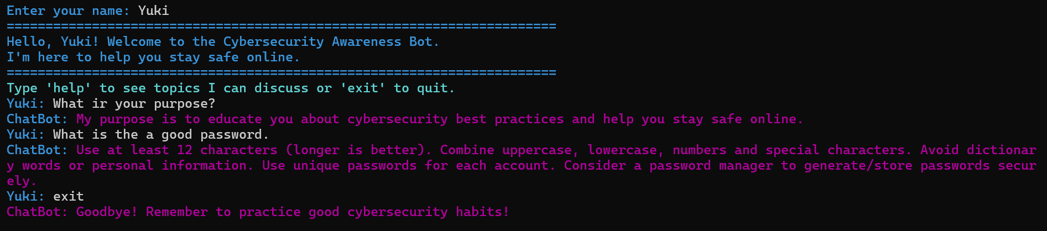
Notes:
‹#›

Slide 8
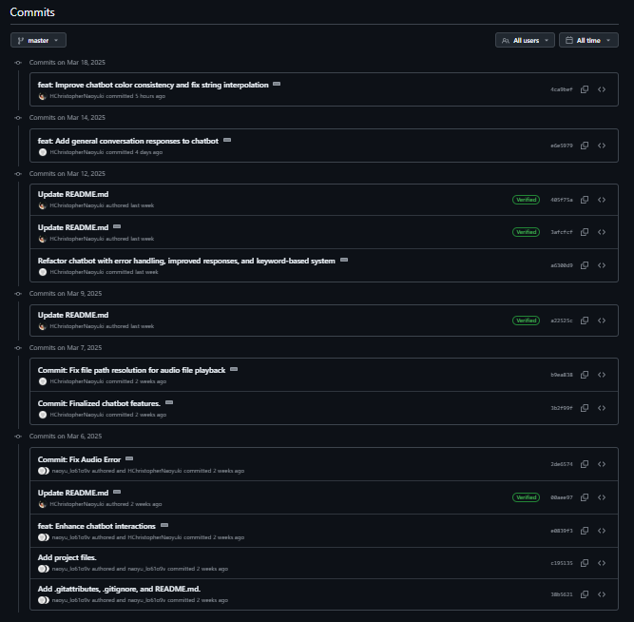
GitHub and Continuous Integration
1
Version Control
Uses GitHub for version control.
2
Meaningful Commits
Made at least three meaningful commits.
3
Automated Checks
GitHub Actions check for syntax errors.
Notes:
‹#›

Slide 9

Conclusion
The chatbot features voice greeting, ASCII art, personalized interaction, cybersecurity responses, input validation, and enhanced UI.
Notes:
‹#›

