Slide 1
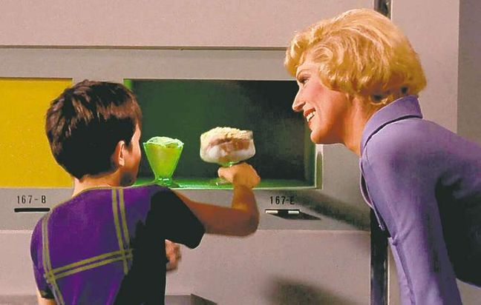
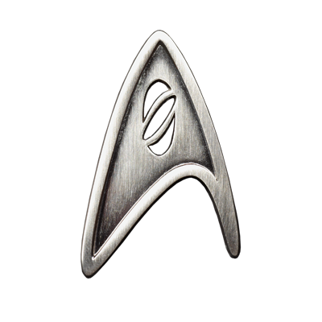
As an innovation in drink service, the “Replicator” drink dispenser will provide hot and cold drinks from one machine. Machines like the Coca-Cola Freestyle brought drink diversity to industries like restaurant franchises and hospitality, but the patron unfriendly design and inconvenience towards all consumers is a disgrace to its efficiency. With the support of major players and producers in the drink service industry, I will use my skills in computer science and engineering to make this dream a reality.
Next Steps:
Patent
Continuing Research
Advanced Designs
Finding Mentoring
Introducing Myself to Industry
The “Replicator” Project
With the $1000, I could finally continue my research and invest in patenting my idea. From there and with what I already know, I will begin drawing more advanced designs including dimensions, components, and circuitry.
Bringing Drink Service into the “Smart” Age of Technology
Haley Currence
haley.currence.jobs@gmail.com
704-490-1792
http://bit.ly/HaleyCurrence

Slide 2
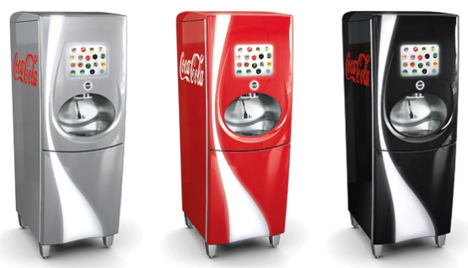
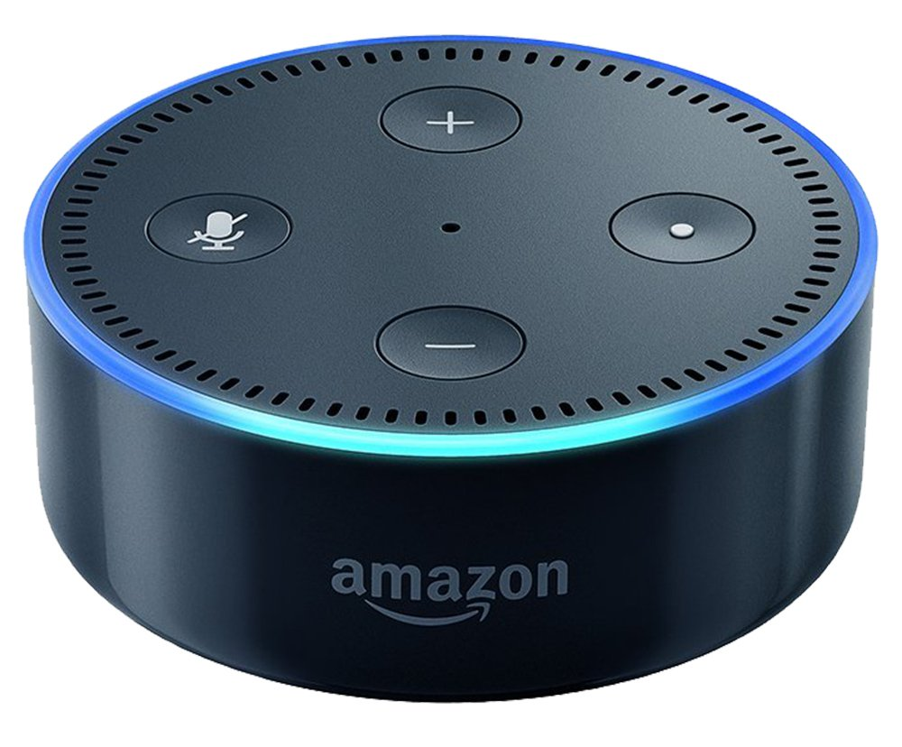
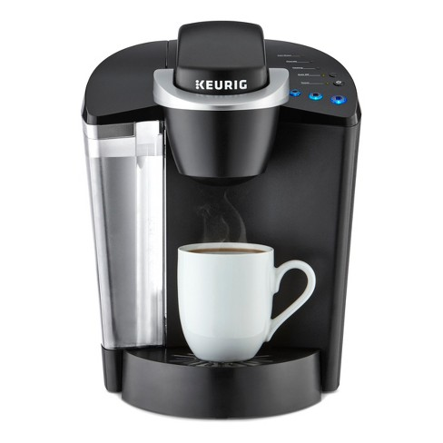

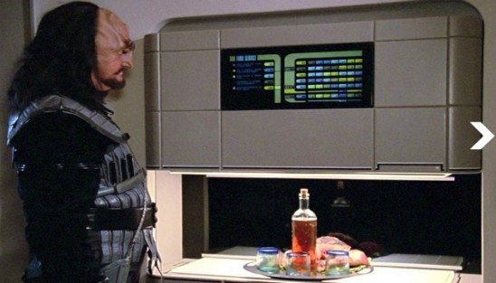
The Legacy of
Star Trek and Innovation
Chasing a Dream
Replicators are devices used throughout the “Star Trek” series.
“A replicator or molecular synthesizer was a device that used matter-energy conversion technology to dematerialize quantities of matter and then rematerialize that matter in another form. … Replicators were capable of producing something as fresh and tasty as non-replicated foodstuffs, inorganically materialized out of patterns used by the transporters. Most people found replicated foods and drinks to taste exactly the same as "real" food, although some people claimed to be able to tell the difference.”
The inspiration for many of today’s technological advances can be traced back to science fiction. “Star Trek” has continued to influence innovators for over 50 years. Here are a few examples:
Cell Phones (Communicators)
IPad (Padds)
Virtual Reality (Holodecks/Holosuites)
Video Calls (Viewscreens)
Floppy Disks (Data Cards)
Voice Interfaces (LCARS)
Using Today’s Tech
for the Future
Today, there are amazing innovations in on-demand technology for both hot and cold beverages. I aim to synthesize existing technology to create a new way to provide a multitude of beverages to satisfy a wide-portion of the population.
-https://memory-alpha.fandom.com/wiki/Replicator

