Slide 1
SPI Bus Protocol

Slide 2
SPI bus
Serial Peripherial Interface (SPI) – developed by Motorola in the mid-1980’s
One of the most widely used interfaces between microcontrollers and peripheral ICs
  Sensors
  ADCs
  DACs
  Shift registers
  SRAM
SPI characteristics
  Synchronous
  Full-duplex
  Master-slave
  Rising or falling edge
  3-wire or 4-wire
  8-bit, 16-bit, or larger word sized transfers
  Operates at SYSCLK/2 up to 12.5MHz

Slide 3
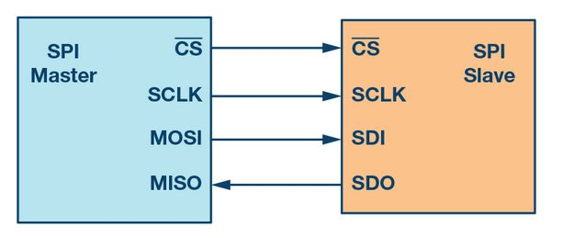
SPI bus
4-wire SPI has 4 signals
  Clock (SCLK)
  Chip select (CS)
  Master out, slave in data (MOSI)
  Master in, slave out data (MISO)

Slide 4
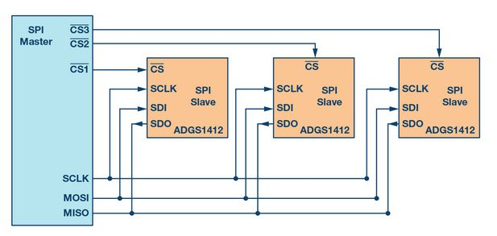
SPI data transmission
Master initiates transfer by sending the clock signal and asserting the chip select (usually active low)
Both master and selected slave can send data at the same time via MISO and MOSI signals
Serial clock edge synchronizes the shifting and sampling of the data
Either the rising or falling edge of the clock can be used to sample and/or shift the data

Slide 5
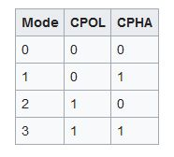
SPI clock polarity and clock phase
All four combinations of clock polarity and clock phase (SPI modes) can be selected
  CPOL – clock polarity
    CPOL=0, clock starts at ‘0’ (non-inverted)
    CPOL=1, clock starts at ‘1’ (inverted)
  CPHA – clock phase
    CPHA=0, data is sampled on the first clock edge
    CPHA=1, data is sampled on the second edge

Slide 6
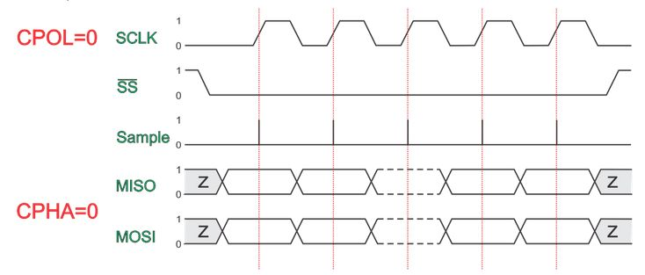
SPI Mode 0
CPOL = 0, clock is low when CS is asserted
CPHA = 0, data is sampled on the rising edge, shifted on the falling edge

Slide 7
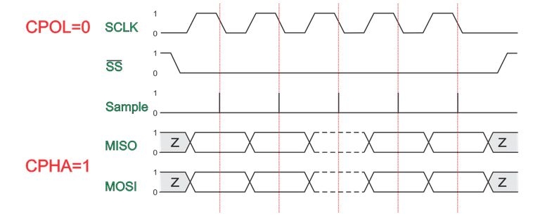
SPI Mode 1
CPOL = 0, clock is low when CS is asserted
CPHA = 1, data is shifted on the rising edge, sampled on the falling edge

Slide 8
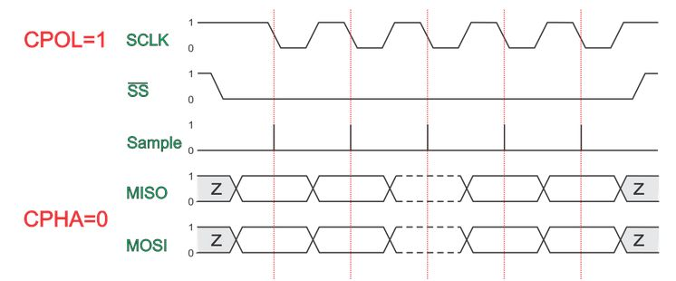
SPI Mode 2
CPOL = 1, clock is high when CS is asserted
CPHA = 0, data is sampled on the falling edge, shifted on the rising edge

Slide 9
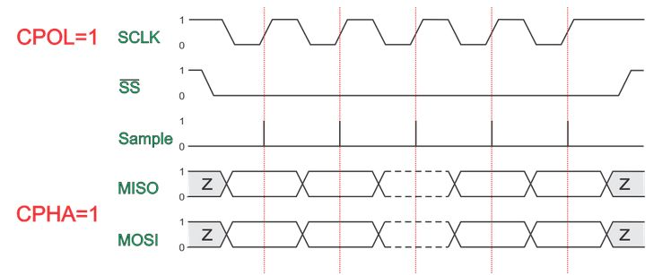
SPI Mode 3
CPOL = 1, clock is high when CS is asserted
CPHA = 1, data is shifted on the falling edge, sampled on the rising edge

