Slide 2
Generating SPARK from Event-B
Providing Fundamental Safety and Security
Asieh Salehi, Thai Son Hoang, Dana Dghaym, Michael Butler and Colin Snook

Slide 3
Outline of talk
Background
Event-B, CamilleX & Event-B notation extensions (including Records)
Spark
Overview -
why generate SPARK from Event-B
From abstract record structures to SPARK
SPARK code generation
Overview of translation rules (inc. records)
SBB Electronic Voting Case study
using latest CamilleX and Records
SBB final refinement -> SPARK specifications

Slide 4
Background - Event-B
Discrete transition systems
Variables representing states
Guarded events representing transitions
Contexts: Static part of the models (carrier sets, constants, etc.)
Machines: Dynamic part of the models (variables, events, etc.)
First-order logic with set theory
Refinement
Start with a simple abstract model
Add detail and design in small steps
Verification by automatic theorem provers
Validation by model checking
Model checker also useful for liveness and debugging
Notes:
Event-B is a modelling language based on discrete transition systems where variables represent the states and guarded events represent the transitions
An Event-B model contains two parts:
+ contexts contain the static part of the model, that is the carrier sets (i.e., types), constants, and axioms constraining them.
+ machines contain the dynamic part of the model, that is the variables and events.
The mathematical language of Event-B is first-order logic and set theory and can be (user-)EXTENDED by the Theory plug-in.
(@Asieh: This is to highlight the important of extensibility for Event-B)
Event-B is highly extensible, both at the mathematical-language level and at the modelling level. We highlight some of the extensions that influence our work here
The theory plug-in allows the mathematical language of Event-B with new operators and supporting reasoning
UML-B allows inputting models with a UML-like diagrammatic notation.

Slide 5
The Need for Textual Representation
(True) Textual representation helps with teamworking
Framework (e.g., XText) for developing IDE for DSLs.
Design Principles:
Reuse the existing Event-B tools of Rodin as much as possible.
Support direct extension of the Event-B syntax to provide additional features.
Provide compatibility with other kinds of ‘higher-level’ models that contribute to the overall model, e.g., UML-B diagrams.
We make use of the Event-B EMF and EMF-2-EMF framework
Notes:
While the Rodin Editor and Camille came quite close with the purpose of having a text editor input, it is still insufficient.
The serialisation is still XMI making version control (e.g., Git) and teamworking difficult.
We can think of Event-B as a domain-specific language and there are mature frameworks for developing text editor for DSLs, such as XText.
XText relies on Eclipse Modelling Framework (EMF) for implementing the modelling languages. Both Rodin Editor and Camille rely on some EMF model of Event-B (previously developed), so why not utilise XText with the EMF model of Event-B.
Before we embark on developing CamilleX, we set of design principles
The first principle (the most important one) is reuse the exiting Event-B tools core (static checker, proof obligation generators, etc.) as much as possible.
Embracing the extensibility of Event-B/Rodin by supporting the direct extension of Event-B syntax while providing compatibility with high-level models such as UML-B.
In passing, we utilise the Event-B EMF and EMF-2-EMF framework
(@Asieh: Time for Colin to talk about them on the next couple of slides).

Slide 6
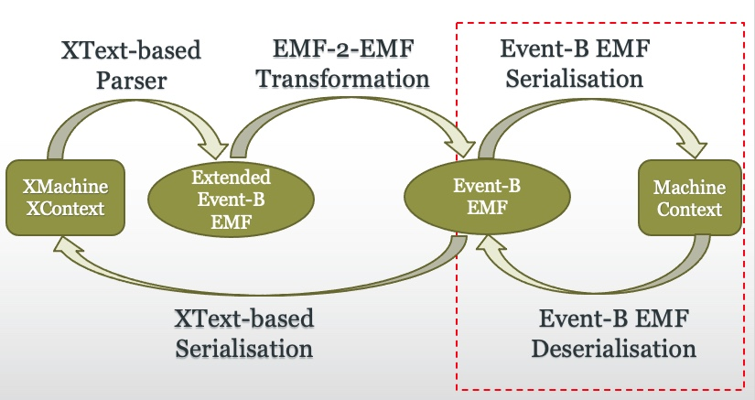
The CamilleX Framework
Notes:
- (@Asieh: Jus talk through the above diagram starting from the left to right. The arrows inside the box are automatic. The Arrow from Event-B EMF to XMachine/XContext can be invoked manually.
- Extended Event-B EMF is to support extensions such as machine inclusions, records, etc.

Slide 7
The CamilleX Framework
SPARK code
Notes:
- (@Asieh: Jus talk through the above diagram starting from the left to right. The arrows inside the box are automatic. The Arrow from Event-B EMF to XMachine/XContext can be invoked manually.
- Extended Event-B EMF is to support extensions such as machine inclusions, records, etc.

Slide 8
Records – an important extension to Event-B
Inherits
Subtyping records
Implicit fields
Refines
Replacing fields
Adding fields
Extends
(Only) Adding fields
Constraints
Properties of record instances
Ongoing research : decomposition of records to prepare for translation to SPARK records

Slide 9
Background - SPARK
Subset of Ada programming language
Assertions, pre-conditions, post-conditions
Targeted at highly reliable software
Formal verification to prove the absence of runtime errors:
arithmetic overflow, buffer overflow and division-by-zero.
Applied over many years
e.g. aircraft systems, control systems and rail systems.

Slide 10
Motivation
Abstraction to isolate important properties
Refinement to add detail and design
Resulting in Validated and Verified models
…But how can we ensure the code complies with the models
Answer: generate Spark outline code
With pre/post-conditions that match events of the model
Assertions for run time checking

Slide 11
Steps : From abstract concept to Spark Implementation
Abstract model of concept
Refinements that introduce more detailed requirements
Refinements that introduce design decisions
Decomposition … Controller + Environment
Refine Controller to prepare for code generation
Generate SPARK from Controller

Slide 12
From Event-B to SPARK
machine m
sees C
variables
…
invariants
…
events
event
INITIALISATION
then
@act1: …
end
event evt
any
parameters
where
@grd1: ..
then
@act1: …
end
end
package P
with SPARK_Mode => On
is
Some_Global : G;
type T is record
…
A : Integer;
B : Integer
end record;
function F(X :)
return ..
…
;
procedure Proc (X : in T)
with
Global => (Input => (..),
… ),
Pre => .. ,
Post => .. ;
end P;
context C
sets
…
constants
…
records
record T
A : Integer
B : Integer
…
axioms
….
end
package body P
with SPARK_Mode => On
is
procedure Proc (X : in T) is
begin
… ;
end Proc;
end P;

Slide 13
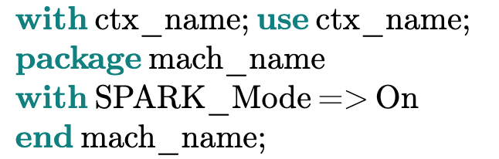
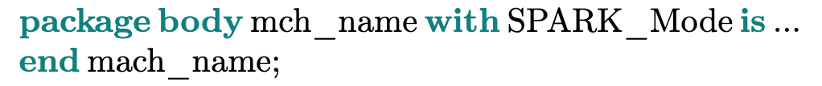
Overview of Event-B to SPARK Translation Rules
Component Translation
(All) Context → specification package
Context extends → context packages use (and all extended context packages)
(Last) Refined Machine → specification and body packages
Machine sees context → use contexts packages (and all extended context packages)

Slide 14
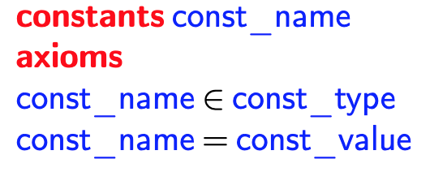
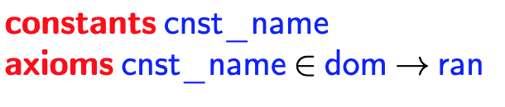
Overview of Event-B to SPARK Translation Rules
Constant Translation
Non function constants → constant, type depends on the axiom definitions
Function type constant → function with return type depending on the range of the function and the function parameters are the domain of the Event-B function.

Slide 15
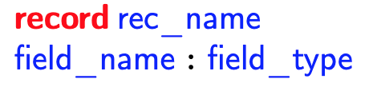
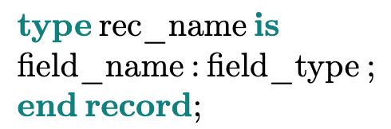
Overview of Event-B to SPARK Translation Rules
Variable Translation
Variable → Global variable,
initialised according to the INITIALISATION event actions
Record Translation
CamilleX Record → SPARK record
with all Event-B record fields (direct and implicit)

Slide 16
Overview of Event-B to SPARK Translation Rules
Event Translation
Event → Procedure (except Initialisation)
Event Guard → Pre-condition
Event Action → Post-condition & Procedure body
Event Parameter → Procedure Parameter
(where output/input/in_out is deduced from guards and actions)

Slide 17
Refinement of SBB example From abstract concept to spark
Ballot
Paper (voter,vote)
Paper (voter,vote,time)
Paper (voter,vote,time,encrypted)
Paper (voter,vote,time,encrypted, mac)
Decompose -> smart ballot box + voters/attackers
Refine SBB data towards arrays etc.
Generate SPARK for SBB

Slide 18
Refinement of SBB example From abstract concept to spark
Ballot
Paper (voter,vote)
Paper (voter,vote,time)
Paper (voter,vote,time,encrypted)
Paper (voter,vote,time,encrypted, mac)
Decompose -> smart ballot box + voters/attackers
Refine SBB data towards arrays etc.
Generate SPARK for SBB
Abstract notion of a ballot as a mapping from voters to vote
We only consider ideal situation of valid votes

Slide 19
Refinement of SBB example From abstract concept to spark
Ballot
Paper (voter,vote)
Paper (voter,vote,time)
Paper (voter,vote,time,encrypted)
Paper (voter,vote,time,encrypted, mac)
Decompose -> smart ballot box + voters/attackers
Refine SBB data towards arrays etc.
Generate SPARK for SBB
Replace ballet with its physical representation :
Paper - fields for voter and vote
This introduces the possibility of invalid papers.. Copying faking etc.

Slide 20
Refinement of SBB example From abstract concept to spark
Ballot
Paper (voter,vote)
Paper (voter,vote,time)
Paper (voter,vote,time,encrypted)
Paper (voter,vote,time,encrypted, mac)
Decompose -> smart ballot box + voters/attackers
Refine SBB data towards arrays etc.
Generate SPARK for SBB
Introduce new field : time
Voting papers can expire,
Reduces opportunity for validity threats

Slide 21
Refinement of SBB example From abstract concept to spark
Ballot
Paper (voter,vote)
Paper (voter,vote,time)
Paper (voter,vote,time,encrypted)
Paper (voter,vote,time,encrypted, mac)
Decompose -> smart ballot box + voters/attackers
Refine SBB data towards arrays etc.
Generate SPARK for SBB
Refine voter,vote with encrypted.
Provide confidentiality

Slide 22
Refinement of SBB example From abstract concept to spark
Ballot
Paper (voter,vote)
Paper (voter,vote,time)
Paper (voter,vote,time,encrypted)
Paper (voter,vote,time,encrypted, mac)
Decompose -> smart ballot box + voters/attackers
Refine SBB data towards arrays etc.
Generate SPARK for SBB
Introduce mac (algorithm for hashing)
Enables checking validity of vote..
E.g. if an attacker tries to alter the vote

Slide 23
Refinement of SBB example From abstract concept to spark
Ballot
Paper (voter,vote)
Paper (voter,vote,time)
Paper (voter,vote,time,encrypted)
Paper (voter,vote,time,encrypted, mac)
Decompose -> smart ballot box + voters/attackers
Refine SBB data towards arrays etc.
Generate SPARK for SBB

Slide 24
Decompose – controller + environment
Event-B model is a closed system
Some parts of model are the controller
Others the environment being controlled
Separate the thing we want to implement in Spark
Only generate from the events that represent control actions
Future Work –
How to decompose records sets e.g. only cast_papers are in the SBB system

Slide 25
Refinement of SBB example From abstract concept to spark
Ballot
Paper (voter,vote)
Paper (voter,vote,time)
Paper (voter,vote,time,encrypted)
Paper (voter,vote,time,encrypted, mac)
Decompose -> smart ballot box + voters/attackers
Refine SBB data towards arrays etc.
Generate SPARK for SBB

Slide 26
Refinement towards Implementation
Sets → Arrays
Data Refinement from abstract SET into Array
Array can be modelled as a Total function from 0..n to set
Can introduce a counter variable to track the size of array
Event-B records are more general than SPARK records:
E.g. fields can be optional and/or many
For SPARK we can only use total functions
Define a null value for optional fields
i.e. record instances that have no field value map to a ‘null’ instance of Type

Slide 27
Refinement of SBB example From abstract concept to spark
Ballot
Paper (voter,vote)
Paper (voter,vote,time)
Paper (voter,vote,time,encrypted)
Paper (voter,vote,time,encrypted, mac)
Decompose -> smart ballot box + voters/attackers
Refine SBB data towards arrays etc.
Generate SPARK for SBB

Slide 28
Generate SPARK from final refinement
Generate SPARK outline code : SPARK functions with pre and post conditions reflect Event-B events with guards and actions
The aim is to ensure the manual implementation of code bodies satisfies the Event-B model.
Note that we have already proved invariants in the Event-B.. No need to translate invariants to SPARK
Or is there! Some industrial partners have suggested that it may still be useful.. E.g. to catch problems caused by interrupts.

Slide 29
Example: Application to Smart Ballot Box Model
procedure cast(paper : in barcode) with
Global => (Proof_In => ( spoiled_arr, curr_time, spoil_count),
In_Out => (cast_arr, cast_count)),
Pre => cast_count in 0 .. Max_Votes-1),
and then not already_cast(paper)
…
Post => already_cast(paper)
and then cast_count = cast_count' old + 1);
event cast_paper
refines cast_paper
any
paper
where
@grd1: paper ∈ BARCODE
@grd2: cast_count ∈ 0 ‥ max_votes −1
….
then
@act1: cast_arr(cast_count)≔ paper
@act2: cast_count ≔ cast_count + 1
end
procedure cast(paper : in barcode) is
begin
cast_arr(cast_count) := paper;
cast_count := cast_count + 1;
end cast;

Slide 31
Case Study – SBB Electronic Voting

Slide 32
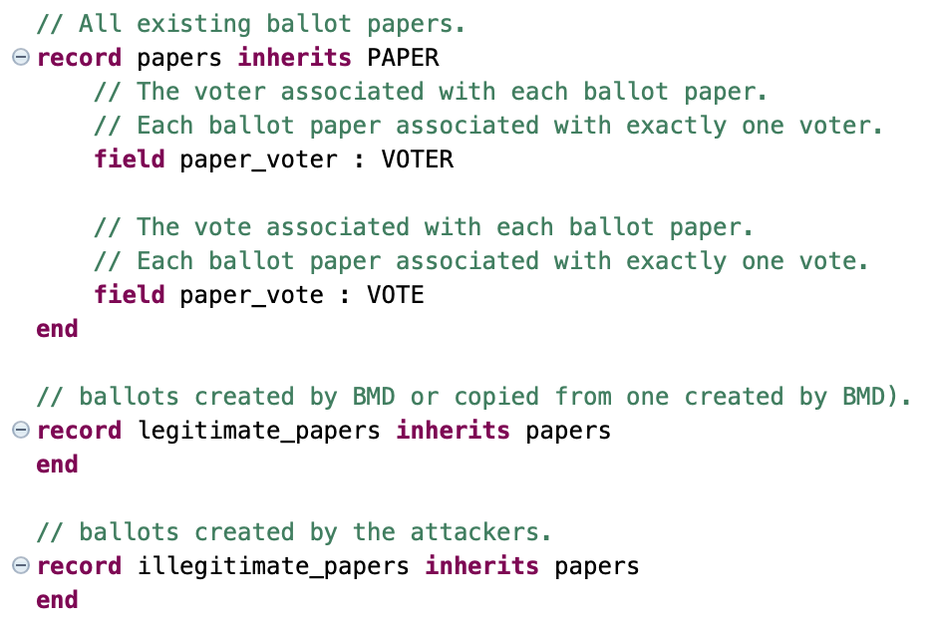

Slide 33
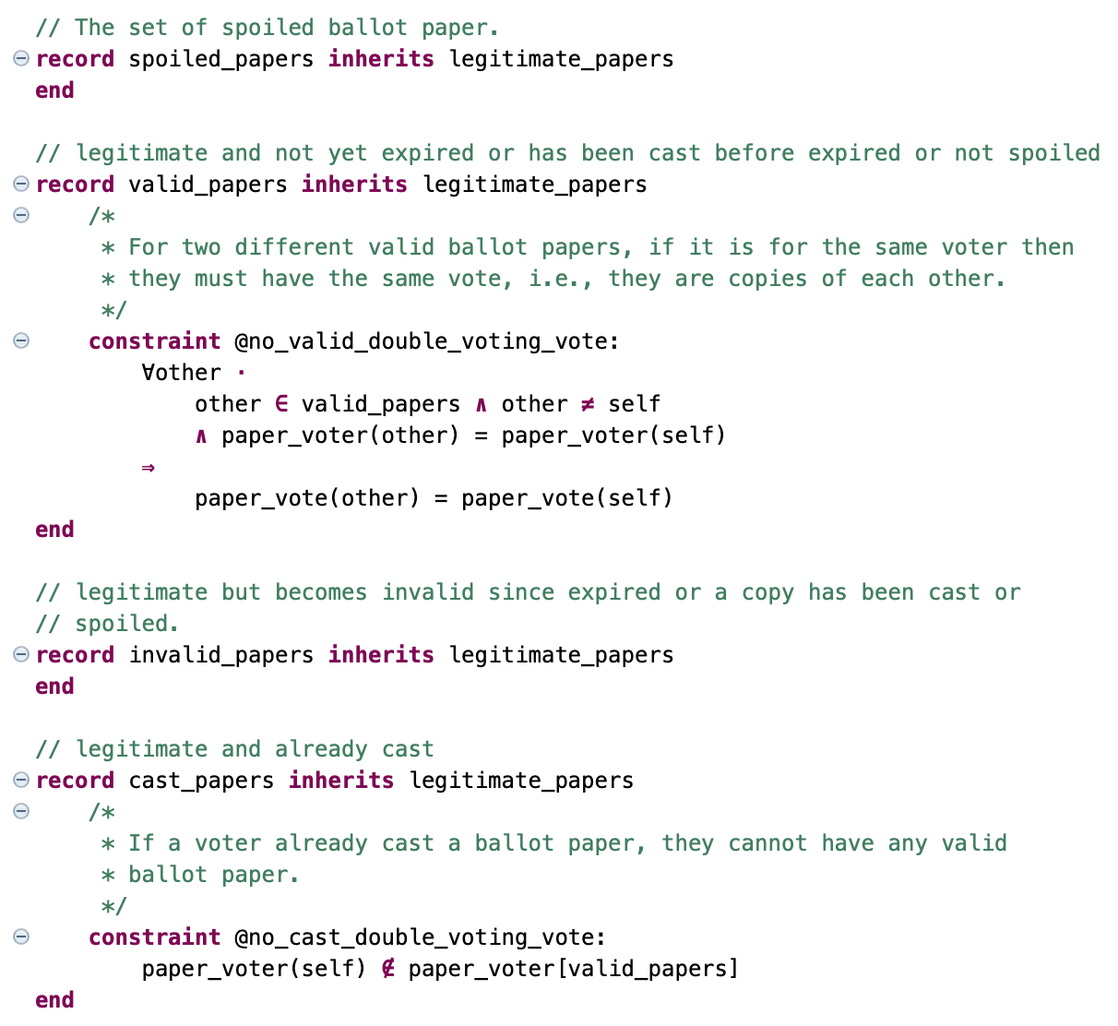

Slide 34
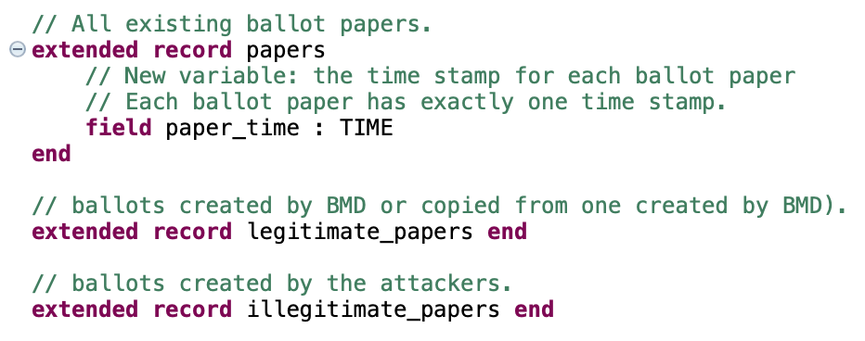

Slide 35
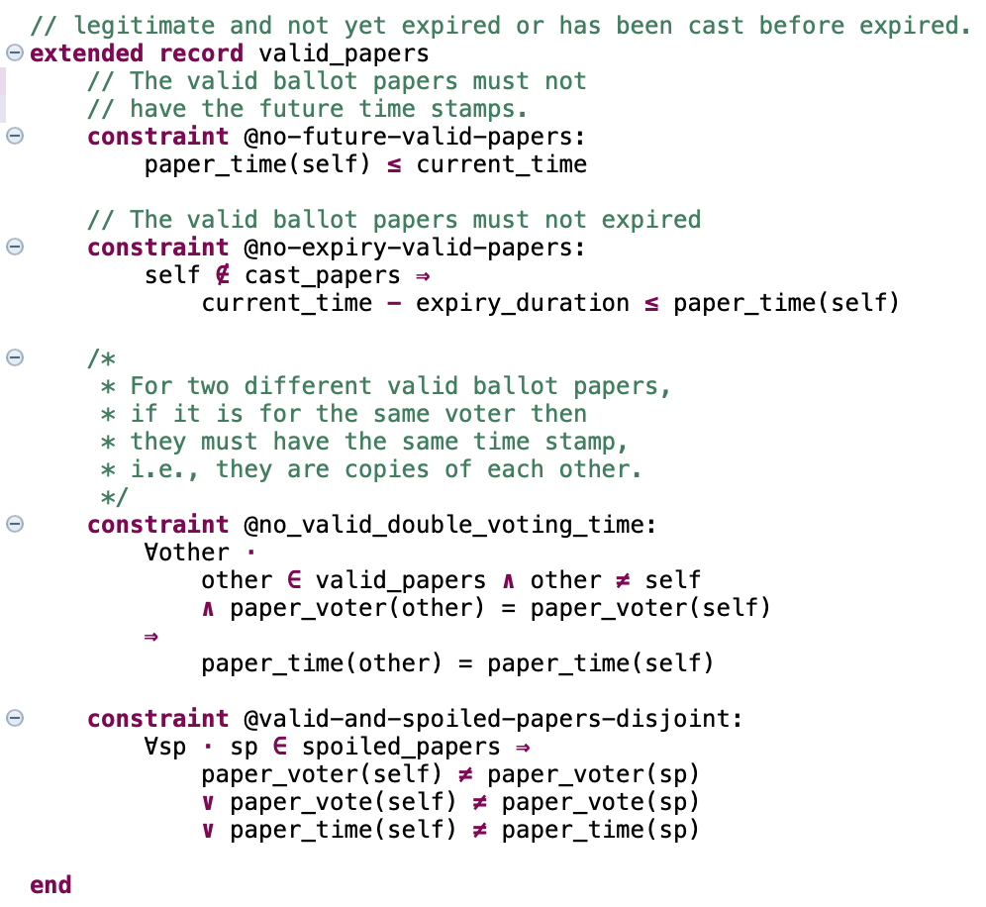

Slide 36
