Slide 1
Hands-on Parallel HDF5 Tutorial
October 13, 2020
Scot Breitenfeld and Elena Pourmal, The HDF Group
Quincey Koziol, NERSC

Slide 2
Tutorial Prerequisites
Tutorial assumes basic knowledge of
HDF5
MPI and MPI I/O
Concept of independent and collective I/O
C
Access to HPC resource is provided by The HDF Group

Slide 3
Tutorial Goals
Give a quick introduction to parallel HDF5 capabilities
Help to avoid common mistakes when using parallel HDF5 library
For more information, check The HDF Group support portal and recent Webinars
https://portal.hdfgroup.org/display/HDF5/HDF5
https://portal.hdfgroup.org/display/HDF5/Introduction+to+Parallel+HDF5
https://www.hdfgroup.org/category/webinar/
Provide an opportunity to explore state-of-the-art HPC cluster

Slide 4
Tutorial Outcome
You should have a better understanding of
How to use parallel HDF5 library
When to use collective or independent raw data I/O
How to avoid HDF5 “metadata storm”

Slide 5
Tutorial programs and how to run them
Get Tutorial examples
git clone https://github.com/HDFGroup/Tutorial.git
README.txt has info about each example program
To compile examples
spack load --first hdf5
make
To run examples
srun –n 4 <exec_name>

Slide 6
Let’s start!

Slide 7
Parallel HDF5 library capabilities
Raw data I/O
All MPI ranks in communicator can write and read to / from the same or different datasets
HDF5 metadata operations
All ranks in MPI communicator can access all objects in the HDF5 file
Parallel HDF5 library limitations
Can’t create or write variable-length data
Doesn’t support SWMR mode
Doesn’t support independent modifications of HDF5 file structure (HDF5 metadata)

Slide 8
It is easy to start using parallel HDF5: h5_ex0.c and h5par_ex0.c
Steps to convert HDF5 application to use the parallel HDF5 library
Convert an application to use MPI
Update H5Fcreate/open to use HDF5 MPI I/O virtual file driver (VFD)
Use h5pcc compilation script to build application
(found in the bin directory of parallel HDF5 library installation)
Run as you would run parallel applications on your HPC system
Try it:
Compare the content of h5_ex0.c and h5par_ex0.c with diff command
Run both examples
Use h5dump utility to examine SDS.h5 and SDSpar.h5
Points to remember
There is no difference in HDF5 files created by the sequential or parallel HDF5 library
Use HDF5 MPI I/O VFD to write / read HDF5 file in parallel

Slide 9
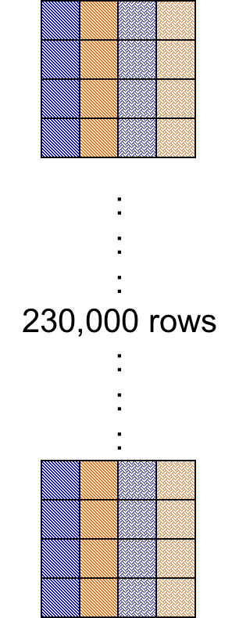
Writing HDF5 dataset by columns: h5_ex1.c, h5par_ex1a.c and h5par_ex1b.c
How to convert HDF5 application to use parallel HDF5 library
Assign data to each MPI rank (vs. looping through parts of data to write / read) using HDF5 hyperslab selection
Try it:
Compare the content of h5_ex1.c and h5par_ex1a.c
Notice that each hyperslab represents noncontiguous selection in the file
Run both examples
Compare the content of h5_ex1a.c and h5par_ex1b.c
Run h5par_ex1b.c and compare the results
Points to remember
Default properties may not be optimal when doing raw data I/O
Consider using H5Pset_dxpl_mpio and H5FD_MPIO_COLLECTIVE to set collective I/O for H5Dwrite/read

Slide 10
Writing HDF5 dataset by columns using chunking and compression h5par_ex1c.c and h5par_ex1d.c
Try it:
Compare the content of h5_ex1a.c and h5par_ex1c.c
Run h5par_ex1c.c
Compare the content of h5_ex1c.c and h5par_ex1d.c
See how to set compression for parallel applications
Run h5par_ex1d and check the sizes of h5par_ex1c.h5 and h5par_ex1d.h5
Points to remember
I/O is performed on the whole chunk
Use chunks of at least 10-100MB (limit for chunk size is 4GB)
Think about chunk sizes if data must be read back
Compression requires collective raw data I/O
Each column is a chunk

Slide 11
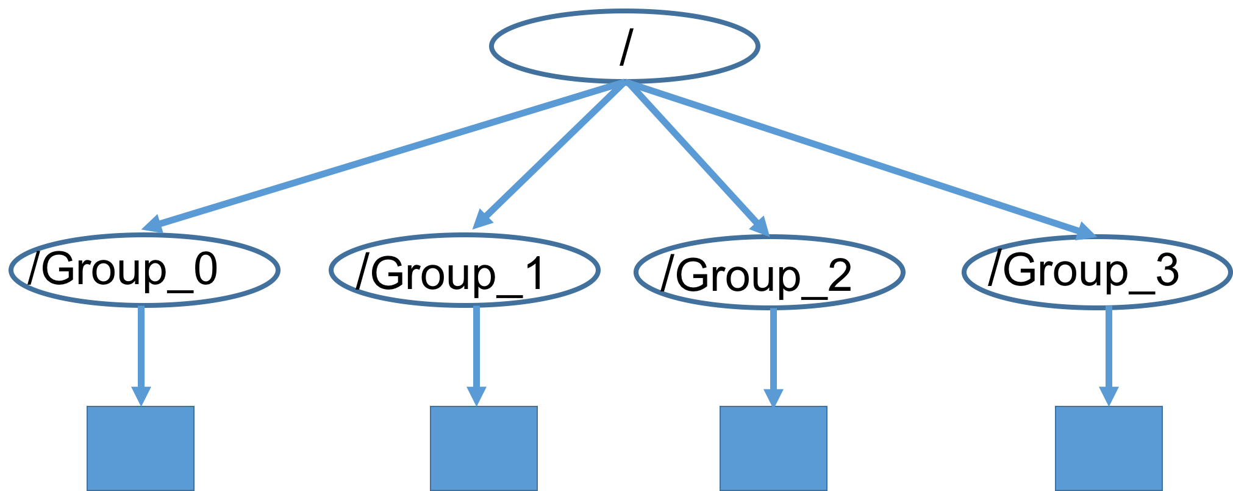
Creating HDF5 file structure: h5par_ex2a.c and h5par_ex2b.c
Try it:
Let’s try to create the file structure shown here
Compare the content of h5_ex2a.c and h5par_ex2b.c
Run h5par_ex2a and h5par_ex2b
Run h5dump -H h5par_ex2a.h5 and h5dump -H h5par_ex2b.h5
Points to remember
Any operations that change HDF5 file structure or HDF5 metadata requires collective operations
See HDF5 documentation, General Topics in HDF5, Parallel HDF5 https://portal.hdfgroup.org/display/HDF5/Collective+Calling+Requirements+in+Parallel+HDF5+Applications

Slide 12
Reading HDF5 file structure: h5par_ex2c.c
Try it:
See h5par_ex2c.c for how to read HDF5 metadata independently
Run h5par_ex2c
Points to remember
H5Fopen is always a collective call
H5G/D/Aopen calls can be independent if the file structure is not modified
Notes:
Maybe make it optional?

Slide 13
Using independent H5Dopen to write data from each MPI rank: h5par_ex2d.c h5par_ex2e.c
Try it:
Review h5par_ex2d.c and h5par_ex2e.c for how to create datasets and to write them independently from each MPI rank
Run h5par_ex2d and h5par_ex2e
Use h5dump h5par_ex2d.h5 to check the content
Points to remember
Use H5Pset_alloc_time dataset creation property and H5D_ALLOC_TIME_EARLY to allocate space in the file
Shown approach cannot be applied to extensible and compressed datasets
Notes:
Make it optional?

Slide 14
Avoid MD storm writes and reads: h5par_comparison
Try it:
Review h5par_comparison.c; it creates a dataset and writes it with hyperslabs using all ranks
Notice that multiple ranks access the same HDF5 metadata when creating a file and a dataset, and again when opening the file and the dataset. (Performance may suffer!)
Run h5par_comparison, h5par-comparison-collmd and h5par-comparison-collio
Points to remember
When all ranks access the same objects in HDF5 file avoid “metadata write/read storm” by using H5Pset_all_coll_metadata_ops and H5Pset_coll_metadata_write
See https://portal.hdfgroup.org/display/HDF5/General+Access+Properties
Other hints:
Use HDF5 1.10.7 and later to use optimizations when reading the entire dataset by all MPI ranks
Use compact storage for a small dataset (order of KBs) and when reading/writing the dataset by all MPI ranks along with optimization above to avoid metadata storm

Slide 15

THANK YOU!
Questions & Comments?

