Slide 1
HDF5 Virtual Dataset
Neil Fortner, Quincey Koziol, Elena Pourmal, Dana Robinson

Slide 2
Challenge

Slide 3
Challenge
How to view data stored across the HDF5 files as an HDF5 dataset on which normal operations can be performed?
High-level approach
Special library that applications like MATLAB and H5Py will need to use
Example : THREDDS Data Server based on OPeNDAP http://www.unidata.ucar.edu/software/thredds/current/tds/TDS.html
Native HDF5 implementation
Transparent to applications
Notes:
THREDDS Dataset Inventory Catalogs are used to provide virtual directories of available data and their associated metadata. These catalogs can be generated dynamically or statically.
The Netcdf-Java/CDM library reads NetCDF, OpenDAP, and HDF5 datasets, as well as other binary formats such as GRIB and NEXRAD into a Common Data Model (CDM), essentially an (extended) netCDF view of the data. Datasets that can be read through the Netcdf-Java library are called CDM datasets.
TDS can use the NetCDF Markup Language (NcML) to modify and create virtual aggregations of CDM datasets.
An integrated server provides OPeNDAP access to any CDM dataset. OPeNDAP is a widely used, subsetting data access method extending the HTTP protocol.
An integrated server provides bulk file access through the HTTP protocol.
An integrated server provides data access through the OpenGIS Consortium (OGC) Web Coverage Service (WCS) protocol, for any "gridded" dataset whose coordinate system information is complete.
An integrated server provides data access through the OpenGIS Consortium (OGC) Web Map Service (WMS) protocol, for any "gridded" dataset whose coordinate system information is complete. This software was developed by Jon Blower (University of Reading (UK) E-Science Center) as part of the ESSC Web Map Service for environmental data (aka Godiva2).
The integrated ncISO server provides automated metadata analysis and ISO metadata generation.
The THREDDS Data Server is implemented in 100% Java, and is contained in a single war file, which allows very easy installation into a servlet container such as the open-source Tomcat web server. Configuration is made as simple and as automatic as possible, and we have made the server as secure as possible. The library is freely available and the source code is released under the (MIT-style) netCDF library license.

Slide 4
Two simple use cases

Slide 5
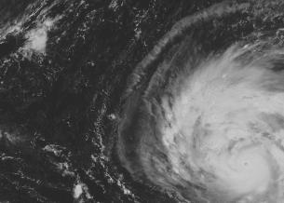
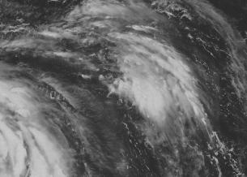
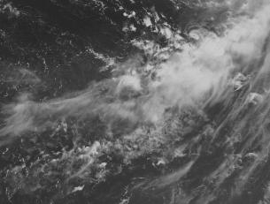
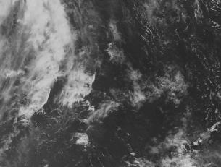
Collect data one way ….
File: a.h5
Dataset /A
File: b.h5
Dataset /B
File: c.h5
Dataset /C
File: d.h5
Dataset /D
Notes:
Images are stored in four different datasets. They represent a part of the bigger image.

Slide 6
Present it in a different way…
Whole image
File: F.h5
Dataset /D
Notes:
Virtual dataset stores a mapping for each quadrant to data stored in the source HDF5 files and datasets a-d.h5. Application can read the whole image from dataset /D using regular H5Dread call. It doesn’t need to know the mapping in order to read data.

Slide 7
Present it in a different way…
Subset of data
File: F.h5
Dataset /F
Notes:
Virtual dataset stores a mapping to part of the data in the four source files to present a detail of interest

Slide 8
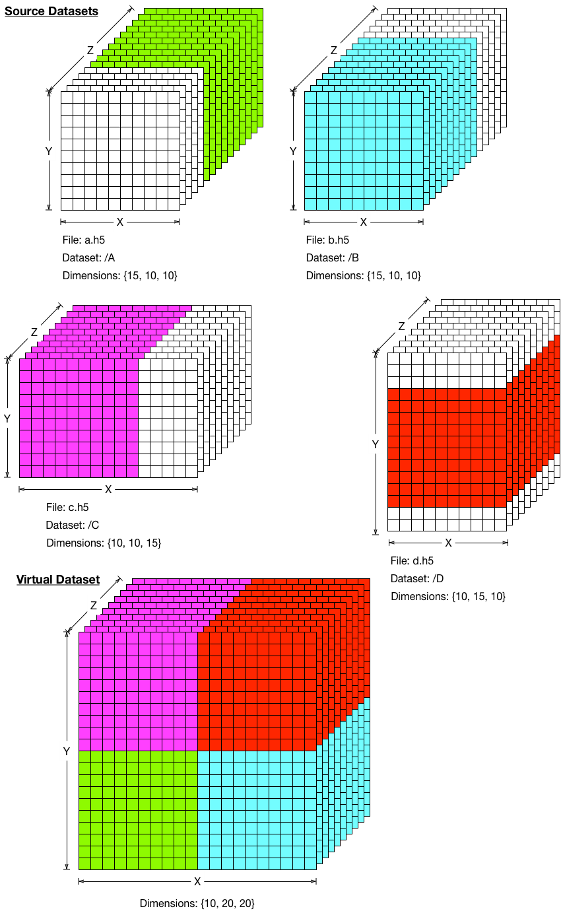
VDS Example
Notes:
The concept can be easily generalized to higher dimensionality and more complex mappings. The dataset at the bottom of the slide is composed of the subsets stored in four source datasets. As with partial I/O each mapping has to have the same number of elements selected in the source dataset and in VDS.

Slide 9
Synchrotron community use cases

Slide 10
Common Characteristics
New detectors have high rates and parallel architecture
Multiple processes are writing compressed parts of the images into HDF5 files in parallel
No synchronization between writing processes
Detectors generate 3-10 GB data per second
Notes:
In the past (and for many old detectors that are still in use now), the data was written one frame per file (tiif). For the low speed detectors it was not a problem, but annoyance to the data users since they had to deal with a lot of files. With the new generation of photon detectors the amount of data and the speed the data is produced the old solution doesn’t not work. Any experiment will saturated a file system very quickly. HDF5 looked as a way to go due to its internal compression, I/O performance, portability and tools available for the users plus a popular NeXus HDF-based format that community has been using since early nineties.
DLS and other centers looked into different ways of writing data into HDF5. Several experiments were done to write non-compressed data using parallel HDF5 , but just with a few processes scaling was not achieved. Scot helped with that benchmark and can provide more details.
It also became very clear in the early stages of detectors development that compression has to be used in order to reduce the amount of data that has to be moved. Most of the detector software write a compressed dataset per process taking advantage of the direct chunk write. While the necessary write speed was obtained and the problem was solved on the data acquisition side, the problem still remained on the users side since the data was spread among several HDF5 files.

Slide 11
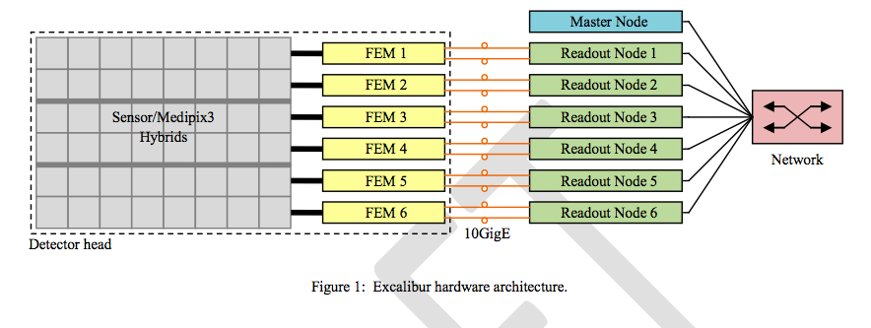
Excalibur Detector Hardware Architecture
Courtesy DLS
See Confluence - DLS – Virtual Dataset Phase 0 for the document
Notes:
This is an example of the Excalibur detector hardware architecture.
“EXCALIBUR is an advanced photon counting detector being designed and built by a collaboration of Diamond and the STFC. It is based around 48 CERN Medipix3 chips arranged as an 8 x 6 array for a total frame size (including gaps) of 2069 x 1793. The hardware architecture is shown in this slide.

Slide 12
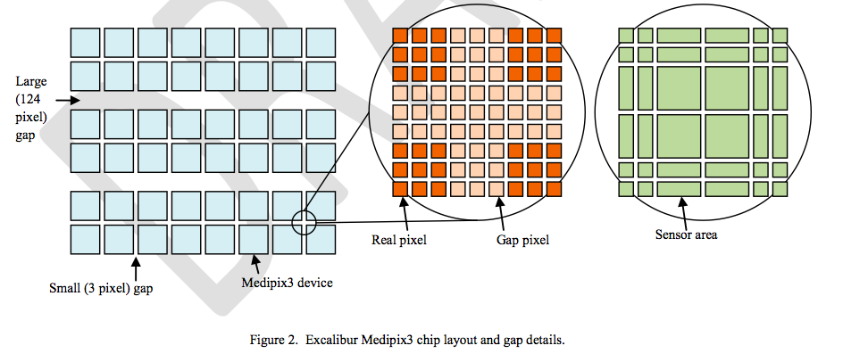
Excalibur Chip Layout and Gap detail
Courtesy DLS
See Confluence - DLS – Virtual Dataset Phase 0 for the document
Notes:
It can be seen that each row of eight Medipix 3 chips is read by a front end module (FEM) into a readout node computer. The six readout nodes then all write their portion of the image to the output file in parallel. This process repeats for each image, roughly (but not completely) in synchronism. There are gaps between the Medipix 3 chips, shown in figure 2 (next slide). The small (3 pixel) gaps are filled by the readout software, but the large gaps are not.”
The HDF Group was asked to provide a solution that will allow to transparently access the whole image or series of images stored among several HDF5 files and datasets. The images have to be accessed while data is still collected (i.e., the new feature has to work with SWMR access).

Slide 13
Unlimited Use Case
Virtual Dataset VDS
Series of images
VDS.h5
time
t₃
t₂
A
Image at time t₂
t₁
A
B
k
A
B
C
k
111
n
B
C
D
n
k
C
D
E
k
n
D
E
F
n
k
E
F
k
n
F
n
M
M
Dataset B
t₂
B
Dataset A
B
t₂
A
b.h5
B
a.h5
A
Dataset C
A
Dataset D
t₂
C
t₂
D
c.h5
C
D
C
d.h5
D
Dataset E
t₂
E
e.h5
E
Dataset F
E
t₂
F
F
f.h5
F
Notes:
Excalibur use case can be represented in HDF5 “land’ as shown on this slide. The difference between this and the previous use cases is unlimited dimensionality of the source datasets. As experiment runs, there is no limit on number of frames written.
Explain the mapping…
The next few slides represent use cases for other detectors architectures.

Slide 14
Use Case with Gaps
A
D
Virtual Dataset VDS with “gaps”
A
D
A
D
E
B
E
C
E
VDS.h5
Dataset A
Dataset D
A
D
a.h5
A
D
d.h5
D
Dataset B
B
B
b.h5
B
Dataset E
Dataset C
E
C
E
c.h5
C
e.h5
E
Notes:
More general example with gaps between the mapped regions. Fill value concept.

Slide 15
“Printf-type” Source Generation
time
A
A
A
A
A
A
A
A
A
A
Virtual Dataset VDS
VDS.h5
DS N
A
A
A
A
f-1.h5
f-2.h5
f-3.h5
f-N.h5
File names are generated by the “printf” capability
Notes:
Another example of unlimited dimension: we have unlimited dimension in VDS but limited sized source datasets. The number of source datasets is unlimited. The names of the source files (or datasets or both) can be generated using printf capability.

Slide 16
Use Case with Interleave Planes
Series of images
C
D
B
A
time
t_{3+4k}
C
B
A
Virtual Dataset VDS has images A, B, C and D interleaved
D
C
B
A
t₄
D
t_{1+4k}
t₃
C
t₂
B
VDS.h5
A
t₁
C
D
B
A
Dataset A
Dataset B
Dataset C
Dataset D
A
B
C
D
a.h5
b.h5
c.h5
d.h5
Notes:
Unlimited dimension VDS with interleaved frames. Mapping becomes more complex. Explain.

Slide 17
High-Level Requirements
No change in the programming model for VDS I/O
Mapping between VDS and HDF5source datasets is persistent and transparent to application
SWMR access to VDS
Other
HDF5 selection mechanism handles “unlimited selections”
Source file names can be generated automatically

Slide 18
Status
The feature is implemented except SWMR access
Source code
https://svn.hdfgroup.org/hdf5/features/vds/
Acceptance test suite
https://svn.hdfgroup.org/hdf5_vds_use_cases/
Documentation
http://www.bigdata.org/HDF5/docNewFeatures/NewFeaturesVirtualDatasetDocs.html

Slide 19
Programming model and examples of mapping

Slide 20
VDS Programming Model
Create datasets that comprise the VDS (the source datasets) (optional)
Create the VDS
Define a datatype and dataspace (can be unlimited)
Define the dataset creation property list (including fill value)
Map elements from the source datasets to the elements of the VDS
Iterate over the source datasets:
Select elements in the source dataset (source selection)
Select elements in the virtual dataset (destination selection)
Map destination selections to source selections
End iteration
Call H5Dcreate using the properties defined above
Access the VDS as a regular HDF5 dataset
Close the VDS when finished

Slide 21
My First VDS Example
File vds.h5 Dataset /VDS
File a.h5 Dataset /A
1 1 1 1 1 1
. . . . . .
. . . . . .
File b.h5 Dataset /B
. . . . . .
2 2 2 2 2 2
. . . . . .
File c.h5 Dataset /C
3 3 3 3 3 3
Notes:
Let’s look at the trivial example. We would like to have a dataset 4x6 called VDS with a fill value -1 and with the first three rows stored in the datasets /A, /B and /C.
We will use a hyperlsab selection mechanism and new API to define the mappings as shown on the next slide.

Slide 22
Defining Mapping
src_space = H5Screate_simple (RANK1, dims, NULL);
for (i = 0; i < 3; i++) {
start[0] = (hsize_t)i;
status = H5Sselect_hyperslab(space, ..., start,...);
status = H5Pset_virtual(dcpl, space, SRC_F[i], SRC_D[i],
src_space);
}
dset = H5Dcreate2 (file, DATASET, H5T_NATIVE_INT, space,
H5P_DEFAULT, dcpl, H5P_DEFAULT);
Notes:
On this slide I wouldn’t emphasize the code, but rather the idea behind mapping builds. I think it will be more useful to show the code and run the example after the concept is explained.
Source datasets will have the same selection – the whole dataspace.
We will need to select a row in VDS and map it to the whole dataspace of the corresponding source dataset to create a mapping. After all mappings are applied to the dataset creation property list, we can create VDS with a regular H5Dcreate call.

Slide 23
My First VDS Example
File vds.h5 Dataset /VDS
File a.h5 Dataset /A
1 1 1 1 1 1
1 1 1 1 1 1
2 2 2 2 2 2
File b.h5 Dataset /B
3 3 3 3 3 3
2 2 2 2 2 2
-1 -1 -1 -1 -1 -1
File c.h5 Dataset /C
3 3 3 3 3 3
Data the application will see when reading /VDS dataset from file vds.h5
The last row is filled with the fill value
Notes:
If we use h5dump or just read VDS, we will get the data shown.

Slide 24
Discovering Mappings
H5Pget_virtual_count
H5Pget_virtual_vspace
H5Pget_virtual_srcspace
H5Pget_virtual_filename
H5Pget_virtaul_dsetname
Notes:
We provide APIs to discover the VDS mapping (used by h5dump ad h5ls tools)

Slide 25
h5dump –p vds.h5
HDF5 "vds.h5" {
GROUP "/" {
DATASET "VDS" {
DATATYPE H5T_STD_I32LE
DATASPACE SIMPLE { ( 4, 6 ) / ( 4, 6 ) }
STORAGE_LAYOUT {
MAPPING 0 {
VIRTUAL {
SELECTION REGULAR_HYPERSLAB {
START (0,0)
STRIDE (1,1)
COUNT (1,1)
BLOCK (1,6)
}
}
SOURCE {
FILE "a.h5"
DATASET "A"
SELECTION ALL
}
}
Notes:
Explain output

Slide 26
DEMO
https://svn.hdfgroup.org/hdf5/features/vds/examples/h5_vds.c
Notes:
I would show the example and how h5dump works without and with –p flag. To support an idea of VDS “regularity” as an HDF5 dataset.

Slide 27
Use Case with Interleaved Planes
Virtual Dataset VDS has images A, B, C and D interleaved
Forth plane goes to the same dataset; VDS and source datasets have unlimited dimension
VDS.h5
Dataset A
Dataset B
Dataset C
Dataset D
A
B
C
D
a.h5
b.h5
c.h5
d.h5
Notes:
Explain here that for this mapping existing limited selections cannot be used to describe mappings. We need unlimited selection concept shown on the next slide.

Slide 28
Defining Mapping
stride[0] = PLANE_STRIDE; stride[1] = 1; stride[2] = 1;
count[0] = H5S_UNLIMITED; count[1] = 1; count[2] = 1;
src_count[0] = H5S_UNLIMITED; src_count[1] = 1;
src_count[2] = 1;
status = H5Sselect_hyperslab (src_space, H5S_SELECT_SET, start, NULL, src_count, block);
for (i=0; i < PLANE_STRIDE; i++) {
status = H5Sselect_hyperslab (vspace, H5S_SELECT_SET,
start, stride, count, block);
status = H5Pset_virtual (dcpl, vspace, SRC_FILE[i],
SRC_DATASET[i], src_space);
start[0]++;
}

Slide 29
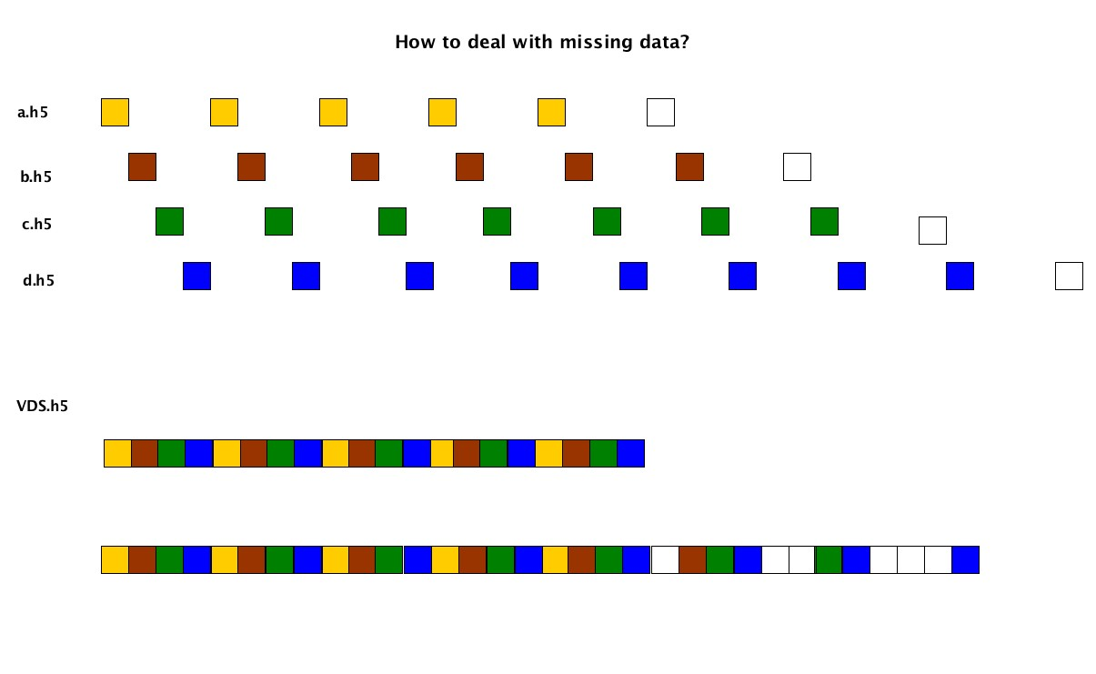
How to deal with missing data?
First missing plane
Last available plane
20 planes
32 planes
H5Pset_virtual_view sets extent to the position of
the first missing plane or the last available. Missing planes will
have fill values.
Notes:
Source dataset can be written with the different speeds. Some datasets may have less data that is mapped to VDS. For unlimited VDS, how do we determine its extent when not all mapped elements exist yet?
We introduced the concept of a view demonstrated on this slide. A user can request a view that will contain only all written data used in mappings (i.e., extend only to the first missing data, 20 planes), or to include any written data used in mappings filling the missing mapped elements with fill values (i.e., extend to the last available).

Slide 30
DEMO
https://svn.hdfgroup.org/hdf5/features/vds/examples/h5_vds-percival-unlim-maxmin.c
Notes:
The example and h5dump will illustrate the concept of unlimited selection and the view. H5dump uses the default – last available.

Slide 31
Unlimited Use Case – Infinite Block Count
VDS with unlimited dimension
VDS.h5
Each block is mapped
to a dataset
A
A
A
f-1.h5
f-2.h5
f-3.h5
f-N.h5
Source files;
Names are generated by the “printf” capability

Slide 32
Defining Mapping
start[0] = 0; start[1] = 0; start[2] = 0;
stride[0] = DIM0; stride[1] = 1; stride[2] = 1;
count[0] = H5S_UNLIMITED; count[1] = 1; count[2] = 1;
block[0] = DIM0;
block[1] = DIM1;
block[2] = DIM2;
status = H5Sselect_hyperslab (vspace, H5S_SELECT_SET,
start, stride, count, block);
status = H5Pset_virtual (dcpl, vspace, "f-%b.h5", "/A",
src_space);

Slide 33
Questions
Thank you!
?

