Slide 1

Regression Performance Test Using H5_HSTest
Rishi Rakesh Sinha
Robert E. McGrath

Slide 2
Outline of the Talk
Hyperslab terminology
Overview of H5_HSTest
Performance test for HS reads
  Test parameters
  Results
Analysis of result
Future proposal

Slide 3
Hyperslab Terminology
Hyperslab
  A way of specifying which data points to consider in a dataspace.
Simple hyperslab
  Rectangular specification
Complex hyperslab
  Combination of various simple hyperslabs.

Slide 4
Simple Hyperslab
Example in 2 – d space.
y
Simple hyperslab
dataspace
x

Slide 5
Complex Hyperslab
Extending the previous example.
y
dataspace
x

Slide 6
Overview of H5_HSTest

Slide 7
H5_HSTest
Tool developed through the last year.
Main purpose to check correctness of hyperslab read and write for large selections.
Still under development
Should be released sometime really soon.

Slide 8
Algorithms Implemented in H5_HSTest

Slide 9
Generating Random HSlabs
Building blocks of a hyperslab
  Hyperplanes. These are planes in the n dimensional space.
  Intersection points of the hyperplanes.
  Combination of various simple hyperslabs into a complex one.

Slide 10
Generating Hyperslab

Slide 11
Generating Testable Datasets
Every point is uniquely defined by its coordinates
The point should hence be related to the coordinates
Currently
  For ( i = 0 to dim)
  Val = size[dim]*val + coord[i]
Obviously mod arithmetic
Extended to floats

Slide 12
Main Parameters
Rank
Dimension sizes
Data type
Chunking
Compression
Extend
Hyperslab complexity
Modify
Chunk dimensions
Strides
Blocks
Because of all these parameters, the input to H5_HSTest is given through a XML control file.
A java widget is being developed to make tuning these parameters easier.

Slide 13
Performance Tests

Slide 14
Goals Of The Test
Measure performance over complex hyperslabs
  Hyperslabs that are selected over large datasets
  Hyperslabs that are more complex than the standard tests
Compare the performances of 1.4, 1.6 and 1.7

Slide 15
Test Parameters
Maximum hyperplanes
  Complex hyperslab: 20
  Simple hyperslab: 2
Rank: 2
Data dimensions
  Large: 100000 * 3000
  Small: 10000 * 3000
Datatype: short

Slide 16
More Test Parameters
Chunk dimensions
  Large chunks: 500 * 500
  Small chunks: 50 * 50
Compression
  Type: gzip
  Level: 5

Slide 17
Test Results
Simple hyperslab with large chunks
  1.7 < 1.6 < 1.4
Other simple hyperslabs
  1.7 > 1.6 < 1.4
All complex hyperslabs
  1.7 ≅ 1.6 > 1.4
  At times up to 300 % slow.

Slide 18
Tests Performed
All Tests | Simple Hyperslab | Large Dataset | Cont
 |  |  | Chunk
 |  |  | Ch & Co
 |  | Small Dataset Large Chunks | Cont
 |  |  | Chunk
 |  |  | Ch & Co
 |  | Small Dataset Small Chunks | Cont
 |  |  | Chunk
 |  |  | Ch & Co
 | Complex Hyperslab | Large Dataset | Cont
 |  |  | Chunk
 |  |  | Ch & Co
 |  | Small Dataset Large Chunks | Cont
 |  |  | Chunk
 |  |  | Ch & Co
 |  | Small Dataset Small Chunks | Cont
 |  |  | Chunk
 |  |  | Ch & Co

Slide 19
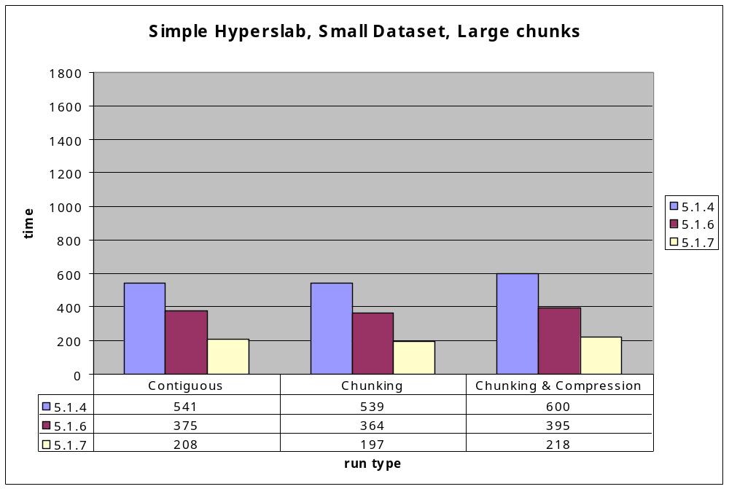
Result Example

Slide 20
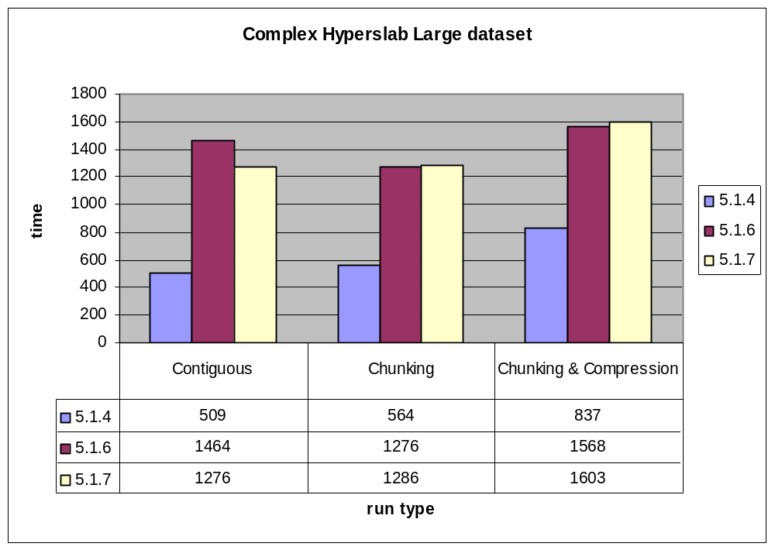
Result Example 2

Slide 21
Result Analysis
For 1.6 and 1.7
  Read time α complexity
For 1.4
  Read time is sort of independent of complexity
Reasons
  Optimizations in 1.6 and 1.7
  A lot of time is spend in trying to optimize for complex hyperslab (conjecture)

Slide 22
Future Options
Don’t do anything
  The cases with bad performance are not important.
Find a better optimizer
  Too much work
Work out a complexity measure
  Then have a switch which decides whether we use the optimizations or not

Slide 23
Complexity Measure
No of hyperplanes
  At some point all hyperplanes must be known.
  The more the no of hyperplanes more complex the hyperslab
Size of chunks
  Smaller chunks cause the hyperslab IO to tend to be better with 1.4

Slide 24
Work Left in H5_HSTest
Adding string data type
Creating a widget to control running of the tests
Complete the documentation

